Slide 1
Server Management
ADARSH KUMAR REDDY PIDAPARTHY
BHANU TEJA KURUCHETI
SAI SUMANTH KATTEKOLA
SAI RAJ KIRAN KANDULA
SRAVYA MADARAPU
HIMA TEJA GUTTA
VAMSHINATH NALLAMIOTHU
Notes:
There is no particular definition for server management. But briefly it can be defined like “set of server support services that helps to work with server”.
There are so many companies or third party services that provide server management services. Like amazon, century link, Manage Engine etc.

Slide 2
Purpose of Server Management
Reduce downtime
Reduce Data loss
Prevent from hacks

Slide 3
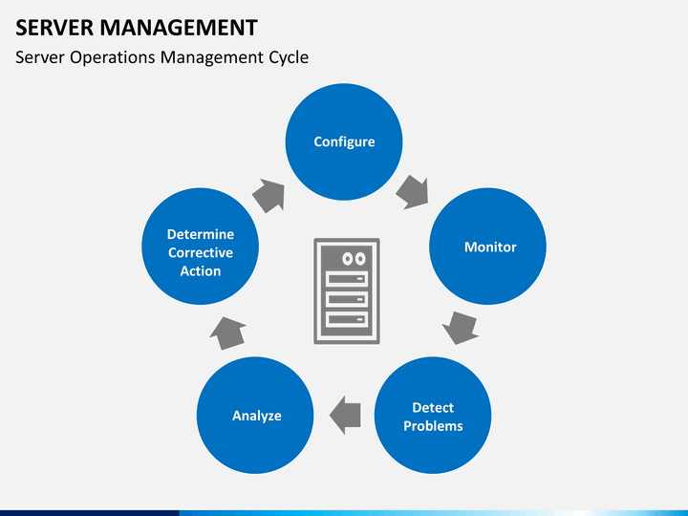

Slide 4
Notes:
Database server: is a computer program that provides database services to other computer programs or computers.
Application server: is a software framework that provides both facilities to create web applications and a server environment to run them.
Transaction server: It manages application and database transactions on a network or Internet.
Mail Server: Mail servers move and store mail over corporate networks and across the Internet.
Proxy server: It acts as a mediator between a client program and an external server to filter requests, improve performance and share connections.
FTP Server: Move files securely between computers while providing file security as well as transfer control.
Chat Server: It serves the users to exchange data in an environment similar to Internet newsgroup which provides real time discussion capabilities.
Telnet Server: It enables the users to log on to a host computer and execute tasks as if they are working on a remote computer.
Web Server: A Web server serves static content to a Web browser by loading a file from a disk and serving it across the network to a user's Web browser.

Slide 5
What are web servers ?
The software (the computer application) that helps to deliver content that can be accessed through the internet.
The most common use of web servers is to host websites
There are other uses such as gaming, data storage or running enterprise applications.
A web server serves web pages to clients across the internet or an intranet. the web server hosts the pages, scripts, programs, and multimedia files and serves them using http, a protocol designed to send files to web browsers and other protocols.
Notes:
I will briefly explain few things about web servers.
The most common use of WS is to host websites.
And there are other uses like gaming, data storage.
Web server hosts the web pages and serves them using a protocol called HTTP, which is designed to send files to web browsers.

Slide 6
Example of Web Servers
Apache HTTP Server
-Developed by Apache software foundation.
- Supports most of the OS like Unix, Linux, Novell Netware, Windows, Mac OS X, Solaris, and FreeBSD.
Microsoft Internet Information Services (IIS)
- Supports only on Windows platform
Sun Java System Web Server
- Web Server is designed for medium to large business applications. Sun Java System Web Server is available for most operating systems.

Slide 7
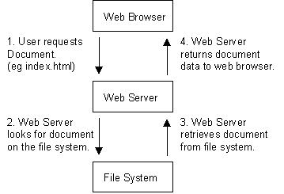
How it Works?
Notes:
If the user requests a file to the server, the web server looks for the file in the file system. If the requested file was found, then the server will retrieve the file, send it to the user’s browser. If not found the server will send some error message.

Slide 8
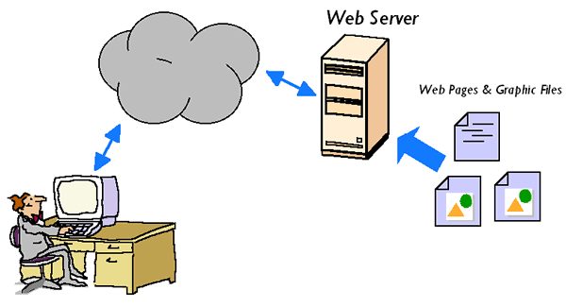

Slide 9

Tomcat
Tomcat is an open source web server and servlet container developed by the Apache Software Foundation (ASF).

Slide 10
Tomcat (Cont.)
What is servlet container?
- Servlet container (also known as a Web container) is the component of a web server that interacts with the servlets. A web container is responsible for managing the lifecycle of servlets, mapping a URL to a particular servlet and ensuring that the URL requester has the correct access rights
Tomcat implements the Java Servlet and the Java Server Pages (JSP) specifications from Oracle Corporation, and provides a "pure Java" HTTP web server environment for Java code to run.

Slide 11
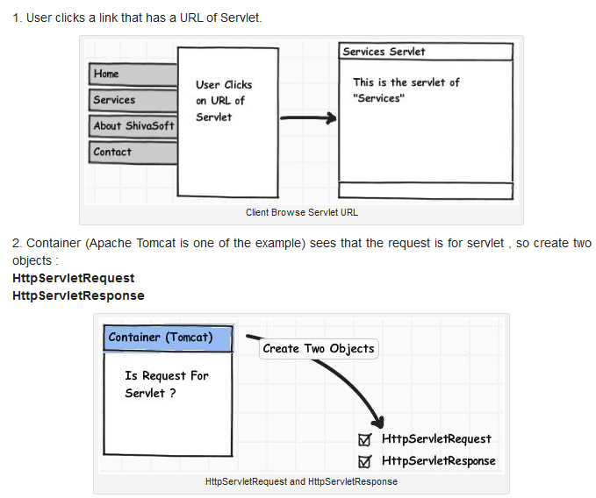
How container handles the Servlet request ?

Slide 12
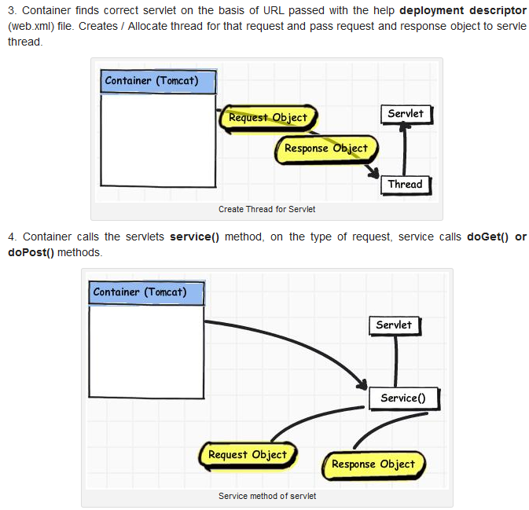
How container handles (cont.)

Slide 13
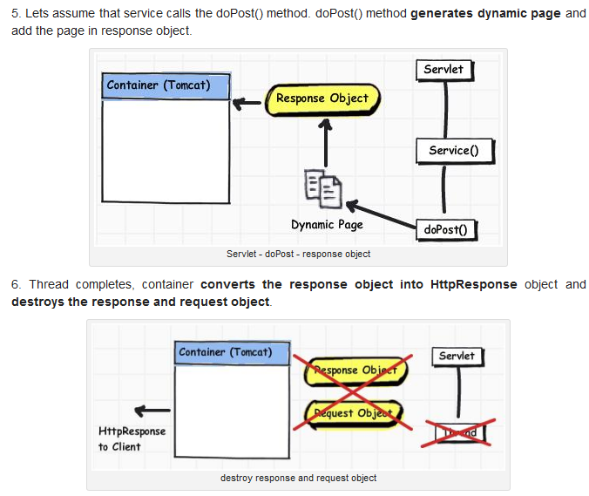
How container handles (cont.)

Slide 14
Components of tomcat
1. Catalina
Catalina is Tomcat's servlet container. Catalina implements Sun Microsystems' specifications for servlet and Java Server Pages (JSP). In Tomcat, a Realm element represents a "database" of usernames, passwords, and roles (similar to Unix groups) assigned to those users. Different implementations of Realm allow Catalina to be integrated into environments where such authentication information is already being created and maintained, and then use that information to implement Container Managed Security as described in the Servlet Specification.

Slide 15
Components (cont.)
2. Coyote
Coyote is Tomcat's HTTP Connector component that supports the HTTP 1.1 protocol for the web server or application container. Coyote listens for incoming connections on a specific TCP port on the server and forwards the request to the Tomcat Engine to process the request and send back a response to the requesting client.

Slide 16
Components (cont.)
3. Jasper
Jasper is Tomcat's JSP Engine. Tomcat 5.x uses Jasper 2, which is an implementation of the Sun Microsystems's Java Server Pages 2.0 specification. Jasper parses JSP files to compile them into Java code as servlets (that can be handled by Catalina). At runtime, Jasper detects changes to JSP files and recompiles them

Slide 17
Tomcat vs. Apache
The Apache Web server
Is faster than tomcat when it comes to static pages.
Is more configurable than tomcat
Is more robust than tomcat and
It supports CGI scripts, Server API modules, Perl, PHP etc.
Hence for world’s web sites apache would generally be a better choice than Tomcat, except that…
In itself, Apache doesn’t support Servlets or Java Server Pages !

Slide 18
Tomcat vs. Apache (cont.)
The solution of course is to allow the two Web servers to work together.
The Apache server will be the principal server, dealing with static documents
Apache will forward requests for Servlets or Java-server pages to tomcat

Slide 19
How to Configure Tomcat ?
LINUX
http://www.youtube.com/watch?v=jWDmG3JnNLE
WINDOWS
http://www.youtube.com/watch?v=IX8xb-suzVg

Slide 20
Thank you

