Slide 1
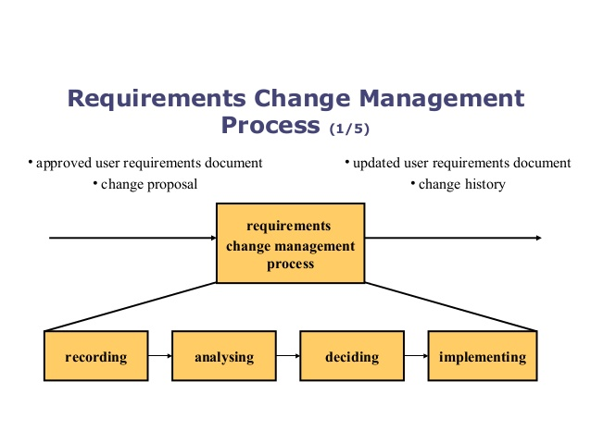
Hima Teja Gutta

Slide 2
Requirements Change Management Process
Recording:Stakeholders submit proposals for requirements changes using a pre-defined form
Analysing a change request: Analyse how it effect time budget, what are benefits?, is it valid or not? , how components and requirements effected?
Deciding on a change request: Change requests are considered formally by a group or a person who decide whether or not the change should be accepted
Implementing a change: Updating the requirements document, Informing all the necessary people
Hima Teja Gutta

Slide 3
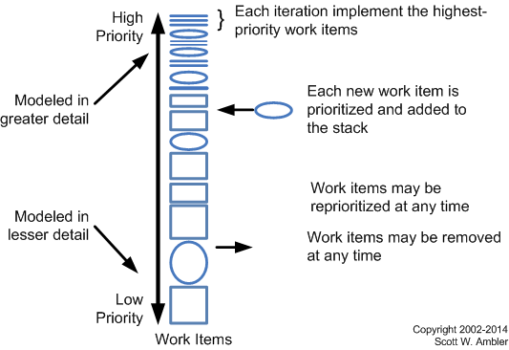
Requirement Mgmt. in Agile
Hima Teja Gutta

Slide 4
Change Request Demo
Element | Description
Date | The date the CR was created
CR# | Assigned by the Change Manager
Title | A brief description of the change request
Description | Description of the desired change, the impact, or benefits of a change should also be described
Submitter | Name of the person completing the CR Form and who can answer questions regarding the suggested change
Phone | Phone number of the submitter
E-Mail | Email of the submitter
Product | The product that the suggested change is for
Version | The product version that the suggested change is for
Priority | A code that provides a recommended categorization of the urgency of the requested change (High, Medium, Low)
Hima Teja Gutta

Slide 5
Change History template
ROW # | DOCUMENT & Version, Release or Build Number | REVISION DATE | REVISION DESCRIPTION | REVISION TRACKING NOTES
1 | Cool-Eye User Guide, V.2.1.5 | 2/3/2012 | ADDED a new section “4.1” about “Calibrating the Lenses” to Chapter 4 “System Configuration”. | Bug Tracker # 2365
2 | Cool-Eye Installation Guide , Build 43 | 5/1/2013 | EDITED the Glossary and ADDED two new items: “DDG” and “CB Porting”. | RE: PM email dated 1/4/2013
3 | Terra-Eye Quick Start Guide, Draft 4, Release 1.0.2 | 12/9/2014 | DELETED Chapter 3 “Importing Data.” ADDED two sections “5.2” and “5.3” to Chapter 5 “Post-Install Care”. | TW-1234
Hima Teja Gutta

