Slide 1
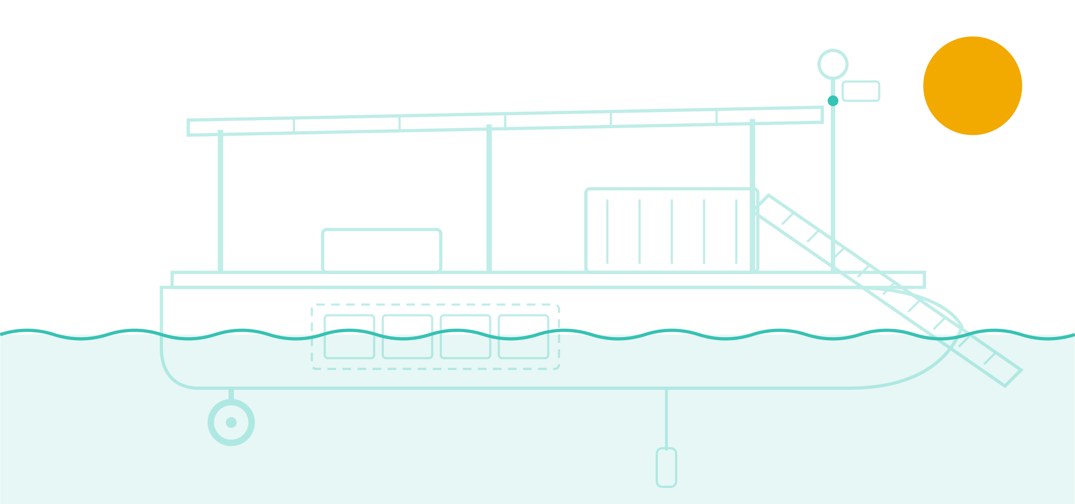
Project SAGAR
CONCEPT DESIGN BRIEF · NOVEMBER 2026
Solar boats and a Swiss-style interceptor plant to bring Hussain Sagar back to life
Target: Hussain Sagar, Hyderabad
SAGAR = Solar Autonomous Grid for Aquatic Restoration
Prepared for product design engineering review
Notes:
Project SAGAR is a concept to clean Hussain Sagar. It combines a Swiss/Swedish-style treatment plant built across the biggest sewage drain with a fleet of small solar-powered boats. This deck is written for a product design engineer: the first half sets out the evidence, the second half is the engineering brief.

Slide 2



A sewage-fed lake that can be fixed
EXECUTIVE SUMMARY
Hussain Sagar gets at least 40 million litres of untreated water a day. SAGAR stops it at the inlet and cleans the surface with solar boats.
The problem
The solution
The ask
≥ 40 million litres of untreated water enter every day
Oxygen averages ~1.9 mg/L; fish need ≥ 4
Organic load (BOD) is 8–25× the bathing limit
Sept 2026 immersion: still not recovered
SAGAR-1: a 100 MLD Swiss-style plant built across Kukatpally nala
12 solar boats skim debris and algae and polish hotspots
Sondes and buoys feed a live public dashboard
Engineer one solar boat platform with two payloads
Build 3 prototypes in 9 months
Field-test at the Ganesh immersion, Sept 2027
Notes:
Three messages. One: the data shows a lake fed by sewage, with oxygen too low for fish. Two: the fix is to stop the volume at the inlet with a plant, and clean the surface with mobile solar boats. Three: we need the product designer to engineer the boat platform and get three prototypes on the water for the 2027 immersion season.

Slide 3

The problem
01
What the latest verified data says about Hussain Sagar
Notes:
Section one: the evidence. All numbers come from the Telangana Pollution Control Board (via press reports of its analyses), HMDA, peer-reviewed studies and the press. Sources are on the last slide and in research/hussain-sagar-pollution-data.md.

Slide 4
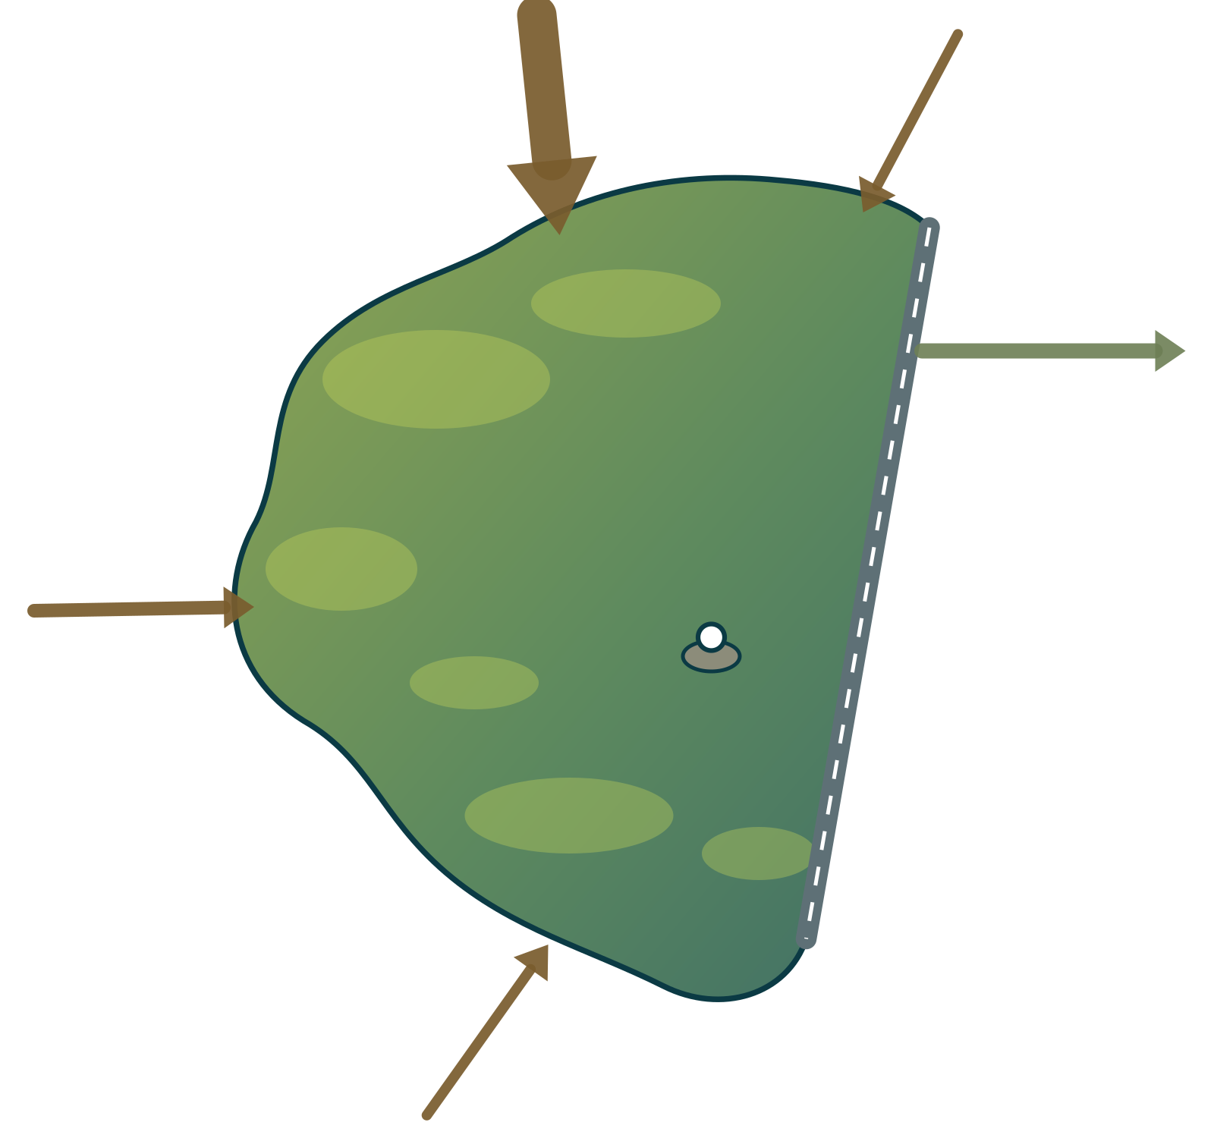
Hussain Sagar at a glance
THE PROBLEM · LAKE PROFILE
A 460-year-old reservoir in the heart of Hyderabad, now fed mainly by four sewage drains.
Kukatpally · 70–155 MLD
Picket · 5.7
1562
240 km²
Built under Ibrahim Quli Qutb Shah
Catchment draining into the lake
Sanjeevaiah Park
Surplus → Musi
4.7–5.7 km²
23.5–27.2 Mm³
Tank Bund
Water-spread area (sources differ)
Volume: 23.5 to 27.2 billion litres
Balkapur
13.3 MLD
Buddha Statue
Necklace Road
~9.8 m
4 nalas
Lumbini Park
Maximum depth (32 ft)
Feeder drains, all carrying sewage
Banjara · 6
NTR Gardens
Schematic map, not to scale; arrow width ∝ inflow (study estimate). Sources: HMDA presentation; Telangana Today; Wikipedia; neliti review of Hussain Sagar pollution.
Notes:
Built in 1562. 240 km² catchment. The figures for area and volume vary by source because they refer to different water levels; HMDA gives 27.18 million m³ at spill level. Four nalas feed it: Kukatpally carries sewage plus industrial effluent, the other three mainly domestic sewage.

Slide 5

Four drains carry sewage in
THE PROBLEM · SOURCES
Kukatpally nala dominates: 70–155 MLD of mixed domestic sewage and industrial effluent.
Kukatpally nala
Mixed sewage and industrial effluent from the north. 70 MLD in a study; 155 MLD reported (Telangana Today, 2020).
Picket, Banjara, Balkapur
Mainly domestic sewage. About 25 MLD combined on the study basis.
Reported total: ~450 MLD
The Federal, Feb 2026. Method not published. Phase 0 meters all four nalas to settle it.
Sources: Review of Hussain Sagar Lake Pollution (neliti); Telangana Today, 15 Dec 2020; The Federal, 18 Feb 2026; HCAIP.
Notes:
Study-basis flows: Kukatpally 70, Balkapur 13.3, Banjara 6, Picket 5.7 MLD, about 95 MLD in total. Telangana Today reported 155 MLD for Kukatpally alone in 2020, and The Federal reported 450 MLD in total in 2026. No verified current flow measurement exists; that is why Phase 0 installs flow meters.

Slide 6
Treatment covers about half
THE PROBLEM · TREATMENT GAP
Even on the lowest estimate, at least 40 MLD enters untreated: about 16 Olympic pools a day.
≥ 40 MLD
enters untreated every day on the lowest estimate (95 in, 55 treated)
~9.5 months
for the nalas to deliver a volume equal to the whole lake (~2 months at 450 MLD)
0
verified, current flow measurements found for the four nalas. Phase 0 fixes this
STP capacity 5 + 20 + 30 MLD (Telangana Today, Nov 2022; a planned upgrade to 110 MLD is unconfirmed). Lake volume 27.18 Mm³ (HMDA). Derived: 27.18 Mm³ ÷ 95,000 m³/day ≈ 286 days.
Notes:
Three STPs around the lake total 55 MLD. On the study inflow of 95 MLD, at least 40 MLD bypasses treatment. On the 2026 reported figure of 450 MLD the gap would be about 395 MLD. Put another way, the drains deliver the lake's whole volume roughly every nine and a half months.

Slide 7
Fails even the fish standard
THE PROBLEM · WATER QUALITY
Typical oxygen is below what fish need, and the organic load is 8–25× the bathing limit.
Parameter | Measured in Hussain Sagar | Limit | Verdict
Dissolved oxygen | 1.28–3.0 mg/L (2016–20); nil at 3 immersion sites (Sept 2025) | ≥ 4 fish · ≥ 5 bathing | Fails
BOD | 24–76 mg/L typical (pre-2020); 94 mg/L peak (Sept 2025) | ≤ 3 mg/L bathing | 8–25× over
Total coliform | 1,600 MPN/100 mL at 8 of 9 points (2023) | ≤ 500 bathing | 3.2× over
COD | Peaks of 164 mg/L (2026) and 280 mg/L (2025) | ≤ 50 mg/L (NGT discharge norm) | 3–6× over
Turbidity | 200 NTU peak, Necklace Road (Sept 2026) | No CPCB lake limit | Very high
1.9
mg/L
typical dissolved oxygen
2016–20 average
Fish need ≥ 4
Bathing needs ≥ 5
During immersion: 0
Sources: IJARIIT (2016–20); TSPCB via Siasat (2020); TGPCB via Telangana Today (Oct 2025), Deccan Chronicle (Oct 2026, Jun 2023). Limits: CPCB criteria; NGT 2019 norms.
Notes:
CPCB Class D (wildlife and fisheries) needs dissolved oxygen of at least 4 mg/L; Class B (bathing) needs at least 5 mg/L DO, BOD of 3 mg/L or less and coliform of 500 MPN or less. Hussain Sagar's 2016–20 mean DO was 1.91 mg/L, and during the 2025 immersion it hit zero at three sites. Note that 1,600 MPN is the top of the standard test range, so the real coliform count could be higher.

Slide 8

Immersion 2026: not recovered
THE PROBLEM · LATEST DATA, OCTOBER 2026
TGPCB sampled six sites before, during and after the festival on 14 September 2026. Every key indicator rose.
11 Sep
14 Sep
17
19
21
23 Sep
28 Sep
Pre
Festival
During
Post: not recovered
200 NTU
164 mg/L
99 mg/L
6 of 6
turbidity peak
COD peak
suspended solids peak
sites saw turbidity, TSS, COD and BOD rise
Necklace Road
Necklace Road
Platform 1, NTR Park
all monitoring points
For comparison, Sept 2025: dissolved oxygen fell to nil at 3 sites; BOD hit 94 mg/L and COD 280 mg/L at Platform 1.
Sources: TGPCB analysis reported by Deccan Chronicle and Telangana Today, 30 Oct 2026; TGPCB via Telangana Today, 5 Oct 2025.
Notes:
This is the most recent official data. TGPCB sampled on 11 September (pre-immersion), 17, 19, 21 and 23 September (during) and 28 September (post). Turbidity peaked at 200 NTU and COD at 164 mg/L at Necklace Road; TSS peaked at 99 mg/L at Platform 1. The post-immersion samples had not returned to pre-immersion levels.

Slide 9
Two decades of decline, one clue
THE PROBLEM · HISTORY
When inflow stopped in the 2020 lockdown, BOD fell from 24–76 mg/L to about 8. Source control works.
2008
Study classifies the lake as hypereutrophic
2016
JICA-funded catchment project ends; pollution persists
2023
Coliform at 1,600 MPN at 8 of 9 sampling points
May 2026
Algal blooms at 5 shoreline sites; spray tankers doubled to 40 a day
~2009
Sediments enriched with lead, cadmium and zinc; up to 30% of cadmium bioavailable
2020
COVID lockdown: BOD falls from 24–76 to ~8 mg/L
Feb 2026
Water turns yellow-green; NGT petition pending
Sources: Wikipedia (2008 study); Springer Env. Monit. Assess. (sediments); HCAIP; TSPCB via Siasat (2020); Deccan Chronicle (2023); The Federal (Feb 2026); Hyderabad Mail (18 May 2026).
Notes:
The key point on this slide is 2020. During the COVID lockdown, with industry shut and less flow, TSPCB reported BOD falling from 24–76 mg/L to about 8 mg/L. That is a natural experiment showing that cutting the inflow is the main lever. Everything else here shows chronic decline despite earlier projects.

Slide 10



Four design principles from the data
THE PROBLEM · SO WHAT
The volume problem sits at the inlets; the visible problem floats on the surface.
1 Stop it at the source
2 Clean the surface with boats
Build treatment across the biggest drain so dirty water never reaches the lake.
The lake is nearly still, so fixed barriers won't work. Use mobile solar boats.
Evidence: ≥ 40 MLD untreated; lockdown BOD drop
Evidence: Interceptor judged unsuitable for low-flow water
3 Put oxygen back at hotspots
4 Measure everything, continuously
Immersion bays and algae zones are where oxygen crashes first.
Every boat carries a sonde; buoys and flow meters fill the gaps.
Evidence: DO nil at 3 sites, Sept 2025
Evidence: no verified current nala flow data
Notes:
Every part of the design traces back to the evidence: stop the source because the gap is at least 40 MLD and the lockdown proved it works; use mobile boats because the lake is still water; target oxygen where it crashes; and measure continuously because the flow data does not exist yet.

Slide 11

The inspiration
02
What Switzerland and Sweden do differently
Notes:
Section two: the European models behind the design.

Slide 12



Learning from Switzerland and Sweden
INSPIRATION
Both treat water hard at the point where it enters the river or sea, instead of cleaning up afterwards.
Switzerland: 4th stage
Sweden: Henriksdal
Solar river clean-up
Law in force since 1 Jan 2016
~100–140 plants add a stage over 20 years
Target: ≥ 80% micropollutant removal with ozone or activated carbon
Funded by ~CHF 9 per person per year
Stockholm's plant is the world's largest underground plant, built in rock
Becoming the world's largest membrane bioreactor (MBR)
> 500,000 m³/day for 1.6 M people by 2040
Ocean Cleanup Interceptor: 100% solar, rated 50 t/day
WasteShark drone: ~500 kg/day, ~8 h per charge
Fixed barriers need current: Jakarta called the Interceptor unsuitable for low-flow rivers
WHAT WE TAKE
Ozone + carbon stage in SAGAR-1; carbon cartridge on the O-1 boat
WHAT WE TAKE
Compact MBR core; covered plant with a public park on top
WHAT WE TAKE
Fixed interception at the nala; mobile solar boats on the still lake
Sources: admin.ch/Eawag (2015); McArdell, Eawag (2019); ICPR; Nordic Investment Bank (2016); GE Reports; Eco-Business (2020); RanMarine.
Notes:
Switzerland amended its Water Protection Act in force from 1 January 2016 so that selected treatment plants add a fourth stage, ozonation or activated carbon, removing at least 80% of micropollutants; it is funded by a small per-person levy. Stockholm's Henriksdal plant is built in rock tunnels and is becoming the world's largest membrane bioreactor. From solar river devices we take one key lesson: fixed barriers need current, so they belong where water flows (the nala mouths), while the still lake needs mobile boats.

Slide 13

The solution
03
Project SAGAR: one plant, twelve solar boats, live data
Notes:
Section three: the system design.

Slide 14
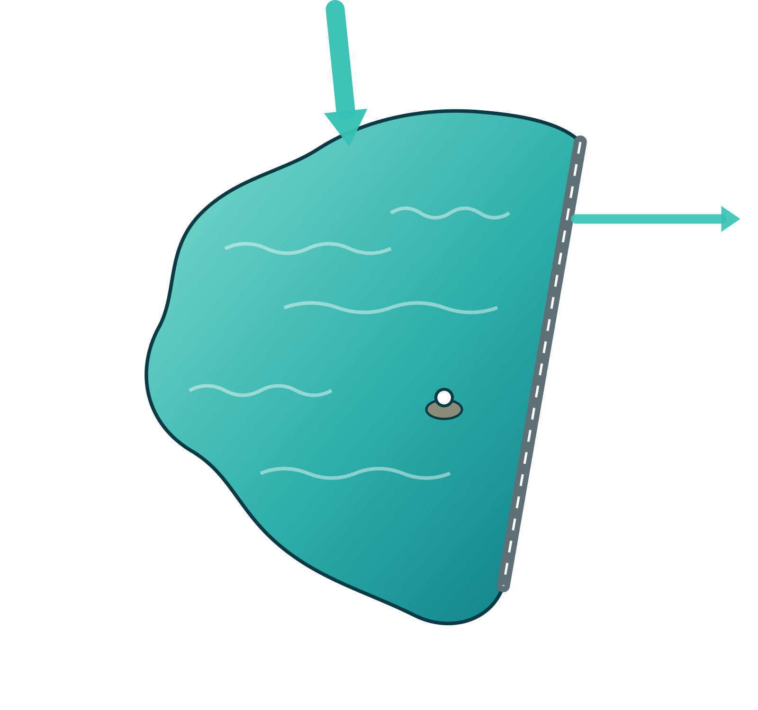


One system, three layers
THE SOLUTION · SYSTEM
The plant stops the volume, the boats clean the surface, and sensors steer both.
SAGAR-1
STOP SAGAR-1 interceptor plant
100 MLD across Kukatpally nala: MBR, ozone + carbon, UV. Clean, oxygenated water flows into the lake.
CLEAN Solar boat fleet
8 S-1 skimmers + 4 O-1 polishers from 2 solar docks. Debris, algae scum and hotspot oxygen.
SENSE Sondes, buoys, dashboard
DO, pH, conductivity, turbidity and chlorophyll on every boat, plus 6 buoys and nala flow meters, live online.
Plant
Boat
Solar dock
Buoy
Notes:
The architecture has three layers. STOP: the SAGAR-1 plant sits across Kukatpally nala, the largest and most industrial inflow, and discharges clean, oxygenated water. CLEAN: twelve solar boats work the surface from two solar docks. SENSE: every boat carries a water-quality sonde, and fixed buoys and nala flow meters feed a public dashboard. Phase 3 replicates the interceptor on the other three nalas.

Slide 15










SAGAR-1: the plant across the nala
THE SOLUTION · SAGAR-1 PLANT
Every litre of dry-weather flow in Kukatpally nala passes five barriers before it reaches the lake.
Stockholm-style
Swiss 4th stage
Inlet weir + coarse screens
Fine screens + grit removal
Biological N & P removal
MBR membranes
Ozone + carbon
UV + cascade aeration
Into the lake
25 mm bars across the nala
6 → 2 mm; grease out
Anoxic / aerobic + bio-P
0.04 µm ultrafiltration
≥ 80% micropollutants
Pathogen barrier; DO ≥ 6
Clean, oxygenated water
SIDE STREAMS
Storm surplus overflows the weir after screening; first-flush tank holds the dirtiest runoff
Sludge → digester → biogas power (~25–30% of plant energy)
Phosphorus recovered as struvite fertiliser
Plastics and screenings sent to recycling
Notes:
This is the Swiss and Swedish model applied to a Hyderabad nala. A weir across the nala diverts all dry-weather flow into the plant. After screening and grit removal, a biological stage removes nitrogen and phosphorus, membrane bioreactors (as at Henriksdal) remove solids and bacteria, ozone plus activated carbon (the Swiss fourth stage) removes micropollutants such as pharmaceuticals and dyes, and UV plus cascade aeration returns oxygen-rich water to the lake. Sludge makes biogas; phosphorus is recovered.

Slide 16
Plant specification at a glance
THE SOLUTION · SAGAR-1 PLANT
Sized to cover the full reported range of Kukatpally flow, with modular trains to grow.
Parameter | NGT 2019 norm | SAGAR-1 target
BOD | ≤ 10 mg/L | ≤ 5 mg/L
COD | ≤ 50 mg/L | ≤ 30 mg/L
Suspended solids | ≤ 20 mg/L | ≤ 2 mg/L
Total nitrogen | ≤ 10 mg/L | ≤ 8 mg/L
Total phosphorus | ≤ 1 mg/L | ≤ 0.3 mg/L
Faecal coliform | < 230 MPN (desirable < 100) | < 10 MPN/100 mL
Micropollutants | Not regulated | ≥ 80% removed
Energy: ~90 MWh/day
Biogas CHP 25–30%
Solar ≤ 4 MWp, ~18%
Green-tariff grid, rest
100 MLD
3.5–4 ha
average (150 peak), as 4 × 25 MLD trains
covered footprint, park on the roof
~0.9 kWh/m³
₹450–550 cr
MBR + ozone + carbon + UV
indicative capex (≈ ₹3.4 cr/MLD + premium)
Norms: NGT order (2019) for STPs in metro areas. Capex benchmark: HMWSSB 17-STP package, 376.5 MLD for ₹1,280.87 cr (Telangana Today, 2022). Energy and cost are first-pass estimates.
Notes:
Design flow is 100 MLD average and 150 MLD peak in four 25 MLD trains, covering the reported 70–155 MLD for Kukatpally nala. Effluent targets beat the 2019 NGT norms by a wide margin. Energy is roughly 0.9 kWh per cubic metre, about 90 MWh a day: biogas covers 25–30%, rooftop solar about 18%, and the rest comes from a green tariff. Hyderabad sits on Deccan granite, so a covered, partly sunken plant with a park on top, Stockholm-style, is realistic. Capex is indicative.

Slide 17
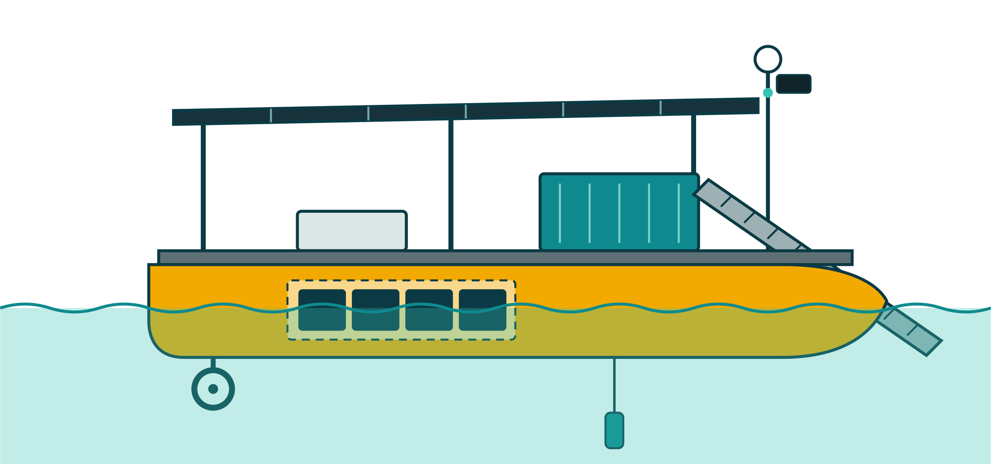
Meet the S-1 solar boat
THE SOLUTION · SOLAR BOAT PLATFORM
A 4.2 m solar catamaran that skims, senses and runs all day on sunlight.
1
Solar canopy 1.62 kWp, 6 × 270 Wp
2
1
2
Sensor mast RTK-GNSS, stereo cameras, radar
3
Debris bin 250 L, ~120 kg per load
3
4
Conveyor intake 1.6 m wide, 5 mm mesh
5
4
5
Electronics bay compute, MPPT, LTE/LoRa, IP67
6
9
Battery 9.6 kWh LiFePO4, 4 hot-swap packs
6
7
7
Rim-drive thrusters 2 × 1 kW, no exposed blades
8
8
Sonde DO, pH, EC, turbidity, temp, chl-a
4.2 m long
2.2 m beam
≤ 0.35 m draft
~380 kg
1–3 knots
9
Twin HDPE hulls high-vis, foam-filled, unsinkable
Notes:
The S-1 is a 4.2 m twin-hull catamaran with high-visibility rotomoulded HDPE hulls that resist corrosion in the lake's high-conductivity water. A 1.62 kWp solar canopy shades the electronics and bin. Four 2.4 kWh LiFePO4 packs of about 22 kg each can be swapped by one person. Rim-drive thrusters have no exposed blades, so they are safer around people and birds and resist weed fouling. Every boat carries a water-quality sonde, so the fleet doubles as a mobile monitoring network.

Slide 18
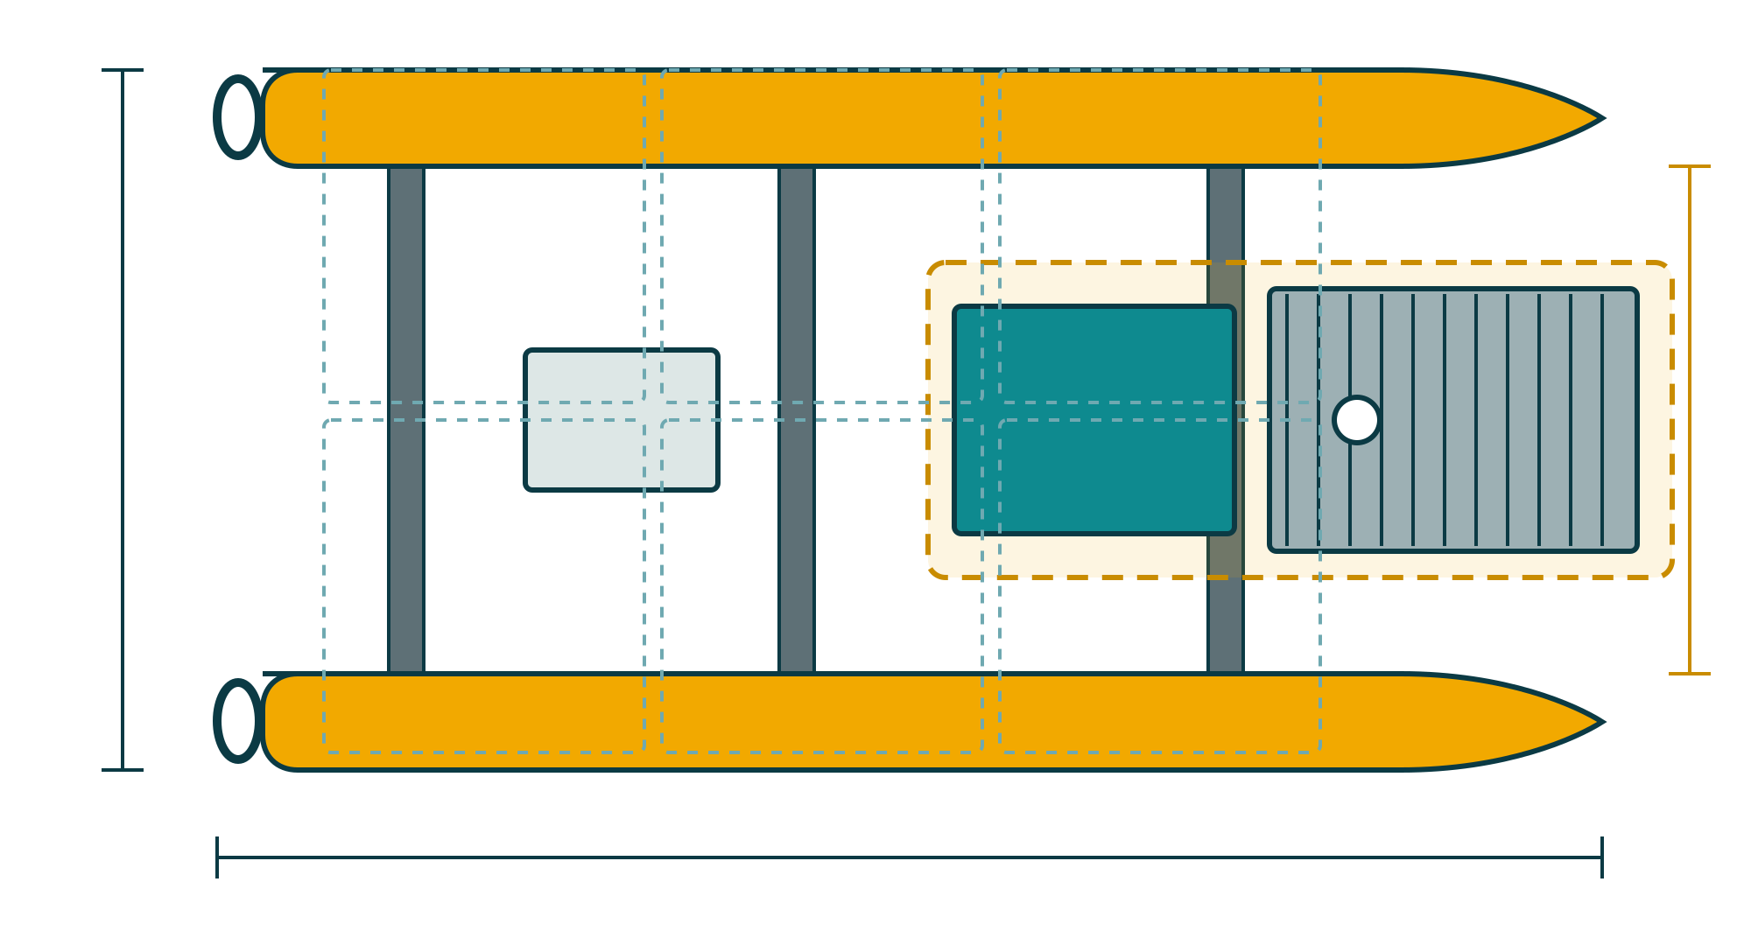

One hull, two jobs
THE SOLUTION · PAYLOAD MODULES
A common platform with swappable payloads: tool one boat, deploy it two ways.
S-1 Skimmer
An inclined mesh conveyor between the hulls lifts plastics, hyacinth, flowers, idol debris and algae scum into a 250 L bin.
2.2 m
1.6 m intake
1.6 m intake · ~400 kg/day · ~1.3 ha per shift
O-1 Polisher: the big plant, shrunk
4.2 m
Swappable payload bay (S-1 shown)
Screen
Filter
Carbon
UV-C
O₂
SHARED hull · solar · battery · propulsion · autonomy · sonde
10 m³/h for immersion bays and algae hotspots
Notes:
One hull, two payloads: the S-1 skimmer and the O-1 polisher. The O-1 is literally the SAGAR-1 process shrunk onto a boat: a 2 mm screen, a 25 µm self-cleaning disc filter, a swappable activated-carbon cartridge, a UV-C LED reactor and venturi oxygen injection, at 10 m³/h. The open question for the designer is whether a 15-minute module swap is practical or whether these should be two SKUs.

Slide 19


Runs all day on its own canopy
THE SOLUTION · ENERGY
1.62 kWp of solar gives ~6.5 kWh on an average Hyderabad day, and both variants use less than that.
6.5 kWh/day
1.62 kWp × 5.0 peak-sun-hours × 0.80 performance ratio
1.3–1.6 days
of reserve with zero sun: 7.7 kWh usable from a 9.6 kWh pack set
Monsoon: ~4.9 kWh
at ~3.8 peak-sun-hours: shorten payload hours or swap packs at the solar dock
Load assumptions. S-1: skim 0.45 kW × 6 h, transit 0.8 kW × 1.5 h, conveyor 0.15 kW × 6 h. O-1: station-keeping 0.1 kW × 6 h, pump 0.30 + UV 0.12 kW × 6 h. Electronics 60 W active, 30 W standby.
Notes:
Energy balance: the canopy yields about 6.5 kWh on an average day in Hyderabad. The skimmer uses about 5.8 kWh and the polisher about 4.8 kWh, so both are energy-neutral on an average day with margin, and the battery gives more than a day of autonomy. In the monsoon, yield drops to about 4.9 kWh, so missions shorten or packs are swapped at the solar dock.

Slide 20


12 boats, two docks, one dashboard
THE SOLUTION · FLEET OPERATIONS
Cameras and sondes send boats to the debris and low-oxygen zones instead of mowing the whole lake.
3.2 t/day
debris capacity across 8 skimmers
Detect
Dispatch
Cameras, sondes and buoys flag debris and low oxygen
Fleet manager sends the nearest charged boat
~10 ha/day
swept by the skimmer fleet
~6 days
to revisit ~60 ha of hotspots: margins, nala mouths, immersion bays
Dock
Clean
Swap packs, unload debris, upload data
Skim, polish or aerate, geofenced away from people
2 shifts
in immersion season, running on swapped packs
Assumes 400 kg/day per skimmer (WasteShark benchmark: ~500 kg/day claimed) and 1.6 m × 1 knot sweep over a 4.5–6 h shift. Heavy idol remains still need shore cranes.
Notes:
Fleet operations follow a loop: detect, dispatch, clean, dock. Debris collects in wind-driven margins, nala mouths and immersion bays, about 60 hectares, so camera detection sends boats there instead of sweeping the full 470 hectares. During Ganesh immersion the fleet runs two shifts on swapped battery packs. Note that heavy idol structures still need cranes; the boats handle the floating fraction.

Slide 21

Why boats alone can't do it
THE SOLUTION · SCALE CHECK
The lake holds ~27 million m³. Volume must be treated at the inlet; boats work the surface and hotspots.
27.2 million m³
240 m³/day
100,000 m³/day
of water in the lake (HMDA, at spill level)
from 4 O-1 polishers combined: ~310 years to pass the lake's volume once
intercepted by SAGAR-1 at the inlet, so new pollution never arrives
With clean inflow, the lake flushes itself. 100 MLD of clean water replaces the lake's entire volume in about 9 months (27.18 Mm³ ÷ 100,000 m³/day ≈ 272 days).
Notes:
This slide is here for honesty. A boat-mounted polisher treats about 60 cubic metres a day, so even four of them would need around 310 years to pass the lake's volume once. That is why the boats are for surface debris, algae scum, hotspot oxygen and data, and the volume is handled by the plant. The good news is that once the inflow is clean, natural flushing replaces the lake's water in about nine months.

Slide 22

Delivery
04
Requirements, open questions, cost, roadmap and targets
Notes:
Section four: what the product designer needs to build it, what it costs and how we measure success.

Slide 23





Design requirements
DELIVERY · FOR THE PRODUCT DESIGNER
Hot, humid and UV-heavy, busy with tourist boats, and full of Plaster-of-Paris debris.
Environment
Materials
Debris
Air 10–46 °C, water 20–35 °C, UV index 11+, monsoon gusts ~60 km/h, pH 7–9.5
HDPE, 316 stainless and anodised aluminium only. No mild steel: conductivity ~1,700 µS/cm
Plastics, hyacinth, cloth, flowers, Plaster-of-Paris idol fragments, algae scum, biofouling
Safety
Service
Manufacture
≤ 3 knots, geofence, e-stop on both sides, collision avoidance, bladeless rim-drives
Payload swap < 15 min; 22 kg battery packs swap in < 2 min each, no tools
Rotomoulded hulls, off-the-shelf 48 V EV parts, ≥ 70% local content
Notes:
Design requirements. Note the conductivity of about 1,700 µS/cm measured at PVNR Marg, which is why mild steel is ruled out. Plaster-of-Paris idol fragments and algae scum are the hardest debris types for the intake. Safety matters because Hussain Sagar is a busy tourist lake with launches and paddle boats.

Slide 24
Six open questions to settle
DELIVERY · FOR THE PRODUCT DESIGNER
The trade-offs where the product designer's call matters most, each with our starting view.
1
Hull: rotomoulded HDPE or welded aluminium?
2
Intake: conveyor or suction for PoP slurry and scum?
Starting view: HDPE: cheap tooling at volume, no corrosion, recyclable.
Starting view: Conveyor for solids; test a suction head for algae scum.
3
Perception: radar + cameras, or add LiDAR?
4
Charging: auto-dock contacts or manual pack swap?
Starting view: Radar + stereo cameras; add LiDAR only if glare tests fail.
Starting view: Manual swap in the pilot; auto-dock in Phase 2.
5
Security: how do we prevent theft and vandalism?
6
Product line: one hull or two dedicated SKUs?
Starting view: GPS tracking, tamper alarms, lockable bays, night mooring at docks.
Starting view: One hull, two swappable payloads, 15-minute swap.
Notes:
These are the decisions we want the product designer to own. We have a starting view on each, but they should be settled with prototypes and tests, especially the intake for Plaster-of-Paris slurry and algae scum.

Slide 25
What it costs
DELIVERY · COST
The boats are cheap enough to pilot now; the plant needs public financing (DBO or Hybrid Annuity).
₹18.5 lakh
S-1 prototype, falling to ≤ ₹12 lakh at 50+ units
~₹0.75 crore
Phase 1 pilot: 3 boats + test dock
~₹2.4 crore
Phase 2 fleet: 12 boats + 2 solar docks
₹450–550 crore
SAGAR-1 plant (DBO / Hybrid Annuity)
Indicative 2026 India pricing for discussion, not quotations. Plant benchmark: ≈ ₹3.4 cr/MLD (HMWSSB 17-STP package) plus an MBR and 4th-stage premium.
Notes:
The boat prototype is about ₹18.5 lakh, with the hull, battery, payload and sonde as the biggest items. At volume it should fall to ₹12 lakh or less. The full 12-boat fleet with two solar docks is about ₹2.4 crore: small next to the plant at ₹450–550 crore, which would go through a design-build-operate or Hybrid Annuity contract, as HMDA used for the earlier STP upgrade.

Slide 26
48 months from survey to clean inflow
DELIVERY · ROADMAP
The boats prove the concept at the 2027 immersion season while the plant is designed and built.
Month 0
6
12
18
24
30
36
42
48
Phase 0 · Baseline
Flow meters, bathymetry, buoys, permits
0–3
Phase 1 · Prototype
2 × S-1 + 1 × O-1; Lumbini Park pilot
3–12
Phase 2 · Fleet + plant design
12 boats, 2 docks; SAGAR-1 tender and build
12–30
Phase 3 · Plant + replicate
SAGAR-1 online; interceptors on 3 more nalas
30–48
Milestones
Immersion field test
Sept 2027
Plant tender
~mid-2028
SAGAR-1 online
~2030
Notes:
Month 0 is assumed to be November 2026. Phase 0 settles the flow-data gap. Phase 1 builds three prototypes and field-tests them during the Ganesh immersion in September 2027, about month 10. Phase 2 scales to 12 boats while SAGAR-1 is designed and tendered. Phase 3 commissions the plant around 2030 and replicates interceptors on the Picket, Banjara and Balkapur nalas.

Slide 27
How we'll know it worked
DELIVERY · TARGETS
Every target is tied to a CPCB criterion and measured live on the public dashboard.
Untreated dry-weather inflow
Dissolved oxygen
BOD
0
≥ 4 mg/L
≤ 10 mg/L
Today: ≥ 40 MLD
Today: ~1.9 mg/L
Today: 24–76 mg/L
SAGAR-1 + interceptors on all 4 nalas
CPCB Class D: fish survive
Then ≤ 3 mg/L (bathing) long-term
Total coliform
Floating debris
Public data
< 500 MPN
−90%
Live 24×7
Today: 1,600 MPN
Today: not measured
Today: none
CPCB bathing criterion, per 100 mL
Camera survey index, set in Phase 0
Open dashboard of every sonde and buoy
Notes:
Targets for the end of Phase 3: zero untreated dry-weather inflow; dissolved oxygen of at least 4 mg/L, so fish can survive; BOD of 10 mg/L or less, falling to bathing quality over time; coliform below the bathing limit; 90% less floating debris; and every measurement public.

Slide 28



Next steps
Design
Weeks 0–4
Freeze the S-1/O-1 platform architecture and settle the six open questions
Build
Months 3–9
2 × S-1 + 1 × O-1 prototypes; tank test, then a lake pilot at Lumbini Park
Partner
Now
MoU with HMDA (lake), TGPCB (monitoring) and HMWSSB (sewerage) for the pilot and the Phase 0 survey
Goal: solar boats on Hussain Sagar for the Ganesh immersion, September 2027.
Notes:
Three next steps: freeze the boat architecture in four weeks, build three prototypes by month nine, and sign MoUs with HMDA, TGPCB and HMWSSB now so that the pilot and the flow survey can start. The goal is boats on the water for the September 2027 immersion.

Slide 29
Sources
APPENDIX
Full links in research/hussain-sagar-pollution-data.md. TGPCB figures are as reported by the press.
1. Deccan Chronicle, 30 Oct 2026: Immersion spiked Hussainsagar pollution levels (TGPCB)
2. Telangana Today, 30 Oct 2026: Water quality yet to return to pre-immersion levels (TGPCB)
3. Telangana Today, 5 Oct 2025: Coliform levels show mixed trends, 2025 vs 2024 (TGPCB)
4. Siasat, 27 Sep 2025: Hussain Sagar records higher pollution after Ganesh immersion
5. The Federal, 18 Feb 2026: Hussain Sagar turns yellowish-green
6. Hyderabad Mail, 18 May 2026: Hussainsagar algal bloom drives away walkers
7. Deccan Chronicle, 7 Jun 2023: Hussainsagar water quality deteriorates
8. Telangana Today, 2 Nov 2022: Capacity of Hussain Sagar STPs to be doubled
9. Telangana Today, 15 Dec 2020: 17 STPs coming up along River Musi
10. Siasat, 2020: TSPCB lockdown BOD readings for Hussain Sagar
11. HMDA: Hussainsagar lake background presentation
12. Review of Hussain Sagar Lake Pollution, Hyderabad (neliti): nala flows
13. IJARIIT: Water Quality Index of Hussain Sagar, 2016–2020 data
14. Springer, Env. Monit. Assess.: Metal fractionation in Hussainsagar sediments
15. Wikipedia: Hussain Sagar; Hussainsagar Lake & Catchment Area Improvement Project
16. admin.ch / Eawag, 3 Sep 2015: 100 treatment plants must be upgraded
17. McArdell (Eawag), Stowa 2019: Micropollutants in Switzerland
18. ICPR: Basel WWTP with 4th treatment stage
19. Nordic Investment Bank, 20 Jun 2016: World's largest underground wastewater facility
20. GE Reports: Deep under Stockholm, water plant blasted from rock
21. Eco-Business, 18 Mar 2020: Will this solar-powered device clean the world's rivers?
22. RanMarine: WasteShark aquatic drone
Notes:
All sources with full URLs are in research/hussain-sagar-pollution-data.md in the repository.

