Slide 1
CRM WEB APPLICATION
React + Spring Boot + MySQL | FULL STACK JAVA REACT APPLICATION
Developed by
ANSHIKA AGGARWAL (2204920100024)
& RAJ KUMAR (2204920100118)
Guide: Ms. Vibha | Dept. of CSE, KCC Institute of Technology & Management

Slide 2
AGENDA
01
Problem Statement
05
Database Design
Why a new CRM was needed
EER schema & relationships
02
Project Overview
06
UML Diagrams
CURIEM – what & who
Use Case, Activity, Sequence
03
System Architecture
07
Results & Survey
Tech stack & design decisions
Findings & deliverables
04
Key Modules
08
Conclusion & Future Scope
Features built & demonstrated
Learnings and what’s next

Slide 3
PROBLEM STATEMENT
Fragmented Tools
Poor Client–Project Linking
Teams used separate CRM, project mgmt, communication & task apps — causing duplicated data & delays.
No clear mapping between clients, projects, tasks & team members in a single system.
Weak Access Control
No Event Management
No proper role-based access for Admins, Managers & Employees across modules.
Meetings & deadlines tracked on separate tools (Google Calendar, Excel, WhatsApp).
No Unified Analytics
Weak Password Recovery
Lack of real-time dashboards combining customer data with task & project performance.
No secure OTP-based account recovery in affordable CRM solutions for SMEs.

Slide 4
OBJECTIVES
Secure authentication and role-based access control (JWT + RBAC) with Admin, Manager, and Employee roles.
Customer & Lead management with advanced filtering, search, pagination, and status tracking.
Analytics via dashboard APIs: conversion rate, pipeline value, revenue trends, and activity logs.
Project and task management — linking clients, projects, tasks, and team members in one unified platform.
OTP-based secure password recovery for account safety in SME-grade deployments.
Real-time event calendar for meetings and deadlines, integrated with team roles.

Slide 5
SCOPE
MVP — Core Features
Advanced — Future Enhancements
Authentication & Authorization
Customer Management (CRUD)
Lead Management & Pipeline
Dashboard & Analytics
Support Tickets Module
Activities: calls / emails / meetings
Email & SMS notifications
Detailed reports & exports
Multi-tenancy architecture
AI-driven lead scoring & forecasting
Mobile app (React Native / Flutter)

Slide 6
TECHNOLOGY STACK
Frontend
Backend
ReactJS · Redux · Bootstrap · Recharts · Axios
Spring Boot · REST APIs · Spring Security · JPA/Hibernate
Database
Security
MySQL — relational schema with FK constraints
JWT Authentication · RBAC (Admin / Manager / Employee)
Dev Tools
Postman · Git/GitHub · VS Code · IntelliJ IDEA

Slide 7
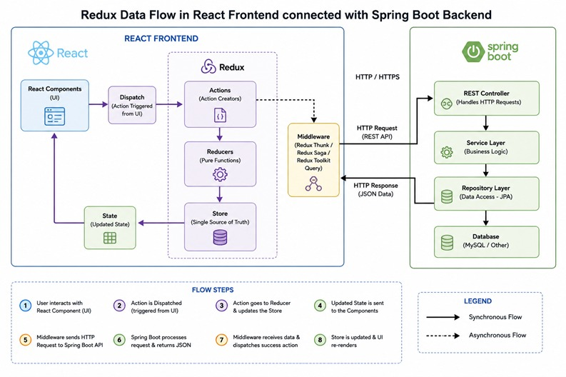
TECHNOLOGY STACK

Slide 8
FUNCTIONAL MODULES
Home Dashboard
Leads Pipeline
Customer Management
Lead summaries · Earnings widget · Sales chart
Upcoming meetings · Top performers · Tasks
Kanban pipeline (New → Contacted → Qualified → Converted → Lost)
Lead distribution · Conversion analytics
Customer card grid · Active/Closed status · Revenue per customer
Contact details · Product subscriptions
Support Tickets
Deals & Tasks Board
Reports & Analytics
Priority filter (High / Medium / Low)
Open / In-Progress / Resolved status tracking
Task types: Follow-up · Call · Deal · Email · Support · Report
Due dates · Priority levels · Progress tracking
Revenue trends · Conversion rate · Lead sources donut chart
Weekly deal activity · Recent activity feed

Slide 9
SECURITY
JWT (JSON Web Token) Authentication — stateless, token-based sessions for all API requests.
HTTPS recommended in production for encrypted communication between client and server.
Role-based authorization with three roles: Admin, Salesperson (Manager), and Customer (Employee).
Spring Security configuration — each endpoint protected by role permissions via @PreAuthorize.
OTP-based secure email verification for password recovery — no plain-text password resets.
Bcrypt password hashing — passwords are never stored in plain text in the MySQL database.

Slide 10
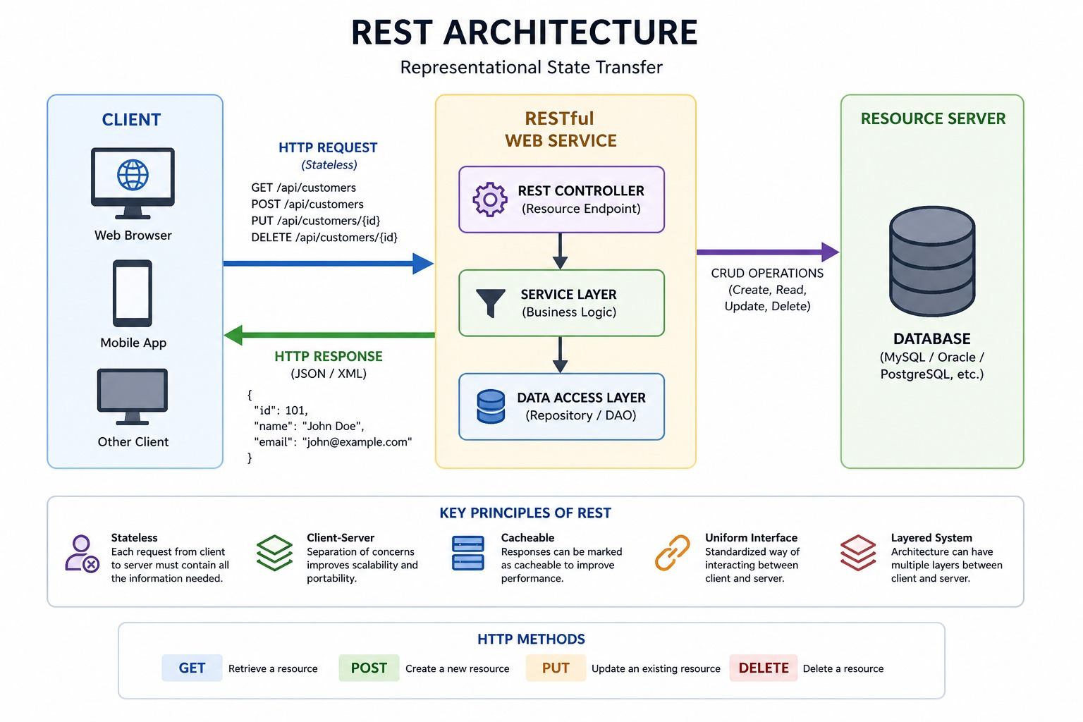
Frontend-Architecture

Slide 11
API BEST PRACTICES
RESTful design with API versioning (e.g., /api/v1/leads, /api/v1/customers).
Pagination & filtering on all list endpoints — prevents performance bottlenecks on large datasets.
Consistent error handling — standard HTTP status codes with structured JSON error responses.
JWT bearer token in Authorization header for all authenticated API requests.
CORS configuration — allows React frontend (Vercel/Netlify) to safely communicate with backend (Render).
Postman collections maintained for API documentation and team collaboration during development.

Slide 12
KEY DASHBOARD APIs
GET /api/v1/leads/overview
GET /api/v1/leads
Aggregated metrics — total, active, converted counts, pipeline value, conversion rate.
Paginated lead details — supports filtering by status, source, owner, and date range.
GET /api/v1/leads/activities
POST /api/v1/auth/login
Activity feed / logs — lists all call, email, meeting interactions per lead.
Authenticates user credentials and returns JWT token with role information.
GET /api/v1/customers
POST /api/v1/customers
Paginated customer list — supports search by name, company, status (Active/Closed).
Create a new customer record with contact, company, and product subscription details.
PUT /api/v1/leads/{id}
GET /api/v1/reports/revenue
Update lead status, score, pipeline value, or assigned owner inline.
Revenue trend data for charting — monthly breakdown for the last 6 months.

Slide 13
RESULTS & SURVEY FINDINGS
50
85%
80%
45%
IT Companies Surveyed
Reported Higher
Client Satisfaction
Streamlined
Processes
Cited High Cost
as Challenge

Slide 14
FUTURE ENHANCEMENTS
SaaS deployment — multi-tenant cloud hosting for SMEs with isolated data per organization.
AI chatbot integration — automated lead responses and qualification via conversational AI.
Mobile app (React Native / Flutter) — on-the-go CRM access for sales teams in the field.
Real-time notifications — WebSockets / push alerts for lead updates and task deadlines.
ML-based customer behaviour prediction — intelligent lead scoring and revenue forecasting.
Automated email campaigns & follow-up sequences — drip marketing inside the CRM.

Slide 15
CONCLUSION & FUTURE SCOPE
Conclusion
Future Scope
CURIEM integrates CRM + project management into a single unified platform
ReactJS + Spring Boot architecture provides scalability and modern UX
RBAC with JWT ensures enterprise-grade security for all user roles
Real-time dashboards enable data-driven decision-making
Automated task status via Spring @Scheduled eliminates manual overhead
Survey of 50 IT firms — 85% saw improved client satisfaction with CRM
SaaS deployment — multi-tenant cloud hosting
AI chatbot for automated lead responses
Mobile app (React Native) for on-the-go access
Real-time notifications via WebSockets
ML-based behaviour prediction & lead scoring
Automated email campaigns & follow-up sequences

Slide 16
THANK YOU
CuriumCRM — Close more deals, faster.
Questions?
Contact: anshikaggarwalcs@gmail.com
Anshika Aggarwal (2204920100024) · Raj Kumar (2204920100118)
Dept. of CSE | KCC Institute of Technology & Management, Greater Noida
Guide: Ms. Sarita Singh

