Slide 1
Coursera Capstone IBM DATA SCIENCE CAPSTONE PROJECT
Opening a new Indian restaurant in Hyderabad , India.
By Rajkumar

Slide 2
Business Problem:
Location of the restaurant is one of the most important decisions that will determine whether the restaurant will be a success or a failure
Objective: To analyze and select the best locations in the city of Hyderabad, India to open a new Indian restaurant.
This project is timely as the city is currently suffering from oversupply of Indian restaurants.
Business question :
->In the city of Hyderabad, India, if a property developer is looking to open a new Indian restaurant, where would you recommend that they open it?

Slide 3
Data
Data required:
➢List of neighborhoods in Hyderabad
➢Latitude and longitude coordinates of the neighborhoods
➢Venue data, particularly data related to Indian restaurants
Sources of data :
➢Wikipedia page for neighbourhoods (https://en.wikipedia.org/wiki/Category:Neighbourhoods_in_Hyderabad,_India)
➢Geocoder package for latitude and longitude coordinates
➢Foursquare API for venue data

Slide 4
Methodology
Web scraping Wikipedia page for neighbourhoods list
Get latitude and longitude coordinates using Geocoder
Use Foursquare API to get venue data
Group data by neighborhood and taking the mean of the frequency of occurrence of each venue category
Filter venue category by Indian restaurant.
Perform clustering on the data by using k-means clustering
Visualize the clusters in a map using Folium

Slide 5
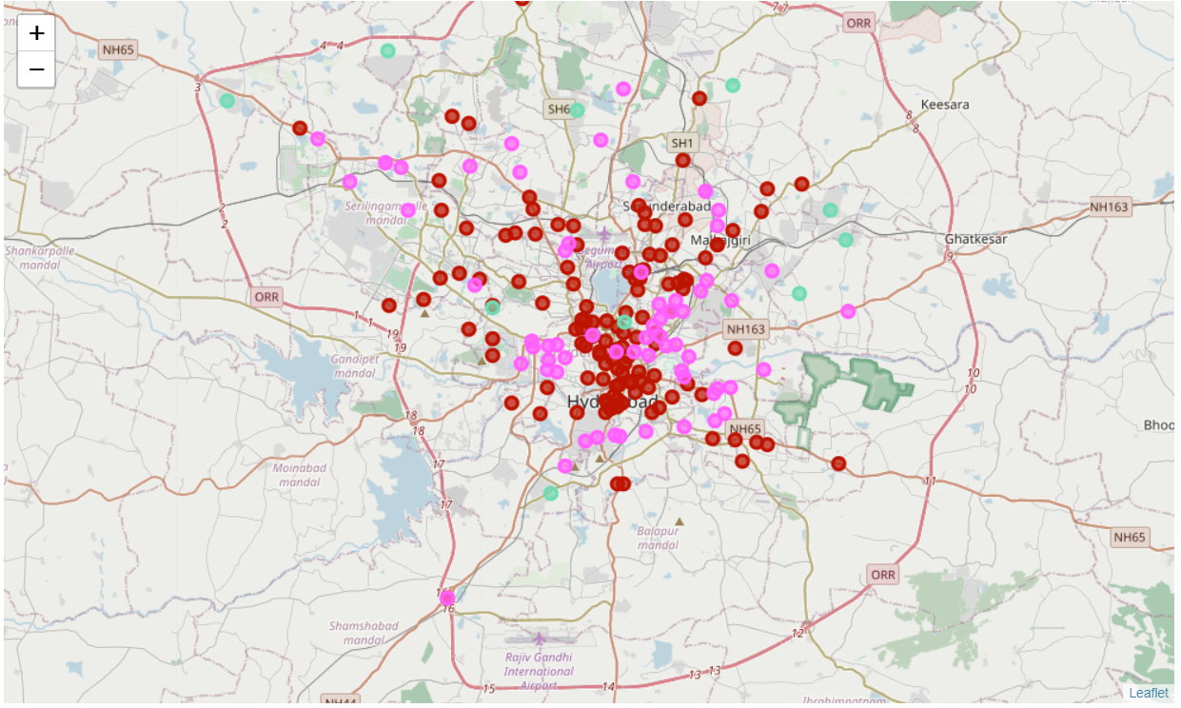
Results:
• Categorized the neighborhood's into 3 clusters:
➢ Cluster 1(red): Neighborhoods with high concentration of Indian restaurants.
➢ Cluster 2(light pink): Neighborhoods with moderate number of Indian restaurants.
➢ Cluster 3(mint green): Neighborhoods with low number to no existence of Indian restaurants.

Slide 6
Discussion:
Most of the Indian restaurants are concentrated in the central area of the city .
Highest number in cluster 1 and moderate number in cluster 2.
Cluster 3 has very low number to no Indian restaurants in the neighborhoods
Oversupply of Indian restaurants mostly happened in the central area of the city, with the suburb area still have very few shopping malls

Slide 7
Recommendations:
Open Indian restaurant in neighborhoods in cluster 3 with little to no competition.
Can also open in neighborhoods in cluster 2 with moderate competition if have unique selling propositions to stand out from the competition.
Avoid neighborhoods in cluster 1, already high concentration of Indian restaurants and intense competition.

Slide 8
Conclusion:
Answer to business question: The neighborhoods in cluster 3 are the most preferred locations to open a new Indian restaurant.
Findings of this project will help the relevant stakeholders to capitalize on the opportunities on high potential locations while avoiding overcrowded areas in their decisions to open a new Indian restaurant.

Slide 9

Thank you

