Slide 1
Crypto Volatility MLOps
End-to-End Machine Learning Pipeline for BTC Volatility Prediction
Automated ingestion | Feature engineering | Model training | Real-time serving | Continuous monitoring
AWS | Airflow | XGBoost | Feast | ONNX | W&B

Slide 2
The Problem
Crypto markets are highly volatile and operate 24/7
Traders need early warnings of upcoming volatility to manage risk
Manual monitoring is impossible at the speed crypto moves
Our Goal:
Predict whether BTC will experience >2% price swing in the next 7.5 hours
Serve predictions via API in real-time (<100ms latency)
Automatically retrain as market conditions change
Monitor model performance and detect when predictions degrade

Slide 3
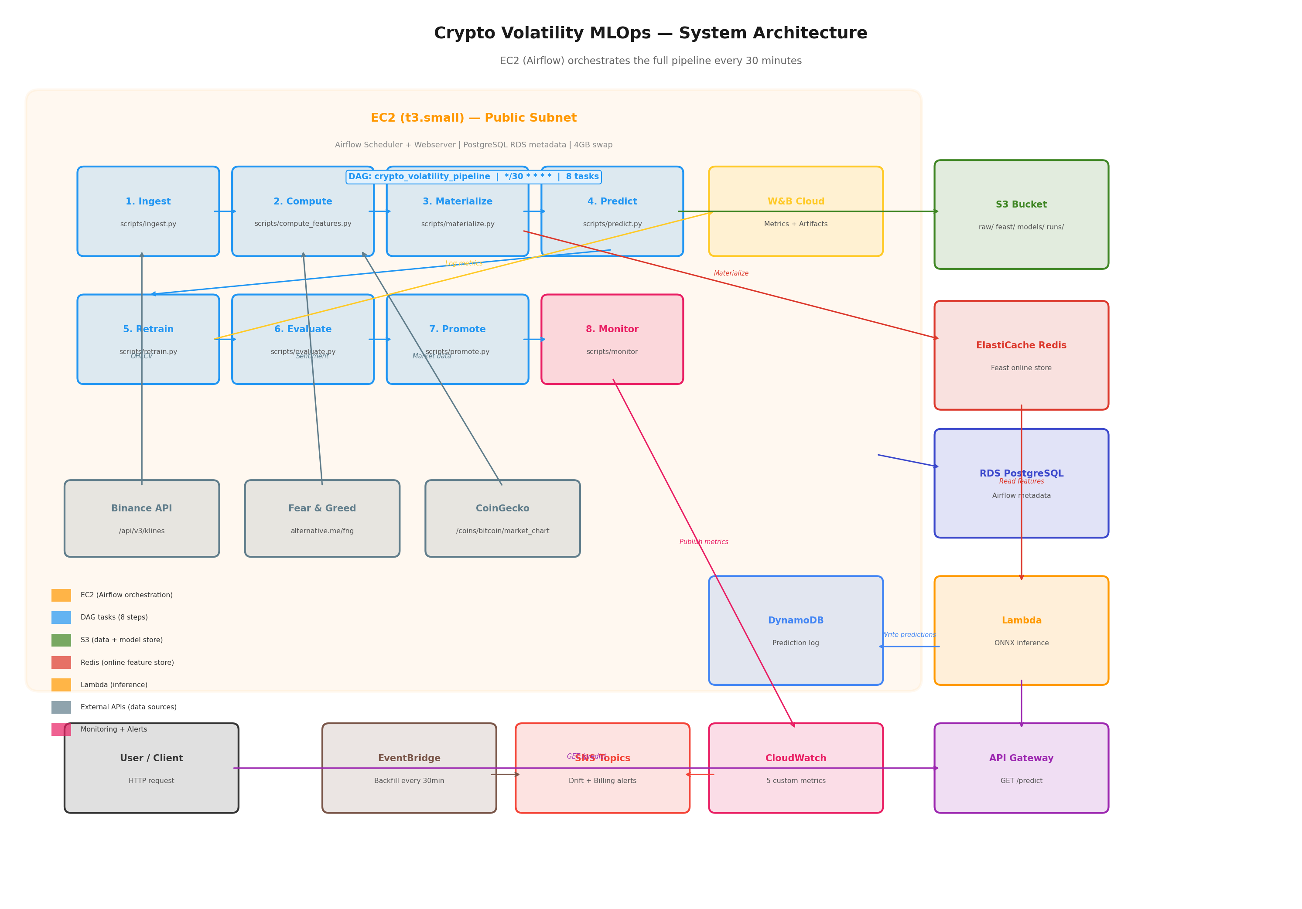
System Architecture

Slide 4
Data Pipeline
Data Sources:
Binance API: 15-min BTC/USDT OHLCV candles
Fear & Greed API: daily sentiment index (0-100)
CoinGecko API: BTC market cap history
Pipeline (every 30 minutes):
1. Ingest 1,000 candles from Binance
2. Compute 15 features + volatility labels
3. Write to S3 Parquet (Feast offline store)
4. Materialize latest features to Redis
Storage Architecture:
S3 (offline store):
~8,000 rows, full history
Used by: training pipeline
Latency: 200-500ms
Redis (online store):
1 row, latest features only
Used by: Lambda serving
Latency: 1-5ms
DynamoDB: prediction log + backfilled actuals

Slide 5
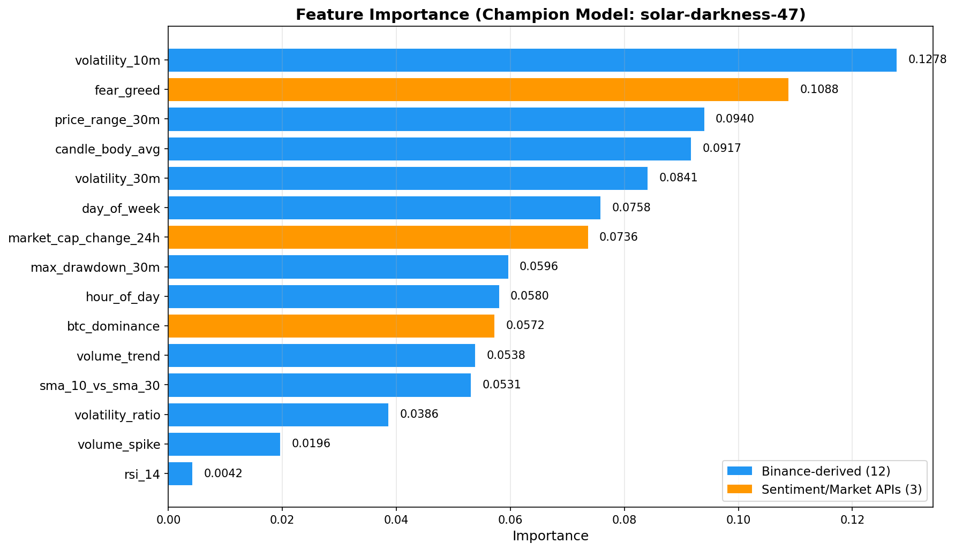
15 Features — What the Model Sees

Slide 6
Feature Categories
Volatility (3):
volatility_10m
volatility_30m
volatility_ratio
Momentum (1):
rsi_14
Volume (2):
volume_spike
volume_trend
Price Structure (4):
price_range_30m
sma_10_vs_sma_30
max_drawdown_30m
candle_body_avg
Temporal (2):
hour_of_day
day_of_week
Sentiment (3):
fear_greed
Daily index from alternative.me
market_cap_change_24h
From CoinGecko market chart
btc_dominance
BTC % of total crypto market
Key Insight:
fear_greed is the #2 most
important feature after
volatility_10m

Slide 7
How We Label Data
For each candle at time T, look forward 30 candles (7.5 hours):
swing = (max_price - min_price) / current_price
If swing > 2% --> label = 1 (VOLATILE)
If swing <= 2% --> label = 0 (CALM)
Example: candle at 14:00, close = $73,000
Future prices (14:15 to 21:30): max = $74,600, min = $72,500
swing = ($74,600 - $72,500) / $73,000 = 2.88%
2.88% > 2% --> VOLATILE
Class distribution: ~63% CALM, ~37% VOLATILE
Last 30 rows always dropped (incomplete forward window)

Slide 8
Model Training Pipeline
Algorithm: XGBoost Classifier
Data Split (time-ordered, no shuffle):
Train: first 80% (older data)
Test: last 20% (newer data)
Hyperparameter Search:
GridSearchCV with TimeSeriesSplit (3 folds)
8 combinations tested:
learning_rate: [0.01, 0.1]
max_depth: [3, 5]
n_estimators: [50, 100]
subsample: [0.8]
Class Imbalance Handling:
scale_pos_weight = neg/pos ratio (~1.7)
Prevents model from always predicting CALM
Export: ONNX format
Framework-agnostic
Lambda doesn't need XGBoost installed
Smoke tested before deployment
Tracking: Weights & Biases
Metrics, hyperparams, feature importance
Model artifacts versioned per run

Slide 9
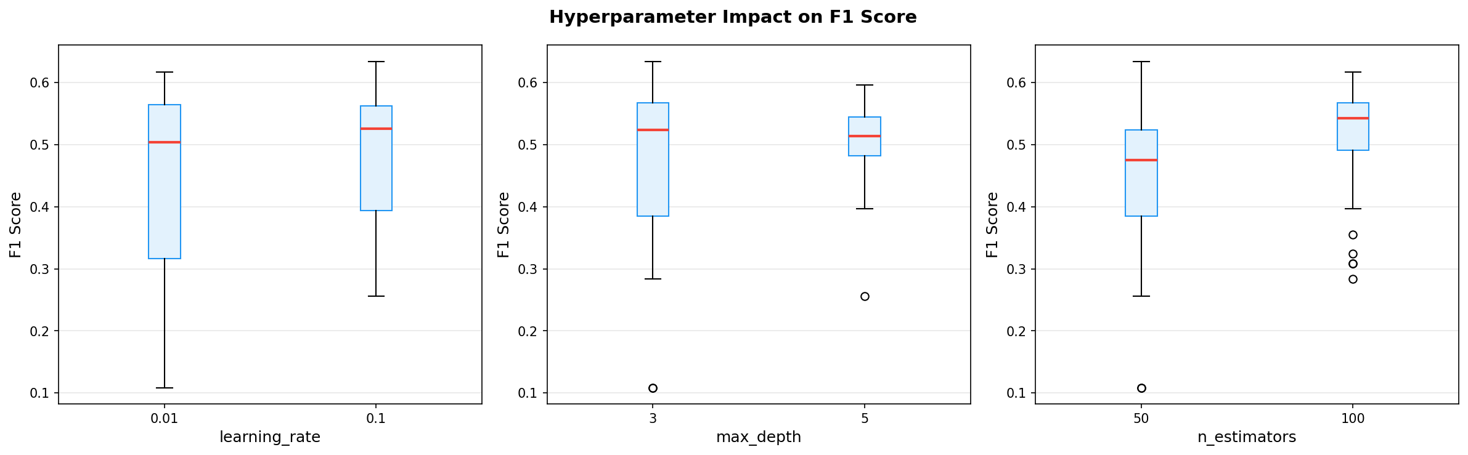
Hyperparameter Impact on F1 Score

Slide 10
Champion / Challenger Model Promotion
Every 30-min retrain produces a challenger model
Promotion rule:
If challenger F1 > champion F1:
--> Promote (copy to models/current.onnx)
Else:
--> Reject (champion stays)
This prevents regression:
49 training runs total
Only ~8 were promoted
~41 were rejected (worse than champion)
Production always serves the best model
Current Champion: solar-darkness-47
Accuracy: 80.3%
F1 Score: 0.634
ROC AUC: 0.742
Params: lr=0.1, depth=3, trees=50
Why F1 as promotion metric?
Accuracy is misleading with imbalanced classes
A model predicting all CALM gets 63% accuracy
F1 forces the model to actually catch
volatile events, not just the majority class

Slide 11
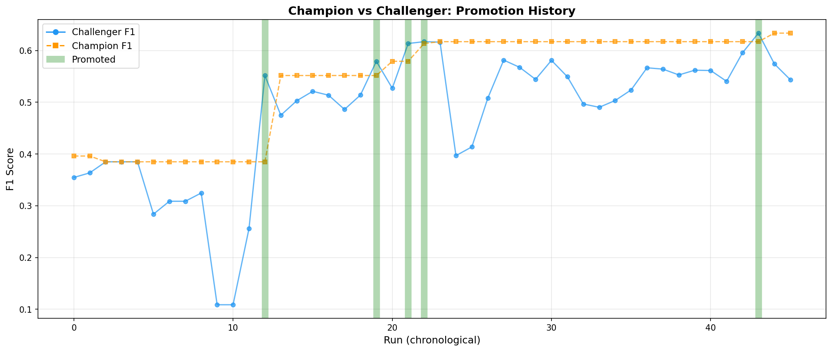
Promotion History — Champion vs Challenger

Slide 12
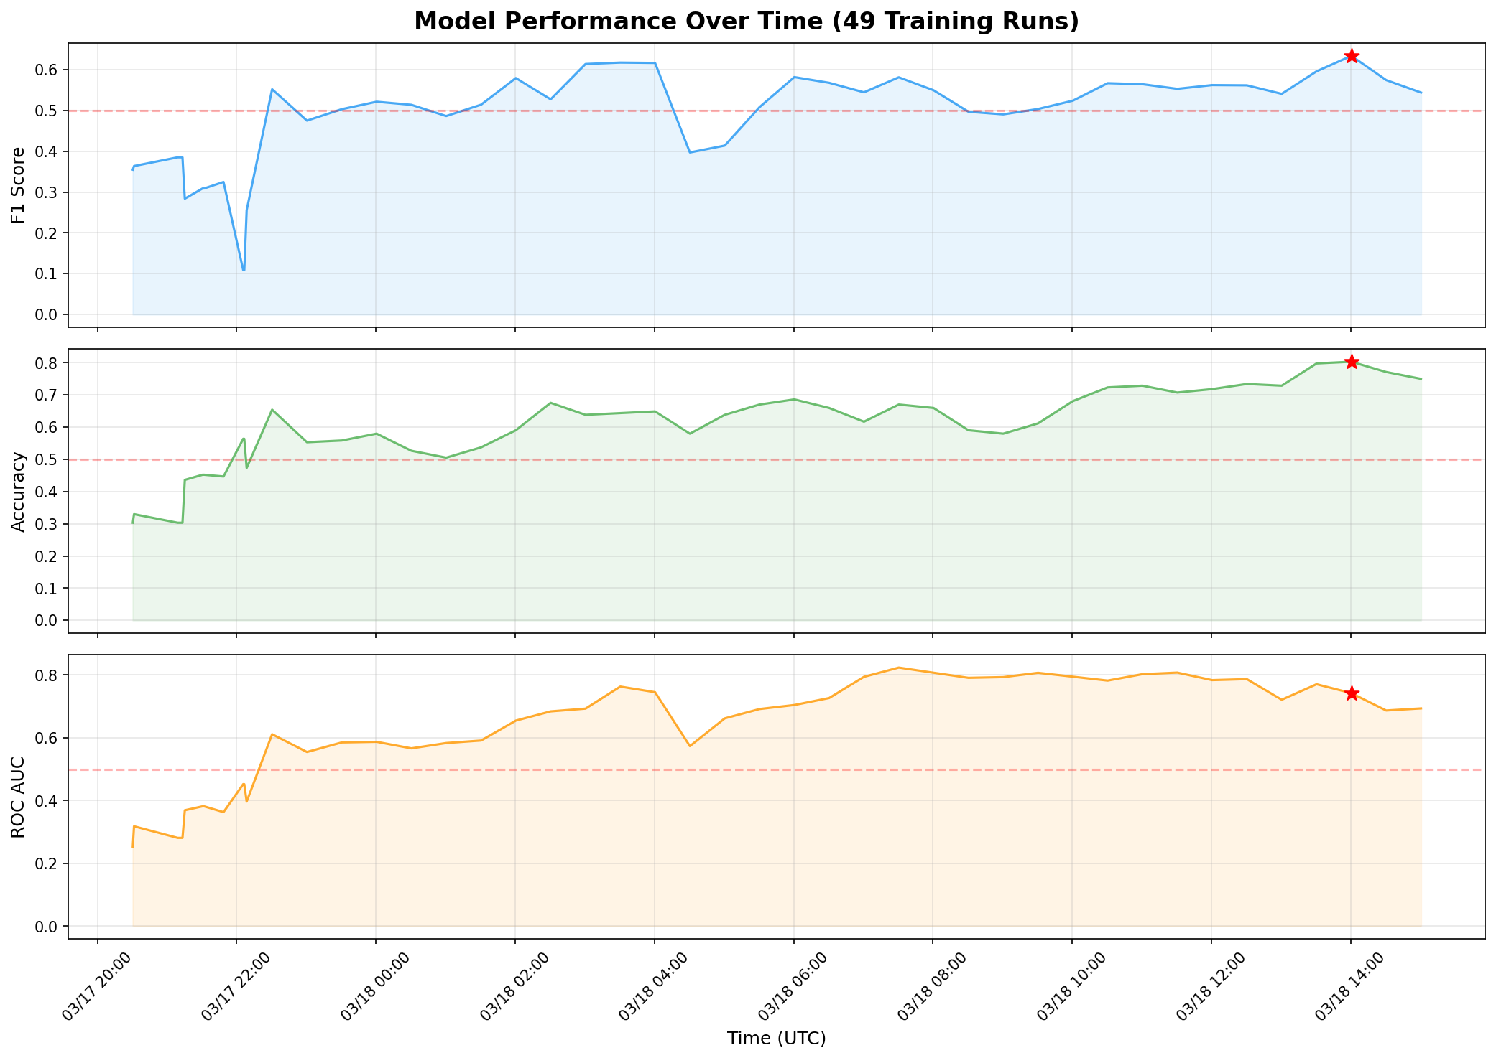
Model Performance Over Time

Slide 13
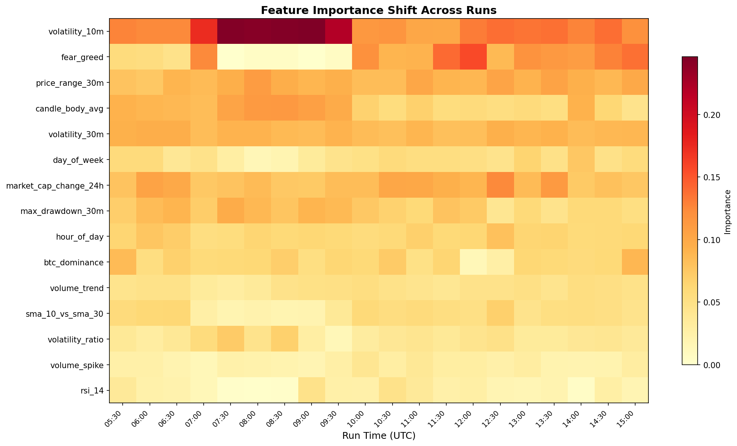
Feature Importance Shifts Across Runs

Slide 14
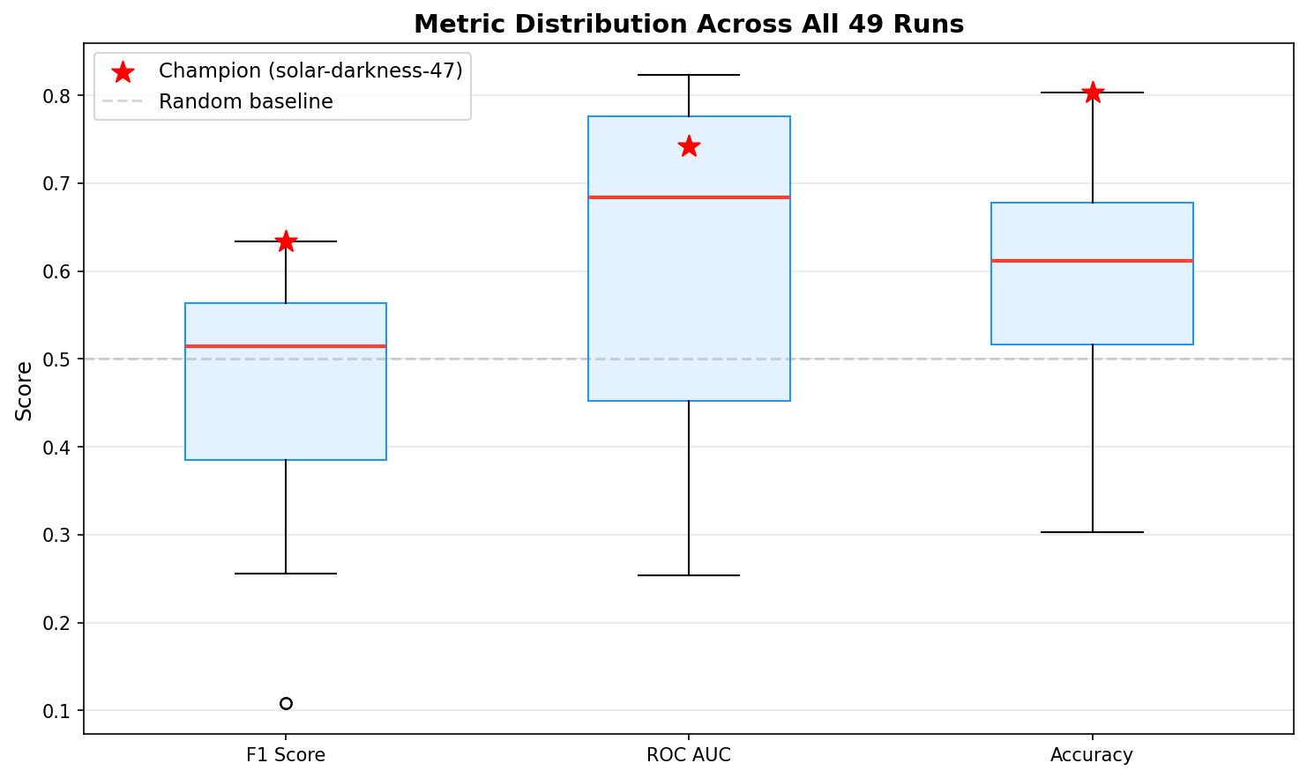
Metric Distribution Across All Runs

Slide 15
Airflow DAG — 8 Tasks Every 30 Minutes
Task 1: Ingest
Fetch candles from Binance --> S3
Task 2: Compute Features
15 features + labels --> S3 Parquet
Task 3: Materialize
S3 Parquet --> Redis (latest row only)
Task 4: Predict
Call Lambda via API Gateway
Writes prediction to DynamoDB
Task 5: Retrain
GridSearchCV + XGBoost + ONNX export
Logs to W&B, backs up to S3
Task 6: Evaluate
Compare challenger F1 vs champion F1
Task 7: Promote
If challenger wins --> new champion
Task 8: Monitor
Drift detection (KS-test)
Rolling accuracy from DynamoDB
Publish 5 CloudWatch metrics

Slide 16
Real-Time Serving
User --> API Gateway (GET /predict) --> Lambda --> Response
Lambda does:
1. Read 15 features from Redis (Feast online store) ~2ms
2. Load current.onnx from S3 (cached after first load) ~0ms
3. Run ONNX Runtime inference ~5ms
4. Write prediction to DynamoDB ~10ms
5. Return: { prediction: VOLATILE, confidence: 0.72 }
Total latency: <100ms
Lambda specs: 512MB memory, 60s timeout, x86_64, container image from ECR
Model size: ~21KB ONNX (tiny — XGBoost with 50 trees)

Slide 17
Monitoring & Drift Detection
5 CloudWatch Metrics:
1. rolling_accuracy (2-hour window)
2. drift_score (fraction of features drifted)
3. model_version (current champion)
4. prediction_latency (Lambda duration)
5. retrain_count (drift-triggered retrains)
Drift Detection:
Kolmogorov-Smirnov test on all 15 features
p_threshold = 0.01 (tight for crypto)
min_drifted = 2 (reduces false positives)
Compares reference vs recent distribution
Backfill Lambda (EventBridge, every 30 min):
Checks old predictions against actuals
Writes actual_label to DynamoDB
Enables rolling accuracy calculation
Alerting:
SNS drift alerts --> email notification
SNS billing alerts --> $1 threshold
CloudWatch alarms on metric thresholds
W&B Dashboard:
Experiment tracking across all runs
Feature importance trends
Promotion decision history

Slide 18
AWS Infrastructure
Provisioned via Terraform (IaC):
EC2 (t3.small): Airflow scheduler + webserver
All DAG tasks run here as subprocesses
Public subnet, 30GB EBS, 4GB swap
RDS (db.t3.micro): PostgreSQL 16
Airflow metadata only
Private subnet
ElastiCache (cache.t3.micro): Redis 7.1
Feast online store (1 row, ~300 bytes)
Private subnet
Lambda (predictor): 512MB, container image
ONNX inference, private subnet (VPC)
Lambda (backfill): 256MB, container image
Backfills actuals to DynamoDB
API Gateway: HTTP API (v2)
GET /predict, GET /health
S3: Central data + model store
DynamoDB: Prediction log
ECR: Container image registry
SNS: Alert notifications
EventBridge: Backfill scheduler

Slide 19
Monthly Cost Estimate
EC2 t3.small (Airflow): ~$15/month
RDS db.t3.micro (PostgreSQL): ~$15/month
ElastiCache cache.t3.micro: ~$13/month
Lambda (low volume): < $1/month
S3 + DynamoDB: < $1/month
API Gateway: < $1/month
────────────────────────────────────────────
Total: ~$45/month
Billing alarm set at $1 via SNS email
Use scripts/tear_down.sh to destroy all resources when not in use

Slide 20
Why Continuous Retraining?
Crypto markets exhibit data drift:
Data drift:
Feature distributions shift
(volatility regime changes)
Concept drift:
Feature-label relationship changes
(RSI stops being predictive)
Label drift:
Class balance shifts
(market becomes more volatile overall)
The ML lifecycle loop:
Train --> Deploy --> Monitor
^ |
| Detect drift |
| v
Promote <-- Evaluate <-- Retrain
Our pipeline runs this loop every 30 min
Champion/challenger gate ensures:
- Only better models reach production
- Bad retrains are rejected automatically
- Production always serves the best model

Slide 21
Key Decisions & Lessons
What worked well:
Sentiment features matter
fear_greed went from constant 50 to #2 feature
after fixing the API integration
90-day backfill was critical
10 days of data: overfit, F1=0.385
90 days: generalized, F1=0.634
scale_pos_weight for class imbalance
Without it: F1 collapsed to 0.109
With it: F1 recovered to 0.634
Challenges:
OOM on t3.small
Reduced param grid from 36 to 8 combos
CoinGecko free tier limitations
No historical total market cap
btc_dominance estimated from BTC trajectory
Model degradation over time
Market regime changes cause concept drift
Champion/challenger gate prevents
bad models from reaching production

Slide 22
Tech Stack
Orchestration:
Apache Airflow 2.10
EC2 + LocalExecutor
ML Framework:
XGBoost (classifier)
scikit-learn (GridSearchCV)
ONNX Runtime (inference)
Feature Store:
Feast (S3 + Redis)
Experiment Tracking:
Weights & Biases
Infrastructure:
Terraform (IaC)
Docker (Lambda images)
AWS Services:
EC2, RDS, ElastiCache
Lambda, API Gateway
S3, DynamoDB, ECR
CloudWatch, SNS
EventBridge
Data Sources:
Binance (OHLCV)
CoinGecko (market data)
Alternative.me (sentiment)

Slide 23
Thank You
Questions?
GitHub | W&B Dashboard | API: GET /predict

