Slide 1
HANDS-ON LAB · UNDERGRADUATE AI
From LLM App to AI Agent
with Meta Muse Spark
Build Mini-Muse step by step: a research agent that searches papers, reads PDFs and calculates — and asks a human before it acts
Muse Spark 1.3
Python · Streamlit
Tools + human approval
Raj Kumar · Byun Lab, Dept. of Electronic Engineering, Jeju National University · September 2026
Notes:
Welcome. Today we turn an ordinary LLM call into a small AI agent built on Meta's Muse Spark model. By the end you will know the four ingredients of an agent: a model that decides, tools that act, a loop that observes, and a human who approves. Everything runs even without an API key, in mock mode.

Slide 2



BACKGROUND
“Muse”: the app, the model and the door
Muse — the app
Muse Spark — the model
Meta Model API — the door
Meta's personal AI agent for consumers (ai.meta.com/muse). It plans and acts for you, but has no developer API.
The reasoning model behind Muse. Current ID: muse-spark-1.3, with a 1,048,576-token context window.
api.meta.ai/v1. OpenAI-SDK compatible, pay per token. This is what our Python code calls.
The app is what is trending. The model is what we can program — so we build our own small agent on Muse Spark.
1M
$1.25
4
tokens of context: several papers fit
per million input tokens (standard tier)
tools our agent may use — nothing else
Mini-Muse · From LLM app to AI agent with Meta Muse Spark
2 / 24
Notes:
ai.meta.com/muse is the consumer app: you talk to it and it acts for you, but there is no developer API. What we can program is the model behind it, Muse Spark, through Meta Model API at api.meta.ai/v1. Facts on this slide were checked against dev.meta.ai/docs on 24 September 2026.

Slide 3



BACKGROUND
LLM app → tool-using LLM → agent
Basic LLM
Tool-using LLM
Agent
User → Muse Spark → answer
User → Muse Spark → 1 tool → answer
Goal → decide → act → observe → … → approve
Answers from what it learned in training. It cannot check facts, read your files or compute exactly.
The model asks our code to run one function, reads the result, then answers.
Repeats the loop until the goal is done. We add a step limit and a human checkpoint.
Same model, same question — only the loop around it changes. Mini-Muse has all three as modes.
Mini-Muse · From LLM app to AI agent with Meta Muse Spark
3 / 24
Notes:
This is the concept of the day. The model is the same in all three columns. What changes is the program around it. A basic LLM only talks. A tool-using LLM can ask our code to run one function. An agent repeats decide, act, observe until the goal is done, and a responsible agent stops for a human before important actions.

Slide 4

TODAY'S BUILD
Mini-Muse: goal in, approved report out
You
Muse Spark
tools.py
agent.py
You again
Goal
Decide
Act
Observe
Approve
Types a research question in the chat
Picks the next tool, or answers
A validated tool runs: papers, PDF, maths
The result goes back to Muse Spark ↺
The report is written only after you click
The loop: Decide → Act → Observe repeats up to 8 rounds. Writing the report is the only action that needs your approval.
3
4
8
123
demo modes: Basic · Tool-using · Agent
tools, each with a JSON Schema
tool rounds at most, then it stops
offline tests, no API key needed
Mini-Muse · From LLM app to AI agent with Meta Muse Spark
4 / 24
Notes:
Walk the boxes left to right. The loop in the middle, decide, act, observe, can run several times. The last box is the important design decision: writing the report is the only action that needs a human, and the program, not the model, enforces that.

Slide 5
SETUP
The project: one file per idea
File | Step | Job
config.py | 0 | Settings from .env: key, model, mock switch
meta_client.py | 1 | Talk to Muse Spark; MockMetaClient for class without a key
tools.py | 2 | Tool registry, JSON Schemas, argument validation
paper_search.py · pdf_reader.py · calculator.py | 3 | The three tools that do real work
agent.py | 4–5 | Agent loop, state machine, human approval
report_generator.py | 5 | Report with [n] citations, saved to outputs/
app.py | 6 | Streamlit chat interface
tests/ | 7 | 123 offline tests + 2 live tests
Mini-Muse · From LLM app to AI agent with Meta Muse Spark
5 / 24
Notes:
Each file has one job and is short enough to read in a few minutes. We go through them in step order. Students can follow along in the mini-muse folder.

Slide 6


STEP 0
Install, add a key, run
python -m venv .venv
.venv\Scripts\activate # macOS/Linux: source .venv/bin/activate
pip install -r requirements.txt # streamlit, openai, httpx, pypdf, pytest
copy .env.example .env # paste MODEL_API_KEY=... (or leave it empty)
streamlit run app.py # open http://localhost:8501
Getting a key
No key? Mock mode
dev.meta.ai → API keys → Create API key. It is shown once; put it in .env, never in code. Pay per token.
An empty key, MINI_MUSE_MOCK=1, or a refused key (401 / 403 / region) switches to a scripted stand-in model. The tools stay real.
Mini-Muse · From LLM app to AI agent with Meta Muse Spark
6 / 24
Notes:
Create a virtual environment, install five packages, copy the example settings file and start the app. Without a key the app runs in mock mode automatically, so every student can follow the lab.

Slide 7
STEP 0
config.py — settings live outside the code
load_dotenv(PROJECT_DIR / ".env") # read .env; the key is never printed
@dataclass(frozen=True)
class Settings:
api_key: str = field(repr=False) # repr=False: the key never shows in logs
model: str = "muse-spark-1.3"
base_url: str = "https://api.meta.ai/v1"
reasoning_effort: str = "low" # reasoning tokens are billed as output
force_mock: bool = False
@property
def use_mock(self) -> bool:
return self.force_mock or not self.api_key
MAX_STEPS = 8 # hard limit on tool rounds in Agent mode
Key idea · one place for every setting. An empty key switches on mock mode; repr=False keeps the key out of error messages.
Mini-Muse · From LLM app to AI agent with Meta Muse Spark
7 / 24
Notes:
All settings in one frozen dataclass, read from environment variables. repr=False means the key never appears if the settings object is printed or shows up in an error. MAX_STEPS is the agent's safety limit.

Slide 8
STEP 1
Call Muse Spark with the OpenAI SDK
client = OpenAI(api_key=api_key, base_url="https://api.meta.ai/v1", # Meta, not OpenAI
timeout=120, max_retries=0) # we retry ourselves
response = client.responses.create(
model="muse-spark-1.3",
instructions=prompts.AGENT, # the agent's rules
input=history, # the conversation so far
tools=tool_schemas, # what the model may ask us to run
reasoning={"effort": "low"}, # think less = faster and cheaper
store=False,
include=["reasoning.encrypted_content"],
)
Key idea · only base_url changes. The SDK does not read MODEL_API_KEY by itself, so we pass it explicitly.
Mini-Muse · From LLM app to AI agent with Meta Muse Spark
8 / 24
Notes:
The most important slide for beginners: no new library. Meta Model API speaks the OpenAI protocol, so we use the official openai package and only change base_url. We pass the key explicitly because the SDK does not read MODEL_API_KEY. We call Meta, never OpenAI's servers or models.

Slide 9



STEP 1
What comes back: an answer or a tool call
output: [
{ "type": "reasoning", "encrypted_content": "gAAA…" },
{ "type": "function_call",
"call_id": "call_8f2a…",
"name": "search_papers",
"arguments": "{\"query\": \"physics-informed solar power forecasting\", \"year_from\": 2024}" }
]
usage: { "input_tokens": …, "output_tokens": … } # output includes reasoning tokens
function_call
call_id
reasoning
The model's decision: which tool, with which JSON arguments.
Ties our tool result back to this exact request.
Hidden thinking, replayed encrypted. Never shown to users.
Mini-Muse · From LLM app to AI agent with Meta Muse Spark
9 / 24
Notes:
This is the shape of a Responses API reply when the model wants a tool, shortened. The model does not run anything: it returns a function_call with a name and JSON arguments. Our wrapper turns every reply into one small dictionary: text, tool_calls, citations and usage. The mock client builds exactly the same shape.

Slide 10


STEP 2
Describe each tool with a JSON Schema
"calculate": {
"description": "Safely evaluate arithmetic. Supports + - * / ** %, parentheses and "
"sqrt, abs, round, mean, rmse(list, list), pct_change(old, new).",
"parameters": {
"type": "object",
"properties": {"expression": {"type": "string", "minLength": 1, "maxLength": 200}},
"required": ["expression"],
"additionalProperties": False,
},
},
description
parameters
The model reads this to decide when to use the tool.
JSON Schema: what arguments are allowed. We check them again in Python.
Mini-Muse · From LLM app to AI agent with Meta Muse Spark
10 / 24
Notes:
A tool is a Python function plus a description the model can read. The description tells the model when to use it; the JSON Schema tells it which arguments are allowed. These dictionaries are sent in the tools parameter.

Slide 11
STEP 2
The model proposes, Python decides
def validate_call(name, raw_arguments, allowed):
"""Return (arguments, None) if valid, else (None, error_message)."""
if name not in TOOLS:
return None, f"Unknown tool '{name}'."
if name not in allowed:
return None, f"Tool '{name}' is not available in this mode."
try:
args = json.loads(raw_arguments)
except json.JSONDecodeError:
return None, "Arguments are not valid JSON."
errors = _check(args, TOOLS[name]["parameters"], "arguments") # mini JSON-Schema check
if errors:
return None, "Invalid arguments: " + "; ".join(errors[:5])
return args, None
Key idea · an unknown tool or a bad argument becomes an error observation the model can read and correct — never a crash.
Mini-Muse · From LLM app to AI agent with Meta Muse Spark
11 / 24
Notes:
Never trust the model's arguments. Before anything runs, Python checks the tool name, the mode, the JSON and the schema. A bad call does not crash the app: it becomes an error message that goes back to the model, which can then fix its call. Code shortened for the slide.

Slide 12



STEP 3
Three tools that do real work
search_papers
read_pdf
calculate
query, year_from, max_results
question
expression
Semantic Scholar first. On HTTP 429 it waits (Retry-After), then falls back to OpenAlex. Returns real papers only: title, authors, year, venue, DOI.
pypdf text → ~2,000-word chunks with 200-word overlap → the 6 chunks with most keyword overlap. Rejects encrypted, scanned and >20 MB files.
Safe maths from an AST whitelist: + − × ÷ ** %, sqrt, mean, rmse, pct_change. No eval().
Key idea · tools return real data or a clear error — never invented papers. Nothing else can run: no shell, no Python, no files.
Mini-Muse · From LLM app to AI agent with Meta Muse Spark
12 / 24
Notes:
Three tools do the real work. Paper search uses free academic APIs and only returns what they return. The PDF tool uses simple keyword overlap instead of embeddings, which keeps it readable. The calculator never uses eval. Notice what is missing: no shell, no Python execution, no file access.

Slide 13


STEP 3
A calculator that cannot be hacked
tree = ast.parse("pct_change(100, 125)", mode="eval") # text → syntax tree; nothing runs
def _eval(node):
if isinstance(node, ast.Constant): # numbers only
...
if isinstance(node, ast.BinOp) and type(node.op) in BIN_OPS:
return BIN_OPS[type(node.op)](_eval(node.left), _eval(node.right))
if isinstance(node, ast.Call):
# Only plain names from the whitelist: no attributes (os.system), no keywords.
if not isinstance(node.func, ast.Name) or node.func.id not in FUNCTIONS:
raise CalculatorError("Function not allowed")
return FUNCTIONS[node.func.id](*[_eval(arg) for arg in node.args])
raise CalculatorError(f"Unsupported syntax: {type(node).__name__}")
pct_change(100, 125) → 25.0
__import__('os') → rejected
Percentage increase: (new − old) / old × 100.
“Function not allowed” — nothing is ever imported or run.
Mini-Muse · From LLM app to AI agent with Meta Muse Spark
13 / 24
Notes:
ast.parse turns the text into a tree without running it. We walk the tree and only allow numbers, the basic operators and six whitelisted functions. Anything else, such as a name, an attribute or an import, raises an error. That is why __import__('os') is harmless here. Code shortened for the slide.

Slide 14


STEP 4
The agent loop: decide → act → observe
def _run_agent_loop(state, client):
allowed = tools.MODE_TOOLS["agent"]
while state["status"] == RUNNING:
if state["steps"] >= MAX_STEPS: # hard stop: 8 rounds
return _finish(state, "Stopped after 8 tool rounds.")
result = _ask_model(state, client, allowed) # DECIDE
if not result["tool_calls"]: # text = final answer
return _finish(state, result["text"])
state["steps"] += 1
for call in result["tool_calls"]:
if call["name"] == "generate_report":
_request_approval(state, call, allowed) # pause!
else:
_run_tool_call(state, call, allowed) # ACT + OBSERVE
if state["pending_report"]:
_set_status(state, WAITING_APPROVAL)
Decide
Muse Spark picks a tool, or writes the final answer.
Act
tools.py validates the call, then the tool runs.
Observe
The result is added to the history; the loop runs again.
Mini-Muse · From LLM app to AI agent with Meta Muse Spark
14 / 24
Notes:
This is the whole agent, about fifteen lines. Each pass: ask Muse Spark. If it answers in plain text, we are done. If it asks for tools, we run them and loop again. Two exits are enforced by our code, not by the model: the eight-round limit, and the pause when it wants to write the report. Log lines removed for the slide.

Slide 15


STEP 4
Observe: the result goes back to the model
history = [
{ "role": "user", "content": "Find recent papers about physics-informed solar power forecasting ..." },
{ "type": "function_call", "call_id": "call_8f2a…", "name": "search_papers",
"arguments": "{\"query\": \"physics-informed solar power forecasting\"}" },
{ "type": "function_call_output", "call_id": "call_8f2a…",
"output": "{\"source\": \"OpenAlex\", \"papers\": [{\"id\": 1, \"title\": \"Physics-informed voting ...\"}, ...]}" },
] # the whole list is sent again for the next decision
function_call_output
papers are numbered
errors are results too
Our result, matched to the request by the same call_id.
[1] … [5]: the only ids the model is allowed to cite.
429, bad arguments, no results → the model adapts.
Mini-Muse · From LLM app to AI agent with Meta Muse Spark
15 / 24
Notes:
Observation is just a message. The tool result is sent back as a function_call_output item with the same call_id, and the whole history goes to Muse Spark again for the next decision. Errors are observations too: a 429 or a bad argument is reported to the model, which can change its plan.

Slide 16
STEP 5
Human approval — enforced by code, not by the model
RUNNING
WAITING_APPROVAL
APPROVED
REJECTED
DONE
Loop runs
Paused
You clicked
Or you said no
Finished
Tools run; the model decides
Model asked for the report; buttons appear
Now, and only now, the report tool runs
The tool never runs; clean stop
Answer or report shown and saved
def approve(state): # called ONLY by the Approve button
if state["status"] != WAITING_APPROVAL: return # a rerun or second click does nothing
pending = state["pending_report"]
markdown = report_generator.build_report(state["goal"], state["papers"], pending["arguments"], ...)
path = report_generator.save_report(markdown, outputs_dir, state["goal"])
_set_status(state, DONE) # no extra model call
Key idea · generate_report is not in the tool executor list — the only path to it is approve().
Mini-Muse · From LLM app to AI agent with Meta Muse Spark
16 / 24
Notes:
Human approval is enforced by the program. When the model calls generate_report, agent.py validates the arguments but does not run it; it stores the call and switches to WAITING_APPROVAL. The report is written only inside approve(), which only the Approve button calls. Reject sends 'rejected' back as the tool result and stops cleanly.

Slide 17


STEP 5
Every claim cites a paper — or says it doesn't
def format_claim(claim: dict, valid_ids: set[int]) -> str:
text = str(claim.get("text", "")).strip()
ids = sorted({i for i in claim.get("sources", []) if i in valid_ids}) # drop invented ids
if ids:
return f"- {text} " + "".join(f"[{i}]" for i in ids)
return f"- {text} *(AI synthesis)*"
# - 5 relevant papers were retrieved from a real academic search API. [1][2][3][4][5]
# - Candidate gap: how well physical constraints generalise across sites. *(AI synthesis)*
Sources are written by code
Ten fixed sections
The list comes from real search results; the model cannot add a paper.
Question, sources, methods, datasets, models, metrics, findings, limitations, gaps, future work.
Mini-Muse · From LLM app to AI agent with Meta Muse Spark
17 / 24
Notes:
The report has ten fixed sections. Our code writes the Sources list from the search results, so the model cannot add a paper. Each claim carries paper numbers; numbers that do not exist are dropped, and a claim with no valid source is labelled AI synthesis so the reader knows to check it.

Slide 18
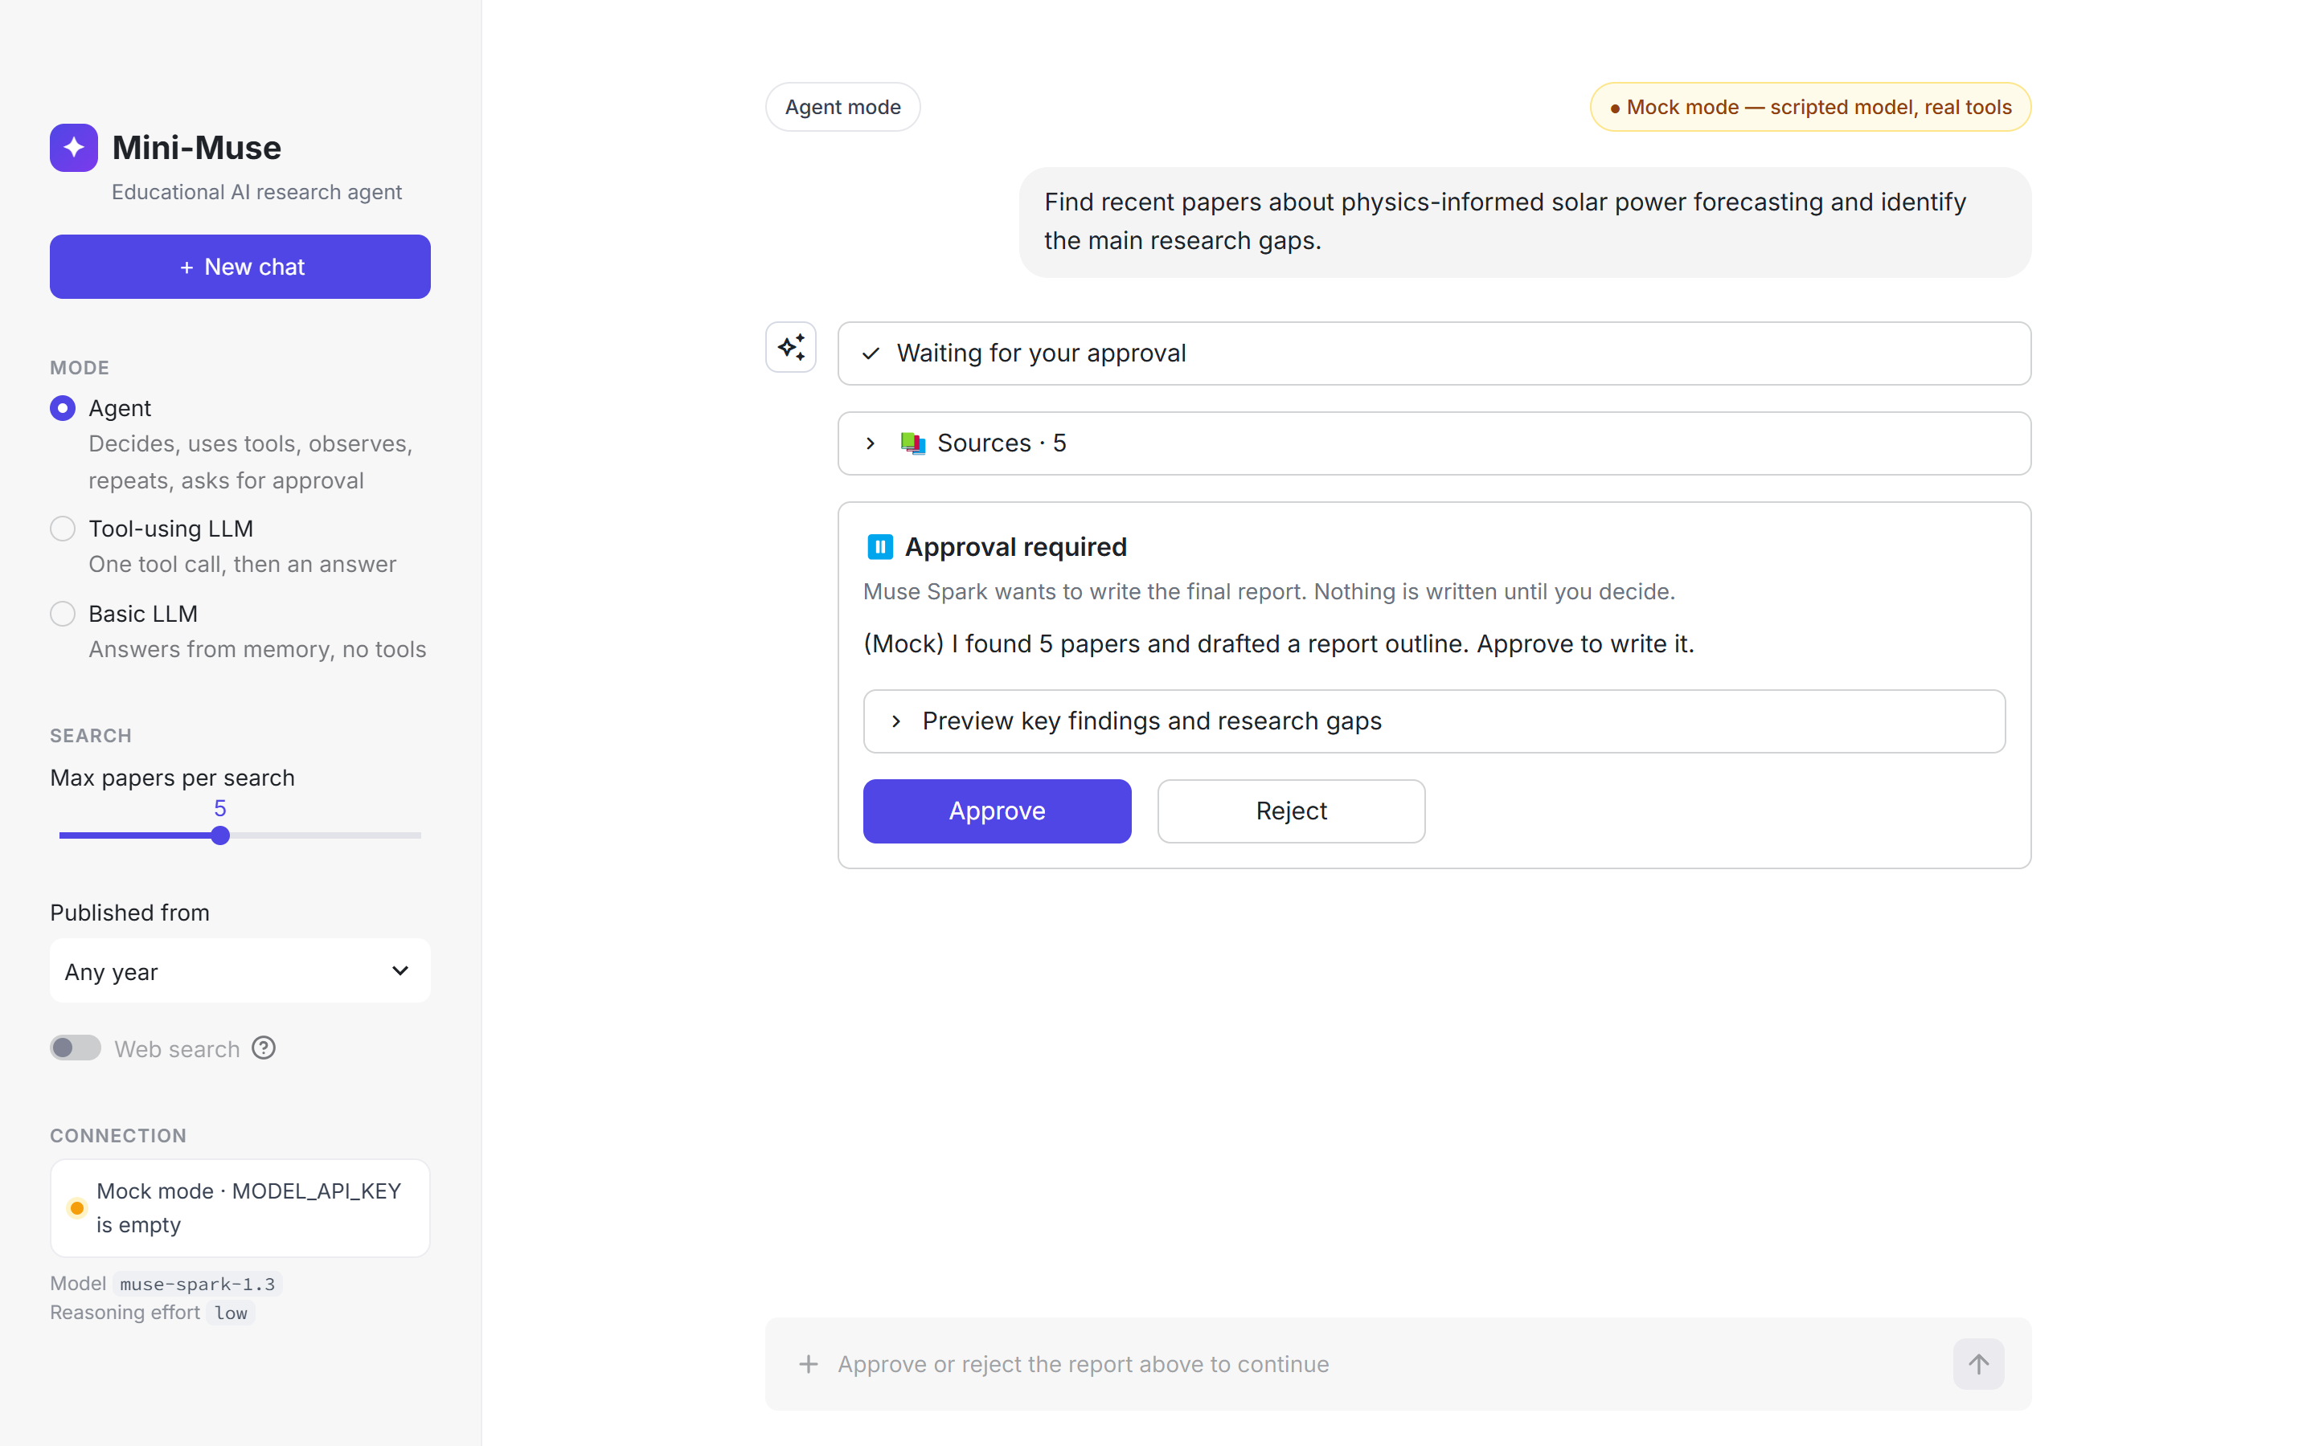
STEP 6
The result: a chat window with a checkpoint
1 · Ask
Type a goal or click an example. Attach a PDF with the + button.
2 · Watch the steps
Each decision and tool call appears live, then folds into “Worked through N steps”.
3 · Approve or reject
The message box stays locked until you decide.
Mini-Muse · From LLM app to AI agent with Meta Muse Spark
18 / 24
Notes:
This is the real app in mock mode, with real papers from OpenAlex. Point out the three parts: the collapsed steps panel, the sources, and the approval card. The message box is locked until the human decides.

Slide 19
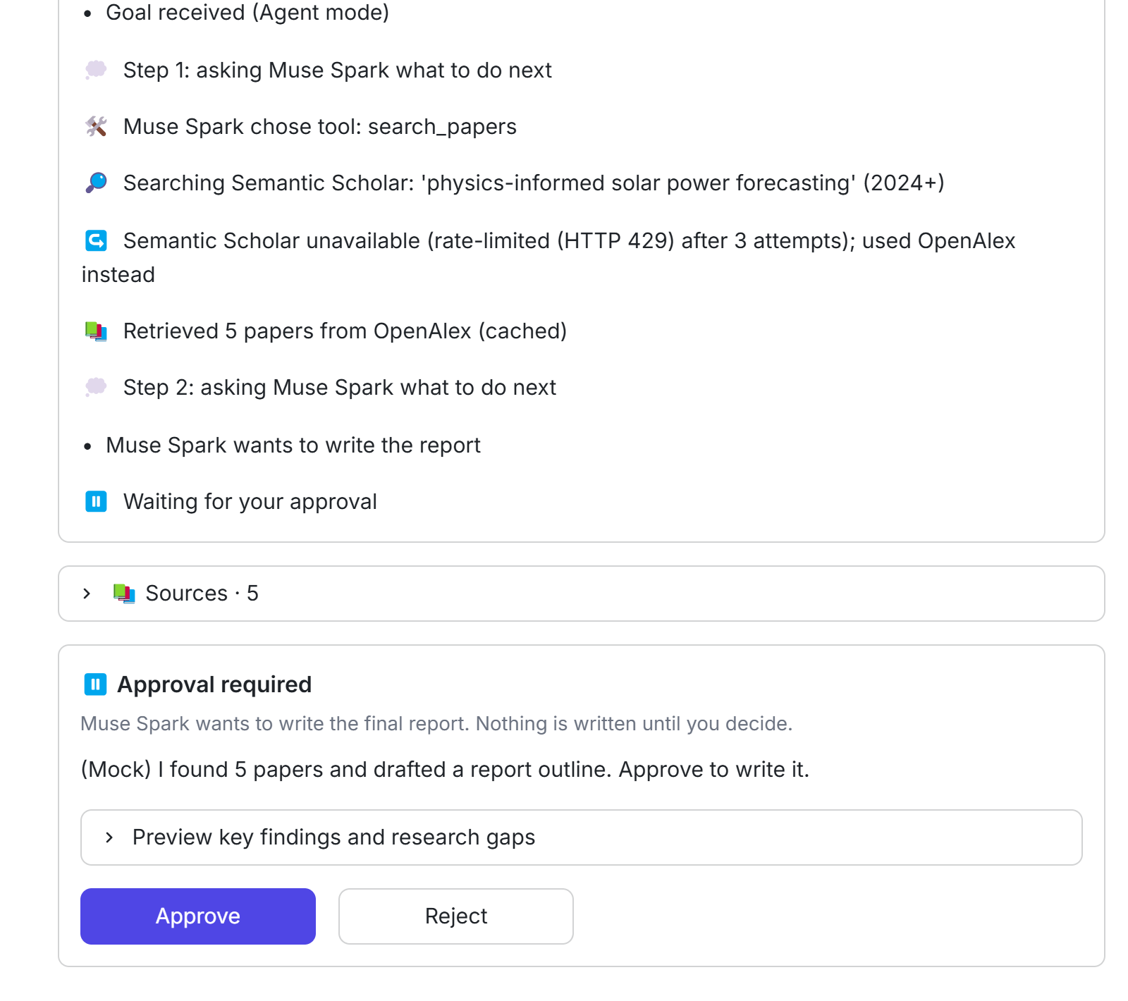


STEP 6
What the agent did — shown live, step by step
Decide
“Step 1: asking Muse Spark what to do next” → it chose search_papers.
Recover
Semantic Scholar answered 429 → the tool fell back to OpenAlex by itself.
Pause
Step 2: the model asked for the report → status WAITING_APPROVAL.
Key idea · Streamlit reruns the script on every click. State lives in st.session_state; the model is called only when you send.
Mini-Muse · From LLM app to AI agent with Meta Muse Spark
19 / 24
Notes:
A real run. Semantic Scholar was rate-limited, so the search tool retried and fell back to OpenAlex on its own, then the agent asked for approval. Streamlit reruns the whole script on every click, so the agent state lives in st.session_state and Muse Spark is only called when a message is sent.

Slide 20
STEP 6
One question, three modes
Mode | What happens | “Percentage increase from 100 to 125” | “Find recent papers on … and the gaps”
Basic LLM | Muse Spark only, no tools | Answers from memory — no calculator | Cannot search: may not know recent papers
Tool-using LLM | At most one tool round | calculate → 25% | One search → list of papers
Agent | Loop + human approval | calculate → 25%; no report needed | Search → approval → cited report
Key idea · the model is the same in every row. The loop, the tools and the checkpoint are what make it an agent.
Mini-Muse · From LLM app to AI agent with Meta Muse Spark
20 / 24
Notes:
The teaching point of the demo. Ask the same questions in each mode and compare. The Basic LLM has no way to check papers, so it can only answer from memory. The Tool-using LLM gets one tool call. The Agent can keep working and stops for your approval before writing the report.

Slide 21
STEP 7
Test it without spending a cent
def test_approve_resumes_and_writes_report(options):
state, client = run(GOAL_A, "agent", options) # MockMetaClient + fake search
assert state["status"] == agent.WAITING_APPROVAL
agent.approve(state)
assert state["status"] == agent.DONE
assert client.calls == 2 # approval did NOT call the model again
assert "*(AI synthesis)*" in Path(state["report_path"]).read_text(encoding="utf-8")
$ pytest -q
123 passed, 2 skipped in 0.8s # the 2 live tests need RUN_LIVE_TESTS=1
Key idea · the mock speaks the same JSON shape as Muse Spark, so the tests check our real code, not a toy copy.
Mini-Muse · From LLM app to AI agent with Meta Muse Spark
21 / 24
Notes:
API calls cost money and change over time, so the tests run offline. MockMetaClient returns the same Responses-API shape as Muse Spark, and paper search is faked, so the tests check the real loop, the validator and the approval rule in under a second. Test shortened for the slide.

Slide 22
BEFORE YOU SHIP
Costs, limits and common errors
Topic | What to know
Cost | muse-spark-1.3: $1.25 in / $4.25 out per million tokens; reasoning counts as output. About $0.05 per agent run (estimate).
Cheaper tier | muse-spark-1.3-contributor: $0.10 / $0.20 — but prompts may be used to improve Meta's products.
Paper search | Free Semantic Scholar / OpenAlex APIs rate-limit (HTTP 429); a search can take ~45 s. Free API keys help.
401 | Missing or wrong MODEL_API_KEY → the app switches to mock mode and says why.
404 | model_not_found → check the MUSE_MODEL spelling.
429 / region | Wait and retry. If the region is refused, use mock mode — never bypass it.
Mini-Muse · From LLM app to AI agent with Meta Muse Spark
22 / 24
Notes:
Prices are from Meta's pricing page, checked 24 September 2026; the per-run cost is an estimate. The contributor tier is much cheaper, but Meta may use prompts for training, so do not send unpublished work with it. The free search APIs are the most common source of delays in class.

Slide 23
YOUR TURN
Six exercises, easy to hard
1 · Easy
2 · Easy
Add a “depth” selector for reasoning effort (minimal → high); compare speed and tokens.
Add a new tool, unit_convert(value, from, to), with its JSON Schema and validation.
3 · Medium
4 · Medium
Let the agent remember earlier questions in the same chat (send previous turns).
Save chats to a chats/ folder and list them in the sidebar, like ChatGPT.
5 · Hard
6 · Hard
Replace keyword PDF ranking with embeddings and compare the answers.
Run the same goal live and in mock mode; log how Muse Spark's tool choices differ.
Mini-Muse · From LLM app to AI agent with Meta Muse Spark
23 / 24
Notes:
Pick one exercise per student or pair. Exercise 6 is a small research question in itself: does the real model choose tools differently from the scripted mock?

Slide 24
SUMMARY
Seven steps from API call to AI agent
0
Settings in .env + mock switch
1
OpenAI SDK → Meta base_url
2
Tools as JSON Schema + validation
3
Real tools: papers, PDF, maths
4
Decide → act → observe loop
5
Human approval, in code
6–7
Chat UI + 123 offline tests
★
The model proposes, code decides
References
Meta Model API docs — dev.meta.ai/docs · Tool calling — dev.meta.ai/docs/tool-calling · Reasoning — dev.meta.ai/docs/reasoning
Semantic Scholar API — api.semanticscholar.org · OpenAlex — openalex.org/rest-api · Muse app — ai.meta.com/muse
Mini-Muse · From LLM app to AI agent with Meta Muse Spark
24 / 24
Notes:
Recap the steps. The design lesson carries over to any model: let the model propose, let plain code validate and limit, ground answers in real sources, and keep a human in the loop for actions that matter.

