Slide 1
Strings

Slide 2
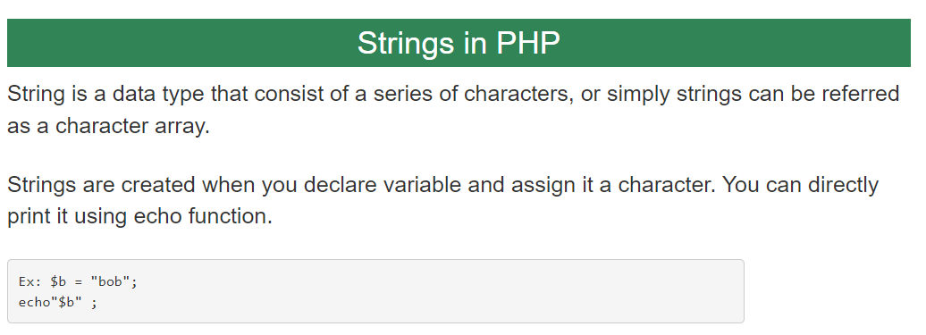

Slide 3
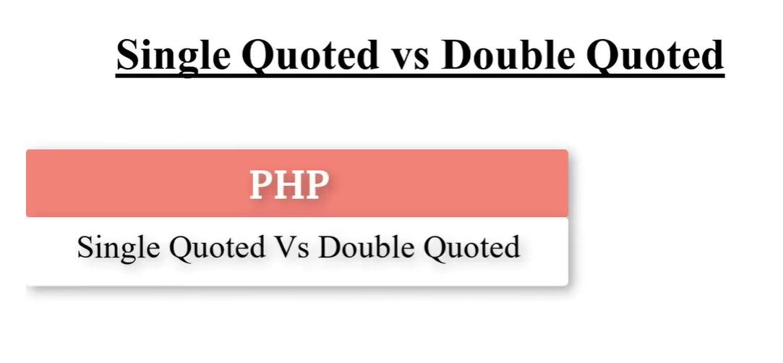

Slide 4
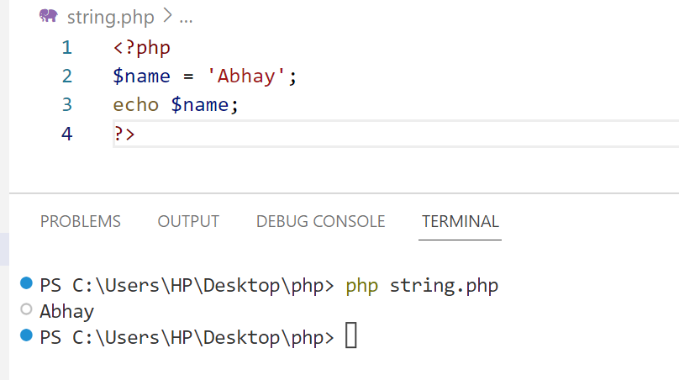
Single Quoted
The simplest way to create a string is to enclose the string literal (i.e. string characters) in single quotation marks ('), like this:

Slide 5
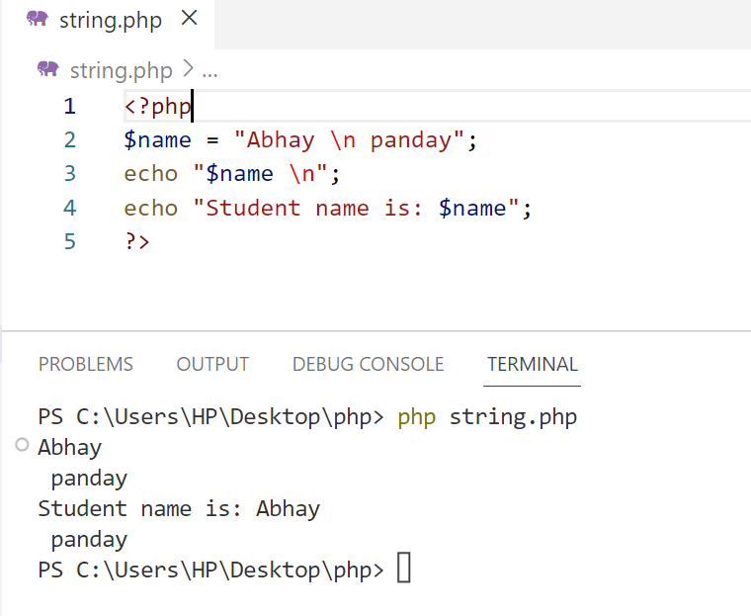
Double-quote strings
Unlike single-quote strings, double-quote strings in PHP are capable of processing special characters.

Slide 6
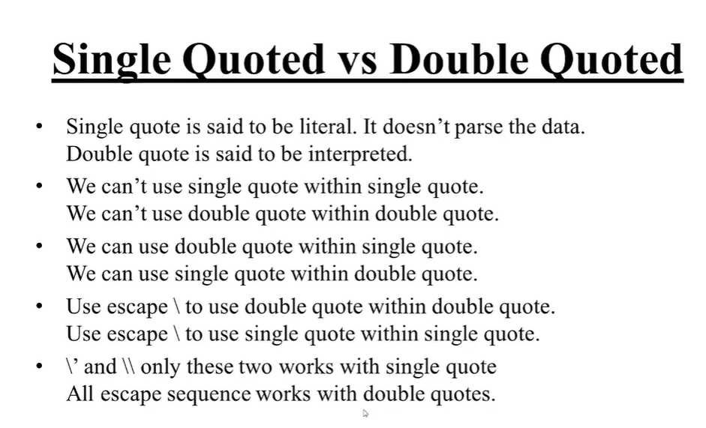

Slide 7
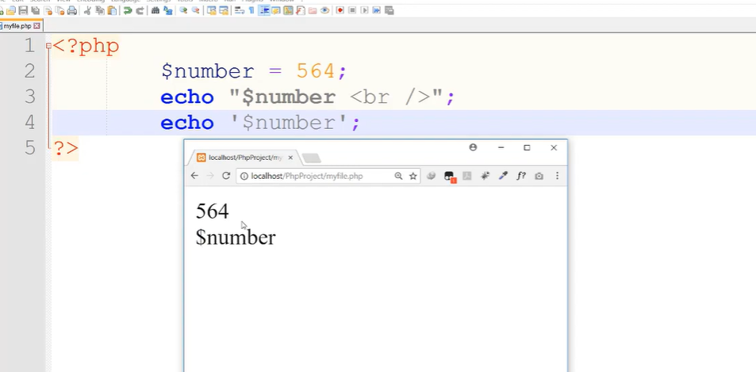

Slide 8
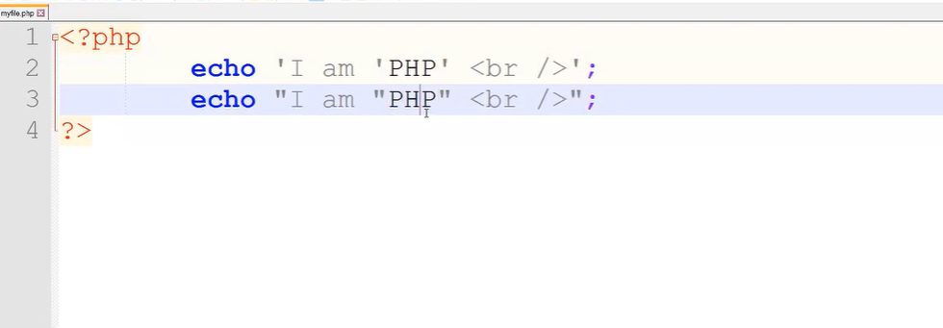

Slide 9
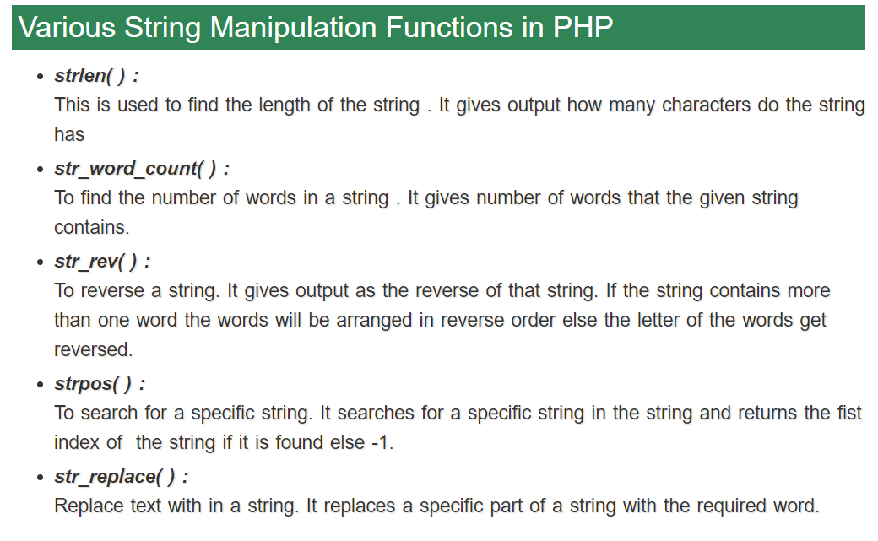
We can perform several functions on string in PHP . The string manipulation functions are.

Slide 10
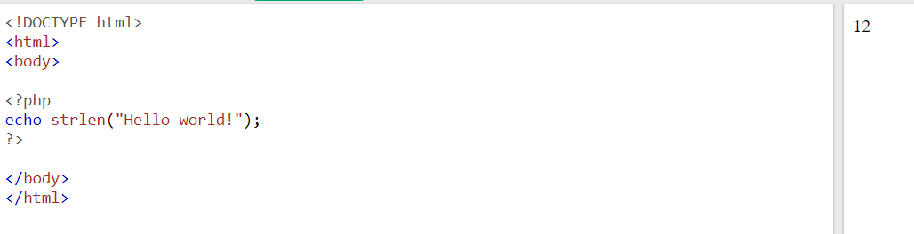
PHP Strings
A string is a sequence of characters, like "Hello world!".
we will look at some commonly used functions to manipulate strings.
strlen() - Return the Length of a String
The PHP strlen() function returns the length of a string.

Slide 11
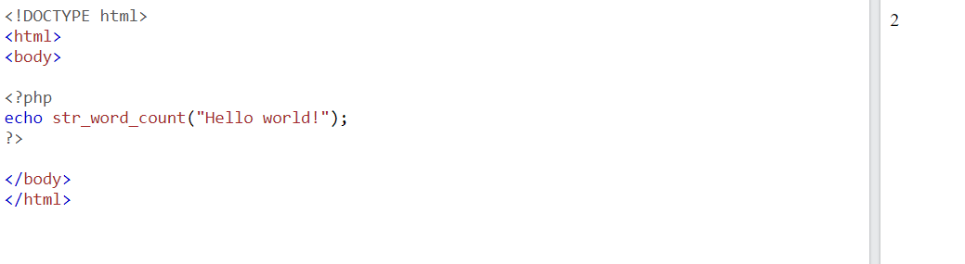
str_word_count() - Count Words in a String
The PHP str_word_count() function counts the number of words in a string.

Slide 12
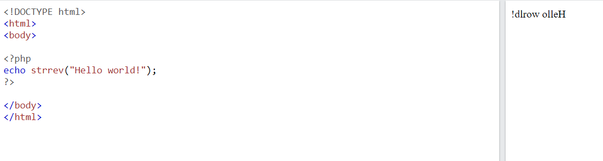
strrev() - Reverse a String
The PHP strrev() function reverses a string.

Slide 13
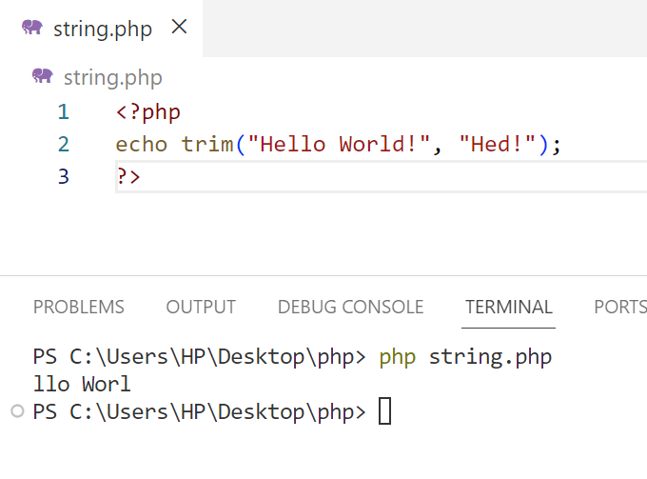
trim() function:
This function allows us to remove whitespaces or strings from both sides of a string.

Slide 14
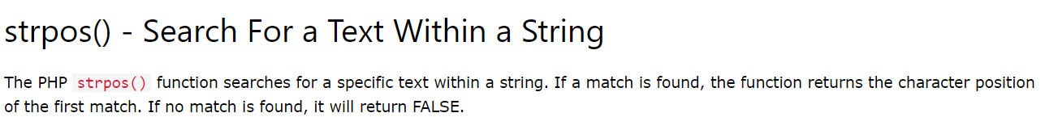
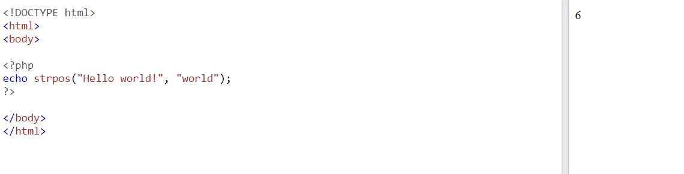

Slide 15
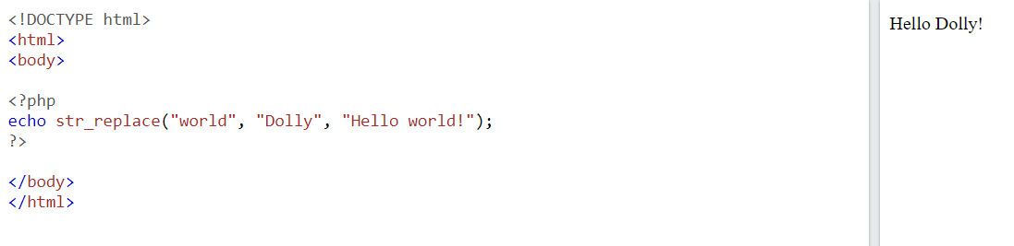
str_replace() - Replace Text Within a String
The PHP str_replace() function replaces some characters with some other characters in a string.

Slide 16
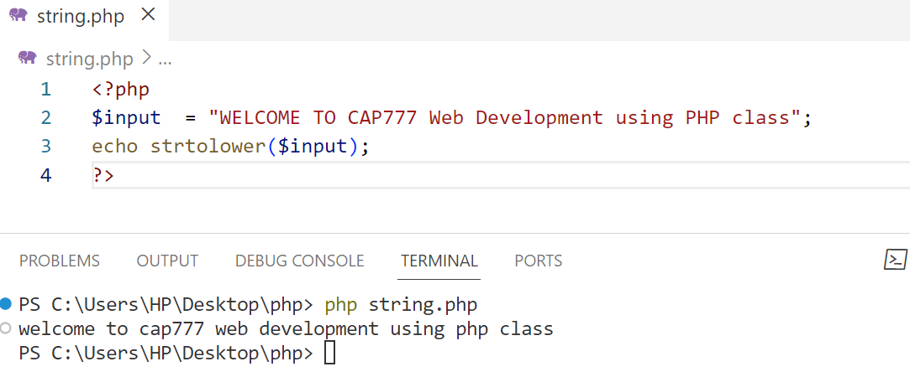
strtolower() function:
This function converts a string into the lowercase string.

Slide 17
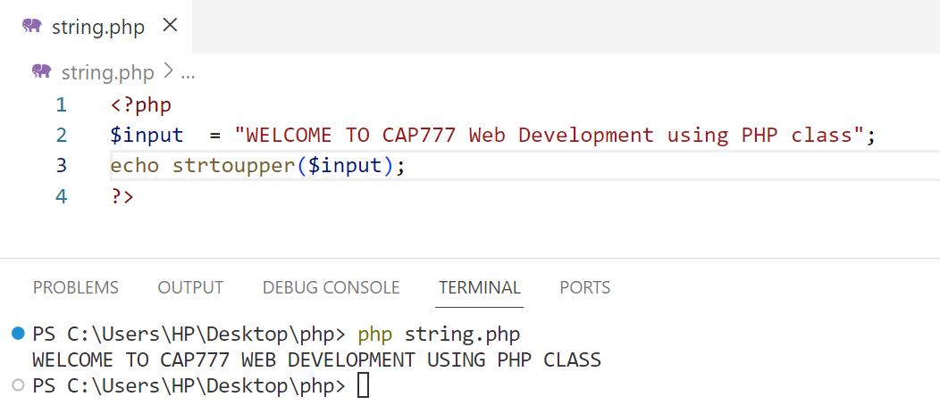
strtoupper() function:
This function converts a string into the uppercase string.

Slide 18
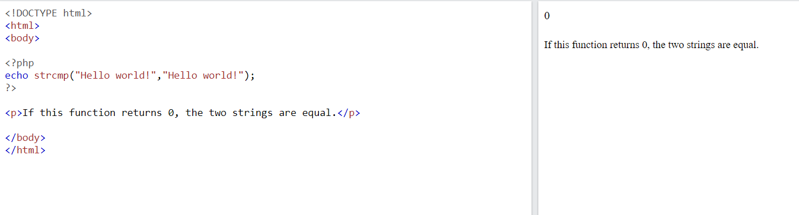
Comparing Strings
PHP strcmp() Function

Slide 19
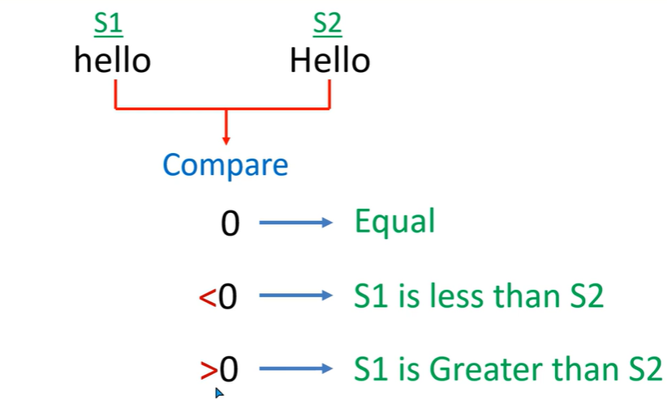
Comparing Strings
PHP strcmp() Function

Slide 20
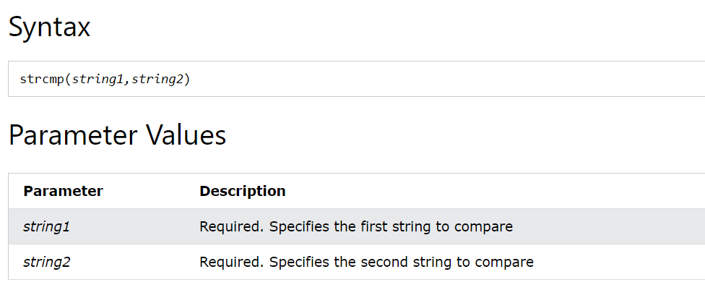
Comparing Strings
The strcmp() function compares two strings.
The strcmp() function is binary-safe and case-sensitive.

Slide 21
Cleaning Strings
The trim() function removes whitespace and other predefined characters from both sides of a string.
Related functions:
ltrim() - Removes whitespace or other predefined characters from the left side of a string
rtrim() - Removes whitespace or other predefined characters from the right side of a string

Slide 22
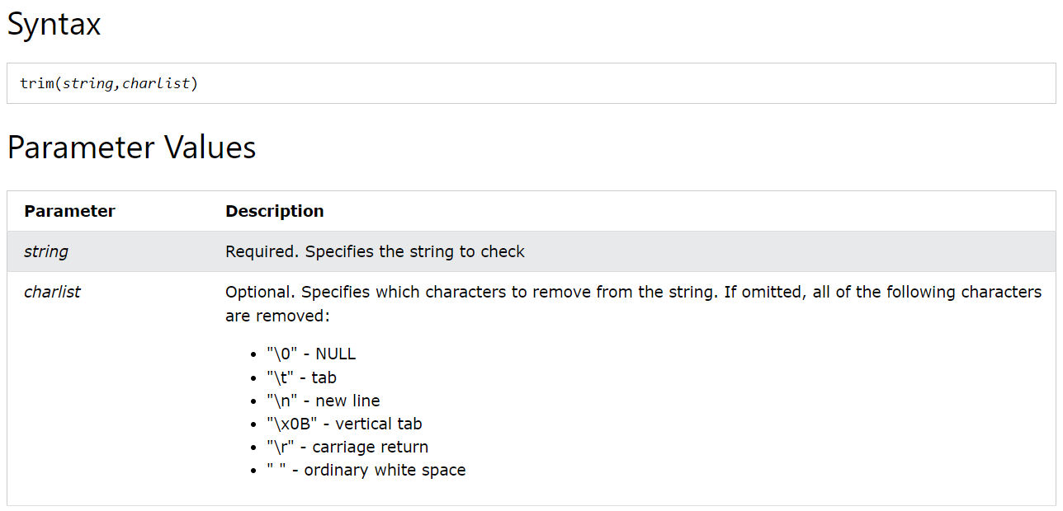
Cleaning Strings

Slide 23
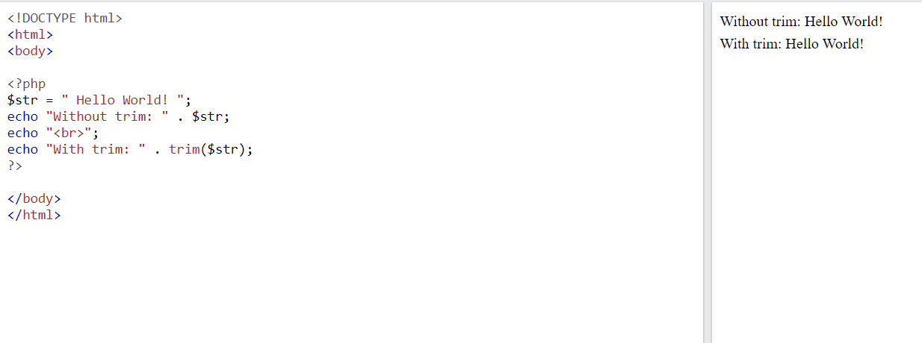
Cleaning Strings

Slide 24
Which of the following functions is used to find the first occurrence of a substring in a string?
strlen()
strpos()
str_replace()
str_split()

Slide 25
Which of the following functions is used to find the first occurrence of a substring in a string?
strlen()
strpos()
str_replace()
str_split()

Slide 26
Which of the following functions is used to replace all occurrences of a substring in a string with another substring?
strlen()
strpos()
str_replace()
str_split()

Slide 27
Which of the following functions is used to replace all occurrences of a substring in a string with another substring?
strlen()
strpos()
str_replace()
str_split()

Slide 28
Which of the following functions is used to count the number of words in a string?
strlen()
strpos()
str_replace()
str_word_count()

Slide 29
Which of the following functions is used to count the number of words in a string?
strlen()
strpos()
str_replace()
str_word_count()

Slide 30
Which of the following is not a built-in PHP function for working with strings?
strlen()
strpos()
str_replace()
str_split()
strrev()

Slide 31
Which of the following is not a built-in PHP function for working with strings?
strlen()
strpos()
str_replace()
str_split()
strrev()

Slide 32
What is the following is the output of the following PHP code?
$str = "Hello, world!";
echo strlen($str);
13

Slide 33
What is the following is the output of the following PHP code?
<?php
$str = "Hello, world!";
echo strpos($str, "world");
?>
7

Slide 34
What is the following is the output of the following PHP code?
<?php
$str = "Hello, world!";
echo str_replace("world", "universe", $str);
?>
Hello universe

Slide 35
What is the following is the output of the following PHP code?
<?php
$str = "Hello, world!";
echo $str[0];
?>
H

