Slide 1

Consumer Goods Ad_Hoc Insights
Presenter : Parth Patoliya

Slide 2
Agenda
Problem Statement
About Company
Company Products & Market Channels
Dataset View
Ad-hoc Requests & Insights

Slide 3
About Company
Atliq Hardware is a leading computer hardware manufacturer based in India, with a strong global presence across 26 countries. The company specializes in three major product divisions: Peripherals & Accessories, PC, Networking & Storage.
With a diverse customer base of 74 clients—including prominent names like Neptune, Sage, Leader, and Vijay Sales—Atliq Hardware serves markets worldwide.
Recently, the management identified a need for deeper, faster insights into sales and performance data to support agile, data-informed decision-making. This has led to the initiation of a data analytics project aimed at transforming raw sales data into actionable intelligence through SQL analysis and visualization.

Slide 4
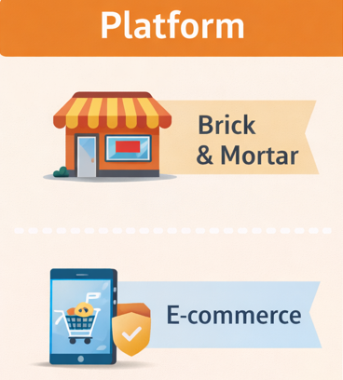
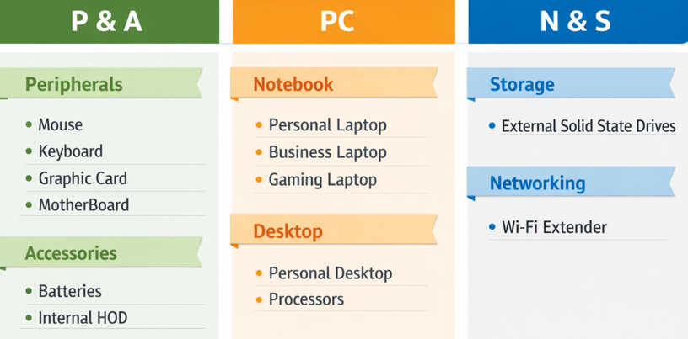
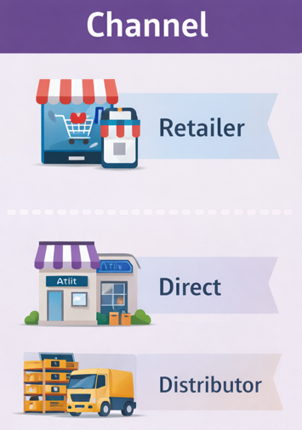
Company Products & Market Channels

Slide 5
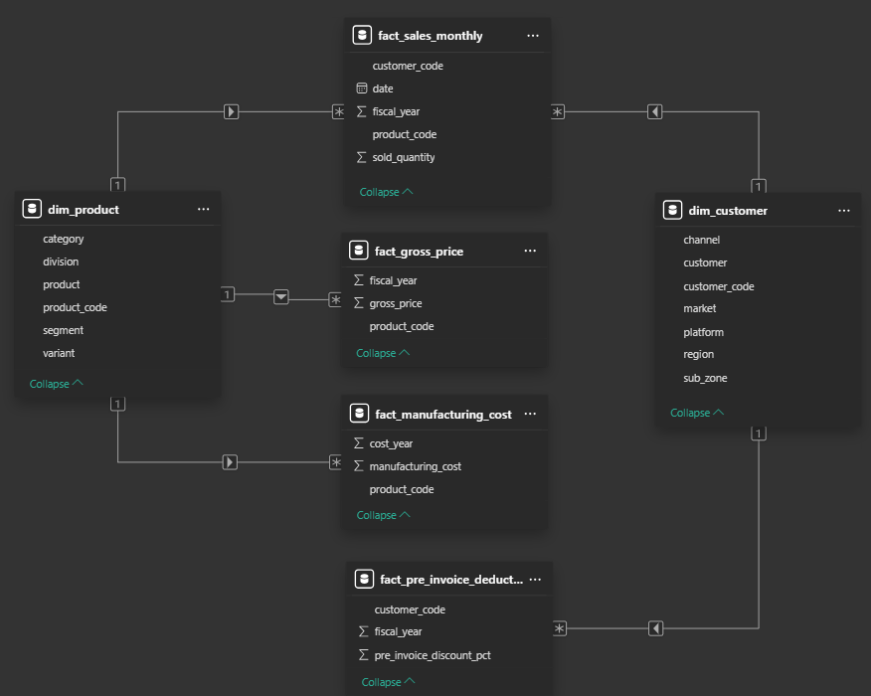
Dataset View
4 fact tables :
fact_sales_monthly
Fact_gross_price
fact_manufacturing_cost
fact_pre_invoice_deduction
2 dimensional tables :
dim_customer
dim_product
Fiscal year for AtliQ Hardware
1st September to 31st August
Sales data is available for fiscal year 2020-2021

Slide 6

Ad-hoc Requests & Insights

Slide 7
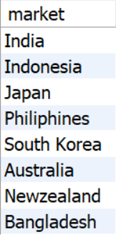
1. Provide the list of markets in which customer "Atliq Exclusive" operates its business in the APAC region.
SELECT
DISTINCT market
FROM dim_customer
WHERE region = 'APAC' AND customer = "Atliq Exclusive";

Slide 8
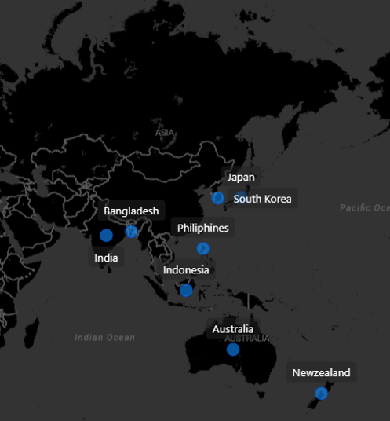
AtliQ Exclusive operates its business in 8 markets of Asia Pacific Region
AtliQ Exclusive is a Brick&Mortar store means it is a physical store directly sold their products from the store
AtliQ has highest store in APAC followed by EU(6), NA(2), LATAM has zero physical stores

Slide 9

2. What is the percentage of unique product increase in 2021 vs. 2020?
WITH unique_products_yearly AS (
SELECT
fiscal_year,
COUNT(DISTINCT product_code) AS unique_products
FROM fact_gross_price
GROUP BY fiscal_year
)
SELECT
MAX(CASE WHEN fiscal_year = 2020 THEN unique_products END) AS unique_products_2020,
MAX(CASE WHEN fiscal_year = 2021 THEN unique_products END) AS unique_products_2021,
ROUND(
(
MAX(CASE WHEN fiscal_year = 2021 THEN unique_products END) -
MAX(CASE WHEN fiscal_year = 2020 THEN unique_products END)
) * 100.0 /
MAX(CASE WHEN fiscal_year = 2020 THEN unique_products END),
2
) AS percent_change
FROM unique_products_yearly;

Slide 10
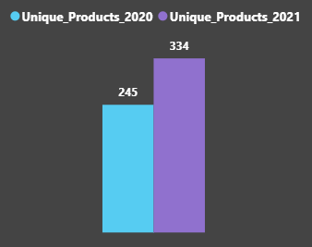
In FY 2020, we had a total of 245 products, but in FY 2021 our count increased by 36.33% to 334 products.
It’s a good sign that we are continuously innovating and introducing new products to the market.
36.33%
Increase

Slide 11
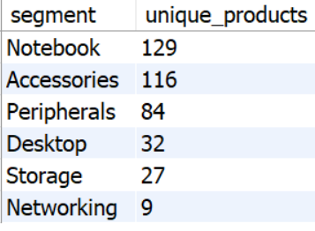
3.Provide a report with all the unique product counts for each segment and sort them in descending order of product counts.
SELECT
segment,COUNT(DISTINCT product_code) AS unique_products
FROM dim_product
GROUP BY segment
ORDER BY unique_products DESC

Slide 12
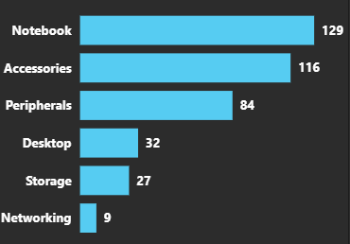
We have a wide range of products under segments : Notebook, Accessories, Peripherals with an average of 110 products per segment
While Desktop,Storage,Networking are lagging with an average of 23 products per segment
Product development team needs to give attention on products that require redesigning as per modern standards
Innovations will keep AtliQ Hardware ahead in this competitive market

Slide 13
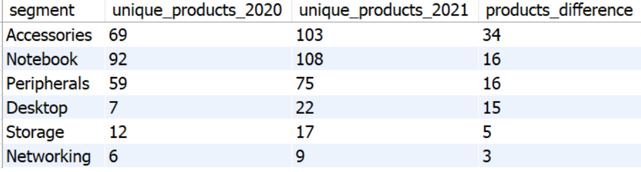
4. Which segment had the most increase in unique products in 2021 vs 2020?
WITH yearly_data AS (
SELECT
p.segment,
g.fiscal_year,
COUNT(DISTINCT g.product_code) AS unique_products
FROM dim_product p
JOIN fact_gross_price g
ON p.product_code = g.product_code
GROUP BY p.segment, g.fiscal_year
)
SELECT
segment,
MAX(CASE WHEN fiscal_year = 2020 THEN unique_products END) AS unique_products_2020,
MAX(CASE WHEN fiscal_year = 2021 THEN unique_products END) AS unique_products_2021,
(
MAX(CASE WHEN fiscal_year = 2021 THEN unique_products END)
-
MAX(CASE WHEN fiscal_year = 2020 THEN unique_products END)
) AS products_difference
FROM yearly_data
GROUP BY segment
ORDER BY products_difference DESC;

Slide 14
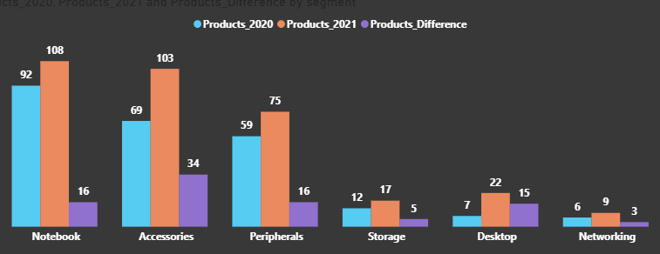
With the introduction of 34 new products, Accessories segment has the highest increase in number of products
Notebook and Peripherals each has an increment of 16 products
Product team has done good job in Desktop segment by increasing count 2020(7) < 2021(22)
Networking segment is at bottom with only 3 new products in 2021

Slide 15
5. Get the products that have the highest and lowest manufacturing costs
SELECT
p.product_code,
CONCAT(p.product, ' (', p.variant, ')') AS product,
m.manufacturing_cost
FROM dim_product p
JOIN fact_manufacturing_cost m
ON p.product_code = m.product_code
WHERE m.manufacturing_cost = (
SELECT MAX(manufacturing_cost)
FROM fact_manufacturing_cost
)
OR m.manufacturing_cost = (
SELECT MIN(manufacturing_cost)
FROM fact_manufacturing_cost
);

Slide 16


AQ HOME Allin1 Gen 2 (Plus 3)
Category : Personal Laptop
Manufacturing Cost : 240.54
AQ Master wired x1 Ms (Standard 1)
Category : Mouse
Manufacturing Cost : 0.89

Slide 17
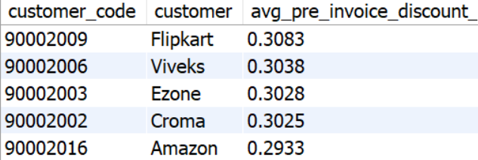
6. Generate a report which contains the top 5 customers who received an average high
pre_invoice_discount_pct for the fiscal year 2021 and in the Indian market.
SELECT
c.customer_code,
c.customer,
round(avg(pre.pre_invoice_discount_pct),4) AS avg_pre_invoice_discount_pct
FROM dim_customer c
JOIN fact_pre_invoice_deductions pre
ON c.customer_code=pre.customer_code
WHERE pre.fiscal_year=2021 AND c.market='India'
GROUP BY c.customer_code,
c.customer
ORDER BY avg_pre_invoice_discount_pct DESC
LIMIT 5;

Slide 18
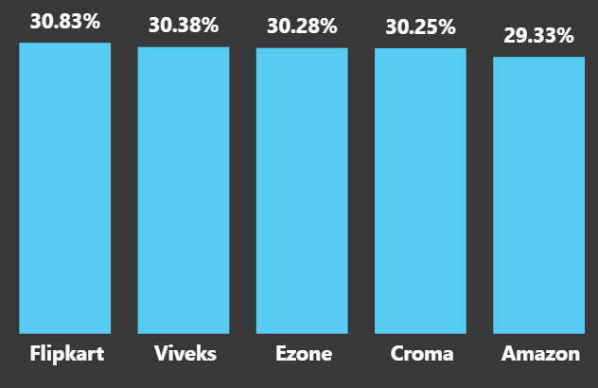
Flipkart has received highest 30.83% pre-invoice discount
Amazon has low pre invoice discount 29.33%

Slide 19
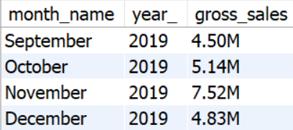
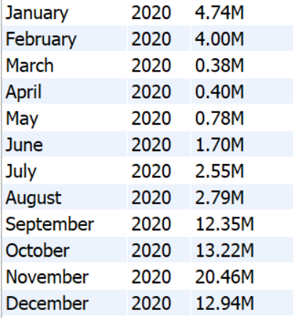
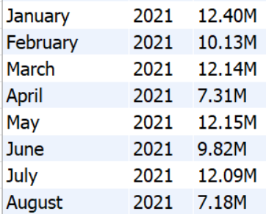
7.Get the complete report of the Gross sales amount for the customer “Atliq Exclusive” for each month.
SELECT
MONTHNAME(date) AS month_name,
YEAR(date) AS year_,
CONCAT(ROUND(SUM(a.sold_quantity * b.gross_price)/1000000,2),'M') AS gross_sales
FROM fact_sales_monthly AS a
INNER JOIN fact_gross_price AS b
ON b.product_code = a.product_code
AND b.fiscal_year = a.fiscal_year
INNER JOIN dim_customer AS c
ON c.customer_code = a.customer_code
WHERE c.customer = 'Atliq Exclusive'
GROUP BY month_name, year_
ORDER BY year_;

Slide 20
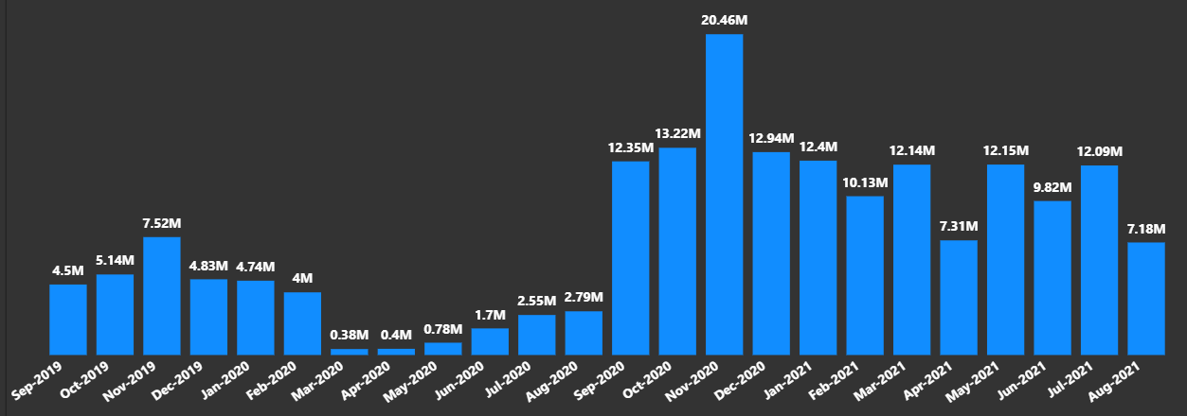
Highest sales were recorderd in November-2020 (20.5M) & lowest sales in March-2020(0.38M)
From March-August in 2020 sales are low because of the pandemic all the stores are closed
Lockdowns increased demand for laptops and other home electronics, due to work from home

Slide 21
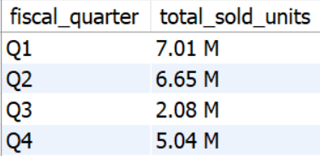
8. In which quarter of 2020, got the maximum total_sold_quantity?
SELECT
CASE
WHEN MONTH(date) IN (9, 10, 11) THEN 'Q1'
WHEN MONTH(date) IN (12, 1, 2) THEN 'Q2'
WHEN MONTH(date) IN (3, 4, 5) THEN 'Q3'
WHEN MONTH(date) IN (6, 7, 8) THEN 'Q4'
END AS fiscal_quarter,
CONCAT(
ROUND(SUM(sold_quantity) / 1000000, 2),
' M'
) AS total_sold_units
FROM fact_sales_monthly
WHERE fiscal_year = 2020
GROUP BY fiscal_quarter
ORDER BY
CASE fiscal_quarter
WHEN 'Q1' THEN 1
WHEN 'Q2' THEN 2
WHEN 'Q3' THEN 3
WHEN 'Q4' THEN 4
END;

Slide 22
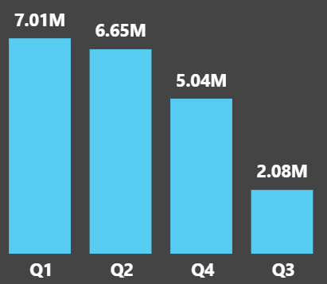
Q1 (September-November) has highest sales (7.01M)
Q3 (March-May) sales dropped because of pandemic
Q4(June-August) sales are increasing

Slide 23
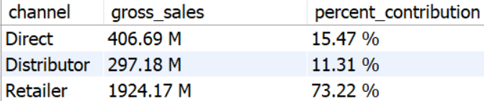
9.Which channel helped to bring more gross sales in the fiscal year 2021 and the pct of contribution?
SELECT
c.channel,
CONCAT(ROUND(SUM(s.sold_quantity * g.gross_price) / 1000000, 2),' M') AS gross_sales,
CONCAT(
ROUND(
SUM(s.sold_quantity * g.gross_price) * 100.0 /
(
SELECT SUM(s2.sold_quantity * g2.gross_price)
FROM fact_sales_monthly s2
JOIN fact_gross_price g2
ON s2.product_code = g2.product_code
WHERE s2.fiscal_year = 2021
),2),' %') AS percent_contribution
FROM fact_sales_monthly s
JOIN fact_gross_price g
ON s.product_code = g.product_code
JOIN dim_customer c
ON s.customer_code = c.customer_code
WHERE s.fiscal_year = 2021
GROUP BY c.channel
ORDER BY gross_sales DESC;

Slide 24
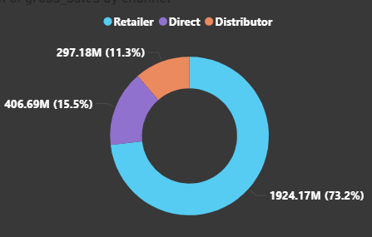
Retailer brings the maximum sales to the company 1024.17M (73.2%)
Channel Direct generates 406.69M (15.5%) sales
Distributor contributes least only 297.18M (11.3%)

Slide 25
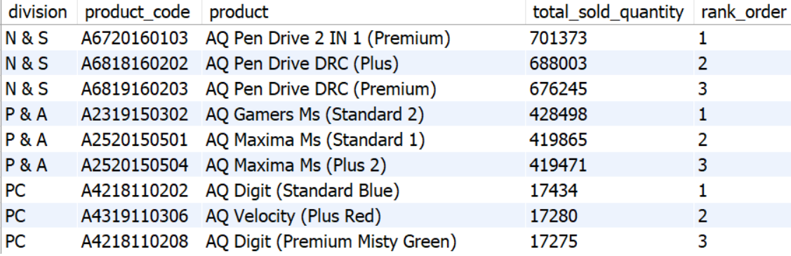
10. Get the Top 3 products in each division that have high total_sold_quantity in the fiscal_year 2021?
WITH total_sold_units AS (
SELECT
p.division,
p.product_code,
CONCAT(p.product, ' (', p.variant, ')') AS product,
SUM(s.sold_quantity) AS total_sold_quantity
FROM fact_sales_monthly s
JOIN dim_product p
ON s.product_code = p.product_code
WHERE s.fiscal_year = 2021
GROUP BY
p.division,
p.product_code,
p.product,
p.variant
),
ranking AS (
SELECT
division,
product_code,
product,
total_sold_quantity,
DENSE_RANK() OVER (
PARTITION BY division
ORDER BY total_sold_quantity DESC
) AS rank_order
FROM total_sold_units
)
SELECT *
FROM ranking
WHERE rank_order <= 3
ORDER BY division, rank_order;

Slide 26
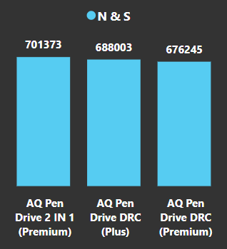
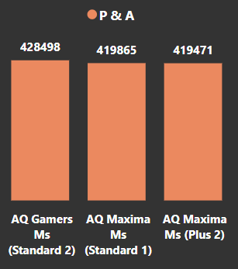
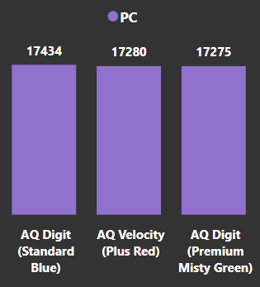
Top selling product is AQ Pen Drive 2 IN 1 with a total of 7,01,373 quantities sold.
followed by two variants of AQ Pen Drive DRC with 6,88,003 and 6,76,245 quantity.
AQ Gamers Ms is top selling product with a total of 4,28,498 quantities sold.
followed by two variants of AQ Maxima Ms
AQ Digit is top selling product with a total of 17,434 quantities

Slide 27


