Slide 1
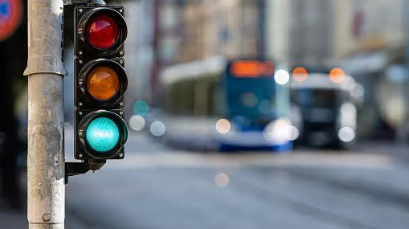

DEPARTMENT OF CIVIL ENGINEERING
MVGR COLLEGE OF ENGINEERING
SIGNAL DESIGN OF AN UNCONTROLLED
ROAD INTERSECTION BY
WEBSTER METHOD
Under the guidance of
Reporter : A. Raj kumar
Mrs. M.Sai Priya

Slide 2
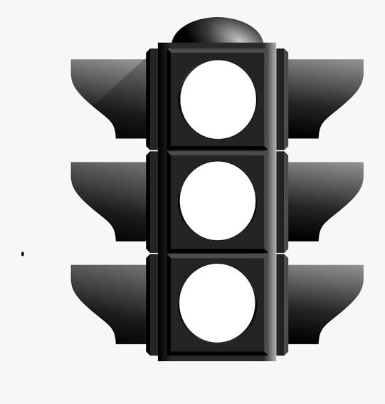
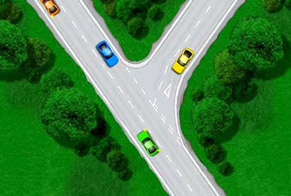
INTRODUCTION
A traffic signal is used as an instructing device that indicates the road user to act according to the displayed sign. Signal designing is a technique which is generally adopted by the traffic engineers use to determine who has the right-of-way at an intersection which involves deciding how much green time the
traffic lights shall provide at an intersection.
Traffic signal controls the movement of
traffic and not only reduces accidents
but enables the road safety users to
effectively use the area of road at the
intersection.
Location of road intersection : 17.8969738, 83.1853109 - Kothavalasa junction, Andhra Pradesh, 535183.

Slide 3
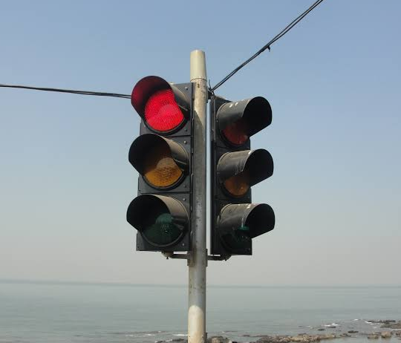
METHODOLOGY
Webster Method :
Webster method is a rational approach for signal design since it is completely mathematical based. The design is simple and is totally based on formulas laid down by Webster.
Steps involved in Webster method of Signal design are as follows :
1. The normal flows q1, q2 and q3 on the approach roads, during the design peak hour traffic are obtained from field observations by manual counting.
2. Saturation flow of traffic S1, S2 and S3,
3. Critical flow ratio (Y)
4. Total Lost time (L)
5. Optimum Cycle length (Co)
6. Effective green time (G)
7. Amber time (A)
8. Red time (R)

Slide 4
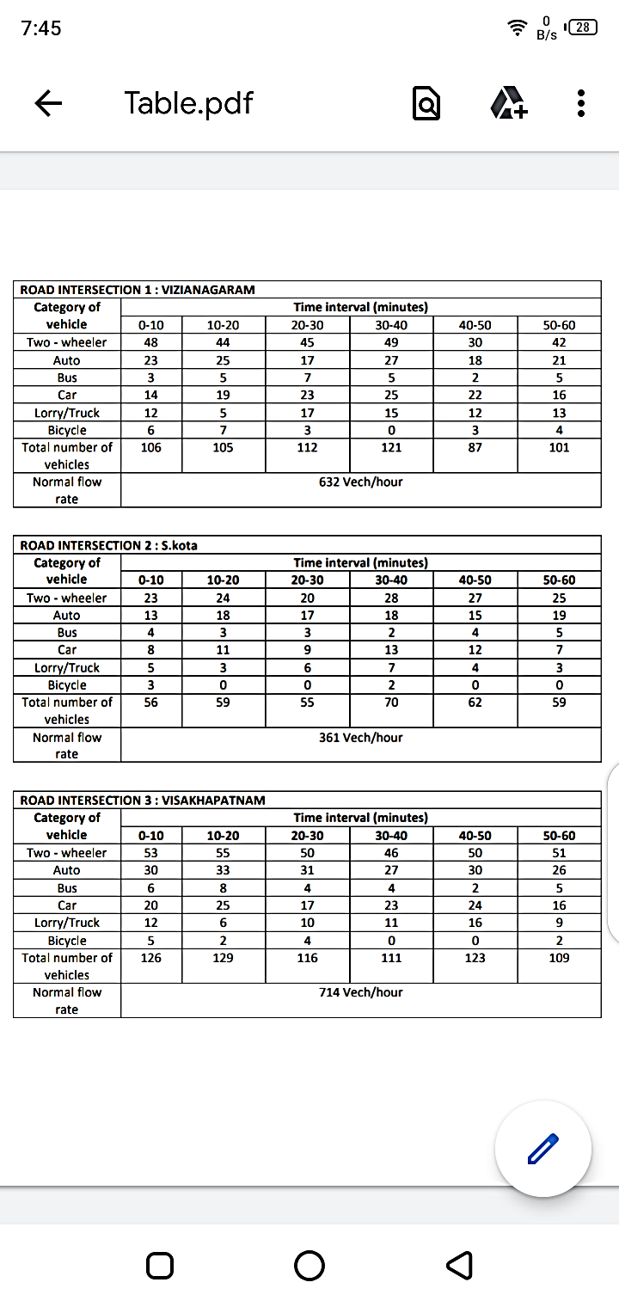
RESULS & DISCUSSIONS
Normal traffic flow at the intersection during a peak hour is measured manually and noted the data such as category of vehicle, number of vehicles travelling for corresponding time interval in a data sheet as shown below,
Table.1 : Road intersection 1 (Vizianagaram)

Slide 5
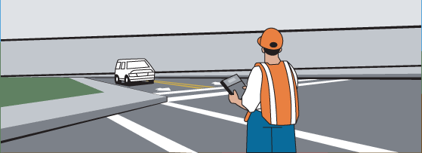
Table.2 : Road intersection 2 (S.kota)
Table.3 : Road intersection 3 (Visakhapatnam)
Normal flow : q1 = 632 PCU q2 = 361 PCU q3 = 714 PCU
Saturation flow : S1 = 525w = 525(7) = 3675 PCU S2 = 525w = 525(7) = 3675 PCU S3 = 525w = 525(7) = 3675 PCU

Slide 6
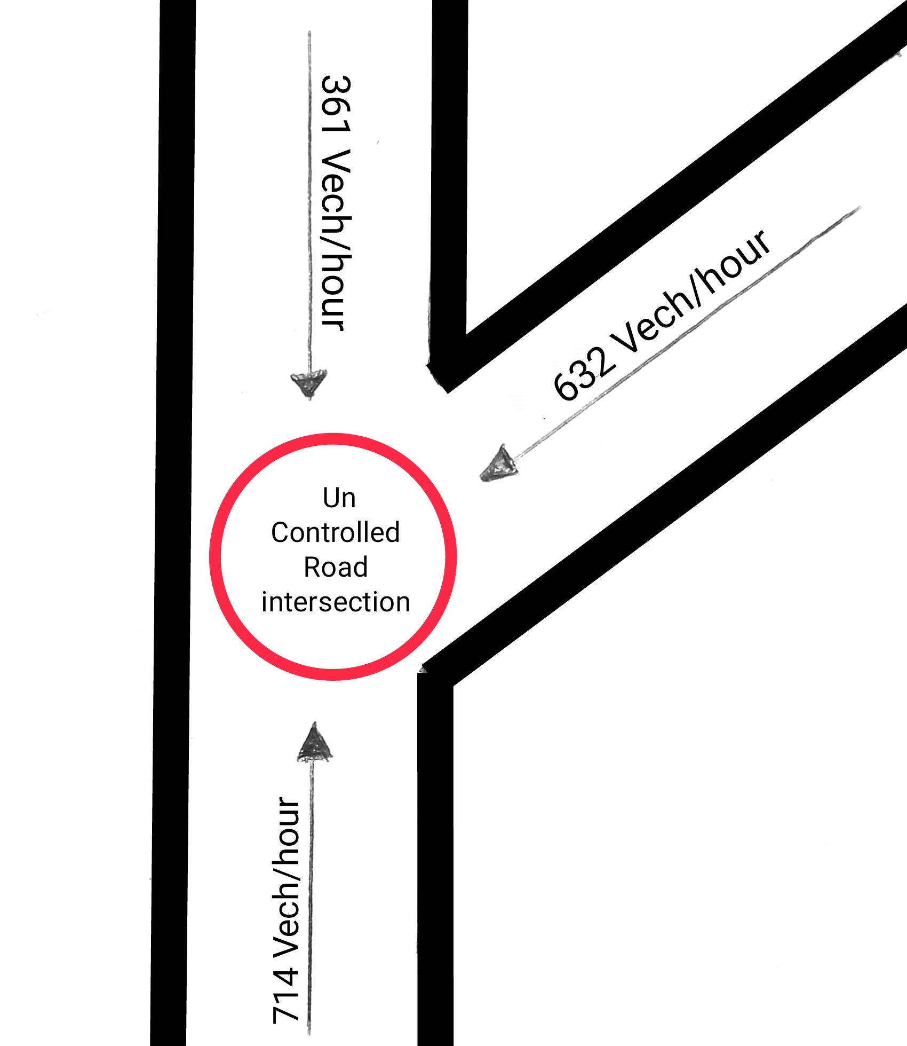
Total lost time (L) : L = 2n+R = 2(2)+12 = 16 sec
Critical flow ratio (Y) : Y = (q1/S1)+(q2/S2)+(q3/S3) Y = (632/3675)+(361/3675)+(714/3675) Y = 0.464
Optimum Cycle length (Co) : Co = (1.5L+5)/(1-Y) = (1.5*16+5)/(1-0.464) = 54.10 sec
Effective Green time (G) : G1 = y1(Co-L)/Y= 0.171(54.10-16)/0.46 = 14.92~15 sec. G2 = y2(Co-L)/Y = 0.098(54.10-16)/0.464 = 8.01~8 sec. G3 = y3(Co-L)/Y= 0.194(54.10-16)/0.464 = 15.96~16 sec.
Amber time (A) : A1 = A2 = A3 = 2 sec
Red time (R) : R1 = 54.10-15-2 = 37.1 sec R2 = 54.10-8-2 = 44.1 sec R3 = 54.10-16-2 = 36.1 sec

Slide 7
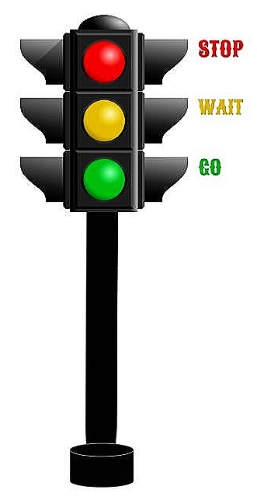
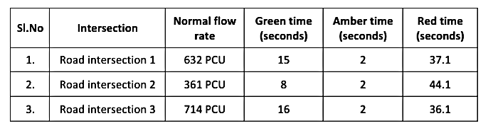
CONCLUSION
Scope for collision of vehicles & accidents is more at uncontrolled road intersections. This can be rectified by designing a traffic signal. Signal designing at an uncontrolled intersection (kothavalasa junction) is carried out using Webster method of signal design & traffic flow regulatory parameters such as green time, amber time & red time are determined. This signal designing ensures smooth flow of traffic, reduce accidents thereby increasing safety of road users.

Slide 8
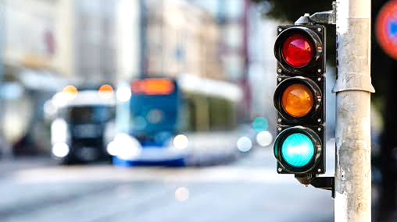
Thank You
For your attention

