Slide 1
Auction Theory
Use of PDFs and CDFs in auction theory

Slide 2
Team Members:
190856 Sourav Agrawal
190382 Hitesh Kumar
190513 Mridul Khare
190019 Abhaya Pratap Singh
190884 Sushant Saini
190829 Shubham
190222 Azad Prajapat
190675 Raj Kumar Yadav
190999 Yash Laddha
190584 Pallepogu Ericlim

Slide 3
Introduction:
Auction theory is an applied branch in the field of economics that analyses how potential bidders bid in the auction market and researches how different features of auction markets affect predictable outcomes.
Auctions prove to be valuable testing grounds for economic theories, especially game theory with incomplete information.
Four basic auction types:
First price sealed-bid auctions
Second-price sealed-bid auctions
English auctions
Dutch auctions

Slide 4
Four traditional or standard auction types:
First-price sealed-bid auction in which bidders simultaneously and independently submit a single bid without any information about other bidders’ bid. The bidder had the highest bid wins and is required to pay the amount bid.
Second-price sealed-bid auctions, also known as Vickrey auctions, are similar to First-price sealed-bid auction. Bidders independently submit their bids without seeing others’ bids—the bidder who bid the highest wins. However, the price that the bidder pays for the item is the second-highest bid made.

Slide 5
In ascending-bid auctions or English auctions, the price is successively raised until only one bidder remains. The bidder remaining at the end wins the object at the price of their final bid. Sometimes, sellers set a reserve price, and if bidding doesn’t cross that amount, the object is not sold to anyone.
Descending-bid auctions or Dutch auctions work in an opposite way to ascending-bid auctions. The auctioneer initially sets a very high price which is progressively lowered until a bidder accepts the object at the current price.

Slide 6
Literary Review:
Auction has been used for a long time, but they were related to economics only recently.
The first proof for the case of two buyers and uniformly distributed values was by Vickrey (1961). It helped analyse the game-theoretic aspect of the problem and develop some special cases of revenue equivalence theorem.
At the end of the 1970s, critical contributions were made by Myerson and others. Myerson (1981), Riley and Samuelson (1981), and Harris and Raviv (1981) showed that Vickrey’s results about the equivalence in expected revenue of different auctions apply very generally.
Myerson developed the mathematics required to prove the revenue equivalence theorem and derive optimal auctions for a broad class of problems. These contributions rapidly moved the auction theory to its current frontier.

Slide 7
Objectives:
Sellers use auction theory to raise higher revenues while allowing buyers to procure at a lower cost. The purpose of this paper is to understand auction theory models and to derive certain results.
We aim to analyse how density functions, conditional density functions, and distribution functions are used in auction theory to analyse data for different types of auctions.
Also prove and review the revenue equivalence theorem. One of the important implications in this theorem is that a single item auction will always generate the same revenue, from all types of auction, for the seller, if the item is sold to the highest bidder only.

Slide 8
Hypothesis:
The distribution functions for bidders’ payoff are different for different types of auction. They depend on type of auctions and bids made by different bidders.
The expected revenue for an item is independent of the auction type, given that the benchmark model and IPV model holds true.
With change in underlying assumptions, the basic model will be affected. Disclosure of a bidder’s valuation will affect others’ valuation.
Change in assumptions in benchmark model can give rise to different models. Examples are risk aversion buyers, correlation between values, asymmetric model.

Slide 9
Methodology and methods:
We assume the benchmark model for our analysis. The benchmark model for auctions offers a generalization of auction formats based on the four assumptions:
Risk-neutral bidders.
Each bidder has their own valuation for the object independently drawn from some probability distribution.
Symmetry between information possessed by bidders.
Payment made by the bidder is a function of bids only.
We would also assume an independent private model where each bidder has their own valuation for the item, and their valuation is private information.

Slide 10
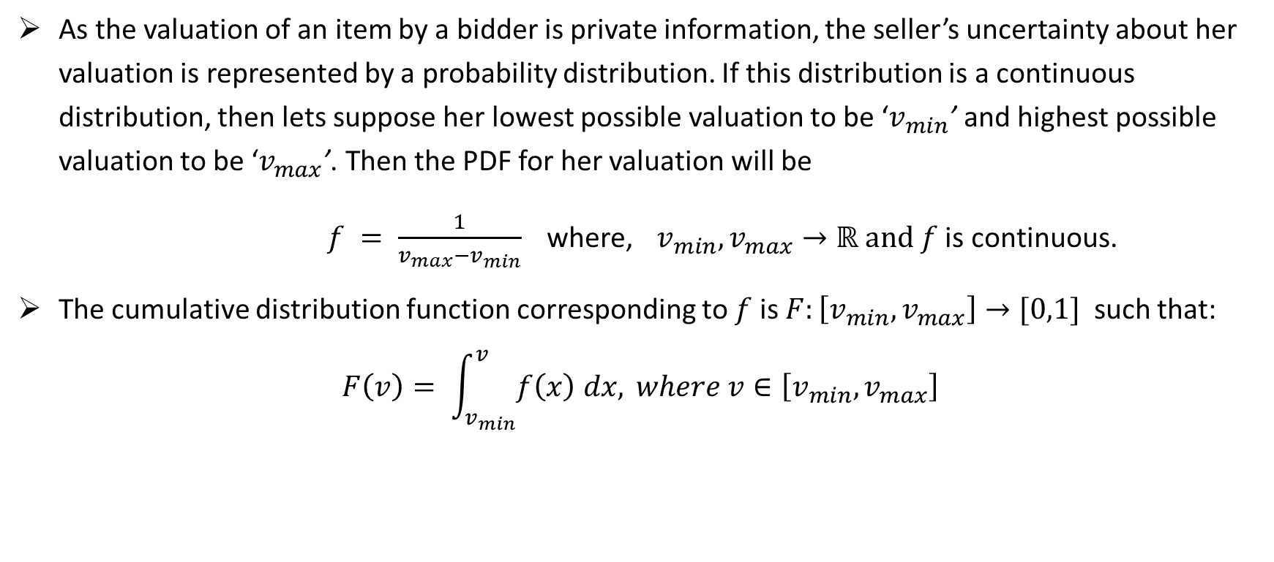
Use of PDFs and CDFs:
As the valuation of an item by a bidder is private information, the seller’s uncertainty about her valuation is represented by a probability distribution. If this distribution is a continuous distribution, then lets suppose her lowest possible valuation to be ‘$v_{min}$’ and highest possible valuation to be ‘$v_{max}$’. Then the PDF for her valuation will be
$f = \frac{1}{v_{max}−v_{min}}$ where, $v_{min},v_{max}→ℝ and f$ is continuous.
The cumulative distribution function corresponding to $f$ is $F:\left[v_{min},v_{max}\right]→[0,1]$ such that: $F\left(v\right)= \int_{v_{min}}^{v}{f\left(x\right) dx,} where v∈\left[v_{min},v_{max}\right]$

Slide 11
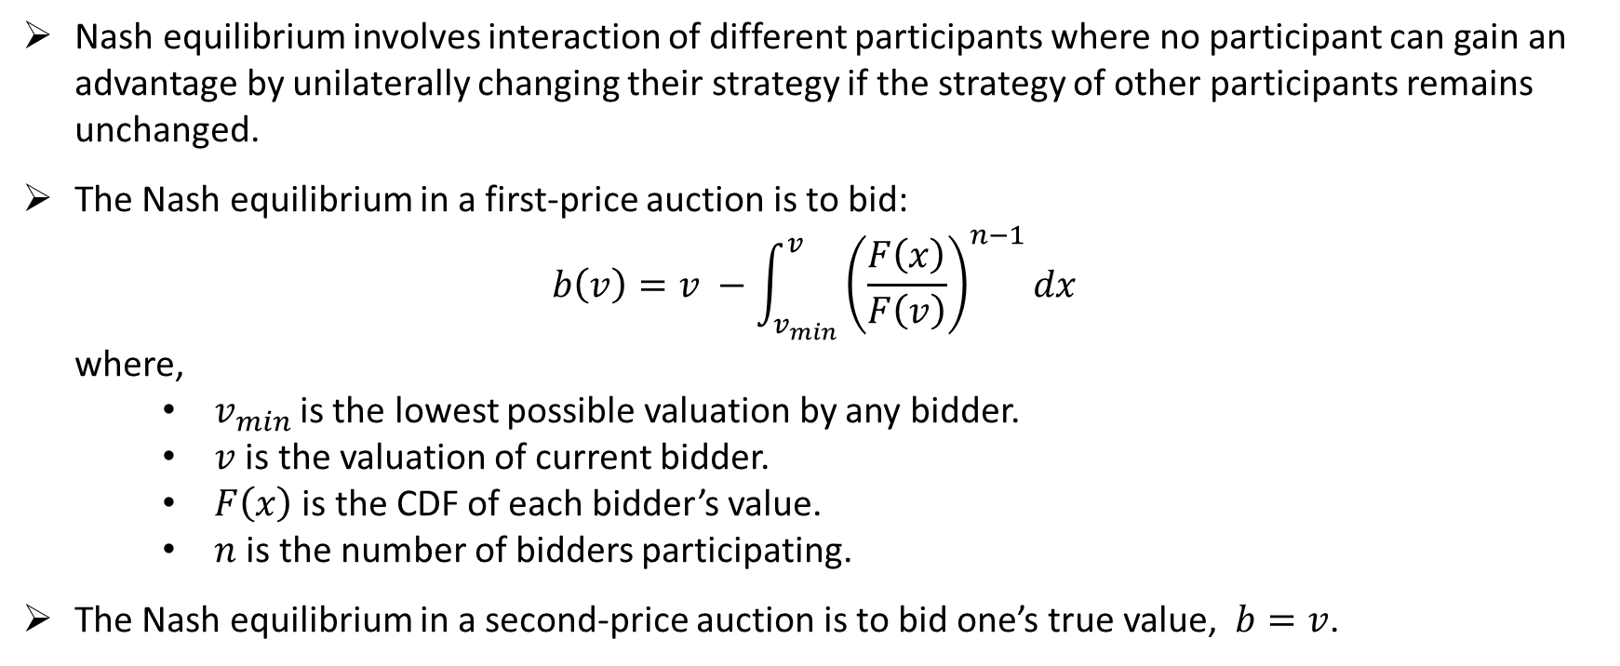
Nash Equilibrium:
Nash equilibrium involves interaction of different participants where no participant can gain an advantage by unilaterally changing their strategy if the strategy of other participants remains unchanged.
The Nash equilibrium in a first-price auction is to bid: $b\left(v\right)=v −\int_{v_{min}}^{v}{{\left(\frac{F\left(x\right)}{F\left(v\right)}\right)}^{n−1}dx}$ where,
$v_{min}$is the lowest possible valuation by any bidder.
$v$ is the valuation of current bidder.
$F\left(x\right)$ is the CDF of each bidder’s value.
$n$ is the number of bidders participating.
The Nash equilibrium in a second-price auction is to bid one’s true value, $b=v$.

Slide 12
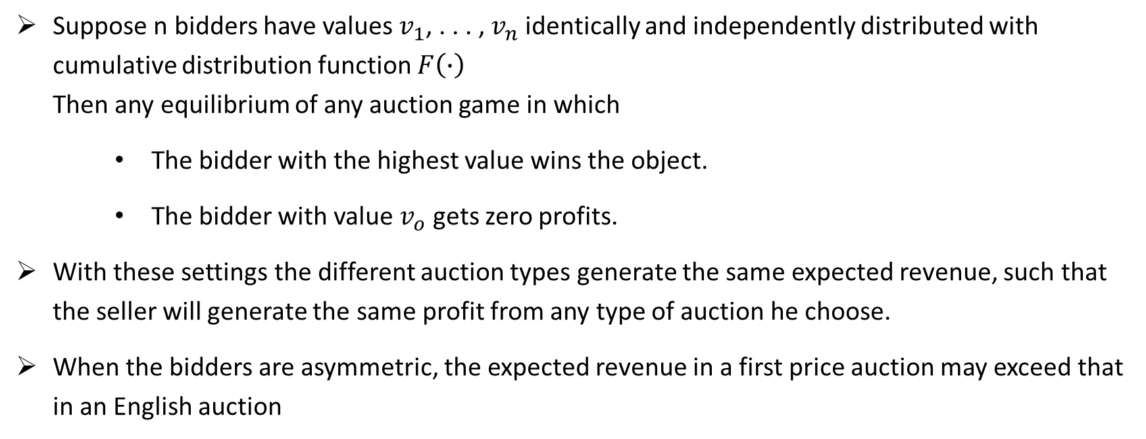
Revenue Equivalence:
Suppose n bidders have values $v_{1}$, . . . , $v_{n}$ identically and independently distributed with cumulative distribution function $F\left(∙\right)$ Then any equilibrium of any auction game in which
The bidder with the highest value wins the object.
The bidder with value $v_{o}$ gets zero profits.
With these settings the different auction types generate the same expected revenue, such that the seller will generate the same profit from any type of auction he choose.
When the bidders are asymmetric, the expected revenue in a first price auction may exceed that in an English auction

Slide 13
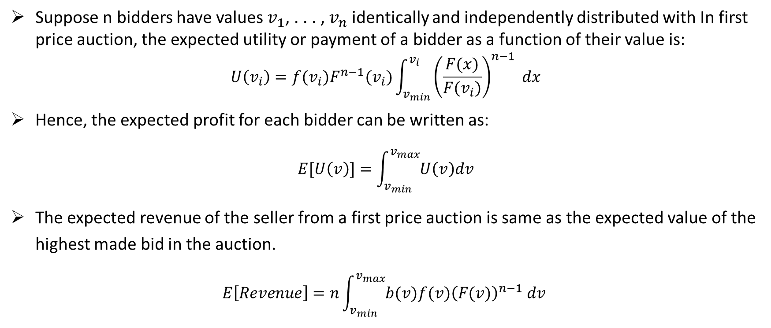
Expected revenue for first price auction:
Suppose n bidders have values $v_{1}$, . . . , $v_{n}$ identically and independently distributed with In first price auction, the expected utility or payment of a bidder as a function of their value is:
$$U\left(v_{i}\right)=f(v_{i})F^{n−1}(v_{i})\int_{v_{min}}^{v_{i}}{{\left(\frac{F(x)}{F(v_{i})}\right)}^{n−1} dx}$$
Hence, the expected profit for each bidder can be written as:
$$E[U\left(v\right)]=\int_{v_{min}}^{v_{max}}{U\left(v\right)dv}$$
The expected revenue of the seller from a first price auction is same as the expected value of the highest made bid in the auction.
$$E\left[Revenue\right]=n\int_{v_{min}}^{v_{max}}{{b(v)f(v)\left(F(v)\right)}^{n−1} dv}$$

Slide 14
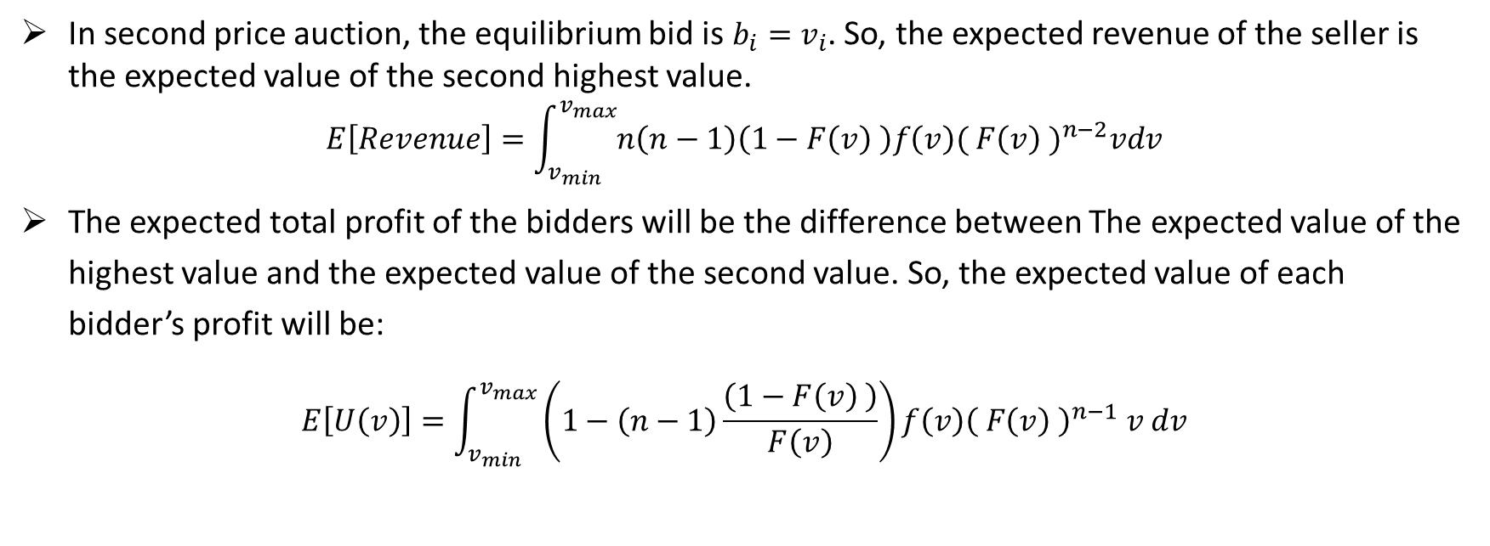
Expected revenue for second price auction:
In second price auction, the equilibrium bid is $b_{i}=v_{i}$. So, the expected revenue of the seller is the expected value of the second highest value.
$$E\left[Revenue\right]=\int_{v_{min}}^{v_{max}}{n\left(n−1\right)\left(1−F\left(v\right) \right)f\left(v\right){( F\left(v\right) )}^{n−2}vdv}$$
The expected total profit of the bidders will be the difference between The expected value of the highest value and the expected value of the second value. So, the expected value of each bidder’s profit will be:
$$E\left[U\left(v\right)\right]=\int_{v_{min}}^{v_{max}}{\left(1−\left(n−1\right)\frac{\left(1−F\left(v\right) \right)}{F\left(v\right)}\right)f\left(v\right){\left( F\left(v\right) \right)}^{n−1} v dv}$$

Slide 15
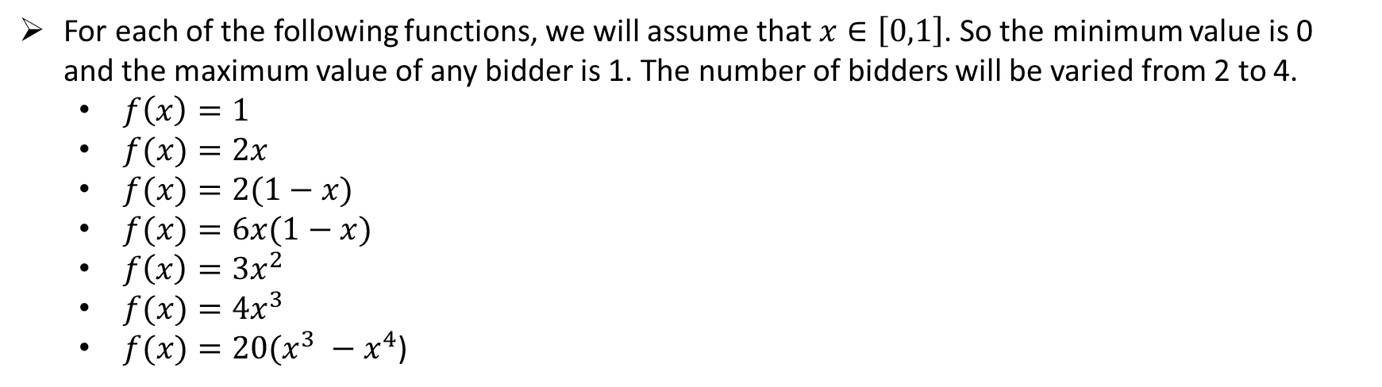
Probability distribution functions for which expected revenue and bidder’s profit will be calculated:
For each of the following functions, we will assume that $x∈\left[0,1\right]$. So the minimum value is 0 and the maximum value of any bidder is 1. The number of bidders will be varied from 2 to 4.
$f\left(x\right)=1$
$f(x)=2x$
$f(x)=2(1−x)$
$f(x)=6x(1−x)$
$f\left(x\right)=3x^{2}$
$f(x)=4x^{3}$
$f(x)=20(x^{3} −x^{4}$)

Slide 16
Simulation Code for calculating values:
import sympy as sy
def f_capital(x):
return (lambda x:eval(fnt_input))(x)
def f_small(x):
t= sy.symbols("t")
derivat = sy.Derivative(f_capital(t),t).doit()
return (lambda t : eval(str(derivat)))(x)
x = sy.symbols("x")
v = sy.symbols("v")
def integral(value,number_of_bidders,low_limit,high_limit):
return sy.integrate(pow(f_capital(x)/f_capital(value),number_of_bidders-1),(x,low_limit,high_limit))
def nash_optimal_bid(v):
return v-integral(v,n,v_o,v)
def u(v):
return f_small(v)*pow(f_capital(v),n-1)*integral(v,n,v_o,v)
def expected_profit_first_price(m):
return sy.integrate(u(v),(v,v_o,m))
def expected_revenue_first_price(m):
return n*sy.integrate(f_small(v)*pow(f_capital(v),n-1)*nash_optimal_bid(v),(v,v_o,m))
def expected_revenue_second_price(m):
return sy.integrate(n*(n-1)*(1-f_capital(v))*f_small(v)*pow(f_capital(v),n-2)*v,(v,v_o,m))
def expected_profit_second_price(m):
return sy.integrate((1-(n-1)*(1-f_capital(v))/f_capital(v))*f_small(v)*pow(f_capital(v),n-1)*v,(v,v_o,m))
fnt_input = str(input("Enter the CDF function:"))
v_o = 0
input_ = 1
n = int(input("Total number of bidders(n): "))
print("Expected profit from first price auction\n",expected_profit_first_price(input_))
print("Expected profit from second price auction\n",expected_profit_second_price(input_))
print("Expected revenue from first price auction\n",expected_revenue_first_price(input_))
print("Expected revenue from second price auction\n",expected_revenue_second_price(input_))
Notes:
import sympy as sy
def f_capital(x):
return (lambda x:eval(fnt_input))(x)
def f_small(x):
t= sy.symbols("t")
derivat = sy.Derivative(f_capital(t),t).doit()
return (lambda t : eval(str(derivat)))(x)
x = sy.symbols("x")
v = sy.symbols("v")
def integral(value,number_of_bidders,low_limit,high_limit):
return sy.integrate(pow(f_capital(x)/f_capital(value),number_of_bidders-1),(x,low_limit,high_limit))
def nash_optimal_bid(v):
return v-integral(v,n,v_o,v)
# Expected revenue for first price auction
# expected utility or payment of a bidder
def u(v):
return f_small(v)*pow(f_capital(v),n-1)*integral(v,n,v_o,v)
# expected profit for each bidder
def expected_profit_first_price(m):
return sy.integrate(u(v),(v,v_o,m))
def expected_revenue_first_price(m):
return n*sy.integrate(f_small(v)*pow(f_capital(v),n-1)*nash_optimal_bid(v),(v,v_o,m))
# Expected revenue for second price auction
def expected_revenue_second_price(m):
return sy.integrate(n*(n-1)*(1-f_capital(v))*f_small(v)*pow(f_capital(v),n-2)*v,(v,v_o,m))
def expected_profit_second_price(m):
return sy.integrate((1-(n-1)*(1-f_capital(v))/f_capital(v))*f_small(v)*pow(f_capital(v),n-1)*v,(v,v_o,m))
fnt_input = str(input("Enter the cost function(CDF):"))
v_o = 0
input_ = 1
n = int(input("Total number of bidders(n): "))
print("Expected profit from first price auction\n",expected_profit_first_price(input_))
print("Expected profit from second price auction\n",expected_profit_second_price(input_))
print("Expected revenue from first price auction\n",expected_revenue_first_price(input_))
print("Expected revenue from second price auction\n",expected_revenue_second_price(input_))

Slide 17
References:
[1] https://www.cs.princeton.edu/courses/archive/spring10/cos444/papers/klemperer_guide.pdf
[2] Myerson, Roger (1981) "Optimal Auction Design," Math. Op. Res, 6, 58—73.
[3] Vickrey, William (1961) "Counterspeculation, Auctions and Competitive Sealed Tenders," Journal of Finance, 16, 8—39.
[4] Riley, John and William Samuelson (1981) "Optimal Auction," American Economic Review, 71, 381—392.
[5] Milgrom, Paul and Ilya Segal (2002) "Envelope Theorems for Arbitrary Choice Sets," Econometrica, 70, 583-601.
[8] Harris, Milton and Arthur Raviv (1981) "Allocation Mechanisms and the Design of Auctions," Econometrica, 49, 1477—1499.
[7] Levin, J. Stanford. Auction Theory, 2004
[8] http://uu.diva-portal.org/smash/get/diva2:938852/FULLTEXT01.pdf

