Slide 1
Auction Theory
Use of PDFs and CDFs in auction theory

Slide 2
Team Members:
190856 Sourav Agrawal
190382 Hitesh Kumar
190513 Mridul Khare
190019 Abhaya Pratap Singh
190884 Sushant Saini
190829 Shubham
190222 Azad Prajapat
190675 Raj Kumar Yadav
190999 Yash Laddha
190584 Pallepogu Ericlim

Slide 3
Introduction:
Auction theory is an applied branch in the field of economics that analyses how potential bidders bid in the auction market and researches how different features of auction markets affect predictable outcomes.
Auctions prove to be valuable testing grounds for economic theories, especially game theory with incomplete information.
Many models and techniques of auction theory also apply to many various other kinds of tournaments and rationing. Also, optimal auction theory finds a close analogy with the theory of monopoly pricing.
Auction theory is a tool used to inform the design of real-world auctions. Sellers use auction theory to raise higher revenues while allowing buyers to procure at a lower cost.

Slide 4
Introduction:
Auction theory has been the basis of much fundamental theoretical work it has been important in developing our understanding of other methods of prize formation and negotiations in which both the buyer and seller are actively involved in determining the prize.
Four basic auction types:
First price sealed-bid auctions
Second-price sealed-bid auctions
English auctions
Dutch auctions

Slide 5
Literary Review:
Auction has been used for a long time, but they were related to economics only recently.
The first proof for the case of two buyers and uniformly distributed values was by Vickrey (1961). It helped analyse the game-theoretic aspect of the problem and develop some special cases of revenue equivalence theorem.
At the end of the 1970s, critical contributions were made by Myerson and others. Myerson (1981), Riley and Samuelson (1981), and Harris and Raviv (1981) showed that Vickrey’s results about the equivalence in expected revenue of different auctions apply very generally.
Myerson developed the mathematics required to prove the revenue equivalence theorem and derive optimal auctions for a broad class of problems. These contributions rapidly moved the auction theory to its current frontier.

Slide 6
Types of Auctions:
In the all the following Auctions n = number of bidders, bi = generic bid by bidder I and vi = value of bidder i
1) English Auction: The English auction is an open ascending price auction in which the auction starts from a low value and interested bidders increase its value gradually and it ends when only one bidder is left (or when no other bidder wants to increase the value). This is almost same as the Second Price Auction because in second price auction, highest bidder wins and have to pay the second highest price.
In English auction, bidders payoff function is given by
ui(b) = ui(b1,….., bn) = vi – max bj, if bi > max bj, where j is not equal to i
ui(b) = ui(b1,….., bn) = 0, otherwise
2) Dutch Auction: The Dutch auction is opposite of English auction as the Dutch auction is the open descending price auction in which the auction starts from a higher value and interested bidders decrease its value gradually and it ends when only one interested bidder wants that at that price. This is same as First Price Auction because in First price auction, highest bidder wins and have to pay his own bid and in Dutch auction also, winner bidder have to pay his own bid.
In Dutch auction, bidders payoff function is given by
ui(b) = ui(b1,….., bn) = vi – bi, if bi = max bi, where i belongs to
ui(b) = ui(b1,….., bn) = 0, otherwise

Slide 7
3) Sealed-Bid First Price Auction (FPA): In Sealed-Bid First Price Auction as the name indicates all the bidders have to submit their bids in a sealed envelope. When the auction happens, all the envelops are supposed to open and the bidder whose bid is highest will wins the auction and have to pay his own bid.
In Sealed-Bid First Price Auction, the bidders payoff function is given by:
ui(b) = ui(b1,….., bn) = vi – bi, if bi = max bi, where i belongs to n
ui(b) = ui(b1,….., bn) = 0, otherwise
As shown here, the bidders payoff function of Sealed-Bid First Price Auction is same as of bidders payoff function of Dutch Auction.
4) Sealed-Bid Second Price Auction (SPA): This auction is also known as a Vickrey Auction. In Sealed-Bid Second Price Auction as the name indicates all the bidders have to submit their bids in a sealed envelope. When the auction happens, all the envelops are supposed to open and the bidder whose bid is highest will wins the auction but have to pay the second highest bid.
In Sealed-Bid Second Price Auction, the bidders payoff function is given by:
ui(b) = ui(b1,….., bn) = vi – max bj, if bi > max bj, where j is not equal to i
ui(b) = ui(b1,….., bn) = 0, otherwise
As shown here, the bidders payoff function of Sealed-Bid Second Price Auction is same as of bidders payoff function of English Auction.

Slide 8
Objectives:
Sellers use auction theory to raise higher revenues while allowing buyers to procure at a lower cost. The purpose of this paper is to understand auction theory models and to derive certain results.
We aim to analyse how density functions, conditional density functions, and distribution functions are used in auction theory to analyse data for different types of auctions.
Also prove and review the revenue equivalence theorem. One of the important implications in this theorem is that a single item auction will always generate the same revenue, from all types of auction, for the seller, if the item is sold to the highest bidder only.

Slide 9
Models and Assumptions:
We assume the benchmark model for our analysis. The benchmark model for auctions offers a generalization of auction formats based on the four assumptions:
Risk-neutral bidders.
Each bidder has their own valuation for the object independently drawn from some probability distribution.
Symmetry between information possessed by bidders.
Payment made by the bidder is a function of bids only.
We would also assume an independent private model where each bidder has their own valuation for the item, and their valuation is private information.

Slide 10
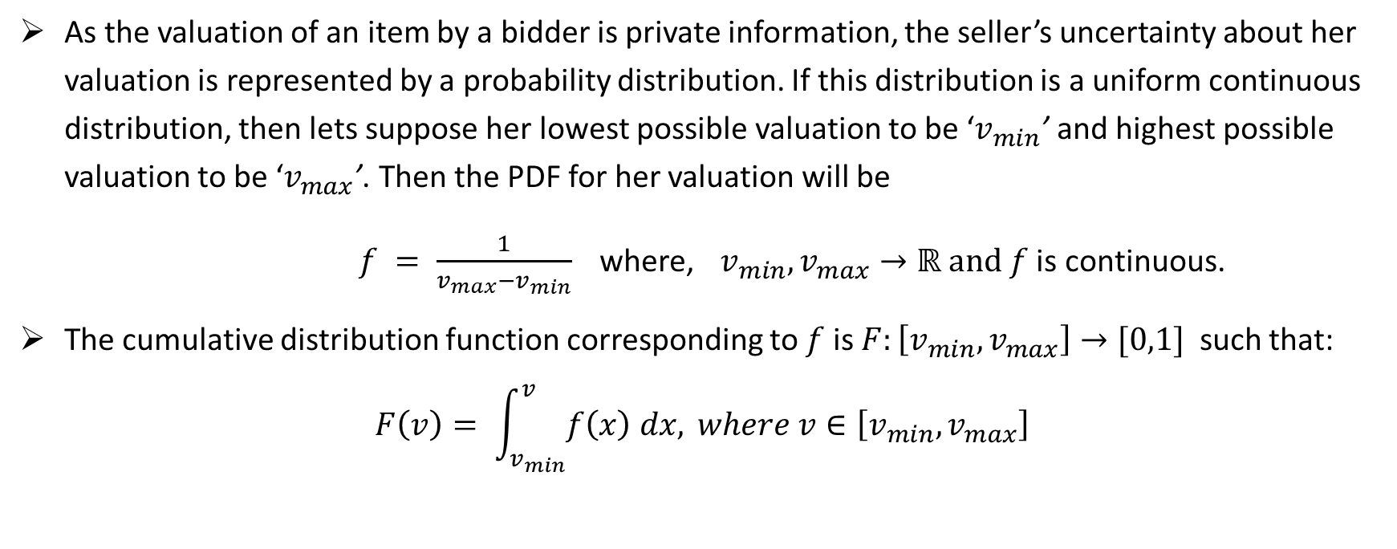
Use of PDFs and CDFs:
As the valuation of an item by a bidder is private information, the seller’s uncertainty about her valuation is represented by a probability distribution. If this distribution is a uniform continuous distribution, then lets suppose her lowest possible valuation to be ‘$v_{min}$’ and highest possible valuation to be ‘$v_{max}$’. Then the PDF for her valuation will be
$f = \frac{1}{v_{max}−v_{min}}$ where, $v_{min},v_{max}→ℝ and f$ is continuous.
The cumulative distribution function corresponding to $f$ is $F:\left[v_{min},v_{max}\right]→[0,1]$ such that: $F\left(v\right)= \int_{v_{min}}^{v}{f\left(x\right) dx,} where v∈\left[v_{min},v_{max}\right]$

Slide 11
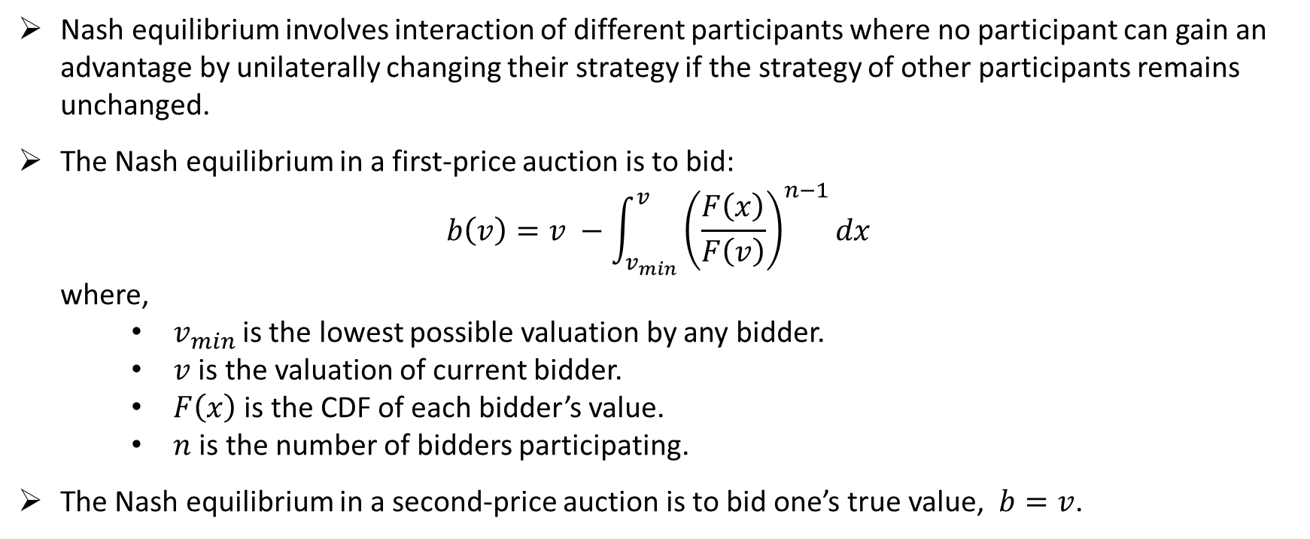
Nash Equilibrium:
Nash equilibrium involves interaction of different participants where no participant can gain an advantage by unilaterally changing their strategy if the strategy of other participants remains unchanged.
The Nash equilibrium in a first-price auction is to bid: $b\left(v\right)=v −\int_{v_{min}}^{v}{{\left(\frac{F\left(x\right)}{F\left(v\right)}\right)}^{n−1}dx}$ where,
$v_{min}$is the lowest possible valuation by any bidder.
$v$ is the valuation of current bidder.
$F\left(x\right)$ is the CDF of each bidder’s value.
$n$ is the number of bidders participating.
The Nash equilibrium in a second-price auction is to bid one’s true value, $b=v$.

Slide 12
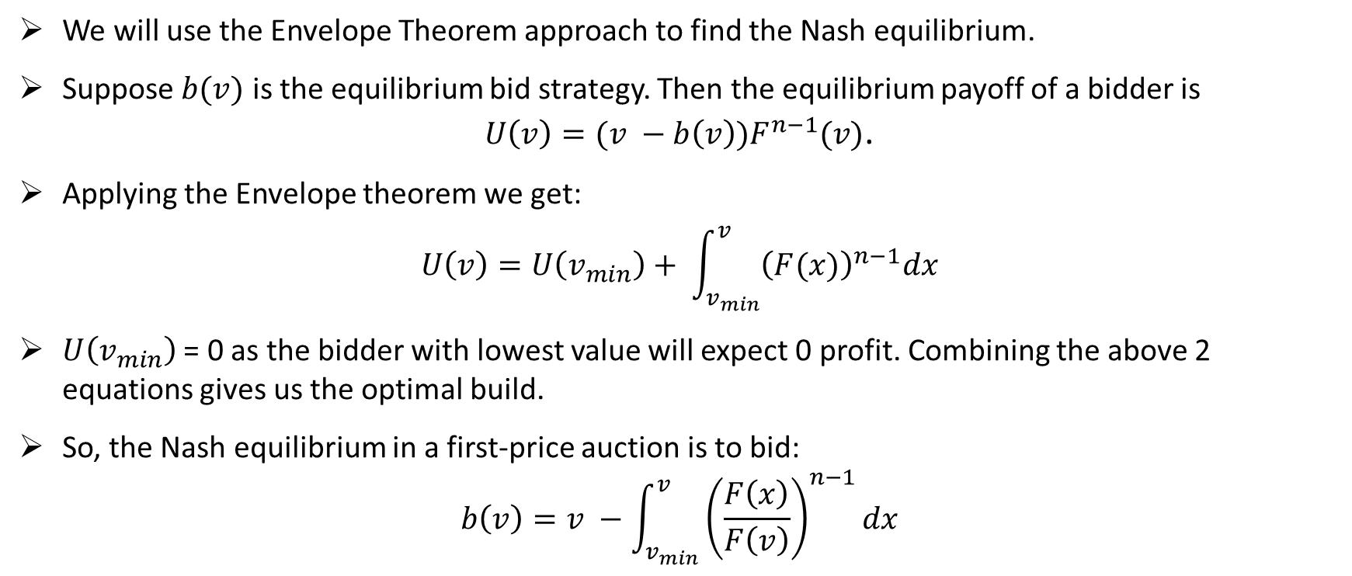
Nash Equilibrium for 1st price auction:
We will use the Envelope Theorem approach to find the Nash equilibrium.
Suppose $b(v)$ is the equilibrium bid strategy. Then the equilibrium payoff of a bidder is $U\left(v\right)=(v −b\left(v\right))F^{n−1}(v)$.
Applying the Envelope theorem we get:
$$U\left(v\right)=U\left(v_{min}\right)+ \int_{v_{min}}^{v}{{\left(F(x)\right)}^{n−1}dx}$$
$U\left(v_{min}\right)$ = 0 as the bidder with lowest value will expect 0 profit. Combining the above 2 equations gives us the optimal build.
So, the Nash equilibrium in a first-price auction is to bid: $b\left(v\right)=v −\int_{v_{min}}^{v}{{\left(\frac{F\left(x\right)}{F\left(v\right)}\right)}^{n−1}dx}$

Slide 13
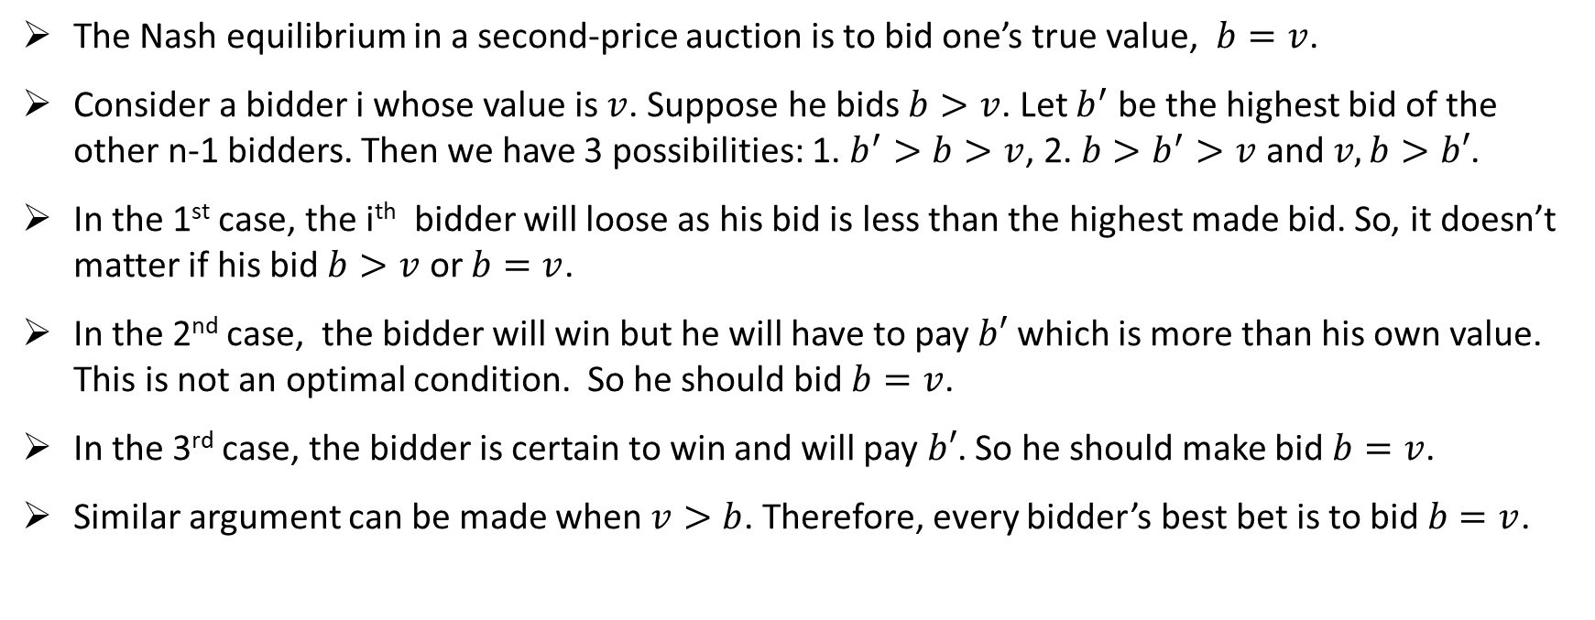
Nash Equilibrium for 2nd price auction:
The Nash equilibrium in a second-price auction is to bid one’s true value, $b=v$.
Consider a bidder i whose value is $v$. Suppose he bids $b>v$. Let $b^{′}$ be the highest bid of the other n-1 bidders. Then we have 3 possibilities: 1. $b^{′}>b>v$, 2. $b>b^{′}>v$ and $v, b>b′$.
In the 1st case, the i^{th} bidder will loose as his bid is less than the highest made bid. So, it doesn’t matter if his bid $b>v$ or $b=v$.
In the 2nd case, the bidder will win but he will have to pay $b′$ which is more than his own value. This is not an optimal condition. So he should bid $b=v$.
In the 3rd case, the bidder is certain to win and will pay $b′$. So he should make bid $b=v$.
Similar argument can be made when $v>b$. Therefore, every bidder’s best bet is to bid $b=v$.

Slide 14
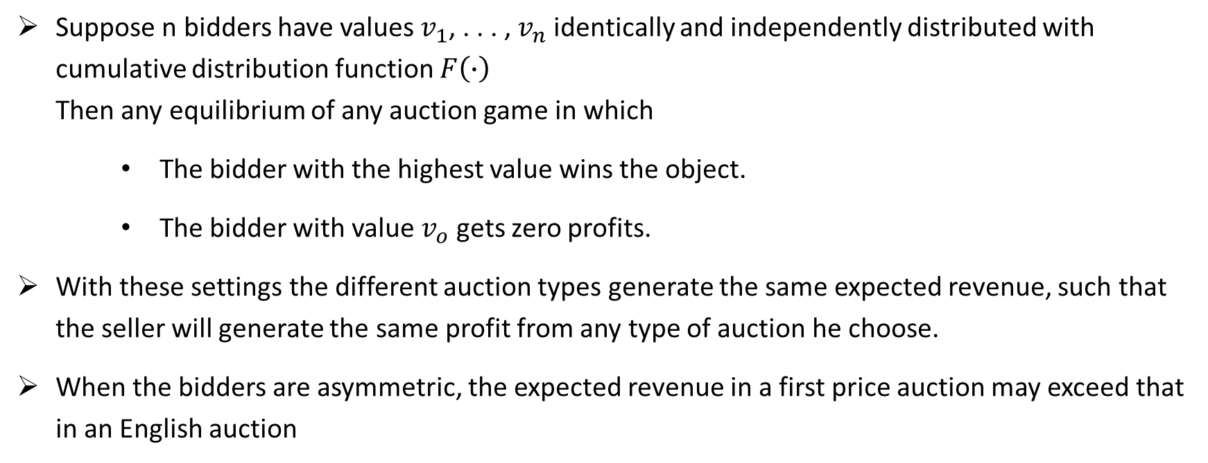
Revenue Equivalence:
Suppose n bidders have values $v_{1}$, . . . , $v_{n}$ identically and independently distributed with cumulative distribution function $F\left(∙\right)$ Then any equilibrium of any auction game in which
The bidder with the highest value wins the object.
The bidder with value $v_{o}$ gets zero profits.
With these settings the different auction types generate the same expected revenue, such that the seller will generate the same profit from any type of auction he choose.
When the bidders are asymmetric, the expected revenue in a first price auction may exceed that in an English auction

Slide 15
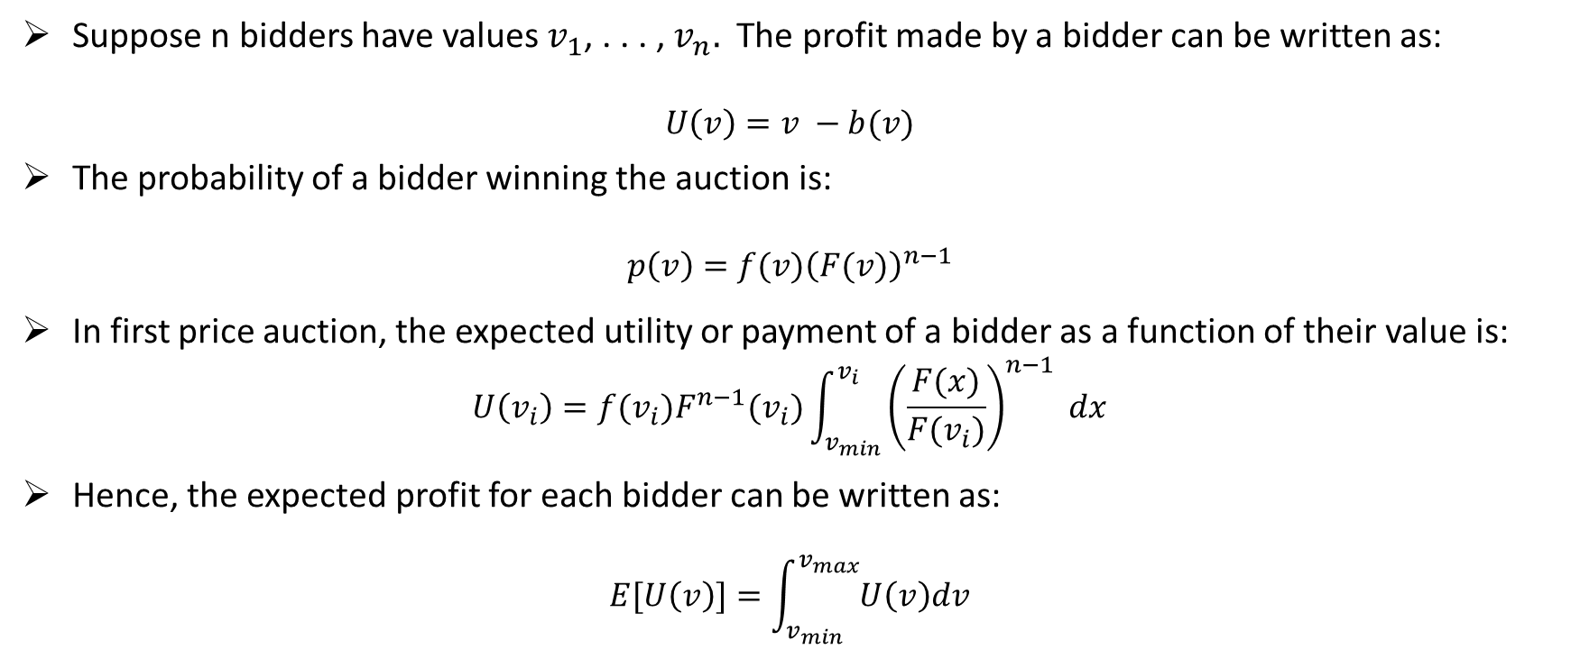
Expected profit in first price auction:
Suppose n bidders have values $v_{1}$, . . . , $v_{n}.$ The profit made by a bidder can be written as:
$$U\left(v\right)=v −b(v)$$
The probability of a bidder winning the auction is:
$$p\left(v\right)={f(v)\left(F(v)\right)}^{n−1}$$
In first price auction, the expected utility or payment of a bidder as a function of their value is:
$$U\left(v_{i}\right)=f(v_{i})F^{n−1}(v_{i})\int_{v_{min}}^{v_{i}}{{\left(\frac{F(x)}{F(v_{i})}\right)}^{n−1} dx}$$
Hence, the expected profit for each bidder can be written as:
$$E[U\left(v\right)]=\int_{v_{min}}^{v_{max}}{U\left(v\right)dv}$$

Slide 16
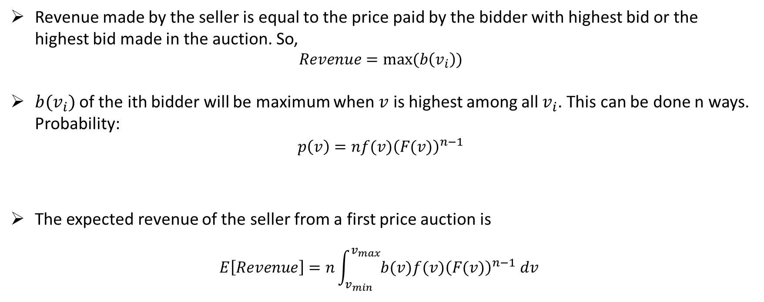
Expected revenue for first price auction:
Revenue made by the seller is equal to the price paid by the bidder with highest bid or the highest bid made in the auction. So,
$$Revenue=max⁡(b\left(v_{i}\right))$$
$b(v_{i})$ of the ith bidder will be maximum when $v$ is highest among all $v_{i}$. This can be done n ways. Probability:
$$p\left(v\right)={nf(v)\left(F(v)\right)}^{n−1}$$
The expected revenue of the seller from a first price auction is
$$E\left[Revenue\right]=n\int_{v_{min}}^{v_{max}}{{b(v)f(v)\left(F(v)\right)}^{n−1} dv}$$

Slide 17
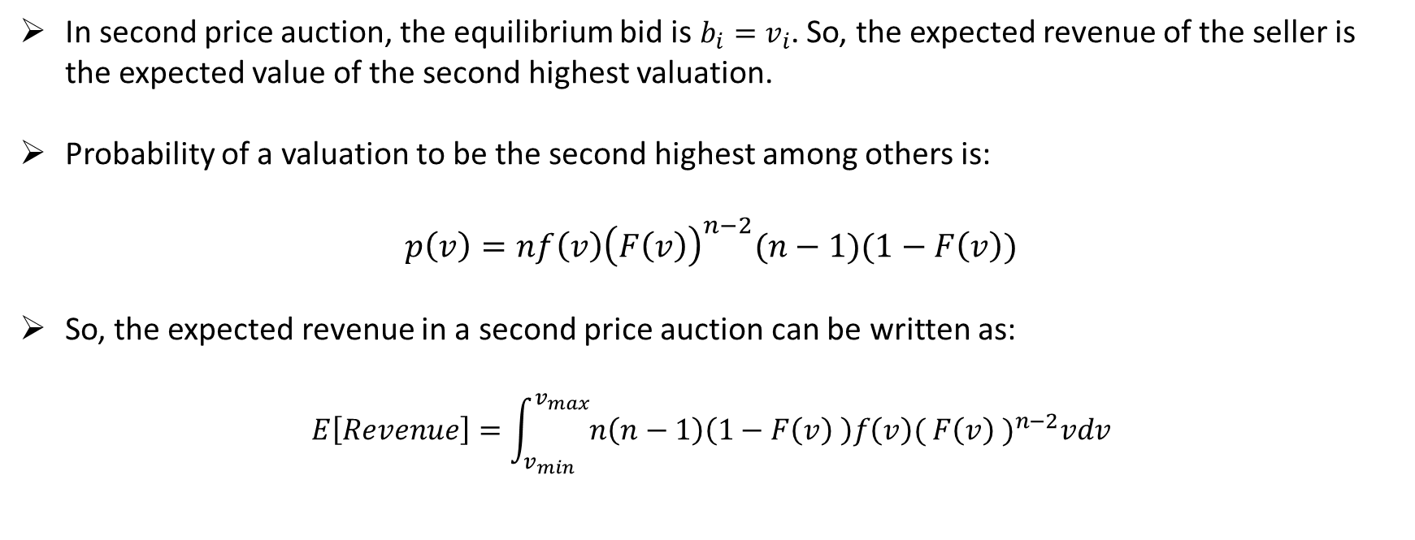
Expected revenue for second price auction:
In second price auction, the equilibrium bid is $b_{i}=v_{i}$. So, the expected revenue of the seller is the expected value of the second highest valuation.
Probability of a valuation to be the second highest among others is:
$$p\left(v\right)=n{f\left(v\right)\left(F\left(v\right)\right)}^{n−2}(n−1)(1−F\left(v\right))$$
So, the expected revenue in a second price auction can be written as:
$$E\left[Revenue\right]=\int_{v_{min}}^{v_{max}}{n\left(n−1\right)\left(1−F\left(v\right) \right)f\left(v\right){( F\left(v\right) )}^{n−2}vdv}$$

Slide 18
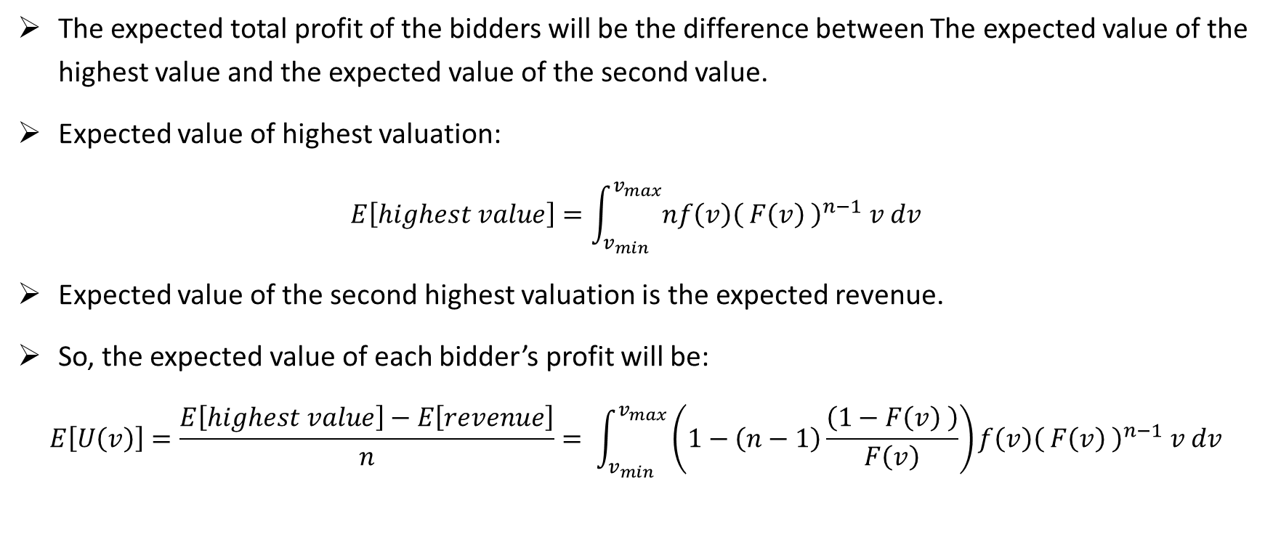
Expected profit for second price auction:
The expected total profit of the bidders will be the difference between The expected value of the highest value and the expected value of the second value.
Expected value of highest valuation:
$$E\left[highest value\right]=\int_{v_{min}}^{v_{max}}{nf\left(v\right){\left( F\left(v\right) \right)}^{n−1} v dv}$$
Expected value of the second highest valuation is the expected revenue.
So, the expected value of each bidder’s profit will be:
$$E\left[U\left(v\right)\right]=\frac{E\left[highest value\right]−E\left[revenue\right]}{n}= \int_{v_{min}}^{v_{max}}{\left(1−\left(n−1\right)\frac{\left(1−F\left(v\right) \right)}{F\left(v\right)}\right)f\left(v\right){\left( F\left(v\right) \right)}^{n−1} v dv}$$

Slide 19
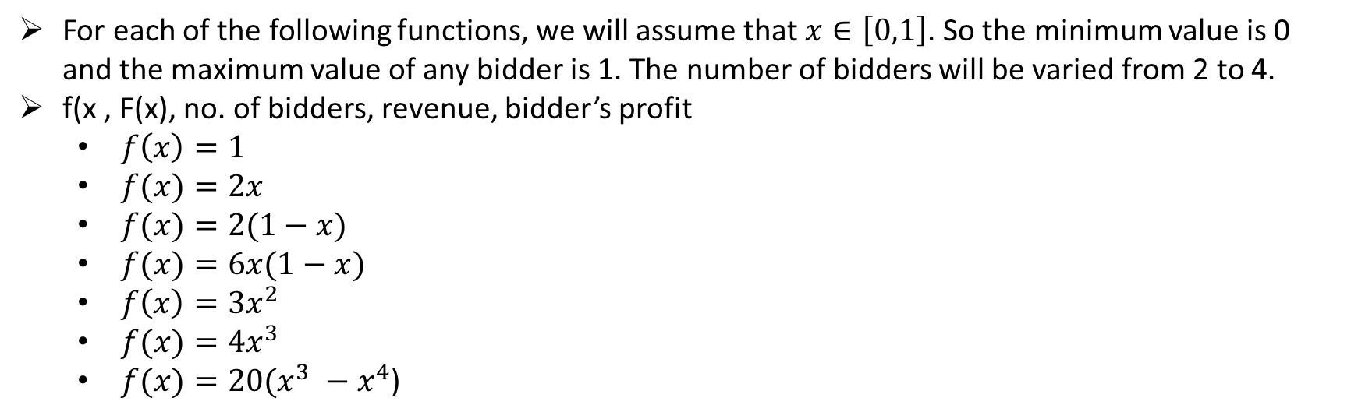
Probability distribution functions for which expected revenue and bidder’s profit will be calculated:
For each of the following functions, we will assume that $x∈\left[0,1\right]$. So the minimum value is 0 and the maximum value of any bidder is 1. The number of bidders will be varied from 2 to 4.
f(x , F(x), no. of bidders, revenue, bidder’s profit
$f\left(x\right)=1$
$f(x)=2x$
$f(x)=2(1−x)$
$f(x)=6x(1−x)$
$f\left(x\right)=3x^{2}$
$f(x)=4x^{3}$
$f(x)=20(x^{3} −x^{4}$)

Slide 20
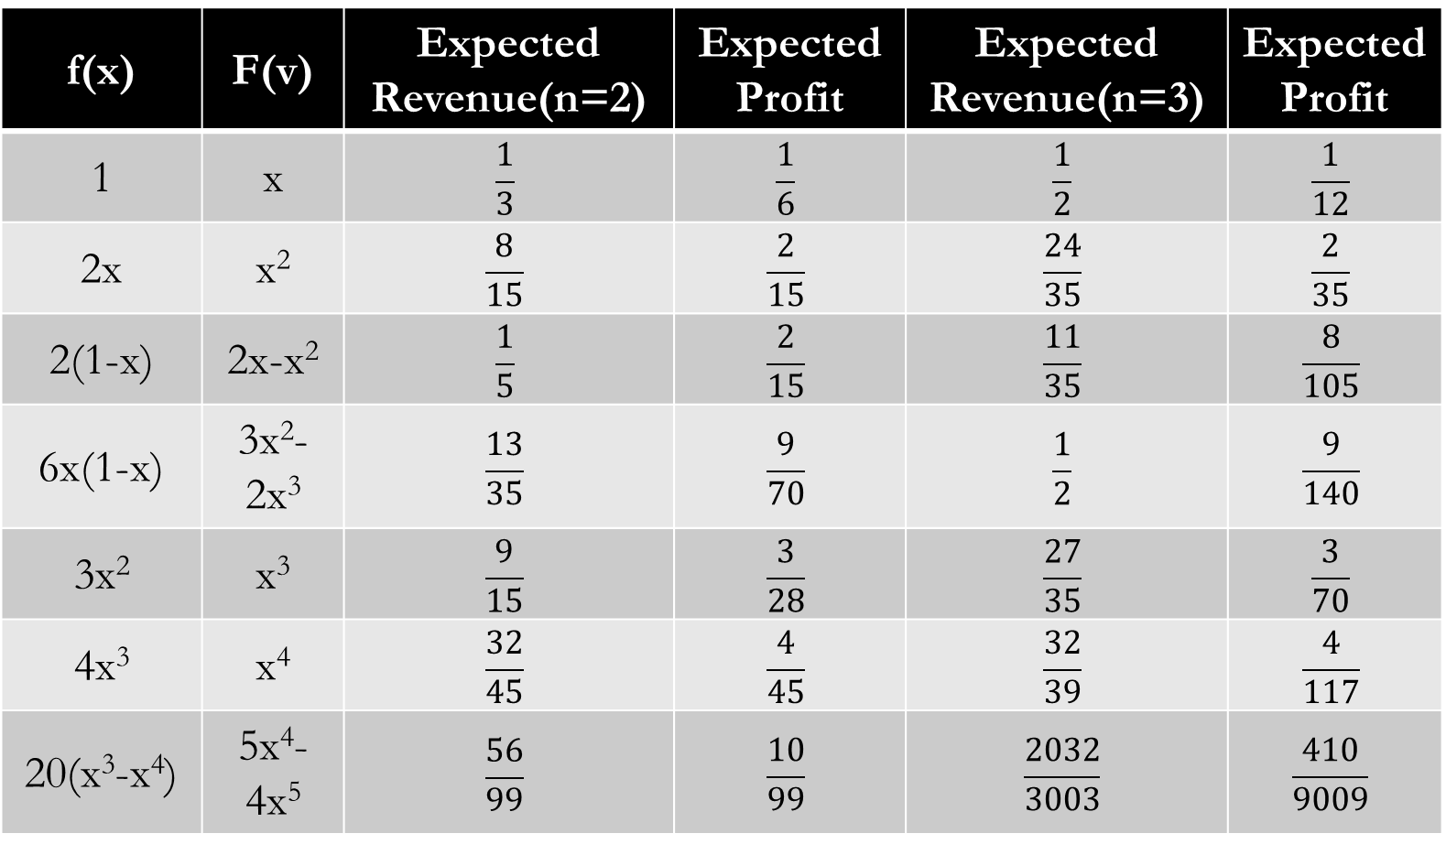
Results:
f(x) | F(v) | Expected Revenue(n=2) | Expected Profit | Expected Revenue(n=3) | Expected Profit
1 | x | $$\frac{1}{3}$$ | $$\frac{1}{6}$$ | $$\frac{1}{2}$$ | $$\frac{1}{12}$$
2x | x² | $$\frac{8}{15}$$ | $$\frac{2}{15}$$ | $$\frac{24}{35}$$ | $$\frac{2}{35}$$
2(1-x) | 2x-x² | $$\frac{1}{5}$$ | $$\frac{2}{15}$$ | $$\frac{11}{35}$$ | $$\frac{8}{105}$$
6x(1-x) | 3x²-2x³ | $$\frac{13}{35}$$ | $$\frac{9}{70}$$ | $$\frac{1}{2}$$ | $$\frac{9}{140}$$
3x² | x³ | $$\frac{9}{15}$$ | $$\frac{3}{28}$$ | $$\frac{27}{35}$$ | $$\frac{3}{70}$$
4x³ | x⁴ | $$\frac{32}{45}$$ | $$\frac{4}{45}$$ | $$\frac{32}{39}$$ | $$\frac{4}{117}$$
20(x³-x⁴) | 5x⁴-4x⁵ | $$\frac{56}{99}$$ | $$\frac{10}{99}$$ | $$\frac{2032}{3003}$$ | $$\frac{410}{9009}$$

Slide 21
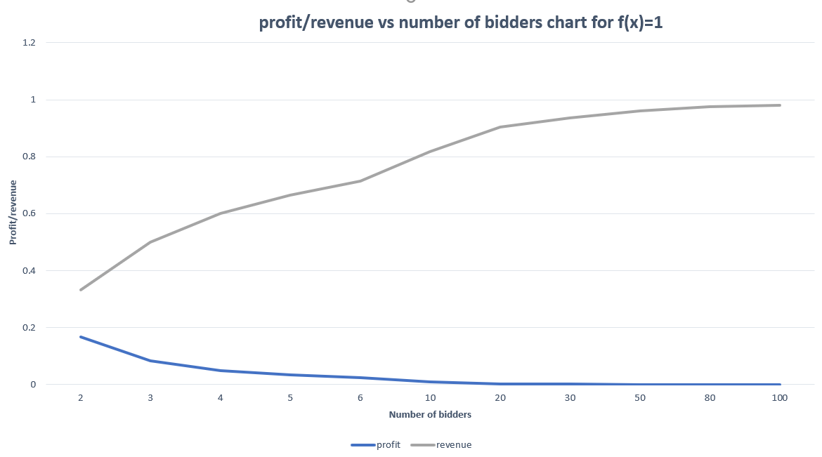
Notes:
import sympy as sy
def f_capital(x):
return (lambda x:eval(fnt_input))(x)
def f_small(x):
t= sy.symbols("t")
derivat = sy.Derivative(f_capital(t),t).doit()
return (lambda t : eval(str(derivat)))(x)
x = sy.symbols("x")
v = sy.symbols("v")
def integral(value,number_of_bidders,low_limit,high_limit):
return sy.integrate(pow(f_capital(x)/f_capital(value),number_of_bidders-1),(x,low_limit,high_limit))
def nash_optimal_bid(v):
return v-integral(v,n,v_o,v)
# Expected revenue for first price auction
# expected utility or payment of a bidder
def u(v):
return f_small(v)*pow(f_capital(v),n-1)*integral(v,n,v_o,v)
# expected profit for each bidder
def expected_profit_first_price(m):
return sy.integrate(u(v),(v,v_o,m))
def expected_revenue_first_price(m):
return n*sy.integrate(f_small(v)*pow(f_capital(v),n-1)*nash_optimal_bid(v),(v,v_o,m))
# Expected revenue for second price auction
def expected_revenue_second_price(m):
return sy.integrate(n*(n-1)*(1-f_capital(v))*f_small(v)*pow(f_capital(v),n-2)*v,(v,v_o,m))
def expected_profit_second_price(m):
return sy.integrate((1-(n-1)*(1-f_capital(v))/f_capital(v))*f_small(v)*pow(f_capital(v),n-1)*v,(v,v_o,m))
fnt_input = str(input("Enter the cost function(CDF):"))
v_o = 0
input_ = 1
n = int(input("Total number of bidders(n): "))
print("Expected profit from first price auction\n",expected_profit_first_price(input_))
print("Expected profit from second price auction\n",expected_profit_second_price(input_))
print("Expected revenue from first price auction\n",expected_revenue_first_price(input_))
print("Expected revenue from second price auction\n",expected_revenue_second_price(input_))

Slide 22
Simulation Code for calculating values:
import sympy as sy
def f_capital(x):
return (lambda x:eval(fnt_input))(x)
def f_small(x):
t= sy.symbols("t")
derivat = sy.Derivative(f_capital(t),t).doit()
return (lambda t : eval(str(derivat)))(x)
x = sy.symbols("x")
v = sy.symbols("v")
def integral(value,number_of_bidders,low_limit,high_limit):
return sy.integrate(pow(f_capital(x)/f_capital(value),number_of_bidders-1),(x,low_limit,high_limit))
def nash_optimal_bid(v):
return v-integral(v,n,v_o,v)
def u(v):
return f_small(v)*pow(f_capital(v),n-1)*integral(v,n,v_o,v)
def expected_profit_first_price(m):
return sy.integrate(u(v),(v,v_o,m))
def expected_revenue_first_price(m):
return n*sy.integrate(f_small(v)*pow(f_capital(v),n-1)*nash_optimal_bid(v),(v,v_o,m))
def expected_revenue_second_price(m):
return sy.integrate(n*(n-1)*(1-f_capital(v))*f_small(v)*pow(f_capital(v),n-2)*v,(v,v_o,m))
def expected_profit_second_price(m):
return sy.integrate((1-(n-1)*(1-f_capital(v))/f_capital(v))*f_small(v)*pow(f_capital(v),n-1)*v,(v,v_o,m))
fnt_input = str(input("Enter the CDF function:"))
v_o = 0
input_ = 1
n = int(input("Total number of bidders(n): "))
print("Expected profit from first price auction\n",expected_profit_first_price(input_))
print("Expected profit from second price auction\n",expected_profit_second_price(input_))
print("Expected revenue from first price auction\n",expected_revenue_first_price(input_))
print("Expected revenue from second price auction\n",expected_revenue_second_price(input_))
Notes:
import sympy as sy
def f_capital(x):
return (lambda x:eval(fnt_input))(x)
def f_small(x):
t= sy.symbols("t")
derivat = sy.Derivative(f_capital(t),t).doit()
return (lambda t : eval(str(derivat)))(x)
x = sy.symbols("x")
v = sy.symbols("v")
def integral(value,number_of_bidders,low_limit,high_limit):
return sy.integrate(pow(f_capital(x)/f_capital(value),number_of_bidders-1),(x,low_limit,high_limit))
def nash_optimal_bid(v):
return v-integral(v,n,v_o,v)
# Expected revenue for first price auction
# expected utility or payment of a bidder
def u(v):
return f_small(v)*pow(f_capital(v),n-1)*integral(v,n,v_o,v)
# expected profit for each bidder
def expected_profit_first_price(m):
return sy.integrate(u(v),(v,v_o,m))
def expected_revenue_first_price(m):
return n*sy.integrate(f_small(v)*pow(f_capital(v),n-1)*nash_optimal_bid(v),(v,v_o,m))
# Expected revenue for second price auction
def expected_revenue_second_price(m):
return sy.integrate(n*(n-1)*(1-f_capital(v))*f_small(v)*pow(f_capital(v),n-2)*v,(v,v_o,m))
def expected_profit_second_price(m):
return sy.integrate((1-(n-1)*(1-f_capital(v))/f_capital(v))*f_small(v)*pow(f_capital(v),n-1)*v,(v,v_o,m))
fnt_input = str(input("Enter the cost function(CDF):"))
v_o = 0
input_ = 1
n = int(input("Total number of bidders(n): "))
print("Expected profit from first price auction\n",expected_profit_first_price(input_))
print("Expected profit from second price auction\n",expected_profit_second_price(input_))
print("Expected revenue from first price auction\n",expected_revenue_first_price(input_))
print("Expected revenue from second price auction\n",expected_revenue_second_price(input_))

Slide 23
References:
[1] https://www.cs.princeton.edu/courses/archive/spring10/cos444/papers/klemperer_guide.pdf
[2] Myerson, Roger (1981) "Optimal Auction Design," Math. Op. Res, 6, 58—73.
[3] Vickrey, William (1961) "Counterspeculation, Auctions and Competitive Sealed Tenders," Journal of Finance, 16, 8—39.
[4] Riley, John and William Samuelson (1981) "Optimal Auction," American Economic Review, 71, 381—392.
[5] Milgrom, Paul and Ilya Segal (2002) "Envelope Theorems for Arbitrary Choice Sets," Econometrica, 70, 583-601.
[8] Harris, Milton and Arthur Raviv (1981) "Allocation Mechanisms and the Design of Auctions," Econometrica, 49, 1477—1499.
[7] Levin, J. Stanford. Auction Theory, 2004
[8] http://uu.diva-portal.org/smash/get/diva2:938852/FULLTEXT01.pdf

