Slide 1

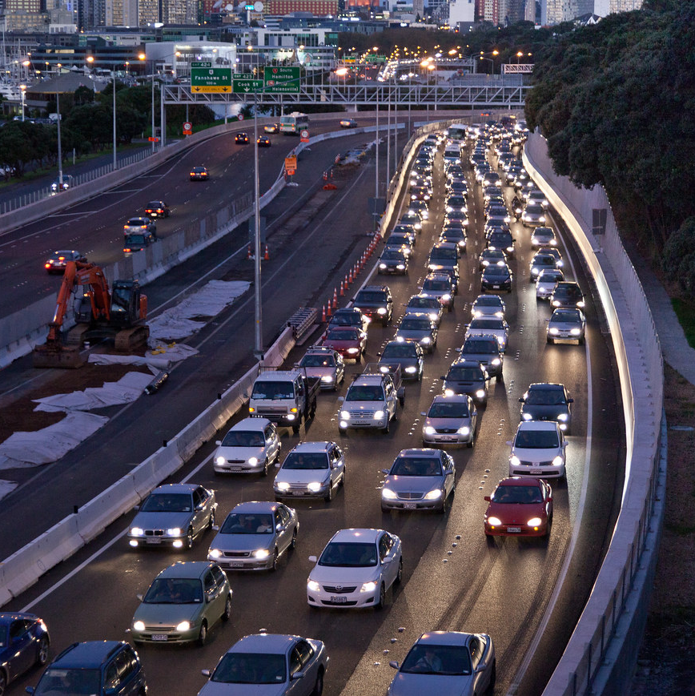
Investigation of Machine Learning Models for Traffic Accident Analysis
Group Name = Counter-strike
Anshul Gautam (2103019)
Raj Kumar Yadav (190675)
This Photo by Unknown author is licensed under CC BY-SA.

Slide 2
Introduction
In this project, we are doing a comparative analysis of different machine learning paradigms appropriate to estimate the accident duration on car accidents dataset.
This dataset was collected between February 2016 to Dec 2021 from different states of U. S.
We have also analyzed the effects of various factors that can influence traffic accidents duration.

Slide 3
Literature Review
In the past, many models have been developed to analyze accident duration ranging from supervised to unsupervised algorithms.
In the Accident duration model, we identify the relationship between accident duration and various influencing factors
Some of the models which have been developed in past to analyze the accident duration are as following:

Slide 4
Literature Review
Yuan Wen, Qin Yuan Xiong (2012) [2] have used the KNN to analyze the accident duration by optimizing the most effective k value. And this model was used on 1853 traffic accident duration dataset which was taken from the Ministry of Transportation, Netherland.
Xuanqiang Wang, Shuyan Chen, Wenchang Zheng (2013) has Analyzed several regression methods, PCR & PLSR, and built models between accident duration & affecting factors.
In PCR principal component analysis is used to estimate the regression coefficient, When the sample size is not enough in quantity and the dataset is highly collinear then the PLSR(partial least sqaure regression ) method is used in developing predictive models.

Slide 5

Dataset
The data is continuously being collected from February 2016, using several data providers, including multiple APIs that provide streaming traffic event data.
Currently, there are about 1.5 million accident records in this dataset.
The dataset covers 49 states of the US.

Slide 6
Dataset
This dataset contains 47 features , from which description of some features is given:
Start_Time = Shows start time of the accident in local time zone.
End_Time = Shows end time of the accident in local time zone. End time here refers to time when the impact of accident on traffic flow was dismissed.
Bump = This indicates presence of speed bump or hump in a nearby location.
Crossing = This indicates presence of crossing in a nearby location.
Civil_Twilight = Shows the period of day (i.e. day or night) based on Civil_Twilight
Nautical_Twilight = Shows the period of day (i.e. day or night) based on Nautical_Twilight
Astronomical_Twilight = Shows the period of day (i.e. day or night) based on Astronomical_Twilight

Slide 7
Data Preprocessing and Cleaning
First, we changed the data type of start time and end time to timestamps,
Duration of the incident was determined by taking the difference between start-time and end-time, then the unit of duration from timestamp format to minutes
The main objective of this project is to predict the accident duration through features that significantly affect the duration of the accident and can be measured and recorded easily when an accident occurs.
Many features that are obtained after an accident has occurred such as Severity and description of the accident are of low significance as they play an insignificant role in the prediction of the duration of the accident and are were hence dropped

Slide 8
Data Preprocessing and Cleaning
Initially dataset contained outliers due to which there was a high level of asymmetry in the dataset.
The minimum value of accident duration was 2 min while the maximum was 1682579 minutes which indicates that accident duration lasts form minutes to years which is practically not feasible to account for prediction of accident duration, so such outliers were removed
The outliers were removed by interquartile range (IQR) method. In this method, Lower and Upper limits of accident duration, and the accident duration not in the range of upper and lower limits was removed

Slide 9
Data Preprocessing and Cleaning
Lower limit was calculated using Q1 - 1.5*IQR and Upper limit Q3 + 1.5*IQR where Q1 is the 25th quantile and Q3 is the 75th quantile and IQR is a difference between Q3 and Q1
After doing outlier removal dataset had a minimum duration of 2 minutes and a maximum of 448 minutes.

Slide 10
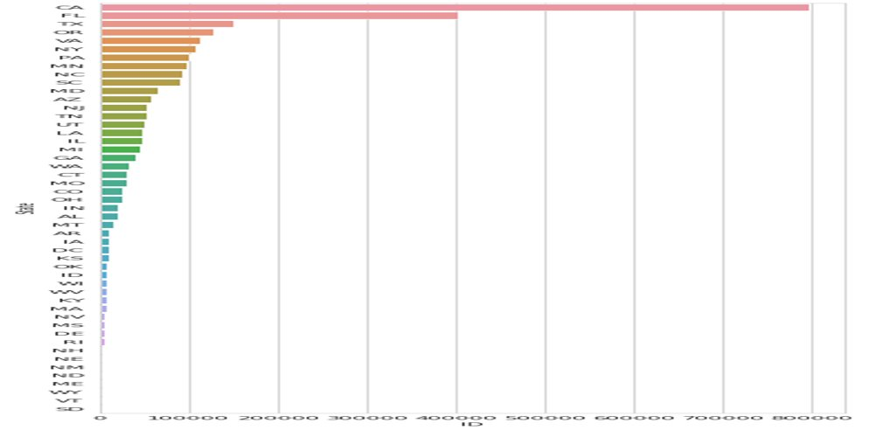
Analysis of Accident Data
State of "California" has the highest number of accidents and is followed by Florida and Texas

Slide 11
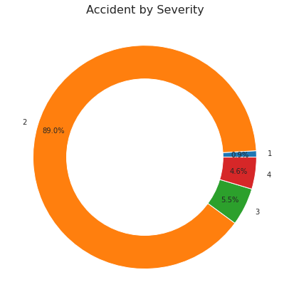
Severity Analysis
89 % of Accidents falls under the category of Severity level 2
5.5 % of Accidents falls under the category of Severity level 3
4.6 % of Accidents falls under the category of Severity level 4
0.9 % of Accidents falls under the category of Severity level 1

Slide 12
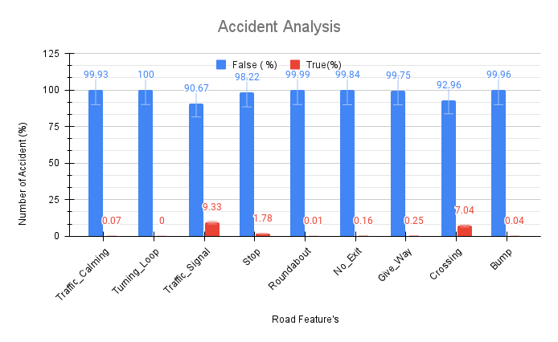
Effect of Road Features on Accidents

Slide 13
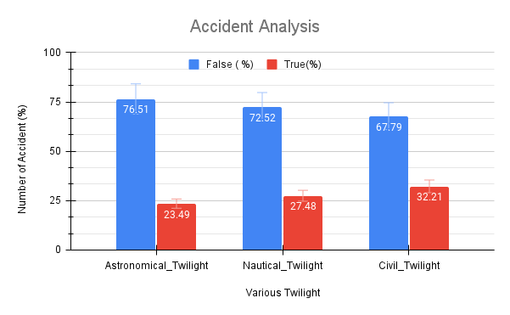
Effect of Various Twilight Condition

Slide 14

Methodology
After Data was preprocessed, cleaned and outliers were removed. Features that were not found relevant to accident duration were dropped.
We divided our dataset into four classes of accident duration and created four different data frames based on accident duration namely
1. Test1 (accident duration less than 60 min)
2. Test2 (accident duration greater than 60 and less than 120 min)
3. Test3(accident duration greater than 120 and less than 180 min) and
4. Test4 (accident duration greater than 180 min)

Slide 15

Methodology
Data of each Test data frame was thus divided into train data and test data with duration as the dependent variable and other features as independent variables.
Various models were then trained on these datasets and results were compared.
There is a wide range of methods that may be applicable to accident duration prediction. In this study, several duration prediction models are discussed and compared, which are following:

Slide 16
Methodology
Multiple Linear Regression
Multiple linear regression is used to predict the dependent variable with two or more features with the assumption that the relationship of each independent variable is linearly related to the dependent variable
the residuals (a measure of how far away the predicted dependent variable from the regression line) is following normal distribution
and that the correlation among the independent features are not highly co-related.

Slide 17

Methodology
For investigating the accuracy of the proposed models the Mean Absolute Error (MAE), the Root Mean Squared Error (RMSE) were adopted. The MAE quantifies the average magnitude of the errors, the RMSE diagnoses their variation.
Errors obtained for Multiple Linear Regression are following:

Slide 18
Methodology
Decision Tree
The decision tree algorithm can be used in both classification and regression problems, but it is used extensively in classification problems.
It is a type of Supervised learning algorithm.
Classification in a decision tree is structured as a tree where the nodes and branches are represented by features and decision methods respectively and Output is represented by leaf nodes

Slide 19

Methodology
Errors obtained for Decision Tree are following:

Slide 20
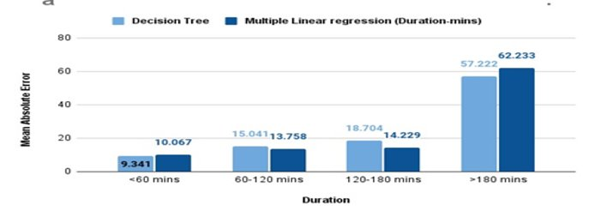
Results & Conlusion
MAE comparison of MLR and DT

Slide 21
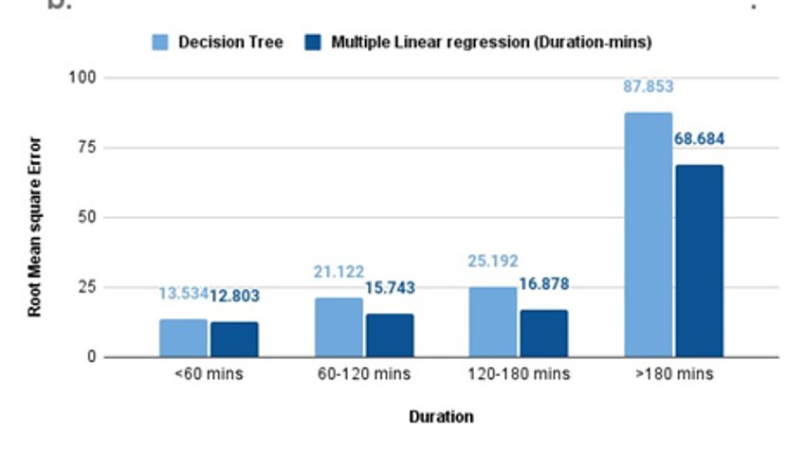
Results & Conlusion
RMSE comparison of MLR and DT add text

Slide 22
Results & Conlusion
Multiple Linear regression is best performing for accident duration less than 60 min and
the decision tree is also performing best for accident duration less than 60 min.
For 60 to 180 minute accident duration MLR is best performing model

Slide 23
References
[1] Moosavi, Sobhan, Mohammad Hossein Samavatian, Srinivasan Parthasarathy, and Rajiv Ramnath. “A Countrywide Traffic Accident Dataset.”, arXiv preprint arXiv:1906.05409 (2019)
[2] Moosavi, Sobhan, Mohammad Hossein Samavatian, Srinivasan Parthasarathy, Radu Teodorescu, and Rajiv Ramnath. "Accident Risk Prediction based on Heterogeneous Sparse Data: New Dataset and Insights." In Proceedings of the 27th ACM SIGSPATIAL International Conference on Advances in Geographic Information Systems, ACM, 2019.
[3] Xuanqiang WANG, Shuyan CHEN, and Wenchang ZHENG." Analysis of Regression Method on Traffic Incident Duration Prediction".(2013)
[4] Yuan Wen, Shuyan Chen, Qinyuan Xiong, Rubi Han,Shiyu Chen. "Traffic Incident Duration Prediction Based On K- Nearest Neighbor"(2012)
[5] A. Garib, A. E. Radwan, H. Al-Deek. "Estimating Magnitude and Duration of Incident Delays" (1997)

Slide 24
Contributions
Below are the contributions made by the group members in presentation.
Raj Kumar Yadav - Has written the Introduction section, and read research paper Analysis of Regression Method on Traffic Incident Duration Prediction[1], has done the analysis of accident duration prediction using Multiple linear regression and decision tree algorithms and has done data preprocessing, outlier removal and missing value section ,report writing , made presentation
Anshul Gautam - has read the research paper Estimating Magnitude and Duration of Incident Delays by A. Garib, A. E. Radwan, H. Al-Deek and provided the summary.[3], has done data exploration and analyzed dataset using relevant graphs , label encoding and modified data preprocessing part and report writing , made presentation

