Slide 1





Dineplan SEO Audit
WELCOME
Information available in wesbite.

Slide 2



Company Selection
The company I've selected for this SEO project is "Dineplan (https://dineplan.net/)."

Slide 3
About the Company
DinePlan is a company that provides a comprehensive software suite designed specifically for restaurant management.
Their platform seamlessly integrates with the operations of various Food and Beverage (F&B) establishments, making it an ideal solution for businesses of all sizes within the industry.
DinePlan offers user-friendly and cost-effective tools that help restaurants manage reservations, streamline operations, and improve overall efficiency.
Back to Agenda

Slide 4
About the Services
Online Reservation Management: This service helps in optimizing table allocation, reducing no-shows, and enhancing the overall guest experience.
Table Management: Their software provides real-time insights into table availability, helping staff manage seating arrangements and maximize occupancy
Customer Relationship Management (CRM): DinePlan’s CRM features enable restaurants to build stronger relationships with their customers by storing guest preferences, tracking visit history, and sending personalized offers or notifications.

Slide 5
Task-1
Initial Audit:
Current Performance:
The DinePlan website currently provides limited insights into its existing SEO performance.
An initial review indicates opportunities to enhance keyword targeting, on-page optimization, and technical SEO to improve visibility and rankings.
Strength and weakness:
DinePlan offers robust customer support, this would be a major strength, as it helps build long-term relationships with clients.
The website isn’t fully optimized for mobile devices, it could negatively impact user experience, especially since many users may access the service via smartphones or tablets.

Slide 6

Task-2
Keyword Research
Targated Keywords:
Primary Keywords: Restaurant management software, Online reservation system, Restaurant booking system, F&B management software.
Secondary Keywords: Restaurant reservation management,
Table management software, CRM for restaurants, Restaurant analytics tools.
Longtail Keywords: Best restaurant management software for small businesses, Affordable online reservation systems for restaurants, Restaurant software for customer relationship management.
Competitive Analysis:
OpenTable: A leading online reservation system widely used by restaurants around the world. Offers extensive marketing tools and a large customer base.

Slide 7

Task-3
On-Page SEO Optimization Audit
Selected page:
https://dineplan.net/restaurant-format-fine-dine/
Strength:
Sleek and intuitive service page layout.
Engaging visuals and infographics enhance the content.
Weakness:
Limited SEO Optimization: The page may not be fully optimized for relevant keywords, which could limit its visibility in search engine results.
Internal Linking: There may be a lack of internal links to other relevant pages on the DinePlan website, which can help improve SEO and guide users through their buyer’s journey.

Slide 8
Task-4
Off-Page SEO
High-Quality Backlink Building:
Guest Blogging: Contribute guest posts to reputable restaurant industry blogs and websites. Include a link back to the DinePlan page within the content or author bio
Industry Directories: Submit the DinePlan website to relevant restaurant management and technology directories. Ensure the listing includes a link to the fine dining page.
Social Media Engagement
Share Content on Social Media: Regularly share the fine dining page on DinePlan’s social media channels (LinkedIn, Facebook, Instagram, Twitter) to drive traffic and engagement.
Social Bookmarking: Submit the page to social bookmarking sites like Reddit, StumbleUpon, or Digg, especially in communities focused on the restaurant industry.

Slide 9
Task-5
Technical SEO
Technical SEO Issues (Website Homepage):
Current State: The URL is clean and descriptive, which is good for both users and search engines.
Implement lazy loading for images and videos to improve initial page load times.
Best Practices to Improve Site and Web Page Speed:
Limit Third-Party Scripts: Reduce external widgets and trackers.
Distribute Content: Store files on servers around the world to speed up access.
Use Cache Headers: Add headers to help browsers know which files to cache and for how long.
Reduce Server Load: Offload some of the data traffic to the CDN to ease the load on your main server and speed up delivery.

Slide 10
Task-6
Content Strategy
1. Audience-Centric Content Creation
Focus on different types of restaurant owners and managers (e.g., fine dining, casual dining, quick service) and create tailored content that addresses their specific challenges and needs.
2. Educational Blog Posts
Publish blog posts on topics like restaurant management trends, the impact of technology in the F&B industry, and tips for improving operational efficiency.
3. Customer Success Stories
Publish blog posts on topics like restaurant management trends, the impact of technology in the F&B industry, and tips for improving operational efficiency.

Slide 11
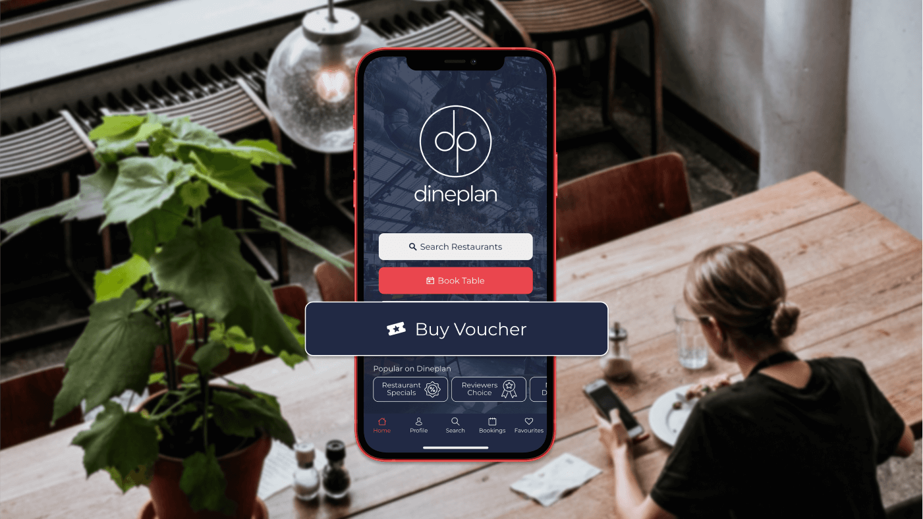
Outcome of the Project:
Focus on On-Page SEO Enhancements: Prioritize improvements to the DinePlan website based on identified SEO opportunities, ensuring that each page, especially the fine dining section, is optimized for both user experience and search engines.
Implement a Content Marketing Strategy: Develop and execute a content marketing plan that targets key industry keywords. Create valuable, SEO-optimized content that resonates with restaurant owners and managers.

Slide 12
Conclusion
This SEO audit report serves as the foundation for enhancing DinePlan's online visibility and search engine rankings. By following the suggested strategies, DinePlan can significantly boost its presence in search results. Implementing these recommendations will help DinePlan improve its digital footprint and attract more targeted traffic.

Slide 13
Thank You

