Slide 1
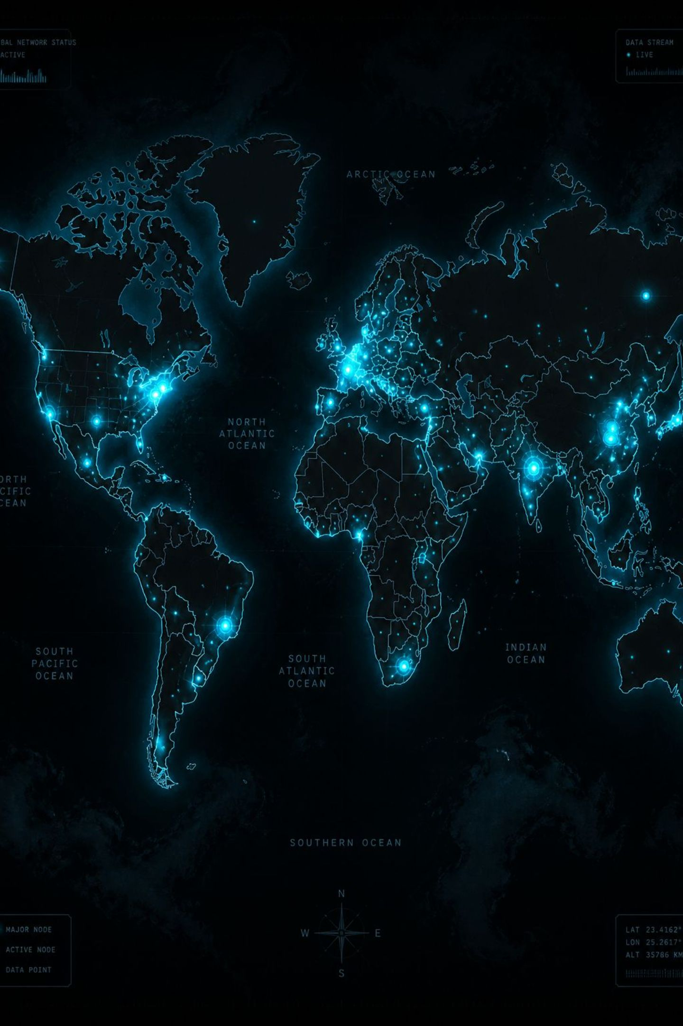
Global Air Quality & Pollutant Analytics
Uncovering Multi-Pollutant Drivers and Regional Disparities Across 23,000+ Global Cities
DATA VISUALIZATION · SUMMER 2026 FINAL PROJECT

Slide 2

Executive Summary & Project Objectives
This project analyzes PM₂.₅, O₃, NO₂, and CO across 175 countries — transitioning from passive air monitoring to actionable, explanatory visual storytelling.
Analysis Notebook
Interactive Dashboard
Exploratory analysis and statistical modeling via Plotly
Live Streamlit app with dynamic filters and KPI metrics
Executive Deck
Policy-ready findings for analysts and decision-makers

Slide 3
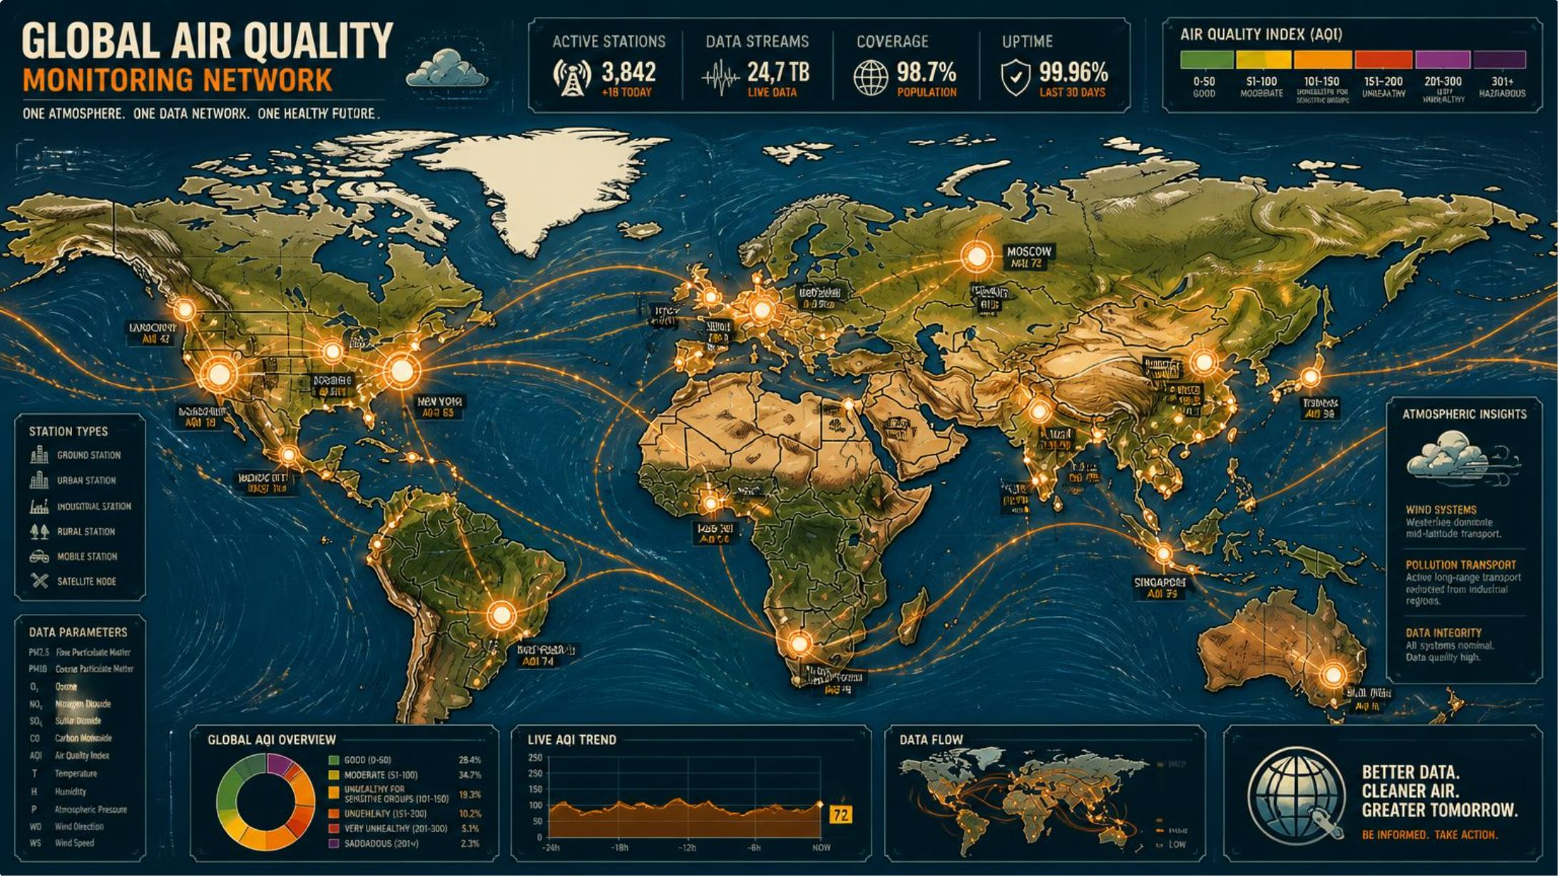

Dataset Scope & Dimensions
Source: Global Air Pollution Dataset (WAQI / Open Data) — one of the most comprehensive open air quality repositories available.
Spatial Coverage
Numerical Dimensions
Categorical Tiers
175 countries · 23,000+ cities worldwide
AQI values for PM₂.₅, O₃, NO₂, and CO
Good · Moderate · Unhealthy · Hazardous

Slide 4
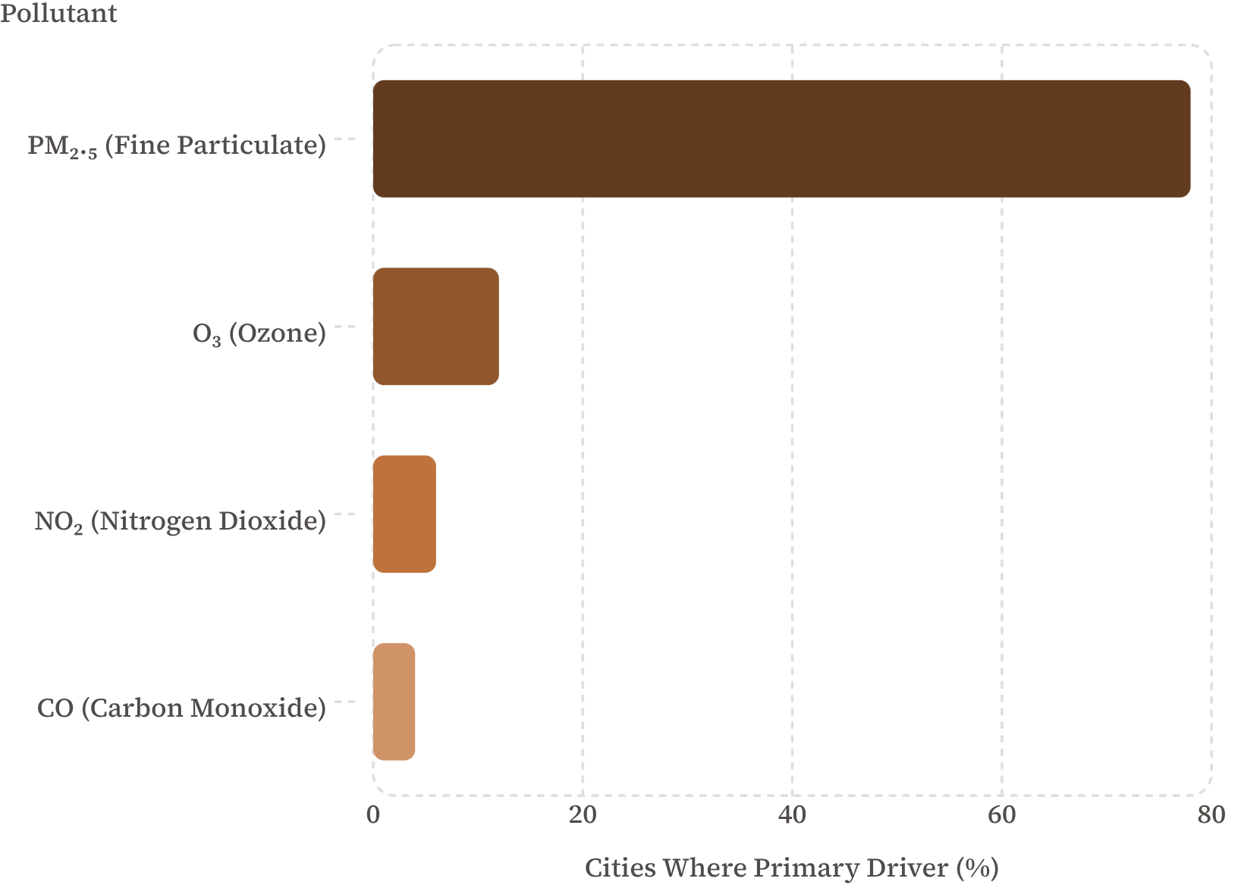

KEY FINDING 1
The Dominant Pollutant Driver
Core Insight
Fine Particulate Matter (PM₂.₅) is the primary driver of severe AQI in over 78% of global cities — dwarfing all other pollutants combined.
Policy interventions targeting ambient particulate dust yield the highest global health return per dollar invested.

Slide 5
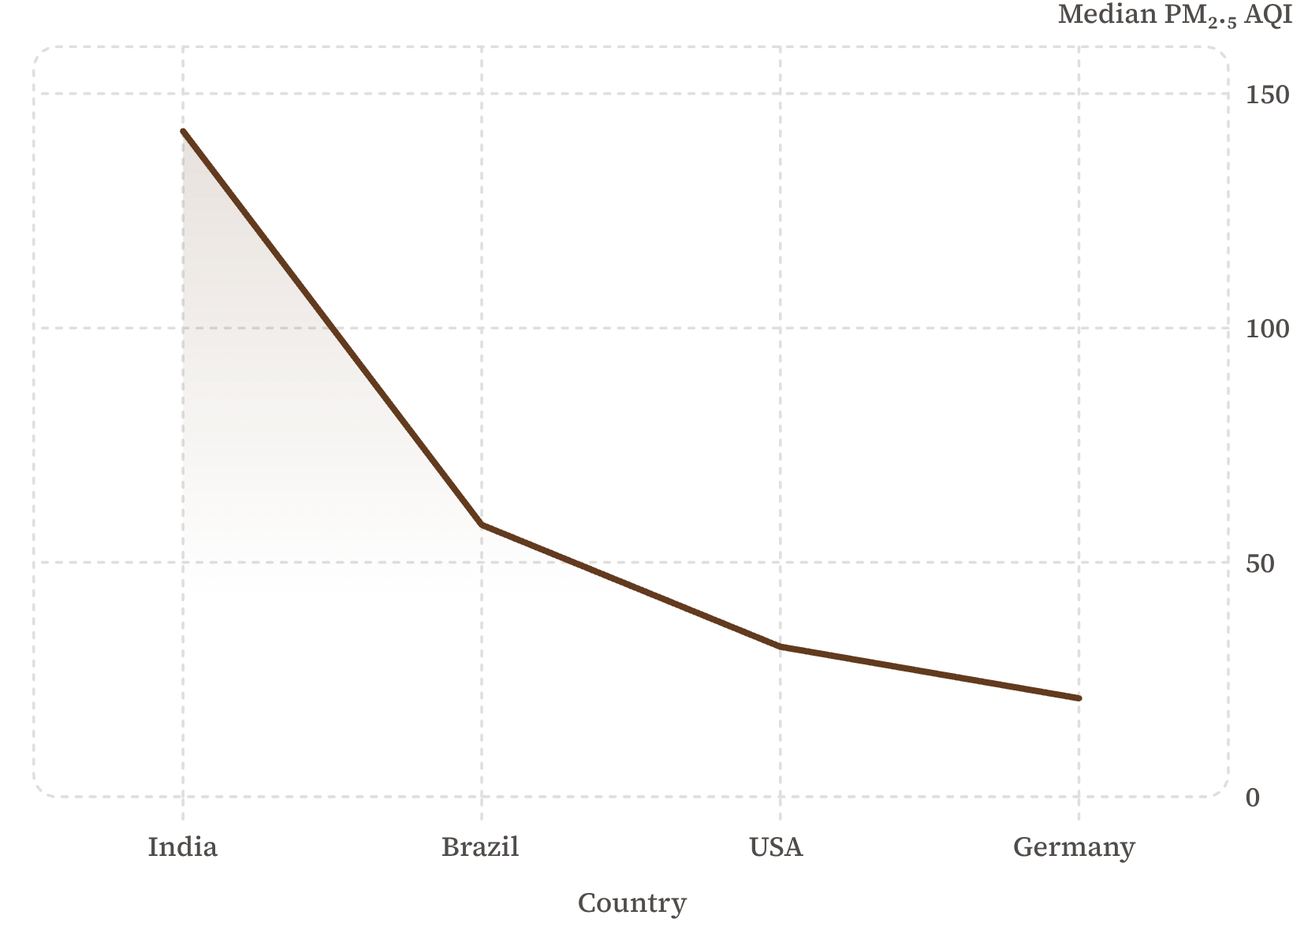
KEY FINDING 2
National Severity & Regional Disparities
Core Insight
South Asian and developing nations exhibit significantly higher median PM₂.₅ baseline levels compared to Western nations. India's median AQI is over 6× Germany's.
High intra-country variance reflects stark industrial vs. rural air quality divides — a single national average masks critical sub-regional risk.

Slide 6
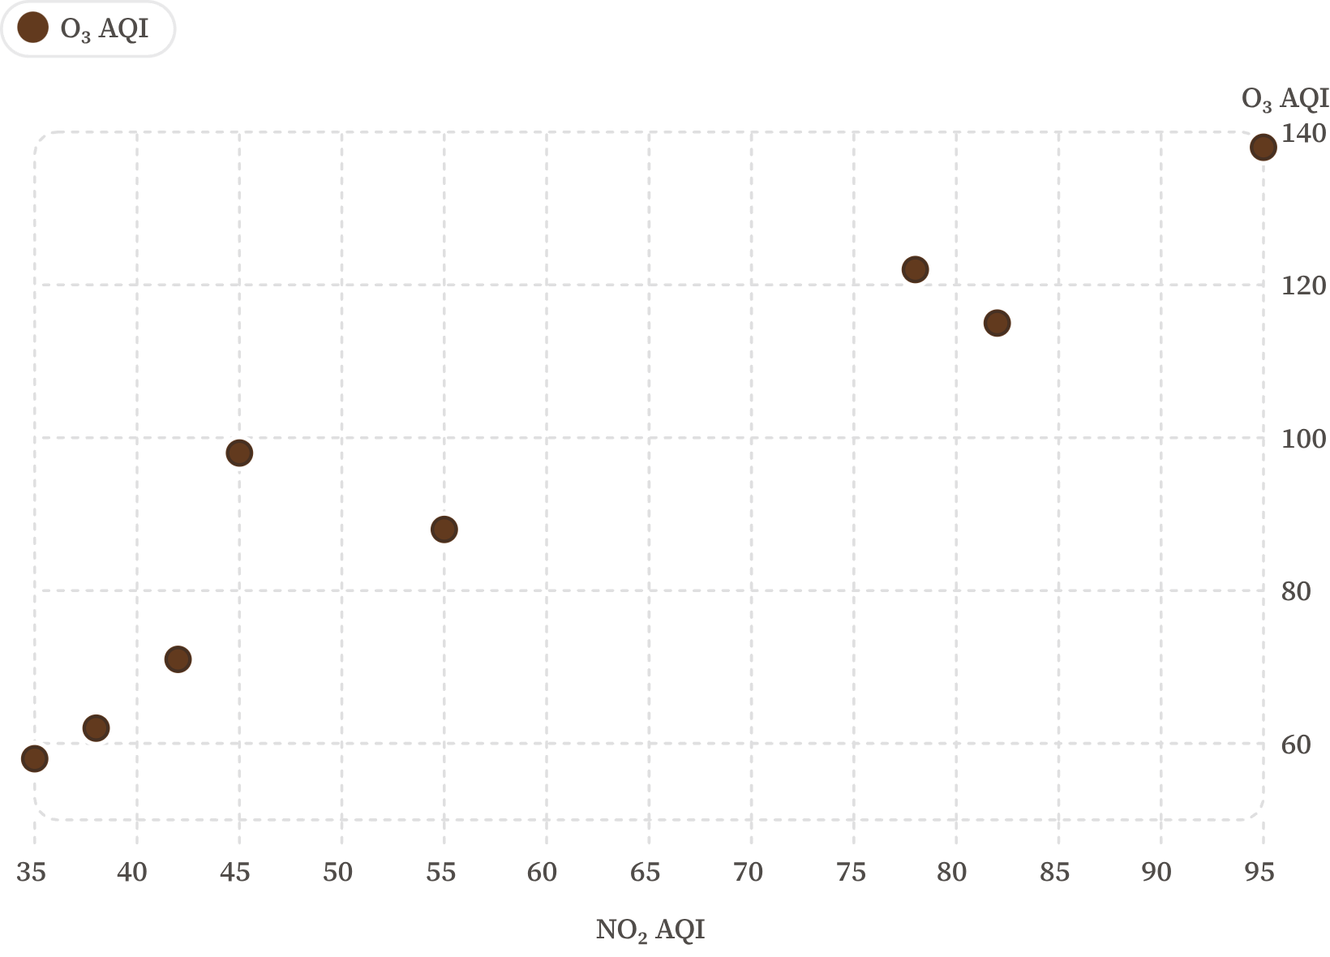

KEY FINDING 3
Photochemical & Gas Dynamics
Core Insight
Ozone (O₃) concentrations scale non-linearly and frequently spike independently of urban NO₂ levels — decoupling from direct vehicle exhaust patterns.
Photochemical ozone buildup poses distinct seasonal threats separate from combustion-based pollutants, requiring different mitigation strategies.

Slide 7
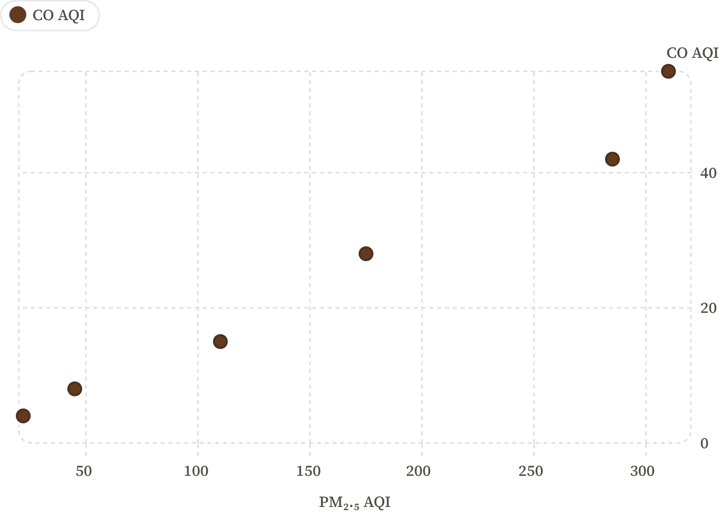
KEY FINDING 4
Combustion & Outlier Profiles
Core Insight
Severe Carbon Monoxide (CO) spikes above 10 AQI almost exclusively coincide with extreme PM₂.₅ hazardous events — a strong compound signature.
Industrial facilities and forest fire combustion events trigger simultaneous multi-pollutant spikes, creating acute compound exposure risk for nearby populations.

Slide 8
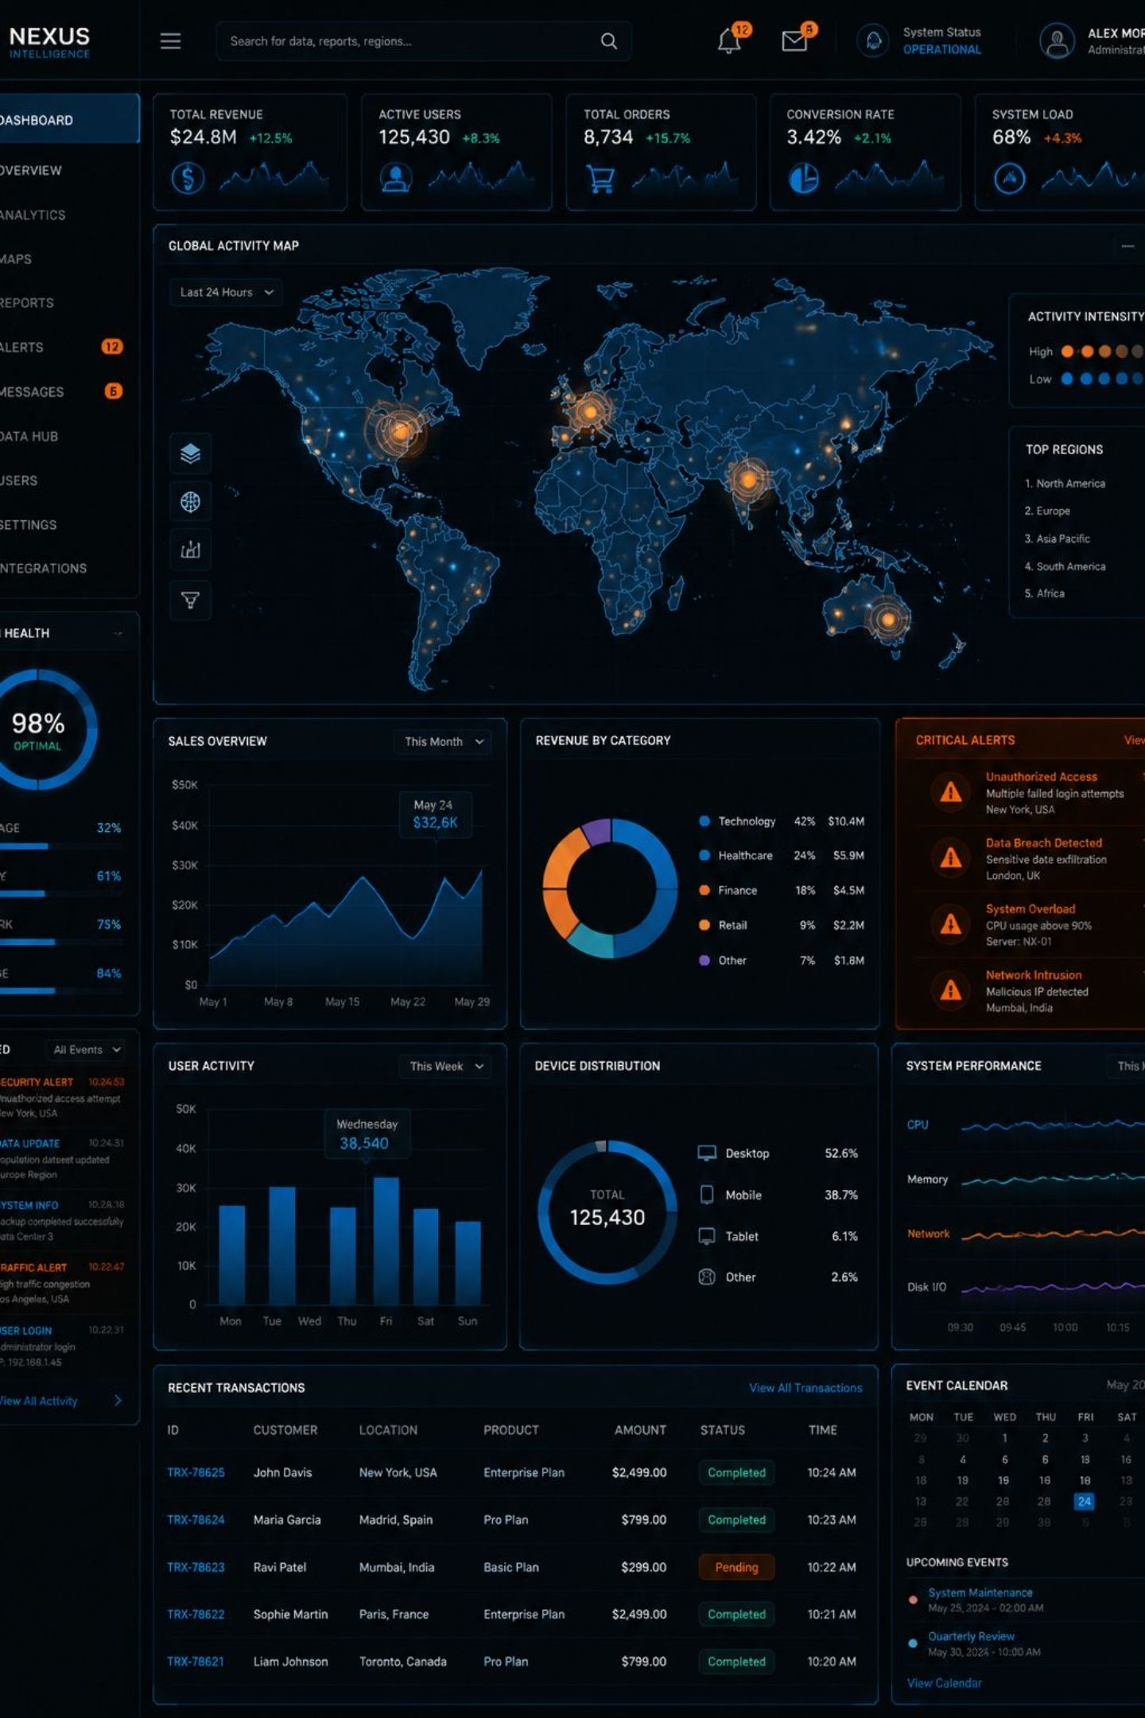


Interactive Dashboard Overview
Built with Streamlit and deployed live on Streamlit Community Cloud — enabling real-time exploration of global air quality patterns without coding.
Dynamic Filters
Country multiselectors and AQI severity category filters for targeted analysis
Live KPI Metrics
Dynamic key performance indicators that update in real time with every filter selection
Tabbed Plotly Views
Multi-chart analytical views — scatter, box, bar, and map — organized in intuitive tabs

Slide 9
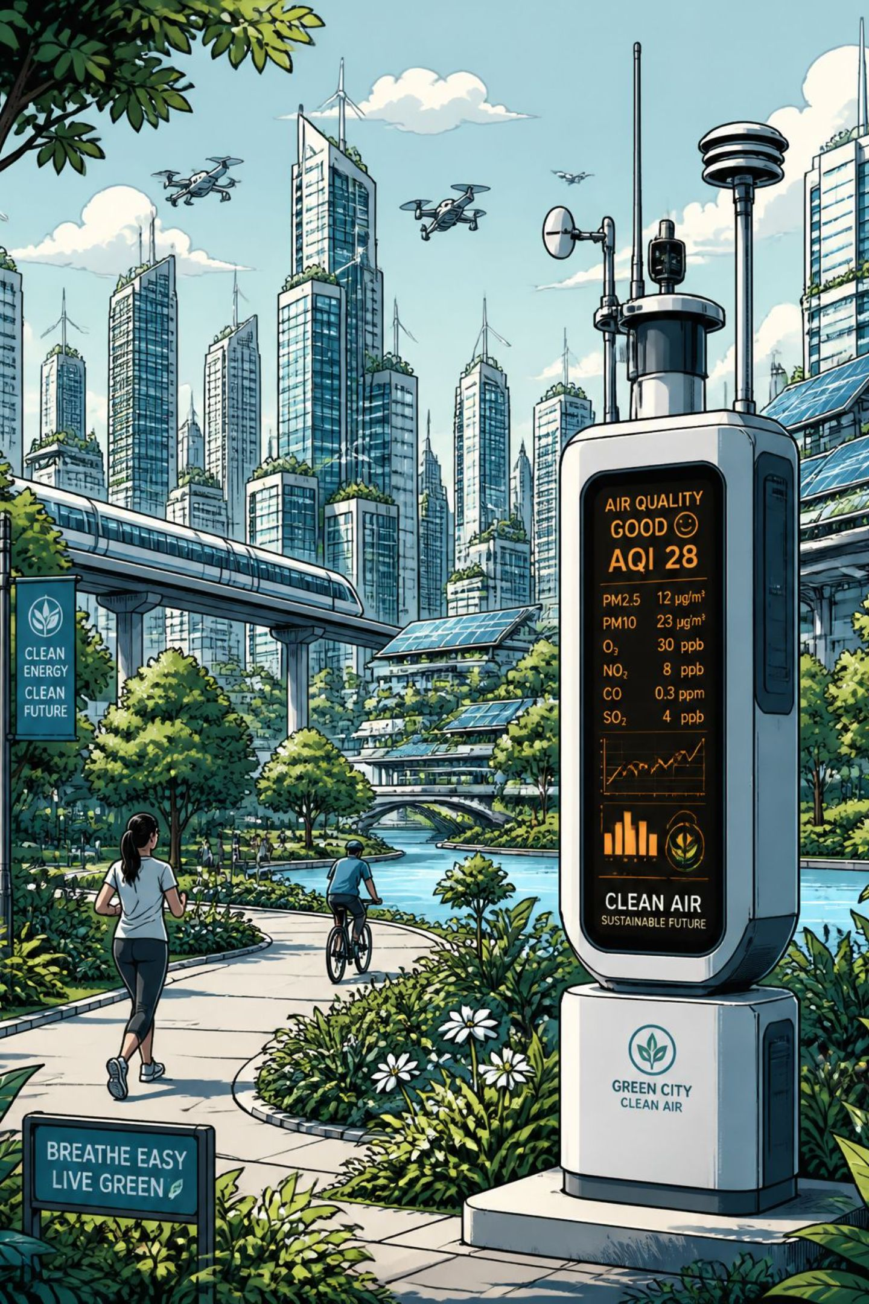


Recommendations & Policy Takeaways
Targeted Dust Suppression
1
Priority funding must focus on PM₂.₅ abatement in high-density urban corridors — the single highest-impact intervention globally.
Localized Sub-Regional Monitoring
2
Addressing internal country AQI disparity requires granular monitoring stations that capture industrial vs. rural divides.
Public Transparency & Access
3
Real-time interactive dashboards empower community-level health awareness and hold regulators accountable.

Slide 10

Conclusion & Project Links
One Dataset. One Story.
Key Takeaways
One dataset, 10+ analytical questions, and one cohesive global air quality narrative — from raw data to policy-ready insight.
PM₂.₅ dominates — 78% of severe AQI events globally
GitHub Repository: https://github.com/rajkumarp0797/dataviz-exercise-Rajkumar
Regional disparity is vast — South Asia vs. Western Europe
O₃ behaves independently — photochemical, not combustion-driven
CO + PM₂.₅ co-spike — compound combustion event signature

