Slide 1
Lending club case study
Lokeshkumar Rajendran

Slide 2
BUSINESS OBJECTIVE
The Objective of the case study is to implement EDA techniques for a real world problem and understand the insights to mitigate the credit loss to Lending club
1.Identifing the potential candidates who can repay the loan is important, if we reject the person who is an potential barrower and who can repay the loan its an loss to the company
2.If we approve a loan to the person who has very less changes of repaying it, then it’s a loss to the leaning club
With this case study we will be able to pin point the applications at risk of defaulting the loans, enabling a reduction in credit loss.
By using the EDA techniques we will be able to understand the driving factor behind the loan defaulters i.e the variables which are strong indicator of default.

Slide 3
Data cleaning & pre-processing
Dataset details:
The data given contains information about the past loan applications, weather if they have defaulted or paid fully or the loan is in still progress
The data set also has the lot of columns which is not needed for the analysis, and few columns which are completely blank
Loading data from csv
Checking for completely null column
Calculating the percentage of null values
Remove the column which is not in need for analysis
Formatting the contents in the data set
Identify outliners in the numerical column
Univariate Analysis
Bivariate Analysis
Multivariate Analysis

Slide 4
Removing the columns
Removing the columns which is not needed for the analysis
Zip code only first 3 characters are visible
pymnt_plan column as it has sinle value n
application_type this column has only one value as INDIVIDUAL
policy_code column has single constant value 1
delinq_amnt column has single constant value 0
tax_liens column has single constant value 0.0 and nan
initial_list_status column has single constant value f
collections_12_mths_ex_med column has single constant value 0.0 and nan
acc_now_delinq' column has single constant value 0
chargeoff_within_12_mths column has a single constant value 0.0 and nan
Identify the columns with the unique values, and remove it as it will not be of any use in analysis

Slide 5
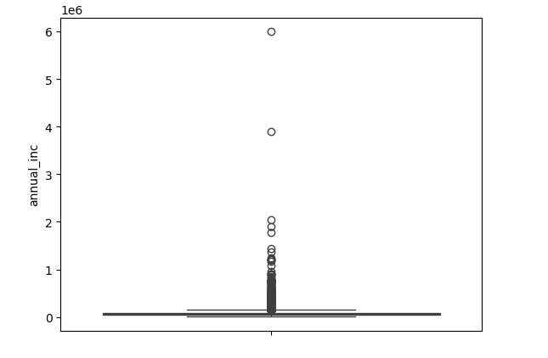
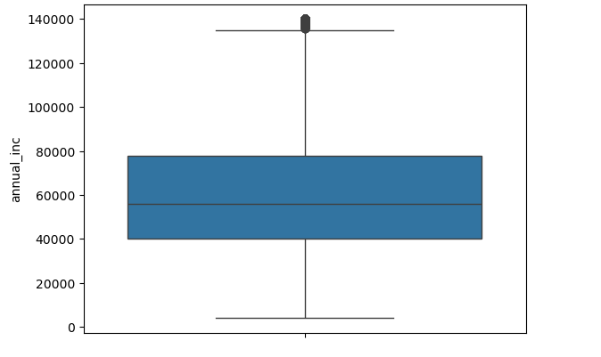
Identifying outliners-Annual Income
The value after 95% seems disconnected,
so removed values after 95%
Clearly the annual income has the outliners

Slide 6
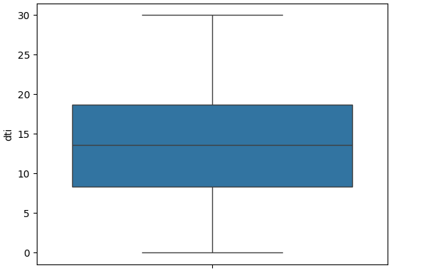
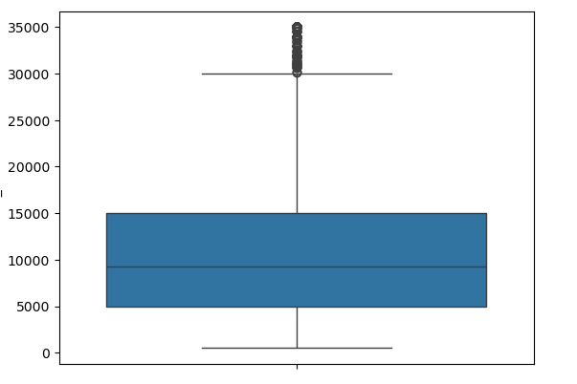
Identifying outliners- Dti, loan amount
DTI column has no outliners
Loan amount column has no outliners

Slide 7
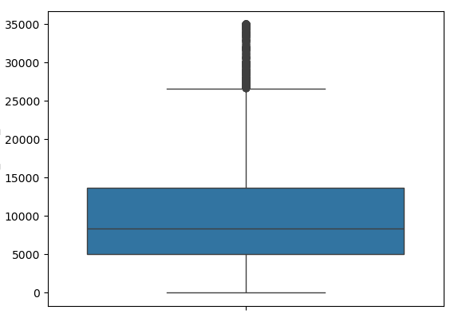
Identifying outliners- Funded amnt inv
The column funded amnt inv has no outliners

Slide 8
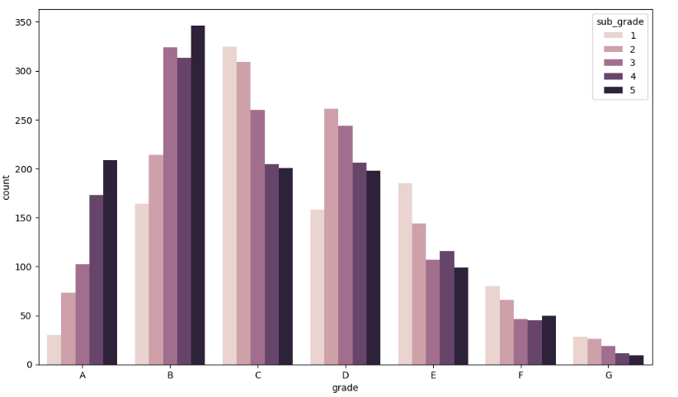
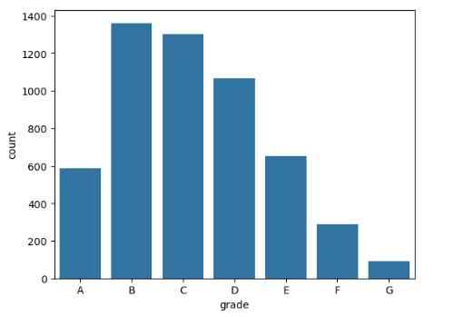
Segmented Univariate Analysis-Grade column
The analysis done on grade column with subgrade as hue, Indicates that person with grade B5 has the high chance of default
The analysis with grade column shows the B grade employees, have defaulted more

Slide 9
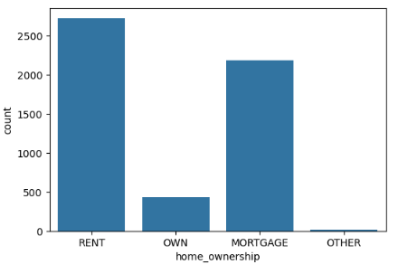
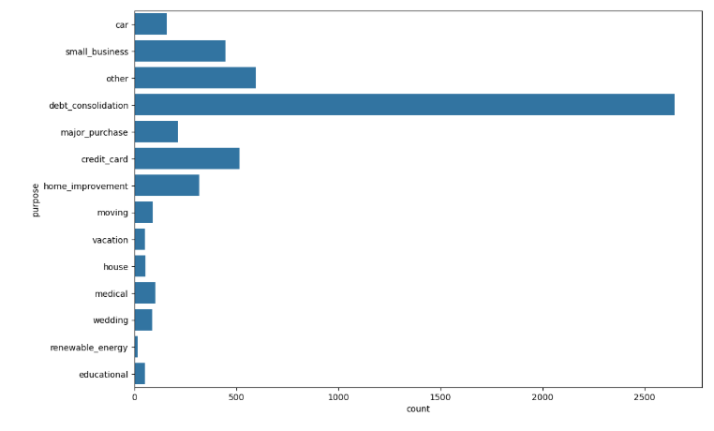
Segmented Univariate Analysis-Home ownership and purpose column
The person who has the home ownership as Rent has defaulted more when compared to Mortage of home
The person who bought the loan to pay other loan i.e debt consolidation has very high chances of defaulting when compared to other purposes

Slide 10
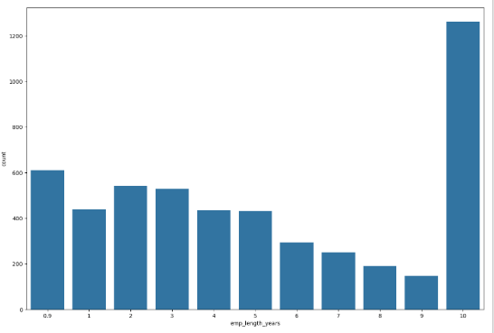
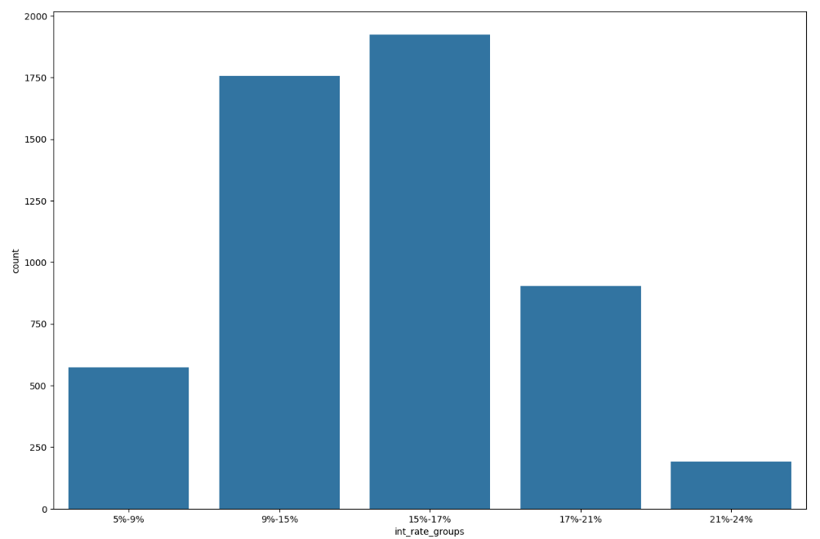
Segmented Univariate Analysis-Employee length, interest rate
The loans that was provided with the interest rate of 15-17% has defaulted more
The Employee who has 10 years or more than 10 years has defaulted more

Slide 11
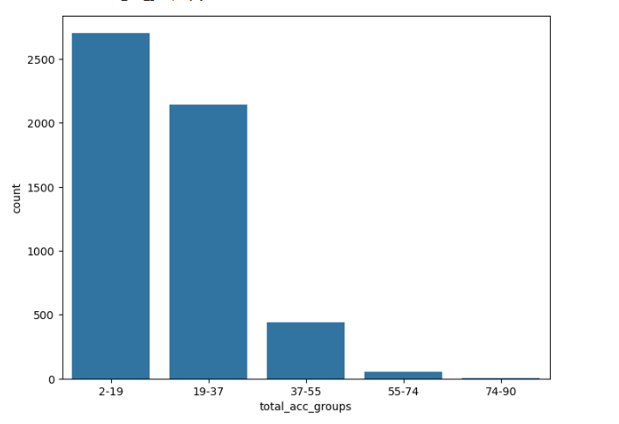
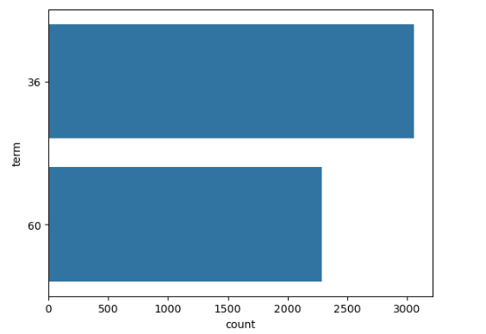
Segmented Univariate Analysis-Total account and term column
The person who has total account between 2-19 has defaulted more
The loan which has the 36 months term has defaulted more when compared to 60 months

Slide 12
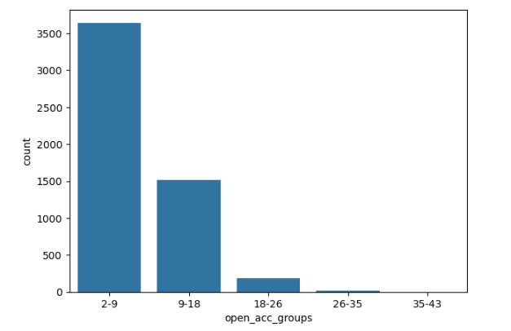
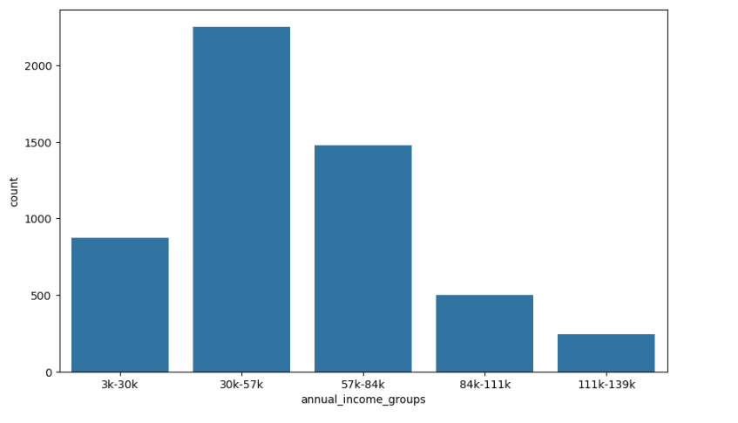
Segmented Univariate Analysis-Annual Income and open account
The person with the income range of 30K to 57K has defaulted more, an extra caution has to be taken for the loans with salary of this range
People with the open account of 2-9 has charged off more when compared to others

Slide 13
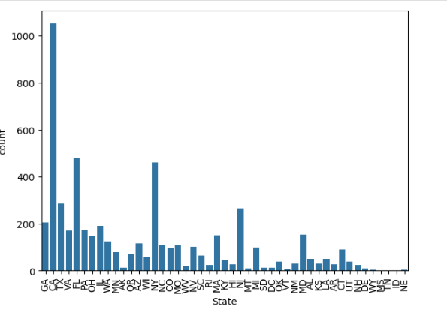
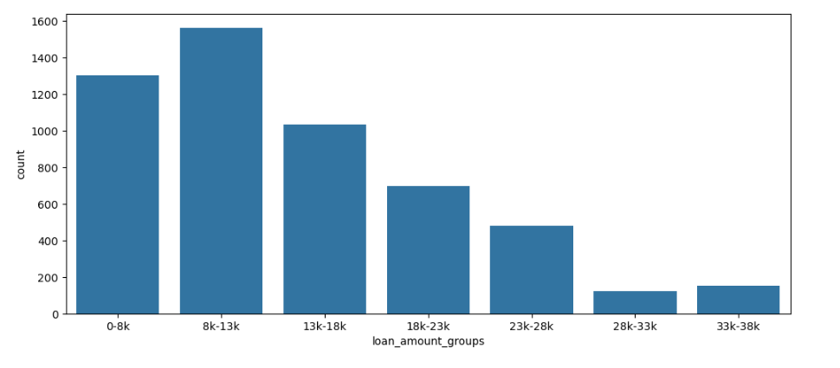
Segmented Univariate Analysis-State and loan amount
People from the CA state has defaulted more when compared to others. Lending club should have extra due diligence on the CA state
Loans provided between 8K to 13K has defaulted more, more the loan amount there is less changes of defaulting

Slide 14
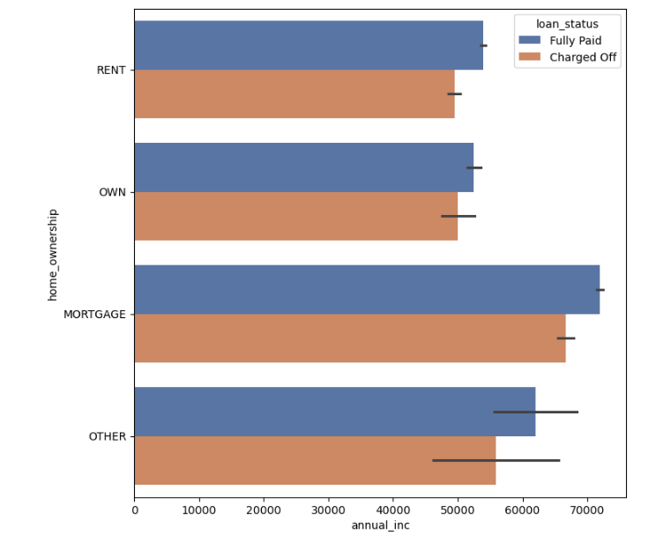
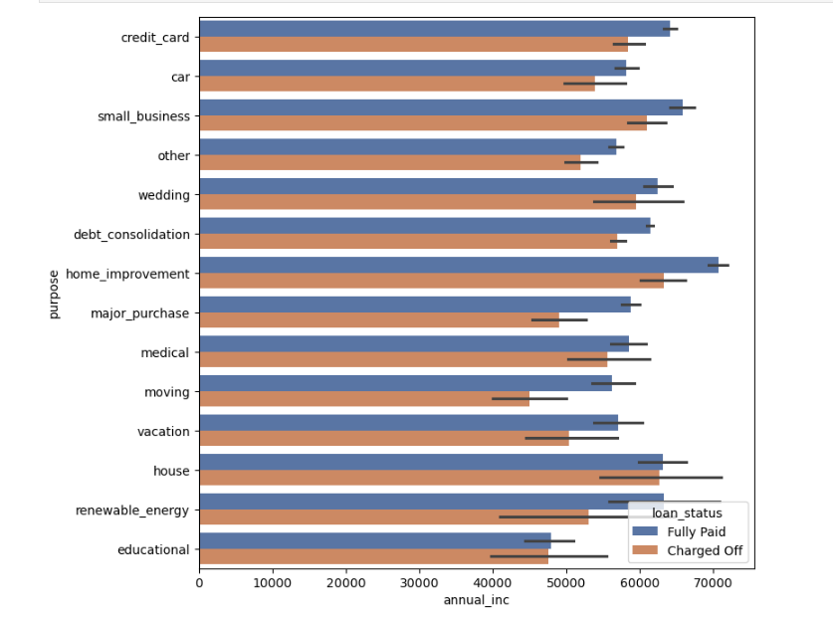
Bivariate Analysis-Annual income vs home ownership and Annual income vs loan purpose
Persons with mortage having the annual income of 60k to 70k has more possibility of defaulting
person who is taking loan for home improvement and if he has salary of 60k to 70k then he is likely to default

Slide 15
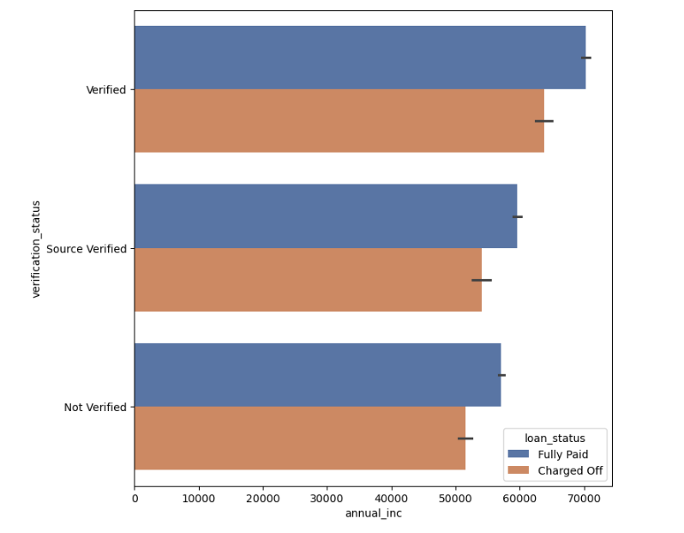
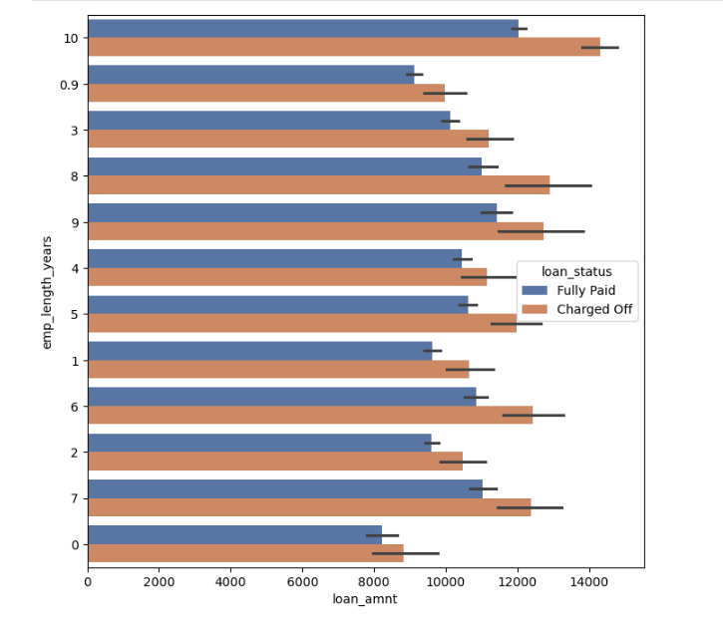
Bivariate Analysis-Annual income vs verification status and Loan amount vs employee length
person with verified status who is having the salary range from 65K to 70K is likely to default
Employee with equal to or more than 10 years of experience has high amount of loan approved and they have charged off more

Slide 16
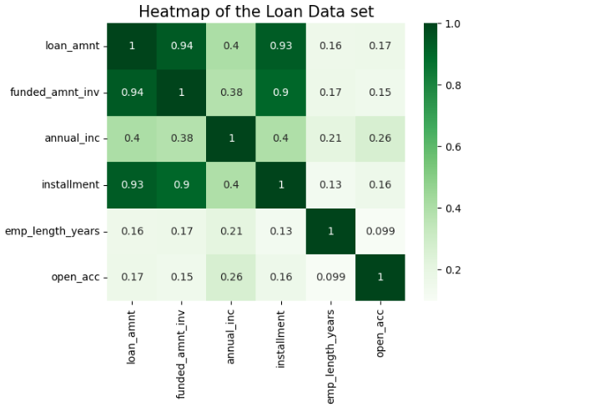
Multivariate Analysis
The multi variate analysis is carried on the below columns
Loan amount
Funded amount inv
Annual inc
Installment
Emp_length
Open_acc
The dark green colour indicates the positive correlation
between the columns
Positive corelation between the loan amount, funded amount and the installment is seen
Weak correlation is found on open account and employee length

Slide 17
Suggestions
The major driving factors which is used to predict the possibility of defaulting is below
Grades
Verification status
Annual income
Loan amount
State
Purpose of the loan
Employee experience
Implement Stricter check for Grade B,C,D employee : we should implement a stricter check or should implement an extra verification for applicants falling under B,C and D category to default minimal risk.

Slide 18
Suggestions
Focus more on subgrades B3,B4,B5,C1 and C2: Analysis shows the employee with this subgrade has more possibility of defaulting , lending club should consider additional risk mitigation measures
Interest Rate decrease for 60 months loan: lending club should consider decreasing the interest rate for the long term loans
Careful Evaluation for Debt Consolidation Loans: Carefully evaluate applicants seeking loan for the purpose of debt consolidation, considering potential interest rate adjustments or offering financial counseling services to manage the associated risks.
Consider home ownership: Home ownership should be considered as an potential factor for repaying the loan, the person who has own home has no need of rent, so the possibility of repayment of loan is high

Slide 19
Suggestions
Strict verification on city: A strict verification has to be conducted on the loan from city’s like CA,NY and FL cities
Thorough Assessment for High Loan Amounts: Conduct more thorough assessments for loan amounts between 8K to 13K. Consider capping loan amounts for higher-risk applicants to mitigate potential defaults
GitHub Repository Link:

