Slide 1

Stochastic Modeling & Calibration of Indian Equity Markets: From Classical SDEs to PINNs
27/11
MA-311
A Comparative Study using SDEs, PDEs, and Physics-Informed Neural Networks
Course Instructor:- Dr. Nitu Kumari
2025

Slide 2
Table of contents
01
Problem statement
04
Methodology
02
Objective
05
Results
03
Data Overview
06
Conclusions
MA-311
What’s the issue? Why we are working on it?
How we are approaching the solution?
What we are doing?
What we got? Why we got?
Which datasets are we using? Why using that?
Where are we? What can we do further? Can we improve it further?

Slide 3
01
Problem statement
27/11
MA-311
Classical Structure broken by Indian Equity Market
2025

Slide 4
Issues with Classical Models
27/11
MA-311
Classical GBM: Assumes Normal returns & constant volatility
Heston-FP: Adds some volatility but still risky assumptions
Indian Equity data shows:
Fat tails & excess kurtosis
Negative skewness
Volatility clustering
Frequent structural breaks
Leading major underestimation of risk
Indian Equity Market:
Complex
Non-linear
Regime-switching
GBM underestimates, bad risk management
We need to capture full probability distributions, not just returns

Slide 5
02
Work Objective
27/11
MA-311
What we did?
How we did?
2025

Slide 6
What We Did?
MA-311
01
02
03
04
GBM-1
Stochastic-2
Empirical-3
PINN-4
Test empirical validity of GBM
Stochastic volatility via Heston FP solver
KDE+Regimes+EVT for data-driven tail behaviour
Inverse-FP via PINNs to learn drift, diffusion, probability directly
Calibrate & show Gaussian assumptions fail
Model stochastic volatility, compute densities, realism with a FP solver
Advanced statistics* (KDE, EVT) to find the behavior without any assumptions
PINN discovers the underlying laws directly from data, Inv-FP
*Regime detection + Extreme Value Theory
Shift from parametric models to an data driven model that reveals complex regimes, tail risks, and non-linear dynamics of Indian equities

Slide 7
03
Dataset overview
27/11
MA-311
Main target market?
Companies Selected?
Why Selected?
2025

Slide 8
Data Characteristics
Entities
Sectors
Time period
Variables
Authenticity
Nifty-50
14 Large Caps
Banking, IT, Metals, FMCG, Energy
10 years, 2660 Days
Jan’2015 - Sept’2025
Price, Returns, Volatility
For Intraday too
Clean, Corporate-action adjusted dataset

Slide 9
04
Methodology
27/11
MA-311
What’s our way?
How it’s being done?
2025

Slide 10
Four-Phase Framework
1. Baseline Validation
3. Empirical Analysis
2. Stochastic Volatility
4. PINN(Inv-FP)
MA-311
a.Test GBM assumptions by MLE
b.Prove statistical Failures
a.Regime detection (PELT)
b.Model extreme tails (EVT)
c.Volatility-normalized KDE
d.Data Driven ground truth density
a.Add stochasticity in Heston
b.Solve 2D FP Equation
c.Full dist(VaR, ES, skew, tails)
a.Drift/Diffs directly from data
b.Embed FP PDE into training
c.Interpretable, non-parametric market dynamics
Simple -> Complex -> Data Driven -> PINN(Natural Learning)

Slide 11
04.1
Phase-1
27/11
MA-311
Geometric Brownian Motion !
2025

Slide 12
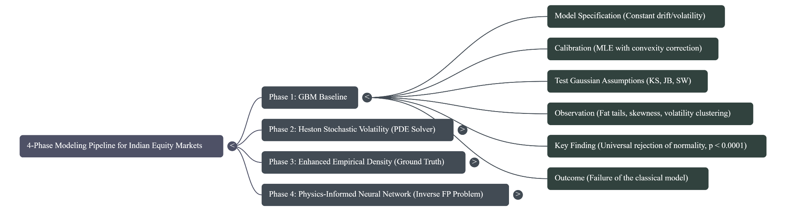
Full Phase-1 (GBM) Outline

Slide 13
Geometric Brownian Motion
Model Intro !
A classical stochastic model for asset prices
Eqn: dSₜ = μSₜdt + σSₜdWₜ
Assumes:
Constant Drift (μ)
Constant Volatility (σ)
Log-returns are normally distributed
Independent Increments
What we Did?
Calibrated (μ) and (σ) using MLE
Added Itô convexity correction for unbiased drift estimation
Prepared GBM-based price paths
Performed Statistical testing framework
Set this as the base for comparison
Conducted rolling-window out-of-sample forecasts

Slide 14
05.1
Results Phase-1
27/11
MA-311
Rejection !!
2025

Slide 15
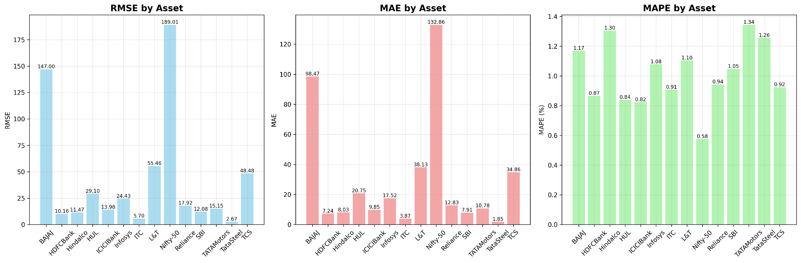
27/11
MA-311
Various Error terms in GBM
2025

Slide 16
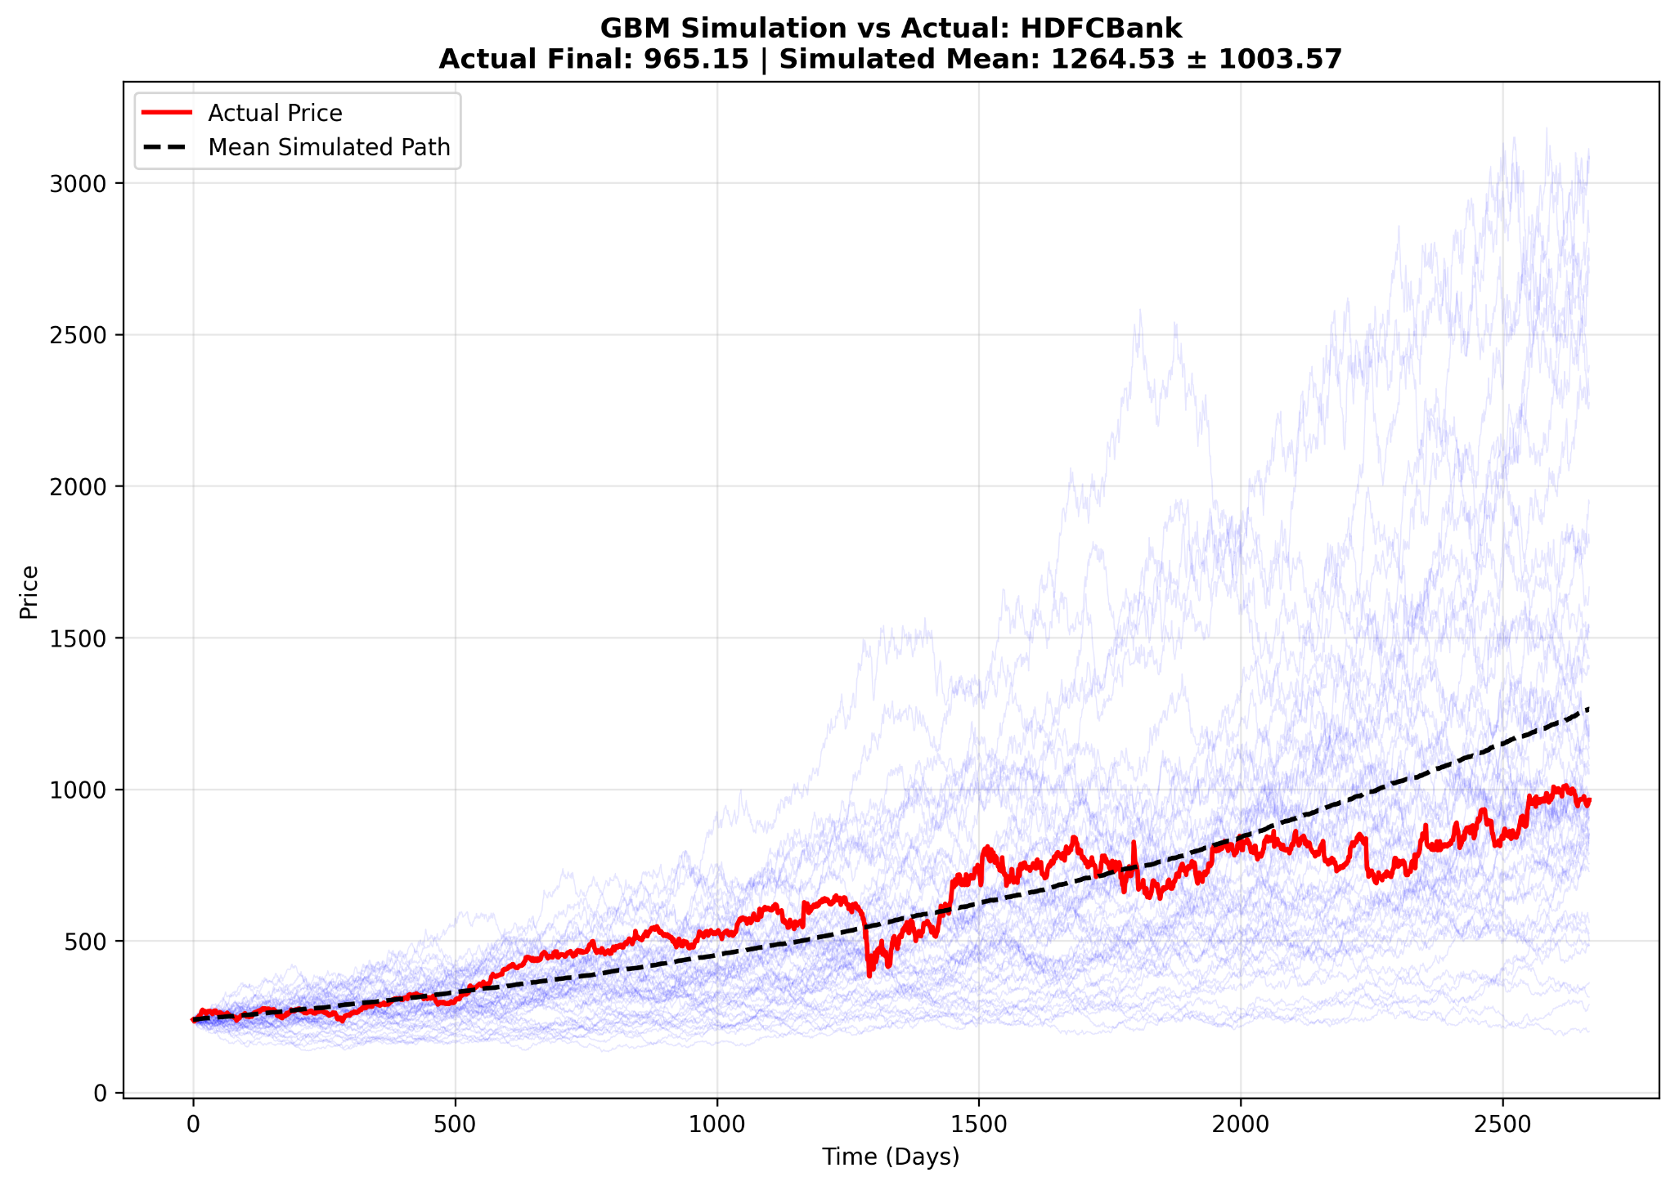
27/11
MA-311
HDFC Forecast by GBM
2025

Slide 17
Results*
Normality Rejection:
All assets failed statistical tests (p < 0.0001)
KS, Jarque–Bera, and Shapiro–Wilk tests
Nifty-50 p-value: 3.28 X 10⁻⁴¹
Non-Gaussian Chars:
Fat Tails: Excess Kurtosis ranged from 3.33 to 20.31
Asymmetric Risk: 11 of 14 stocks showed negative skewness
Poor Predictive Performance:
High Forecast Errors: MAPE from 4.17% to 34.59%
Volatility Correlation: Fails to capture real market dynamics
GBM, a clean theoretical baseline, but is empirically invalid for Indian equities – mandates advanced models
*Other Results on the Git

Slide 18
04.2
Phase-2
27/11
MA-311
Stochasticity
2025

Slide 19
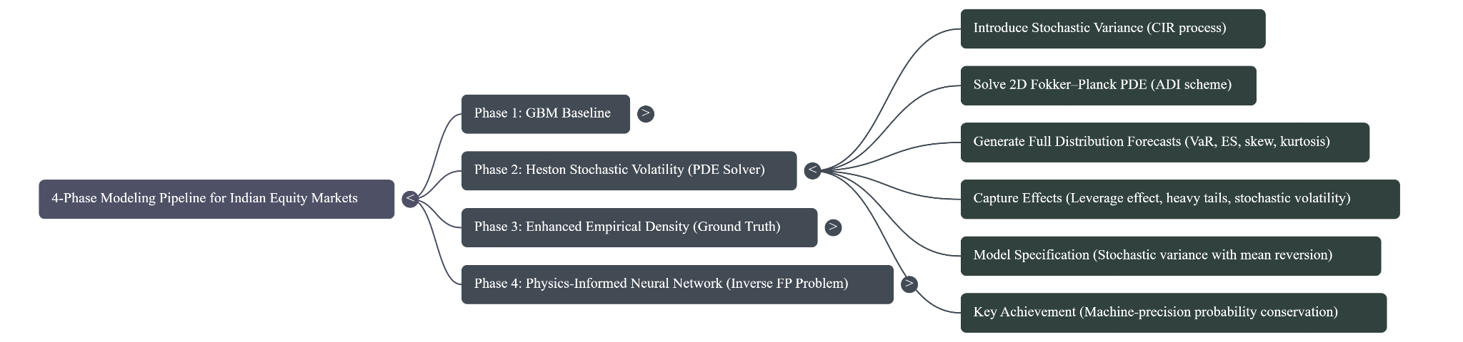
Phase-2 (Heston Stochastic) Outline

Slide 20
Heston Stochastic Volatility Model
Model Intro !
Extends GBM by making volatility stochastic, Other SDE for stochastic variance (vₜ) (CIR)
Coupled System:
dSₜ = μSₜdt + √vₜ Sₜ dWₛ
dvₜ = κ(θ − vₜ)dt + ξ√vₜ dWᵥ
Captures:
Volatility clustering and mean-reversion
Leverage effect (correlation between price & volatility shocks)
What we Did?
Set up the 2D Fokker–Planck PDE
Implemented a numerically stable ADI solver
Constructed price and variance grids for simulation
Used historical data to configure μ, θ, v₀ and so
Generated full future probability distributions, not just price paths

Slide 21
Expected Improvements*
Capture volatility smiles and leverage effects
Better tail-risk quantification (VaR, Expected Shortfall)
Handles clustering and regime shifts in volatility
Move from point-based modeling (GBM) to distribution-level modeling
More realistic representation of short-term and medium -term risk
*Wrt Phase-1

Slide 22
05.2
Results Phase-2
27/11
MA-311
Improvement against GBM but still we lag something
2025

Slide 23
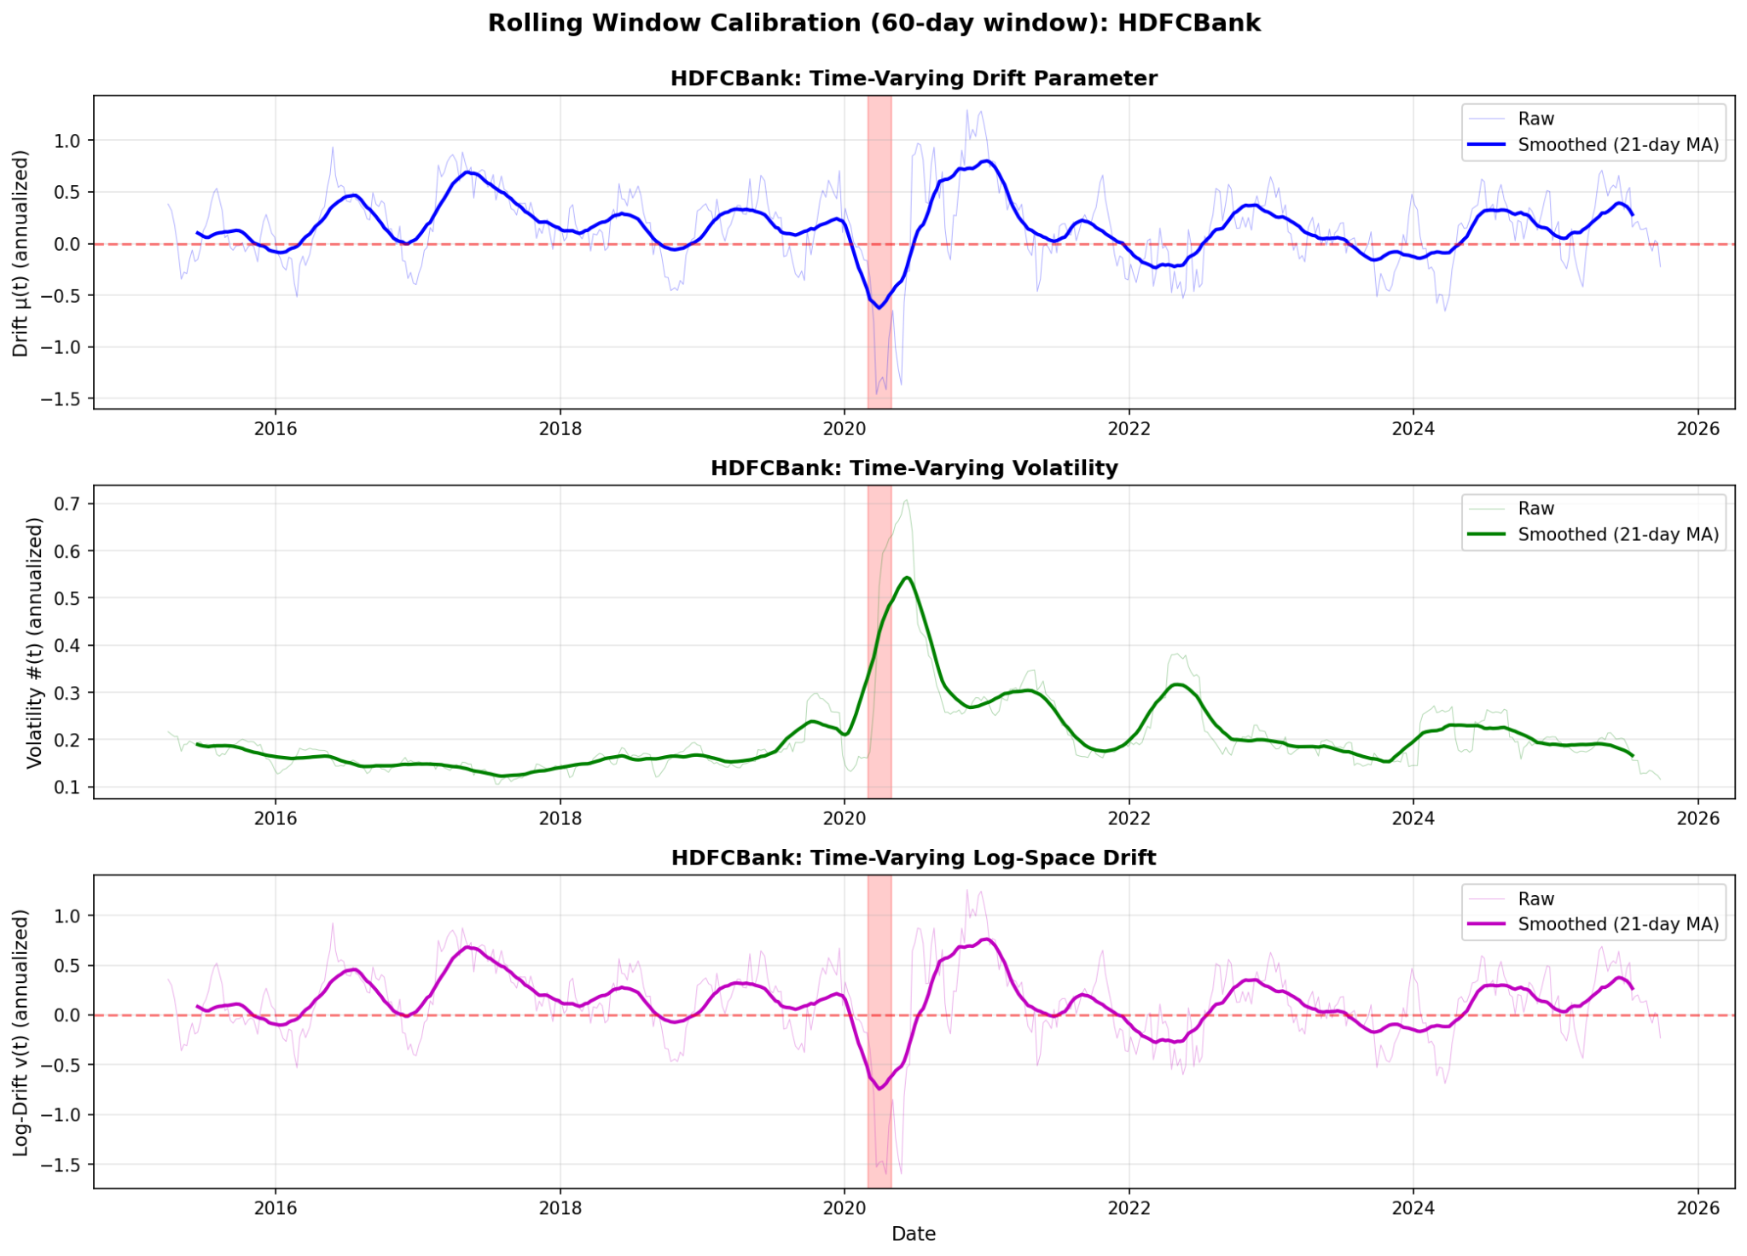
27/11
MA-311
HDFC Bank rolling window calibration
2025

Slide 24
Results*
Positive Results:
Machine-Precision Conservation: Probability error < 1e-11%
Better Risk Metrics: Realistic VaR & Expected Shortfall
Captured Leverage Effect: Negative correlation (ρ = -0.7) between price & volatility
Sector-Specific Patterns:
Metals: Right-skewed distributions (upside potential)
Banks: Left-skewed (crash risk)
Performance vs GBM:
Distributional forecasting vs point estimates
Time-varying volatility vs constant volatility
Realistic tail risk vs underestimated risk
Overcomes the major flaw by allowing volatility to move, producing distributions that better match empirical behavior but still not too better
*Other Results on the Git

Slide 25
What’s still missing?
Persistent Parametric Constraints:
Drift & diffusion follow rigid Heston forms; real markets are more complex.
Heuristic Calibration: Parameters (κ, ξ, ρ) not fully optimized from data.
Structural & Numerical Shortcomings:
No Regime-Awareness: Cannot adapt to different volatility regimes or structural breaks.
Incomplete Tail Behavior: EVT shows empirical tails are more extreme.
Theoretical Instability: Feller condition violated for 3 assets (e.g., Nifty-50).
High-Dimensional Bias: PDE solution depends on fixed grids, hiding finer structures.
Core Limitation:
Cannot discover market dynamics directly from data and Equations
Data-driven discovery without pre-specified models?
*Other Results on the Git

Slide 26
04.3
Phase-3
27/11
MA-311
Non-parametric Data Driven Approach
2025

Slide 27
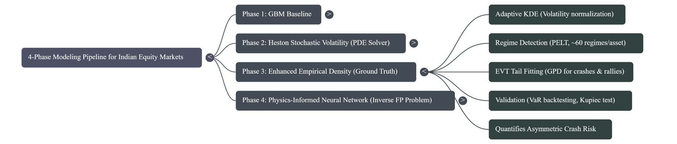
Phase-3 (Empirical Density Estimation) Outline

Slide 28
Empirical Density & Regime Modeling
What we mean?
Data-driven, non-parametric approach, of how markets behave
No SDE or Model structure
Extracting the probability distribution, regime changes, and tail behavior directly from return
Why we are doing?
Robust, model-free benchmark for market behavior, against which all parametric and AI models can be validated

Slide 29
How we are Doing?
Adaptive Kernel Density Estimation
Normalize returns using rolling realized volatility
Estimate smooth, data-driven densities
Capture distribution shapes independent of model assumptions
Regime Detection (PELT Algorithm)
Identify structural breaks in volatility and return dynamics
Discover market regimes (calm, turbulent, crisis, recovery)
Understand how distributions change across time segments
Extreme Value Theory for Tails
Fit Generalized Pareto Distributions to crash/rally extremes
Quantify true tail heaviness beyond Gaussian/Heston assumptions
Build model-free tail risk estimates
Establish “Ground Truth” Distributions
Combine KDE + Regimes + EVT
Produce high-fidelity empirical densities to benchmark Phase-2 and Phase-4
Provide reference distributions for validating PINN outputs

Slide 30
05.3
Results Phase-3
27/11
MA-311
Data validity for Validations
2025

Slide 31
What we Got till here?
Market Regime Analysis
~60 distinct regimes detected per asset (avg. 44 days/regime)
Identified: Calm periods, High-volatility bursts, Crash phases (COVID-19), Recovery cycles
Validated Risk Management
EVT-based VaR passes Kupiec backtesting
Superior to standard models that consistently underestimate tail risk
Systemic Risk Patterns
Correlation Clustering Spikes to 0.685 during crises (COVID-19)
Diversification Breakdown Lower tail dependence > Upper tail dependence
Distribution Characteristics
High-resolution empirical densities via volatility-normalized KDE
Universal Fat Tails All assets show positive tail shape parameters (ξ > 0)
Crash Dominance 11 of 14 stocks have heavier left tails (ξ_left vs ξ_right)

Slide 32
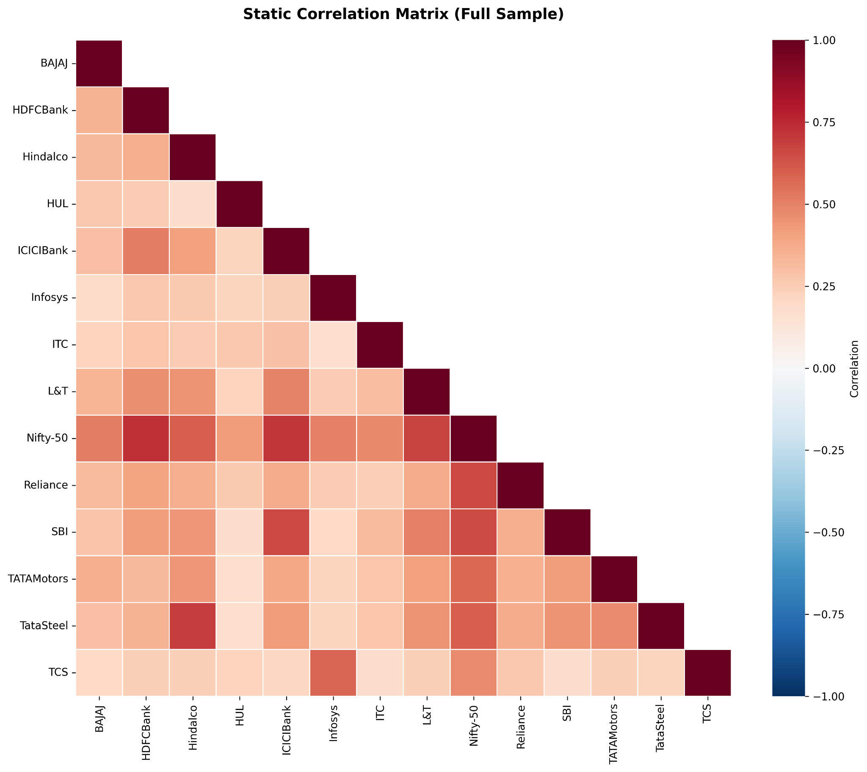
27/11
MA-311
Correlation between all assets
2025

Slide 33
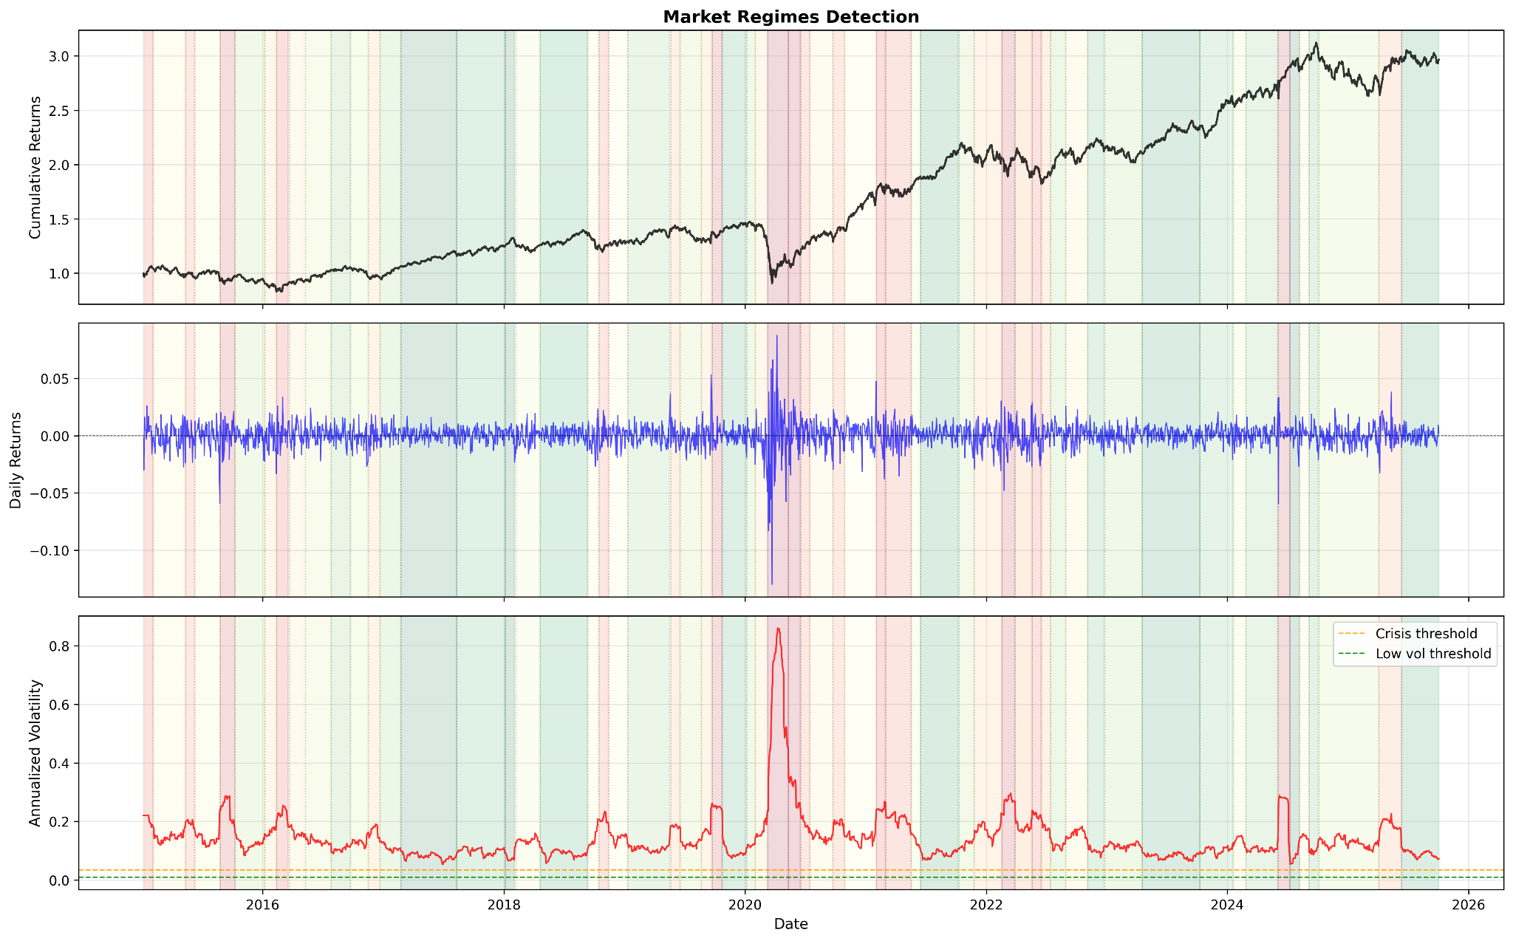
27/11
MA-311
Nifty-50 Regimes(61 for 43.7 days)
2025

Slide 34
Where are we still Lagging?
Purely Descriptive, Not Predictive
Excellent at describing what happened, but cannot forecast how distributions evolve
No Underlying Dynamics
Identifies regimes but provides no drift µ(x,t) or diffusion σ(x,t) function
Lacks the generative mechanism to produce observed dynamics
Limited Financial Applications
Cannot price derivatives (no continuous-time stochastic process)
No unified mapping between detected regimes and mathematical model
The "Why" Remains Unknown
We see the stylized facts, but not the fundamental mathematical laws causing them
Discovering the governing equations directly from data using PINNs?

Slide 35
04.4
Phase-4
27/11
MA-311
PINN !
2025

Slide 36
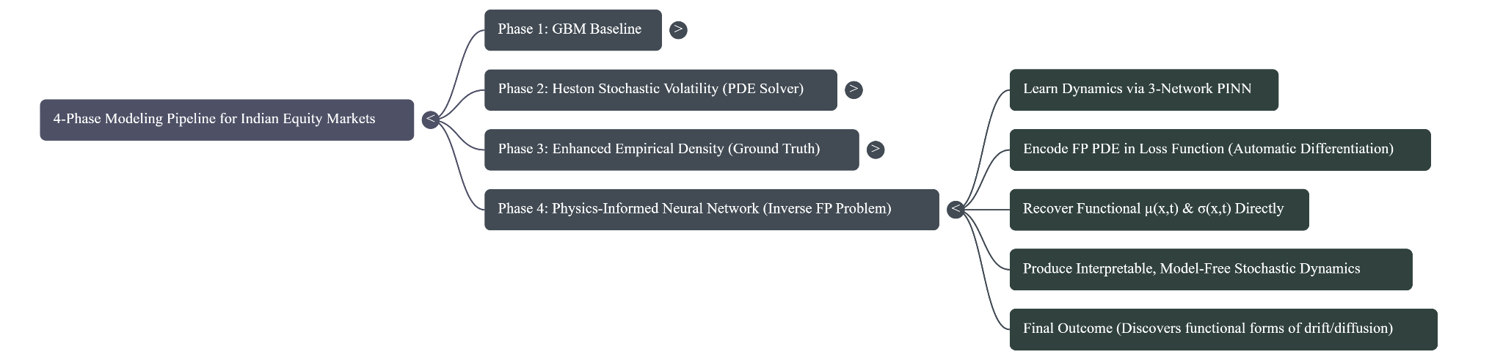
Phase-4 (PINN) Outline

Slide 37
What we are Doing?
1.Define PDE (FP)
∂p/∂t​​ + ∂​[a(x,t)p]/∂​x - ∂²​[b(x,t)p]/∂x²=0
2.Formulate the inverse problem
Inputs: empirical densities from Phase-3
Goal: discover drift (a(x,t)) and diffusion (b(x,t)) directly from data
Constraints: initial density, absorbing boundaries, normalization
3.Train a PINN with physics + data losses
PDE residual (physics)
CDF matching (data assimilation)
Boundary/initial conditions
Mean-reversion & volatility-smile constraints
Regularization + smoothness penalties
4.Output of the phase
A validated non-parametric model of drift and diffusion
A generative density model consistent with both data and PDE

Slide 38
PINN Architecture
1. Solution Network - (p(x,t))
Input: ([x, t])
Hidden layers: 4 × 256-unit layers
Output: predicted density (p), [10⁻⁸, 20]
Purpose: approximate the evolving probability density
2. Drift Network - (a(x,t,z))
Input: ([x, t, z₁…z₅])(multi-scale vol features: 20, 60, 90, 150, 240-day volatilities)
Hidden layers: 3 × 128-unit layers
Output: drift value, clamped to ([-20, 20])
Purpose: learn mean-reversion and nonlinear drift effects
3. Diffusion Network - (b(x,t,z))
Input: ([x, t, z₁…z₅])
Hidden layers: 3 × 128-unit layers
Output: diffusion/volatility, ([10⁻⁵, 2])
Purpose: learn volatility smiles, clustering, and leverage effects
Overall Architecture Summary
Total parameters: ~500k
Three coordinated networks: (p), (a), (b)
Auto Grad computes PDE residuals
Combined physics + data + financial priors ensure meaningful learning
Fourier feature encoding and Swish activation

Slide 39
05.4
Results Phase-4
27/11
MA-311
Are we Good now?
2025

Slide 40
Key Success
Fall Short
Functional Discovery: Learned drift a(x,t) and diffusion b(x,t) functions
Physics Consistency: PDE residuals minimized, probability conserved
Financial Patterns Found:
Mean reversion structure: `a(x) ≈ -λ·x` (λ = 0.4-1.8)
Volatility smiles: U-shaped patterns across returns
Sector insights: Banking (λ ≈ 0.15-0.25) vs Tech (weaker mean reversion)
Numerical Stability: No explosions despite complex training (PDF clamping effective)
Practical Risk Metrics: VaR/ES reasonably accurate for risk applications
Poor Density Match: Correlation 0.37-0.67 (Target: >0.95)
Statistical Test Failures: KS/AD tests reject distribution equality
Inconsistent Functions: Mean reversion strength varies; volatility structure sometimes inverted
Physics-Data Trade-off: Strong PDE enforcement hurts data fit, and vice versa
Limited Generalization: Some assets show anti-correlated densities (-0.35)

Slide 41
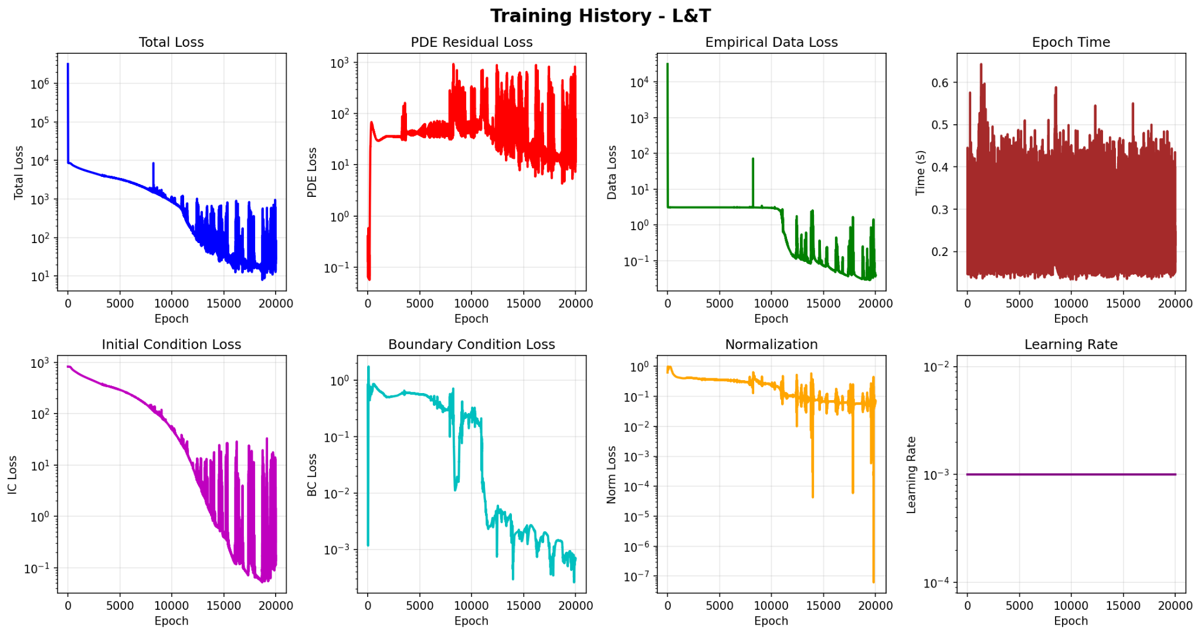
27/11
MA-311
PINN Training Losses
2025

Slide 42
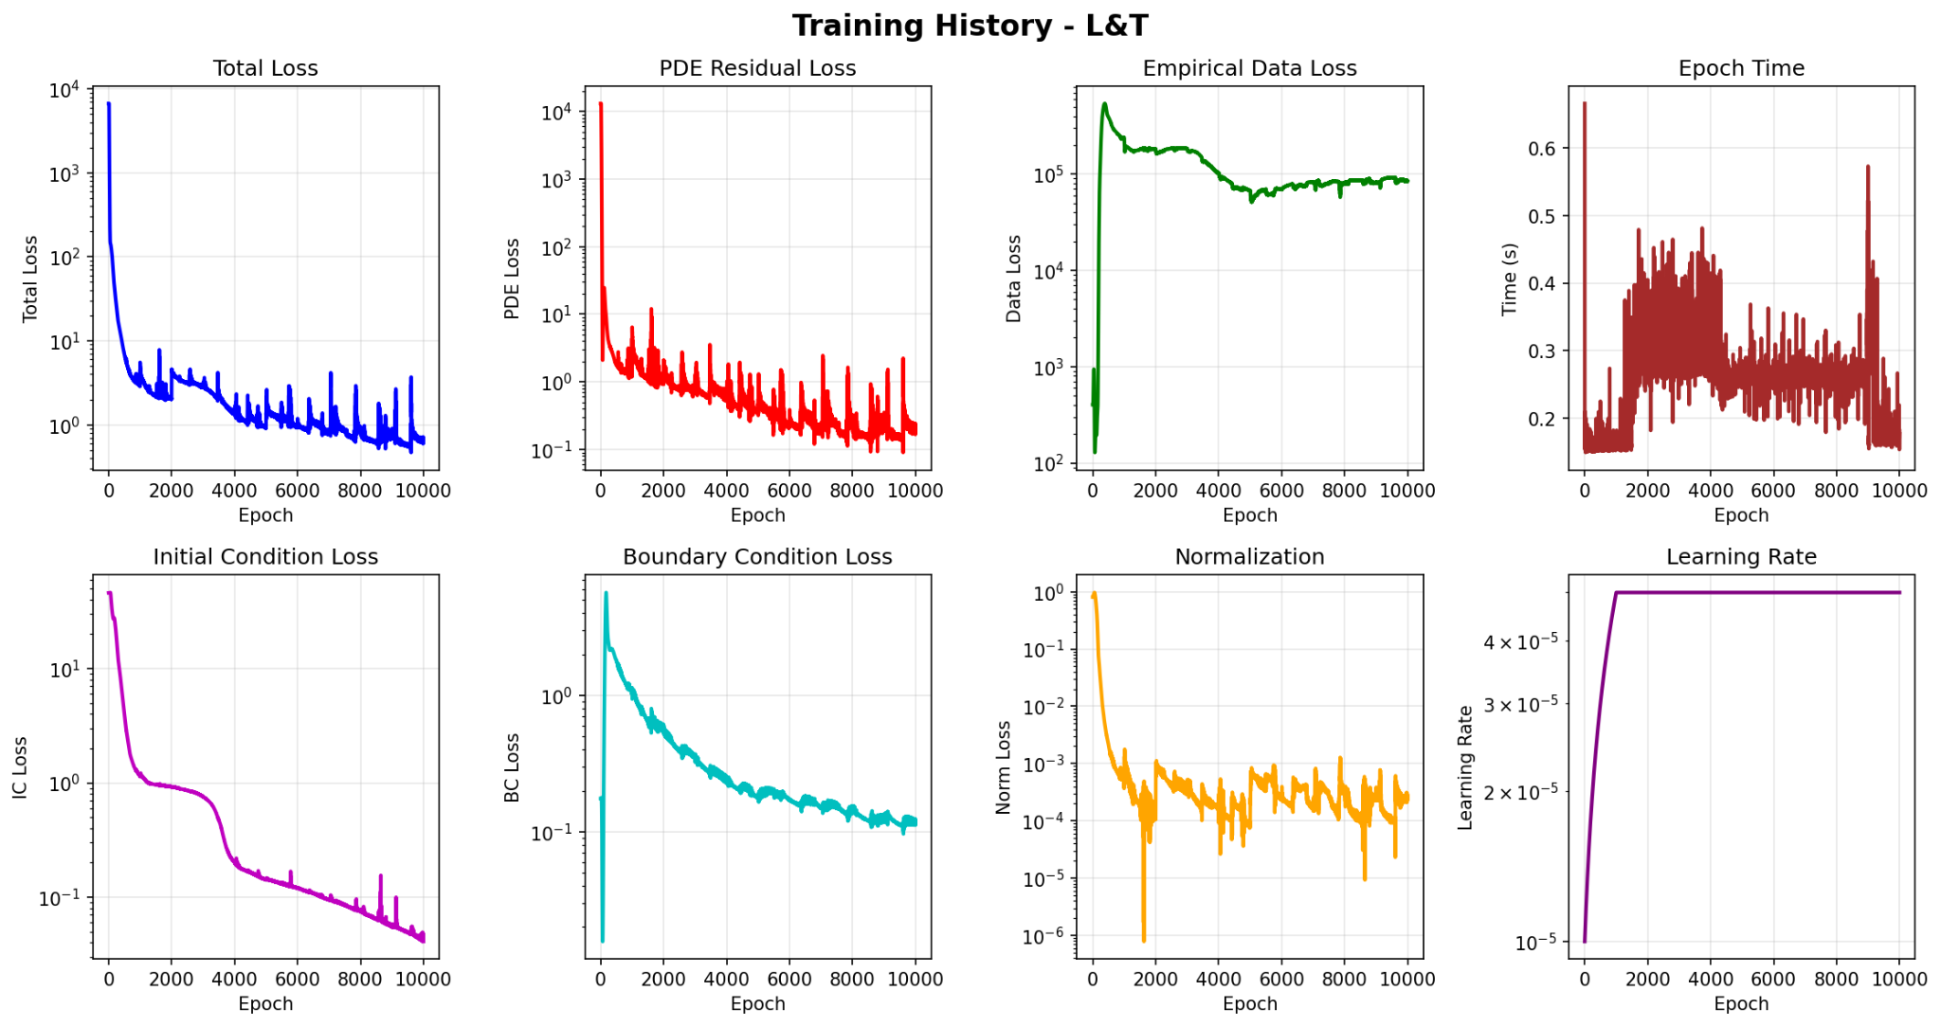
27/11
MA-311
Improved PINN Training Losses
2025

Slide 43
Why we still Lag?
1.Computational Bottlenecks
3-4 hours/stock on GPU - limits experimentation
Constant monitoring required to prevent silent failures
No recovery from mid-training errors → hours wasted
2.Architectural Gaps
MLPs instead of LSTMs/Transformers - misses temporal patterns
No attention mechanisms - cannot focus on crisis periods
Rigid constraints - mean reversion enforcement limits flexibility
3.Optimization Challenges
10+ loss terms - extremely difficult to balance
PDF clamping - prevents explosions but caps tail accuracy
Physics-Data trade-off - can't optimize both perfectly
4.Missed Opportunities
No LLM integration for market context & regime priors
No transfer learning between similar assets
No meta-learning for faster convergence

Slide 44
06
Conclusion-Future work
27/11
MA-311
We can still improve it …
2025

Slide 45
Conclusion
1.What We Built:
4-Phase Pipeline: GBM → Heston → Empirical → PINN
Progressive Improvement: Each phase addresses previous limitations
Unified Framework: Connects classical finance, empirical stats, and AI
2.Impact: Bridges mathematical rigor with data-driven flexibility for:
Advanced risk management
Derivatives pricing
Regime-adaptive strategies
3.Key Insights Discovered:
Indian Markets are Complex: Heavy-tailed, regime-dependent (~60 phases), non-Gaussian
Distributional Thinking Wins: Point estimates insufficient for real risk management
Physics-Informed AI Works: Successfully discovered interpretable drift/diffusion functions
4.The Fundamental Trade-off:
Achieved: Physical consistency, interpretability, stable training
Sacrificed: Some predictive accuracy on density matching

Slide 46
Future Works
1.Architecture & Intelligence
LSTM/Transformer Integration: Temporal
LLM-Powered Priors: Market context and Regime
Hybrid PINN+FNO: Faster PDE solving
Relaxed Constraints: Physics vs data
2.Computational Scaling
Multi-GPU Training: Reduce runtime
Checkpoint Safety: Prevent mid-run losses
Distributed Learning: Train across multiple assets
Efficient Sampling: Smart collocation points
3.Advanced Modeling
Multi-Asset PINNs: Correlated systems with coupled FP equations
Jump-Diffusion Extensions: Capture discontinuities
Regime-Switching PINNs: Distinct models for bull/bear markets
Bayesian Uncertainty: Credible intervals for risk measures
4.Real-World Applications
If you know, you know !!

Slide 47
Thanks !
27/11
MA-311
All the related works, code, plots, sources can be found on GIT
Open to Questions?
2025

