Slide 1


PLEDGE TO PROGRESS Sustainability Hackathon
Sponsored By
Team Name : eduOnlineSystems
team bio : Team comprises of 5 members working in IT specialized in IT software development , testing and supporting business applications.
Date : 4/29/2023

Slide 2
Problem Statement?
Education is the foundation in eradicating poverty and imparting social equality. Digital E-learning provides learners to acccess online learning content with accessbility and affordability. A systematic approach to learning will help the learners to get skills that are required for personal development , regional development and become employable. Multilingual language supports learners to learn in native languages and the ability to think clearly. Video, audio, diagrams are available for cognitive learning. Contents are uploaded as per requriements and approved by authorized faculty. Exam module validates the learners knowlege and helps them get certified. Leaderboard enables the learners to be competitative and motivating them to achieve more.

Slide 3
User Segment & Pain Points
Rural students from schools, working professionals, continuous learners are the immediate users of the application. E-learning provides a learning environment that is accessible immediately and provides cognitive learning. Mobile devices provide anytime and anywhere education. Provision for learners with disability will be included. Multi-lingual content development and faculty/teacher support for the contents target students in multiple regions of India and the World and even in remote places where content can be downloaded and used offline when needed in areas with low Internet services. Content will be available online 24/7 and be a repository for teaching and content authoring. Content review workflow will be an important part of this application. The Expert panel can review the content even sitting from the opposite end of the world. For example, teaching/creating/reviewing English could be done by professors willing to contribute time from UK as well.
Rural students, poor students, regional village students will definitely benefit from this platform.
Being fully digital makes it environment friendly and sustainable.

Slide 4
Pre-Requisite
Google classroom, content learning with various learning providers are the alternatives. EduOnlineSystems application runs on all the browsers.

Slide 5
Tools or resources
Azure native development for UI, API, Databases.
Tools/Technologies: Visual studio Code, Angular, .Net, Java, Azure, Reporting, AI/ML, ChatGPT, C#, Python, Jhipster, github, Chatbot, AI, ML

Slide 6
Functional Features - Overview
Agile based development
Azure cloud hosted application to support non functional requirements
Microservice architecture for API development
Three layered architecture with User Interface, Middler Layer and Data layer in cloud
Client focussed archecture with shared resources and data isolation and data protection.
Modules seperated for client admin, expert faculty, end users.
Admin facility for client admin to set contents, questions and get approval for content.
Multi lingual content supporting regional languages
Modules support for learning with content aggregators with module, units, sections, exercises,
Exam modules for specialised skills and reports supporting the learning results.
Leaderboard and reports showcasing the learners activity and interests.
Scalability, security, performance, availability design with azure infrastructcure and services.

Slide 7
Key Differentiators & Adoption Plan
Online Edu Systems is a online learning portal availble in cloud and available 24/7. The application supports mobile devices and multi-lungual support. Cognitive learning is provided with video, audio, diagrams supports. The courses will have systematic ways of learning and the best practices of Instructional Design. Collaborative learning and the ability to discuss and learn topics not only from the Instructor but also from each other in moderated forums will be provided. Each learning modules will have submodules, units, sections and exercises. The exam module provides the testing services to validate the learning and certify them. Leader board provides ai/ml features to categorise learners and motivate the learners. Admin will add content and expert faculty will approve the content for learners.

Slide 8
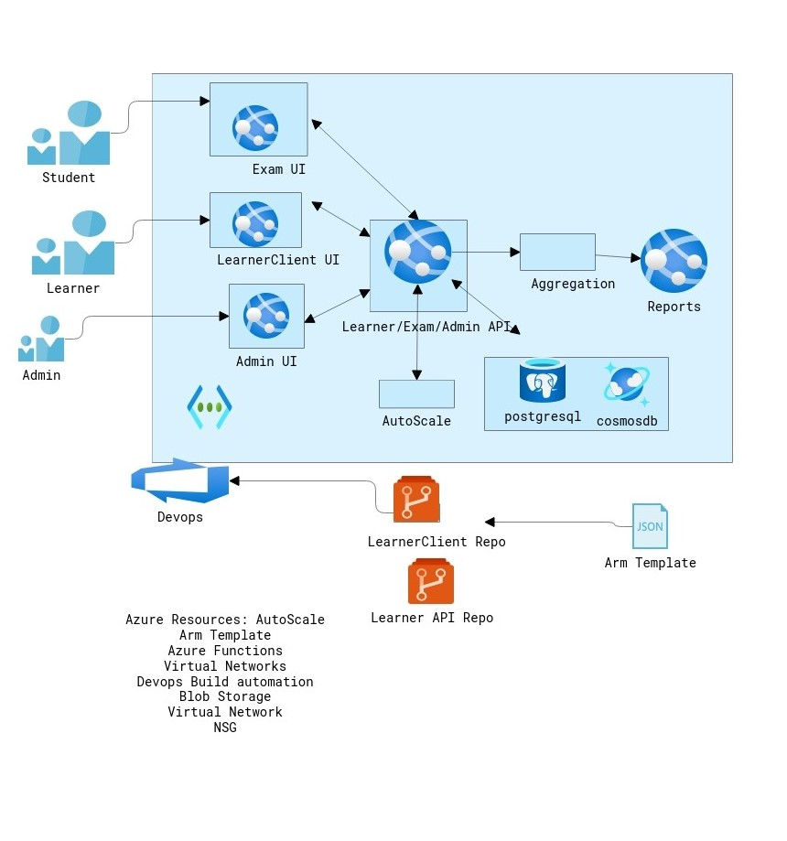
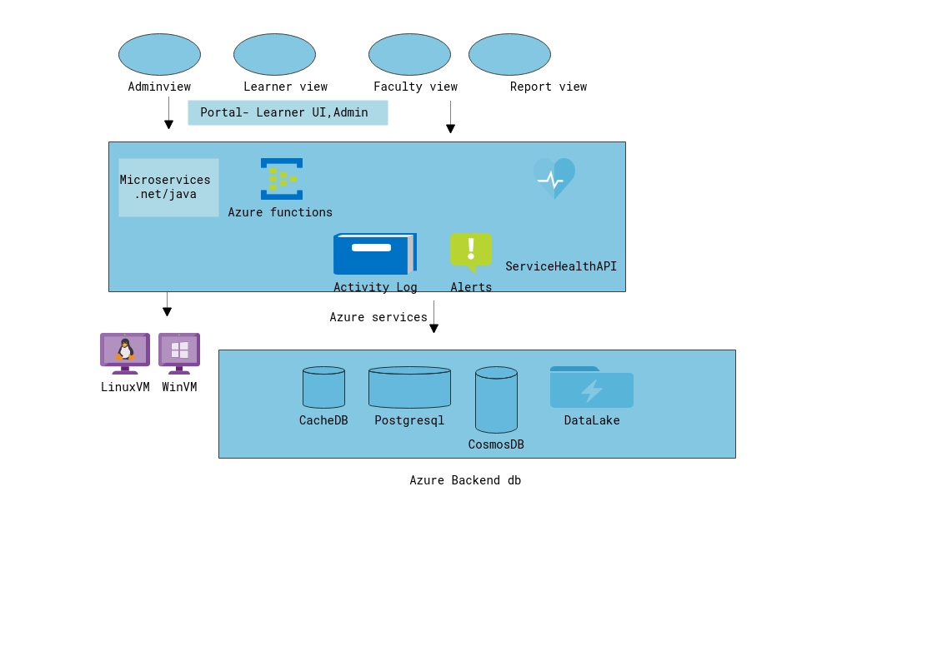
Application Cloud View
Solution architecture
Application Tech overview

Slide 9
Our USP - what differentiates us
We will use Microsoft ChatGPT API extensively within the application
For helping course creation and Content summarization :
For example a provision will be provided for the Content creator to upload his or curated content to Chat GPT get feedback, and then review it and also pass it via the configurable workflow to authorized reviewers.
Content translation to traditional languages etc. :
Most of the best works of teaching would be in English therefore we would use Chat GPT for automatic translation services.
Generate questions from Course Content provided:
We would provide Teachers a User Interface to provide content to ChatGPT and request ChatGPT to generate a set of questions and answers that they can then validate and then submit it for review.
ALL CONTENT generated by Chat GPT WILL go through a Review Workflow by authorized domain experts before it gets approved within the Teaching Application.

Slide 10
Architectural framework for an educational platform using Azure platform and ChatGPT API:
User Interface Layer: The user interface layer will be responsible for rendering the web pages and user interfaces for the educational platform. It will be built using Azure App Service, which is a fully managed platform for building, deploying, and scaling web apps.
Authentication and Authorization: Azure Active Directory will be used to authenticate and authorize users of the educational platform. This provides a secure and reliable way to manage user identities and access to resources.
Chat GPT Integration: ChatGPT API will be integrated with the platform to provide a conversational interface for students and teachers. This will allow users to ask questions, get help with assignments, and engage in natural language conversations.
Content Management and Delivery: Azure Blob Storage will be used to store educational content such as videos, documents, and images. This will provide a reliable and scalable way to manage and deliver content to users.
Analytics and Reporting: Azure Stream Analytics will be used to collect and analyze data about user behavior and engagement with the platform. This data will be used to improve the platform and provide insights to teachers and administrators.
Integration with Learning Management Systems: The educational platform will be integrated with popular learning management systems such as Moodle or Blackboard. This will allow teachers to easily import and export course materials and assignments.
Overall, this architecture provides a secure, scalable, and reliable platform for delivering educational content and engaging with students and teachers through natural language conversations using ChatGPT API.

Slide 11
Use Cases of Current Rural Development Programmes that would definitely benefit from a fully Online and Offline Platform
A non-profit organization that focuses on providing education and training to rural communities, particularly women, in order to promote sustainable development. They can offer programs in areas such as solar engineering, water management, and healthcare, and students learn through a combination of classroom instruction and hands-on experience facilitated by the collaborative platform.
Programs developed to help farmers in rural areas improve their agricultural practices and increase their yields. The program is based on a participatory learning approach, in which farmers work together to share knowledge and experience, and learn from each other and from expert trainers. The program has been successful in improving crop yields and income for participating farmers.
Programs that bring science education to rural communities by providing a mobile laboratory that travels from village to village. The laboratory is equipped with basic science equipment and materials, and trained facilitators conduct hands-on experiments and activities with students. The online platform would assist teachers.
A Rural Livelihoods and Climate Change Adaptation program: This program focuses on building the resilience of rural communities to the impacts of climate change. The program provides training in sustainable agriculture, natural resource management, and climate-resilient livelihoods, and also helps communities develop adaptation plans and strategies. The program has been successful in improving food security and livelihoods for participating communities. Again the online platform would assist greatly in this endeavour.
A program that aims to improve access to healthcare in rural communities by training community health workers and providing them with basic medical equipment and supplies. The program also focuses on promoting preventive healthcare and behavior change, and has been successful in reducing child mortality and improving health outcomes for participating communities. Mobile and easy accessible teaching program would really help in rural health care awareness.

Slide 12
Functional view
Main
| Online Learner Portal | | | Teacher Portal | | | Content Authoring/Validation Portal | | | Administrator Portal
Online Learner Portal (Mobile Included)
| Learner | Course, Module, Units, | | | sections, exercises, Forums | | Exam | Multiple choice, Subjective, | | | Drag and drop, time-based | | | exams, certificates, badges | | Leaderboard| Team-wise, class-wise, | | | industry-wise |
Learner Dashboard
| Courses in progress| | | Tests completed |
Teacher Portal
Administer Courses and timings | | | Manage Students | | | Administer Tests and marks | | | Subjects and Groups | | | Reports
Content Authoring/Validation Portal
| Content Creation | | | Content Validation | | | Workflow Management | | | Chat GPT API Integration | | | Business Rules |
Administrator Portal
| User Management | | | Manage the Application

Slide 13
Functional components
Main Module
Admin Portal
Master data UI
Online Learner Portal
End User UI , API
Sub Module
Learner
Course, Module, Units, sections, exercises , Forums,
Exam
Multiple choice, Subjective,
Drag and drop, time-based exams
certificates, badges
Leaderboard
team wise board, class wise board, industry wise board
Learner dashboard
courses in progress, tests complete
Reports
Test marks
Reports on subject group wise
Admin & Settings
Content approval
Business Rules
Will use Microsoft ChatGPT API extensively within the application for helping course creation, content summarization, content translation to traditional languages etc. For example, a provision will be provided for the Content creator to upload his or curated content to Chat GPT get feedback, and then review it and also pass it via the configurable workflow to authorized reviewers.

Slide 14
Functional design
Functional Module / Components | Technical Evaluation/Design considerations | Remarks/Actions
Study Editor mode (admin) Display mode (learner) API/Microservices Forum Private Public | Course-> Subject -> Module -> Unit -> Section -> Learning object Video, Audio, Image storage Storage Database storage | Chatgpt api integration for admin Content in db as json data and references to content and links to images Azure storage for video, images, audio Content in cosmos dB Exams assessment in PostgreSQL db analytics Api Services: open source JHipster Database : PostgreSQL , Cosmos dB Chatbot , AI, ML
Exam Mode Editor (admin) Practice mode (learner) Exam mode (learner) API/Microservices | Exam Scenario ->Questions Set Questionnaire Display exam | Chatgpt api integration for admin Content taken from databases Api Services: open source JHipster Chatbot , AI, ML
Leaderboard Admin Learner | Display learners in proficiency Use AI/ML is get leaderboard details using statistics, industry data, chatgpt | Use: Statistics, AI/ML , Chatgpt Api Services: open source JHipster Excel output and integrate with leaderboard.
Reports | Exam reports Course completions | Use: Angular reports
Dashboard | Courses completed Tests completed Badges | Interests topics/courses display.
Admin | Exam settings Courses settings User settings

Slide 15
Non-Functional design
Non-Functional Requirements | Technical consideration | Remarks/Actions
Performance | Retrieval of data and display with a 3 seconds of time | User data segmentation, distribution of user data
Security | Secure login to application. API secure for anonymous Active Directory for access, auth | Social login/OpenID/OAuth provider for authentication Azure active directory for authorization Client maintains their data in the shared db for common functionality. Client maintains either separate or common db with secured db
Scalability | Distribution of data | NoSQL
Accessibility, Navigations | User Interfaces for Admin editor, learner navigation Mobile view | Bootstrap, Html ,Angular
Availability | Available for data anytime, anywhere | Course/Exam content data is available in the NoSQL db Tests data is available in the SQL db Analytics user data is available in the SQL db Use: Cosmos dB, PostgreSQL, cache, Redis
Globalization and Localization | Multilingual support of content Content to be saved in db. | Language translation services

Slide 16
Use cases Scenarios view
The following are use cases scenarios to consider in the Happy path flow of the Application flow.
As a Admin user, need to create course, exam, learner master data
As a faculty user, need to approve the content from the admin.
As a learner, need to view the course , enroll the course and learn the modules
As a learner, need to view the exam and get assess in the exams.
As a learner, need to view the leaderboard.
As a learner, need to view the reports
As a faculty, need to view the reports.
As a admin user, need to view the admin setting for the client and change it.
As a learner , need to view the content in the language of preference.
As a learner, need to view the exam in the language of preference.
Note: The intention will be to provide the minimum viable product features in the initial phases.

Slide 17
GitHub Repository Link & supporting diagrams, screenshots, if any
https://github.com/rajmanic15/sustainability-hackathon
https://salmon-glacier-0882e7810.3.azurestaticapps.net/
https://docs.google.com/spreadsheets/d/17BUlSRZEn0qdPFxkfAm21QzkCruflNLISYLmYAmu9lY/edit#gid=0

Slide 18
Thank You
Rajamanickam T https://www.linkedin.com/in/rajamanickamt/
Avinash Singh https://www.linkedin.com/in/avisatna
Sivaprasad R https://www.linkedin.com/in/siva-prasad-2b03138b
Pramod Koshy https://www.linkedin.com/in/Pramod-koshy
Abhishek Kumar Singh

