Slide 1

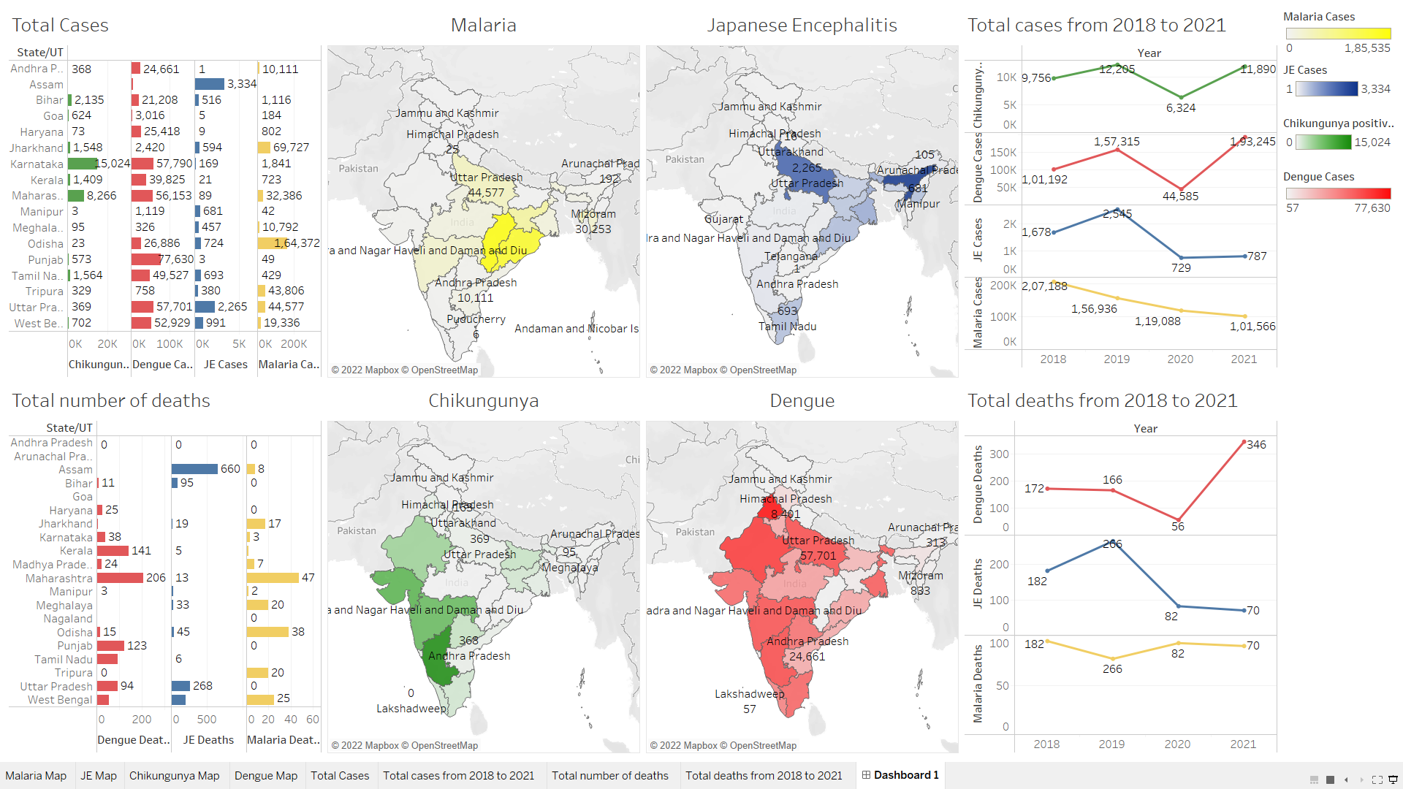
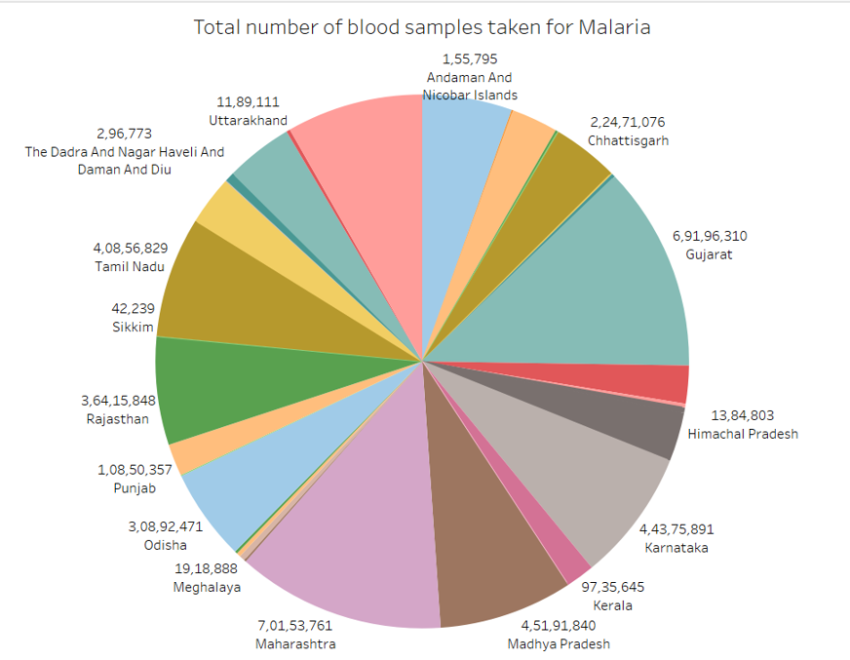
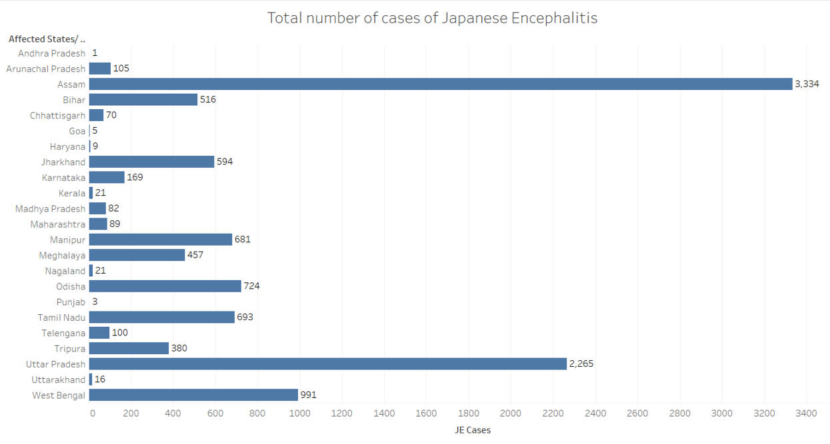
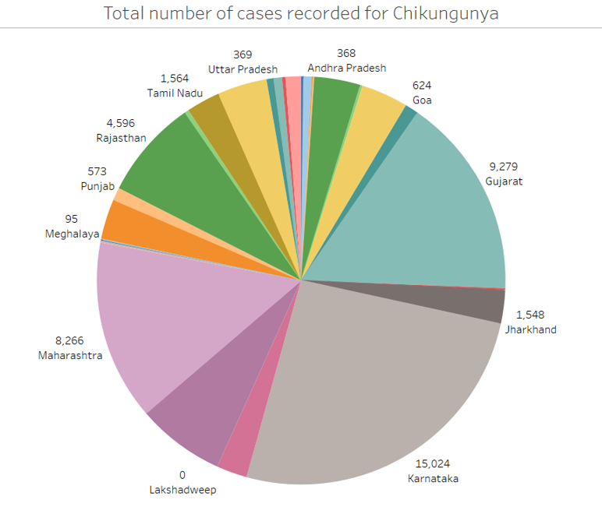
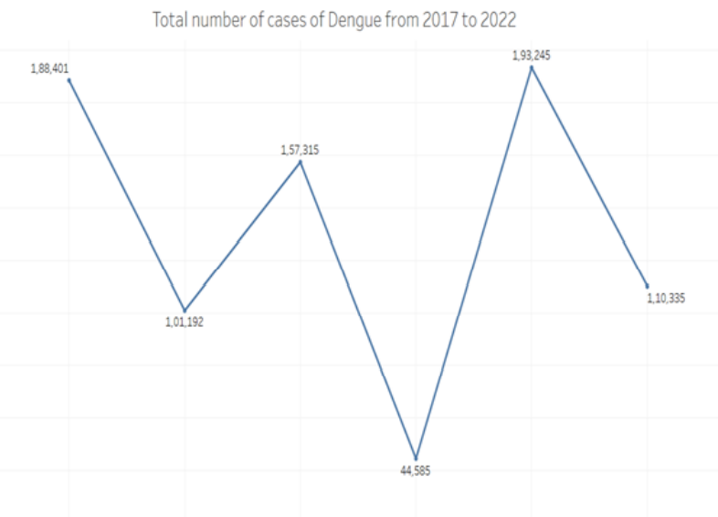
Analysis of Vector Borne Diseases and Curability Facilities Across India
OBJECTIVE
INTRODUCTION
DASHBOARD
Total no. of blood samples taken for malaria
The objective of this project is to visualize the number of samples collected, number of cases and number of deaths due to various vector borne diseases across India.
For this project we have plotted the data using parameters like:
Year-wise distribution of patients
State wise distribution.
The Vector - Borne Diseases (VBDS) are a group of communicable diseases transmitted by mosquitoes and other vectors. People suffer from a significant disease burden from these diseases in local and focal areas of India, which is reflected in the form of morbidity and mortality from Malaria, Dengue, Chikungunya, Japanese Encephalitis (JE).
Total no. of cases recorded for Japanese Encephalitis
METHODOLOGY
Our dataset consists of data collected from government sources which contains details about Vector- Borne diseases like Malaria, Dengue, Chikungunya and Japanese Encephalitis.
The data has various attributes like total number of cases of that disease, number of samples collected, number of positive cases, number of deaths and the year in which it was reported.
The first step is to clean the data. It involves adding relevant and removing irrelevant rows and columns, removing null values, etc.
Using tableau, we will plot this data and find the relationship between these attributes.
GROUP MEMBERS
Manas Shukla | 20MIM10003
Mudita Singh | 20MIM10024
Chetan Garg | 20MIM10146
Raj Mansuriya | 20MIM10147
CONCLUSION
Total no. of cases recorded for Chikungunya
Trend of cases of Dengue from 2017 to 2022
DISEASE | Most Affected State | Least Affected State
Malaria | Chhattisgarh | Sikkim
Japanese Encephalitis | Assam | Andhra Pradesh
Dengue | Punjab | Arunachal Pradesh
Chikungunya | Karnataka | Manipur
Guided by:- Dr. Ankur Jain

