Slide 1

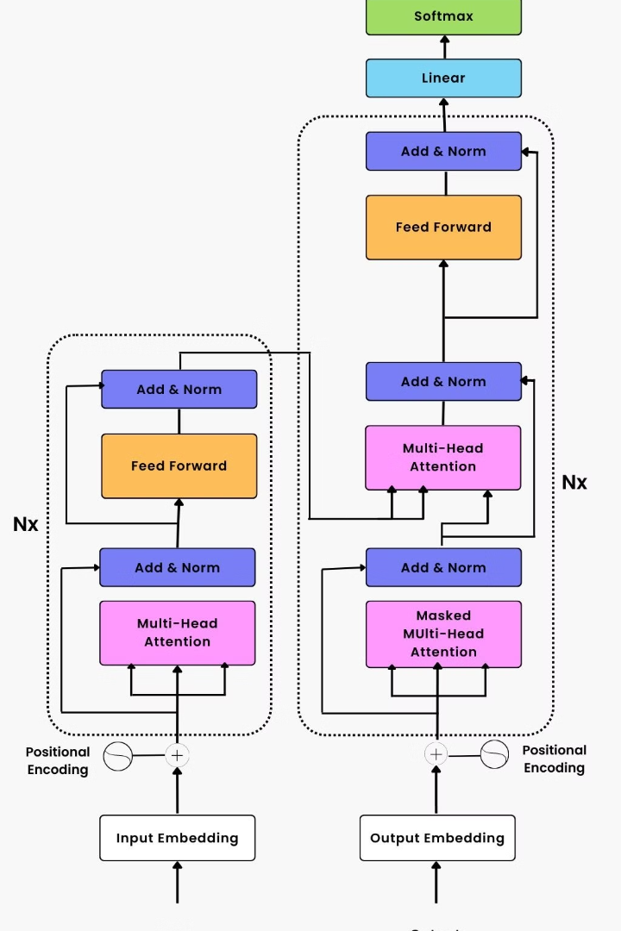


Understanding Transformer Architecture
An in depth explanation of the Transformer architecture, its components, math behind it, and a simplified approach
by Raj matam

Slide 2

Introduction to Transformer architecture
Definition
Importance & Applications
Components Overview
The Transformer architecture is a deep learning model that revolutionized natural language processing tasks.
The architecture consists of self attention mechanisms, positional encodings, and feed forward neural networks.
The Transformer architecture is widely used in machine translation, text summarization, and speech recognition.

Slide 3

Flowchart of Transformer architecture
1
Step 1: Input Embeddings
Convert the input sequence into a continuous vector representation.
2
Step 2: : Encoding of Positions
Add positional encodings to maintain word order information.
3
Step 3: Self Attention Mechanism
Compute attention weights to capture the dependencies between words.

Slide 4
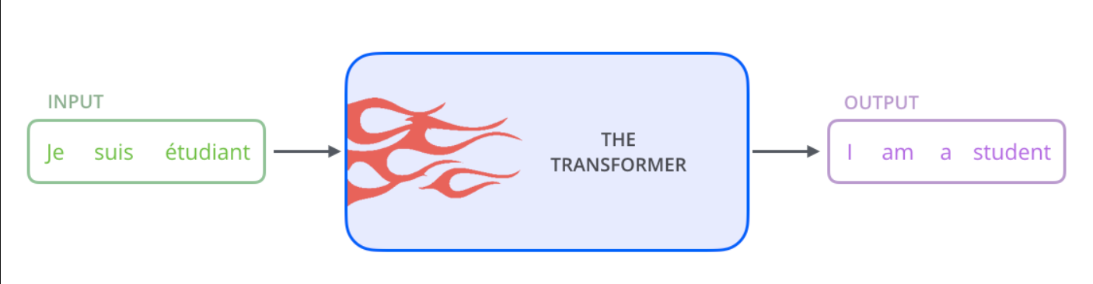
Let’s begin by looking at the model as a single black box. In a machine translation application, it would take a sentence in one language, and output its translation in another.

Slide 5
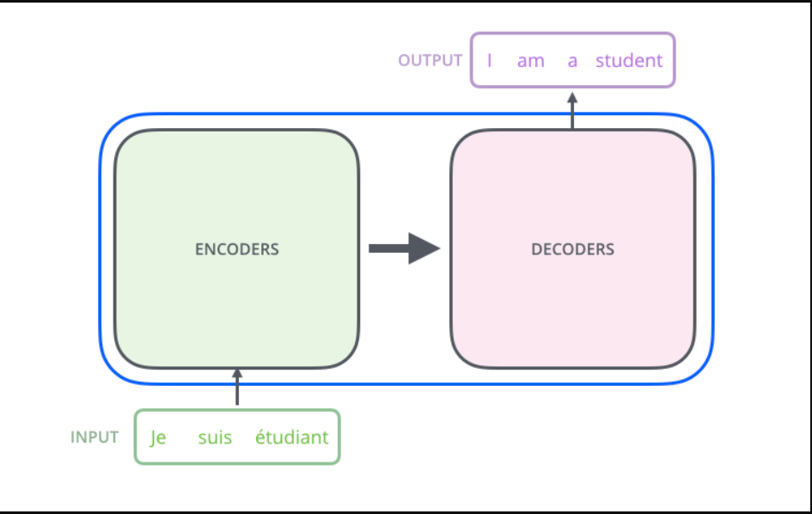
Popping open that Optimus Prime goodness, we see an encoding component, a decoding component, and connections between them..
The encoding component is a stack of encoders (the paper stacks six of them on top of each other – there’s nothing magical about the number six, one can definitely experiment with other arrangements). The decoding component is a stack of decoders of the same number.

Slide 6
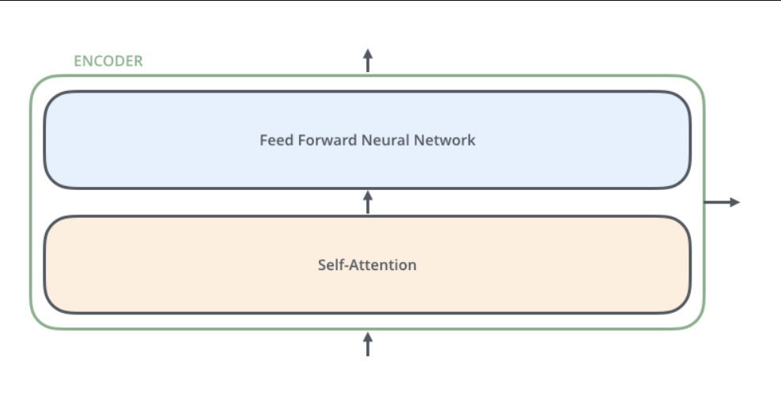
The encoders are all identical in structure (yet they do not share weights). Each one is broken down into two sub layers:.

Slide 7
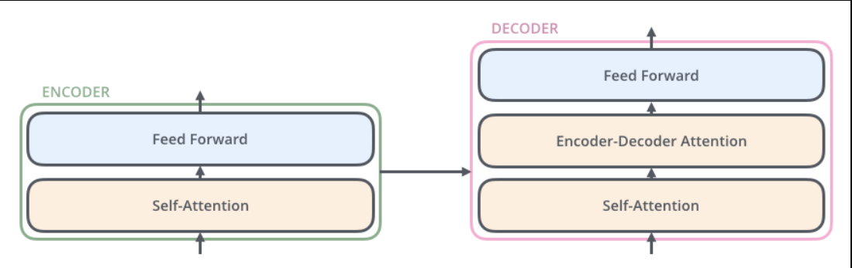
The encoder’s inputs first flow through a self attention layer – a layer that helps the encoder look at other words in the input sentence as it encodes a specific word. We’ll look closer at self attention later.
The outputs of the self attention layer are fed to a feed forward neural network. The exact same feed forward network is independently applied to each position.
The decoder has both those layers, but between them is an attention layer that helps the decoder focus on relevant parts of the input sentence (similar what attention does in seq2seq models).

Slide 8
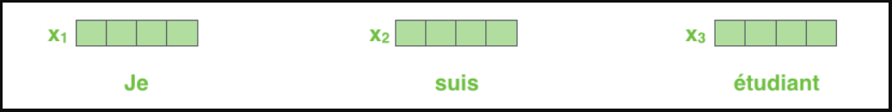
Input Embedding:
As is the case in NLP applications in general, we begin by turning each input word into a vector using an embedding algorithm.
Each word is embedded into a vector of size 512. We'll represent those vectors with these simple boxes.

Slide 9
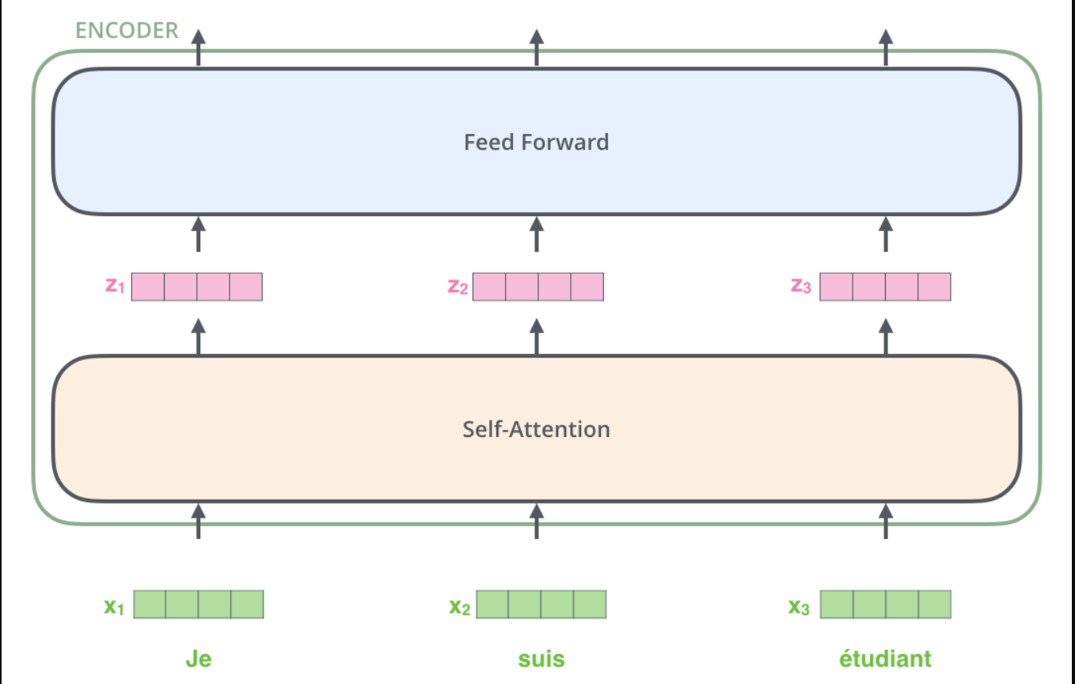
After embedding the words in our input sequence, each of them flows through each of the two layers of the encoder.

Slide 10
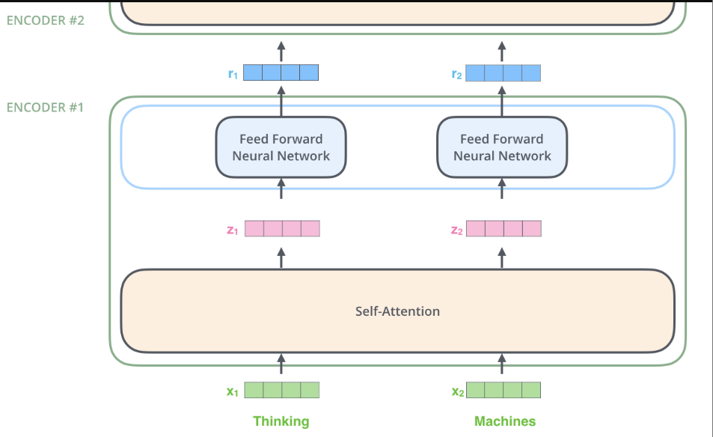
Encoding:
Next, we’ll switch up the example to a shorter sentence and we’ll look at what happens in each sub layer of the encoder.
The encoder receives a list of vectors as input. It processes this list by passing these vectors into a ‘self attention’ layer, then into a feed forward neural network, then sends out the output upwards to the next encoder.
The word at each position passes through a self attention process. Then, they each pass through a feed forward neural network the exact same network with each vector flowing through it separately.

Slide 11
Self Attention Mechanism : Say the following sentence is an input sentence we want to translate:
”The animal didn't cross the street because it was too tired”
1. Contextual Understanding:
The challenge in translation arises from ambiguous pronouns like "it," which could refer to multiple entities in a sentence.
2. Self Attention Mechanism:
The Transformer model employs self attention to dynamically associate words with their context during encoding.
3. Associating Pronouns:
When processing the word "it" in the sentence, self attention allows the model to associate "it" with the most relevant entity, in this case, "The Animal.“
4. Sequential Relationship:
Unlike traditional RNNs that use hidden states, self attention enables the model to consider the entire input sequence, maintaining a contextual understanding across positions.

Slide 12
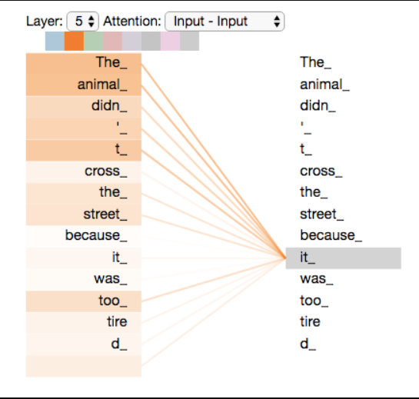
Baking Context into Representation:
As the model encodes "it" in encoder #5, the attention mechanism focuses on "The Animal," effectively incorporating its representation into the encoding of "it." This ensures a nuanced understanding of the pronoun's reference

Slide 13
Self Attention Overview:
The first step :
in self attention involves creating three vectors for each word in the encoder's input (word embeddings).
Vector Types:
For each word, we generate a Query vector, a Key vector, and a Value vector. This are abstractions that are useful for calculating and thinking about attention. Once you proceed with reading how attention is calculated below, you’ll know pretty much all you need to know about the role each of these vectors play
Matrix Multiplication:
The creation of these vectors involves matrix multiplication with three matrices (WQ, WK, WV), which were trained during the model training process.
Dimensionality Consideration:
The dimensionality of the newly created vectors (Query, Key, Value) is intentionally reduced to 64, contrasting with the original 512 dimensional embedding and encoder vectors.
Architectural Choice:
This reduction in dimensionality is an architectural choice, streamlining the computation of multiheaded attention and contributing to more efficient processing during self attention calculations.

Slide 14
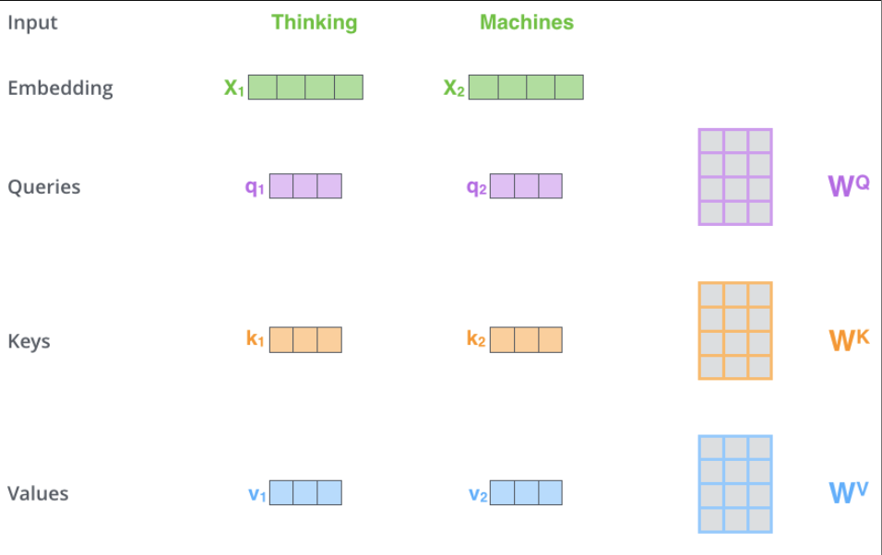

Slide 15
Second step:
Scoring Mechanism:
To calculate self attention, the model assigns a score to each word in the input sentence relative to the word being processed (e.g., "Thinking" in position #1).
Dot Product Calculation:
The score for each word is determined by taking the dot product of the query vector (e.g., q1 for the word in position #1) with the key vector of the respective word in the sequence.
Example Calculation:
if we're processing self attention for the first word ("Thinking"), the first score would be the dot product of q1 and k1. The second score would be the dot product of q1 and k2, and so on.
Importance of Scores:
The scores obtained through the dot product reflect the relevance or importance of each word in the input sequence concerning the current word being processed. This step contributes to capturing contextual dependencies during encoding.

Slide 16
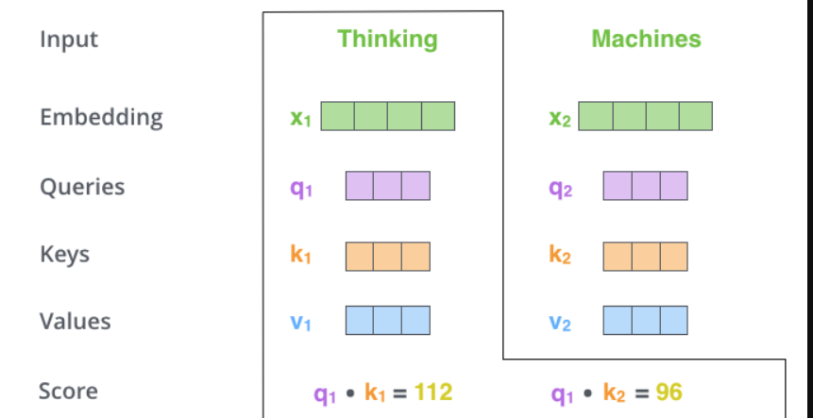

Slide 17
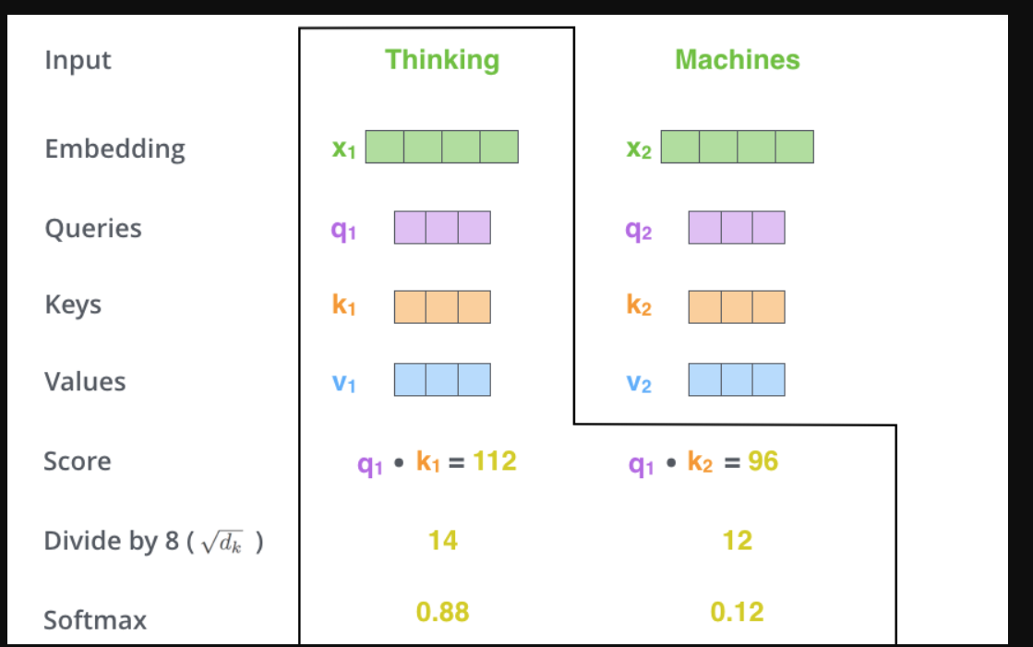
Third and fourth steps :
The third and fourth steps are to divide the scores by 8 (the square root of the dimension of the key vectors used in the paper – 64. This leads to having more stable gradients. There could be other possible values here, but this is the default), then pass the result through a softmax operation. Softmax normalizes the scores so they’re all positive and add up to 1.
This softmax score determines how much each word will be expressed at this position. Clearly the word at this position will have the highest softmax score, but sometimes it’s useful to attend to another word that is relevant to the current word.

Slide 18
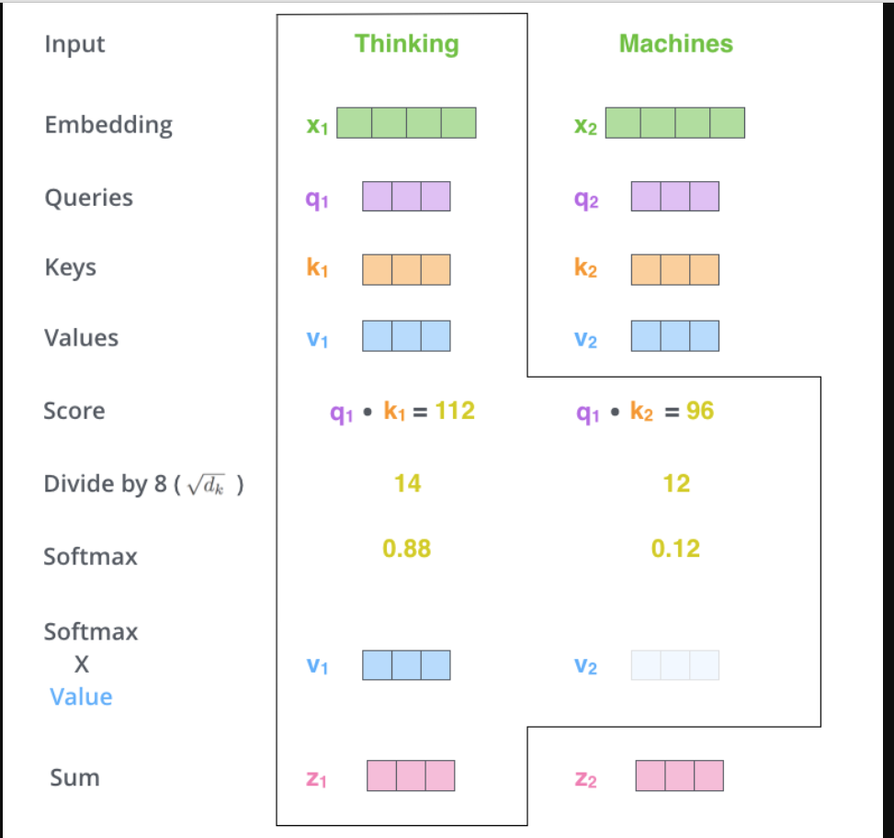
Fifth step:
The fifth step is to multiply each value vector by the softmax score (in preparation to sum them up). The intuition here is to keep intact the values of the word(s) we want to focus on, and drown out irrelevant words (by multiplying them by tiny numbers like 0.001, for example).
sixth step:
The sixth step is to sum up the weighted value vectors. This produces the output of the self attention layer at this position (for the first word).

Slide 19
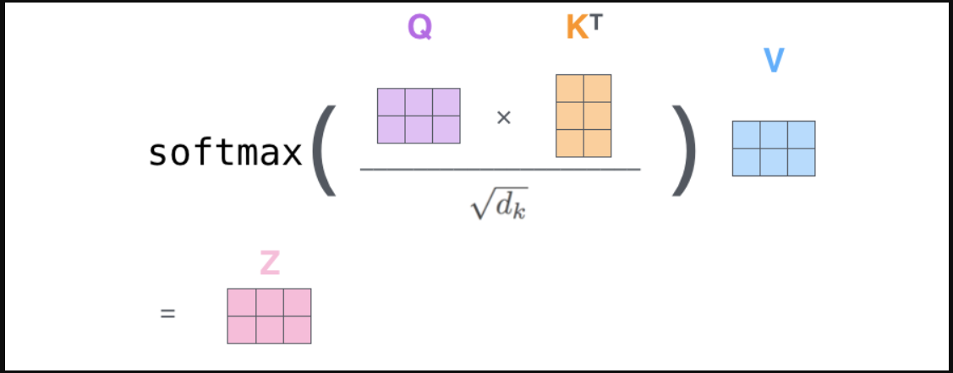
Finally, since we’re dealing with matrices, we can condense steps two through six in one formula to calculate the outputs of the self attention layer.
That concludes the self attention calculation. The resulting vector is one we can send along to the feed forward neural network. In the actual implementation, however, this calculation is done in matrix form for faster processing. So let’s look at that now that we’ve seen the intuition of the calculation on the word level.

Slide 20
The Beast With Many Heads:
The paper further refined the self attention layer by adding a mechanism called “multi headed” attention. This improves the performance of the attention layer in two ways:
It expands the model’s ability to focus on different positions. Yes, in the example above, z1 contains a little bit of every other encoding, but it could be dominated by the actual word itself. If we’re translating a sentence like “The animal didn’t cross the street because it was too tired”, it would be useful to know which word “it” refers to.
It gives the attention layer multiple “representation subspaces”. As we’ll see next, with multi headed attention we have not only one, but multiple sets of Query/Key/Value weight matrices (the Transformer uses eight attention heads, so we end up with eight sets for each encoder/decoder). Each of these sets is randomly initialized. Then, after training, each set is used to project the input embeddings (or vectors from lower encoders/decoders) into a different representation subspace.

Slide 21
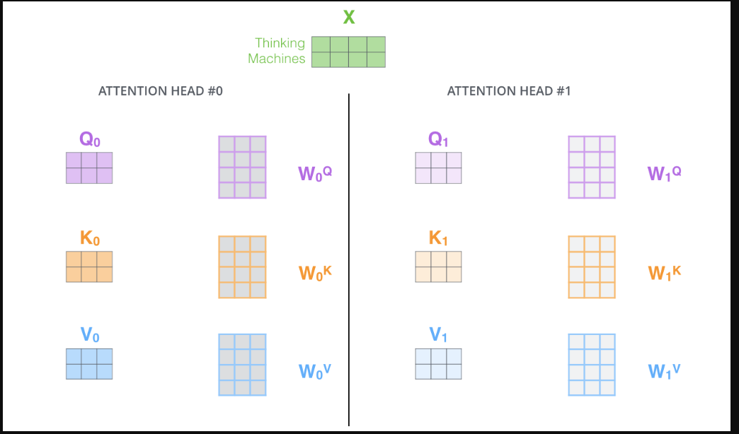
”
With multi headed attention, we maintain separate Q/K/V weight matrices for each head resulting in different Q/K/V matrices. As we did before, we multiply X by the WQ/WK/WV matrices to produce Q/K/V matrices.

Slide 22
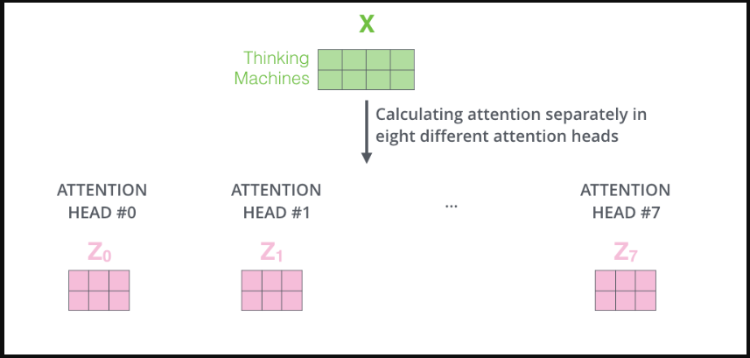
If we do the same self attention calculation we outlined above, just eight different times with different weight matrices, we end up with eight different Z matrices
”

Slide 23
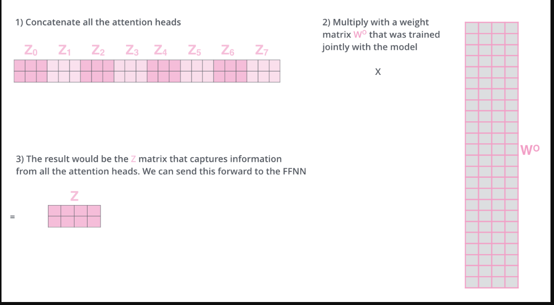
The feed forward layer is not expecting eight matrices – it’s expecting a single matrix (a vector for each word). So we need a way to condense these eight down into a single matrix.
We concat the matrices then multiply them by an additional weights matrix WO.
”

Slide 24
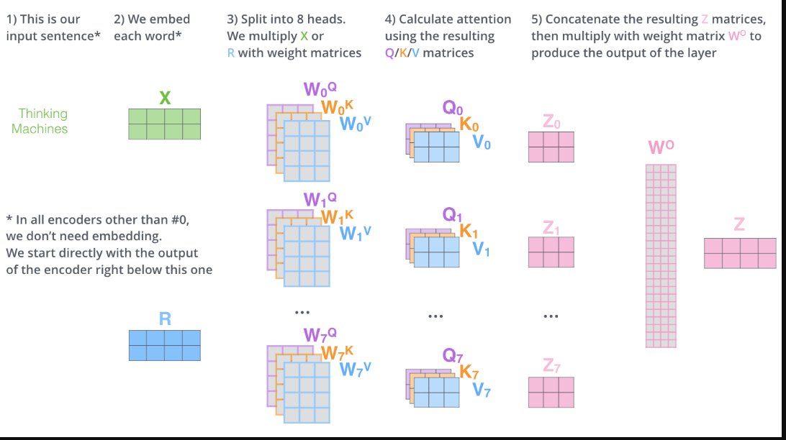
That’s pretty much all there is to multi headed self attention. It’s quite a handful of matrices, I realize. Let me try to put them all in one visual so we can look at them in one place
”

Slide 25
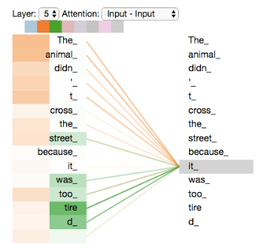
As we encode the word "it", one attention head is focusing most on "the animal", while another is focusing on "tired" in a sense, the model's representation of the word "it" bakes in some of the representation of both "animal" and "tired".
”

Slide 26
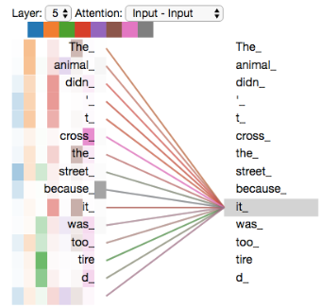
If we add all the attention heads to the picture, however, things can be harder to interpret:
”

Slide 27
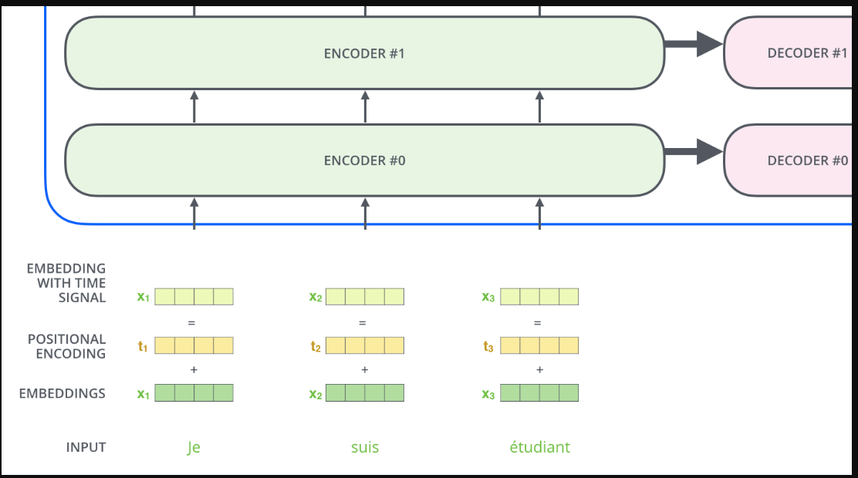
Encoding of Positions :
To address the order deficiency, the Transformer incorporates positional encoding vectors into each input embedding.
Learned Pattern:
These vectors adhere to a specific pattern that the model learns during training. This pattern helps the model discern the position and distance between words in the sequence.
Intuition Behind Addition:
By adding positional encodings to the embeddings, the model gains insights into the relative positions of words. This is crucial for capturing sequential relationships during the attention mechanism.

Slide 28
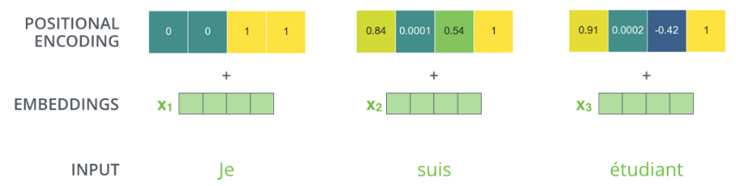
Example Dimensionality:
If we assume an embedding dimensionality of 4, the actual positional encodings are added to the embeddings, enriching the vectors with meaningful information about the order of words in the sequence.

Slide 29
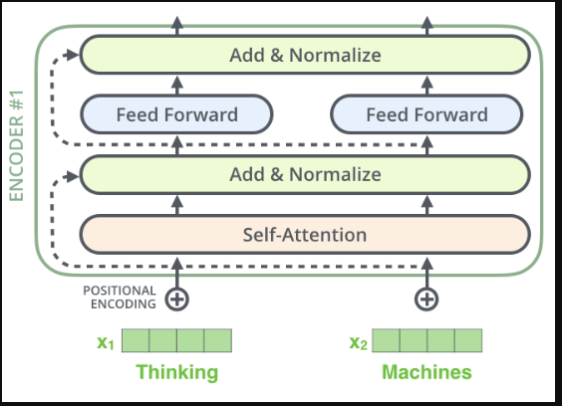
Residual Connections in Encoder Architecture:
Each sub layer in both the encoder and decoder (e.g., self attention, feed forward neural network) features a residual connection around it.

Slide 30
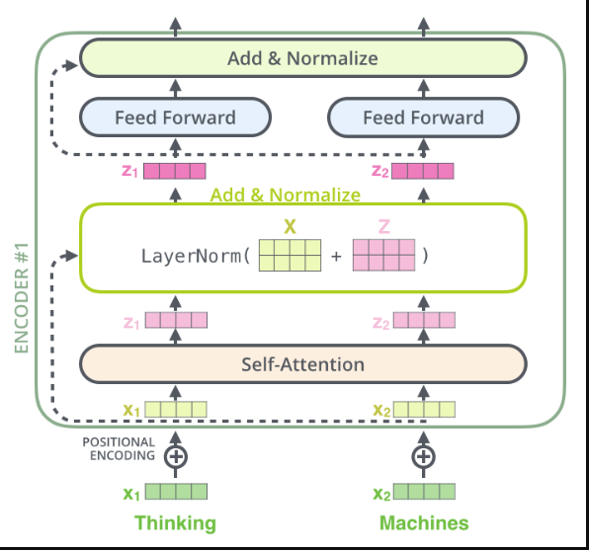
Visualization of Vectors and Layer Norm:
Visualizing the vectors and layer norm operation associated with self attention reveals a structured pattern, showcasing the integration of residuals and layer normalization.

Slide 31
Encoder Structure Overview:
In a Transformer with stacked encoders and decoders, the architecture consists of multiple layers, and each sub layer within them maintains a residual connection, followed by layer normalization.
Residuals in Decoder Sub Layers:
The concept of residuals and layer normalization is not exclusive to encoders; it extends to sub layers within the decoder as well.

Slide 32
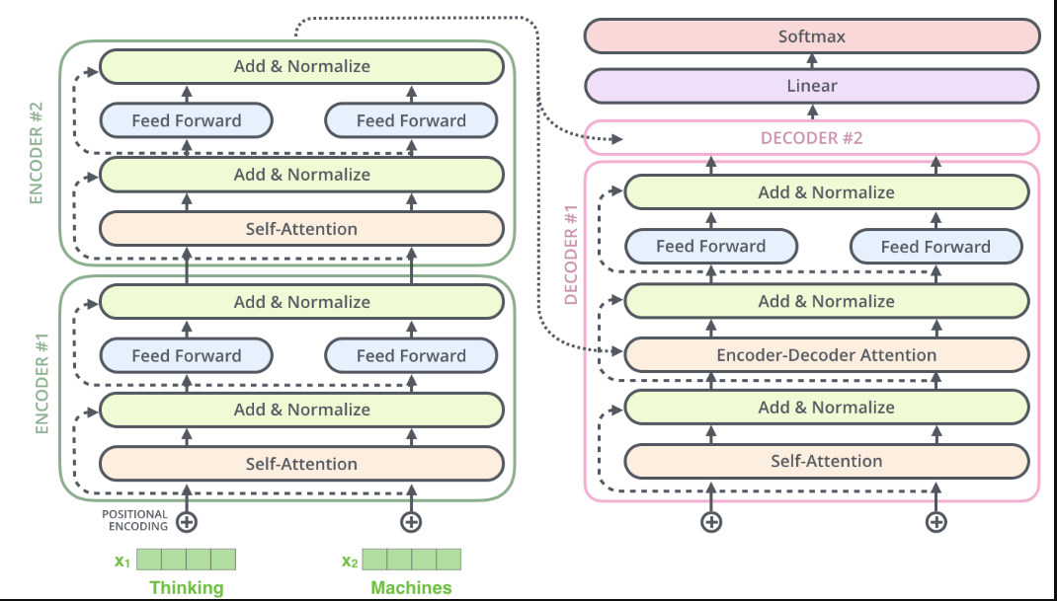
Graphical Representation:
A simplified graphical representation demonstrates the stacking of encoder and decoder layers, highlighting the consistent use of residual connections and layer normalization for improved model performance.

Slide 33

Conclusion
Recap of Key Points
Significance of Understanding
The Transformer architecture is a powerful deep learning model with applications in language and sequence tasks.
By understanding Transformer architecture, we unlock the potential to develop innovative solutions and contribute to the field.
The Decoder Side:
The decoder side of Transformer architecture is in understanding the transformer architecture side-b

