Slide 1



MLSA Full Stack Web
Development Internship
Name- Raj Maurya
University Roll No. - 2300290100196
Section-3 C

Slide 2


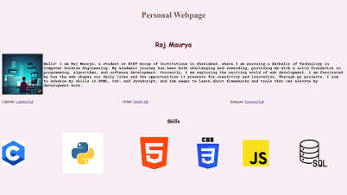
Easy Project- Personal Webpage
This web page includes-
Skills used- HTML, CSS
Profile photo
Brief Introduction of myself
Skills
My social media handles

Slide 3
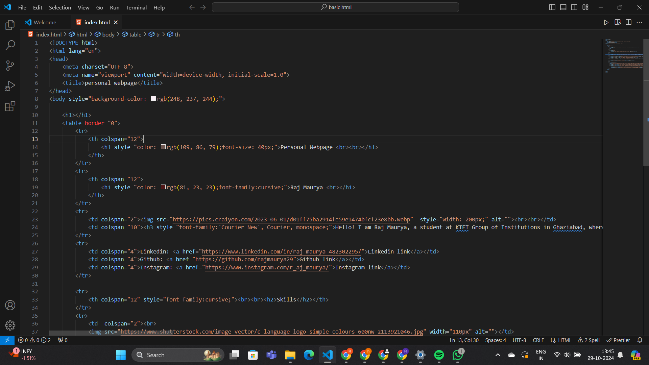
Easy
project-
Source code

Slide 4
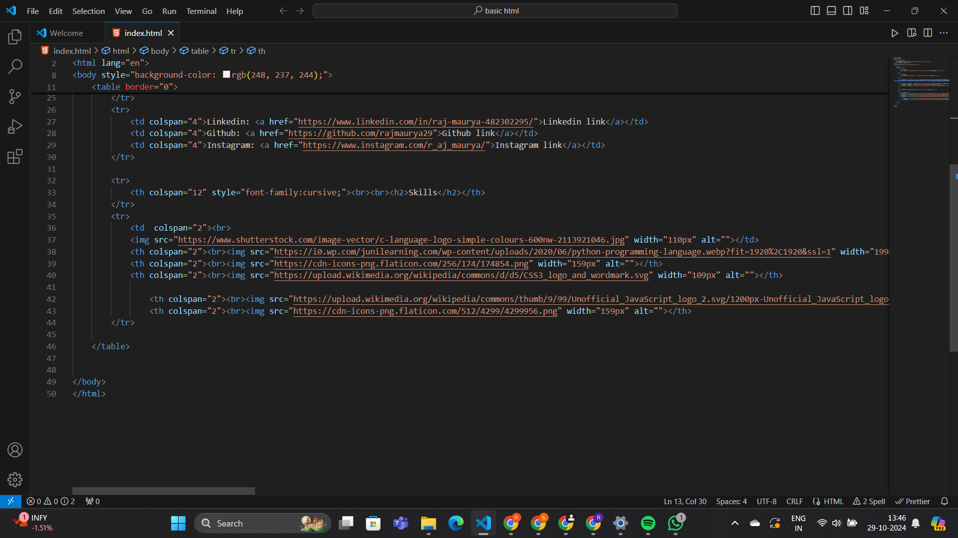
Easy
project-
Source code

Slide 5


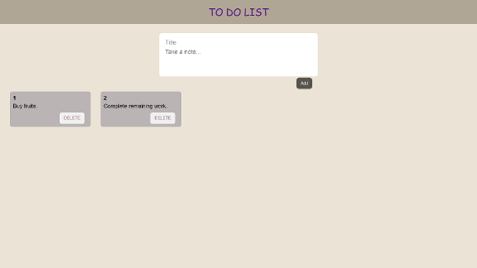
Intermediate project-
This webpage includes functionlity like-
Skills used- Html, Css, JS, React
Adding an item
Deleting an item from anywhere in list
Project name- To-Do List(React)

Slide 6
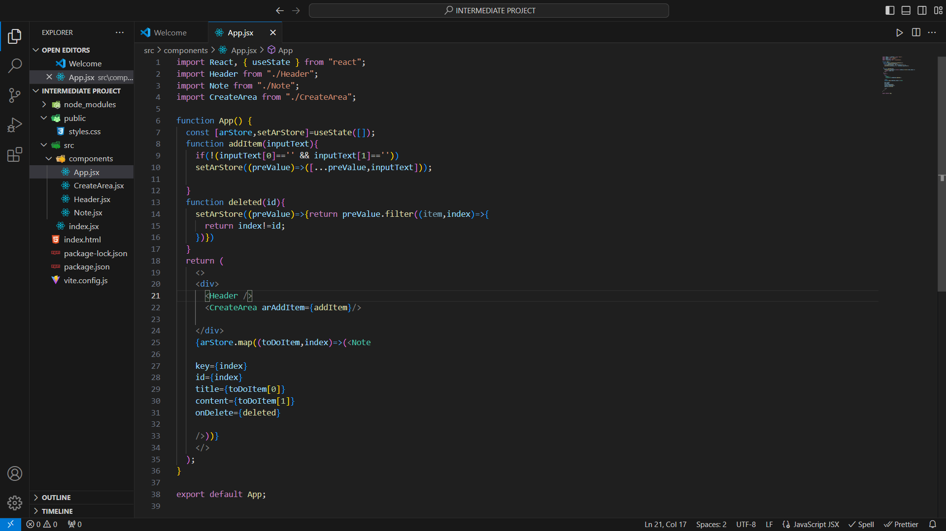
Intermediate project-
This webpage includes functionlity like-
Skills used- Html, Css, JS, React
Adding an item
Deleting an item from anywhere in list
Project name- To-Do List(React)
Source code

Slide 7
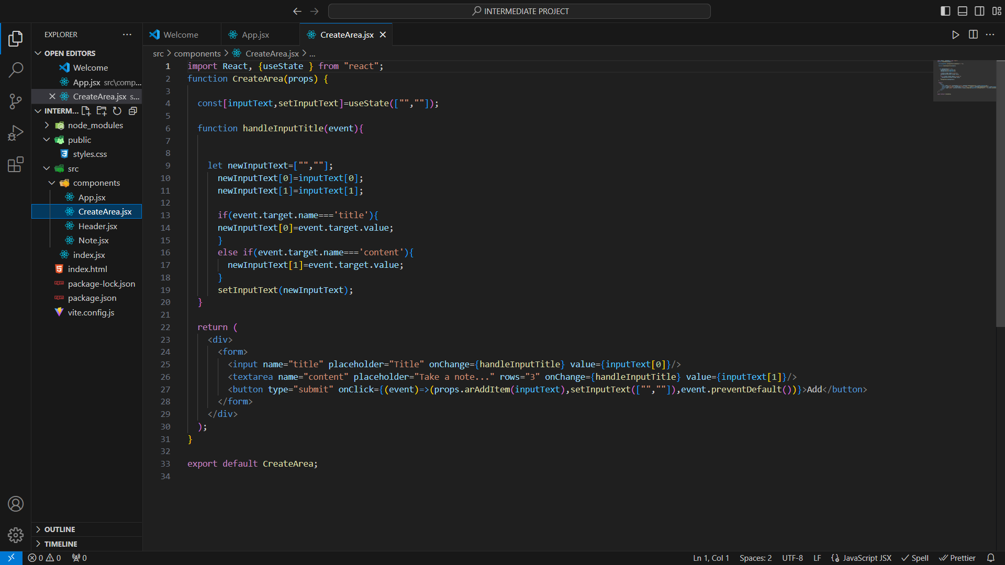
Intermediate project-
This webpage includes functionlity like-
Skills used- Html, Css, JS, React
Adding an item
Deleting an item from anywhere in list
Project name- To-Do List(React)
Source code

Slide 8
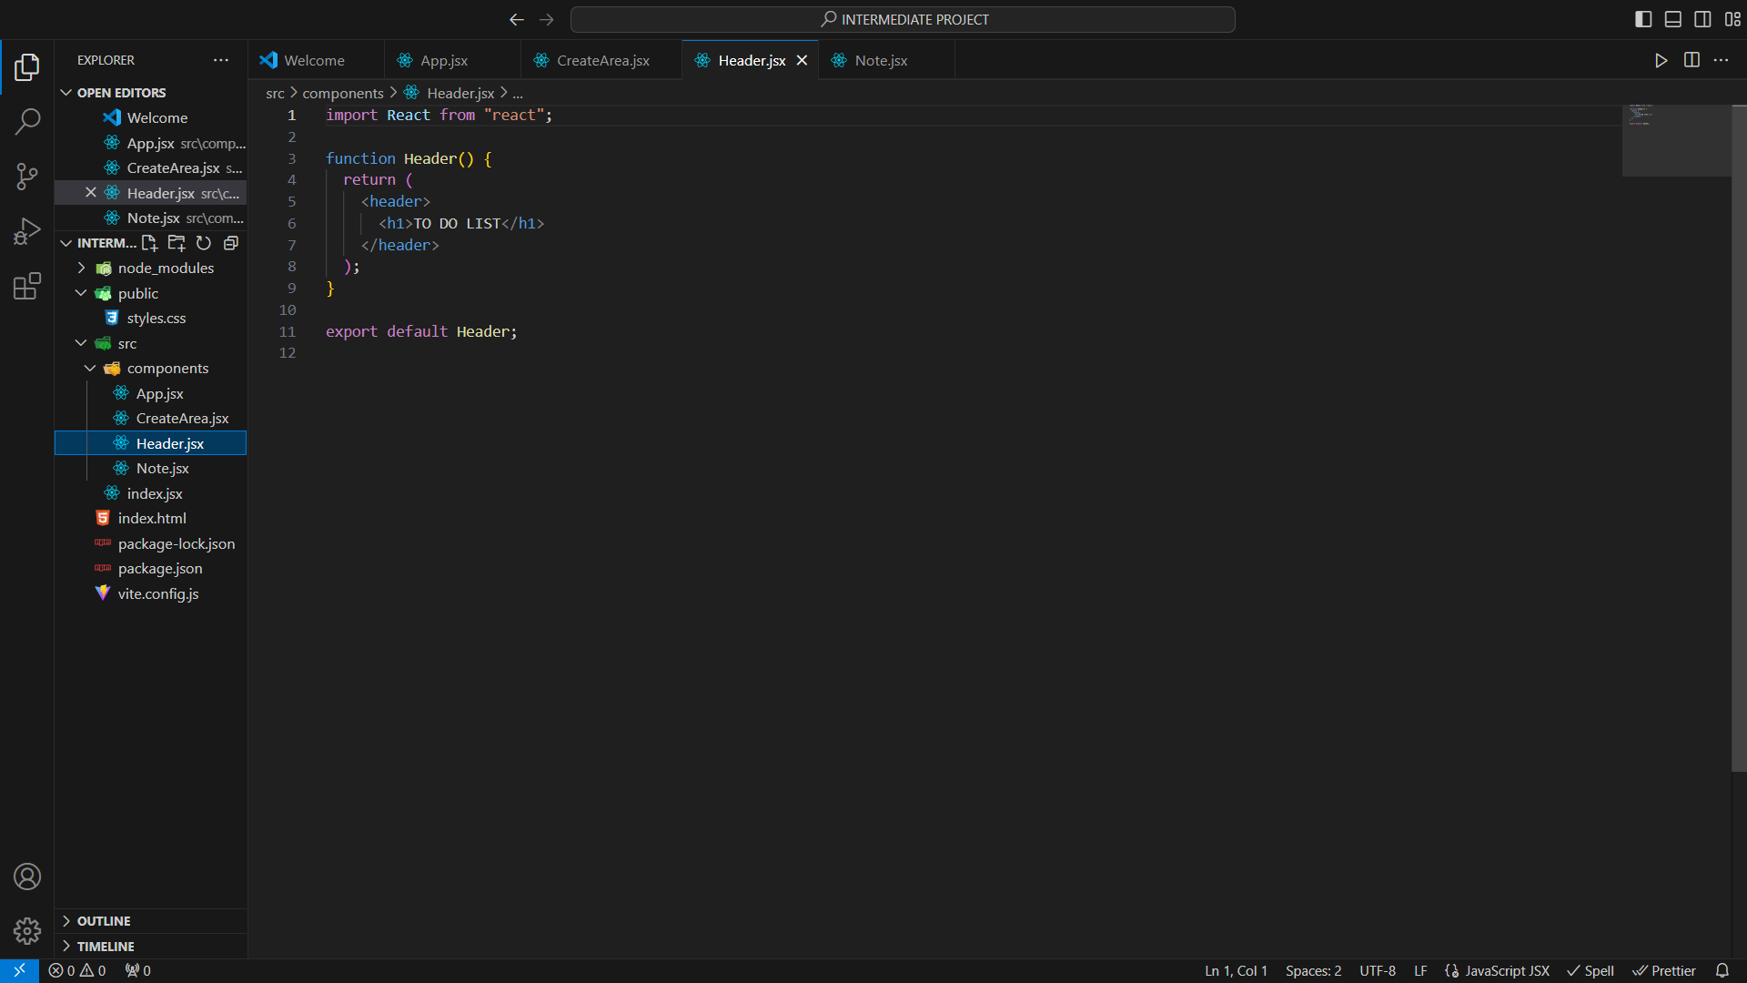
Intermediate project-
This webpage includes functionlity like-
Skills used- Html, Css, JS, React
Adding an item
Deleting an item from anywhere in list
Project name- To-Do List(React)
Source code

Slide 9
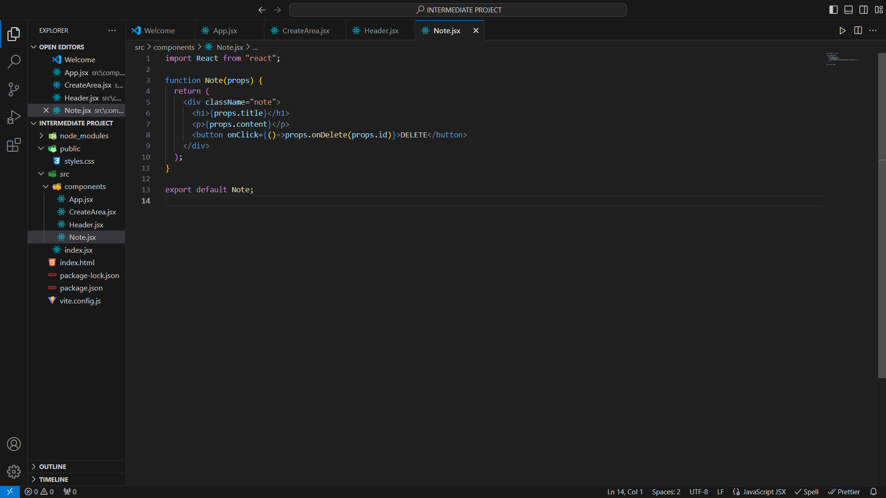
Intermediate project-
This webpage includes functionlity like-
Skills used- Html, Css, JS, React
Adding an item
Deleting an item from anywhere in list
Project name- To-Do List(React)
Source code

Slide 10
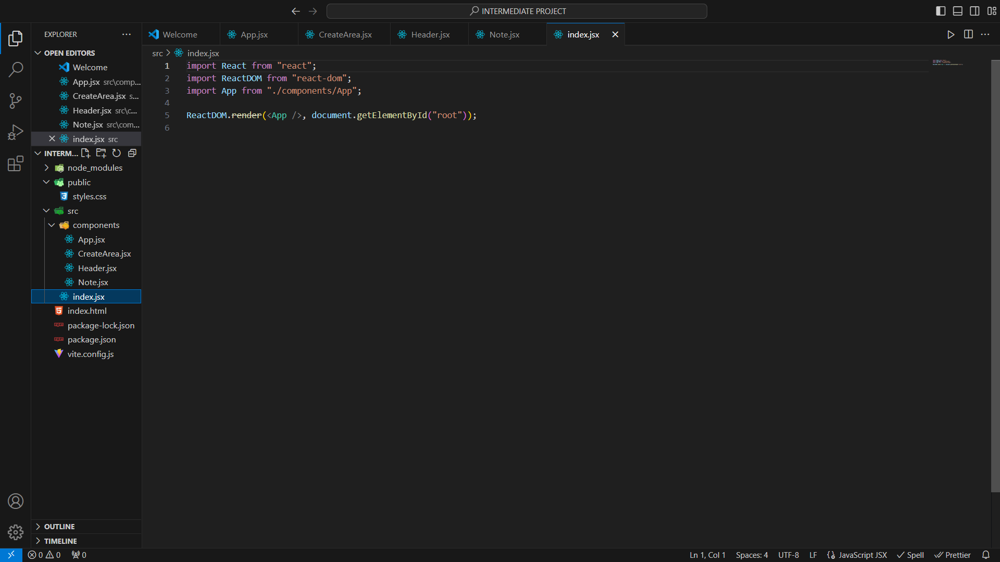
Intermediate project-
This webpage includes functionlity like-
Skills used- Html, Css, JS, React
Adding an item
Deleting an item from anywhere in list
Project name- To-Do List(React)
Source code

