Slide 1




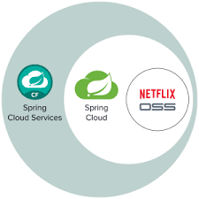
Food Ordering System Design
Order Complete Service
Health Check Service
HTTP Request
JSON Response
Payment Service
Web Socket
Health Check Service
Payment Distributor Service
Health Check Service
Order Service
Health Check Service
Restaurant Service
Health Check Service
Cloud Infrastructure Service

