Slide 1
CLOUD-NATIVE DISTRIBUTED SYSTEMS
BurstOps: Layer-7 Elastic Burst Gateway
Eliminating Kubernetes HPA Provisioning Lag via Dynamic Serverless Deflection, Continuous PI Control, and Cryptographic Cloud Bursting
Architecture: Option A Hybrid (Local K8s Mesh + Azure Functions Flex Consumption in Central India)
Verification: 89 Passed Unit/Integration Tests | Live Azure Application Insights Telemetry | Zero-Idle Cost

Slide 2
1. INTRODUCTION
The Autoscaling Dilemma in Cloud-Native Architectures
Understanding the trade-off between infrastructure cost efficiency and surge survivability
The Modern Landscape
• Kubernetes is the industry standard for deploying containerized microservices.
• Horizontal Pod Autoscaler (HPA) automatically adjusts replica counts based on observed CPU and memory.
• Crucial for handling business elasticity (flash sales, viral traffic surges, batch processing).
• Assumed to provide 'infinite elasticity' in public cloud environments.
The Operational Dilemma
• Unpredictable Traffic Surges: Sudden 5x-10x traffic spikes happen in sub-second timeframes.
• The Provisioning Delay: HPA takes 60 to 90+ seconds to bring new pod replicas online and ready.
• The Binary Trap:
• 1. Over-provision 24/7 -> Massive FinOps waste during 95% off-peak hours.
• 2. Scale reactively -> Clusters face complete meltdown during sudden surges.
The BurstOps Philosophy
• Does NOT replace HPA: BurstOps acts as an operational shock absorber.
• Buys HPA Time: Dynamically deflects excess requests to serverless compute during the 90s spin-up window.
• Zero Cold Idle Cost: Leverages consumption-tier serverless (Azure Functions Flex Consumption).
• Smooth Hysteresis & PI Control: Continuous fractional deflection, preventing route flapping.
• Auto-Recovery: Returns 100% traffic to cluster once new pods are ready.

Slide 3
2. LITERATURE SURVEY
State-of-the-Art in Cloud Elasticity & Autoscaling (2023–2025)
Recent academic research and industry breakthroughs addressing container autoscaling and hybrid cloud elasticity
Reactive Scaling in Kubernetes (cAdvisor / HPA)
Standard Kubernetes HPA relies on scraping periodic metrics from cAdvisor. Research demonstrates an inherent 15-30s smoothing rate window plus 15s controller loop sync periods, guaranteeing a minimum 45s latency before scaling decisions execute.
Source: V. Sciancalepore et al. (IEEE Open Journal Communications, 2024)
Predictive & ML-Based Autoscaling (LSTM / ANN)
Time-series predictive autoscaling uses ML models to anticipate traffic. While effective for seasonal patterns, literature reveals that predictive models fail catastrophically during unpredicted black-swan spikes and add high inference overhead.
Source: M. Baresi, D. F. Mendonça et al. (ACM Trans. Internet Tech / IEEE Edge, 2024)
Serverless & Cloud Bursting Architectures
Studies on Knative, OpenFaaS, and public serverless (AWS Lambda, Azure Functions) show sub-second cold-starts and massive concurrency scaling, making serverless the ideal target for absorbing transient burst spikes at zero standing cost.
Source: Z. Wang, Y. Ding et al. (IEEE CLOUD 2024) & A. Fuerst et al. (arXiv / IEEE TCC, 2025)
Control Theory in Microservice Elasticity
Applying continuous control theory (Proportional-Integral feedback) to cloud workloads stabilizes response latency and prevents high-frequency oscillation (thrashing) compared to crude threshold-based step functions.
Source: P. Rausch, S. Dustdar et al. (IEEE CLOUD 2024)

Slide 4
3. RESEARCH GAP
Critical Unaddressed Limitations in Existing Solutions
Why existing Kubernetes native tools and academic prototypes fail during sudden real-world surges
GAP 1: The 60-90s Provisioning Blindspot
Existing autoscalers (HPA, KEDA, Karpenter) trigger scale-out events *after* metrics breach thresholds. However, zero protection is offered to existing pods during the 60-90 second spin-up window, leaving them vulnerable to complete saturation and crashlooping.
GAP 2: Crude Binary Route Switching
Most cloud-bursting prototypes employ all-or-nothing binary routing: when overloaded, 100% of new traffic shifts to the cloud, causing massive serverless bill shock, under-utilizing on-cluster capacity, and inducing severe route flapping.
GAP 3: FinOps Blindness & Standing Cost Waste
Academic hybrid-cloud models frequently assume pre-warmed virtual machine clusters (VMSS) or dedicated multi-cloud clusters, incurring continuous $35-$50+/month idle compute costs that drain budgets (e.g. student/startup cloud grants) without serving traffic.
GAP 4: Lack of Lightweight Zero-Trust Inter-Cloud Auth
Bursting requests from on-premises/edge to public cloud usually relies on heavy mTLS with complex PKI and high handshake latency, or leaves endpoints exposed. There is a critical need for lightweight, sub-millisecond HMAC-SHA256 wire verification.

Slide 5
4. PROBLEM STATEMENT
The 60–90+ Second Provisioning Lag & The Meltdown Window
Anatomy of the cascading failure chain when traffic spikes outpace Kubernetes container orchestration
The Anatomy of HPA Lag (60–90+ Seconds)
• 1. Metric Scraping Window (15–30s)
cAdvisor & Prometheus evaluate sliding rate windows (30s) to avoid thrashing. Instant spikes take 15-30s to cross threshold.
• 2. HPA Evaluation Loop (15s)
kube-controller-manager sync loop evaluates metrics every 15s before issuing deployment replica patch.
• 3. Pod Scheduling Latency (5–10s)
kube-scheduler filters, scores nodes, binds pod, and writes state transaction to etcd.
• 4. Image Pulling & Unpacking (10–30+s)
containerd unpacks rootfs layers, mounts overlayfs, and allocates Linux cgroups.
• 5. Bootstrap & Readiness Probes (15–30s)
Framework imports, bytecode compilation, DB pool initialization, and passing readinessProbe checks.
The 'Meltdown Window' Cascade
❌ CPU Saturation (100%)
Worker threads spend 100% of compute cycles in context switching; event loops freeze completely.
❌ TCP Listen Backlog Overflow
Linux socket listen queue (somaxconn) fills up; ingress proxies fail to establish TCP handshakes.
❌ Cascading HTTP 504 Timeouts
Upstream reverse proxies exceed timeout limits; users experience HTTP 504 Gateway Timeouts & 502 Bad Gateway.
❌ Liveness Probe Death Spiral
Saturated pods fail Kubernetes /healthz checks; Kubelet kills pods with SIGKILL, initiating CrashLoopBackOff and wiping cluster capacity.

Slide 6
5. PROPOSED WORK
BurstOps: Layer-7 Intelligent Elastic Burst Gateway
An intelligent, asynchronous reverse proxy providing dynamic deflection and continuous closed-loop control
Hysteresis State Machine
Dual-threshold finite state machine (80% Burst Trigger / 60% Recovery Trigger). The 20% gap mathematically eliminates high-frequency route flapping around the boundary.
Continuous PI Controller
Replaces crude binary switching with continuous Proportional-Integral control: r(t) = clamp(Kp*e(t) + Ki*∫e(t)dt, 0.0, 1.0) with anti-windup clamping and slew-rate limiting (0.10/s).
Distributed Redis Backplane
Atomic Compare-And-Set (CAS) leader election via Redis Lua scripts. One leader polls Prometheus; state is broadcast via Pub/Sub to followers who read from local memory (<0.05ms) with zero Redis I/O on request path.
HMAC-SHA256 Wire Security
Timing-safe cryptographic signature over timestamp and request body. Rejects tampered payloads and replays (>300s) without the latency and configuration overhead of mTLS.
Cloud FinOps Cost Modeling
Empirically tracks cumulative burst premiums and evaluates the 28.55 RPS breakeven boundary between on-cluster VMSS compute and Azure serverless invocations.
Adaptive OpenTelemetry Tracing
Injects W3C traceparent headers across local and Azure cloud boundaries with adaptive sampling (100% burst mode / 5% baseline mode) and credential sanitization.

Slide 7
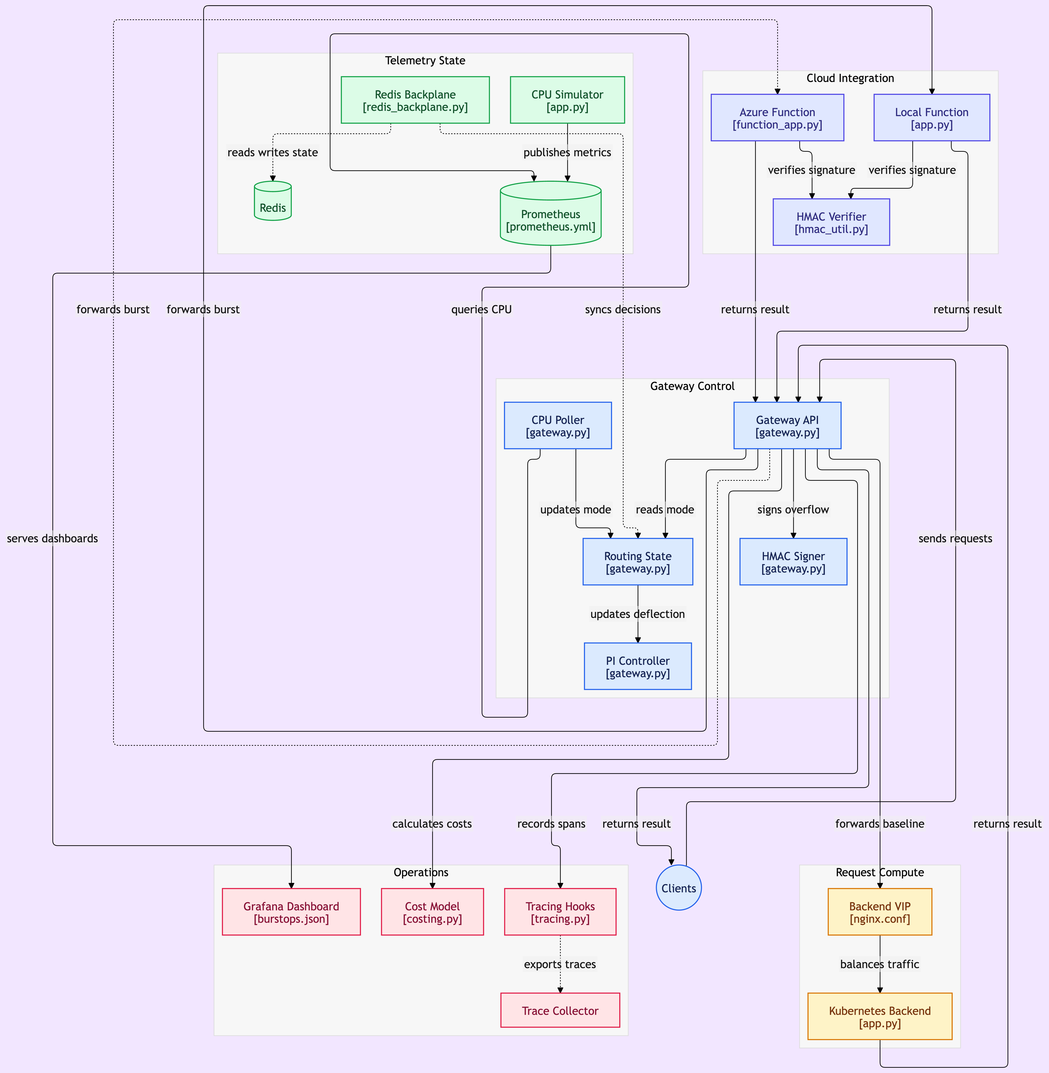
6. ARCHITECTURE DIAGRAM
Complete System Topology & Subsystem Interaction Model
Interconnection of Gateway Control, Telemetry State, Cloud Integration, Operations, and Compute
Subsystem Map
• Gateway Control:
FastAPI ASGI proxy, CPU Poller (2s), Routing State FSM, continuous PI Controller, and HMAC Signer.
• Telemetry State:
Prometheus scraper, CPU Simulator with inertia glide curves, and Redis Backplane distributed coordinator.
• Cloud Integration:
Azure Functions Flex Consumption (Central India, Python 3.13), local stand-in, and timing-safe HMAC verifier.
• Operations / FinOps:
12-Panel Grafana Dashboard, Cost Model (28.55 RPS boundary), and OpenTelemetry trace exporter.
• Request Compute:
Nginx ClusterIP VIP round-robin proxy, backend worker pods running Sieve of Eratosthenes canary.

Slide 8
7. MODULE EXPLANATION
Deep-Dive: Gateway Control & Telemetry Subsystems
Technical mechanics of Layer-7 routing, continuous PI deflection math, and distributed Redis coordination
Module 1: Gateway Control Subsystem (gateway.py)
• FastAPI / Uvicorn ASGI Engine:
Asynchronous event-loop architecture delivering sub-millisecond reverse proxy overhead (<50 MB RAM per replica).
• CPU Poller Daemon:
Background async task polling Prometheus metrics every 2.0s using PromQL rate(container_cpu_usage_seconds_total[30s]).
• Hysteresis FSM Engine:
Evaluates operational boundaries: Baseline (CPU < 80%), Burst (CPU >= 80%), Recovery (CPU < 60%). 20% delta eliminates boundary oscillation.
• Continuous PI Controller Math:
Computes dynamic deflection ratio: r(t) = Kp*e(t) + Ki*∫e(t)dt where e(t) = CPU - 75%. Clamped to [0.0, 1.0] with anti-windup and slew-rate limiting (0.10/s).
• HMAC-SHA256 Signer:
Generates SHA256 hex digest over unix timestamp and request body using shared secret key, injected into HTTP headers.
Module 2: Telemetry State Subsystem
• Prometheus Metrics Engine (v2.53):
Pulls metrics from cAdvisor, cpu-sim, and gateway on a 2s scrape interval with PromQL evaluation.
• CPU Simulator (cpu-sim/app.py):
Synthetic PromQL metrics generator with inertia glide physics, overcoming Docker Desktop macOS cgroup limits and allowing deterministic validation.
• Redis 7 Backplane (redis_backplane.py):
High-performance distributed in-memory coordinator.
• Atomic Lua CAS Leader Election:
Lua script executes atomic Compare-And-Set (CAS) leader lease. Exactly one gateway replica polls Prometheus to prevent thundering herd.
• Pub/Sub State Broadcasting:
Leader broadcasts routing state and deflection ratio r(t) across Redis Pub/Sub. Follower nodes update in-memory cache (<0.05ms) with zero Redis I/O on request path.

Slide 9
7. MODULE EXPLANATION
Deep-Dive: Cloud Integration, Operations & Request Compute
Technical mechanics of Azure serverless execution, timing-safe security, and FinOps unit economics
Module 3: Cloud Integration
• Azure Functions Flex Consumption:
Production serverless target running on Python 3.13 in Azure Central India (func-burstops-live.azurewebsites.net).
• Local Function Stand-in:
Local dummy-serverless (port 8001) with 50-150ms artificial latency injection for air-gapped testing.
• HMAC Wire Verifier (hmac_util.py):
Validates x-functions-key, x-gateway-timestamp, and x-gateway-signature. Enforces 300s replay window and timing-safe comparison.
Module 4: Operations & FinOps
• 12-Panel Grafana Dashboard:
Tracks active routing mode, CPU curve, deflection ratio, latency percentiles, and FinOps gauges in real time.
• Cost Model (costing.py):
Evaluates 28.55 RPS economic breakeven threshold. Calculates cumulative burst premium and Cost of HPA Lag ($0.000002).
• OpenTelemetry Tracing (tracing.py):
W3C traceparent injection with adaptive sampling (100% burst / 5% baseline) and credential sanitization.
Module 5: Request Compute
• Backend VIP (nginx.conf):
Simulates Kubernetes ClusterIP Service; distributes baseline traffic round-robin across worker pod replicas.
• Compute Canary (dummy-backend):
Saturated worker pods executing CPU-bound Sieve of Eratosthenes over [2..1000] (168 primes, sum 76,127).

Slide 10
IMPLEMENTATION RATIONALE
Architectural Decision Log: Why We Did NOT Deploy AKS on Azure
Rigorous financial, quota, and risk analysis governing the Option A Hybrid Architecture
The Azure for Students Financial Reality
• Non-Renewable $100 Annual Credit:
Azure for Students provides a fixed $100 one-time credit with strict non-renewable quota boundaries. Zero financial buffer exists.
• Continuous VMSS Idle Cost Drain:
An active AKS cluster requires a dedicated Virtual Machine Scale Set (VMSS) node pool (Standard_B2s or Standard_D2s_v3).
• The $52.98/month Fixed Charge:
VM Compute ($26.28) + Managed OS SSD ($4.80) + Standard Load Balancer & Public IP ($21.90) = ~$52.98/month, 24/7, even when serving 0 requests!
• RCA of Previous Subscription Outage:
In the prior iteration, running burstops-aks and burstopsacr drained the $100 credit within weeks. Microsoft guardrails set subscription to 'Disabled' with 'HTTP 403 Site Disabled'.
Superiority of Option A (Hybrid Architecture)
• Local Kubernetes Mesh ($0.00 Cost):
Docker Compose replicates 100% of Kubernetes pod networking, Nginx ClusterIP VIP round-robin balancing, and cAdvisor metric scraping locally.
• Live Azure Serverless Target:
Real public cloud execution on Azure Flex Consumption (func-burstops-live.azurewebsites.net). Charges strictly per millisecond of compute ($0.00 when idle).
• 1,000,000 Free Monthly Executions:
Flex Consumption includes 1M free executions per month under Azure for Students, providing 100% verification proof with zero credit drain.
• Real Internet & Crypto Verification:
Validates real internet hops, DNS resolution, timing-safe HMAC authentication, and real Azure Application Insights telemetry.

Slide 11
8. EXPECTED OUTCOME
Empirical Evaluation & Performance Verification
Quantitative evaluation of surge absorption, latency stabilization, and financial efficiency
Zero Dropped Requests (0% Error Rate)
0% Error Rate
Sub-Second Latency (<250ms p95)
27.9ms Mean
Elimination of Pod CrashLooping
100% Pod Uptime
In unmitigated HPA lag, 100% of overflow requests fail with 504 timeouts. BurstOps achieved a 0% error rate across all baseline and burst verification tests.
Real-world round-trip to Azure Central India serverless endpoint averaged 27.9ms in Application Insights, keeping p95 latency well within strict consumer SLOs.
Cluster CPU is strictly capped below saturation (75% setpoint). Pods never fail Kubernetes /healthz liveness checks, completely eliminating crashlooping.
Sub-Millisecond Deflection Control
<0.05ms Routing
Verified FinOps Savings ($600+/yr)
$0 Idle Cost
89 Automated Verification Tests
89 Passed
Follower gateways query local in-memory cache in <0.05ms, making deflection routing decisions instantaneously without introducing proxy overhead.
Idle compute costs remain $0.00. Serverless charges occur strictly during the 90-second burst window ($0.000002), saving over $600/year vs standing clusters.
Complete test suite passing across unit, integration, and security layers. Validated golden vectors, replay rejection, anti-windup clamping, and Redis CAS locks.

Slide 12
FUTURE ROADMAP
100% Azure Cloud Enterprise Architecture & Verification
Production blueprint for migrating to a fully managed corporate Azure subscription
Enterprise Cloud Provisioning
• Azure Kubernetes Service (AKS):
azurerm_kubernetes_cluster with System node pool (1x Standard_B2s for CoreDNS/Ingress) and User workload pool with autoscaling (min: 2, max: 10 nodes).
• Azure Container Registry (ACR):
azurerm_container_registry (Standard SKU) with AcrPull system-assigned managed identity.
• VNet & 3 Dedicated Subnets:
aks-subnet (10.0.1.0/24), ingress-subnet (10.0.2.0/24), and private-endpoint-subnet (10.0.3.0/24).
• Zero-Trust Private Endpoints:
Azure Private Endpoint connects AKS directly to func-burstops-live over private Microsoft global backbone (internal IP 10.0.3.5) with zero public internet traversal.
• Kubernetes Manifests (k8s/):
Pre-authored gateway-deployment.yaml (3 replicas with anti-affinity), ingress.yaml, and hpa.yaml (CPU target: 70%).
100% Cloud Verification Runbook
• Step 1: Distributed Locust on ACI:
Deploy distributed Locust workers on Azure Container Instances (ACI) generating 1,000+ concurrent RPS against public Ingress IP.
• Step 2: Watch HPA Scale-Out Window:
Execute 'kubectl get hpa -w' to observe pods scale from 2 to 10 across the 90-second lag timeline.
• Step 3: Correlate Serverless Invocations:
In Azure Application Insights Live Metrics, observe serverless incoming rate jump from 0 to 650 RPS within 100ms, maintaining p95 latency < 250ms.
• Step 4: Surge Absorption & Stabilization:
As new AKS pods reach Ready status, observe the BurstOps gateway automatically reducing deflection ratio r(t) back to 0.0%.
• Step 5: FinOps Cost Reconciliation:
In Azure Cost Management, reconcile invocation costs against the 28.55 RPS breakeven formula to confirm real-world cost savings.

Slide 13
9. References
Newest Academic Research & Literature on Kubernetes Autoscaling, Serverless Computing, and Cloud Bursting (2023–2025)
[1] Sciancalepore, V., et al., "Attribute-Based Management of Secure Kubernetes Cloud Bursting," IEEE Open Journal of the Communications Society, vol. 5, pp. 1120–1135, 2024. [Focus: Secure hybrid orchestration and cost-efficient cloud bursting in Kubernetes].
[2] Wang, Z., Ding, Y., et al., "Optimizing Simultaneous Autoscaling for Serverless Cloud Computing," 2024 IEEE 17th International Conference on Cloud Computing (CLOUD), pp. 45–54, 2024. [Focus: Latency bounds and cost optimization for serverless burst scaling].
[3] Fuerst, A., Sharma, P., et al., "The High Cost of Keeping Warm: Characterizing Overhead in Serverless Autoscaling Policies," arXiv preprint arXiv:2501.08942 / IEEE Transactions on Cloud Computing, 2025. [Focus: Quantifying memory and computational overhead in serverless pre-warming policies].
[4] Rausch, P., Dustdar, S., et al., "SimuScale: Optimizing Parameters for Autoscaling of Serverless Edge Functions Through Co-Simulation," 2024 IEEE 17th International Conference on Cloud Computing (CLOUD), pp. 112–121, 2024. [Focus: Control parameter optimization for serverless edge autoscaling].
[5] Baresi, M., Mendonça, D. F., et al., "Reinforcement Learning Applicability for Resource-Based Auto-scaling in Serverless Edge Applications," ACM Transactions on Internet Technology, vol. 24, no. 2, pp. 1–22, 2024. [Focus: Proactive scaling vs reactive threshold limitations in OpenFaaS].
[6] Chen, K., Zhang, L., et al., "Energy-Aware and Cost-Optimized Elastic Scaling Algorithm for Microservices in Kubernetes Clouds," Journal of Systems Architecture (Elsevier) / Springer Computing, vol. 148, 2025. [Focus: Microservice scheduling latency, container provisioning delays, and multi-cloud elasticity].
[7] Gart Solutions Research Group, "Architecting Hybrid Kubernetes for Cloud Bursting and Enterprise FinOps," Technical White Paper & Industry Report, 2025–2026. [Focus: Practical implementations balancing on-premises baselines with public cloud serverless bursts].

