Slide 1

PRESENTATION ON COLLECTION FRAMEWORK

Slide 2
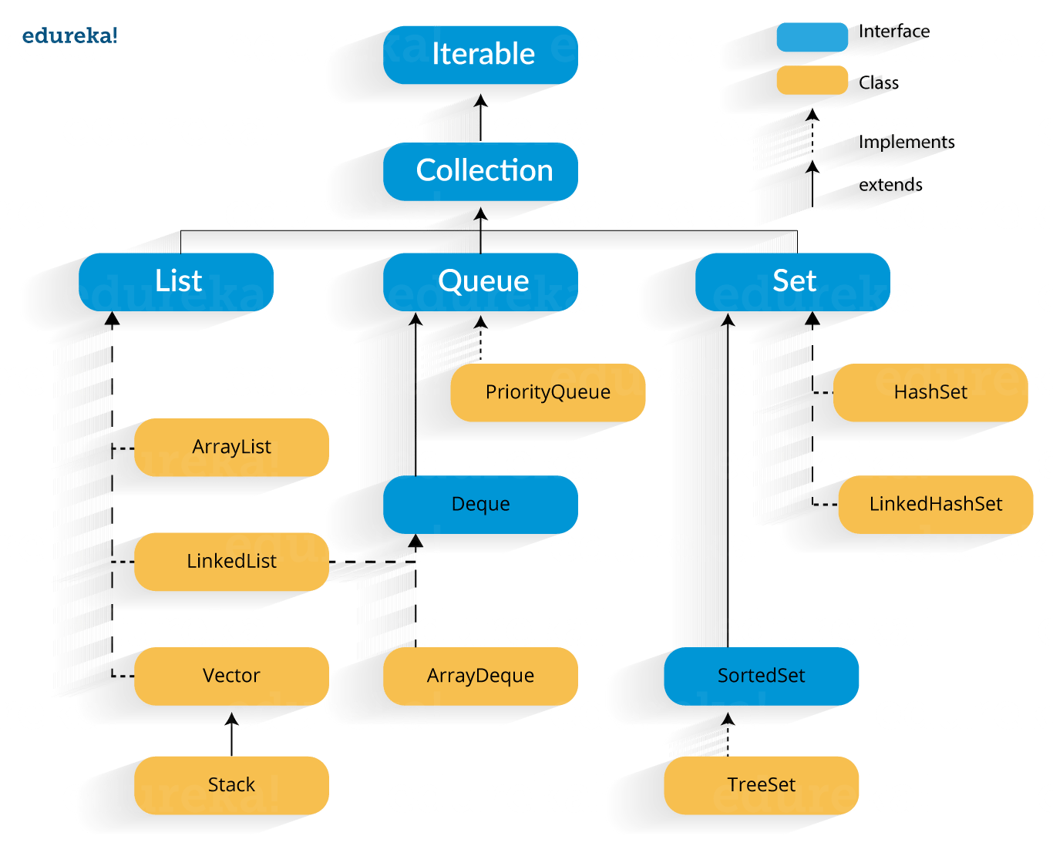
COLLECTION FRAMEWORK
A Java collection framework provides an architecture to store and manipulate a group of objects. A Java collection framework includes the following:
Interfaces (Example-> Collection ,List ,Set etc.)
Classes (Example-> ArrayList ,LinkedList etc.)
Algorithm (Example-> compareTo() etc. )

Slide 3
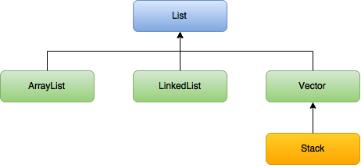
LIST Interface
List is extendable
List allows duplicate entry
List preserves the Insertion order

Slide 4
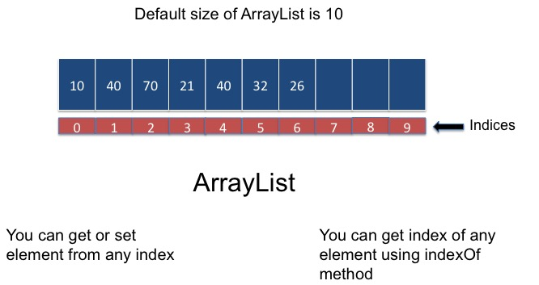
ARRAYLIST CLASS
Heterogenous Elements
Searching Elements
Extendable

Slide 5
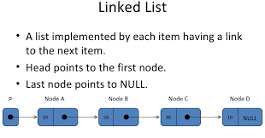
LINKEDLIST CLASS
Heterogenous Elements
Inserting Elements
Extendable

Slide 6
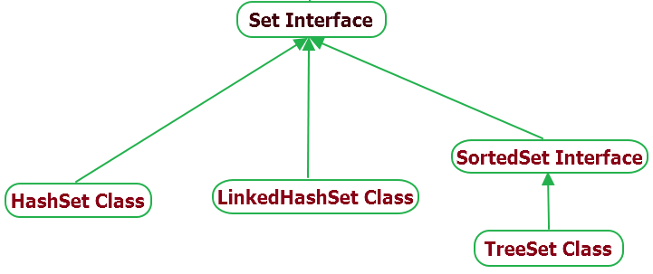
SET Interface
Set is extendable
Set doesn’t allow duplicate entry
List doesn’t preserves the Insertion order

Slide 7
HASHSET CLASS
Heterogenous Elements
Doesn’t preserve Insertion order
Extendable
Allows One Null Element

Slide 8
LINKEDSET CLASS
Heterogenous Elements
Doubly LinkedList
Preserves Insertion order
Extendable
Allows One Null Element

Slide 9
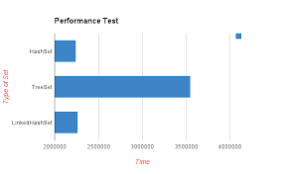
TREESET CLASS
Homogeneous Elements
Sorted order
Extendable
Allows One Null Element

Slide 10

Thank You

