Slide 1
Exception handling
BY
P DEEPTHI

Slide 2
Introduction:
Mechanism of converting system error messages into user friendly messages.
Errors are of two types:
1.Compile errors
2.Run time errors

Slide 3
Compile errors occurs because of poor understanding of language.
Run time errors occurs when user enters invalid input data.
Run time errors must be always converted by the java programmer into user friendly messages.

Slide 4
Types of exceptions:
There are two types of Exceptions:
1.Checked
2.Unchecked

Slide 5
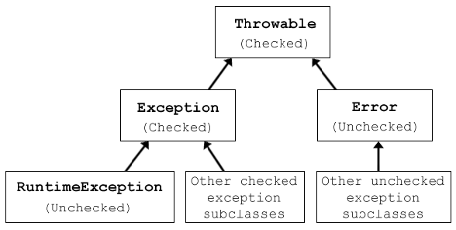

Slide 6
Checked exceptions:
Checked Exceptions are the Exceptions that are compiled at run time.
Here are few Checked Exceptions:
1.SQL Exception
2.IO Exception
3.ClassNotfoundException
4.InvocationTarget Exception

Slide 7
Unchecked exceptions:
These are the Exceptions which occur during run time.
Here are few Unchecked Exceptions:
1.Arithmetic Exception
2.ArrayIndexOutOfBound Exception
3.Nullpointer Exception
4.NumberFormat Exception

Slide 8
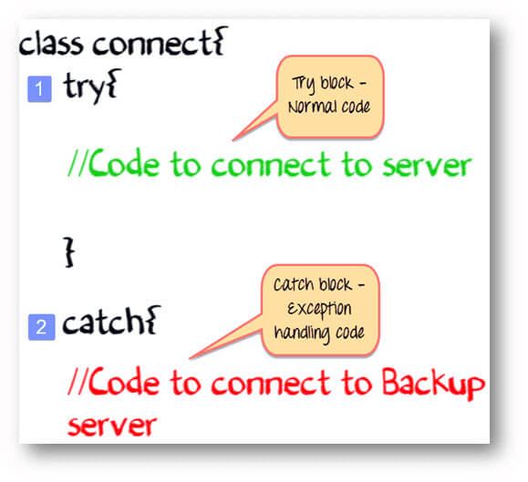

Slide 9
Keywords:
Some of the Keywords used in java are:
1.Try
2.catch
3.Finally
4.throw
5.throws

Slide 10
Thank you!!

