Slide 1
POLYMORPHISM

Slide 2

What is polymorphism????

Slide 3
What is polymorphism in programming??
It is an object oriented programming concept.
It refers to the ability of variable, function or object
to take on multiple forms.
It allows developers to program in the general rather than program in the specific.

Slide 4
Types of Polymorphism
Static Polymorphism also known as compile time polymorphism
Ex : Method Overloading
Dynamic Polymorphism also known as runtime polymorphism
Ex : Method Overriding

Slide 5

Method Overloading
What is it?

Slide 6
In programming:
Method Name is same but Signature is different.
Ex : class SimpleCalculator {
int add(int a, int b) {
return a+b; }
int add(int a, int b, int c)
{ return a+b+c; } }
public class Demo { public static void main(String args[])
{ SimpleCalculator obj = new SimpleCalculator();
System.out.println(obj.add(10, 20));
System.out.println(obj.add(10, 20, 30)); } }

Slide 7
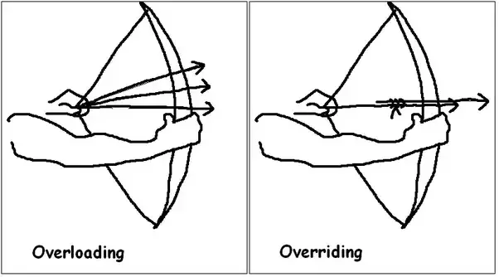
Method Overriding
What is it?

Slide 8
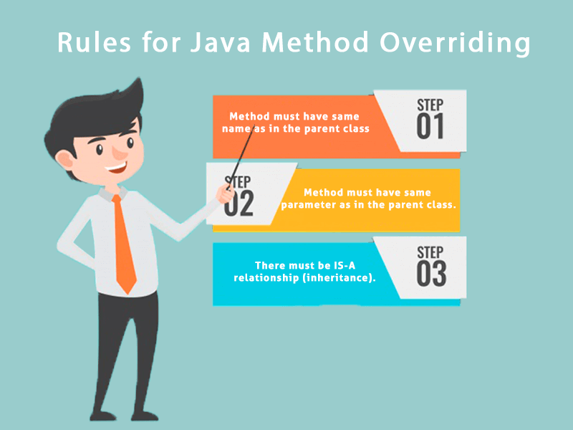
In programming:

Slide 9
Example:
class ABC{ public void myMethod(){
System.out.println("Overridden Method");
} }
public class XYZ extends ABC{
public void myMethod(){
System.out.println("Overriding Method");
}
public static void main(String args[]){
ABC obj = new XYZ();
obj.myMethod(); } }

Slide 10
Thank You

