Slide 1
Database Management System

Slide 2
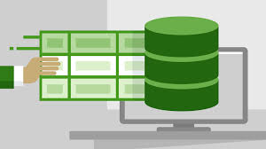
What is a database?
Database is a collection of inter-related data which helps in efficient retrieval, insertion and deletion of data from database and organizes the data in the form of tables, views, schemas, reports etc.

Slide 3
Database Management System
The software which is used to manage the database is called Database Management System.
It allows the users to create, update, delete and retrieve the data from the database.
It provides protection and security to the database. In the case of multiple users, it also maintains data consistency.

Slide 4
Advantages
Controls Redundancy
Data Sharing
Security
Backup
Easy Maintenance

Slide 5
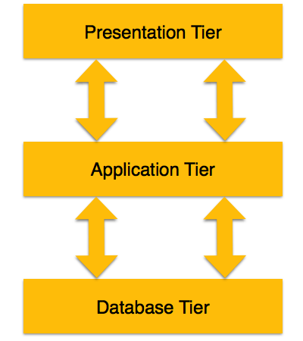
3- TIER ARCHITECTURE

Slide 6
DATABASE TIER
This tier allows the users to communicate directly with the database. It is used for logical applications. It is managed by database administrators.
APPLICATION TIER
This tier follows client server approach to communicate with the database.
PRESENTATION TIER
This is end user module where users communicate with the database using intermediate tier called Application tier.

Slide 7


