Slide 1

Prediction of Diabetes using Machine Learning Techniques
Mohammed Subhan Pasha
Raj Mohammed
Patnam Rahaman Siraj Ahmed

Slide 2

Introduction
Diabetes is the most widely prevailing and rapidly spreading disease in all the countries all over the world.
According to (WHO) World Health Organization about 422 million people suffering from diabetes particularly from low- or idle income countries. And this could be increased to 490 billion up to the year of 2030.
Diabetes caused because of obesity or high blood glucose level, and so forth. It affects the hormone insulin, resulting in abnormal metabolism of crabs and improves level of sugar in the blood.
Diabetes is major cause of death in the world. Early prediction of disease like diabetes can be controlled and save the human life.

Slide 3

Prediction using Data Mining Techniques
Data mining is the process of extracting and analyzing hidden patterns of data according to different perspectives for categorization into useful information
Data mining uses the Machine Learning algorithms for extraction of patterns /knowledge from unstructured data.
The machine learning techniques play a significant role in prediction and diagnosis of various health problems like heart disease, diabetes, diabetic retinopathy, cancer, skin disease and many more
Classification is one of the fundamental tasks which follow the predictive approach to predict the group membership of data instance.

Slide 4

Problem Specification
The most usual and conventional method for diagnosis and detection of diabetes by using human test reports.
In our study, we focus on prediction of diabetes using health records of the diabetic patients.
By using machine learning techniques, knowledge is acquired through these records, containing numerical values, to predict whether the patient is having diabetes or not.
For this prediction of Diabetes different classification algorithms (Support Vector Machine, Random forest, Logistic Regression) have been used.

Slide 5

Dataset
In this project, records of 520 patients form our experimental dataset.
We used the information of a group of regular outpatients.
the data is gathered from Kaggle UCI repository which is named as Diabetes Dataset.
Dataset has been collected using direct questionnaires from the patients of Sylhet Diabetes Hospital in Sylhet, Bangladesh, and approved by a doctor..
Both, male and female, patients with the age between the range 20 to 75 have been considered.

Slide 6

Data Pre-Processing
Data pre-processing is crucial step.
If the data collected contains any missing attributes or attribute values, contains noisy, outliers, duplicate or wrong data, then resultant accuracy will be depleted.
Moreover, the inconsistencies in the collected data may also affect the subsequent work.
That’s why we have applied pre-processing on the gathered data.

Slide 7

Data Pre-Processing
The transformation steps include:
Retaining some general demographic data like gender and age.
Removing of all text description for experimental accuracy
Representing more descriptive values by binary numbers
Removing of duplicate columns and redundant values from the dataset.
Replacing and/or substituting missing values
Data type classification

Slide 8
Methodology
Various Classifiers that have been used in this study are
Logistic Regression
SVM
Random Forest

Slide 9
Logistic Regression
Logistic regression is one of the most popular supervised machine learning algorithms used for predicting categorical dependent variable using a given set of independent variables.
In our study of prediction of Diabetes , our dataset contains two classes i.e. Diabetes and non Diabetes patients. Logistic regression will help us to train the hypothesis and will give us the probabilistic outcome in terms of 1 (Diabetes ) and 0 (non Diabetes ) cases.

Slide 10
Support Vector Machine (SVM)
SVM is a classification model which basically is a representation of different classes in a hyperplane in multidimensional space.
The goal of the SVM algorithm is to create this hyperplane or decision boundary that can segregate n-dimensional space into classes (Diabetes or Non-Diabetes ) so that we can easily put the new data point in the correct category.

Slide 11
Random Forest
Random Forest is a popular machine learning algorithm that belongs to the supervised learning technique. It can be used for both Classification and Regression problems in ML. It is based on the concept of ensemble learning, which is a process of combining multiple classifiers to solve a complex problem and to improve the performance of the model.
As the name suggests, "Random Forest is a classifier that contains a number of decision trees on various subsets of the given dataset and takes the average to improve the predictive accuracy of that dataset." Instead of relying on one decision tree, the random forest takes the prediction from each tree and based on the majority votes of predictions, and it predicts the final output.
The greater number of trees in the forest leads to higher accuracy and prevents the problem of overfitting.

Slide 12
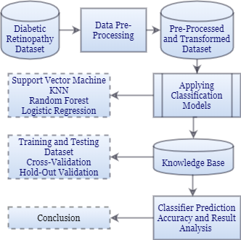
Proposed Model for prediction of Diabetic Retinopathy and Evaluating outcome

Slide 13
Implementation
This is most important phase which includes model building for prediction of diabetes. In this we have implemented various machine learning algorithms which are discussed above for diabetes prediction. Procedure of Proposed Methodology
Step1: Import required libraries, Import diabetes dataset.
Step2: Pre-process data to remove missing data.
Step3: Perform percentage split of 80% to divide dataset as Training set and 20% to Test set.
Step4: Select the machine learning algorithm i.e Support Vector Machine,Random forest and logistic regression.
Step5: Build the classifier model for the mentioned machine learning algorithm based on training set.

Slide 14
Implementation(Contd..)
Step6: Test the Classifier model for the mentioned machine learning algorithm based on test set.
Step7: Perform Comparison Evaluation of the experimental performance results obtained for each classifier.
Step8: After analyzing based on various measures conclude the best performing algorithm.
Step9: Create a website for input using the best algorithm.

Slide 15
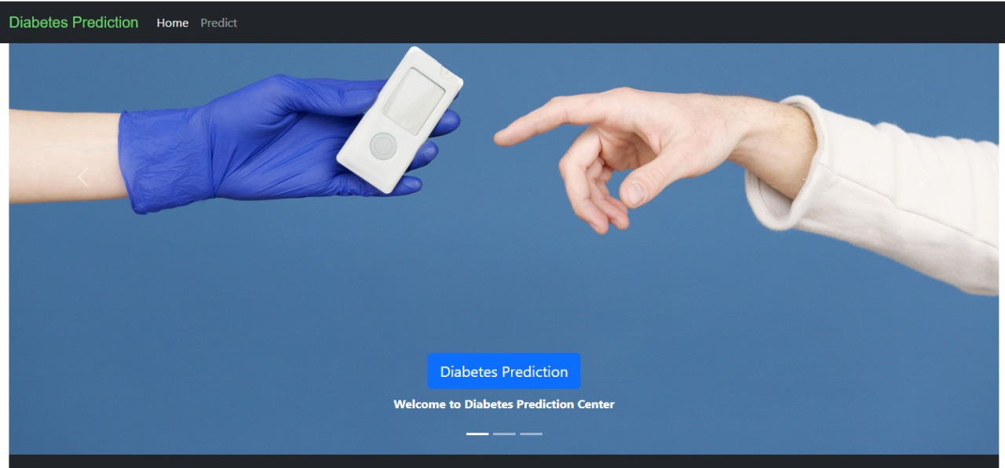
Website

Slide 16
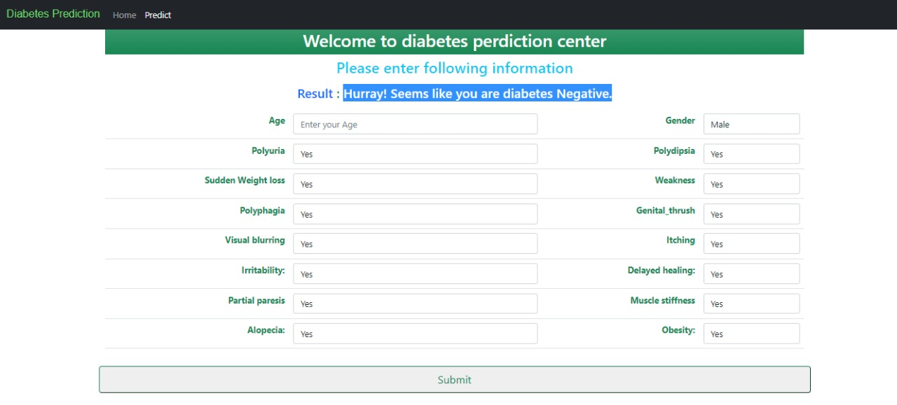
website

Slide 17
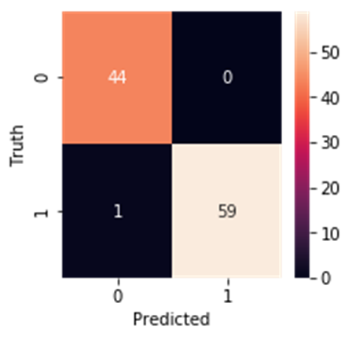
Result Analysis
After building the suitable model(Random Forest) the result was analyzed using confusion matrix and a heat map was plotted using the seaborn library as shown
Using the Heat map it was found that out of the 104 test cases the model has successfully predicted 103 test cases correctly and failed just once.
Hence the accuracy of the model was found to exemplary.

Slide 18
CONCLUSION
The main aim of this project was to design and implement Diabetes Prediction Using Machine Learning Methods. The proposed method uses Random forest, logistic regression and Support vector machine(svm) and has an accuracy of 98% for the random forest model. The Experimental results can be asst health care to take early prediction and make early decision to cure diabetes and save humans life.
These health records were organized in a structured way by eliminating noisy data. With the help of machine learning algorithms, knowledge is extracted from these records in the form of numerical values for the prediction of Diabetes . Then three types of machine learning models were used to find out the results.

Slide 19
References
https://www.kaggle.com/
https://scikit-learn.org/
https://docs.python.org/3/
https://docs.djangoproject.com/en/4.0/
https://developer.mozilla.org/en-US/docs/Web/HTML
https://jupyter-notebook.readthedocs.io/en/stable/

Slide 20

Thank You

