Slide 1
Topic: Multilingual Real-Time Sign Language Translator
Mixture-of-Experts (MoE) Architecture for Real-Time Gesture Recognition & Translation
Under the guidance of: Dr. Prabha Seetaram Naik (Associate Professor & HOD, Dept. of CSE(DS))
Under the Co-guidance of: Prof. Bhagya M (Assistant Professor)
Team Members (Dept. of Computer Science and Engineering, CITNC):
• Lekhana N (1AJ23CS069)
• Mohith Raj N (1AJ23CS082)
• Pragathi N (1AJ23CS105)
• Shohith Kumar K (1AJ23CS138)

Slide 2
Contents
❖ Previous Review Feedback
❖ System Design (Data Flow Diagram & SQLite Data Schema)
❖ System Architecture (Modular Mixture-of-Experts Architecture)
❖ Methodology & Implementation Pipeline (8-Step Execution & Continual Learning)

Slide 3
Previous Review Feedback & Project Solution
Title:
Multilingual Real-Time Sign Language Translator
Problem Definition:
Communication between sign language users and non-signers is difficult due to language barriers and limited real-time translation tools.
Proposed Solution:
Develop a real-time system utilizing a Hierarchical Mixture-of-Experts (MoE) deep learning architecture that recognizes static letters (A-Z) and dynamic word gestures, translating them into text and speech in multiple languages.
Objectives:
• Recognize sign language gestures accurately in real time with an MoE router (0/1/2 hands).
• Translate recognized signs into multiple target languages (Kannada, Hindi, Tamil, Telugu, etc.) with 0ms cache lookup.
• Provide synchronized text overlay and audio speech (TTS) output.
• Support live continual learning to extend the dictionary with custom gestures without full retraining.

Slide 4
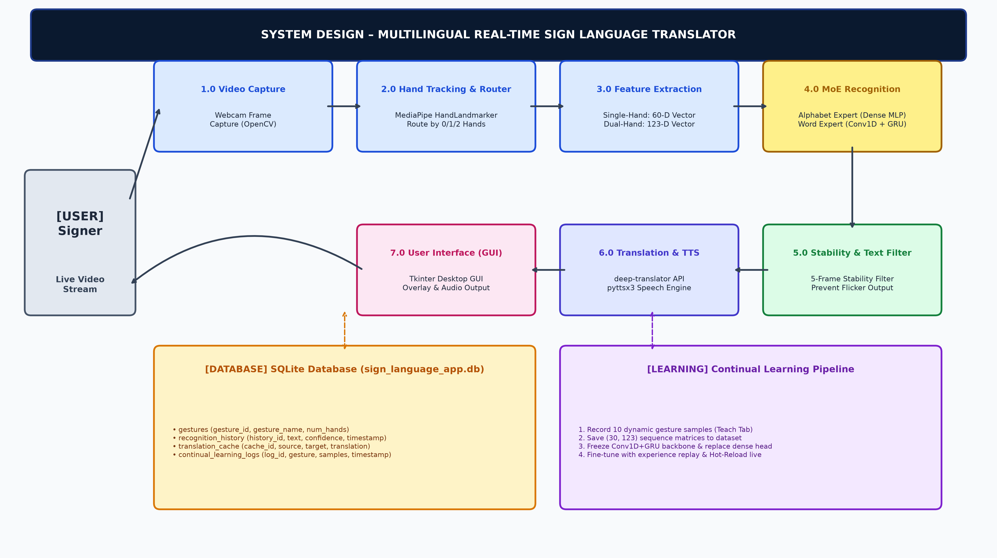
System Design

Slide 5
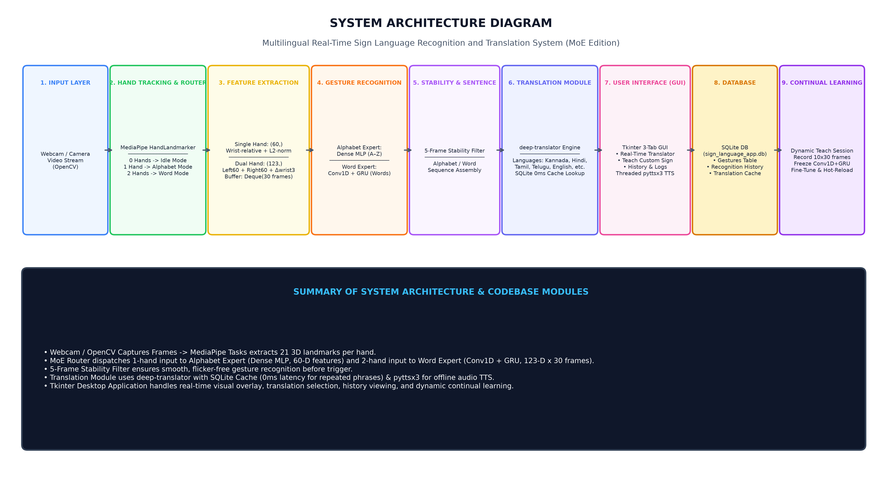
System Architecture

Slide 6
Methodology
Step 1: Data Collection & Input — Collect static images (Kaggle ASL A-Z) and dynamic video sequences (WLASL word dataset) via webcam.
Step 2: Hand Landmark Tracking — Detect 21 3D hand landmark coordinates per hand using MediaPipe HandLandmarker (supports dual hands).
Step 3: Feature Engineering — Extract 60-D wrist-relative normalized features for single hand, and 123-D features for dual hands across 30 frames.
Step 4: MoE Routing & Gesture Recognition — Route single-hand features to Alphabet Expert (Dense MLP) and dual-hand features to Word Expert (Conv1D + GRU).
Step 5: Stability Filtering & Sentence Assembly — Apply a 5-frame consecutive stability filter to prevent flicker and assemble recognized gestures into sentences.
Step 6: Multilingual Translation & Audio TTS — Translate recognized text into selected target languages using deep-translator with SQLite cache lookup (0ms repeat latency) & pyttsx3 TTS.
Step 7: Continual / Transfer Learning — Record 10 custom gesture samples live in the GUI Teach Tab, freeze Conv1D+GRU backbone, fine-tune dense head, and hot-reload model.
Step 8: Output & Persistence — Display real-time visual overlay, play speech output, and persist recognition history and logs in SQLite database.

Slide 7
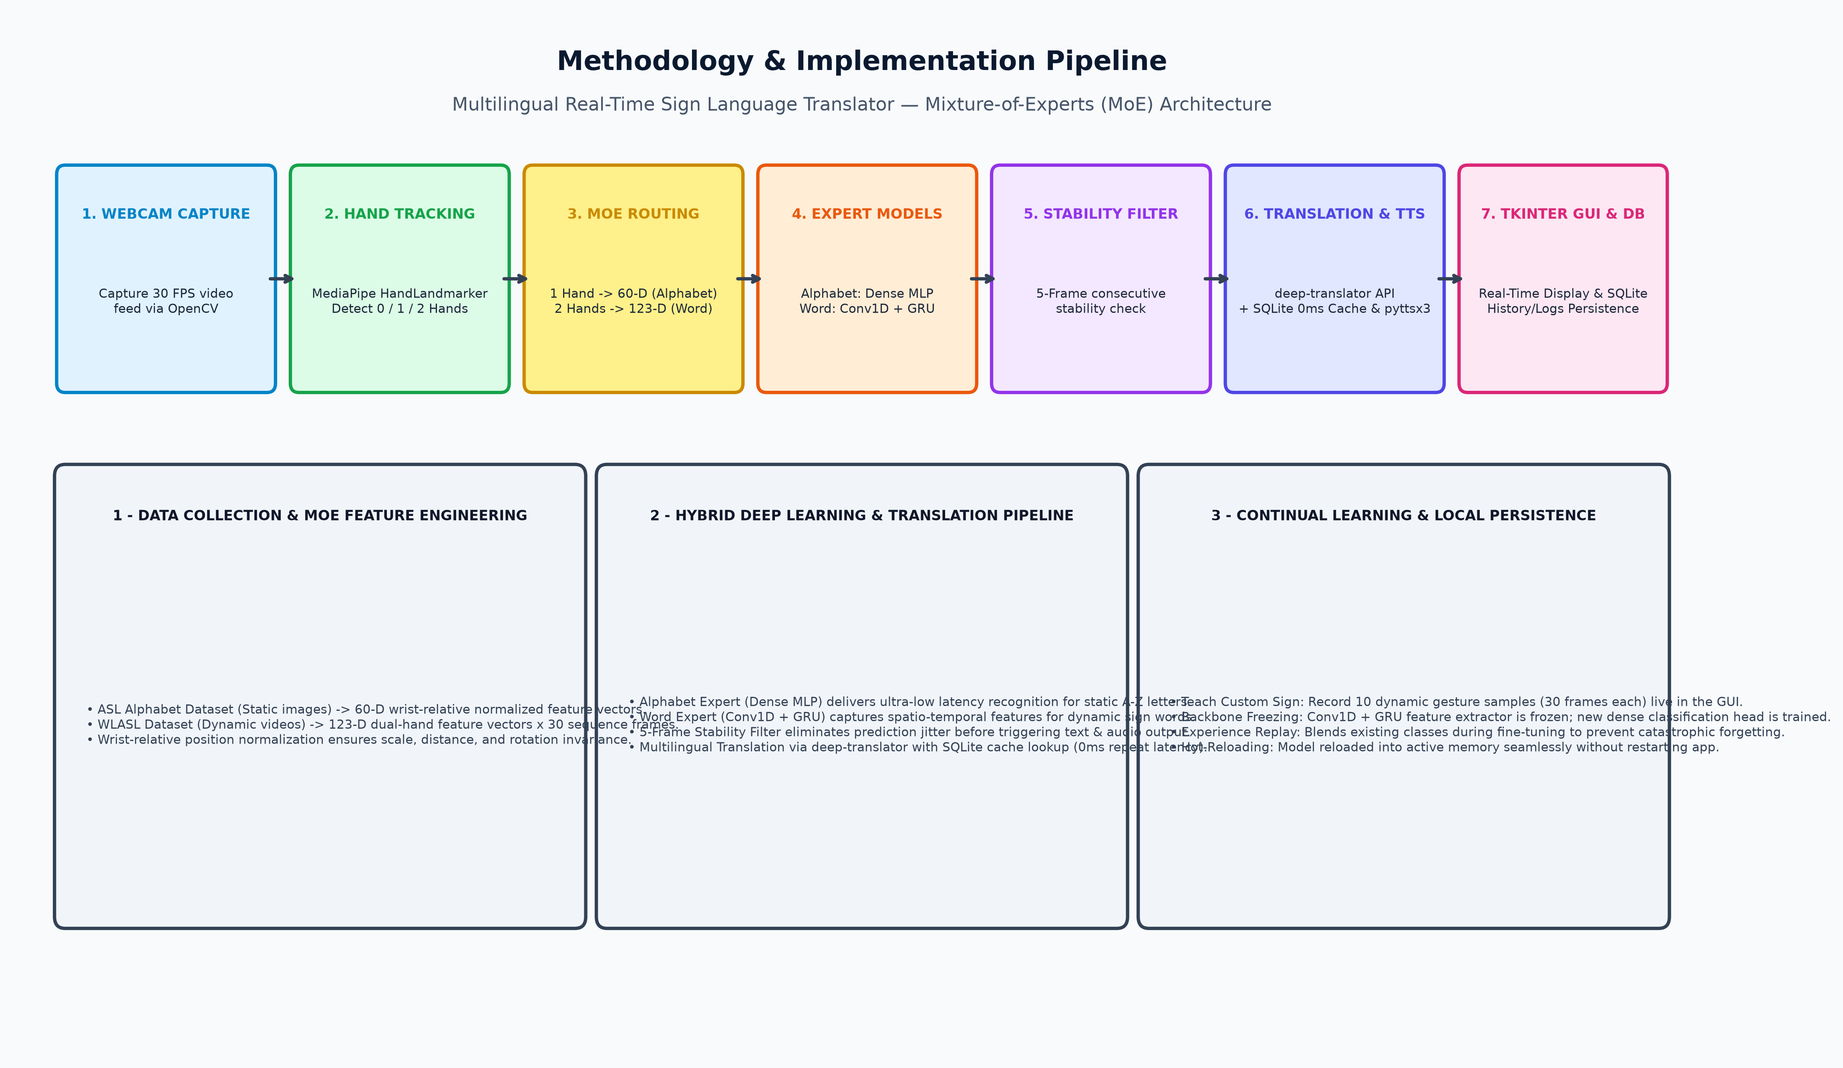
Methodology & Implementation Pipeline

Slide 8
Thank You!

