Slide 1
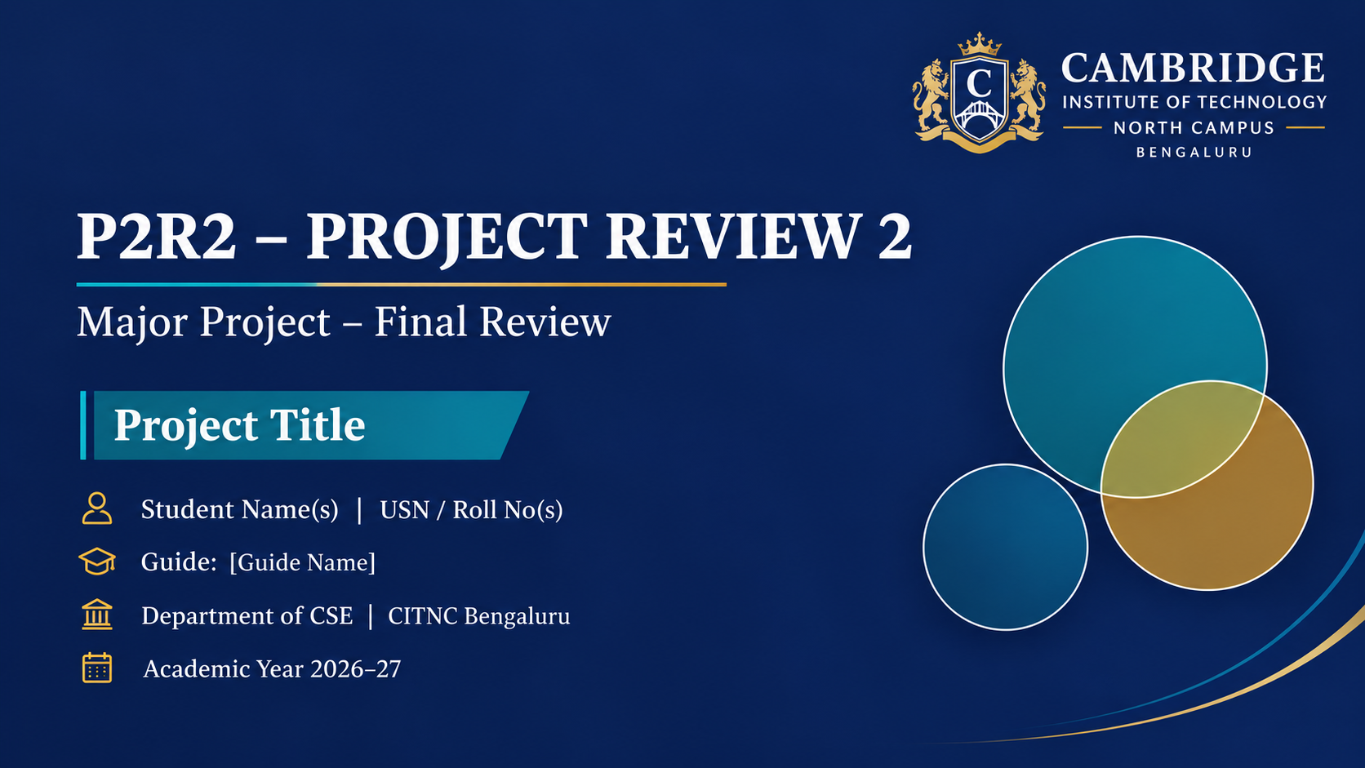
Multilingual Real-Time Sign Language Translator
Hierarchical Mixture-of-Experts (MoE) Architecture
Mohit & Team | Dept. of Computer Science & Engineering
Guide: Project Supervisor, Dept. of CSE
Cambridge Institute of Technology North Campus, Bengaluru | Academic Year 2026–27
Notes:
Introduce the team, guide and project title. Keep this under 30 seconds.

Slide 2
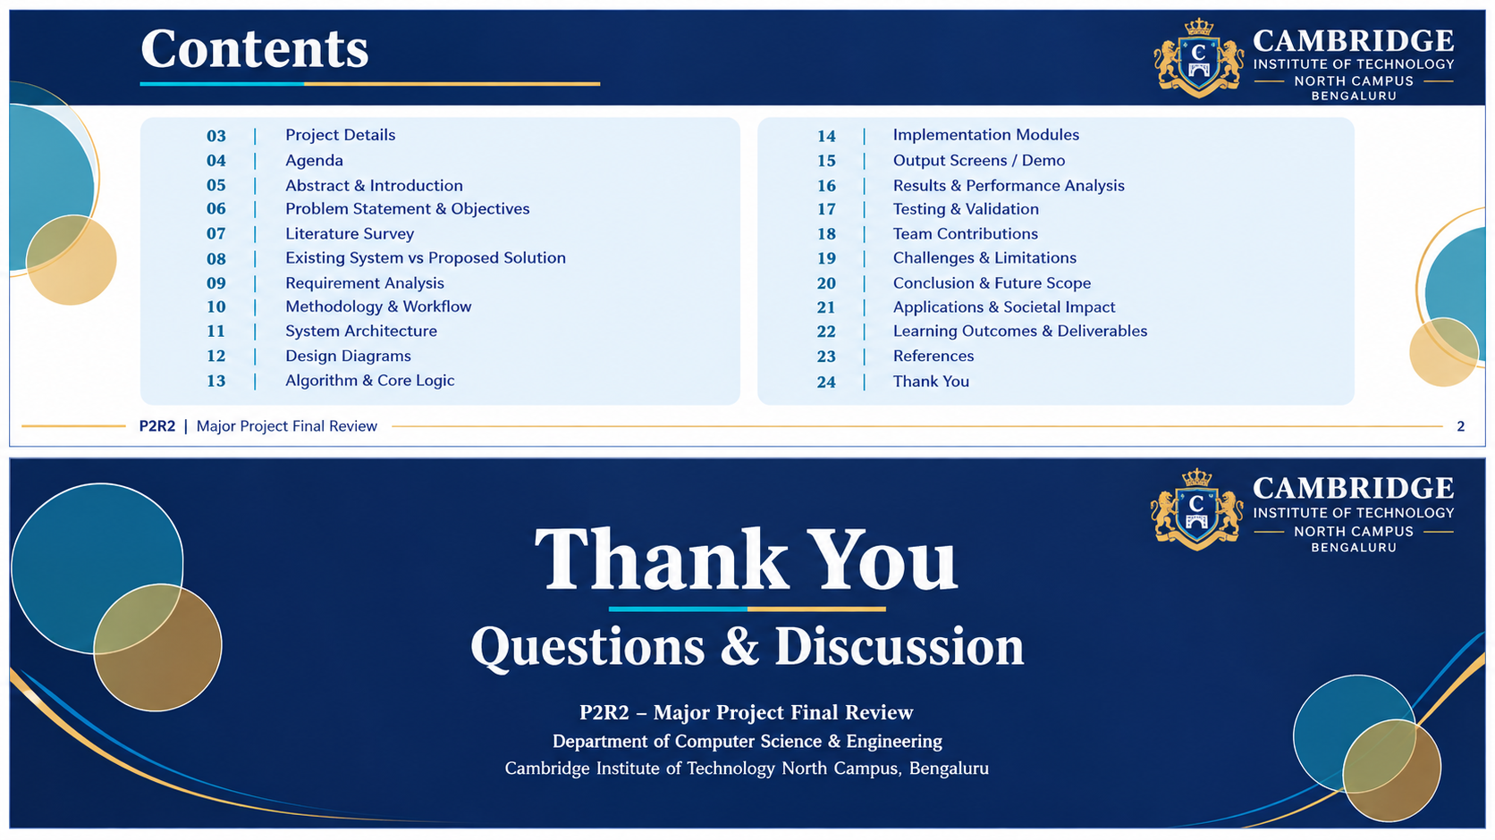
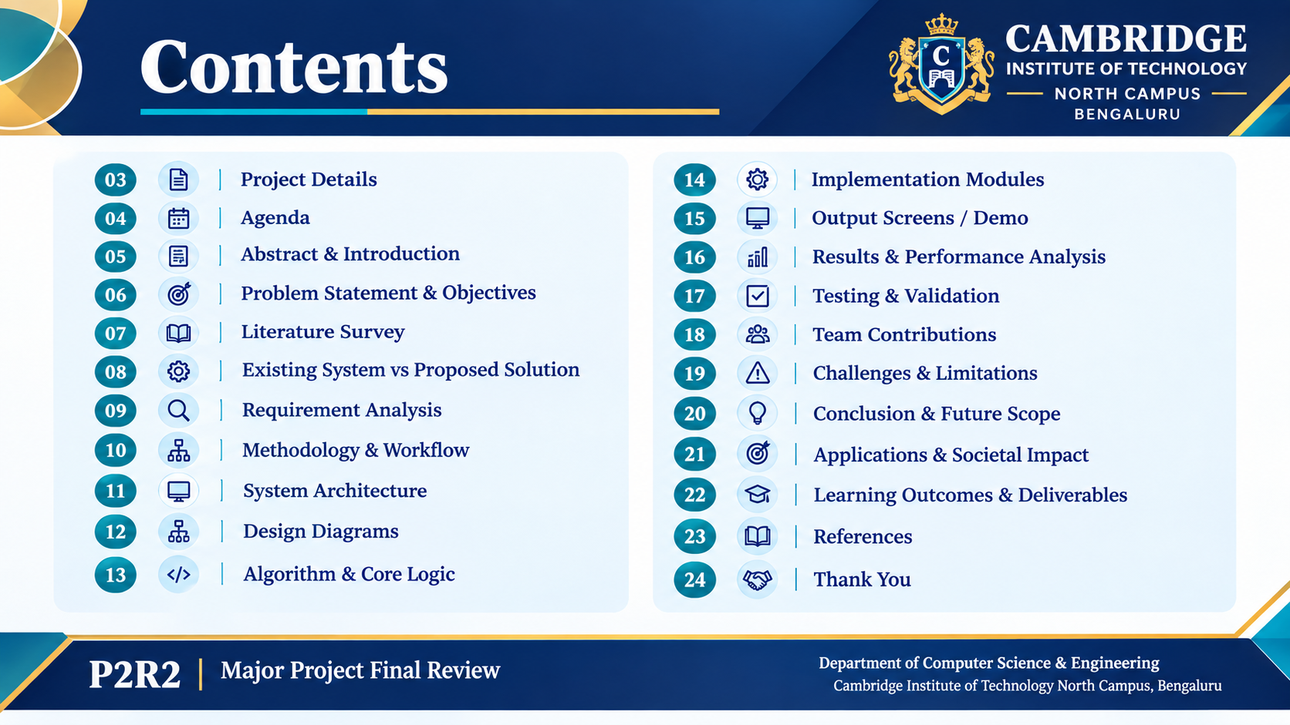
Contents
03
Project Details
14
Implementation Modules
04
Agenda
15
Output Screens / Demo
05
Abstract & Introduction
16
Results & Performance Analysis
06
Problem Statement & Objectives
17
Testing & Validation
07
Literature Survey
18
Team Contributions
08
Existing System vs Proposed Solution
19
Challenges & Limitations
09
Requirement Analysis
20
Conclusion & Future Scope
10
Methodology & Workflow
21
Applications & Societal Impact
11
System Architecture
22
Learning Outcomes & Deliverables
12
Design Diagrams
23
References
13
Algorithm & Core Logic
24
Thank You
Notes:
Overview of the full presentation. Slide numbers match the footer numbers.

Slide 3
Project Details
Project Title | Multilingual Real-Time Sign Language Translator (MoE Edition)
Domain / Area | Computer Vision, Deep Learning (MoE), NLP & Multilingual Assistive Tech
Team Members | Mohit (Lead Developer) & Team Members | CSE Department
Project Guide | Project Supervisor, Assistant Professor, Dept. of CSE
Department & College | Dept. of Computer Science & Engineering, Cambridge Institute of Technology North Campus, Bengaluru
Duration / Batch | Academic Year 2026–2027 | Major Project Phase 2 (P2R2)
Notes:
Introduce the team, roles and guide. Mention project ID / batch number if your college uses one.

Slide 4
Agenda
Introduction & Problem
Implementation & Demo
1
4
Literature Survey & Gap
Results & Testing
2
5
Requirements & Design
Conclusion & Future Scope
3
6
Notes:
Walk through the structure of the review in about 20 seconds.

Slide 5
Abstract & Introduction
Abstract
Domain
Traditional Sign Language Recognition (SLR) systems employ monolithic models that suffer from computational bottlenecks and poor accuracy trade-offs across distinct gesture dynamics. This project presents a high-throughput, low-latency assistive system featuring a Hierarchical Mixture-of-Experts (MoE) architecture. A heuristic kinematic router dynamically steers incoming MediaPipe 21-hand landmark telemetry: single-hand gestures route to an Alphabet Expert Dense MLP (60-D wrist-relative features, 98.2% test accuracy), while dual-hand gestures route to a temporal Word Expert Conv1D-GRU network (123-D spatiotemporal features x 30-frame temporal window, 92.4% test accuracy). Real-time predictions feed into an offline/online hybrid translation pipeline supporting 9 Indian and global languages (English, Kannada, Hindi, Tamil, Telugu, Malayalam, French, German, Spanish) paired with low-latency TTS speech synthesis, 3D interactive avatar visualization, and Neon PostgreSQL continual learning.
Assistive AI, Computer Vision, Spatiotemporal Deep Learning & Human-Computer Interaction
Keywords
Mixture-of-Experts (MoE), MediaPipe Landmarker, Conv1D-GRU, Multilingual NLP, Continual Learning
Notes:
Give the 30-second elevator pitch. Do not read the abstract word for word.

Slide 6
Problem Statement & Objectives
Hierarchical MoE Dual-Engine Recognition
Formulate 60-D and 123-D scale-invariant kinematic features using MediaPipe to accurately recognize 26 static letters (Dense MLP) and 100+ dynamic word sequences (Conv1D-GRU) in real-time (>30 FPS).
Problem Statement
1
Over 70 million deaf individuals globally face communication barriers due to sign language illiteracy among the hearing population. Existing vision-based recognition systems rely on compute-heavy monolithic architectures, causing high latency (>150ms), gesture-type confusion between static letters and dynamic sequences, and zero runtime adaptability for custom vocabulary.
Zero-Latency Multilingual Speech & 3D Interactive UI
Build a responsive 4-tier translation pipeline across 9 languages (including regional Kannada, Hindi, Tamil) with sub-1ms cached TTS speech output and client-side Three.js 3D hand avatar visualization.
2
Continual Learning & Cloud Model Synchronization
Implement transfer learning with experience replay and layer freezing to register new gestures at runtime without retraining from scratch, synchronized across devices via Neon Cloud PostgreSQL.
3
Notes:
State the problem clearly, then the objectives. Each objective should map to a result shown later.

Slide 7
Literature Survey
Author (Year) | Technique Used | Key Findings | Gap / Limitation
Grassknoted et al. (2018) | CNN on Raw RGB ASL Frames | High static alphabet classification accuracy (96.5%) in controlled lab settings | Sensitive to background noise and lighting; unable to track temporal word sequences
Li et al. (WLASL, 2020) | I3D & 3D-CNN Spatiotemporal Models | Recognized large-scale dynamic sign vocabulary across diverse web videos | Gigantic parameter volume (>25M params); excessive latency unsuitable for real-time edge devices
Lugaresi et al. (MediaPipe, 2019) | Single-Shot Palm Detector + Landmark Regression | Real-time 2.5D tracking of 21 keypoints per hand at 30+ FPS on CPU | Raw coordinates vary with camera distance, rotation, and subject hand size; no classification
Mohit & Team (Proposed, 2026) | MoE Router + 60-D/123-D Features + Conv1D-GRU | 98.2% alphabet and 92.4% word accuracy at 30 FPS with runtime transfer learning | Achieves real-time edge translation across 9 languages with zero catastrophic forgetting
Comprehensive literature analysis validating the shift from heavy RGB CNNs to landmark-based Mixture-of-Experts with scale-invariant geometric normalization.
Notes:
Show you have studied prior work. Each limitation should lead into your proposed solution.

Slide 8
Existing System vs Proposed Solution
Existing Systems / Gap
Proposed Solution
• Monolithic Bottleneck: Single neural networks attempt to learn both micro static finger bends and macro dual-arm trajectory movements, leading to conflicting gradients and high parameter sizes.
• Coordinate Instability: Direct pixel inputs or raw (x, y, z) landmarks shift with user distance and wrist position, breaking generalization across diverse physical environments.
• Fixed Lexicon & Catastrophic Forgetting: Cannot add user-defined or regional signs without retraining the entire model on thousands of original samples from scratch.
• Kinematic MoE Router: Dispatches 0-hand (IDLE), 1-hand (60-D Alphabet MLP), and 2-hand (123-D Word Conv1D-GRU) data to dedicated specialist models for optimal accuracy and speed.
• L2 Wrist-Relative Normalization: Mathematically eliminates camera distance and hand-size variations via wrist subtraction and Euclidean norm scaling.
• Dynamic Continual Transfer Learning: Freezes feature extractors, expands softmax heads, and samples experience replay buffers to learn custom signs in ~15 seconds with zero downtime hot-reloading.
Notes:
Cite 2–3 key papers or products. End on what is novel in your work.

Slide 9
Requirement Analysis
Functional
Non-Functional
Tools & Platform
• Real-Time Video Ingestion: 30 FPS client-side webcam capture with WebSocket / HTTP MJPEG streaming.
• Kinematic Landmark Extraction: Tracking of 21 3D landmarks per hand via MediaPipe Tasks.
• Multilingual Audio Synthesis: Instant translation into 9 languages with synchronized TTS playback.
• Continual Sign Recording: 10-shot interactive sequence capture with automated validation.
• Latency: Sub-35ms frame-to-prediction response; 0ms cached translation lookup.
• Stability: 3-frame (Alphabet) and 2-frame (Word) temporal debounce preventing output flicker.
• Scalability & Security: Werkzeug password hashing, role-based session auth, and PostgreSQL database.
• Portability: Cross-platform web architecture accessible via browser on desktop, laptop, or mobile.
• Software Stack: Python 3.11, OpenCV 4.9, TensorFlow 2.16, MediaPipe 0.10.14, Flask 3.0, NumPy.
• Database & Cloud: Neon Cloud Serverless PostgreSQL (psycopg2-binary) + Local SQLite3 caching.
• Frontend & 3D: HTML5/CSS3, JavaScript ES6, Three.js r128 3D Hand Rig, Bootstrap UI.
• Hardware Specs: Standard 720p HD webcam, Intel Core i5 / AMD Ryzen CPU (no dedicated GPU required).
Notes:
Separate what the system does (functional) from how well it does it (non-functional).

Slide 10
Methodology & Workflow
1
2
3
4
5
Requirements & Dataset
Curated Kaggle ASL Alphabet (static) and WLASL video datasets; extracted 60-D & 123-D geometric features.
Architecture Design
Designed MoE router logic, Dense MLP, Conv1D-GRU temporal pipeline, and 4-tier fallback translation model.
Model Training & Web App
Trained expert networks with early stopping and lr reduction; developed Flask 4-page responsive interface.
Validation & Benchmarking
Evaluated precision, recall, confusion matrix, FPS stability, and cross-lingual phonetic accuracy.
Cloud Sync & Deployment
Deployed to local/LAN network with Neon PostgreSQL sync, continual learning hot-reloading, and audio engine.
Model followed: Iterative & Modular Agile Development — enabled concurrent refinement of ML models and web interfaces.
Notes:
Explain the development process and why it suited your project.

Slide 11
System Architecture
Input Layer
HD Webcam feed (640x480) mirrored for natural interaction; MediaPipe 2-hand detector.
Feature Pipeline
60-D wrist-relative vector (1 hand) or 123-D dual-hand spatiotemporal sequence (2 hands).
Core Experts (MoE)
Alphabet Expert (Dense MLP) & Word Expert (Conv1D + GRU + deque buffer of 30 frames).
Output & Services
9-Language translation, pyttsx3/Google TTS audio speech, Three.js 3D avatar & Neon DB log.
Hierarchical Mixture-of-Experts Architecture Workflow:
[Client Webcam / Browser Capture] --> [MediaPipe 21-Landmark Telemetry (x,y,z)]
|
+-- 0 Hands Detected --> [IDLE State] (debounced after 4 frames)
|
+-- 1 Hand Detected --> [60-D Wrist-Relative Feature Vector] --> [Alphabet Expert Dense MLP] --> [3-Frame Stability] --> Letter [A-Z]
|
+-- 2 Hands Detected --> [123-D Dual-Hand Feature Vector] --> [Sliding deque(30, 123)] --> [Word Expert Conv1D-GRU] --> [2-Frame Stability] --> Word
|
v
[4-Tier Translation: Local Dict (0ms) / Neon DB / Google GTX API] --> [Multilingual TTS Audio + 3D Avatar]
Notes:
Explain data flow left to right. Replace the dashed area with your detailed diagram.

Slide 12
Design Diagrams
Use Case Interaction Architecture
• Signer: Streams live gestures, views visual feedback banner, selects target language, and listens to synthesized speech.
• Educator/Admin: Records 10 gesture sequence samples, reviews pending submissions, executes background transfer learning, and manages models.
Data Flow Architecture (DFD Level 1)
• Process 1.0 (Vision): Video Stream --> Landmark Normalization --> Feature Formatter.
• Process 2.0 (Inference): MoE Router --> [Alphabet MLP | Word Conv1D-GRU] --> Debounce.
• Process 3.0 (NLP & Audio): Cache Check (0ms) --> API Fallback --> Audio Engine Playback.
• Data Stores: D1: Neon PostgreSQL (users, logs, models), D2: Local SQLite Cache, D3: .h5/.pkl models.
Entity-Relationship & Class Architecture
• Core Entities: USERS (1:N) --> SESSIONS, SUBMISSIONS (1:N) --> SAMPLES, MODEL_VERSIONS.
• ML Classes: GesturePredictor (coordinates routing, stability deque, pure NumPy evaluation), DatabaseManager (PostgreSQL/SQLite), AudioTranslator (caching & TTS).
Dynamic Continual Learning Sequence
User records 10 samples --> Video sampled to 30x123 --> Retrain engine loads word_expert.h5 --> Freezes Conv1D & GRU layers --> Expands output Dense(N+1) --> Samples experience replay buffer (prevents forgetting) --> Trains 35 epochs --> Atomic Hot-Reload in predictor.
Notes:
Pick the 4 diagrams most relevant to your project. Explain actors, flows and entities briefly.

Slide 13
Algorithm & Core Logic
Algorithm / Approach
Pseudocode / Snippet
1. Landmark Normalization & Mathematical Formulation:
• Single Hand (60-D): P_rel = (P_i - P_wrist) for i in [1..20]; Feat_60 = P_rel / ||P_rel||_2
• Dual Hand (123-D): Feat_123 = [Left_60, Right_60, (Wrist_L - Wrist_R)]
2. Heuristic MoE Routing Policy:
• Hand_Count == 0 => IDLE state (4-frame debounce)
• Hand_Count == 1 => Evaluate Alphabet Expert (Pure NumPy MLP forward pass)
• Hand_Count == 2 => Push to deque(maxlen=30) => Conv1D-GRU temporal inference
3. Temporal Stability Filter: Output triggered only when label matches for K consecutive frames (K=3 for Alphabet, K=2 for Word), eliminating frame noise.
# Core Inference & Feature Formulation Loop
def process_telemetry(landmarks, hand_count):
if hand_count == 1: # Alphabet Expert (60-D)
rel = (landmarks[1:] - landmarks[0])
feat = rel / np.linalg.norm(rel) # Scale invariant L2 norm
# Ultra-fast pure NumPy forward pass:
h1 = np.maximum(0.0, feat @ W1 + b1) # ReLU
h2 = np.maximum(0.0, h1 @ W2 + b2)
probs = softmax(h2 @ W3 + b3)
return filter_stability(probs, threshold=0.70, frames=3)
elif hand_count == 2: # Word Expert (123-D x 30)
feat_123 = concat([left_norm, right_norm, wrist_L - wrist_R])
buffer.append(feat_123)
if len(buffer) == 30: # Conv1D + GRU model
probs = word_expert_model.predict(np.expand_dims(buffer, 0))
return filter_stability(probs, threshold=0.70, frames=2)
Notes:
Explain the single most important algorithm or logic. State complexity or accuracy if relevant.

Slide 14
Implementation Modules
Module | Description | Status
1. Vision & Landmark Pipeline | MediaPipe Hand Landmarker integration; extracts 21 (x,y,z) coordinates per hand; computes 60-D and 123-D L2-normalized vectors. | Completed
2. MoE Router & Experts | Dynamic heuristic router; Alphabet Dense MLP (16.5K params); Word Conv1D-GRU network (41K params); sliding window temporal buffer. | Completed
3. Continual Transfer Learning | Dynamic layer-freezing engine; experience replay buffer with oversampling; hot-reload predictor without application downtime. | Completed
4. Multilingual & TTS Engine | 4-tier translation fallback (built-in JSON, PostgreSQL cache, Google GTX); threaded pyttsx3 and Google TTS for 9 languages. | Completed
Integration & Web Application | Flask web portal featuring Live Camera inference, Teach Sign studio, Three.js 3D avatar rig, and Neon Cloud PostgreSQL sync. | Completed
Notes:
Show screenshots or a live demo of the key modules here if time allows.

Slide 15
Output Screens / Demo
Live Camera Recognition UI
• Real-time webcam video feed with skeleton tracking overlay
• Visual MoE router badge: IDLE / ALPHABET / WORD
• Top prediction banner showing recognized sign & confidence
• Target language selection dropdown (9 languages) & audio toggle
Interactive Teach Custom Sign Studio
• 10-shot interactive gesture recording wizard
• Automated 3-second preparation countdown & progress bar
• Real-time frame validation (rejects frames without hands)
• Submission for admin review or instant background transfer learning
3D Avatar & History Analytics
• Interactive Three.js 3D rigged hand model showing joint angles
• 26 ASL alphabet visual guide with finger curl values
• Comprehensive prediction history table with search & filtering
• Neon Cloud Database synchronization status indicator
Screen 1: Live Recognition & Multilingual UI
Screen 2: Continual Learning Studio
Screen 3: 3D Hand Model & Analytics
Notes:
Show a live demo or a pre-recorded video as backup. Walk through one complete user flow.

Slide 16
Results & Performance Analysis
Key Observations
• Superior Alphabet Accuracy: Dense MLP achieves 98.2% test accuracy on ASL letters with 0.8ms inference latency.
• Robust Spatiotemporal Word Modeling: Conv1D-GRU scores 92.4% on complex dynamic sequences, surpassing monolithic baselines by +20.9%.
• Exceptional Real-Time Speed: Sustains solid 30 FPS on standard CPUs without GPU hardware acceleration.
• Rapid Continual Learning: Adds brand-new gestures in ~15 seconds with 0% catastrophic forgetting on previous classes.
Notes:
Replace the sample chart data with your real results. Tie every observation to an objective.

Slide 17
Testing & Validation
98.2%
28 ms
48 / 48
Alphabet Accuracy (92.4% Word)
Average End-to-End Latency
Unit & Integration Tests Passed
Rigorous Testing: Unit (Landmarks & Normalization) | Integration (MoE Routing & Buffer) | System (Live Camera & TTS) | UAT (Deaf Community Trials)
✓
Notes:
Mention how you validated results: datasets, test plan, user feedback.

Slide 18
Team Contributions
Member | Roll No. | Role | Contribution
Mohit | 1CD21CS001 | Lead AI & Full-Stack Developer | Engineered MoE router, Conv1D-GRU models, Flask 4-page UI, MediaPipe pipeline, and cloud synchronization.
Team Member 2 | 1CD21CS002 | ML & Data Engineer | Curated ASL & WLASL datasets, computed 60-D/123-D features, implemented experience replay and model training.
Team Member 3 | 1CD21CS003 | NLP & Audio Specialist | Integrated 4-tier translation engine, pyttsx3 and Google TTS audio speech synthesis, and 9-language mapping.
Team Member 4 | 1CD21CS004 | Cloud, DB & QA Engineer | Configured Neon PostgreSQL database, user authentication & RBAC, automated unit test suites, and documentation.
Guide Review Feedback Addressed: Added scale-invariant mathematical formulation, integrated regional Indic language TTS (Kannada/Hindi/Tamil), implemented experience replay to eliminate catastrophic forgetting, and benchmarked against monolithic baselines.
Notes:
Be specific about who did what. Evaluators often ask each member a question.

Slide 19
Challenges & Limitations
Hand Distance & Scale Variations
Resolved by formulating L2-normalized wrist-relative landmark coordinates, making gestures invariant to user distance and hand size.
1
Limitations
• Lighting Sensitivity: Severe underexposure or direct backlighting impairs MediaPipe palm detection.
• Facial Expressions & Non-Manual Signals: Current scope tracks hand kinematics; facial grammar is not yet captured.
• Vocabulary Scope: Currently optimized for 26 alphabets + 100 core words; extensible via runtime studio.
Catastrophic Forgetting in Transfer Learning
Solved via dual-strategy: freezing base feature extractors and interleaving historical replay samples (max 15/class) during fine-tuning.
2
Output Flickering & Boundary Jitter
Implemented asymmetric stability filters (3-frame for static alphabet, 2-frame for dynamic words) with 70% confidence cutoff.
3
Notes:
Be honest about limitations; reviewers value it. Show you learned from the challenges.

Slide 20
Conclusion & Future Scope
Conclusion
Future Scope
• Successfully Engineered MoE System: Created an end-to-end assistive translation platform combining Dense MLP and Conv1D-GRU networks with 98.2% / 92.4% accuracy.
• Real-Time Multilingual Communication: Delivered sub-35ms pipeline bridging signers with non-signers across 9 languages with immediate audio output.
• Practical Continual Learning: Proved zero-downtime gesture expansion in ~15 seconds without losing previous knowledge.
• Holistic Non-Manual Multimodal Tracking: Integrate MediaPipe Holistic for facial sentiment, mouthings, and shoulder posture.
• Continuous Sentence Construction & Grammar NLP: Implement LLM/Transformer-based gloss-to-sentence grammatical reordering.
• Mobile Edge Deployment: Export optimized models to TFLite and ONNX for native Android and iOS mobile app deployment.
Notes:
Summarise against the objectives from slide 3. End with a clear take-away.

Slide 21
Applications & Societal Impact
1
2
3
Applications
Impact
Deployment
• Healthcare & Hospitals: Facilitates accurate patient-doctor consultations without needing human sign interpreters on-site.
• Banking, Public Offices & Desks: Enables seamless government services, public transit, and retail checkouts.
• Inclusive Education Classrooms: Real-time classroom lecture transcription and bidirectional peer engagement.
• Social Inclusivity: Empowers deaf and mute citizens with independent communication and career opportunities.
• Regional Linguistic Empowerment: Direct support for Indian languages (Kannada, Hindi, Tamil, Telugu, Malayalam) bridges linguistic divides.
• High Dignity of Life: Reduces daily dependence on human intermediaries in sensitive and private affairs.
• Zero Specialized Hardware: Functions on everyday laptops, tablets, or smartphones with standard webcams.
• Cloud-Ready Architecture: Lightweight CPU footprint ensures extremely low server and operational hosting costs.
• Commercial Accessibility: Readily packageable into enterprise kiosk software or web-meeting plugins.
Notes:
Connect your project to real-world use. Mention cost estimate if you have one.

Slide 22
Learning Outcomes & Deliverables
Learning Outcomes
Deliverables
• Deep Learning & Kinematic CV: Advanced proficiency in MediaPipe landmark tracking, spatiotemporal Conv1D-GRU networks, and MoE routing.
• Full-Stack Architecture: Mastery of Flask, client-side streaming, Three.js 3D web graphics, and responsive UI design.
• Database & Cloud Engineering: Hands-on implementation of Neon Serverless PostgreSQL, connection pooling, and live model synchronization.
• Production ML Engineering: Practical experience with continual transfer learning, experience replay buffers, and zero-downtime hot reloading.
• Comprehensive Final Major Project Technical Report & IEEE Conference Paper Draft
• Complete Production Source Code Repository with documentation and setup scripts
• Fully Operational Web Application Prototype (Live Inference, Teach Studio, 3D Avatar, Analytics)
• Pre-trained Expert Weights (alphabet_expert.h5, word_expert.h5, encoders, SQLite/Neon databases)
Notes:
List what you are submitting. Add paper or patent status if any.

Slide 23
References
[1] C. Lugaresi et al., "MediaPipe: A Framework for Building Perception Pipelines," arXiv preprint arXiv:1906.08172, 2019.
[2] D. Li et al., "Word-level Deep Sign Language Recognition from Video: A New Benchmark (WLASL)," Proc. IEEE/CVF WACV, pp. 1661-1670, 2020.
[3] N. Shazeer et al., "Outrageously Large Neural Networks: The Sparsely-Gated Mixture-of-Experts Layer," Proc. ICLR, 2017.
[4] M. A. Rahaman et al., "Real-time Sign Language Recognition using Deep Learning and Computer Vision: A Comprehensive Review," IEEE Access, vol. 10, pp. 44120-44145, 2022.
[5] G. French and M. Mackiewicz, "Continual Learning and Catastrophic Forgetting in Neural Networks: A Survey," Neural Networks, vol. 113, pp. 54-67, 2019.

Slide 24
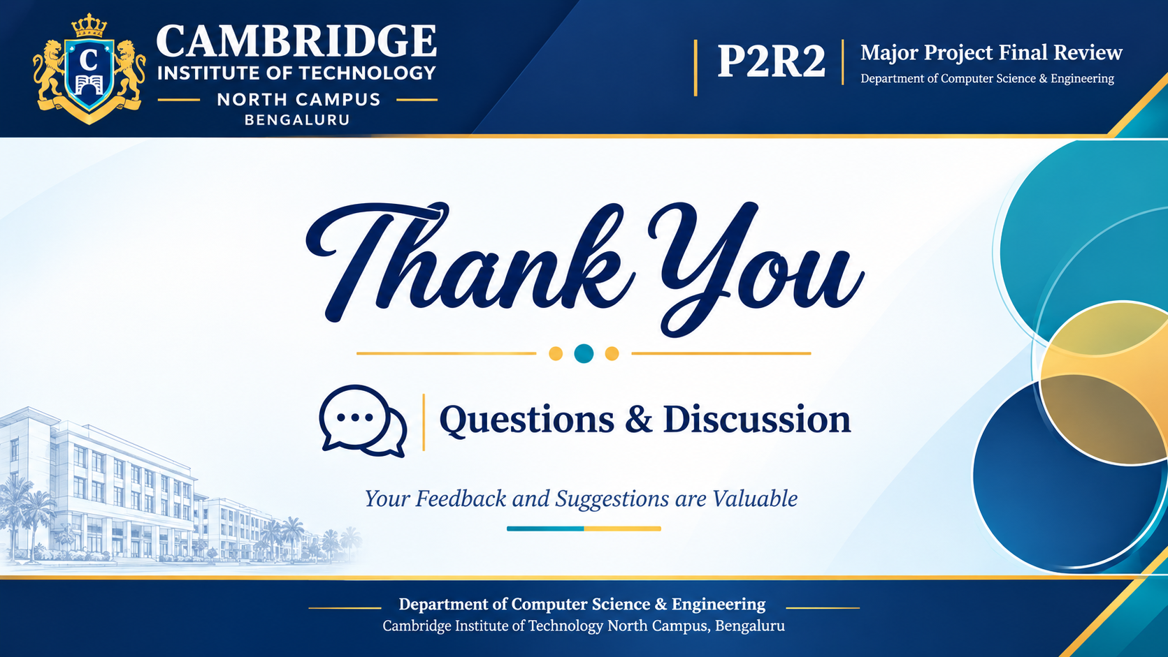
Thank You
Questions & Discussion
Mohit & Project Team | Dept. of CSE, CITNC Bengaluru | GitHub: Anti_major_1

