Slide 1

Blue Mountain Resort, Montana
Pricing Strategy recommendation
Image Credit: - https://www.teepublic.com/pin/14645669-blue-mountain-montana

Slide 2
Context & Business Problem
Blue Mountain resort, Located in Montana, USA is one of the premium skiing resorts offering a variety of fun and adventure filled services and activities
It has recently installed a chair lift costing $1.5 Million and is in dilemma if it can cover the operational costs with the current pricing strategy
Current issue is to come up with a new and efficient pricing model and strategy that can strengthen Blue Mountain’s revenue growth as well as improve the investment program for future before the new season open
It plans to improve the pricing for tickets by comparing it to other resorts by at least 15-20% based on its resort features

Slide 3
Recommendation & Key Findings
Based on in depth analysis of comparing states as well as Resort features, it was found that
Blue Mountain is one of the best resorts in market context when it comes to a lot of features such as Skiable area, Vertical Drop, Number of chairs and runs, Snow Making and longest run
Based on the best Ml Model chosen, the new effective ticket price after comparing with other resorts and their pricing, it comes out to be around $96.00 whereas it was $81.00 last season.
Although this new price is just based on Resorts features, it might not be the most optimum as we are lacking data related to operational and maintenance costs, which could have been more helpful in determining more optimum price

Slide 4
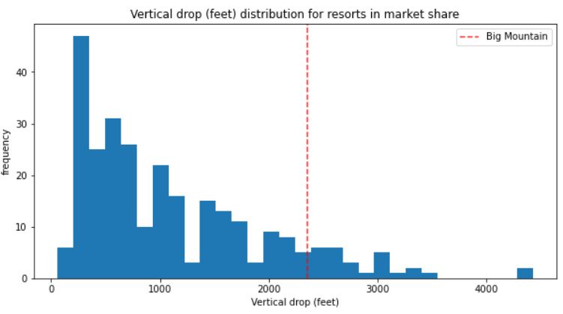
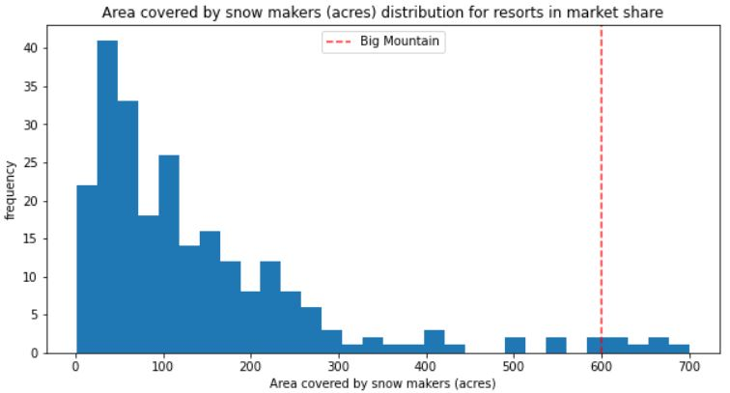
Modelling & Analysis
Based on the most suitable model chosen after pro processing and predicting the price on other resort’s features and their pricing strategy, new ticket price for blue Mountain came out to be $96.00
In terms of Market context, to show where Blue Mountain stands as compared to other resorts based on the features mentioned below:
vertical_drop & Snow Making_ac
Big Mountain has a pretty good vertical drop though some resorts have more high but it leads when it comes to snow making

Slide 5
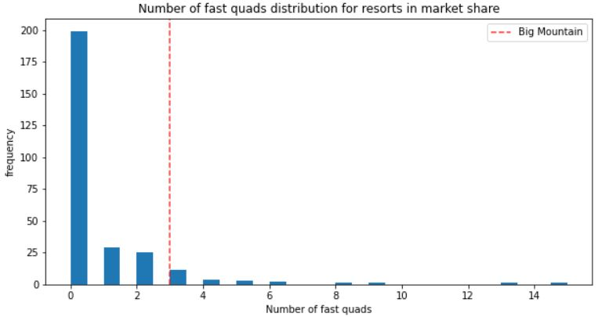
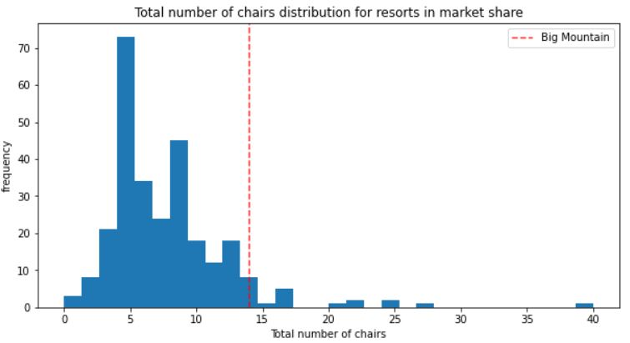
Modelling & Analysis - Contd.
total_chairs & fastQuads
Big Mountain is one of the leading resorts in terms of Total chair lifts although some see to be outliers, same is the case in fast squads

Slide 6
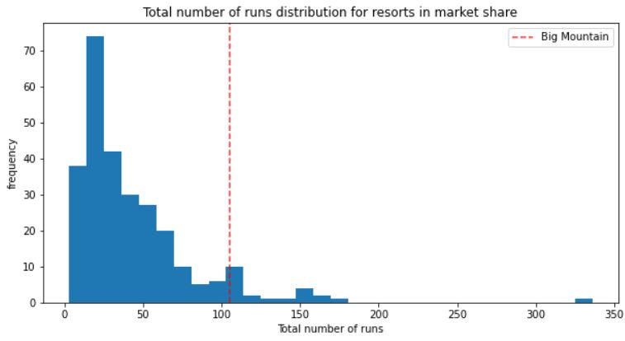
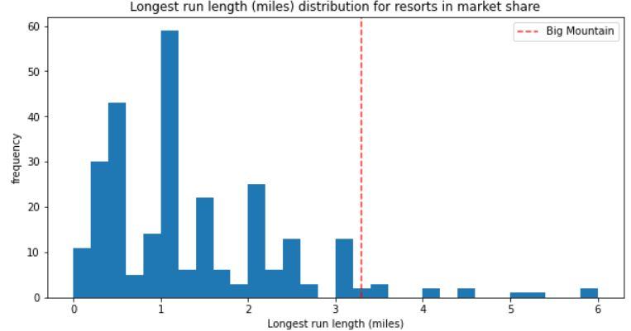
Modelling & Analysis - Contd.
total_runs & Longest Run
Big Mountain is one of the leading resorts both in terms of runs and longest run, very few are above Blue Mountain

Slide 7
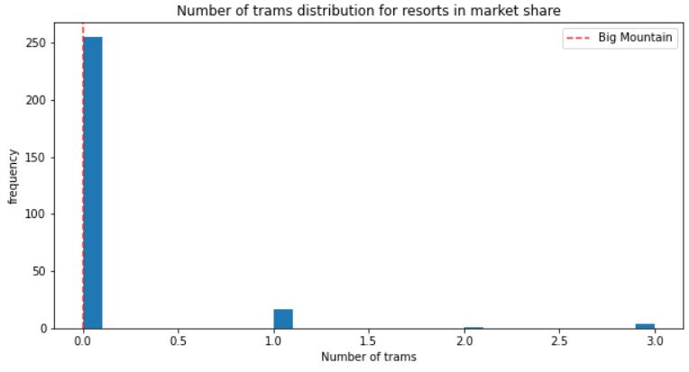
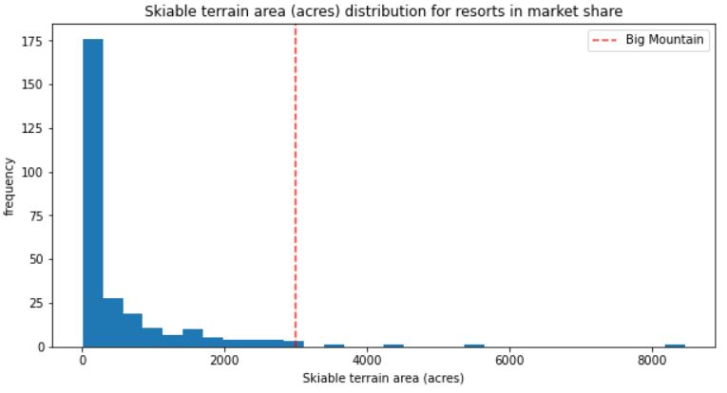
Modelling & Analysis - Contd.
trams & Skiable terrain
Most of the resorts almost 250 don’t have trams, where as Blue Mountain offers one of the largest terrain areas for skiing

Slide 8
Summary & Conclusion
Although after a detailed analysis I was ale to predict a new ticket price for Blue Mountain resort but , there is a lot of scope for improvement as data we used is not sufficient for the most optimum price
We can still include a lot more data related to operational costs which can significantly alter our model and pricing
Since State analysis didn’t show any specific grouping, all states were considered equal
I also run some scenarios to check if we can further improve our pricing, and it was found that Increasing vertical drop by 150-200 and adding an additional chair and run can increase our price further by $8.00 based on current chosen model
In the end, although the nest model was chosen but still more comparisons can be done and there is some scope of improvement for our pricing strategy

