Slide 1
सॉफ्ट एंड कम्युनिकेशन स्किल डेवलपमेंटप्रमुख सॉफ्ट स्किल्स जिन्हें संस्थान में लागू किया जाता है उनमें शामिल हैं-
-बच्चों के साथ हिंसा व प्रकार
-कार्यस्थलध्स्कूल मे अधिकारियों एवं अन्य स्टाफ के साथ आदर्श व्यवहार
-बच्चों के साथ व्यवहार करते समय सावधानी संचार(कम्युनिकेशन)
-छात्रों से कैसे बात करें या जवाब देंए
-अधिकारियों से वार्तालाप और समन्वयनए व्यक्तिगत जिम्मेदारी
-छात्रों के साथ कैसे बात करें
-घटना की सूचना-

Slide 2
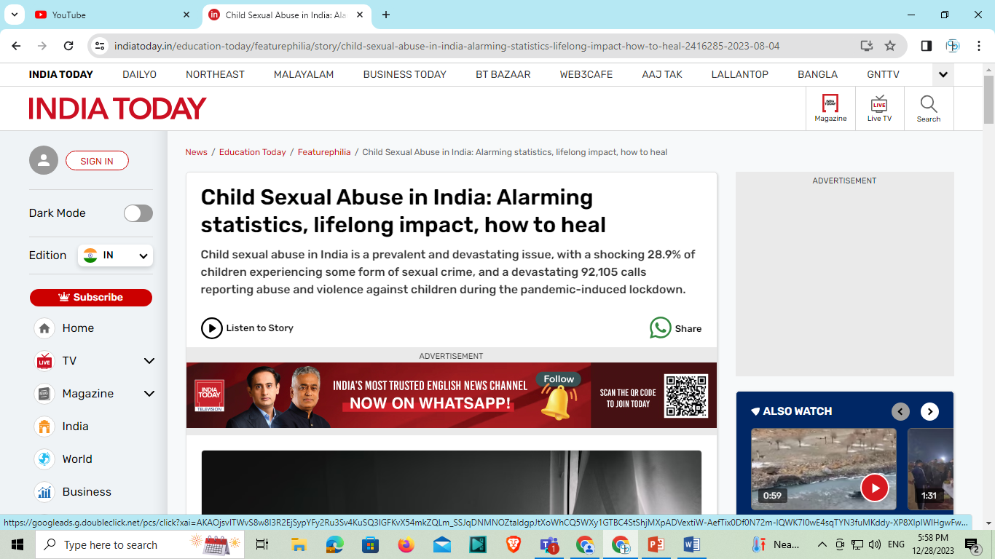
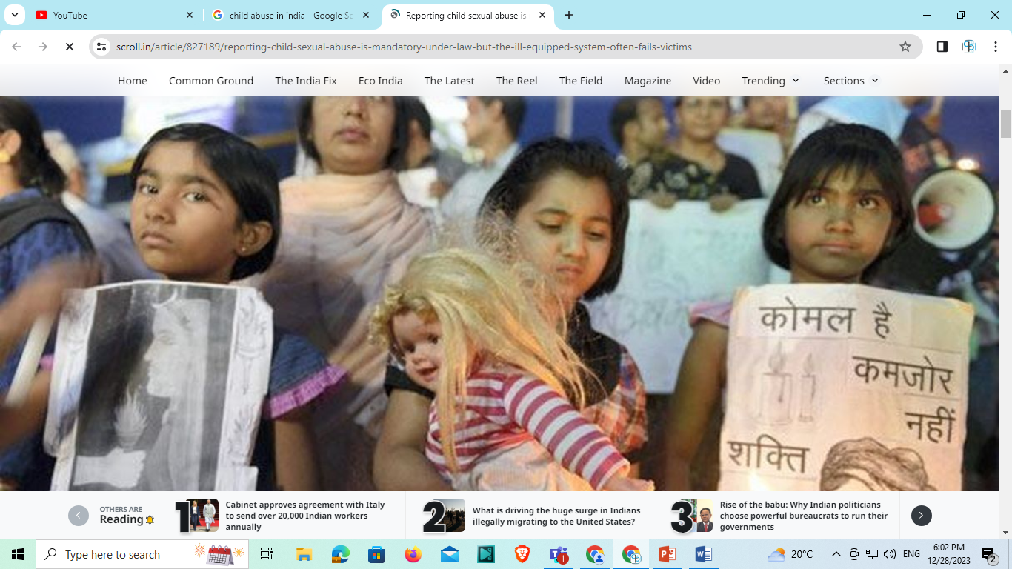

Slide 3
1 बच्चों के साथ हिंसा के प्रकार
शारीरिक, मानसिक , यौनिक , उपेक्षा
2 कार्यस्थल स्कूल मे अधिकारियों एवं अन्य स्टाफ के साथ आदर्श व्यवहार
आप यह सुनिश्चित करने के लिए जिम्मेदार हैं कि सभी छात्रों को सीखने में पूरी तरह से भाग लेने के लिए अवसर और सहायता देना ?
मानव संसाधन प्रबंधन के साथ साथ आप वित्तीय और भौतिक संसाधनों के प्रबंधन के लिए भी जिम्मेदार होंगे ताकि सुनिश्चति किया जा सके कि वे छात्रों की सीखने की प्रक्रिया को सुधारने के लिए उपयुक्त और सुलभ हैं और उनका उपयोग प्रभावी ढंग से किया जाय।
हर बच्चों की बातों को ध्यान से सुनना
यदि वह कोई होम वर्क या कार्य नहीं कर पा रहा है तो उसके कारणो को समझना न की उसको दोष देना

Slide 4
बच्चा यदि बिना कीसी इन्फॉर्मेशन के 2 दिन से अधिक स्कूल नहीं आ रहा है तो उसके बारे में पता करना व उसके लिए परिवार से संपर्क करना
-बच्चों के साथ भेद भाव न करना
-बच्चों को बिना स्पर्श किए बात करना
-यौन उत्तेजक खेलों में शामिल न होने दें।
-बच्चों को निजी काम में न लगाएँ जैसे स्कूल एवं कक्षा की सफाई ।
-अपने पद का उपयोग अपने लाभ के लिए न करे
-शराब या किसी अन्य पदार्थ जैसे नशीले पदार्थों के प्रभाव में काम न करें जो सौंपे गए कार्य को करने की क्षमता को काफी हद तक ख़राब कर देता है।
-कोई भी ऐसी तस्वीर न लें जो किसी भी तरह से बच्चे की गरिमा, या गोपनीयता का उल्लंघन करती हो या कर सकती हो।

Slide 5
5 छात्रों के साथ कैसे बात करे , घटना की सूचना
विभिन्न प्रकार के बाल शोषण के बारे में स्वयं को शिक्षित करना सुनिश्चित करें
अपने बच्चों से बात करने से न शर्माएं, बल्कि यह भी सुनिश्चित करें कि आप उनके पर्सनल स्पेस पर आक्रमण न करें.
बच्चों को उनके अधिकारों के बारे में शिक्षित करें
अपने बच्चों से उचित और अनुचित व्यवहार के बारे में बात करें.
अपने बच्चे को बताएं कि आप उनके लिए हमेशा मौजूद हैं और प्रोडक्टिव बातचीत को प्रोत्साहित करें.
यदि आप दुर्व्यवहार की कोई घटना देखते हैं, तो तुरंत इसकी रिपोर्ट करें या जांच की मांग करें

Slide 6
Types of offences against children
1) RAPE (IPC 366A) (IMPRIONSMENT UPTO 10 YEARS AND A FINE)
2) CRUELTY (IPC -75)
3) ABETMENT OF SUICIDE (IPC-76)
4) INFANTICIDE (IPC-315)
5) ABANDONMENT (IPC-317) (Imprisonment up to seven years or fine or both )
6) CHILD TRAFFICKING (IPC- 372-373) ( Penalizes selling or buying minor girls for prostitution ad illicit intercourse for any unlawful and immoral purpose /imprisonment which may extend upto 10 years and fine)
7) CHILD LABOUR\SLAVERY (IPC-374)
8) ASSAULT (IPC-75)
9) KIDNAPPING (Ransom, Begging)
10) CHILD ABUSE \DOMESTIC ABUSE
11) NEGLECTION (EMOTIONAL, BEHAVIOURAL)
12) CHILD PORNOGRAPHY

Slide 7
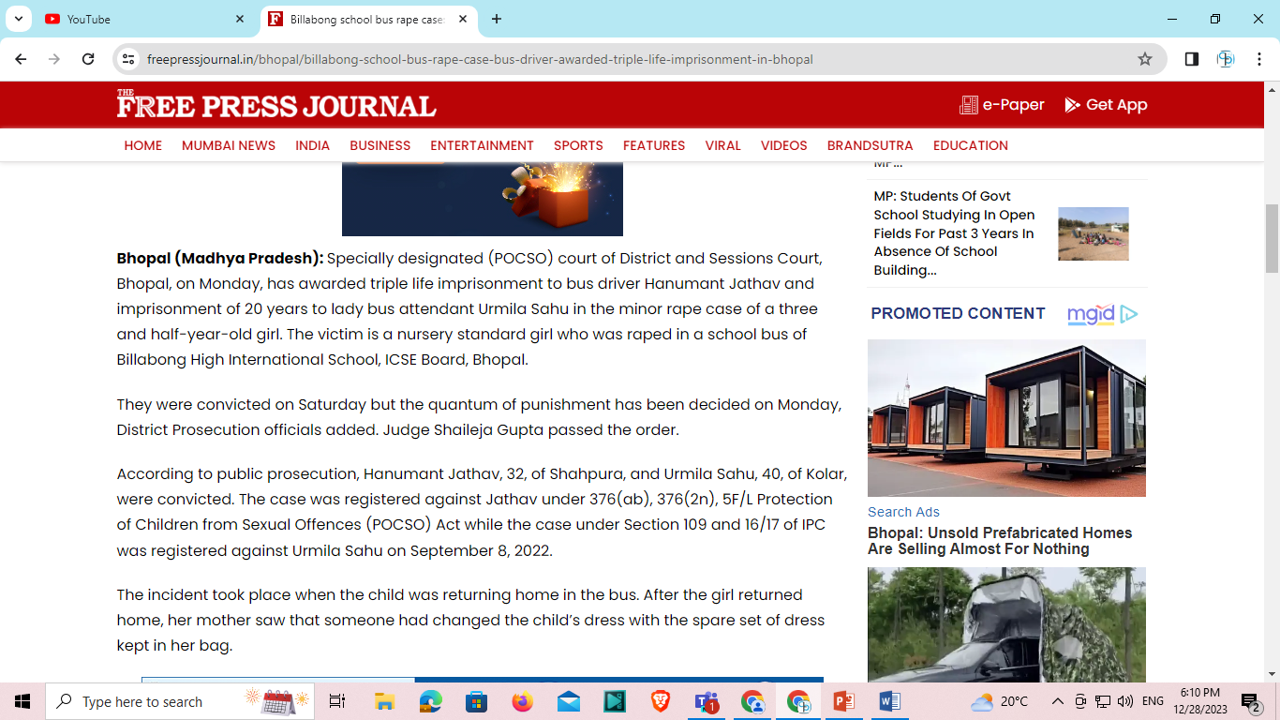

Slide 8
Crimes against children are a serious problem in our society. They can include physical or sexual abuse, neglect, emotional abuse, and exploitation. These crimes can have a lasting impact on a child's physical and emotional health, as well as their social and economic well-being . Child abuse and neglect are major public health problems in the India. Each year, hundreds of thousands of children are abused or neglected. The vast majority of these children are never reported to authorities. The ones that are reported often end up in the foster care system or in the juvenile justice system . Most child victims of abuse and neglect are never seen by the child welfare or juvenile justice systems. However, the ones that are seen by these systems often have long-term physical, emotional, and behavioral problems. These problems can lead to a cycle of abuse and violence that can span generations . There are many things that can be done to prevent child abuse and neglect. We can start by increasing public awareness of the problem. We can also improve the child welfare and juvenile justice systems so that they are better able to identify and protect child victims. Finally, we can support families so that they are better able to care for their children . Child abuse and neglect are serious problems that need to be addressed. We can start by increasing public awareness of the issue. We can also make sure that the child welfare and juvenile justice systems are better able to identify and protect child victims.

Slide 9
And we can support families so that they are better able to care for their children . Definition of crime The Criminal Law of India has been codified in the Penal Code and in the Criminal Procedure Code ; the former Code deals specifically with offences and states what matter will afford and excuse or a defense to a charge of offence .The penal Code is the substantive Law and the Criminal Procedure Code is the adjective Law .
Section 5 of the latter Code says : “ All offences under the Indian Penal Code shall be investigated , inquired into ,tried and other wise dealt with according to the provisions here in after contained. Mental elements in crime --- Intention , motive , mens - rea , knowledge , innocence , mistake of fact, mistake of law, are the some of mental elements that play a significant part in criminal law .In India, crimes against children are classified in a variety of ways, including physical and emotional abuse, neglect, and exploitation, as well as child pornography and the trafficking in minors for sex . Children in India are particularly vulnerable to kidnapping, forced labor, and sexual assault. PENAL PROVISIONS IN IPC 1860. Of Kidnapping, Abduction, Slavery, and Forced labor :Section 359 Kidnapping is of two kinds : kidnapping from India, and kidnapping from lawful guardianship . The literal meaning of ‘kidnapping ‘ is child stealing . Kidnapping is two kinds .But there are may be cases in which one two kinds overlap each other . For instance, an mirror may be kidnapped from India ,as well as lawful guardianship . A bare perusal of the provisions clearly shows that the legislature did not confine to constitute the offence only if a minor girl is taken away from the place of where she used to reside but emphasis is upon taking away the girl from the “lawful guardianship ”Section 359 and 361 IPC do not spell - out any territorial jurisdiction for committing the offence .In my view the rigor of the law travels with ward/subject and any person involving himself or herself in the offence of kidnapping or procuring a minor girl at any point of time would also come within the preview of section 359 and 361,IPC.

Slide 10
Section 360. Whoever conveys any person beyond the limits of India without consent of that person or of some person legality authorized to consent on behalf of that persons is said to kidnapping that person from India . The offence under this section may be committed on a grow-up person or a minor by conveying him or her beyond the limits of India. If the person kidnapped is above 12 years of age has and given consent to his or her being conveyed beyond the limits of India.no offence is committed . Now ,the age limit for boys is to 16 and for girls under 18 under Act XLII of 1949. Section 361 Whoever takes or entices any minor under sixteen years of age if male, or under eighteen years of age if a female ,or any person of un sound mind, out of the keeping of the lawful person unsound mind, out of the keeping of the lawful guardian of such minor person of unsound mind, without the consent of such guardian, is said to kidnap such minor or person from lawful guardianship . The words lawful guardian in this section include any person lawfully entrusted with care or custody of such minor or other person . This section does not extend to he act of any person who in good faith believes himself to the b father of an illegitimate child, or who in good faith believes himself to be entitled to the lawful custody of such child, unless such act is committed for an immoral or unlawful purpose . The offence under this section may be committed in respect of either a minor or a person of unsound mind To kidnap a grown up person of sound mind , therefore, would not amount to an offence under it . The object this section is at least as much to protect children of tender age from being abducted or seduced for improper purpose, as for the protection of the rights of the parents and guardians having the lawful charges or custody of minors or insane persons in Shajahan V. State of Kerala, High court opined that the purpose and object of S.361 IPC to be in dispute.

Slide 11
The Protection of Children from Sexual Offences Act,2012 ( ‘POCSO Act’ ) has been invoked to book men marrying girls under age of 14 years . The Prohibition of Child Marriage Act ,2006 ( ‘PCM Act, 2006’ ) has been used in cases where girls aged under 14 to 18 years. Supreme Court Guidelines to prevent child sexual abuse :
The person of in -charge of the school /educational institutions ,special homes children's homes, shelter homes hostels , remand homes jails, etc .. or wherever children are housed, if they come across instances of sexual abuse or assault on a minor child which they believe to have committed or come to know that they are being sexually molested or assaulted are directed to report those fact keeping upmost secrecy to the nearest S.J.P.U. or local police , and they depending upon the gravity of the complaint and its genuineness , take appropriate follow up action casting to sigma to the child or to the family members.
Children with intellectual disability are more vulnerable to physical, sexual and emotional abuse . Institutions which house them or persons in care and protection come across any act of sexual abuse, have a duty to bring to the notice of the juvenile justice board /SJPU or local police and they in turn in touch with the competent authority and take appropriate action.
Media personals, persons in charge of Hotels, lodge, hospitals ,clubs, studios, photograph facilities, have to duly comply with provisions of section 20 of the Act 32 of 2012 and provide information to the SJPU or local police. Media has to strictly comply with section 23 of the Act as well. Further its made clear that if the perpetrator of the crime is a family member himself, then utmost care be taken and further action be taken consultation with the mother or other female members of the family of the child, bearing in mind the fact that best interest of the child is of paramount consideration.

Slide 12
5) Hospitals, whether government or privately owned or medical institutions where children are being treated come to know that children admitted are subjected to sexual abuse, the same will immediately be reported to the nearest J.J Board /SJPU and the JJ Board, in consultation with SJPU , should take appropriate steps in accordance with the law safeguarding the interest of child.
6) The non-reporting of crime the crime any body, after having to come to know that a minor child below the age of 18 years was subjected to any sexual assault, is a serious crime and by not reporting they screening offenders, from legal punishments and hence be held liable under the ordinary criminal law and prompt action to be taken against them, in accordance with law.
7) Complaint , if any, received by NPCR , SCPCR , Child welfare committee (CWC) and Child Help Line, NGO’s or Women’s Organizations etc., they may be take further follow up actions in consultation with the nearest J.J. Board S.J.P.U or local police in accordance with law.
(8) The central Government and State Governments are directed to constitute SJPU in all Districts, If not already constituted and they have to take prompt and effective action in consultation with JJ Board to take care of child and protect the child and also take appropriate steps against the perpetrator of the crime.
(

Slide 13
9) The Central Government and every State Government should take all measures as provided under section 43 of the Act 32 /2012 to give wide publicity of the provisions of the Act through media including television, radio and print Media, at regular intervals, to make the general public, Children as well as their parents and guardians, aware of the provisions of the Act.[ Sharkar Kisanrao Khade V.Satae t of Maharashtra, (2013)5 SCC 546 : 2013 (6) SCALE 277 : 2013 CrLJ 2595.]
CONCLUSION :Mentioned above penal provisions and enactments shall be enforced by Central Government and State Governments accordance with Law against offenders who doing these crime against children. As well as do the necessary action where due lapses process of the Law .The incidence of crime against children is a major concern in today's society. There are a number of factors that contribute to this problem, including poverty, family dysfunction, Despite the many efforts of law enforcement and child protection agencies, the problem persists. The best way to protect children from becoming victims of crime is to provide them with a safe and stable home environment. Families that are struggling financially or experiencing other forms of stress are more likely to have children who are at risk of being involved in crime. Therefore, it is important to provide support to families in need. , this can help to prevent crimes against children.

Slide 14
Child Protection Laws in India are framed in line with constitutional provisions for safeguarding child rights. More than 250 statutes in India have been passed by the Union and State Governments. Some of the important legislations and their important provisions are as follows:
Indian Penal Code, 1860 (IPC)Section 75 of the code provides for punishment for cruelty to a child, while Section 76 provides for punishment for abetment of suicide of a child.The abandonment of a child below the age of twelve years is dealt under Section 317, Punishment for abandonment is imprisonment up to seven years or fine or both.
Inducing any minor girl to have sexual intercourse with another person is punishable under Section 366A. This crime shall be punishable with imprisonment up to ten years and a fine.
Section 372and Section 373 of the act penalises selling or buying minor girls for prostitution and illicit intercourse for any unlawful and immoral purpose, with imprisonment under, which may extend up to ten years and a fine. [2]The Indian Evidence Act, 1872 (IEA)As per Section 118 of the Indian Evidence Act, all persons, including a child or an aged except a tender year, extreme old age, disease – whether of body or mind or any other similar cause, are competent to be considered as a witness in the court of law if they are able to understand the questions put to them, or able to give rational answers to those questions.[3]
Criminal Procedure Code, 1973 (CrPC)Also, after the Criminal Law (Amendment) Act, 2013, the punishment for rape of a minor girl has been aggravated (made more serious) under section 376(2)(i) of IPC. The punishment for rape of females below 16 years of age shall be minimum rigorous imprisonment of ten years which can extend up to life imprisonment. [4]

Slide 15
The list of the child protection laws passed by the Union Government includes the following:Children Pledging of Labour Act, 1933 (CPLA)CPLA prohibits the pledging of the labour of children by the parent and any other person who employs children who have been pledged for labour.
[5]Child Labour (Prohibition and Regulation) Act, 1986 (CLA)Child Labour (Prohibition and Regulation) Act of 1986
[6] is a law for the protection of children from child labour in India. The act prohibits the employment of children in hazardous occupations and also sets the minimum age for employment in any kind of work.The Immoral Traffic (Prevention) Act, 1987 (ITPA)The act makes it illegal to procure, transport, or hire a person for the purpose of sexual exploitation or prostitution. This act also makes it illegal to traffic children for any purpose, regardless of their gender. [7]Prohibition of Child Marriage Act, 2006 (POCMA):POCMA
[8] follows the basic premise to make a child go through marriage is an offence, and child or minor is a person up to 18 years of age in the case of girls and 21 years in the case of boys . Right of Children to Free and Compulsory Education Act, 2009
The State were mandated to provide free and compulsory education within ten years under the Right to education. It was earlier a Directive Principles of State but now, the Right to Education is acknowledged under the fundamental rights, making it a justiciable right under Article 21A. The Right to Education Act, 2009, [9] also known as RTE Act describes modalities of the importance of free and compulsory education for children aged between 6-14 years in India.

Slide 16
Conclusion: While the world has made significant progress in education, nutrition and child health in the past decade, India has been ranked 118 on the End of Childhood Index [14]. Despite several child protection acts, we still witness various forms of child rights being violated, including denial and inability to access the right to food, right to education, right to health and right against exploitation. There are extensive laws to protect children, and child protection is increasingly accepted as a core component of social development. The challenge is in implementing the laws due to inadequate human resource capacity on the ground and quality prevention and rehabilitation services. As a result, millions of children are prone to violence, abuse and exploitation . Furthermore, the lack of awareness and understanding of the issue among the general public, as well as among law enforcement and judicial officials, makes it difficult to identify and prosecute perpetrators of child abuse. This lack of awareness also makes it difficult for victims to seek help and support . To address the issue of child abuse in India, it is essential to implement effective laws and policies that provide adequate protection for children, and to educate the public about the issue. This can include measures such as strengthening the existing laws, increasing funding for child protection services, and implementing awareness campaigns to educate the public about the signs and effects of child abuse. Another effective method of dissemination of information could be through designing workshops to be given in schools, to educators, to caretakers and to the minors about the forms of abuse, the remedies and the rights.

