Slide 1
Supply Chain Management
Tools: Excel | MySQL | Power BI | Tableau
Team: Group No. 1
Members:
1. Inamdar Faran
2. Sahima Mukadam
3. Vishal Sopan Godase
4. Peetla Pranai Sai
5. Damarla Sneha
6. Rajni Devrara
7. Thuniki Supriya

Slide 2
Objective
To analyze inventory levels and supply chain performance in order to identify inefficiencies, stock risks, and demand–supply gaps. Support data-driven decisions
To build an interactive dashboard that enables data-driven decisions for inventory optimization, supplier evaluation, and operational planning.

Slide 3
Tools Used
Excel
Tableau
Power BI
MySQL

Slide 4
Methodology
Data import
Data modeling
KPI creation
Dashboard development

Slide 5
KPIs (Inventory)
Total Sales
Product Wise Sales
State Wise Sales
Top 5 Store Wise Sales
Total Inventory
Inventory Value
Purchase Method Wise Sales

Slide 6
KPIs (Supply Chain)
Total Orders
Average Order Value
Orders by Region/Country/City
Stock on Hand
Inventory Turnover Ratio
Transportation Cost
On-Time Delivery %
Average Delay
Orders by Ship Mode
Demand vs Actual Sales Trend

Slide 7
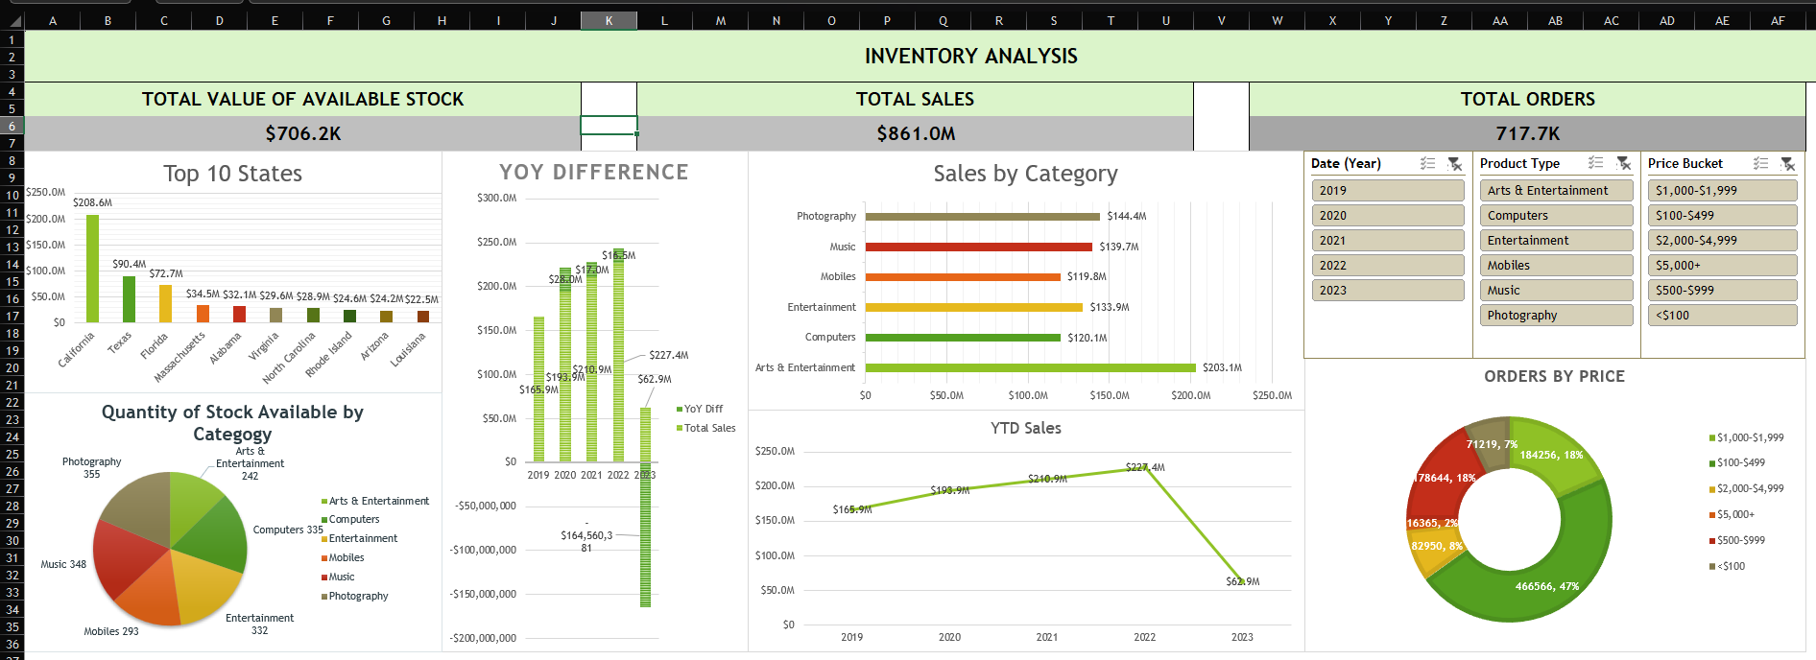
Dashboard: Excel (Inventory)

Slide 8
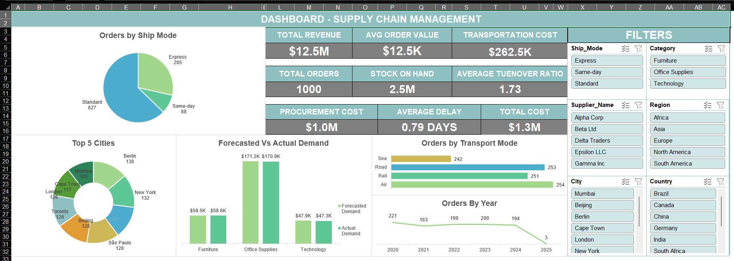
Dashboard: Excel (Supply Chain)

Slide 9
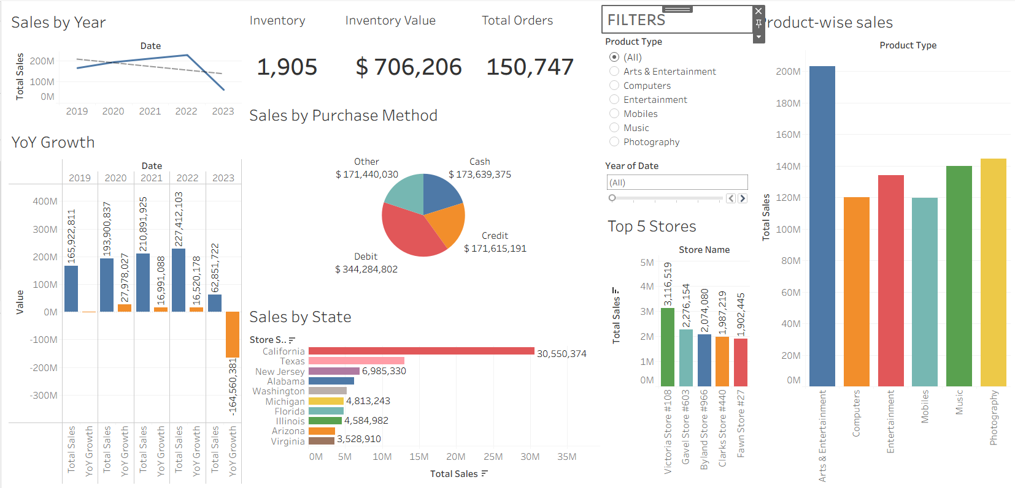
Dashboard: Tableau (Inventory)

Slide 10
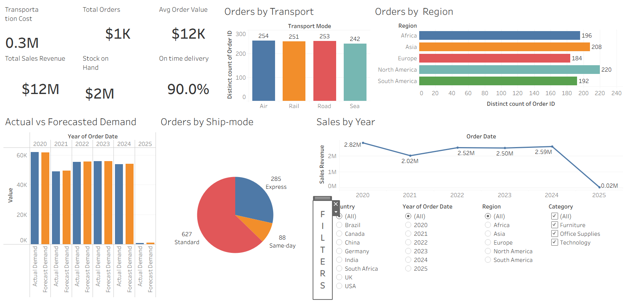
Dashboard: Tableau (Supply Chain)

Slide 11
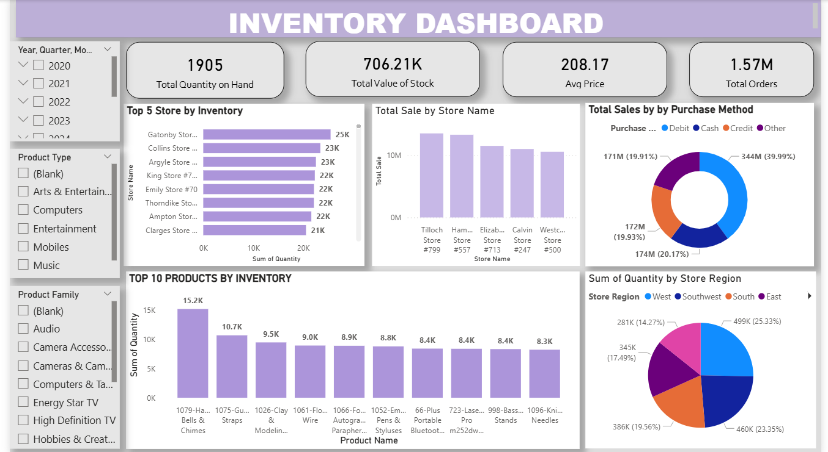
Dashboard: PowerBI (Inventory)

Slide 12
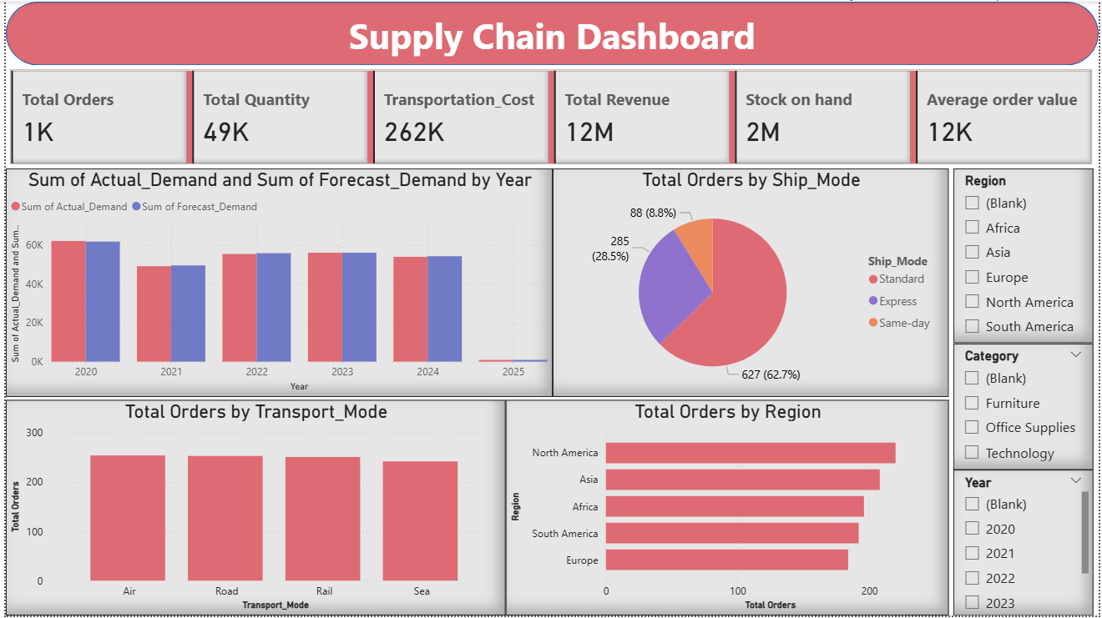
Dashboard: PowerBI (Supply Chain)

Slide 13
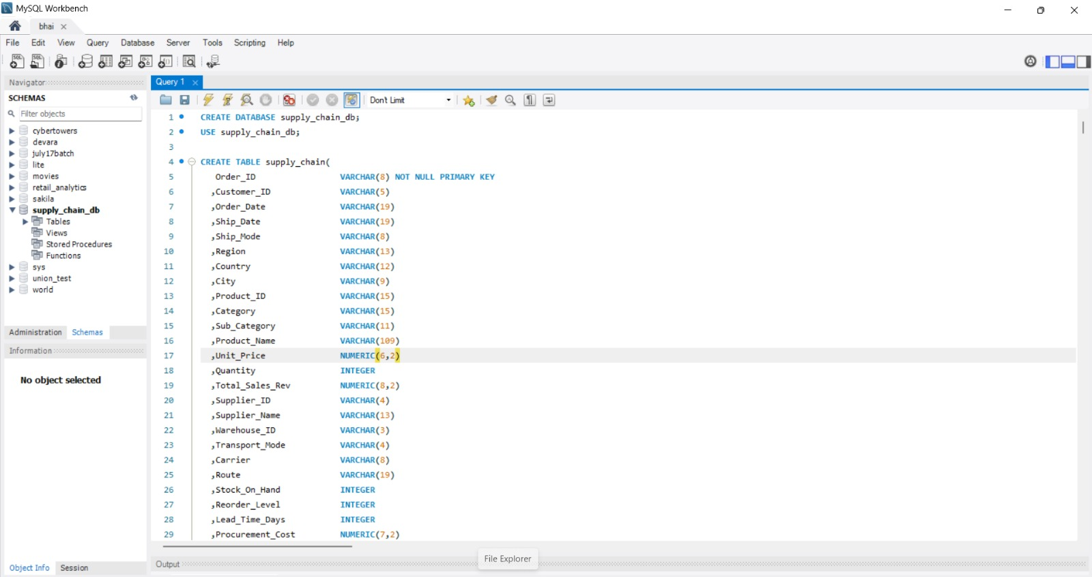
MySQL Script

Slide 14
Challenges
Data cleaning
Integrating multiple datasets
Dashboard slicer limitations when combining multiple visuals and KPIs

Slide 15
Key Insights
Sales peaked in 2022, declined sharply in 2023
YoY growth turned negative in recent year
Arts & Entertainment highest revenue-generating category
Transportation costs significantly impact total cost
Inventory levels high relative to sales trend

Slide 16
Conclusion
Successfully built an end-to-end analytics pipeline using Excel, MySQL, and BI tools
Created a scalable data model and calendar structure for time-based analysis
Developed meaningful KPIs and dashboards for decision-making
The analysis provides clear visibility into pricing, ratings, services, and location trends

