Slide 1
Northwind Traders – Data Analytics Project
By: Rajni
Tools Used: Excel, MySQL Workbench, Power BI
Objective: To analyze Northwind Traders’ sales and operations using data-driven insights.

Slide 2
Project Objective & Dataset
Objective:
To visualize key performance indicators of Northwind Traders.
To identify trends in sales, customer behavior, and employee performance.
Dataset:
8 tables from Northwind Database (Customers, Orders, OrderDetails, Products, etc.)
Data cleaned in Excel → Analyzed in SQL → Visualized in Power BI.

Slide 3
Workflow & Tools
Step-by-Step Workflow:
Excel → Data Cleaning (missing values, duplicates, date checks)
MySQL → EDA Queries (sales, customers, suppliers analysis)
Power BI → Interactive dashboards and visual insights
Tools Used: Excel | MySQL Workbench | Power BI

Slide 4
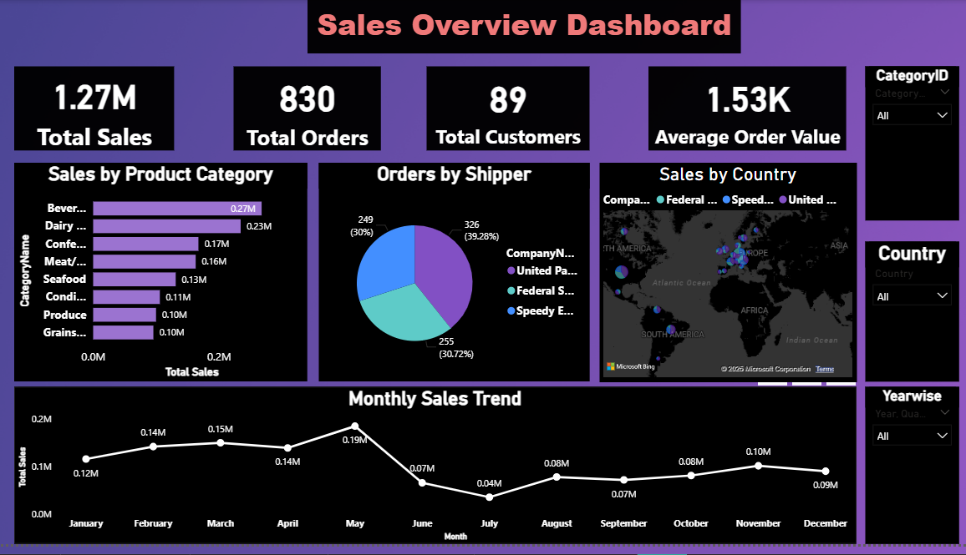
Sales Dashboard Overview

Slide 5
Conclusion & Next Steps
Conclusion: Power BI dashboards help visualize and track sales, customer, and employee performance efficiently.
Next Steps:
Add Customer and Employee Dashboards
Automate updates using database connection
Thank You!

