Slide 1
Computer Graphics Mini Project
Gender and Personality prediction using Handwritten Signature
J Mohit Reddy -14CO118
Samarth Mishra - 14CO240
T Guru Pradeep Reddy - 14CO246

Slide 2
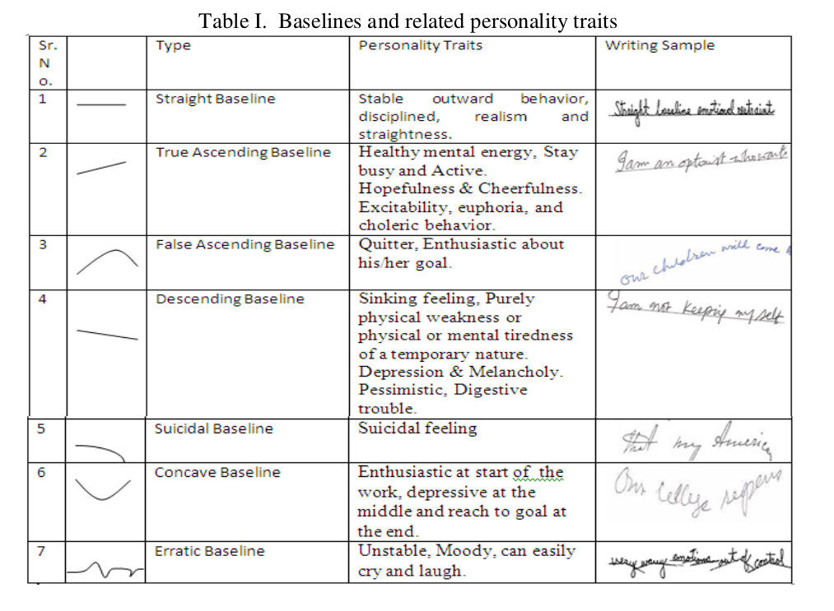

Slide 3
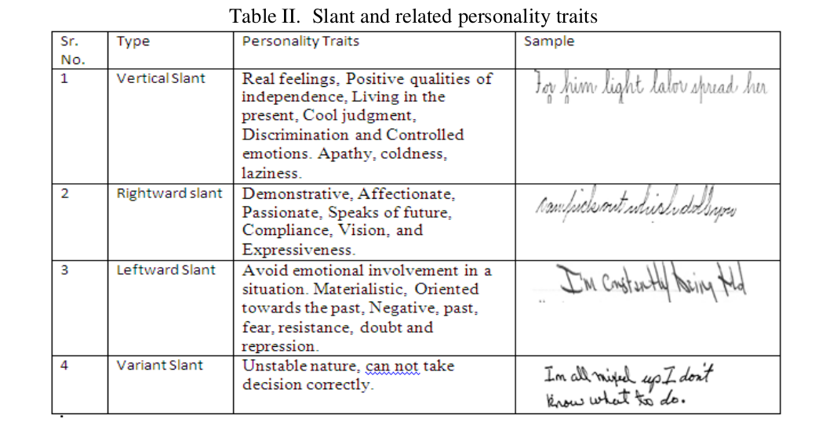

Slide 4
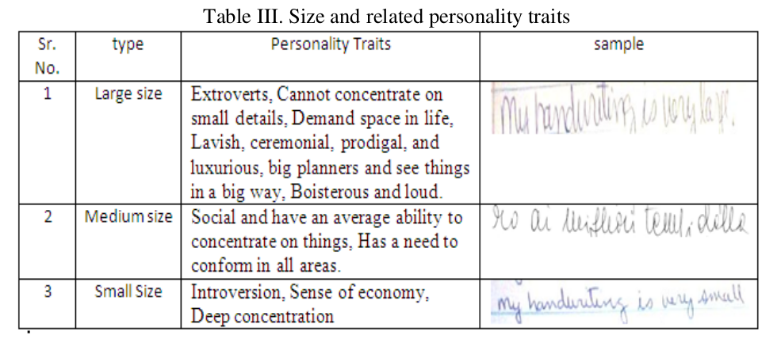

Slide 5
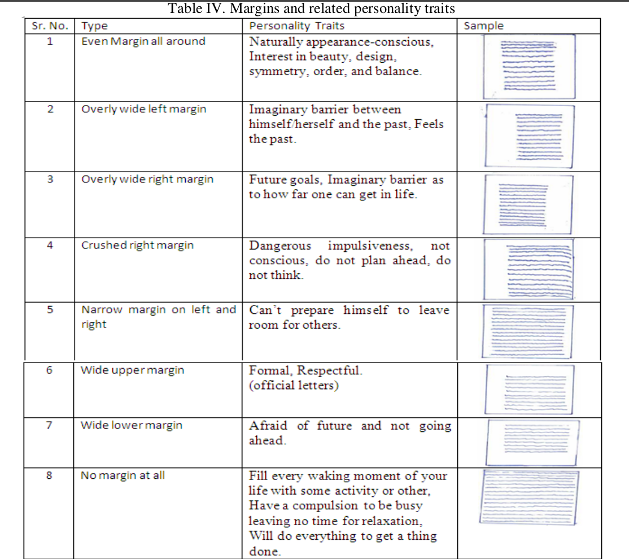

Slide 6
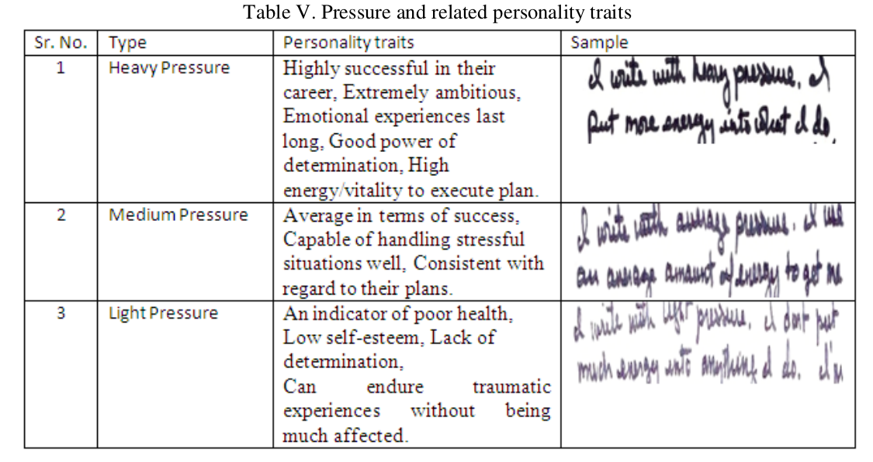

Slide 7
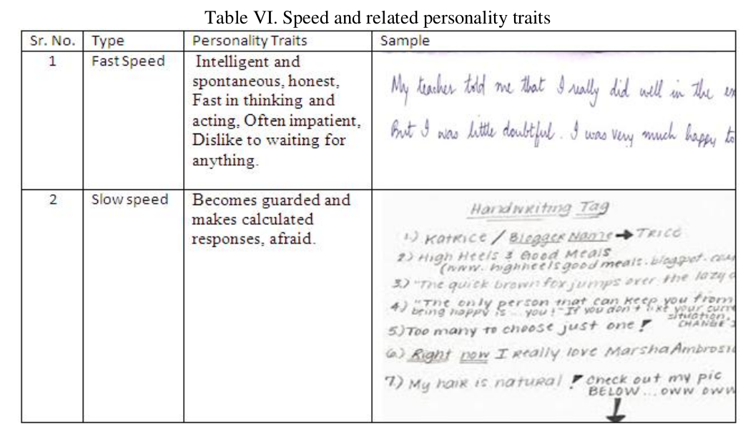

Slide 8
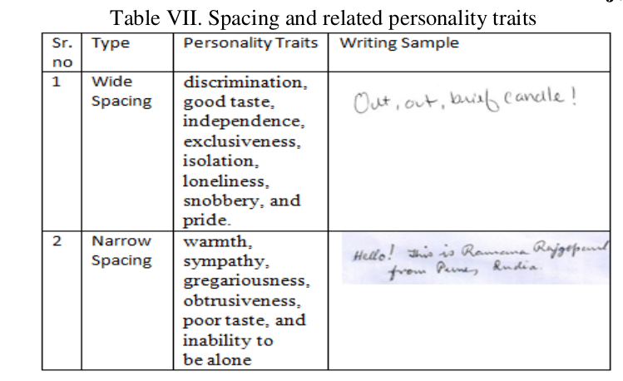

Slide 9
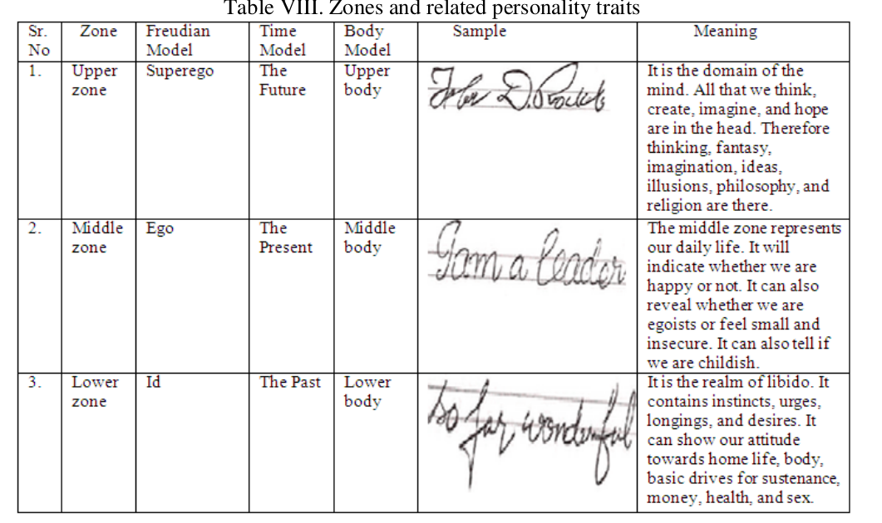

Slide 10
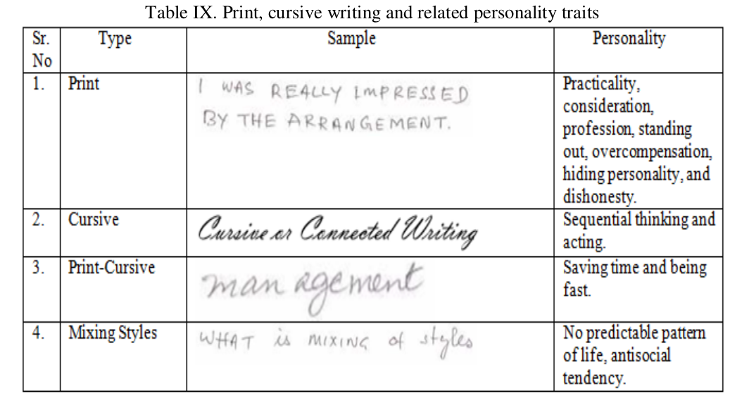

Slide 11
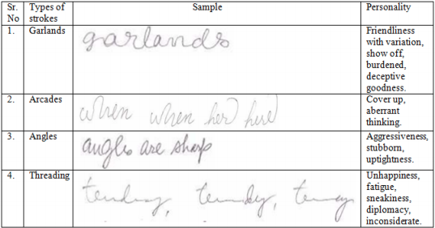

Slide 12
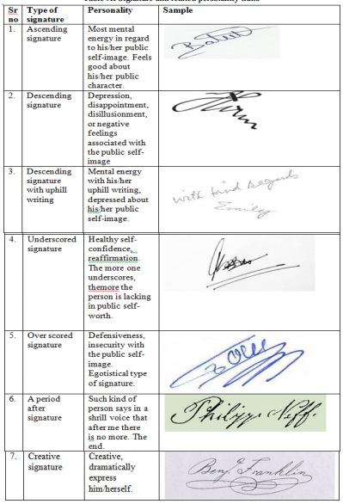

Slide 13
Papers
[1] D. John Antony, O. F. M. Cap,“Personality profile through handwriting analysis”.
[2] Champa H N, K R Ananda Kumar, “Artificial neural network for human behaviorprediction through
handwriting analysis”. International Journal of Computer Applications, Vol. 2, May 2010, pp. 36-41
[3] Sheikholeslami, S. N. Srihari, V. Govindaraju, “Computer aided graphology Center of Excellence for Document
Analysis and Recognition” (New York).
[4] Champa H. N. and K. R. Ananda Kumar, 2010, “Automated Human Behavior Prediction through Handwriting
Analysis”, First International Conference on Integrated Intelligent Computing.
[5] Abdul Rahiman M, Diana Varghese, Manoj Kumar G, “HABIT- Handwriting Analysis Based Individualistic
Traits Prediction”.
[6] Ricard Coll, Alicia Forn´es, Josep Llad´os, “Graphological Analysis of Handwritten Text Documents for
Human Resources Recruitment”. 2009 10th International Conference on Document Analysis and Recognition.
[7] Parmeet Kaur Garewal, Deepak Prashar, “Behavior Prediction through Handwriting Analysis”.
[8] Vlad Atanasiu, “Surveys and projects in handwriting analysis”, MIT Postdoctoral fellow, Department of Brain
and Cognitive Sciences 77, Massachusetts Av., Cambridge MA 02139, USA.
[9] Bin Zhang Sargur N. Srihari, “Analysis of Handwriting Individuality Using Word Features”, State University of
New York at Buffalo, Buffalo, NY 14228.
[10] Reâ Jean Plamondon, Sargur N. Srihari,” On-Line And Off-Line Handwriting Recognition: A Comprehensive
Survey”, Ieee Transactions On Pattern Analysis And Machine Intelligence, Vol. 22, No. 1, January 2000.
[11] Dharam Veer Sharma, Geeta Saini, Mohit Joshi, “Statistical Feature Extraction Methods for Isolated
Handwritten Gurumukhi Script”, Vol. 2, Issue 4, July-August 2012, pp.380-384.
[12] Vikram Kamath, Nikhil Ramaswamy, P. Navin Karanth, Vijay Desai And S. M. Kulkarni, “Development Of An
Automated Handwriting Analysis System”, Vol. 6, No. 9, September 2011.

