Slide 1
INSTAGRAM CLONE
SQL DATABASE DESIGN & ANALYTICS PROJECT
A relational database built in MySQL to model users, photos, likes, comments, follows and hashtags — followed by analytical SQL challenges.
TECH STACK
MySQL • ER Modeling • Joins • Aggregations • Subqueries • HAVING
SQL Portfolio Project
Prepared for professional / portfolio presentation
Rajnish Singh
01

Slide 2
Project Objective
Translate a social-media workflow into a structured relational database and solve business-style SQL questions.
01 Model the platform
02 Load realistic data
03 Analyze behavior
Design normalized tables for users, content, engagement, relationships and hashtags with PK/FK constraints.
Populate the schema with synthetic users, photos, comments, likes, follows, tags and photo-tag mappings.
Answer practical questions around posting activity, engagement, inactive users, hashtags and suspicious behavior.
CORE SQL CAPABILITIES
Project flow
• Relational schema design and referential integrity
• INNER / LEFT JOIN patterns
• GROUP BY, aggregate functions and HAVING
• Subqueries and derived tables
• Date / day-of-week analysis
• Business-question driven SQL
Schema → Data loading → Relationship validation → Analytical queries → Business interpretation
02

Slide 3
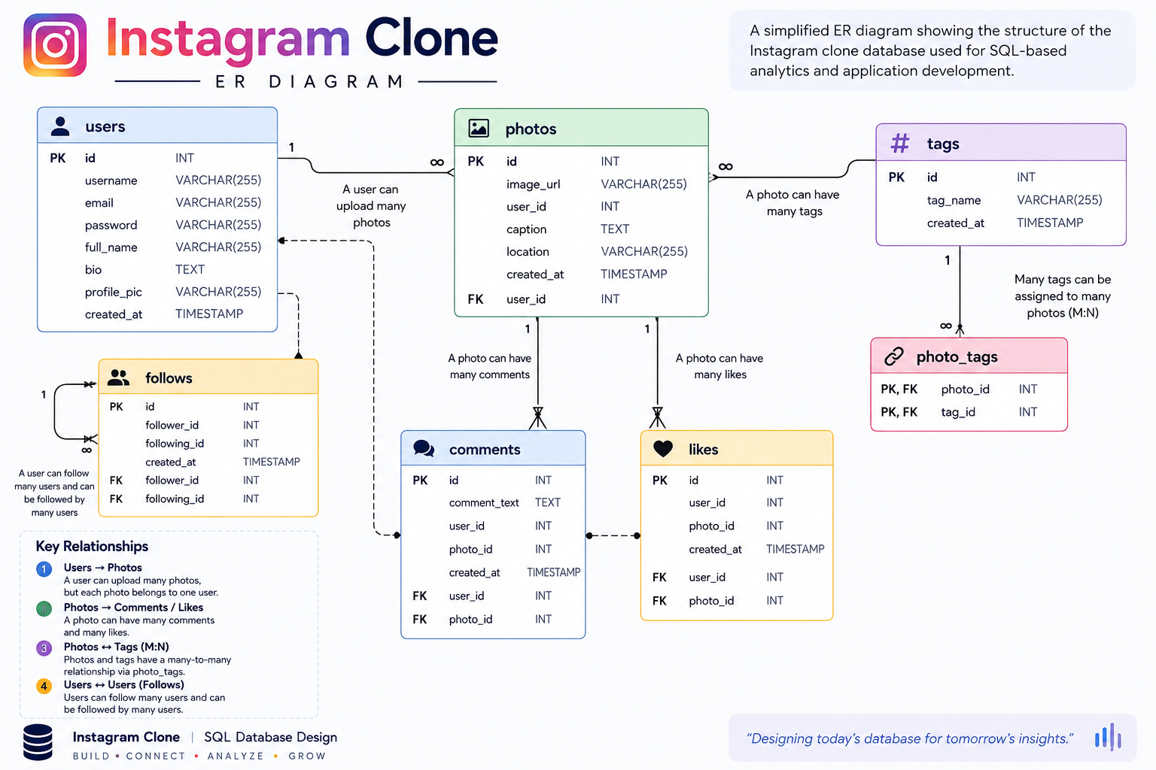
Database Architecture & ER Diagram
The schema connects core entities through foreign keys and junction tables.
03

Slide 4
Relational Schema
Seven tables form the core Instagram Clone data model.
users
photos
comments
PK id
username
created_at
PK id
image_url
FK user_id
created_dat
PK id
comment_text
FK user_id
FK photo_id
created_at
likes
follows
tags
PK/FK user_id
PK/FK photo_id
created_at
PK/FK follower_id
PK/FK followee_id
created_at
PK id
tag_name UNIQUE
created_at
photo_tags
PK/FK photo_id
PK/FK tag_id
Design highlights: composite primary keys prevent duplicate likes/follows and the photo_tags table resolves the many-to-many photo ↔ tag relationship.
04

Slide 5
Data Footprint
Row counts derived from the INSERT statements in the supplied Instagram Clone SQL file.
100
257
7,488
8,782
7,623
21
502
Users
Photos
Comments
Likes
Follows
Tags
Photo–Tag mappings
What the data enables
Data modeling choices
• User growth / registration patterns
• Content creation activity
• Engagement measurement through likes and comments
• Social graph analysis through follows
• Hashtag usage and content discovery
• Foreign keys enforce entity relationships
• Composite keys avoid duplicate interactions
• UNIQUE tag names improve consistency
• Junction table supports many-to-many tagging
• Timestamps support temporal analysis
05

Slide 6
SQL Business Challenges
The second SQL file converts the schema into practical analytical questions.
User lifecycle
Registration timing
Find the 5 oldest users and users who never posted a photo.
Identify the days of the week with the highest number of registrations.
Content performance
Posting behavior
Find the photo with the highest number of likes and rank users by posts.
Calculate average posts per user and total users who have posted.
Hashtag strategy
Behavior anomalies
Identify the most commonly used hashtags.
Find users who liked every photo and users who never commented.
06

Slide 7
Query Showcase — User & Registration Analysis
Simple queries answer direct business questions with clean aggregation and date functions.
01 OLDEST USERS
02 REGISTRATION TIMING
-- 5 oldest users
SELECT *
FROM users
ORDER BY created_at
LIMIT 5;
-- registrations by weekday
SELECT DAYNAME(created_at) AS day,
COUNT(*) AS total
FROM users
GROUP BY day
ORDER BY total DESC
LIMIT 2;
SQL techniques demonstrated
ORDER BY + LIMIT for top-N retrieval • DAYNAME() for time-based analysis • GROUP BY for categorical aggregation • COUNT() for business metrics
Business use: identify long-standing users and understand when new users are most likely to register so campaigns can be scheduled around observed activity.
07

Slide 8
Query Showcase — Engagement & Content Analysis
Joins and aggregation connect content with the users and interactions behind it.
03 TOP-PERFORMING PHOTO
04 AVERAGE POSTING RATE
-- photo with the most likes
SELECT users.username,
photos.id,
photos.image_url,
COUNT(*) AS total_likes
FROM likes
JOIN photos ON photos.id = likes.photo_id
JOIN users ON users.id = photos.user_id
GROUP BY photos.id
ORDER BY total_likes DESC
LIMIT 1;
-- average posts per user
SELECT ROUND(
(SELECT COUNT(*) FROM photos) /
(SELECT COUNT(*) FROM users), 2
);
Why these queries matter
The first query combines three entities to connect engagement back to the content owner. The second creates a high-level platform activity KPI from two table-level counts.
08

Slide 9
Advanced SQL — Behavior & Anomaly Detection
The project also includes relational logic for identifying unusual interaction patterns.
05 ALL-PHOTO LIKERS
06 NEVER-COMMENTED USERS
-- users who liked every photo
SELECT users.id, username,
COUNT(users.id) AS total_likes_by_user
FROM users
JOIN likes ON users.id = likes.user_id
GROUP BY users.id
HAVING total_likes_by_user =
(SELECT COUNT(*) FROM photos);
-- users who never commented
SELECT username, comment_text
FROM users
LEFT JOIN comments
ON users.id = comments.user_id
GROUP BY users.id
HAVING comment_text IS NULL;
Advanced concepts
LEFT JOIN for missing activity • HAVING for post-aggregation filtering • Scalar subquery for comparison against total photos • Derived tables for percentage calculations in the mega challenges
09

Slide 10
Key Takeaways
A portfolio project demonstrating both database design and analytical SQL thinking.
Database design
SQL analytics
Built a connected relational model with PKs, FKs, composite keys and a junction table.
Used joins, aggregations, subqueries, HAVING and date functions to answer business questions.
Product thinking
Scalable foundation
Translated social-media use cases into measurable questions around users, content and engagement.
The schema separates entities cleanly, making future analytics and application features easier to extend.
Project theme: DESIGN → CONNECT → ANALYZE → INSIGHT
Instagram Clone Database | MySQL SQL Project
10

