Slide 1

California State University, Los Angeles
“Enhanced Interior Gateway Routing Protocol”
Guided By:
Edmund Gean
(Professor)
Presented By Group#11:
Rajnish Kumar [304470392]
Manan Patel [304373828]
Gaurav Prajapati [304470132]

Slide 2
Overview
About EIGRP
IGRP Vs. EIGRP
Advantages
Terminology
EIGRP Packets
Project Demo

Slide 3
About EIGRP
Cisco proprietary protocol, advanced version of IGRP
Hybrid Routing protocol (best of SPF and Distance vector)
Supports CIDR/VLSM
Supports multiple routed protocols independently
EIGRP includes following features:
1. Reliable Transport Protocol (RTP)
2. Bounded Updates
3. Diffusing Update Algorithm (DUAL)
4. Establishing Adjacencies
5. Neighbor and Topology Table

Slide 4
IGRP Vs. EIGRP
Similarities
Both developed by Cisco
Both calculate metrics using bandwidth and delay
Use autonomous system numbers
Differences
EIGRP scales metric of IGRP by a factor of 256 (EIGRP=32 bits, IGRP=24 bits)
Hop count, IGRP=255, EIGRP=224
EIGRP supports CIDR/VLSM
EIGRP offers multi-protocol support
=> The main reason to replace IGRP to EIGRP is that the design of Internet Protocol had been changed to support classless IPV4 addresses.

Slide 5
Advantages
Low usage of network resources during normal operation
When a change occurs, only routing table changes are propagated, not the entire routing table, this reduces the load the routing protocol itself places on the network
Rapid convergence times for changes in the network topology
EIGRP uses the Diffusing Update Algorithm (DUAL) to issue queries to neighbors for a loop-free route to the destination.

Slide 6
Terminology
Term | Definition
Neighbor Table | Lists adjacent routers
Topology Table | Each router has one of each network protocol
Routing Table | Chooses routes from topology table – maintains one of each network protocol
Successor | Route selected as the primary route to use to reach a destination
Feasible Successor | A back up route

Slide 7
EIGRP Packets
Hello
Acknowledgement
Update
Query
Reply

Slide 8
EIGRP Packet Header

Slide 9
Hello Packets

Slide 10
Update and ACK Packets

Slide 11
Query & Reply Packets

Slide 12
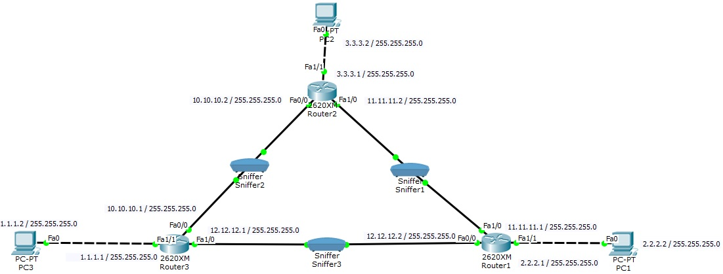
Project Demo
Network Diagram
To Do:
EIGRP Configuration
Capturing and Decoding EIGRP Packets

Slide 13
Configuration (Router1)
Router1> en
Router1# config t
Router1(config)# int fastEthernet 0/0
Router1(config-if)# ip address 12.12.12.2 255.255.255.0
Router1(config-if)# no shutdown
Router1(config-if)# exit
Router1(config)# int fastEthernet 1/0
Router1(config-if)# ip address 11.11.11.1 255.255.255.0
Router1(config-if)# no shutdown
Router1(config-if)# exit
Router1(config)# int fastEthernet 1/1
Router1(config-if)# ip address 2.2.2.1 255.255.255.0
Router1(config-if)# no shutdown
Router1(config-if)# exit
Router1(config)# router eigrp 10
Router1(config-router)# network 12.12.12.0
Router1(config-router)# network 11.11.11.0
Router1(config-router)# network 2.2.2.0
Router1(config-router)# exit
Router1(config)# exit
Router1#

Slide 14
Configuration (Router2)
Router2> en
Router2# config t
Router2(config)# int fastEthernet 0/0
Router2(config-if)# ip address 10.10.10.2 255.255.255.0
Router2(config-if)# no shutdown
Router2(config-if)# exit
Router2(config)# int fastEthernet 1/0
Router2(config-if)# ip address 11.11.11.2 255.255.255.0
Router2(config-if)# no shutdown
Router2(config-if)# exit
Router2(config)# int fastEthernet 1/1
Router2(config-if)# ip address 3.3.3.1 255.255.255.0
Router2(config-if)# no shutdown
Router2(config-if)# exit
Router2(config)# router eigrp 10
Router2(config-router)# network 10.10.10.0
Router2(config-router)# network 11.11.11.0
Router2(config-router)# network 3.3.3.0
Router2(config-router)# exit
Router2(config)# exit
Router2#

Slide 15
Configuration (Router3)
Router3> en
Router3# config t
Router3(config)# int fastEthernet 0/0
Router3(config-if)# ip address 10.10.10.1 255.255.255.0
Router3(config-if)# no shutdown
Router3(config-if)# exit
Router3(config)# int fastEthernet 1/0
Router3(config-if)# ip address 12.12.12.1 255.255.255.0
Router3(config-if)# no shutdown
Router3(config-if)# exit
Router3(config)# int fastEthernet 1/1
Router3(config-if)# ip address 1.1.1.1 255.255.255.0
Router3(config-if)# no shutdown
Router3(config-if)# exit
Router3(config)# router eigrp 10
Router3(config-router)# network 10.10.10.0
Router3(config-router)# network 12.12.12.0
Router3(config-router)# network 1.1.1.0
Router3(config-router)# exit
Router3(config)# exit
Router3#

Slide 16
Configuration (PC)
PC1:
IP Address: 2.2.2.2
Subnet Mask: 255.255.255.0
Default Gateway: 2.2.2.1
PC2:
IP Address: 3.3.3.2
Subnet Mask: 255.255.255.0
Default Gateway: 3.3.3.1
PC3:
IP Address: 1.1.1.2
Subnet Mask: 255.255.255.0
Default Gateway: 1.1.1.1

Slide 17
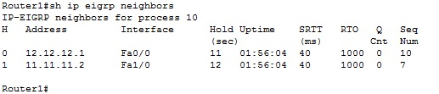
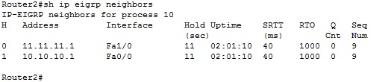
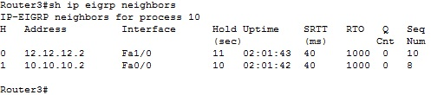
Neighbors Table (For All 3 Routers)

Slide 18
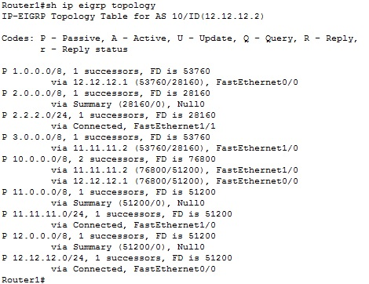
Topology Table (Router1)

Slide 19
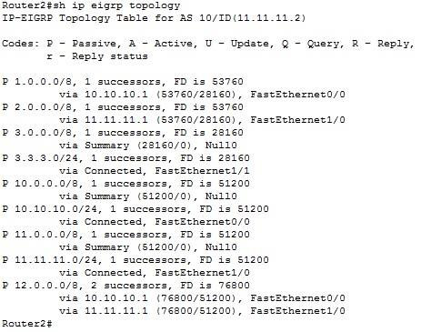
Topology Table (Router2)

Slide 20
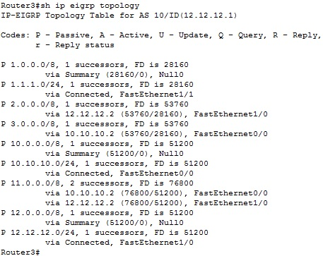
Topology Table (Router3)

Slide 21
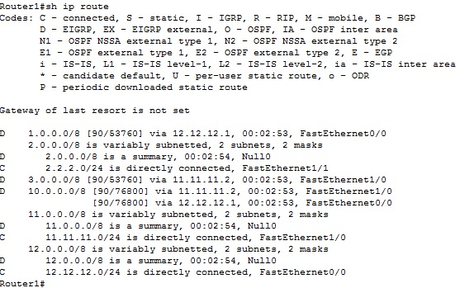
Routing Table (Router1)

Slide 22
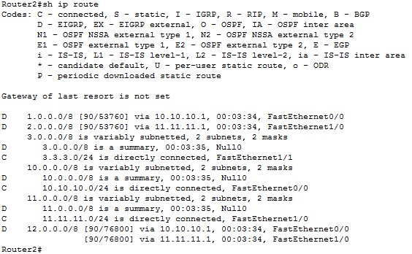
Routing Table (Router2)

Slide 23
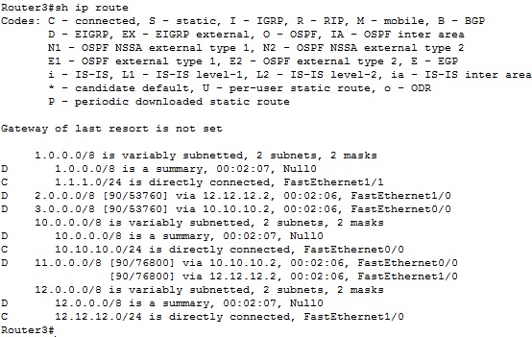
Routing Table (Router3)

Slide 24
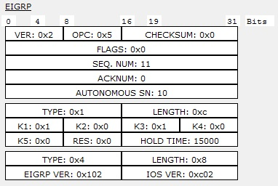
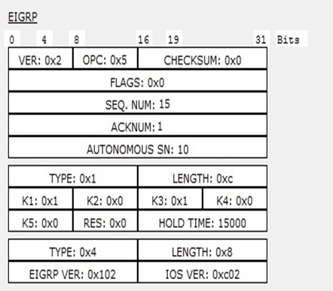
EIGRP Packets: Hello & ACK

Slide 25
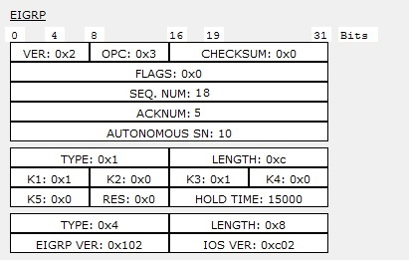
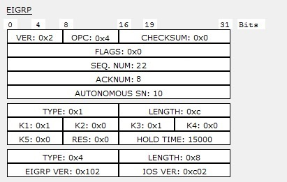
EIGRP Packets: Reply, Query

Slide 26
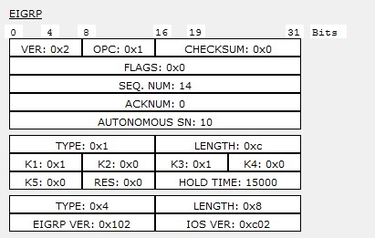
EIGRP Packets: Update

Slide 27
Any Questions??..

Slide 28
Thank you..

