Slide 1
Network Address Translations Project no. : 12
Guided by
Presented by
DhruvaPatel(304398996)
Sweta Patel(304398905)
Rushika Patel (304385840)
Prof. Edmund Gean

Slide 2
Contents
What is NAT?
Why NAT?
Purposes of NAT
Types of NAT
NAT Terms
Demo

Slide 3
What is NAT ?
NAT is the method of Translation of private IP address into public IP address.
In order to communicate with internet we must have registered public IP address.
NAT helps improve security and decrease the number of IP addresses an organization needs.
NAT offers the dual functions of security and address conservation and is typically implemented in remote-access environments.

Slide 4
Why NAT ?
Address translation was originally developed to solve two problems:
To handle a shortage of IPv4 address.
Hide network addressing schemes.

Slide 5
Purposes of NAT
Provides a type of firewall by hiding internal IP addresses.
Enables a company to use more internal IP addresses.
Since they're used internally only, there's no possibility of
conflict with IP addresses used by other companies and
organizations.
Allows a company to combine multiple ISDN connections into a single Internet connection.

Slide 6
Types of NAT
Static NAT
Dynamic NAT
Port Address Translations (PAT) NAT

Slide 7
NAT Terms
The main difference between all of 4 terms :
Inside local : Source host inside address before translation.
Outside local : Address from which source host is known on the Internet. This is usually the address of the router connected to ISP—the actual Internet address.
Inside global : Source host address used after translation to get onto Internet. This is also the actual Internet address.
Outside global :Address of outside destination host and, again, the real Internet address.

Slide 8
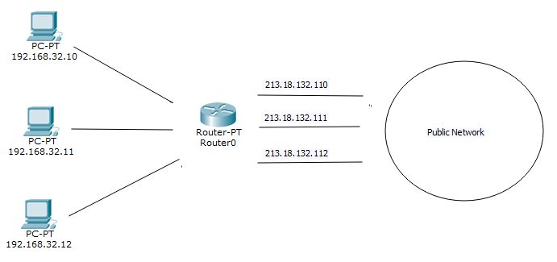
Static NAT
Static NAT is designed to allow one-to-one mapping between local and global addresses.
For every private IP needs on registered IP address (One : One)
Typically, static translation is done for inside resources that outside people want to access.

Slide 9
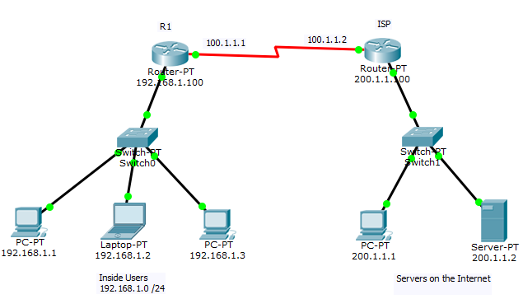
How to setup Static NAT ?
Configure IP address.
Configure default route towards ISP from R1
Configure static route from ISP to public IP used for translation

Slide 10
Configure static NAT using Following Translations
Private IP Public IP
192.168.1.1 50.1.1.1
192.168.1.2 50.1.1.2
192.198.1.3 50.1.1.3

Slide 11
Configuration of static NAT
(Config) # IP nat inside source static <private IP> < public IP>
R-1(config) # ip nat inside source static 192.168.1.1 50.1.1.1
R-1(config) # ip nat inside source static 192.168.1.2 50.1.1.2
R-1(config) # ip nat inside source static 192.168.1.3 50.1.1.3
Implementation
R-1(config) # interface fastEthernet 0/0
R-1(config-if) # ip nat inside
R-1(config-if) # exit (interface facing towards LAN)
R-1(config) # ip interface serial 0/0
R-1(config-if) # ip nat outside (interface facing towards ISP)

Slide 12
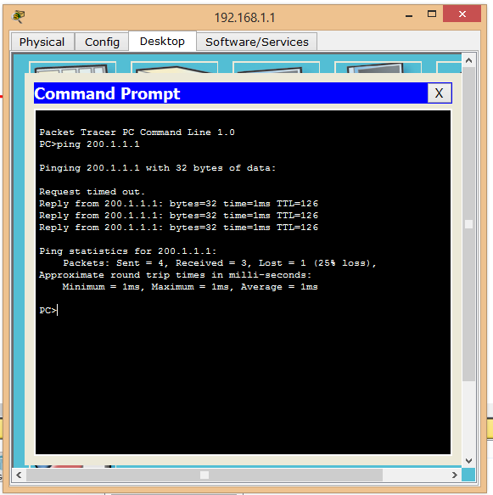
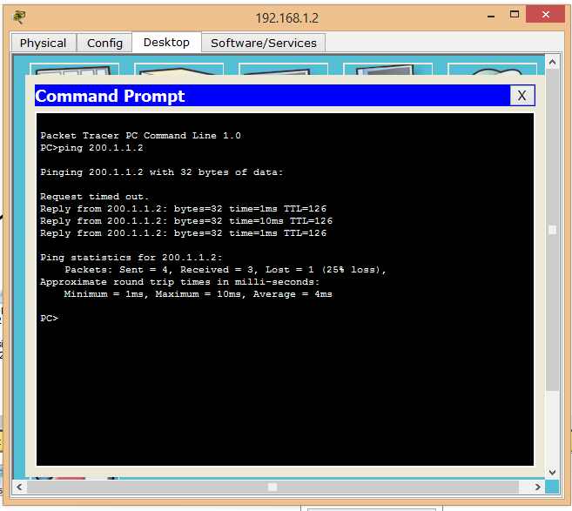
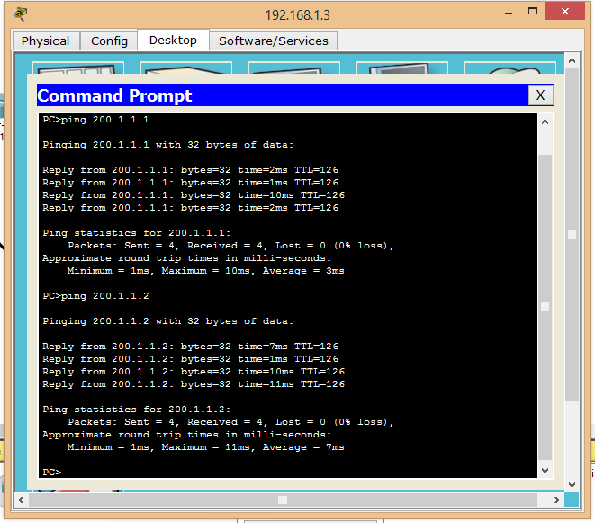
Generate some traffic from inside LAN devices

Slide 13
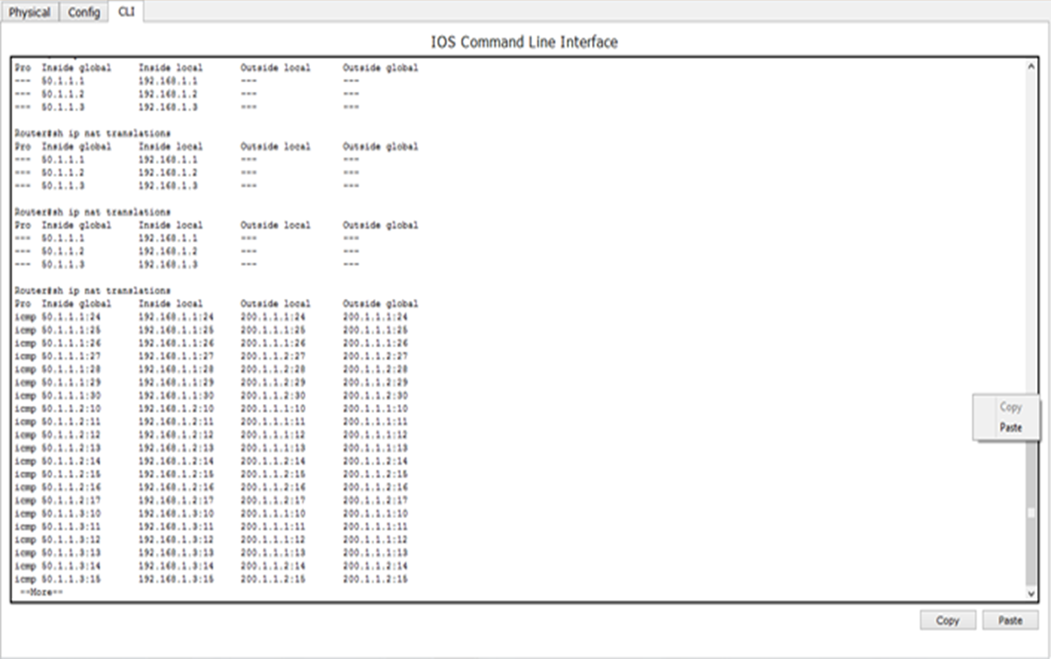
Show IP NAT Translations

Slide 14
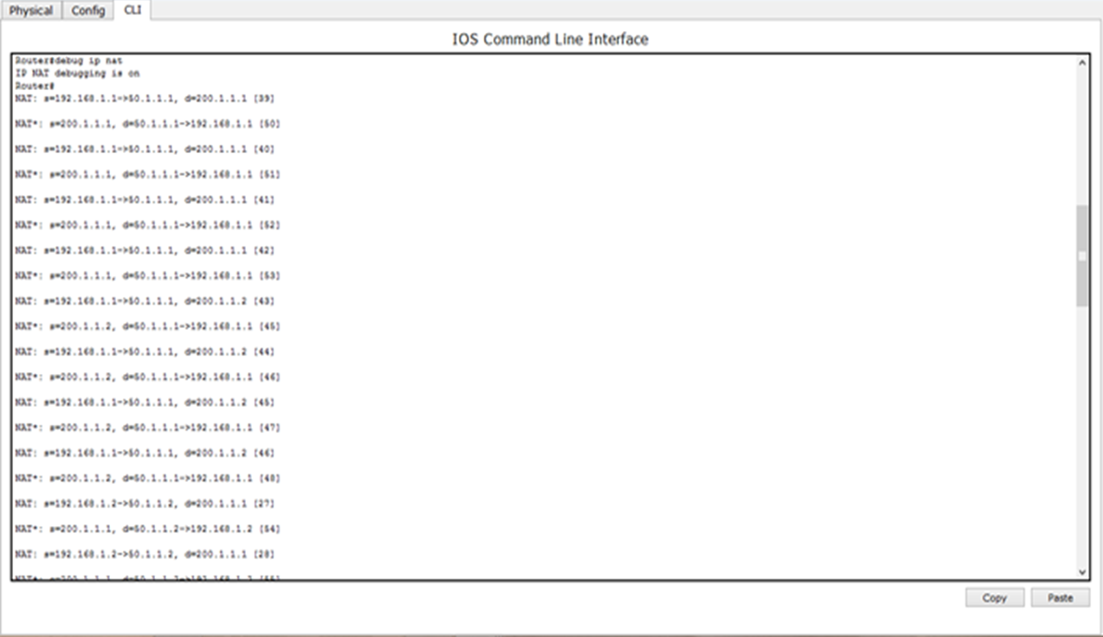
Debug IP NAT

Slide 15
What is Dynamic NAT
Dynamic NAT gives you the ability to map an unregistered IP address to a registered IP address from out of a pool of registered IP addresses.
We don't need to statically configure our router to map each inside address to an individual outside address as we would using static NAT.
Dynamic NAT is mostly used when inside users needs to access outside resources.

Slide 16
How to Setup Dynamic NAT
Syntax :
(Config) # access-list <ACL-No>permit<NET.ID> <WCM>
(Config) # ip nat pool <NAME> <starting public IP> <end public IP> netmask <mask>
(Config) # ip nat inside source list <ACL-NO> pool <NAME>

Slide 17
Configuration of Dynamic NAT
R-1(Config) # access-list 55 permit 192.168.1.0 0.0.0.255
R-1(Config) # ip nat pool CCNA 50.1.1.1 50.1.1.200 netmask 255.255.255.0
R-1(Config) # ip nat inside source list 55 pool CCNA
Implementation
R-1(config) # interface fastEthernet 0/0
R-1(config-if) # ip nat inside
R-1(config-if) # exit (interface facing towards LAN)
R-1(config) # ip interface serial 0/0
R-1(config-if) # ip nat outside (interface facing towards ISP)

Slide 18
Generate some traffic from inside LAN devices

Slide 19
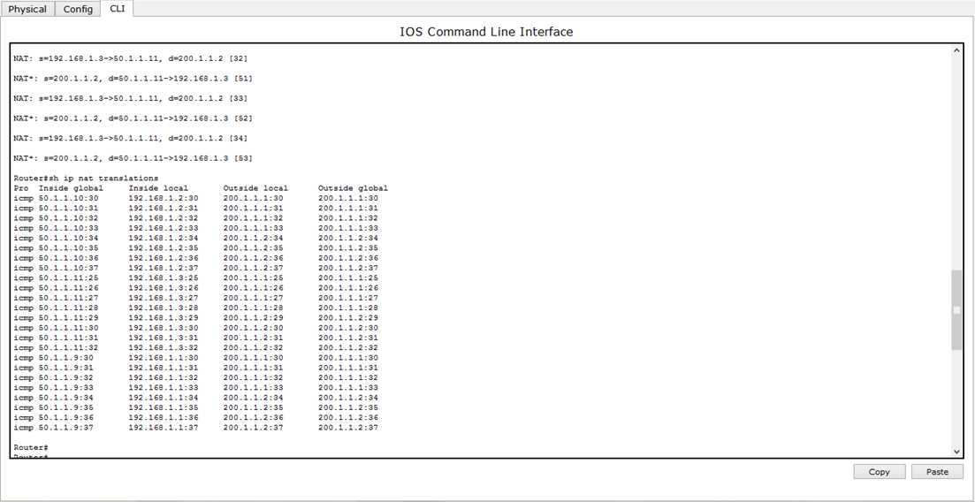
Show IP NAT Translations

Slide 20
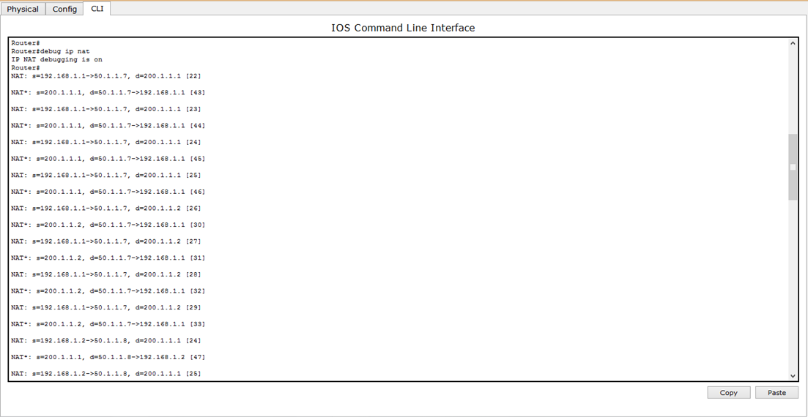
Debug IP NAT

Slide 21
What is PAT?
Port Address Translation is a form of dynamic NAT that maps multiple unregistered IP addresses to a single registered IP address (many-to-one) by using different source ports.
Major difference between NAT and PAT is In NAT Only IP addresses are translated (not port numbers).

Slide 22
How to Setup PAT NAT?
Syntax
(Config) # access-list <ACL-No> permit <NET.ID> <WCM>
(Config) # ip nat inside pool <NAME> <starting public IP> <end public IP> netmask <mask>
(Config) # ip nat inside source list <ACL-NO> pool <NAME> overload

Slide 23
Configuration of Port Address Translation NAT
R-1(Config) # access-list 55 permit 192.168.1.0 0.0.0.255
R-1(Config) # ip nat pool CCNA 50.1.1.1 50.1.1.200 netmask 255.255.255.0
R-1(Config) # ip nat inside source list 55 pool CCNA overload
Implementation
R-1(config) # interface fastEthernet 0/0
R-1(config-if) # ip nat inside
R-1(config-if) # exit (interface facing towards LAN)
R-1(config) # ip interface serial 0/0
R-1(config-if) # ip nat outside (interface facing towards ISP)

Slide 24
Generate some traffic from inside LAN devices

Slide 25
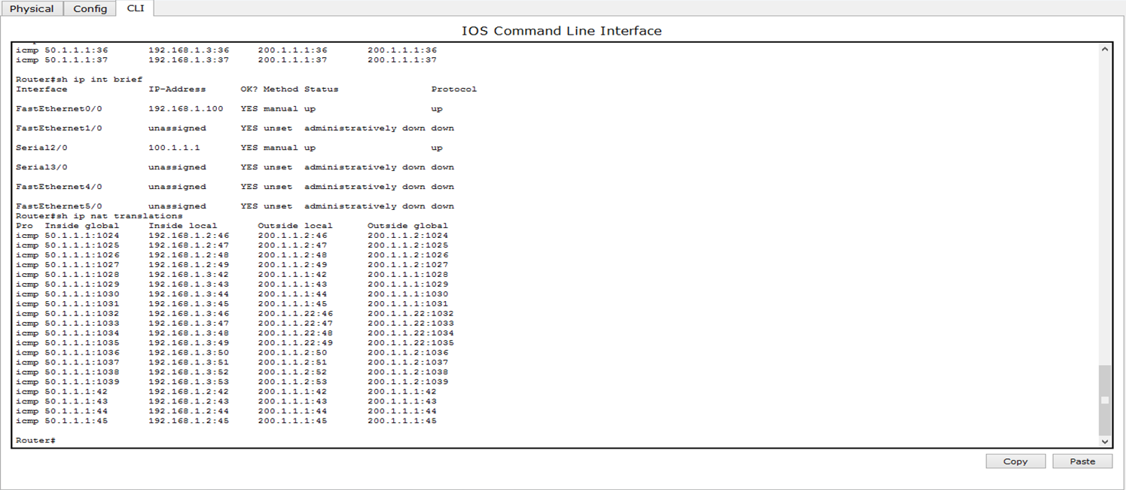
Show IP NAT Translation

Slide 26
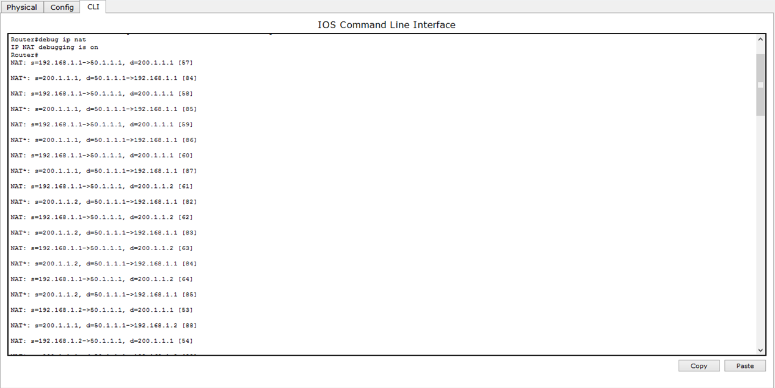
Debug IP NAT

Slide 27
Demo

Slide 28


