Slide 1
Open Shortest Path First (OSPF)
Presented by,
Palak Lakhani(303229022)
Rajvi Barfiwala(304389259)
Shruti Kapadiya(304381680)

Slide 2
Project Title
Setup OSPF on a group of routers. Capture and decode various types of OSPF packets (Hello, database description, LSA request, LSA update, and link-state acknowledge). Capture and decode the OSPF packets transmitted whenever a router link becomes unavailable, forcing the router to dynamically reroute traffic.

Slide 3
Link-State Routing
Link-state routing algorithms, also known as shortest path first (SPF) algorithms.
It maintains a complex database of topology information
Use triggered updates that allow efficient use of bandwidth and faster convergence
Maintain full knowledge of distant routers and how they interconnect
Link-state routing protocols were designed to overcome the limitations of distance vector routing protocols

Slide 4
Link-state routing protocols perform the following functions:
  - Respond quickly to network changes.
  - Send triggered updates only when a network change has occurred.
  Send periodic updates known as Link-State refreshes.
Link-state routing uses the following features:
  - Link-state advertisements (LSAs)
  - A topological database
  The shortest path first (SPF) algorithm
  A routing table of paths and ports to each network to determine the best paths for packets

Slide 5
Link-state protocols support…
  - Classless interdomain routing (CIDR)
  - Variable-length subnet mask (VLSM)
Link-state protocols generally outperform distance vector protocols on any size network.
Link-state protocols are not implemented on every network because…
- They can overwhelm slower equipment
- They are quite complex and require well-trained administrators to correctly configure and maintain them

Slide 6
What is a “link” in Link-State Routing?
A “link” is the same as an interface on a router
The “state of the link” describes an interface and the relationship to its neighboring routers
It includes…
  the IP address of the interface
  the subnet mask
  the type of network to which it is connected
  the routers connected to that network

Slide 7
OSPF
Open Shortest Path First (OSPF) is a link-state routing protocol based on open standards
  The Open in OSPF means that it is open to the public and is non-proprietary.
  OSPF is becoming the preferred IGP protocol when compared with RIP v1 and RIP v2 .
OSPF can be used and configured as a single area for small networks
  can also be used for large networks if hierarchical network design principles are used

Slide 8
OSPF Packet Types
There are 5 different type of packets.
Type | Packet Name | Protocol Function
1 | Hello | Discover/maintain neighbors
2 | Database Description | Summarize database contents
3 | Link State Request | Database download
4 | Link State Update | Database update
5 | Link State Ack | Flooding acknowledgment

Slide 9
Hello Packet
It is the type 1 packet. The hello message will perform 4 major functions such as:
It discovers the other OSPF speaking routers on the common subnets.
Verify the bidirectional visibility between the routers
Check for the agreement on a particular configuration parameter
Monitor the neighbor's health to react suppose the neighbor fails.

Slide 10
Database descriptor packet
For the link state routing protocols, it is essential that the link state database for all the routers remain synchronized. This synchronization will begin as soon as an adjacency formed between the neighbors. The OSPF uses the DBD - database descriptor packets for that purpose.
The poll response procedure is mainly used for the multiple packet description usage. Among the routers, one is designated to be a slave and other as a master.
A database description packets are mainly sent by a slave after sending a database description packet by the master.

Slide 11
Link state request packet
The LSR packet is one of the OSPF packets. After the DBD packet exchange process, a router can find that it has not any up-to-date database.
An LSR packet is mainly used to request the pieces of a neighbors database which is more up-to-date.

Slide 12
Link state update packet
This packet implements the LSA flooding. Every LSA comprises the metric, topology information and routing to describe the OSPF network portion.
A local router will advertise the LSA within the LSU packet to the neighboring router. Additionally, a local router advertises an LSU packet with the information in response to the LSR packet.

Slide 13
Link state acknowledgement packet
The OSPF needs acknowledgement for a receipt of the each LSA. The multiple LSA may be acknowledged in the single LSAck packet.
The LSR/LSA process will use the reliable protocol, which has 2 options, in that link state acknowledgement is among them. The LSU can be acknowledged by a receiver of an LSU simply repeating a same LSU back to the sender.
Alternatively, the router will send back the LSAck packet to acknowledge the packets that contain the acknowledged LSA header list.

Slide 14
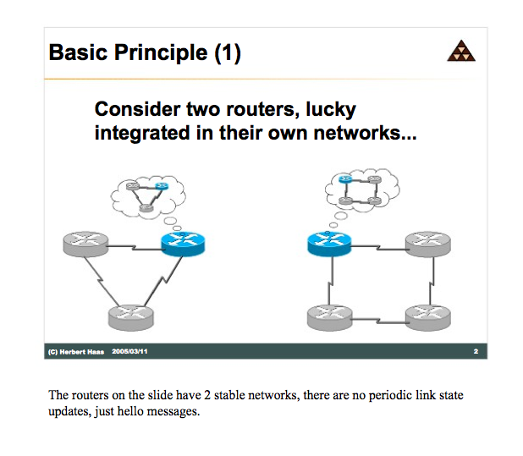

Slide 15
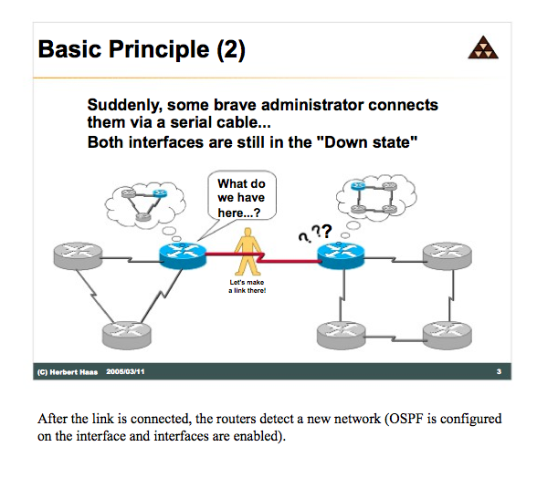

Slide 16
When a router starts an OSPF routing process on an interface, it sends a hello packet and continues to send hellos at regular intervals
  The rules that govern the exchange of OSPF hello packets are called the Hello protocol.
Hello packet timing…
  sent every 10 seconds by default on broadcast multi-access and point-to-point networks.

Slide 17
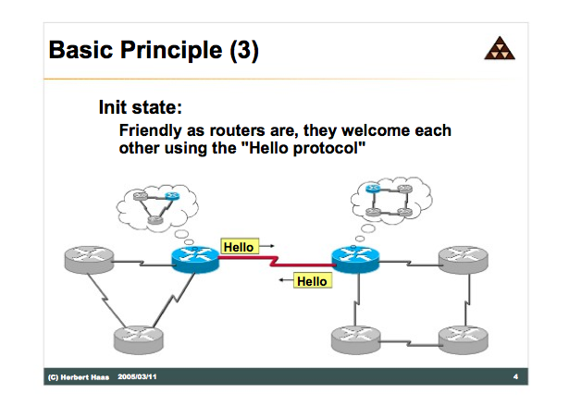

Slide 18
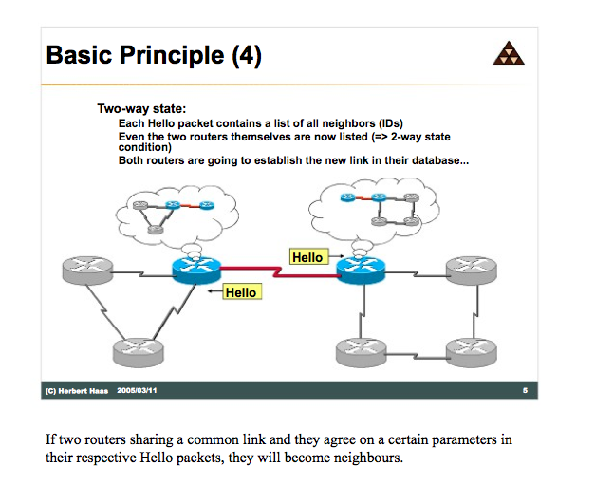

Slide 19
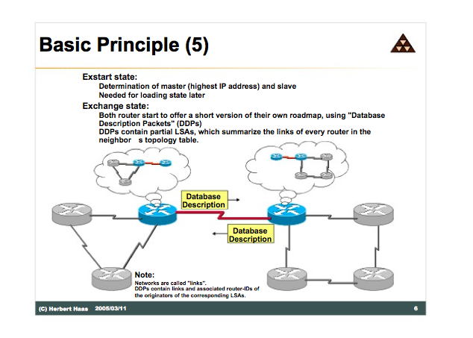

Slide 20
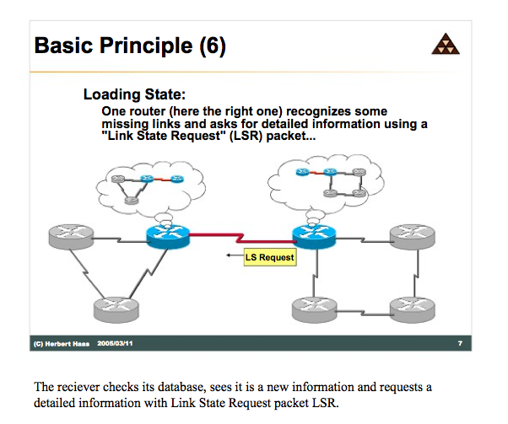

Slide 21
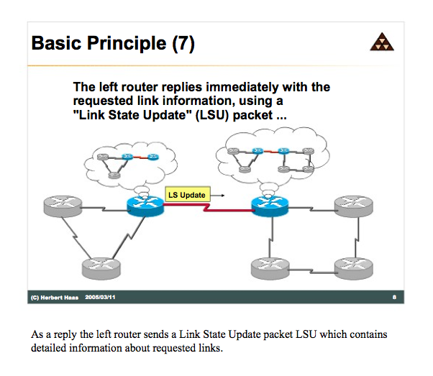

Slide 22
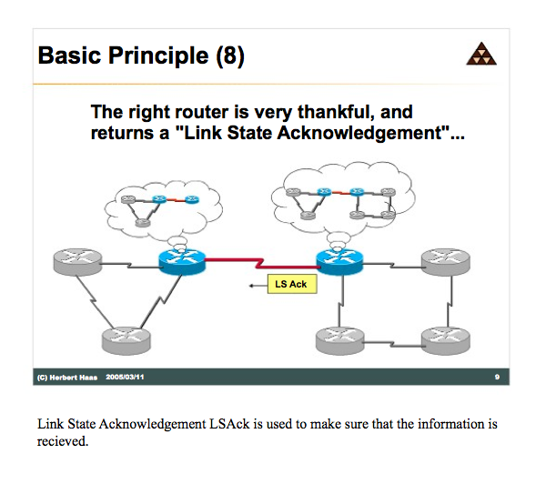

Slide 23
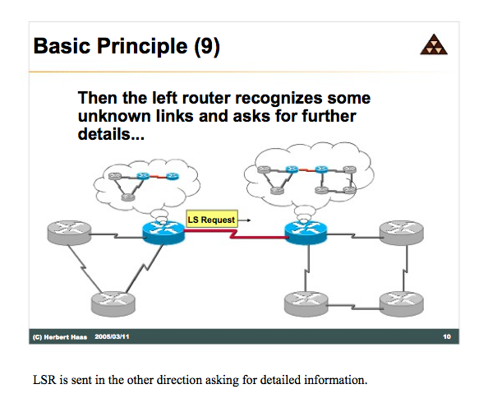

Slide 24
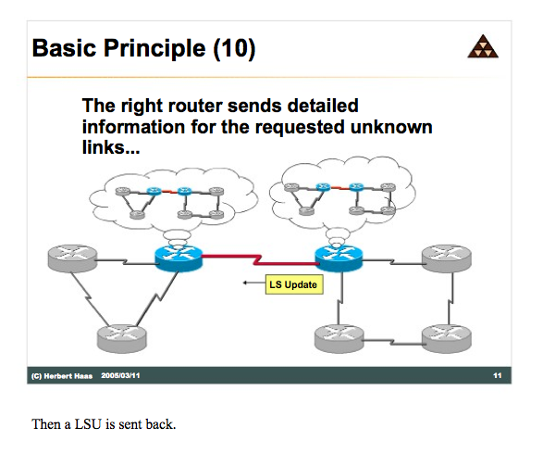

Slide 25
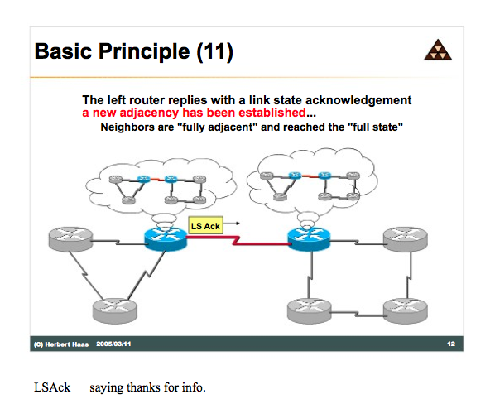

Slide 26
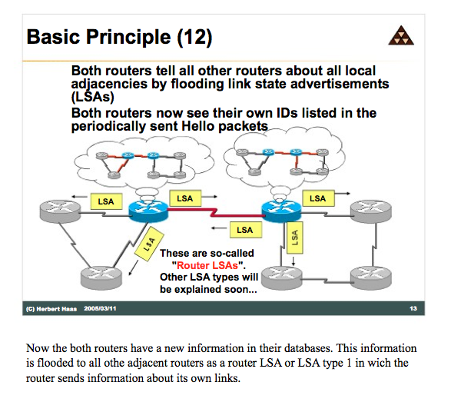

Slide 27
Advantages
OSPF uses multitasking within areas.
OSPF will run on most routers, since it is based on an open standard, not related to any particular vendor.
OSPF uses link-state Algorithm and OSPF network can be much larger than that of RIP.
It provides fast convergence with triggered, incremental updates via Link State Advertisements (LSAs).
Using areas, OSPF network can be logically segmented to improve administrator and decrease the size of routing tables.
It supports Variable Length Subnet Mask, resulting in efficient use of networking resources

Slide 28
Disadvantages
Requires very strict network design.
It requires more memory to hold the adjacency (list of OSPF neighbors), topology and routing tables.
It requires extra CPU processing to run the SPF algorithm.
Requires a knowledgeable network administrator.
Significant demands on memory and processing resources.
It is complex to configure and more difficult to troubleshoot compared to RIP.

Slide 29
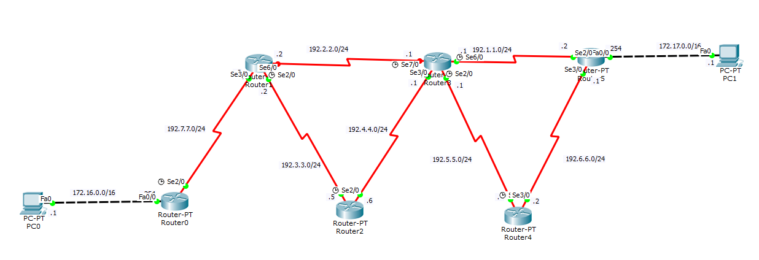
Network Design

Slide 30
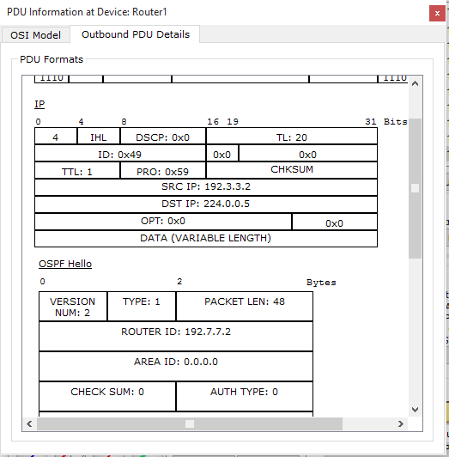


Slide 31
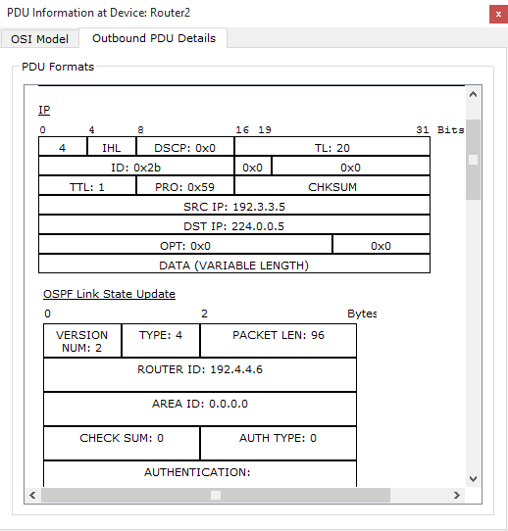

Slide 32
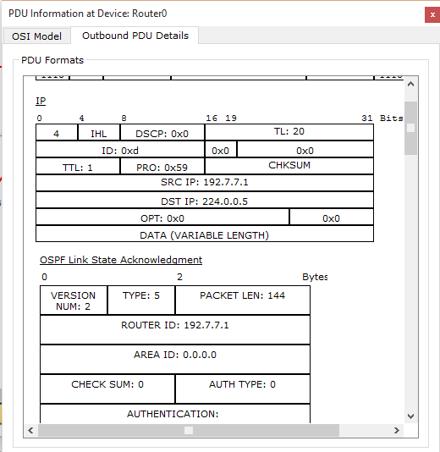

Slide 33


