Slide 1
Voice Over Internet Protocol
(VoIP)
By Wayne Wong

Slide 2
Agenda
Concepts
How it works
Demonstration
- Telephone Service
- VOIP call between two IP phones

Slide 3
Concepts
VoIP vs IP Telephony
IP Telephony turns PSTN -> VoIP
VoIP messages/packet will go through OSI
Sender - message must go down to the stack at the sender from layer 7 to layer 1)
Receiver – message must go traverse up to the stack from layer 1 to layer 7
7 Application Interactive Voice
6 Presentation Codec
5 Session RTP,RTCP
4 Transport UDP
3 Network IP
2 Data Link Ethernet
1 Physical UTP Cat 5

Slide 4
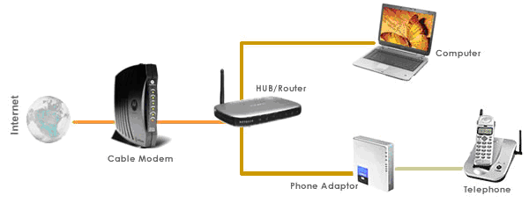
How it works

Slide 5
Demonstration
Router
Assigned IP for Fa0/0
Created DHCP Pool for VOIP to assign IP addresses to the IP phones
Created Telephony Service to assign number of phones and phone numbers (5)
Switch
Configured Switch Port voice and VLAN
IP Phone
Two IP Phones configured – make call between phones
Will add a third IP Phone and a Sniffer
Will assign a number from the router
Make call again and trace the packets

Slide 6
New Features
VOIP is a form of communication that allows you to make phone calls over a broadband internet connection instead of a typical telephone lines.

