Slide 1



Global Academy of Technology Rajarajeshwari Nagar,Bengaluru-560098
Accreditated by NAAC ‘A’ Grade and NBA
Department of Electronics and Communication Engineering
Mini Project Presentation
on
“SENTIMENT ANALYSIS THROUGH TEXT RECOGNITION”
PRESENTED BY:
[LIKHITH K 1GA19EC075]
[MAHESH TR 1GA19EC079]
[MUKESH TS 1GA19EC088]
[RAJNISH KUMAR 1GA19EC117]
Under The Guidance of:
[Mrs. Kruthik Chand D C]

Slide 2
Contents
Introduction
Literature Survey
Problem Definition
Objectives
Methodology / Working
Implementation / Block Diagram / Flow chart
Results and Expected outcomes
Advantages / Disadvantages
Applications
Conclusion
References

Slide 3
INTRODUCTION
SENTIMENT ANALYSIS
*Project aim is to recognize the text image and the emotion of the text by the process called ‘sentiment analysis’.
*This is a part of natural language processing(NLP).
*Sentiment analysis is the process of finding the polarity present in text.
*This analysis gives the power to computer to understand and interrupt the sentences, paragraph, whole document by analyzing the grammatical structure & identifying the relationship between individual word of sentence in a particular context.

Slide 4
*Sentiment analysis (or opinion mining) is a natural language processing (NLP) technique used to determine whether data is positive, negative, or neutral. Sentiment analysis is often performed on textual data to help businesses monitor brand and product sentiment in customer feedback, and understand customer needs.
*Sentiment Analysis, an area of Natural Language Processing (NLP), is used to classify the reviews using the sentiment of the words into positive or negative. Using the sentiment expressed in the words, opinions on any entity can be categorized as positive or negative, or neutral.

Slide 5
*Therefore, the goal of Sentiment analysis is to draw the exact dictionary meaning from the text.
*Emotion detection sentiment analysis allows us to go beyond polarity to detect emotions like positivity, negativity and neutrality.
*Sentiment analysis is the process of drawing meaning from text
*Human language has many words that have different meanings, or any sentence can have different tones like emotional or sarcastic. It is very hard for computers to interpret the meaning of those sentences.
*Sentiment analysis is a subfield of NLP that helps in understanding the context of any text and understanding the emotions that might be depicted in the sentence.

Slide 6
LITERATURE SURVEY
Opinion Mining and sentiment Classification: A survey By S. Chandrakala, Dr. Sindhu C in recent year i.e 2020: This survey gives an overview of the efficient techniques, recent advancements and the future research directions in the field of Sentiment Analysis.
Sentiment Analysis in Today’s Trend: This survey is presented by Surendra Kumar, D. Kumar, D. Kalita in year 2018: This survey paper has presented an elaborative hierarchy of sentiment analysis techniques and sub – techniques or mechanisms and algorithms along with their pros and cons.

Slide 7
3. An analysis and discussion of Human Sentiment Based on social network Information: A survey By S. Chatterjee in 2020: This paper looks at the various aspects of study of feelings and their effect on the power of social platform like twitter, facebook, Instagram , Youtube etc.
4. A simple proposal for sentiment analysis on Movies reviews with Hidden Markov Models: This survey is presented by B. Peralta, Victor Tirapegui, C. Pieringer, L. Caro in 2019: This work proposes the use of Hidden Markov Chains to determine the polarity of the opinions expressed on movie reviews through clustering techniques and carries out a sensitivity analysis of the model.

Slide 8
PROBLEM STATEMENT
A basic task in sentiment analysis is classifying the polarity of a given text at the document, sentence, or feature/aspect level — whether the expressed opinion in a document, a sentence or an entity feature/aspect is positive, negative, or neutral.

Slide 9
OBJECTIVES
The main objective of this project is to detect the emotion being expressed by the given image. With the emergence of the Internet, web, and mobile technologies, people have changed their way of consuming content. As social media and the internet grows in both size and importance, becoming an integral part of daily life, it is a vital new area of social concern. Sentiment analysis (or opinion mining) is a natural language processing (NLP) technique used to determine whether data is positive, negative, or neutral. Sentiment analysis is often performed on textual data to help businesses monitor brand and product sentiment in customer feedback, and understand customer needs.
The purpose of sentiment analysis is to draw overall meaning, or you can say dictionary meaning from the text. The work of sentiment analyzer is to check the text for meaningfulness.

Slide 10
METHODOLOGY/WORKING
Pre-processing & Text Detection
Text Recognition & Filter out Text
Image
Sentiment Analysis
Emotion
There are 3 main processes to detect the emotion of the given image. These processes are executed in order as given below. Pre-processing of the image and Detection of text on the image and getting the region (geometrical points) of the text in the image. Next recognition of the text in those regions. The last step is to analyse the emotion of the obtained text. Here the text obtained from the previous step is filtered for the stop words, punctuations, etc, and emotion, and the result is analysed from the remaining text.

Slide 11
Program library and functions used
OpenCV
EAST
Tesseract
Math
OS
VADER
Natural Language Toolkit
String

Slide 12
OpenCV:
Computer vision is a process by which we can understand the images and videos how they are stored and how we can manipulate and retrieve data from them. Computer Vision is the base or mostly used for Artificial Intelligence. Computer-Vision is playing a major role in self-driving cars, robotics as well as in photo correction apps. OpenCV (Open-Source Computer Vision Library) is an open-source computer vision and machine learning software library. OpenCV was built to provide a common infrastructure for computer vision applications and to accelerate the use of machine perception in commercial products. OpenCV is the huge open-source library for computer vision, machine learning, and image processing and now it plays a major role in real-time operation which is very important in today’s systems.

Slide 13
EAST:
EAST is a deep learning-based algorithm (EAST) that detects text with a single neural network with the elimination of multi-stage approaches. It translates to an Efficient Accurate Scene Text Detector. The key component in this proposed algorithm is a neural network model, which is trained to directly predict the existence of text instances and their geometries from full images. Also, since this model has been designed as a fully convolutional neural network adapted for text detection, it outputs dense per-pixel predictions of words or text lines thus eliminating the need for intermediate steps which were there in traditional models. The key component in this proposed algorithm is a neural network model, which is trained to directly predict the existence of text instances and their geometries from full images.

Slide 14
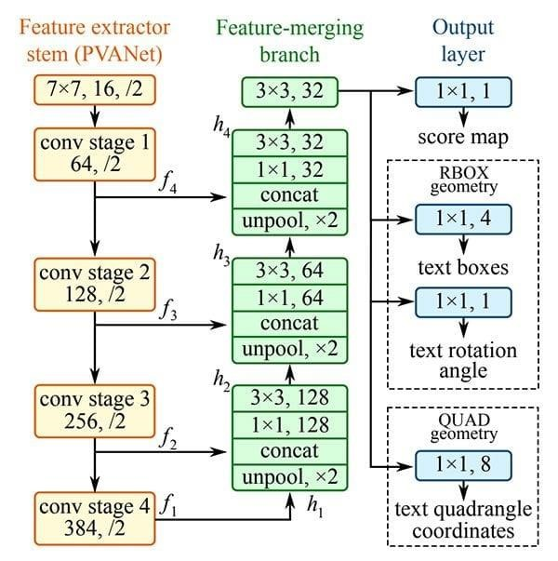
The EAST deep learning text detector

Slide 15
EAST has 3 layers which are Feature Extractor Stem, Feature Merging Branch, and Output Layer:
Feature Extractor Stem – It is used to extract features from different layers of the network. Within this, the stem can be a convolutional network pre-trained on ImageNet dataset, with interleaving convolution and pooling layers. As we can see in the diagram, four levels of feature maps, denoted as f1, f2, f3, and f4 are extracted from the stem.
Feature Merging Branch – This branch of the EAST network merges the feature outputs from a different layer of the VGG16 network. The input image is passed through the VGG16 model and outputs from different four layers of VGG16 are taken and then feature maps are merged using U-net architecture. So, h1, h2, h3, and h4 are the merged feature maps.
Output Layer – The output layer consists of a score map and a geometry map. The score map tells us the probability of text in that region while the geometry map defines the boundary of the text box. This geometry map can be either an RBOX also called a rotated box or a QUAD which is a quadrangle. A rotated box consists of top-left coordinate, width, height and rotation angle for the text box. While quadrangle consists of all four coordinates of a rectangle.

Slide 16
Tesseract
Tesseract is an open-source optical character recognition (OCR) platform. OCR extracts text from images and documents without a text layer and outputs the document into a new searchable text file, PDF, or most other popular formats. Tesseract is highly customizable and can operate using most languages, including multilingual documents and vertical text. Although the software can be used on Windows or Linux, this guide will be based on Mac operating systems which is done through the terminal application. It follows following 4 steps for recognizing text.
Pre-process image data, for example: convert to gray scale, smooth, de-skew, filter.
Detect lines, words, and characters.
Produce ranked list of candidate characters based on trained data set. (here the setDataPath() method is used for setting path of trainer data)
Post process recognized characters, choose best characters based on confidence from previous step and language data. Language data includes dictionary, grammar rules, etc.

Slide 17
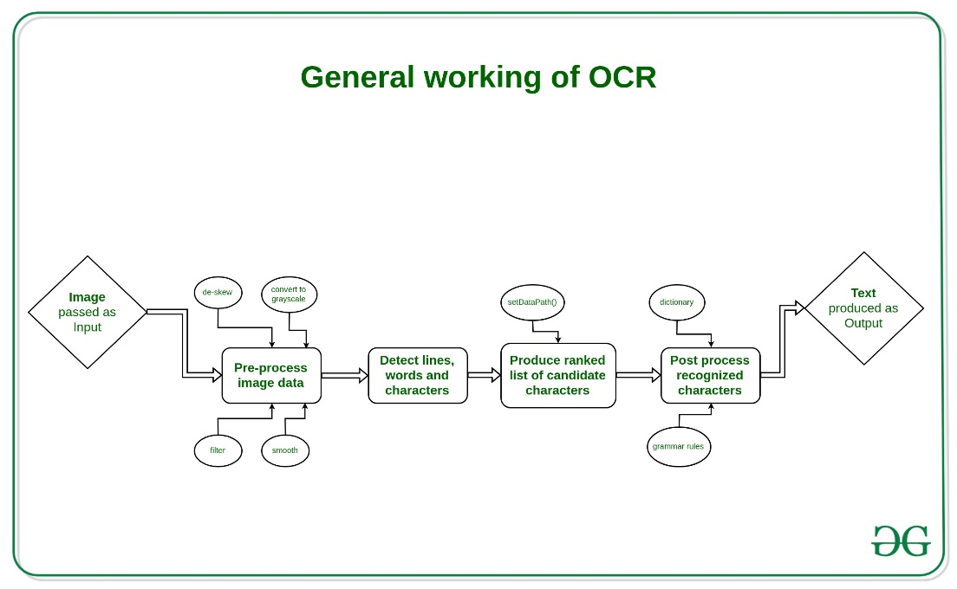

Slide 18
Math module
The Python Math Library provides us access to some common math functions and constants in Python, which we can use throughout our code for more complex mathematical computations. The library is a built-in Python module, therefore you don't have to do any installation to use it. In this article, we will be showing example usage of the Python Math Library's most commonly used functions and constants. The constants include Pie, Euler’s number, etc. Exponents, Logarithms (log10(), log2()), Arithmetic, Trigonometric, Type Conversion are among most used math library functions.

Slide 19
OS module
The OS module in Python provides functions for interacting with the operating system. OS comes under Python’s standard utility modules. This module provides a portable way of using operating system-dependent functionality. The *os* and *os.path* modules include many functions to interact with the file system. We are using OS to get list of image files in given directory so that emotions of all the images files can be determined. Commonly used OS functions includes:
Getting Current Working Directory
Creating a Physical Directory
Changing Working Directory
Removing Directory
Listing Files and Directories

Slide 20
Natural Language Toolkit
The Natural Language Toolkit (NLTK) is a platform used for building Python programs that work with human language data for applying in statistical natural language processing (NLP). It contains text processing libraries for tokenization, parsing, classification, stemming, tagging and semantic reasoning. It also includes graphical demonstrations and sample data sets as well as accompanied by a cook book and a book which explains the principles behind the underlying language processing tasks that NLTK supports. It was originally developed by Steven Bird, Edward Loper and Ewan Klein for use in development and education.

Slide 21
String
It’s a built-in module and we have to import it before using any of its constants and classes. The string module contains a number of functions to process standard Python strings. These functions include:
String Module Constants
string capwords() function
String Module Classes (Formatter, Template)
We are using string’s built-in function get all the punctuations to eliminate them from data obtained to get clean data.

Slide 22
IMPLEMENTATION/BLOCK DIAGRAM/FLOWCHART
Input Image
Re-Format Image
Create Image Blob
Find ROI through
EAST Algorithm
Text Recognition
Compare with Dictionary and Tokenize
Sentiment Analysis
Stop words and Punctuation Removal

Slide 23


Reformat Image
Changing dimension is an important role in processing image, because one cannot recognise text from any size of photos. The EAST algorithm works better with images with size i.e., width and height which are multiple of 32. Therefore, here we cap large image to 1024 and resize the width and height of image to multiple of 32 using OpenCV through area interpolation method. Also, if the image channel is more than 3 it is converted to 3. This new image data obtained is used for all further processes.
Result: Dimensions are changed.

Slide 24
Creating Image Blob
Now that we have a image with required size and dimensions, but these image cannot be feed to EAST layers as it was trained with image blob of training images with mean being 103.94, 116.78, 123.68 which represent blue, green, red respectively.
Finding ROI through EAST Algorithm(Text Detection)
Now a days text detection in images is very important. To detect text means to get the region of text which is usually called as region of interest (ROI). This is obtained by passing the image blob created in previous step through EAST layers. These layers are ‘feature_fusion/Conv_7/Sigmoid’ and ‘feature_fusion/concat_3’. The output obtained from these layers are bounding boxes (ROI) i.e 4 vertices and their Confidence (probability). Bounding boxes with non-maximum confidence are eliminated using OpenCV’s ‘dnn.nmsBoxesRotated’ function. Now all the obtained bounding boxes are used for text recognition.

Slide 25


Result: ROI is created and bounding boxes around text
is formed.

Slide 26
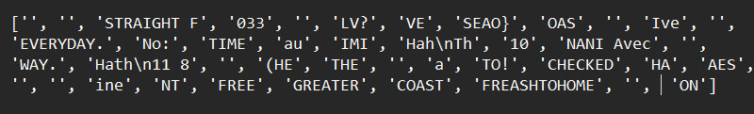
Text Recognition
The text in the image is obtained at this step. The bounding boxes (ROI) is converted to grayscale using OpenCV’s ‘cvtColor’ function and then de-skewed using user defined function which rotates the image if is at an angle. This new image is used to recognise string using ‘image_to_string’ function of pytesseract.
For example

Slide 27
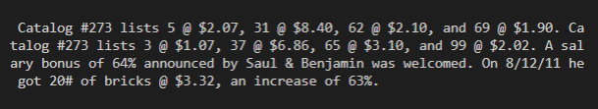
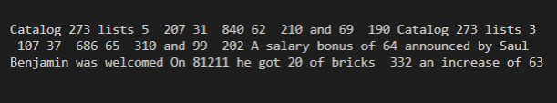
Punctuations Removal
Removing punctuations becomes very important in sentimental analysis. It behaves as noise in our sentimental analysis, so it’s become very important to remove all punctuations that are present in our text. Because there is no contribution of punctuations in analysing the sentiment of text. For removing Punctuations, string module has been used. The string module of Python helps us to quickly access some useful string constants.
Result: Punctuations are removed

Slide 28
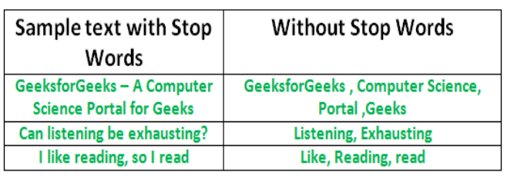
Removing all stop words
The words which are generally filtered out before processing a natural language are called stop words. These are actually the most common words in any language (like articles, prepositions, pronouns, conjunctions, etc) and does not add much information to the text. Examples of a few stop words in English are “the”, “a”, “an”, “so”, “what”.
For example:
Sample 1:

Slide 29
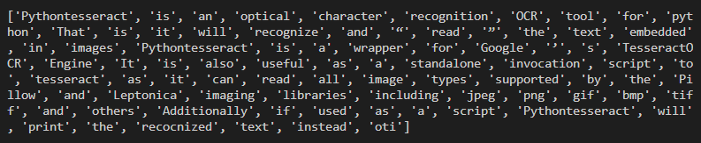
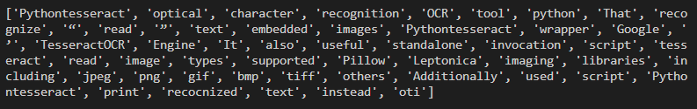
Sample 2:
Result: All stop words removed

Slide 30
Tokenization
Tokenization is breaking the raw text into small chunks. Tokenization breaks the raw text into words, sentences called tokens. These tokens help in understanding the context or developing the model for the NLP. The tokenization helps in interpreting the meaning of the text by analysing the sequence of the words.
tokenization is even more important in sentiment analysis than it is in other areas of NLP, because sentiment information is often sparsely and unusually represented.
It’s step after removing all punctuations and stop words. It’s important to tokenize the word in our dataset because there is chances that some words can be repeated in data set, so it’s required to count the number of times it’s repeating in itself.

Slide 31
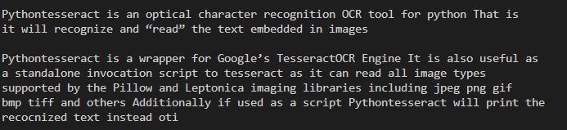
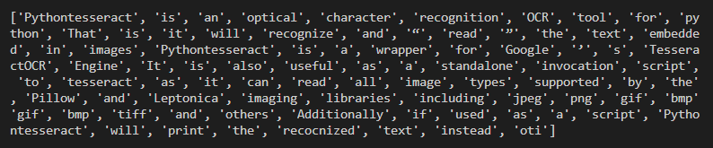
Example:
Result: Sentences are tokenized.

Slide 32
Comparison with English Dictionary and extracting all useful words
After tokenization it’s important to compare our dataset with English dictionary. There might be possibility that some words will not be in English dictionary like name of person, place, monuments or any extra wrong words. Name of any person or anymaterial doesn’t constituent any meaning in sentimental analysis of given data. So, it’s necessary to remove these words.
So it’s very important to compare it with English dictionary in order to remove these words.

Slide 33
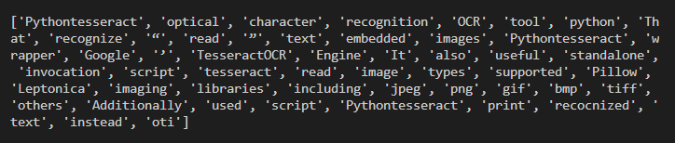
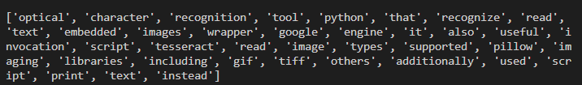
Example:
Result: All useful words are extracted from tokenized word.

Slide 34
Sentiment Analysis
Sentiment Analysis is the process of computationally determining whether a piece of writing is positive, negative or neutral. It’s also known as opinion mining, deriving the opinion or attitude of a speaker.
For finding sentiment of text, there we have VADER tool present in python
VADER (Valence Aware Dictionary and Sentiment Reasoner) is a lexicon and rule – base sentiment analysis tool that is specifically attuned to sentiments expressed in any kind of media. VADER uses a combination of a sentiment lexicon is a list of lexical features (e.g., words) which are generally labelled according to their semantic orientation as either positive or negative. VADER not only tells about the Positivity and Negativity score but also tells us about how positive or negative a sentiment is.
The Compound score is a metric that calculates the sum of all the lexicon ratings which have been normalized between -1(most extreme negative) and +1 (most extreme positive).
positive sentiment: (compound score >= 0.05) neutral sentiment: (compound score > -0.05) and (compound score < 0.05) negative sentiment: (compound score <= -0.05)

Slide 35

Result of Sentiment Analysis:

Slide 36
ADVANTAGES AND DISADVANTAGES
Advantages
The benefits of sentiment analysis extend into your bottom line. With sentiment analysis, you can identify a dissatisfied customer as and when they’re chatting with your team. This enables your agents to offer a smooth service and quick resolution to appease, and ultimately retain, the customer.
When sentiment analysis from text is applied, this gigantic pool of data helps a company gain actionable and relevant insights. AI-enabled sentiment analysis thus helps to improve products, better customer experience (CX), increase efficiency in operations, and in general, makes analyzing data simpler through automation.

Slide 37
Sentiment analysis is the new kid on the live chat block. Only now are brands beginning to understand the benefits of sentiment analysis wrapped within their chat channels. This new technology detects the emotional tone behind text, offering key insights into customer satisfaction.
Disadvantages
Misspellings and grammatical mistakes may cause the analysis to overlook important words or usage.
Sarcasm and irony may be misinterpreted.
Analysis is language-specific.
Discriminating jargon, nomenclature, memes, or turns of phrase may not be recognized.

Slide 38
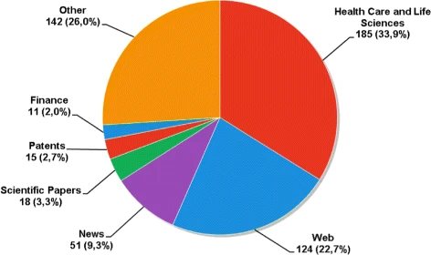
APPLICATIONS
Sentiment analysis methods will provide companies the ability to understand the meaning of the text and achieve comprehension and communication levels that are at par with humans.
These are the top five applications of sentiment analysis in 2022:
Conversational chatbots
Automated ticketing support
Search engine results
Language translation
Sentiment analysis

Slide 39
CONCLUSIONS
At present, most of the work of sentiment analysis focuses on the research of sentiment polarity directly presented by the text.
Sentiment analysis is an evolving field with a variety of use applications. Although sentiment analysis tasks are challenging due to their natural language processing origins, much progress has been made over the last few years due to high demand for it. Not only do companies want to know how their products and services are perceived by consumers (and compare to competitors), but consumers want to know the opinions of others before making buying decisions.

Slide 40
The growing need for product insights- and the technical challenges currently facing the field – will keep sentiment analysis and opinion mining relevant for the foreseeable future. Next – generation opinion mining systems need a deeper bind between complete knowledge bases with reasoning methods inspired by human thought and psychology. This will lead to a better understanding of natural language opinions and will more efficiently bridge the gap between unstructured information in the form of human thoughts and structure data that can be analysed and processed by a machine
The result: Intelligent opinion mining systems capable of handling semantic knowledge, making analogies, continuous learning, and detecting emotions – leading to highly efficient sentiment analysis.

Slide 41
REFERENCES
* A guide to sentiment analysis: What is it and how does it work? (https://awario.com/blog/sentiment-analysis/#anchor3)
* Sentiment Analysis and Professor Dan Jurafsky (https://web.standford.edu/class/cs124/lec/ sentiment.pdf)
* Sentiment Analysis using Vader by Boula Akaldyous (https://akladyous.medium.com/sentiment-analysis-using-vader-c56bcffe6f24#:~:text=%20Sentiment%20Analysis%20using%20VADER%20%201%20Introduction.,rule-based%20sentiment%20analysis...%206%20Conclusion.%20%20More%20)

Slide 42
* NLP sentiment Analysis Using Vader- Analytics Vidhya (https://www.analyticsvidhya.com/blog/2021/06/vader-for-sentiment-analysis/)
* Sentiment Analysis: A Definitive Guide (https://monkeylearn.com/sentiment-analysis/)
*Sentiment Analysis and opinion mining by Bing Liu (http://www.cs.uic.edu/~liub/FBS/SentimentAnalysisand-OpinionMining.html)
* Deep Learning based Text Detection Using OpenCV (C++/Python) (https://learnopencv.com/deep-learning-based-text-detection-using-opencv-c-python/)

Slide 43
Thank You

