Slide 1
1BEIT105/205
Programming in C
Module 4
Chapter 6
Functions
Dhivya Kalaiselvan
Assistant Professor
CSE,CMRIT

Slide 2
Content
Functions
The General form of a Function
Understanding the scope of Function
Function Arguments
argc and argv-arguments to main()
The return statement
What does main() return
Recursion,Function Prototype
Declaring Variable Length Parameter Declarations
The inline Keyword

Slide 3

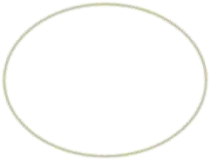



Functions
Functions are the building blocks of C and the place where all program activity occurs.
This chapter examines their features, including function arguments, return values, prototypes, and recursion.
The General Form of a Function
The general form of a function is
ret-type function-name(parameter list)
{
body of the function
}

Slide 4
The ret-type specifies the type of data that the function returns. A function may return any type of data except an array.
The parameter list is a comma-separated list of variable names and their associated types. The parameters receive the values of the arguments when the function is called.
A function can be without parameters, in that case the parameter list is empty. An empty parameter list can be explicitly specified as such by placing the keyword void inside the parentheses.
In variable declarations, you can declare several variables to be of the same type by using a comma-separated list of variable names. In contrast, all function parameters must be declared individually,each including both the type and name. That is, the parameter declaration list for a function takes this general form:
f(type varname1, type varname2, . . . , type varnameN)

Slide 5
Understanding the Scope of a Function
Each function is a discrete block of code.
Thus, a function defines a block scope.
This means that a function's code is private to that function and cannot be accessed by any statement in any other function except through a call to that function. (For instance, you cannot use goto to jump into the middle of another function.)
The code that constitutes the body of a function is hidden from the rest of the program, and unless it uses global variables, it can neither affect nor be affected by other parts of the Code.

Slide 6
Understanding the Scope of a Function
Variables that are defined within a function are local variables. A local variable comes into existence when the function is entered and is destroyed upon exit.
Thus, a local variable cannot hold its value between function calls.
The only exception to this rule is when the variable is declared with the static storage class specifier.
This causes the compiler to treat the variable as if it were a global
variable for storage purposes, but limit its scope to the function.
The formal parameters to a function also fall within the function's scope. This means that a parameter is known throughout the entire function.
A parameter comes into existence when the function is called and is destroyed when the function is exited.

Slide 7
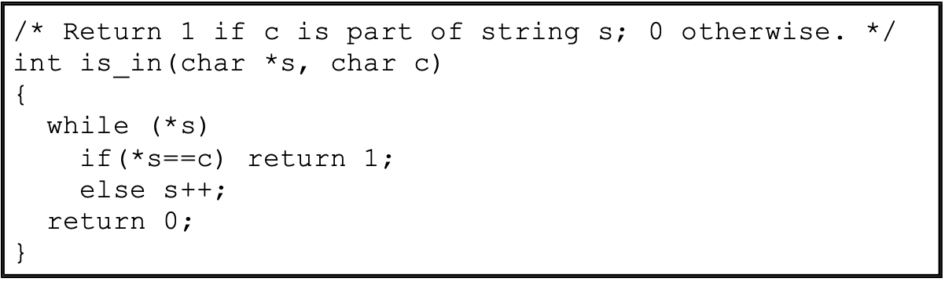
Function Arguments
If a function is to accept arguments, it must declare the parameters that will receive the values of the arguments.
As shown in the following function, the parameter declarations occur after the function
name.The function is_in( ) has two parameters: s and c. This function returns 1 if the character c is part of the string s; otherwise, it returns 0.

Slide 8
Call by Value,Call by Reference
In a computer language there are two ways that arguments can be passed to a subroutine.
The first is call by value.
This method copies the value of an argument into the formal parameter of the subroutine.
In this case, changes made to the parameter have no effect on the argument.
Call by reference is the second way of passing arguments to a subroutine. In this method, the address of an argument is copied into the parameter. Inside the subroutine, the address is used to access the actual argument used in the call. This means that changes made to the parameter affect the argument.

Slide 9
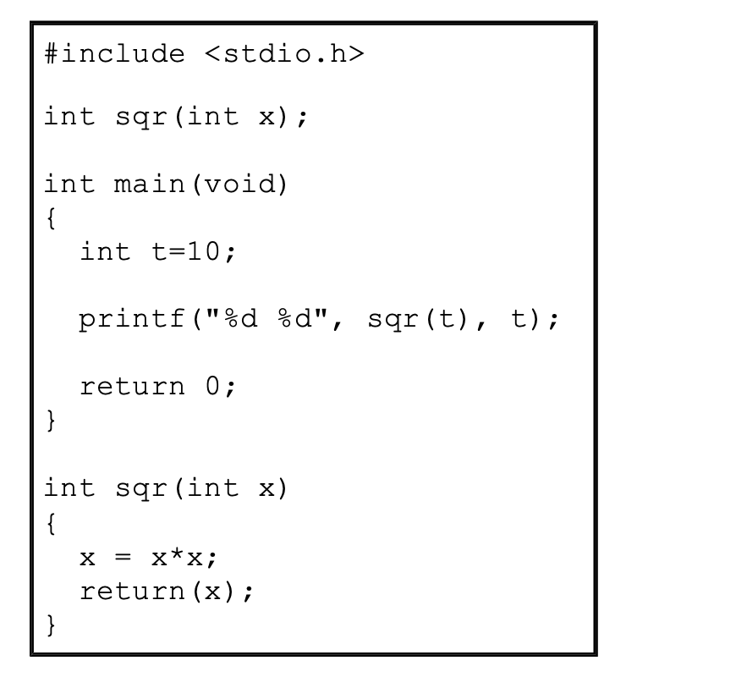
In this example, the value of the argument to sqr( ), 10, is copied into the parameter x. When the assignment x = x*x takes place, only the local variable x is modified. The variable t, used to call sqr( ), still has the value 10. Hence, the output is 100 10.

Slide 10
Creating a Call by Reference
Even though C uses call by value for passing parameters, you can create a call by reference by passing a pointer to an argument, instead of passing the argument itself.
Since the address of the argument is passed to the function, code within the function can change the value of the argument outside the function.
Pointers are passed to functions just like any other argument.
Of course, you need to declare the parameters as pointer types.
For example, the function swap( ).

Slide 11
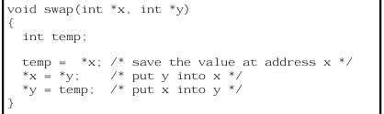
The swap( ) function is able to exchange the values of the two variables pointed to by x and y because their addresses (not their values) are passed.
Within the function, the contents of the variables are accessed using standard pointer operations, and their values are swapped.

Slide 12
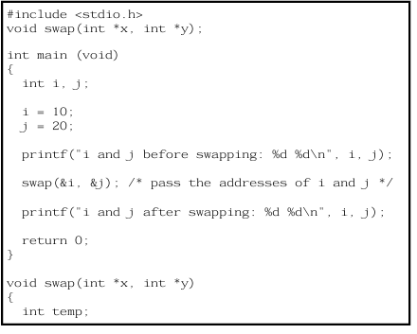
Remember that swap( ) (or any other function that uses pointer parameters) must be called with the addresses of the arguments. The following program shows the correct way to call swap( )

Slide 13
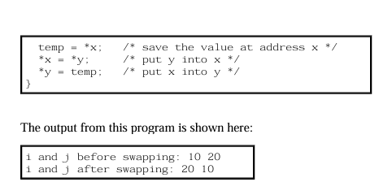
Remember that swap( ) (or any other function that uses pointer parameters) must be called with the addresses of the arguments. The following program shows the correct way to call swap( )
In the program, the variable i is assigned the value 10, and j is assigned the value 20. Then swap( ) is called with the addresses of i and j. (The unary operator & is used to produce the address of the variables.) Therefore, the addresses of i and j, not their values, are passed into the function swap( ).

Slide 14
Calling Functions with Arrays
When an array is used as a function argument, its address is passed to a function.
This is an exception to the call-by-value parameter passing convention.
In this case, the code inside the function is operating on, and potentially altering, the actual contents of the array used to call the function.
For example, consider the function print_upper( ), which prints its string argument in uppercase
when we pass variables to a function in C, values are copied (Call by Value).
But with arrays, the address of the first element is passed → so the function can
directly work on the original array.

Slide 15
What happens when we pass an array to a function?
Normally, when we pass variables (like int x), only a copy of the value is passed (call by value).
But with arrays, the base address (location in memory) is passed to the function.
This means the function can access the original array elements directly.
So, any changes made inside the function will change the actual array in main().

Slide 16
Calling Functions with Arrays
When an array is used as a function argument, its address is passed to a function.
This is an exception to the call-by-value parameter passing convention.
In this case, the code inside the function is operating on, and potentially altering, the actual contents of the array used to call the function.
For example, consider the function print_upper( ), which prints its string argument in uppercase
when we pass variables to a function in C, values are copied (Call by Value).
But with arrays, the address of the first element is passed → so the function can
directly work on the original array.

Slide 17
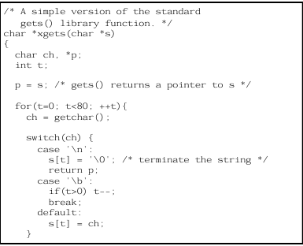

The standard library function gets( ) is a classic example of passing arrays into functions. Although the gets( ) in your standard library is more sophisticated, the following simpler version, called xgets ( ), will give you an idea of how it works.

Slide 18
The xgets( ) function must be called with a char * pointer.
This, of course, can be the name of a character array, which by definition is a char * pointer.
Upon entry, xgets( ) establishes a for loop from 0 to 80.
This prevents larger strings from being entered at the keyboard. If more than 80 characters are entered, the function returns.
The real gets( ) function does not have this restriction.Because C has no built-in bounds checking, you should make sure that any array used to call xgets ( ) can accept at least 80 characters.
As you type characters on the keyboard, they are placed in the string.
If you type a backspace, the counter t is reduced by 1, effectively removing the previous character from the array
.
When you press ENTER, a null is placed at the end of the string, signaling its termination.
Because the array used to call xgets( ) is modified, upon return it contains the characters that you type.

Slide 19
Command Line Arguments in C
argc and argv— Arguments to main
main() can take two special parameters:
int main(int argc, char *argv[])
argc → Argument Count
Number of arguments passed (including program name).
argv → Argument Vector
Array of strings storing the actual arguments.
Helps programs take input directly from the command line.

Slide 20
argv is a box (array) that stores each word you typed.
argv[0] → program name (./a.out)
argv[1] → first input (e.g., Dhivya)
argv[2] → second input (if given)…
So argv = list of words you typed when starting the program.
argc is a counter. It just counts how many words you typed when you ran the program.
First word is always the program name (./a.out).
Rest are your inputs
argc = 1 → only program name given.
argc = 2 → program name + 1 input.
argc = 3 → program name + 2 inputs … and so on.

Slide 21
The return Statement
The return statement is used inside a function.
Its purpose is to send a value back from the function to the part of the program that called it.
If the function does not need to send anything back, we can just use return; in a void function.
In the main() function, return 0; is usually written to show the program ended successfully.

Slide 22
Returning from a Function
A function terminates execution and returns to the caller in two ways. The first occurs when the last statement in the function has executed, and, conceptually, the function's ending curly brace (}) is encountered.
1. Function ends at the closing brace }
When the last statement in the function is finished,
Control goes back to the main program automatically.
👉 Example:
void hello() {
printf("Hello Students");
} // Ends here
Output: Hello Students (After this, control returns to main().)

Slide 23
2.Function ends early using return
A return statement sends control back to the main program immediately.
It can also send back a value.
👉 Example:
int add(int a, int b) {
return a + b; // Ends here and sends result
}
Output: If add(5, 3) → it returns 8.
Functions can stop in two ways:
By reaching the end (}) naturally.
By using a return statement.

Slide 24
All functions, except those of type void, return a value.
The return statement is used to send back the value.
If a non-void function does not return a value → garbage value is returned (bad practice). Rules
A function’s return type must match the value it returns.
A function can be used inside an expression because it produces a value.
Example: x = power(y);
if(max(x,y) > 100) printf("greater");
A function call cannot be on the left side of an assignment.
❌ swap(x,y) = 100; // Error

Slide 25
Types of Functions (based on return values)
Computational functions → Perform calculation and return result.
Example: sqrt(), sin().
Status functions → Return success (0) or failure (e.g., EOF).
Example: fclose().
Procedural functions (void) → Do not return a value.
Example: exit().

Slide 26
Using Return Values
#include <stdio.h>
int mul(int a, int b);
int main(void) {
int x, y, z;
x = 10; y = 20;
z = mul(x, y); // (1) Return value assigned to z
printf("%d", mul(x,y)); // (2) Return value used directly in printf
mul(x, y); // (3) Return value is ignored
return 0;
}
int mul(int a, int b) {
return a * b;
}

Slide 27
Explanation of Example
Line 1: Return value stored in variable z.
Line 2: Return value directly used in an expression (printf).
Line 3: Return value is produced but ignored (lost).

Slide 28
Returning Pointers
A pointer stores the memory address of a variable, not the variable itself.
Pointer arithmetic depends on the base type
(e.g., incrementing an int * moves 4 bytes if int = 4 bytes).
A function that returns a pointer must declare the type of pointer it returns.
Example: char * for characters, int * for integers.
If a function returns a generic pointer, its return type is void *.

Slide 29
Although functions that return pointers are handled just like any other type of function, it is helpful to review some key concepts and look at an example.
Pointers are neither integers nor unsigned integers. They are the memory addresses of a certain type of data.
One reason for this distinction is that pointer arithmetic is relative to the base type.
For example, if an integer pointer is incremented, it will contain a value that is four greater than its previous value (assuming 4-byte integers).
In general, each time a pointer is incremented (or decremented), it points to the next (or previous) item of its type.
Since the length of different data types may differ, the compiler must know what type of data the pointer is pointing to.
For this reason, a function that returns a pointer must declare explicitly what type of pointer it is returning.
For example, you should not use a return type of int * to return a char * pointer!
In a few cases, a function will need to return a generic pointer.

Slide 30
Here is a short program that uses match( ):
#include <stdio.h>
char *match(char c, char *s); /* prototype */
int main(void)
{
char s[80], *p, ch;
gets(s);
ch = getchar();
p = match(ch, s);
if(*p) /* there is a match */
printf(''%s ", p);
else
printf("No match found.");
return 0;
}
This program reads a string and then a character.
It then searches for an occurrence of the character in the string.
If the character is in the string, p will point to that character, and the program prints the string from the point of match.
When no match is found, p will be pointing to the null terminator, making *p false.
In this case, the program prints No match found

Slide 31
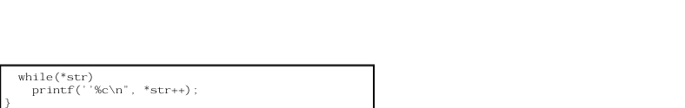
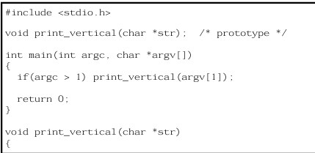
Functions of Type Void
One of void's uses is to explicitly declare functions that do not return values.
This prevents their use in any expression and helps avert accidental misuse.
For example, the function print_vertical( ) prints its string argument vertically down the side of the screen.
Since it returns no value, it is declared as void.

Slide 32
What Does main( ) Return?
The main( ) function returns an integer to the calling process, which is generally the operating system.
Returning a value from main( ) is the equivalent of calling exit( ) with the same value.
If main( ) does not explicitly return a value, the value passed to the calling process is technically undefined.
In practice, most C compilers automatically return 0, but do not rely on this if portability is a concern

Slide 33
Recursion Definition
Recursion: A function calls itself during execution.
Process of defining something in terms of itself → circular definition.
Each recursive call works with a new set of local variables (stored on the stack).
Factorial Example
Factorial of n = product of all numbers from 1 to n.
Example: 3! = 1 × 2 × 3 = 6

Slide 34
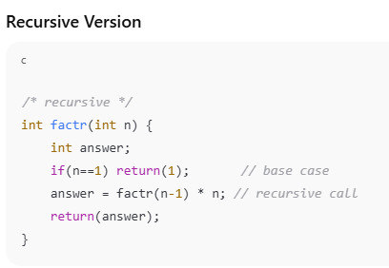
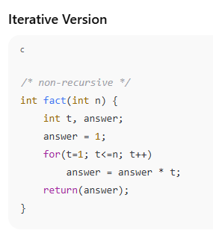

Slide 35
How Recursive factorial works
If n == 1, return 1 (base case).
Otherwise, return factr(n-1) * n.
Example:
factr(3) → factr(2) * 3
factr(2) → factr(1) * 2
factr(1) → 1
Answer = 1 × 2 × 3 = 6

Slide 36
In C, a function can call itself. In this case, the function is said to be recursive. Recursion is the process of defining something in terms of itself, and is sometimes called circular definition. A simple example of a recursive function is factr( ), which computes the factorial of an integer. The factorial of a number n is the product of all the whole numbers between 1 and n. For example, 3 factorial is 1 × 2 × 3, or 6. Both factr( ) and its iterative equivalent are shown here
/* recursive */
int factr(int n) {
int answer;
if(n==l) return(1);
answer = factr(n-l)*n; /* recursive call */
return(answer);
}
/* non-recursive */
int fact(int n) {
int t, answer;
answer = 1;
for(t=1; t<=n; t++)
answer=answer*(t);
return(answer);
}

Slide 37
The nonrecursive version of fact( ) should be clear.
It uses a loop that runs from 1 to n and progressively multiplies each number by the moving product.
The operation of the recursive factr( ) is a little more complex.
When factr( ) is called with an argument of 1, the function returns 1.
Otherwise, it returns the product of factr(n-1)*n. To evaluate this expression, factr( ) is called with n-1.
This happens until n equals 1 and the calls to the function begin returning.
Computing the factorial of 2, the first call to factr( ) causes a second, recursive call with the argument of 1.
This call returns 1, which is then multiplied by 2 (the original n value).
The answer is then 2. Try working through the computation of 3 factorial on your own.
(You might want to insert printf( ) statements into factr( ) to see the level of each call and what the intermediate answers are.)
When a function calls itself, a new set of local variables and parameters are allocated storage on the stack, and the function code is executed from the top with these new variables.
A recursive call does not make a new copy of the function. Only the values being operated upon are new. As each recursive call returns, the old local variables and parameters are removed from the stack, and execution resumes immediately after the recursive call inside the function.
Recursive functions could be said to ''telescope" out and back. Although recursion seems to offer the possibility of improved efficiency, such is seldom the case.

Slide 38
Often, recursive routines do not significantly reduce code size or improve memory utilization. Also, the recursive versions of most routines may execute a bit slower than their iterative equivalents because of the overhead of the repeated function calls.
In fact, many recursive calls to a function could cause a stack overrun. Because storage for function parameters and local variables is on the stack and each new call creates a new copy of these variables, the stack could be exhausted. A stack overrun is what usually causes a program to crash when a recursive function runs wild.
The main advantage to recursive functions is that you can use them to create clearer and simpler versions of several algorithms.
Finally, some people seem to think recursively more easily than iteratively.
When writing recursive functions, you must have a conditional statement, such as an if, somewhere to force the function to return without the recursive call being executed.
If you don't, the function will never return once you call it. Omitting the conditional statement is a common error when writing recursive functions
.
Use printf( ) liberally during program development so that you can watch what is going on and abort execution if you see a mistake

Slide 39
Function Prototypes in C
What is a Function Prototype?
A declaration of a function before it is used.
Tells the compiler:
Return type of the function
Number and type of parameters
Helps the compiler perform type checking.
General Form
return_type function_name(type param1, type param2, ...);
Why Use Prototypes?
✅ Ensures correct number of arguments. ✅ Catches type mismatches. ✅ Improves program reliability. ✅ Required in C++, strongly encouraged in modern C.

Slide 40
Example
/* Using function prototype */
void sqr_it(int *i); // prototype
int main(void) {
int x;
x = 10;
sqr_it(x); // ❌ error: type mismatch
return 0;
}
void sqr_it(int *i) {
*i = *i * *i;
}
👉 Compiler shows error because an int was passed instead of int*.

Slide 41
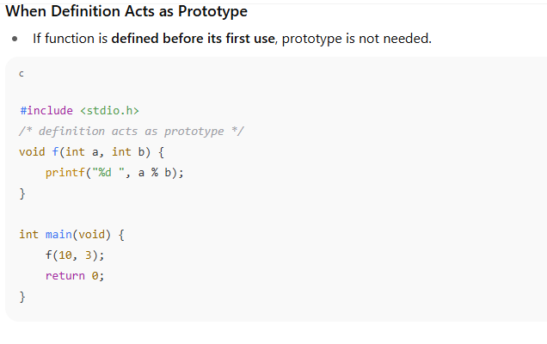

Slide 42
Declaring Variable Length Parameter Lists
Definition
Some functions can accept a variable number of arguments.
Example: printf()
Declared using ellipsis (...) at the end of the parameter list.
Syntax
int func(int a, int b, ...);
func() has at least two integer parameters.
After that → any number of additional arguments (including 0).

Slide 43
Rules
A function with ... must have at least one fixed parameter. int func(...); // ❌ Illegal
int func(int x, ...); // ✅ Correct
To access the extra arguments, use <stdarg.h> library:
va_list → declare argument list
va_start → initialize
va_arg → retrieve arguments
va_end → clean up

Slide 44
The ''Implicit int" Rule
Definition
In early versions of C (C89), if no type was specified, the compiler assumed int.
This is called the implicit int rule (or “default to int” rule).
Removed in C99 and not supported in C++.
Today, always explicitly specify types.

Slide 45
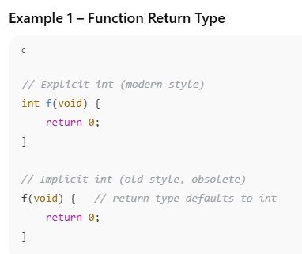
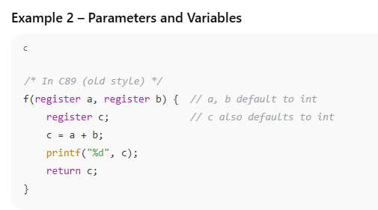

Slide 46
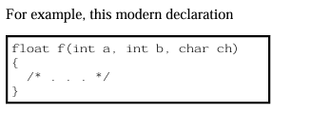
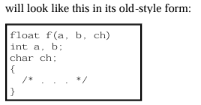
Old-Style vs. Modern Function Parameter Declarations
The old-style function parameter declaration consists of two parts: a parameter list, which goes inside the parentheses that follow the function name, and the actual parameter declarations, which go between the closing parentheses and the function's opening curly brace. The general form of the old-style parameter definition is type func_name(parm1, parm2, . . . parmN) type parm1; type parm2; . . . type parmN; { function code }

Slide 47
The Inline Keyword
The inline Keyword C99 has added the keyword inline, which applies to functions. It is described fully in Part Two, but a brief description is given here. By preceding a function declaration with inline, you are telling the compiler to optimize calls to the function. Typically, this means that the function's code will be expanded in line, rather than called. However, inline is only a request to the compiler, and can be ignored.

Slide 48
THANK YOU

