Slide 1


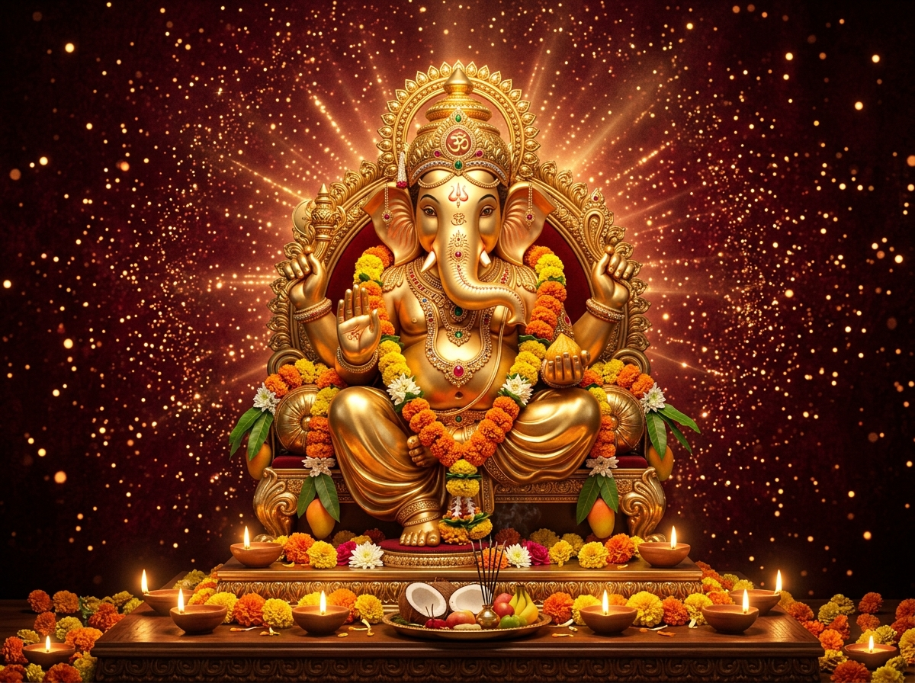
விநாயகர் சதுர்த்தி உலா
2026
PRESENTED BY
INDIA MEDIA HOUSE
A Divine Step in Tamil Nadu Media Industry Showcasing Cultural Unity towards Celebrating Vinayagar Chaturthi.
((( LIVE ))) ON YouTube
1

Slide 2
─── ✤ WHY INDIA MEDIA HOUSE? ✤ ───
 | India Tamil News | India Tamil Divine
YouTube Subscribers | 64,510 | 2,200+
Facebook Followers | 1,45,033 | 15,000+
Instagram Followers | 1,569,052 | 247,744
OUR OFFICIAL LINKS
India Tamil News
India Tamil Divine
https://youtube.com/@IndiaTamilNews
https://www.youtube.com/@indiadivine24
India Media House (Facebook)
India Media House (Instagram)
https://facebook.com/indiamediahouse.in
https://instagram.com/indiamediahouse.in
2

Slide 3
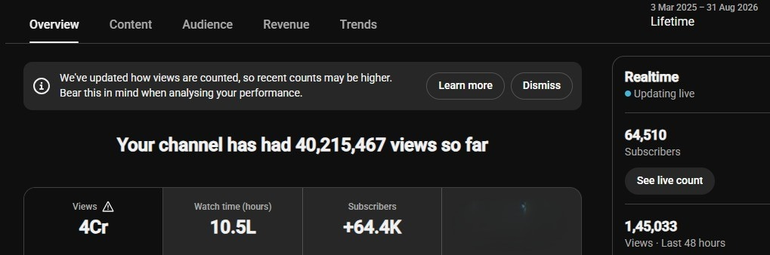
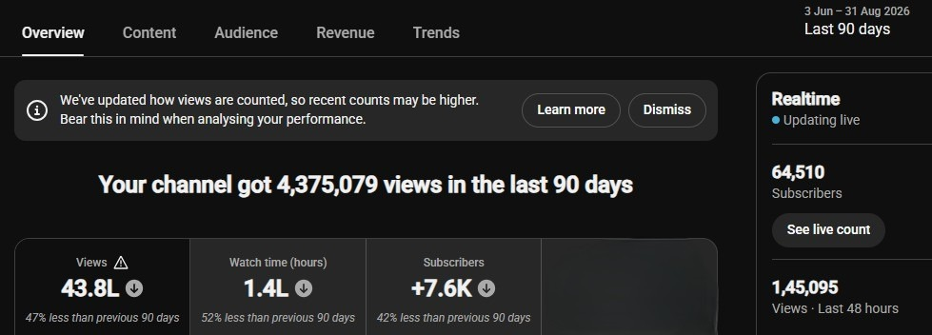
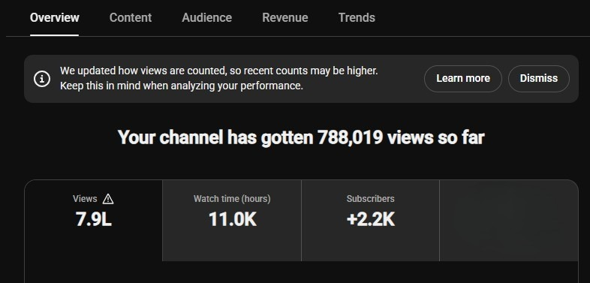
─── ✤ OUR REACH & PERFORMANCE ✤ ───
Verified Analytics & High-Impact Viewership Proof (All figures in Millions)
INDIA TAMIL NEWS - LIFETIME
INDIA TAMIL NEWS - 90 DAYS
INDIA TAMIL DIVINE - LIFETIME
HIGHLIGHTED VIEWS:
40.2M Views
(40,215,467 Exact • 10.5L Watch Hrs)
HIGHLIGHTED VIEWS:
4.37M Views
(4,375,079 Exact • 1.4L Watch Hrs)
HIGHLIGHTED VIEWS:
0.78M Views
(788,019 Exact • 11.0K Watch Hrs)
META SOCIAL: 1.8M Total Views (+320.2%) | 1.2M Reach (+392.7%) | IG: 1.56M Views | FB: 0.24M Views
3

Slide 4
─── ✤ ADVERTISEMENT PLACEMENTS ✤ ───
Multiple high-visibility ad opportunities in YouTube & Meta
VJ ANCHOR SHOUT OUT
1 Brand Only
VOICE OVER AD
3 Brands Only
L-BAND & BANNER
15 + 15 Brands Only
ROTATING LOGO
15 Brands Only
All placements are visible in both YouTube , Facebook & Instagram
4

Slide 5
─── ✤ AD PLACEMENTS PREVIEW ✤ ───
Where your brand will appear
VOICE OVER AD
(Audio Mention in VO)
ROTATING LOGO
[YOUR LOGO]
(Top Right Corner)
L-BAND AD
(Left Strip)
VJ ANCHOR SHOUT OUT
(Prominent Center Screen Mention)
L-BAND & BANNER ── YOUR BRAND HERE ── (Bottom Banner Strip)
5

Slide 6
VINAYAGAR CHATURTHI SPECIAL PRICING
Exclusive Festival Offer – Limited Slots Only!
AD TYPE | USUAL MARKET PRICE (INR) | VINAYAGAR CHATURTHI SPECIAL PRICE (INR)
VJ ANCHOR SHOUT OUT (1 Brand Only) | ₹8,000 | ₹5,000 / per ad
VOICE OVER AD (3 Brands Only) | ₹6,000 | ₹4,000 / per ad
L-BAND & BANNER (15 + 15 Brands Only) | ₹4,000 | ₹2,500 / per ad
ROTATING LOGO (15 Brands Only) | ₹3,000 | ₹1,500 / per ad
All prices are inclusive of placement in YouTube , Facebook & Instagram
6

Slide 7

─── ✤ PARTNER WITH US ✤ ───
Be a part of the biggest cultural celebration and showcase your brand to lakhs of audiences!
Massive Reach
High Engagement
Brand Visibility
Trusted Channels
விநாயகர் சதுர்த்தி உலா 2026
Let's celebrate together. Let's grow together.
SLOT BOOKINGS
📞 +91 9XXXXXXXXX
💬 +91 9XXXXXXXXX
✉️ contact@indiamediahouse.in
🌐 www.indiamediahouse.in
INDIA MEDIA HOUSE
7

