Slide 1
Matrix Chain Multiplication

Slide 2
Instructed By
Md. Shamsujjoha
Senior Lecturer
Department of Computer Science & Engineering
East West University

Slide 3
Prepared By
Abdullah Al Rifat [2016-2-60-030]
Tasnova Bintee Taher [2016-2-60-023]
Md. Mahmudul Haq [2016-2-60-031]
Reaz Ahmed [2016-1-63-029]

Slide 4
Overview
Introduction
Background Study
What is Matrix Chain Multiplication?
Applications
Where we can use MCM?
Functions
Brute force approach
Dynamic approach
Conclution

Slide 5
Dynamic Programming
1. Dynamic Programming is a technique for algorithm design.
2. It is a tabular method in which it uses divide-and-conquer to solve problems.
3. Dynamic programming is applicable when the subproblems are not independent.
4. So to solve a given problem, we need to solve different parts of the problem.

Slide 6
Matrix Chain Multiplication
Matrix multiplication problem determines the way to perform a series of operations in an optimal sequence. The goal is to find the most efficient way to multiply a chain of matrices from a given sequence. The problem is not actually to perform the multiplications, but merely to decide the sequence of the matrix multiplications involved.

Slide 7
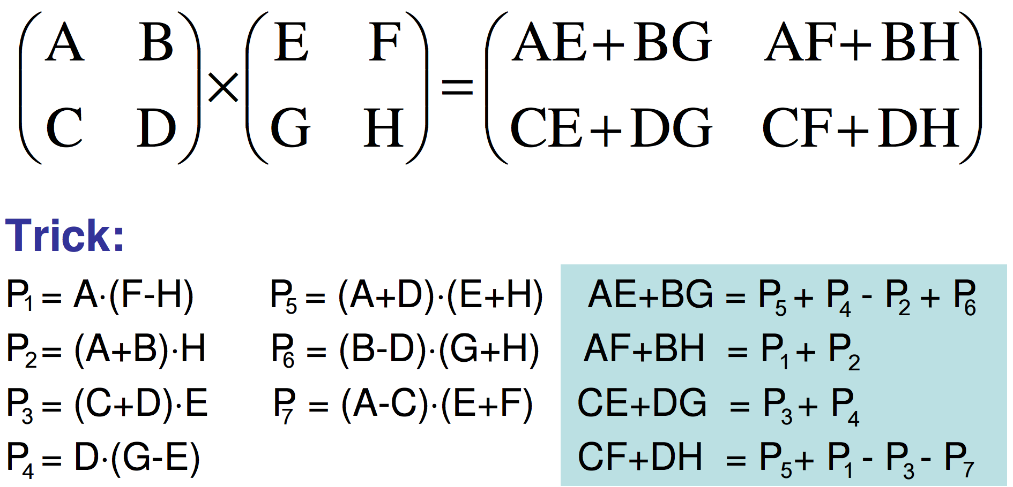
Method of Matrix Multiplication
To multiply multiple matrices we need to check if the column of 1st matrix and the row of 2nd matrix are equal.If not then we can not multiply the matrices.

Slide 8
Example of MCM
Consider the chain A, B, C, D of 4 matrices
Let us compute the product of ABCD
5 different orderings = 5 different parenthesizations
1. (A(B(CD)))
2. ((AB)(CD))
3. (((AB)C)D)
4. (A((BC)D))
5. ((A(BC))D)
Matrix multiplication is associative ,e.g., so parenthenization does
not change results.

Slide 9
Applications of MCM
1. Matrix can be used to create binary images
2. Matrix multiplication is also used in medical science.[Greyscale images are represented by matrix]
3. Matrix multiplications are also used in RGB system & cube.
4. By using matrix multiplications we can Rotate , Reflect, shear an image .

Slide 10
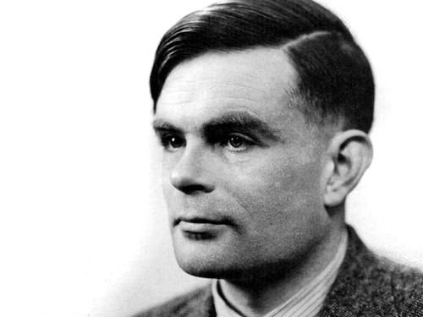
A Simple Binary Image
0000000000000000000000111111110000000000
0000000000000000000111111111111100000000
0000000000000000011111111111111110000000
0000000000000000111111111111111110000000
0000000000000001111111111111111111000000
0000000000000001111000000001111111100000
0000000000000011100000000000111111100000
0000000000000011000000000000111111100000
0000000000000010000000000000111111100000
0000000000000000000000000000111111100000
0000000000000000000000000000111111100000
0000000000000000000011111000011111100000
0000000000000001100111111110001000100000
0000000000000001110111111110000011100000
0000000000000000000000000000000010000000
0000000000000000000000000000000010000000
0000000000000000000000000000000000000000
0000000000000000011100000001110000000000
0000000000000000001000000000000000000000
0000000000000000000000000110011110000000
0000000000000000001111111111111100000000
0000000000000000000111111111111110000000
0000000000000000001110111111111111000000
0000000000000000000000111111111001100000
0000000000000000000011111111111011110000
0000000000000000001111111111110011111100
0000000000000000000011111111100111111111
0000000000000000000010111111000111111111
0000000000000000111101011110001111111111
0000000000000011111110101000001111111111

Slide 11
Matrix Multiply Algorithm
Matrix-Multiply(A,B)
1.If columns[A]!=rows[B]
2. then error “incomplete dimensions”
3. else for i <-1 to rows[A]
4. do for j<- 1 to columns[B]
5. do C[i,j] 0
6. for k 1 to columns[A]
7. Do C[i,j]=C[i,j]+A[i,k]*B[k,j]
8. Return C

Slide 12
Matrix Multiply Algorithm
Matrix-Multiply(A,B)
1.If columns[A]!=rows[B]
2. then error “incomplete dimensions”
3. else for i <-1 to rows[A]
4. do for j<- 1 to columns[B]
5. do C[i,j] 0
6. for k 1 to columns[A]
7. Do C[i,j]=C[i,j]+A[i,k]*B[k,j]
8. Return C

Slide 13
(A ₁ ,A ₂ ,A ₃)
10×100, 100× 5, 5×50

Slide 14
(A ₁ ,A ₂ ,A ₃)
10×100, 100× 5, 5×50
((A ₁A₂ )A ₃ )

Slide 15
(A ₁ ,A ₂ ,A ₃)
10×100, 100× 5, 5×50
((A ₁A₂ )A ₃ )
10*100*5=5000

Slide 16
(A ₁ ,A ₂ ,A ₃)
10×100, 100× 5, 5×50
((A ₁A₂ )A ₃ )
10*100*5=5000
+

Slide 17
(A ₁ ,A ₂ ,A ₃)
10×100, 100× 5, 5×50
((A ₁A₂ )A ₃ )
10*100*5=5000
+
10*5*50=2500

Slide 18
(A ₁ ,A ₂ ,A ₃)
10×100, 100× 5, 5×50
((A ₁A₂ )A ₃ )
10*100*5=5000
+
10*5*50=2500
Total=7500

Slide 19
(A ₁ ,A ₂ ,A ₃)
10×100, 100× 5, 5×50
((A ₁A₂ )A ₃ )
10*100*5=5000
+
10*5*50=2500
Total=7500
(A ₁ (A₂ A ₃ ))

Slide 20
(A ₁ ,A ₂ ,A ₃)
10×100, 100× 5, 5×50
((A ₁A₂ )A ₃ )
10*100*5=5000
+
10*5*50=2500
Total=7500
(A ₁ (A₂ A ₃ ))
100*5*50=25000
+
10*100*50=50000
Total=75000

Slide 21
((A ₁A₂ )A ₃ )
10*100*5=5000
+
10*5*50=2500
Total=7500
(A ₁ (A₂ A ₃ ))
100*5*50=25000
+
10*100*50=50000
Total=75000
10 times faster

Slide 22
Our Goal
Find the low cost order for multiplying matrices

Slide 23
Matrix Chain Multiplication
Input: a chain of matrices to be multiplied
Output: a parenthesizing of the chain
Objective: minimize number of steps needed for the multiplication.
11

Slide 24
Brute-force
A fully parenthesized matrix product is the product of the two fully parenthesized matrix subproducts

Slide 25
Brute-force
Split between the subproducts between k^{th} and (k+1)st matrices for any k=1, 2,….,n-1

Slide 26
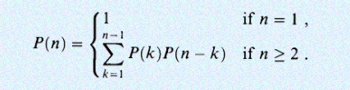
Brute-force
Split between the subproducts between k^{th} and (k+1)st matrices for any k=1, 2,….,n-1

Slide 27
Brute-force
Split between the subproducts between k^{th} and (k+1)st matrices for any k=1, 2,….,n-1
* But poor strategy

Slide 28
Applying dynamic programming
Charecterize the structure of an optimal solution

Slide 29
Applying dynamic programming
Characterize the structure of an optimal solution
Recursively define the value of an optimal solution

Slide 30
Applying dynamic programming
Charecterize the structure of an optimal solution
Recursively define the value of an optimal solutuin
Compute the value of an optima solution

Slide 31
Applying dynamic programming
Charecterize the structure of an optimal solution
Recursively define the value of an optimal solutuin
Compute the value of an optima solution
Construct an optimal solution from computed information

Slide 32
A Dynamic Algorithm
Mem-Matrix-Chain(array p, int i, int j) { if (m[i, j] != UNDEFINED) then return m[i, j]; // already defined else if ( i = = j) then m[i, i] = 0; // basic case else { m[i, j] = infinity; // initialize for k = i to j − 1 do { // try all splits cost = Mem-Matrix-Chain(p, i, k) +
Mem-Matrix-Chain(p, k + 1, j) + p[i − 1] p[k] p[j]; if (cost < m[i, j]) then m[i, j] = cost; // update if better } } return m[i, j]; // return final cost }
6

Slide 33

A Dynamic Algorithm
Mem-Matrix-Chain(array p, int i, int j) { if (m[i, j] != UNDEFINED) then return m[i, j]; // already defined else if ( i = = j) then m[i, i] = 0; // basic case else { m[i, j] = infinity; // initialize for k = i to j − 1 do { // try all splits cost = Mem-Matrix-Chain(p, i, k) +
Mem-Matrix-Chain(p, k + 1, j) + p[i − 1] p[k] p[j]; if (cost < m[i, j]) then m[i, j] = cost; // update if better } } return m[i, j]; // return final cost }
Complexity of this algorithm is ${O(n}^{3})$
16

Slide 34
Dynamic Approach to Solve MCM
Let us look at this matrices
A[5][4] B[4][6] C[6][2] D[2][7]
Our goal is to multiply these matrices….
From this we will get a dimension array p[] = {5,4,6,2,7}
P[]
5 | 4 | 6 | 2 | 7

Slide 35
Dynamic Approach to Solve MCM
For calculating the upper matrix ….
P[]
5 | 4 | 6 | 2 | 7
i j
1 2
3
4
d = 1
i j
1 3
4
d = 2
i j
1 4
d = 3
M[][]
0 | 1 | 2 | 3 | 4
0
1
2
3
4
0 | 0 | 0 | 0 | 0
0 | 0
0 |  | 0
0 |  |  | 0
0 |  |  |  | 0
Here, n = 5,
d < n-1 -> d<4
j = i + d

Slide 36
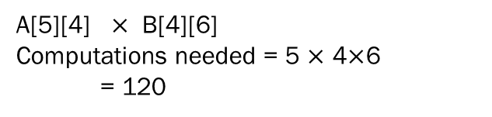
Dynamic Approach to Solve MCM
For calculating the upper matrix ….
P[]
5 | 4 | 6 | 2 | 7
Let us look at this matrices
A[5][4] B[4][6] C[6][2] D[2][7]
Our goal is to multiply these matrices….
M[][]
0 | 1 | 2 | 3 | 4
A[5][4] $×$ B[4][6]
Computations needed = 5 $×$ 4$×$6
= 120
0
1
2
3
4
0 | 0 | 0 | 0 | 0
0 | 0
0 |  | 0
0 |  |  | 0
0 |  |  |  | 0

Slide 37
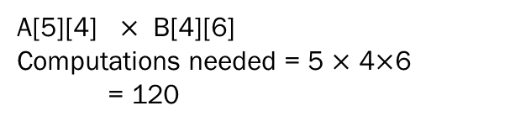
Dynamic Approach to Solve MCM
For calculating the upper matrix ….
P[]
5 | 4 | 6 | 2 | 7
Let us look at this matrices
A[5][4] B[4][6] C[6][2] D[2][7]
Our goal is to multiply these matrices….
M[][]
0 | 1 | 2 | 3 | 4
A[5][4] $×$ B[4][6]
Computations needed = 5 $×$ 4$×$6
= 120
0
1
2
3
4
0 | 0 | 0 | 0 | 0
0 | 0 | 120
0 |  | 0
0 |  |  | 0
0 |  |  |  | 0

Slide 38
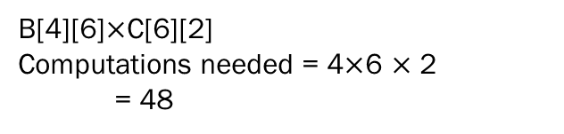
Dynamic Approach to Solve MCM
For calculating the upper matrix ….
P[]
5 | 4 | 6 | 2 | 7
Let us look at this matrices
A[5][4] B[4][6] C[6][2] D[2][7]
Our goal is to multiply these matrices….
M[][]
0 | 1 | 2 | 3 | 4
B[4][6]$×$C[6][2]
Computations needed = 4$×$6 $×$ 2
= 48
0
1
2
3
4
0 | 0 | 0 | 0 | 0
0 | 0 | 120
0 |  | 0 | 48
0 |  |  | 0
0 |  |  |  | 0

Slide 39
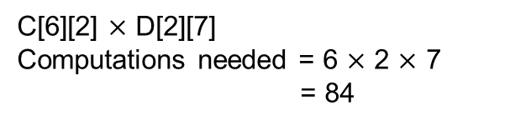
Dynamic Approach to Solve MCM
For calculating the upper matrix ….
P[]
5 | 4 | 6 | 2 | 7
Let us look at this matrices
A[5][4] B[4][6] C[6][2] D[2][7]
Our goal is to multiply these matrices….
M[][]
0 | 1 | 2 | 3 | 4
C[6][2]$×$ D[2][7]
Computations needed = 6 $×$ 2$×$ 7
= 84
0
1
2
3
4
0 | 0 | 0 | 0 | 0
0 | 0 | 120
0 |  | 0 | 48
0 |  |  | 0 | 84
0 |  |  |  | 0

Slide 40
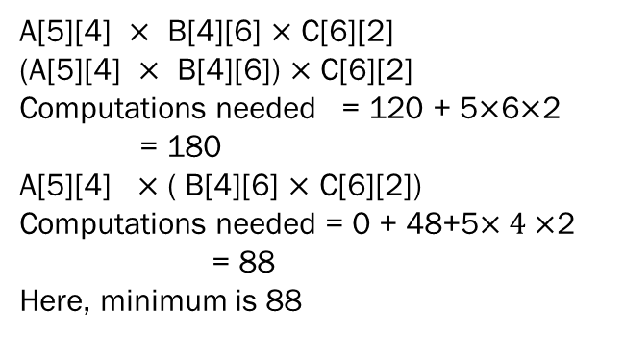
Dynamic Approach to Solve MCM
For calculating the upper matrix ….
P[]
5 | 4 | 6 | 2 | 7
Let us look at this matrices
A[5][4] B[4][6] C[6][2] D[2][7]
Our goal is to multiply these matrices….
M[][]
0 | 1 | 2 | 3 | 4
A[5][4] $×$ B[4][6] $×$ C[6][2]
(A[5][4] $×$ B[4][6]) $×$ C[6][2]
Computations needed = 120 + 5$×$6$×$2
= 180
A[5][4] $×$ ( B[4][6] $×$ C[6][2])
Computations needed = 0 + 48+5$×4×$2
= 88
Here, minimum is 88
0
1
2
3
4
0 | 0 | 0 | 0 | 0
0 | 0 | 120 | 88
0 |  | 0 | 48
0 |  |  | 0 | 84
0 |  |  |  | 0

Slide 41
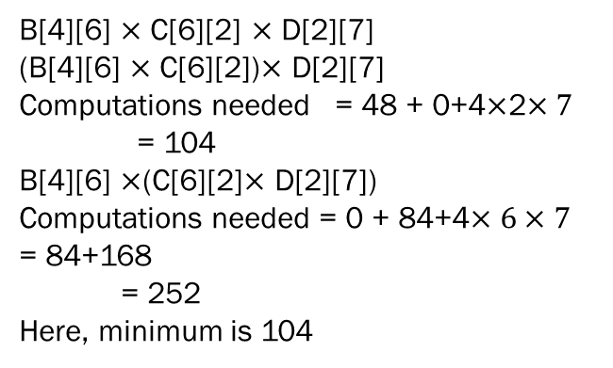
Dynamic Approach to Solve MCM
For calculating the upper matrix ….
P[]
5 | 4 | 6 | 2 | 7
Let us look at this matrices
A[5][4] B[4][6] C[6][2] D[2][7]
Our goal is to multiply these matrices….
M[][]
0 | 1 | 2 | 3 | 4
B[4][6] $×$ C[6][2] $×$ D[2][7]
(B[4][6] $×$ C[6][2])$×$ D[2][7]
Computations needed = 48 + 0+4$×$2$×7$
= 104
B[4][6] $×$(C[6][2]$×$ D[2][7])
Computations needed = 0 + 84+4$×6×7$
= 84+168
= 252
Here, minimum is 104
0
1
2
3
4
0 | 0 | 0 | 0 | 0
0 | 0 | 120 | 88
0 |  | 0 | 48 | 104
0 |  |  | 0 | 84
0 |  |  |  | 0

Slide 42
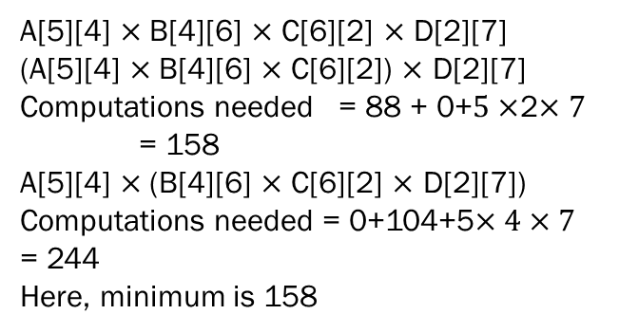
Dynamic Approach to Solve MCM
For calculating the upper matrix ….
P[]
5 | 4 | 6 | 2 | 7
Let us look at this matrices
A[5][4] B[4][6] C[6][2] D[2][7]
Our goal is to multiply these matrices….
M[][]
0 | 1 | 2 | 3 | 4
A[5][4] $×$B[4][6] $×$ C[6][2] $×$ D[2][7]
(A[5][4] $×$B[4][6] $×$ C[6][2]) $×$ D[2][7]
Computations needed = 88 + 0+$5×$2$×7$
= 158
A[5][4] $×$(B[4][6] $×$ C[6][2] $×$ D[2][7])
Computations needed = 0+104+5$×4×7$ = 244
Here, minimum is 158
0
1
2
3
4
0 | 0 | 0 | 0 | 0
0 | 0 | 120 | 88 | 158
0 |  | 0 | 48 | 104
0 |  |  | 0 | 84
0 |  |  |  | 0

Slide 43
158
That is our minimum cost.
A[5][4] X B[4][6] X C[6][2] X D[2][7]

Slide 44
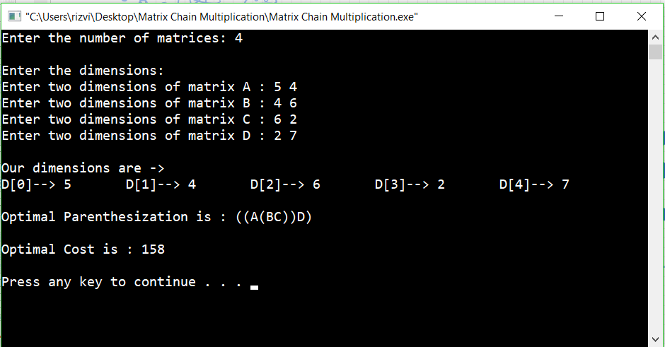

Whoa! Our program also gives the same result for multiplying
A[5][4] $×$B[4][6] $×$ C[6][2] $×$ D[2][7]

Slide 45
Have you any Question?

Slide 46
Thank You

