Slide 1


Sales Data Analysis – Customer & Product Insights
Using Python, SQL, and Data Visualization
Web Scraping and Data Insights from quotes.toscrape.com
Using Python, SQL, and Data Visualization
Team Lead : Nicky
Member : Raj Yadav
Date : 11 May 2025
Team Lead: Raj Yadav
Role: Project Coordinator &
Responsibilities: Performed data cleaning and preprocessing using Python. Conducted Exploratory Data Analysis (EDA) to uncover trends and anomalies
Team Members: Nicky
Role: SQL Specialist
Responsibilities: Wrote queries for data extraction, transformation, and aggregation from raw datasets.
Team Members: Kaniska
Role: Data Visualization Analyst
Responsibilities: Designed visual dashboards and created meaningful charts using Python libraries.
Date : 11 June 2025

Slide 2
Project Overview
Goal: Scrape quotes, authors, and tags from the website.
Tools: Python (BeautifulSoup), SQL, Pandas, Matplotlib, Seaborn.
Outcomes: Dataset, SQL queries, and insights visualized.
Project Overview
Goal: Analyze sales performance, customer behavior, and product trends to provide actionable insights for the business.
Tools Used: Python , SQL, Visualizations ( Matplotlib, Seaborn), PowerPoint (Reporting).
Outcomes: Dataset, SQL queries, and insights visualized.

Slide 3
Web Scraping
Data Cleaning & Preprocessing (Python)
Target Website: http://quotes.toscrape.com/
Data Extracted: Quote Text, Author Name, Tag Names.
All pages scraped using pagination and saved as CSV.
Loaded the raw dataset using Pandas
Converted date columns like Order Date to datetime format
Handled missing values by:
Removing or imputing nulls in sales/profit fields
Removing duplicate rows
Formatted column names for consistency and readability
Extracted features like:
Month-Year from date for time series analysis
Profit Margin and other derived metrics

Slide 4
Thank You
Questions & Discussion
Contact Info (Optional)
Exploratory Data Analysis (EDA)
- Analyzed summary statistics for key metrics (Sales, Profit, Quantity).
- Created group-wise aggregations:
Sales & profit by Category, Sub-Category, Region.
Identified top customers by revenue.

Slide 5
Thank You
Key Insights Discovered
Questions & Discussion
Contact Info (Optional)
- High-discount orders often led to negative profits.
- Technology category had highest average profit.
- Sales peaked during November and December, indicating seasonality.
- Profit variability was high in Furniture, indicating need for review.

Slide 6
SQL Insights
Loaded CSV into SQL database.
Queries Answered:
1. Number of quotes by each author.
2. Top 5 most common tags.
3. Authors with more than 5 quotes.
4. Longest quote and its author.
SQL Insights
Loaded CSV into SQL database.
Queries Answered:
Total sales by customer segment.
Average discount applied per region.

Slide 7
Key SQL Results (Example)
Key SQL Insights
Most quoted author: Albert Einstein.
Top tag: inspirational.
Authors with more than 5 quotes: e.g., Einstein, Twain.
Longest quote: '...' by XYZ Author.
1. The Consumer Segment has highest Total Sales, followed by corporate and home office segments.
2. The West Region has highest average profit .
3. The Central Region has Lowest average profit.

Slide 8
Visualization Highlights
Visualization Highlights
Top 10 authors bar chart.
Top 10 tags bar chart.
Top 5 authors pie chart.
Quote length histogram.
Boxplot: Quote length by author.
1. Bar charts for top products.
2. Line charts for sales trends.
3. Heatmaps for regional sales distribution.
4. Pie Chart: Sales by Region
5. Boxplot: Profit Distribution by Category

Slide 9
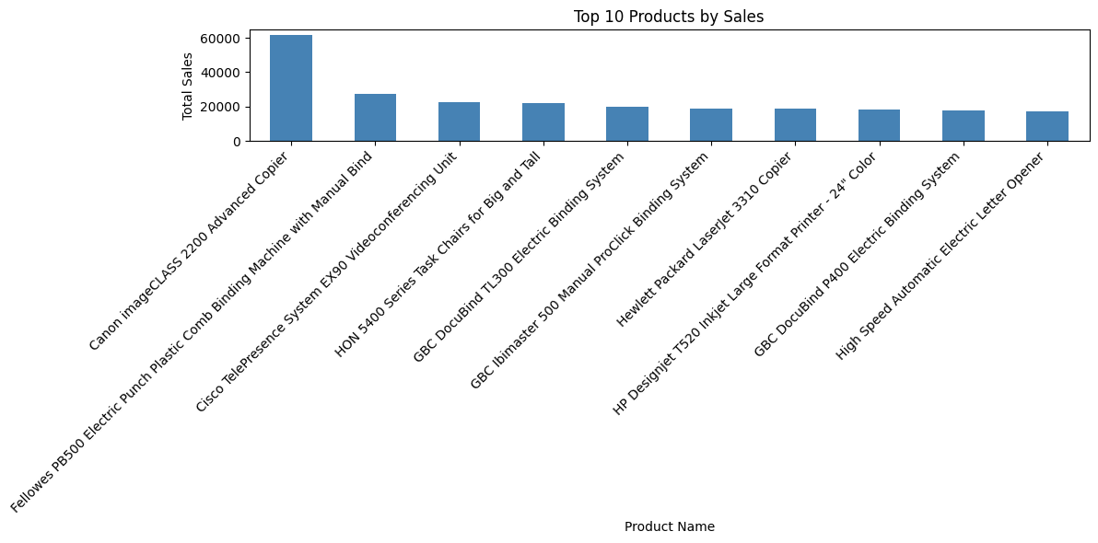
Visualization Result
Visualization Highlights
1. Bar Chart: Top 10 Products by Sales
Top 10 authors bar chart.
Top 10 tags bar chart.
Top 5 authors pie chart.
Quote length histogram.
Boxplot: Quote length by author.

Slide 10
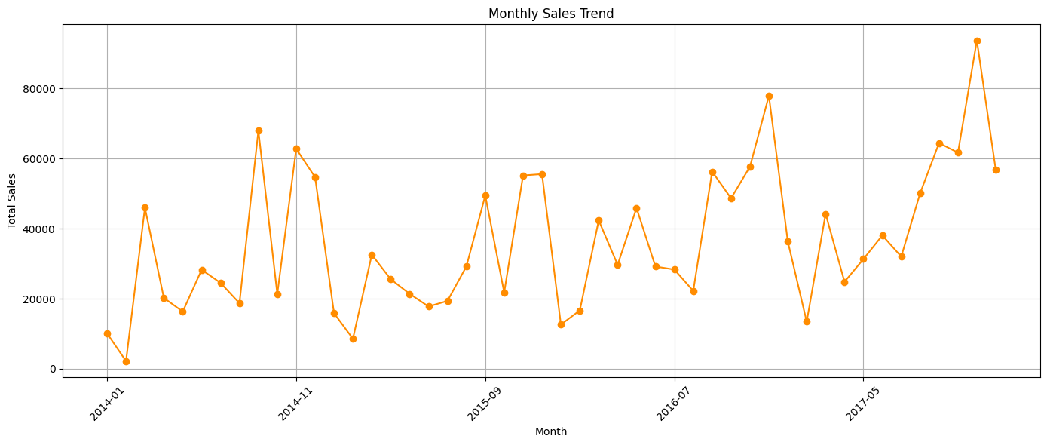
Visualization Result
Visualization Highlights
2. Line Chart: Monthly Sales Trend.
Top 10 authors bar chart.
Top 10 tags bar chart.
Top 5 authors pie chart.
Quote length histogram.
Boxplot: Quote length by author.

Slide 11
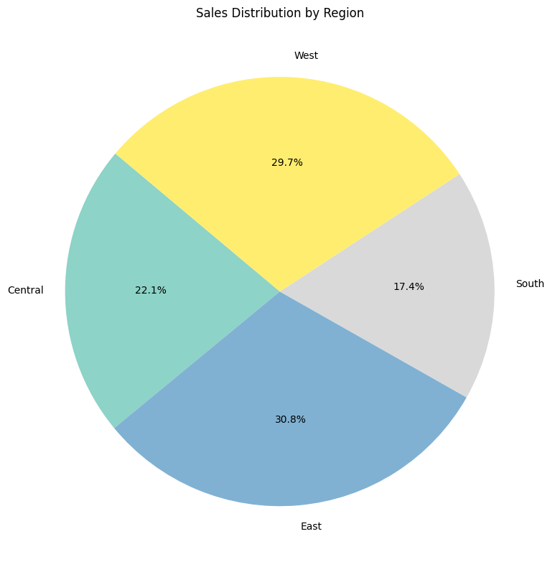
Visualization Result
Visualization Highlights
3. Pie Chart: Sales by Region.
Top 10 authors bar chart.
Top 10 tags bar chart.
Top 5 authors pie chart.
Quote length histogram.
Boxplot: Quote length by author.

Slide 12
Conclusion
Conclusion & Business Insights
Successfully applied web scraping and SQL analysis.
Cleaned and visualized data using Pandas and Seaborn.
Learned end-to-end data workflow integration.
Scalable to other websites or datasets.
1. Technology is the most profitable category.
2. Western region leads in sales performance.
3. Seasonal peak in Nov–Dec.
4. High-discount products can result in negative profit.
5. Opportunities: Region-based strategy, Discount optimization.

Slide 13
Conclusion
Successfully applied web scraping and SQL analysis.
Cleaned and visualized data using Pandas and Seaborn.
Learned end-to-end data workflow integration.
Scalable to other websites or datasets.
Thank You !

