Slide 1


Web Scraping and Data Insights from quotes.toscrape.com
Using Python, SQL, and Data Visualization
Team Lead : Nicky
Member : Raj Yadav
Date : 11 May 2025
Web Scraping and Data Insights from quotes.toscrape.com
Using Python, SQL, and Data Visualization
Team Lead : Nicky
Member : Raj Yadav
Date : 11 May 2025

Slide 2
Project Overview
Project Overview
Goal: Scrape quotes, authors, and tags from the website.
Tools: Python (BeautifulSoup), SQL, Pandas, Matplotlib, Seaborn.
Outcomes: Dataset, SQL queries, and insights visualized.
Goal: Scrape quotes, authors, and tags from the website.
Tools: Python (BeautifulSoup), SQL, Pandas, Matplotlib, Seaborn.
Outcomes: Dataset, SQL queries, and insights visualized.

Slide 3
Web Scraping
Web Scraping
Target Website: http://quotes.toscrape.com/
Data Extracted: Quote Text, Author Name, Tag Names.
All pages scraped using pagination and saved as CSV.
→ Target Website: http://quotes.toscrape.com/
→ Data Extracted: Quote Text, Author Name, Tag Names.
→ All pages scraped using pagination and saved as CSV.

Slide 4
Sample Data
author: Albert Einstein
quote: 'The world as we have created it is a process of our thinking.'
tag_name: change, deep-thoughts, thinking, world
Sample Data
→ author: Albert Einstein
→ quote: 'The world as we have created it is a process of our thinking.'
→ tag_name: change, deep-thoughts, thinking, world

Slide 5
SQL Insights
Loaded CSV into SQL database.
Queries Answered:
1. Number of quotes by each author.
2. Top 5 most common tags.
3. Authors with more than 5 quotes.
4. Longest quote and its author.
SQL Insights
Loaded CSV into SQL database.
Queries Answered:
1. Number of quotes by each author.
2. Top 5 most common tags.
3. Authors with more than 5 quotes.
4. Longest quote and its author.

Slide 6
Key SQL Results (Example)
Key SQL Results (Example)
Most quoted author: Albert Einstein.
Top tag: inspirational.
Authors with more than 5 quotes: e.g., Einstein, Twain.
Longest quote: '...' by XYZ Author.
→ Most quoted author: Albert Einstein.
→ Top tag: inspirational.
→ Authors with more than 5 quotes: e.g., Einstein, Twain.
→ Longest quote: 25 by Albert Einstein Author.

Slide 7
EDA Summary
Total quotes: 1000+
Unique authors: 50+
Missing values cleaned, duplicates dropped.
Tag names normalized (hyphens removed).
EDA Summary
→ Total quotes: 97
→ Unique authors: 49
→ Missing values cleaned, duplicates dropped.
→ Tag names normalized (hyphens removed).

Slide 8
Visualization Highlights
Visualization Highlights
Top 10 authors bar chart.
Top 10 tags bar chart.
Top 5 authors pie chart.
Quote length histogram.
Boxplot: Quote length by author.
→ Top 10 authors bar chart.
→ Top 10 tags bar chart.
→ Top 5 authors pie chart.
→ Quote length histogram.
→ Boxplot: Quote length by author.

Slide 9
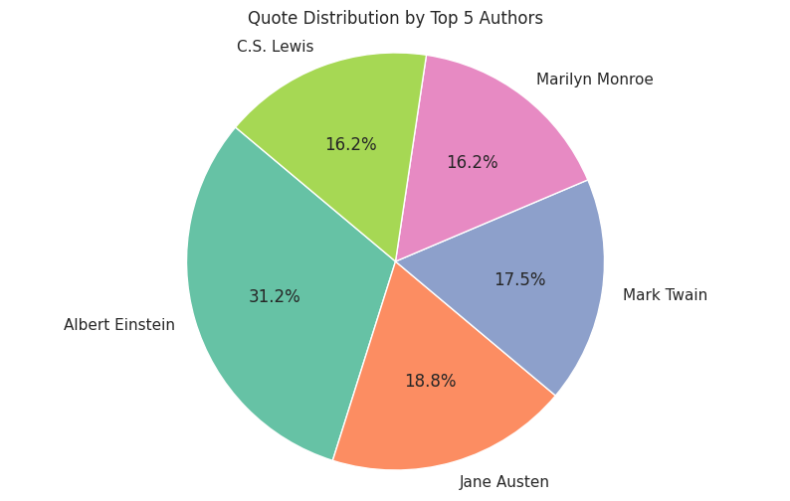
Visualization Result
Visualization Highlights
1. Top 5 authors pie chart.
Top 10 authors bar chart.
Top 10 tags bar chart.
Top 5 authors pie chart.
Quote length histogram.
Boxplot: Quote length by author.

Slide 10
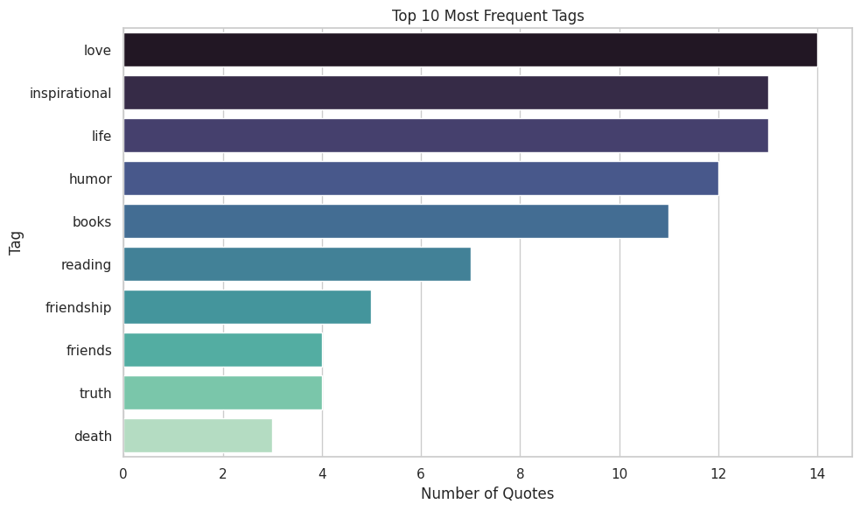
Visualization Result
Visualization Highlights
2. Top 10 tags bar chart.
Top 10 authors bar chart.
Top 10 tags bar chart.
Top 5 authors pie chart.
Quote length histogram.
Boxplot: Quote length by author.

Slide 11
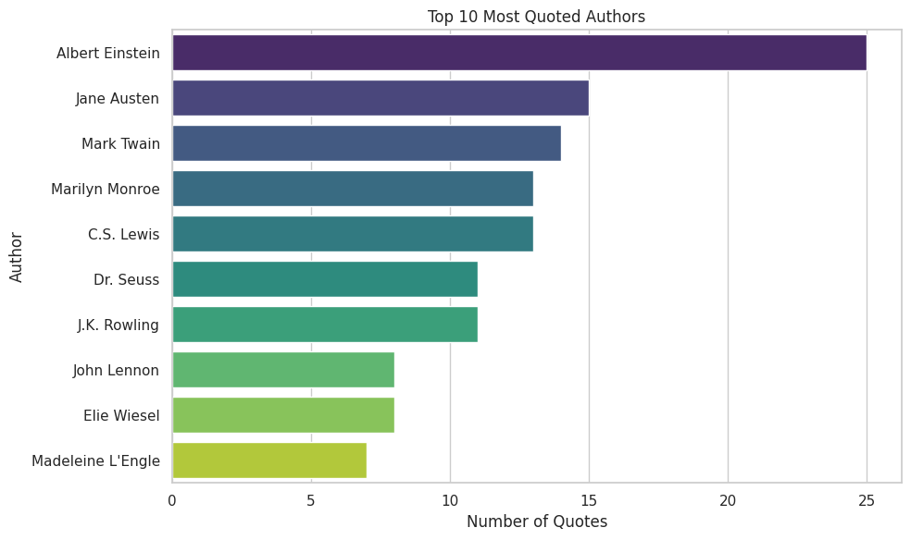
Visualization Result
Visualization Highlights
3. Top 10 authors bar chart.
Top 10 authors bar chart.
Top 10 tags bar chart.
Top 5 authors pie chart.
Quote length histogram.
Boxplot: Quote length by author.

Slide 12
Conclusion
Conclusion
Successfully applied web scraping and SQL analysis.
Cleaned and visualized data using Pandas and Seaborn.
Learned end-to-end data workflow integration.
Scalable to other websites or datasets.
→ Successfully applied web scraping and SQL analysis.
→ Cleaned and visualized data using Pandas and Seaborn.
→ Learned end-to-end data workflow integration.
→ Scalable to other websites or datasets.

Slide 13
Thank You
Questions & Discussion
Contact Info (Optional)

