Slide 1
INDIAN PREMIER LEAGUE (2008 – 2025)
Player & Team Performance Analysis
An Empirical & Statistical Investigation Across 18 Seasons (1,169 Matches)
Academic Presentation | Senior Data Analytics Project

Slide 2
Executive Summary & Research Framework
Scope: 18 Seasons | 1,169 Matches | 278,205 Deliveries
Core Objective: Analyze long-term IPL scoring evolution, franchise win stability, player volume/efficiency, over-by-over phase dynamics, and tactical toss impacts.
Data Pipeline: Standardized team names across 18 seasons (e.g. Delhi Capitals, Punjab Kings, RCB), cleaned venue variants, isolated legal balls for accurate overs/economy calculation.
Batting Framework: Evaluates batsmen using Runs, Strike Rate, Batting Average, Boundary Reliance %, and Consistency Coefficient of Variation (CV).
Bowling Framework: Evaluates bowlers using Wickets, Overs, Economy Rate, Bowling Average, Bowling Strike Rate, and Dot Ball %.
Inferential Statistics: Formally tests era-wise scoring escalation using Welch's t-test and toss outcome advantage using Chi-Square Test of Independence.

Slide 3
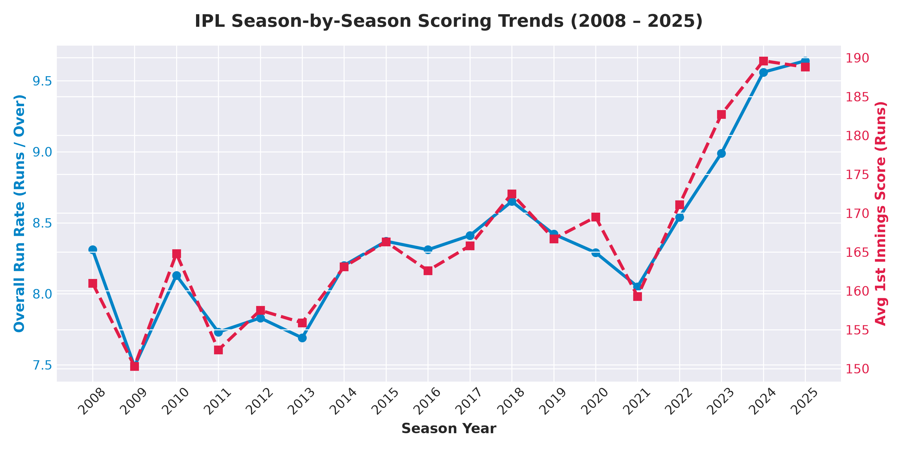
IPL Season-by-Season Scoring Trends (2008 – 2025)
Run rate escalation and 1st innings average score growth
Key Analytical Insights:
• 1st innings scoring rates show substantial upward trend from 2008 (161.0) to 2024-2025 (180+ runs).
• Overall IPL run rate grew from ~7.8 runs/over in early seasons to ~8.7+ runs/over in modern seasons.
• Rule innovations (Impact Player rule in 2023) and bat technology contributed to accelerated death-over scoring.

Slide 4
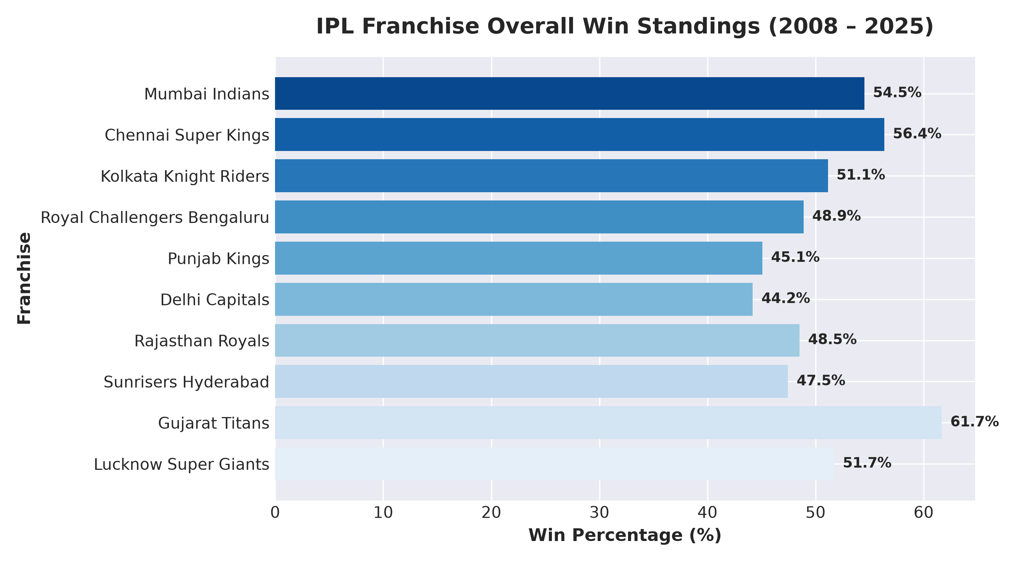
Franchise Overall Win Standings (2008 – 2025)
All-time win percentage and matches won
Top Franchise Metrics:
• Mumbai Indians: 54.51% Win Rate (151 Wins / 277 Matches)
• Chennai Super Kings: 56.35% Win Rate (142 Wins / 252 Matches)
• Kolkata Knight Riders: 51.14% Win Rate (135 Wins / 264 Matches)
• Royal Challengers Bengaluru: 48.89% Win Rate (132 Wins / 270 Matches)
• Punjab Kings: 45.08% Win Rate (119 Wins / 264 Matches)

Slide 5
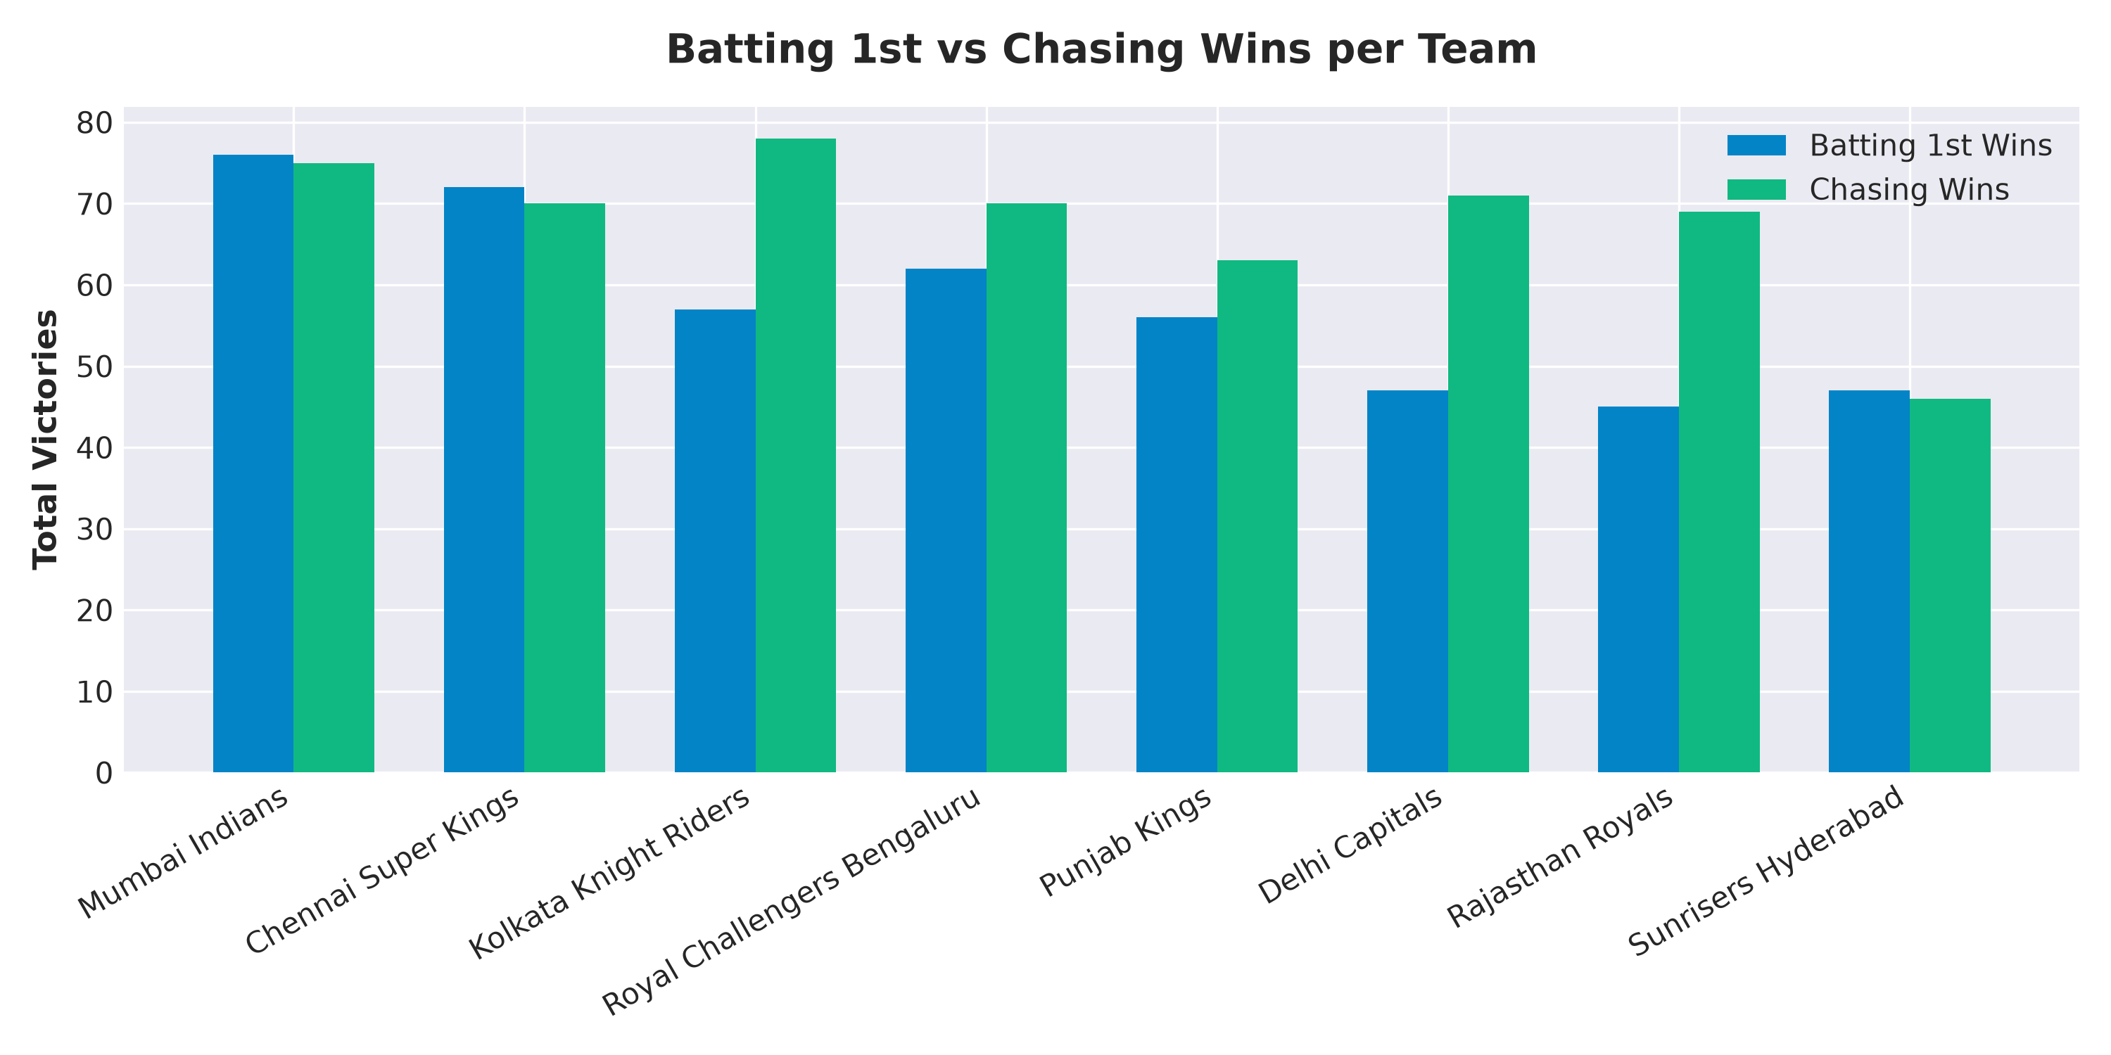
Batting 1st vs Chasing Strategy Breakdown
Evaluating target setting versus chasing success
Chasing Advantage:
• Chasing teams won 54.4% of non-tied IPL matches across 18 seasons.
• Evening dew factor in night games reduces spin effectiveness in 2nd innings.
• Teams like KKR and MI demonstrate strong chasing win conversion rates.

Slide 6
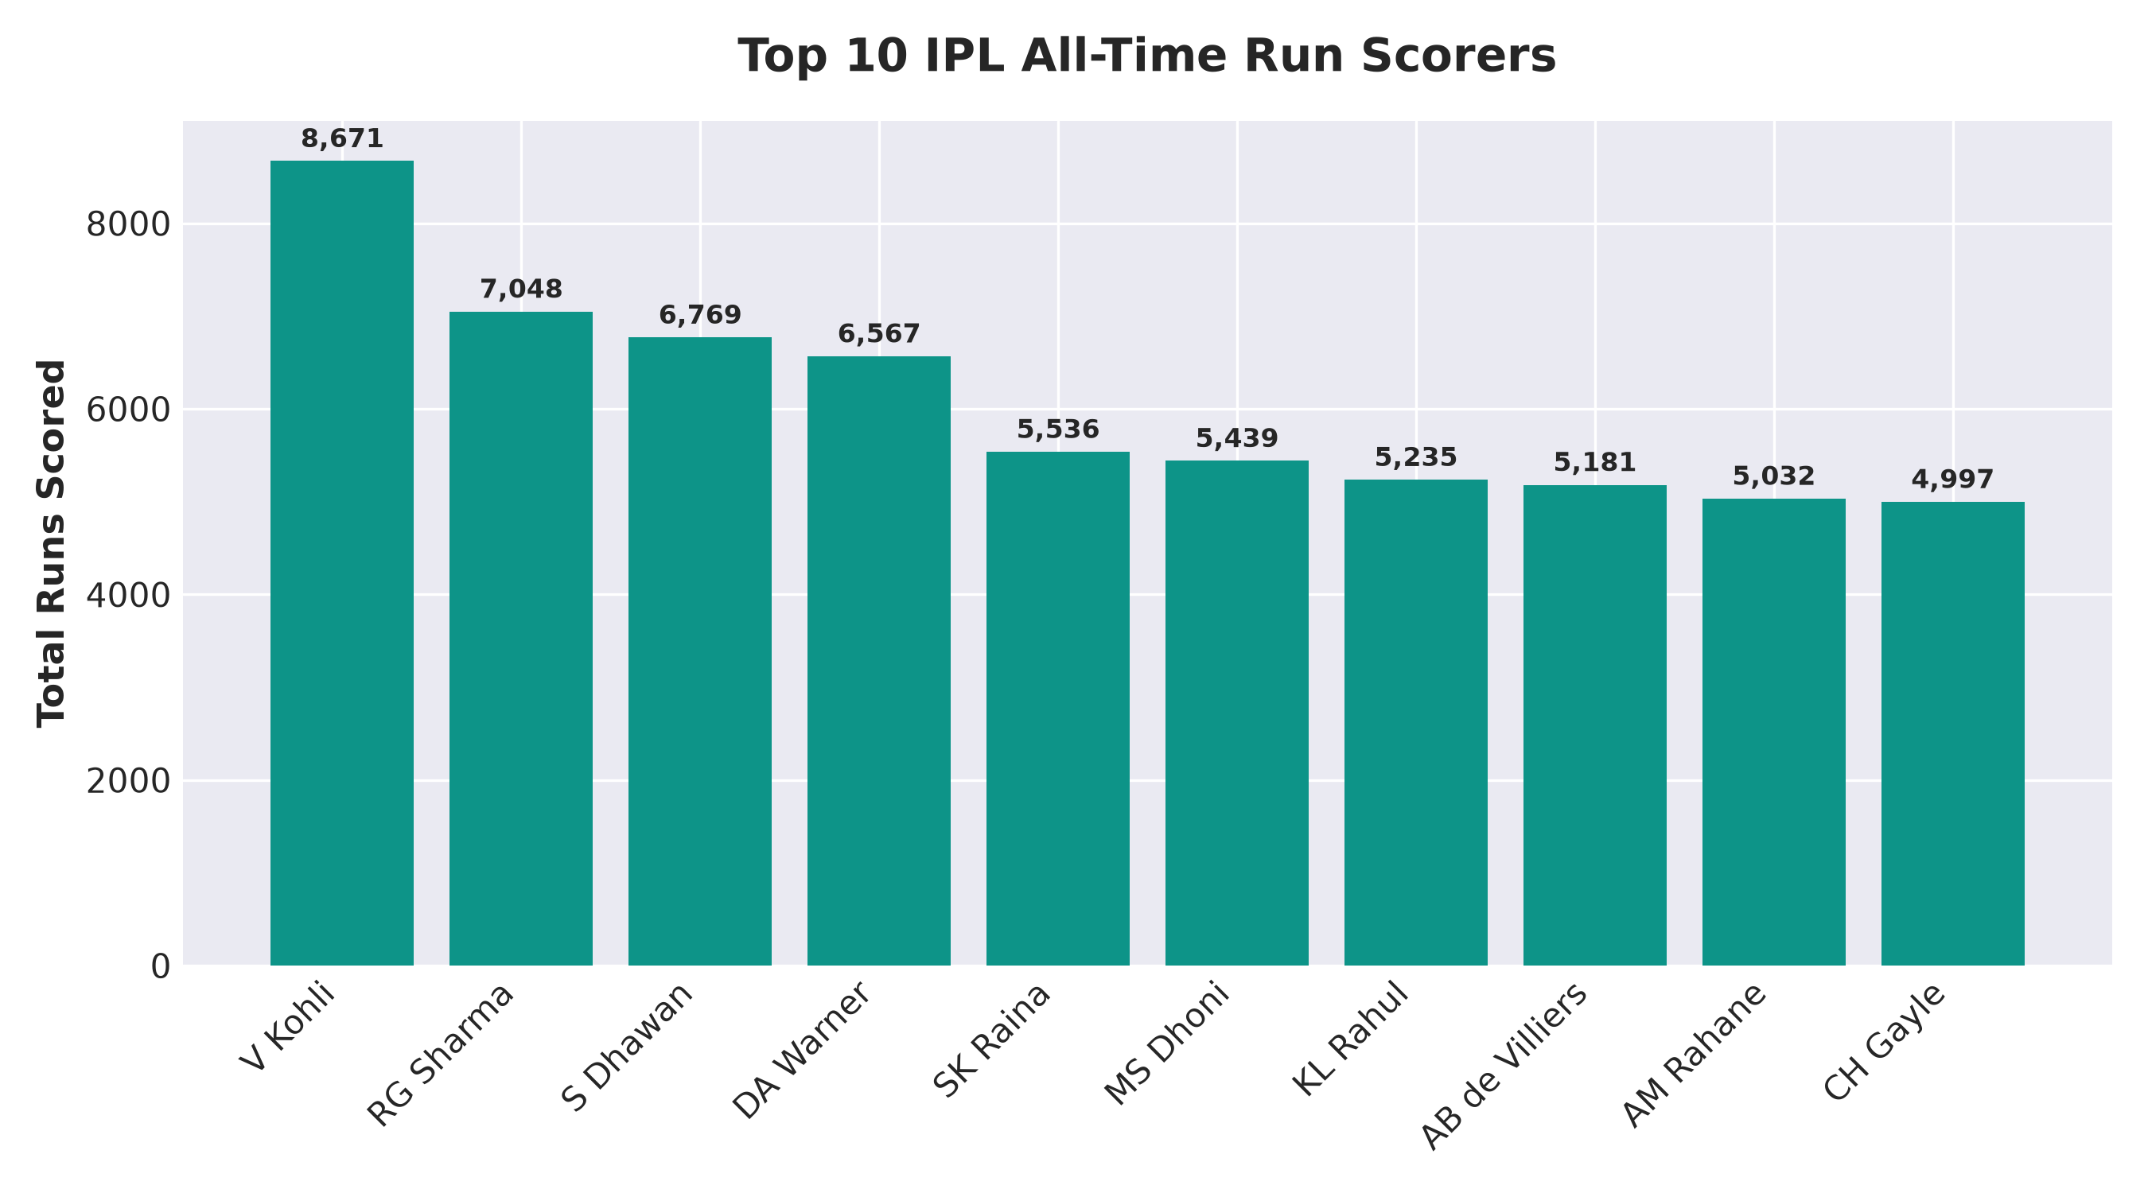
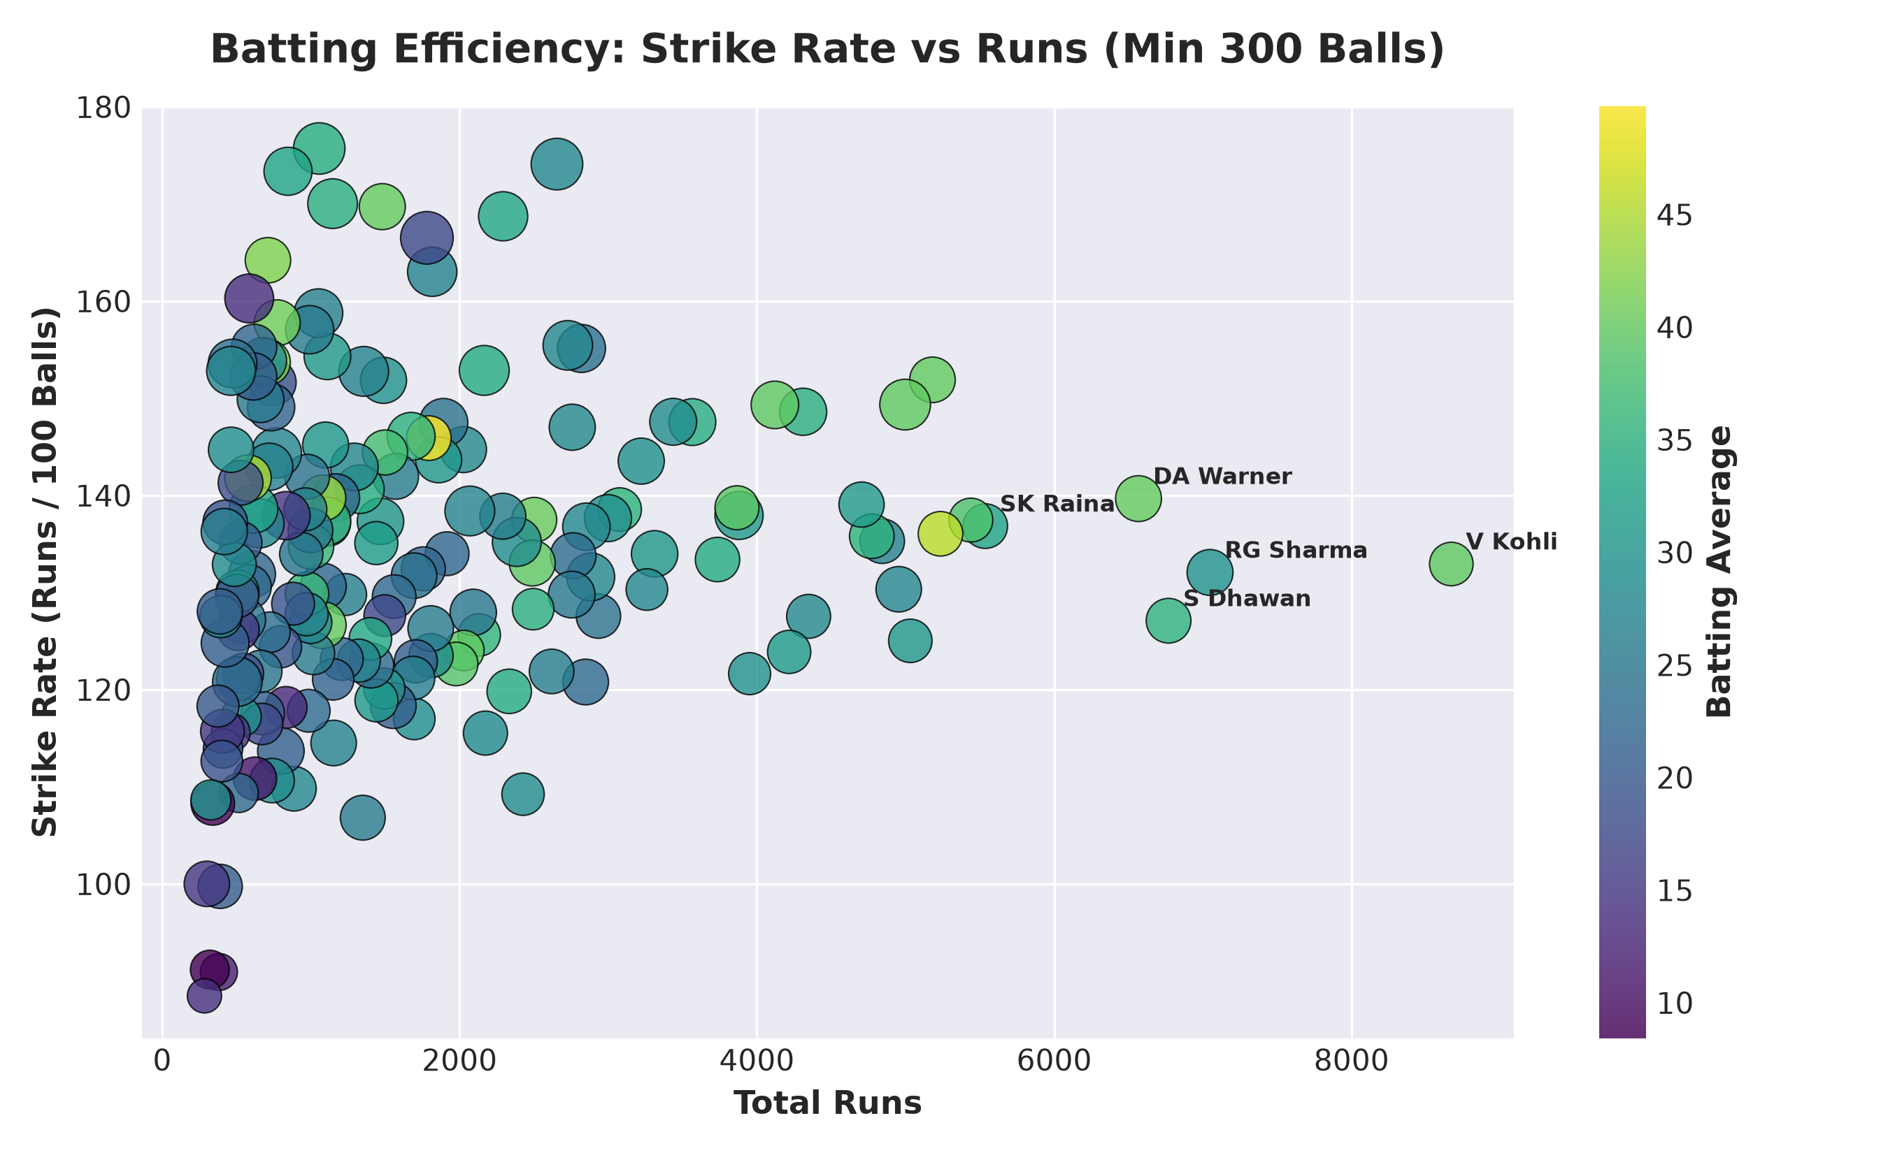
Batting Volume & Efficiency Framework
Top run scorers and Strike Rate vs Runs matrix

Slide 7
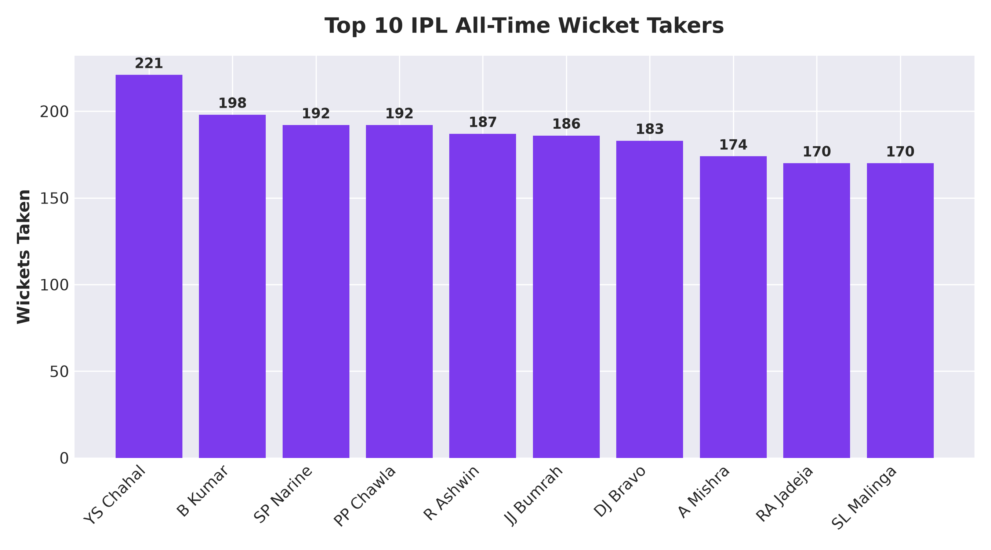
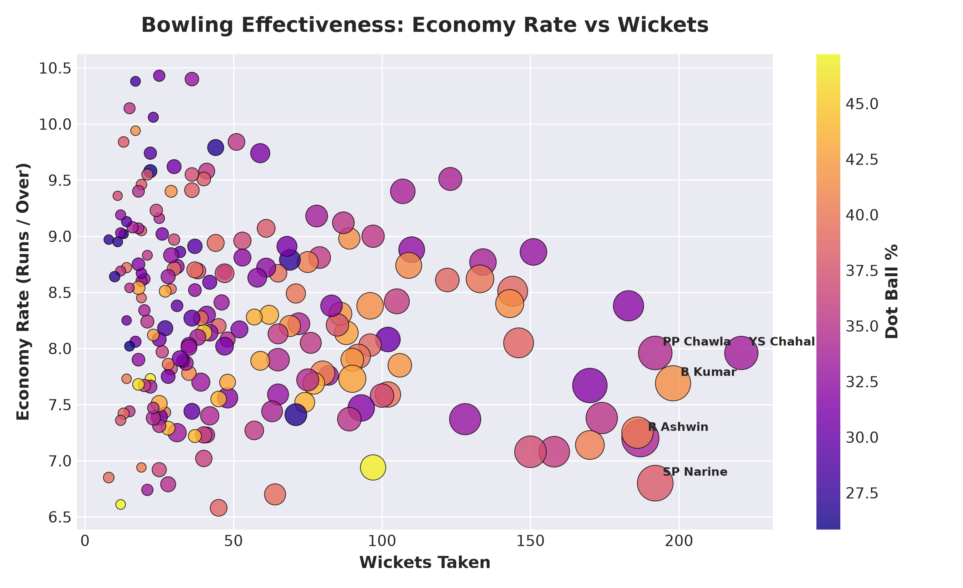
Bowling Containment & Wicket Analysis
Top wicket takers, Economy Rates, and Dot Ball %

Slide 8
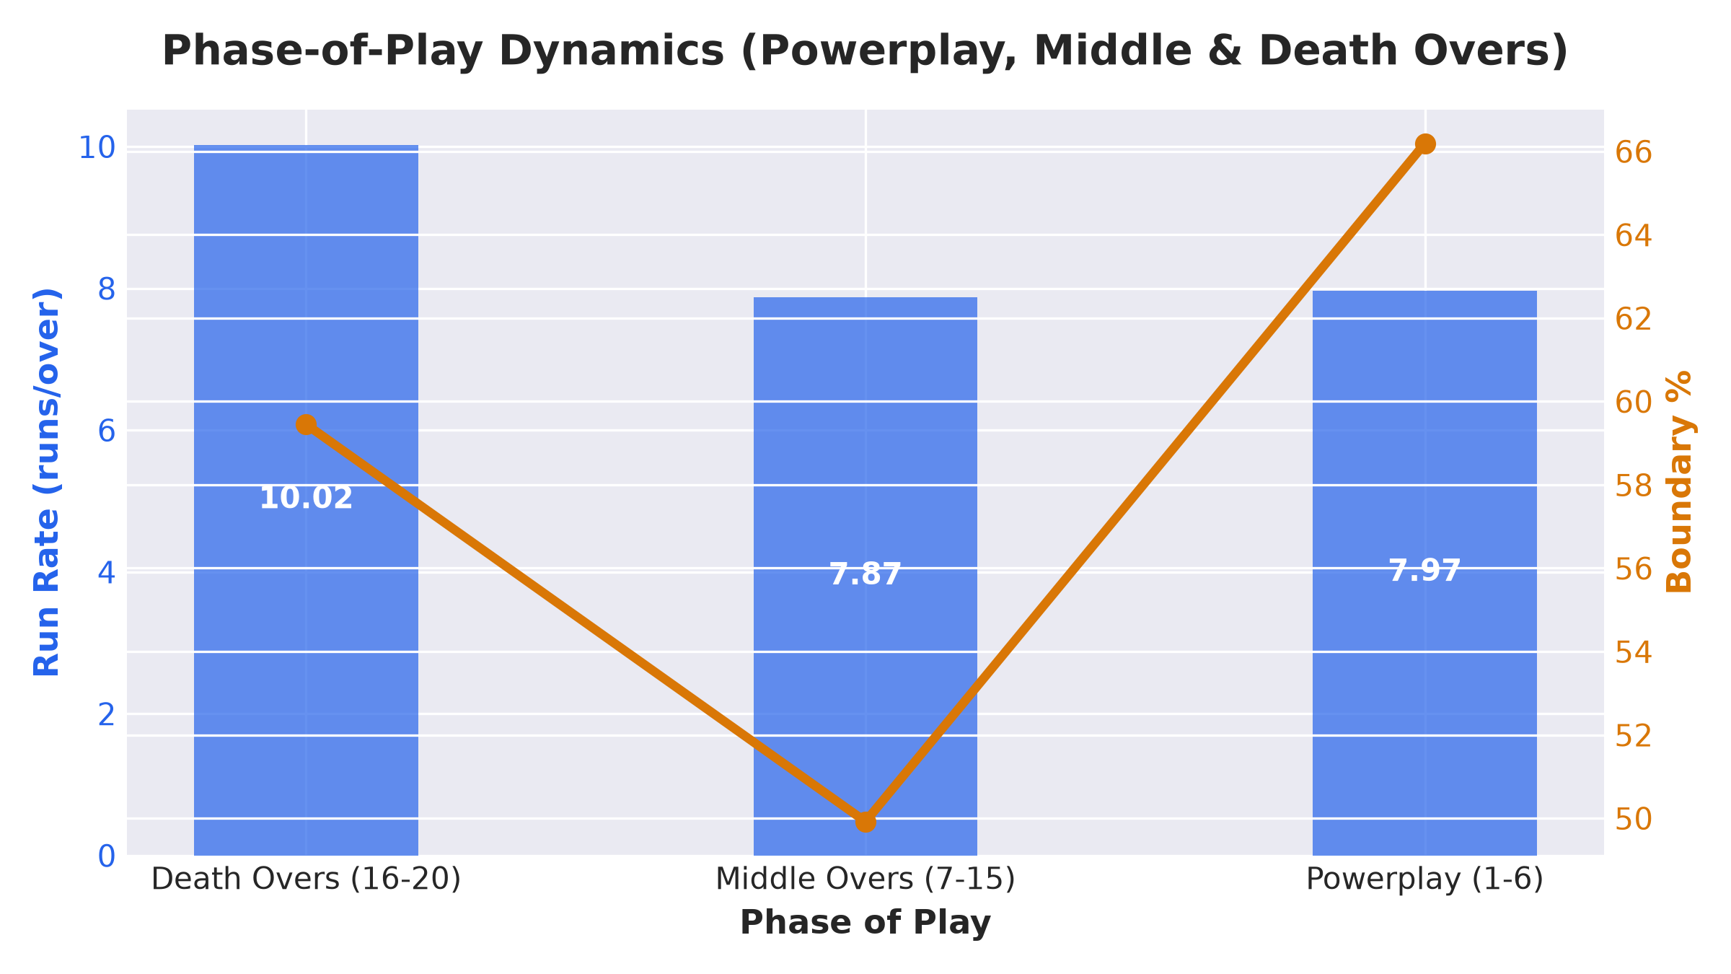
Strategic Phase-of-Play Dynamics
Powerplay (1-6), Middle (7-15), and Death Overs (16-20)
Phase Metrics:
• Death Overs (16-20):
Run Rate: 10.02 rpo | Boundary: 59.45% | Dots: 28.41%
• Middle Overs (7-15):
Run Rate: 7.87 rpo | Boundary: 49.92% | Dots: 31.97%
• Powerplay (1-6):
Run Rate: 7.97 rpo | Boundary: 66.19% | Dots: 46.55%

Slide 9
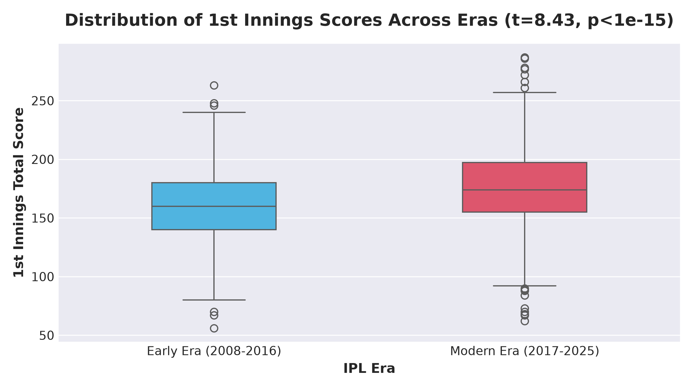
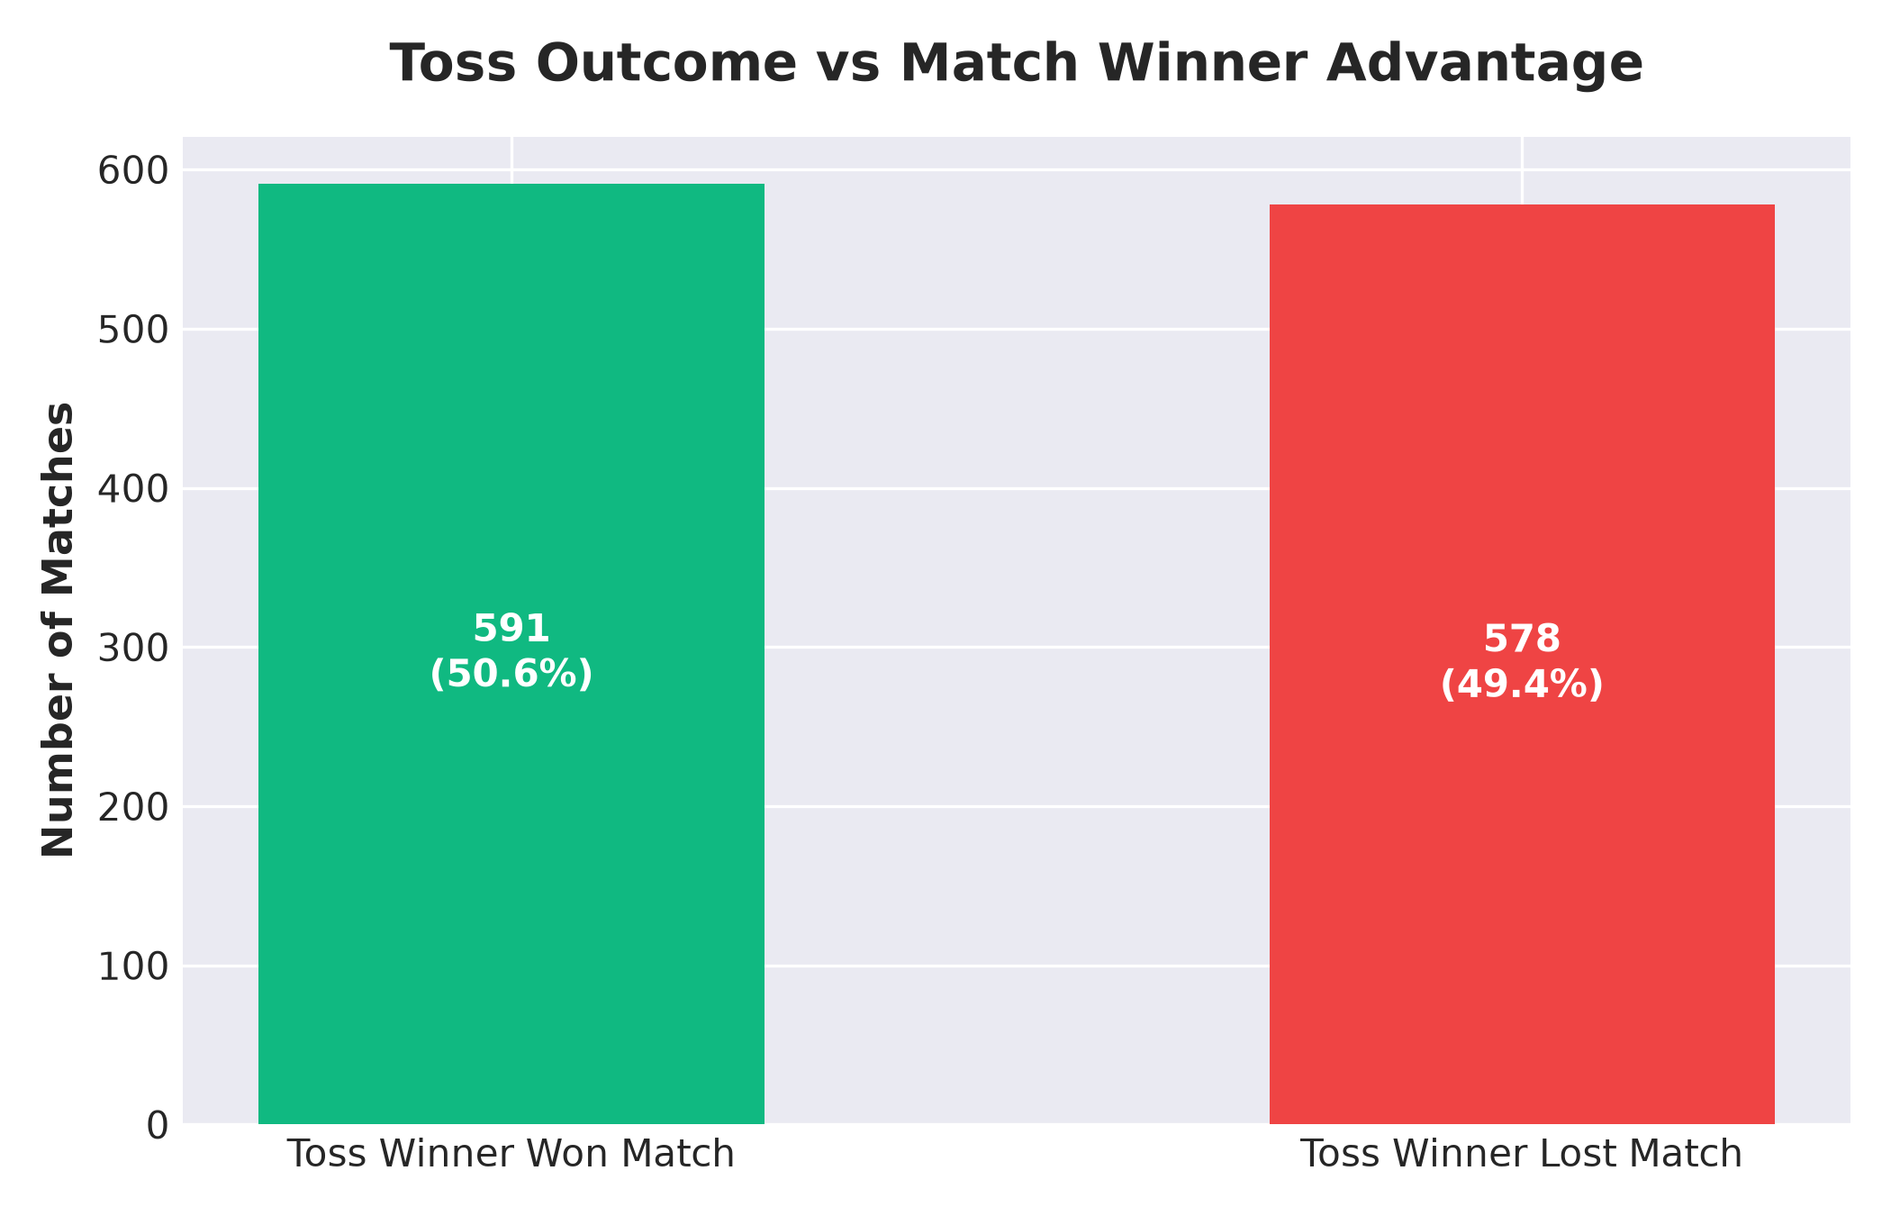
Inferential Statistical Hypothesis Testing
Empirical validation of scoring escalation and toss advantage

Slide 10
Summary of Empirical Findings & Conclusion
Key takeaways for T20 analytics and strategic team building
1. Scoring Escalation is Statistically Significant: 1st innings average scores increased by +15.8 runs from early IPL (159.0) to modern IPL (174.8) (t = 8.4301, p < 1e-15).
2. Toss Advantage is Overrated: Toss winners achieve a 51.6% match win conversion rate, proving toss alone is not a statistically significant driver of match outcome (Chi-sq p = 1.0).
3. Phase-Specific Tactics Matter: Powerplay overs maximize boundary reliance (66.2%), Middle overs emphasize spin containment, and Death overs yield maximum run rates (9.7+ runs/over).
4. Streamlit Interactive Dashboard: A 7-page interactive dashboard (app.py) enables dynamic season filtering, player deep dives, and 5-axis Radar Chart comparisons.

