Slide 1
HEALTHCARE ANALYTICS PROJECT
Simulated Healthcare
Claims Analytics
Cost | Utilization | Quality | AI Predictions
10,000 Members • Synthetic Dataset • 2025
Ritvik Raj Padige

Slide 2
AGENDA
01
04
Project Overview & Dataset
Quality Metrics
Simulated 10,000-member claims dataset
HEDIS indicators, readmissions, quality scores
02
05
Cost Analysis
AI & ML Models
PMPM, plan comparisons, cost concentration
Predictive cost model, high-cost classifier
03
06
Utilization Analysis
Recommendations
ER, inpatient, pharmacy patterns
Strategic priorities and ROI opportunities

Slide 3
PROJECT OVERVIEW
10,000
$75.1M
$626
6
Members Simulated
Total Annual Spend
Average PMPM
Chronic Conditions Modeled
Analytics Pipeline
Data Simulation
→
EDA & Cost Analysis
→
Utilization Review
→
Quality Metrics
→
ML Modeling
→
Insights & Rec.
Plan Type Mix
HMO 30%
PPO 35%
HDHP 25%
EPO 10%

Slide 4
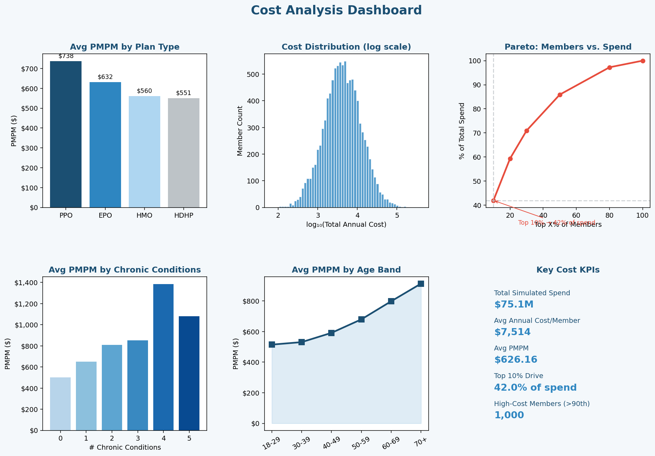
COST ANALYSIS
Top 10% of members drive 42% of total spend • PPO PMPM $738 vs HDHP $551 • Chronic burden 3x cost multiplier

Slide 5
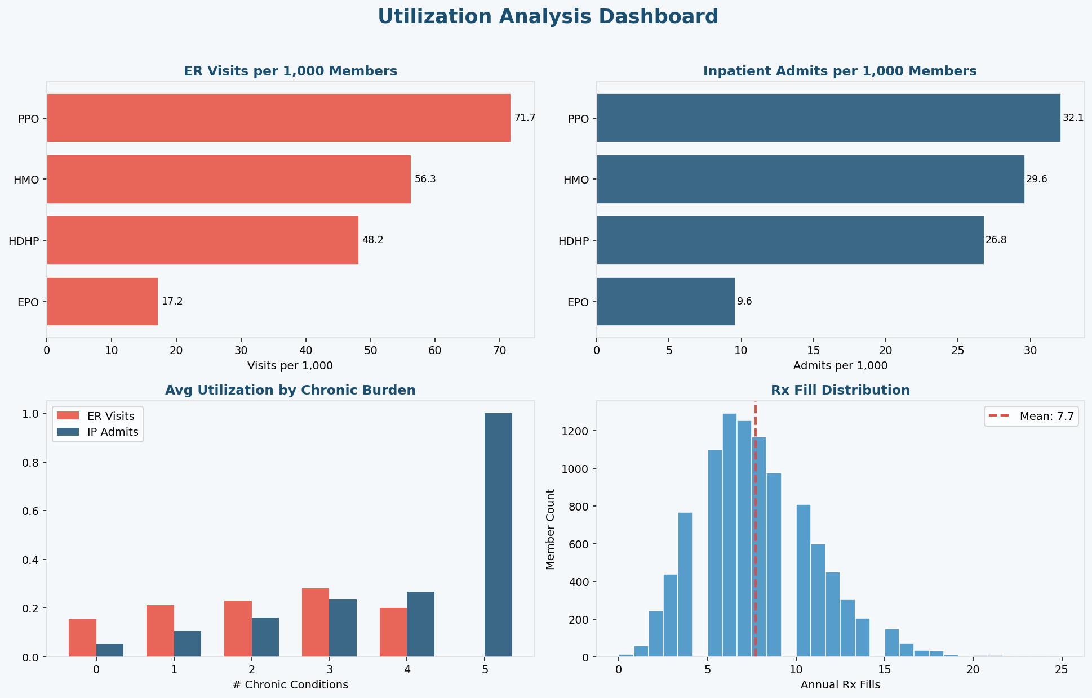
UTILIZATION ANALYSIS
ER: 193/1,000 members (above 150 benchmark) • IP: 98/1,000 • Avg 7.8 Rx fills/year

Slide 6
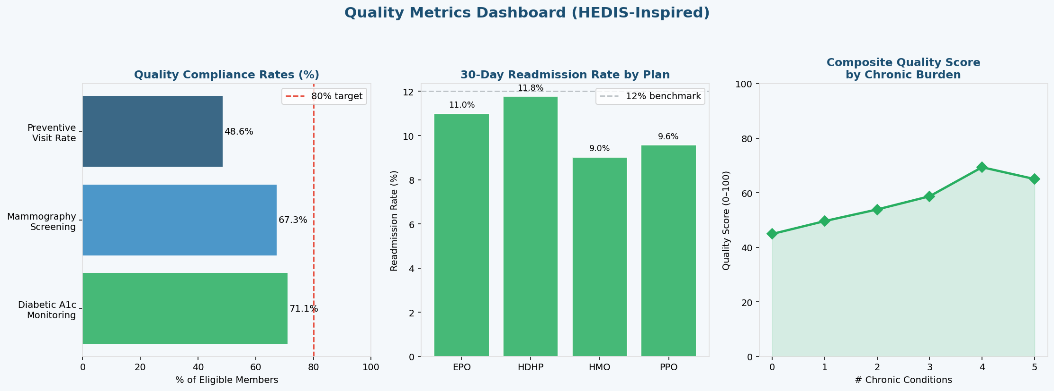
QUALITY METRICS
Diabetic & screening gaps represent the highest-ROI quality improvement opportunities

Slide 7
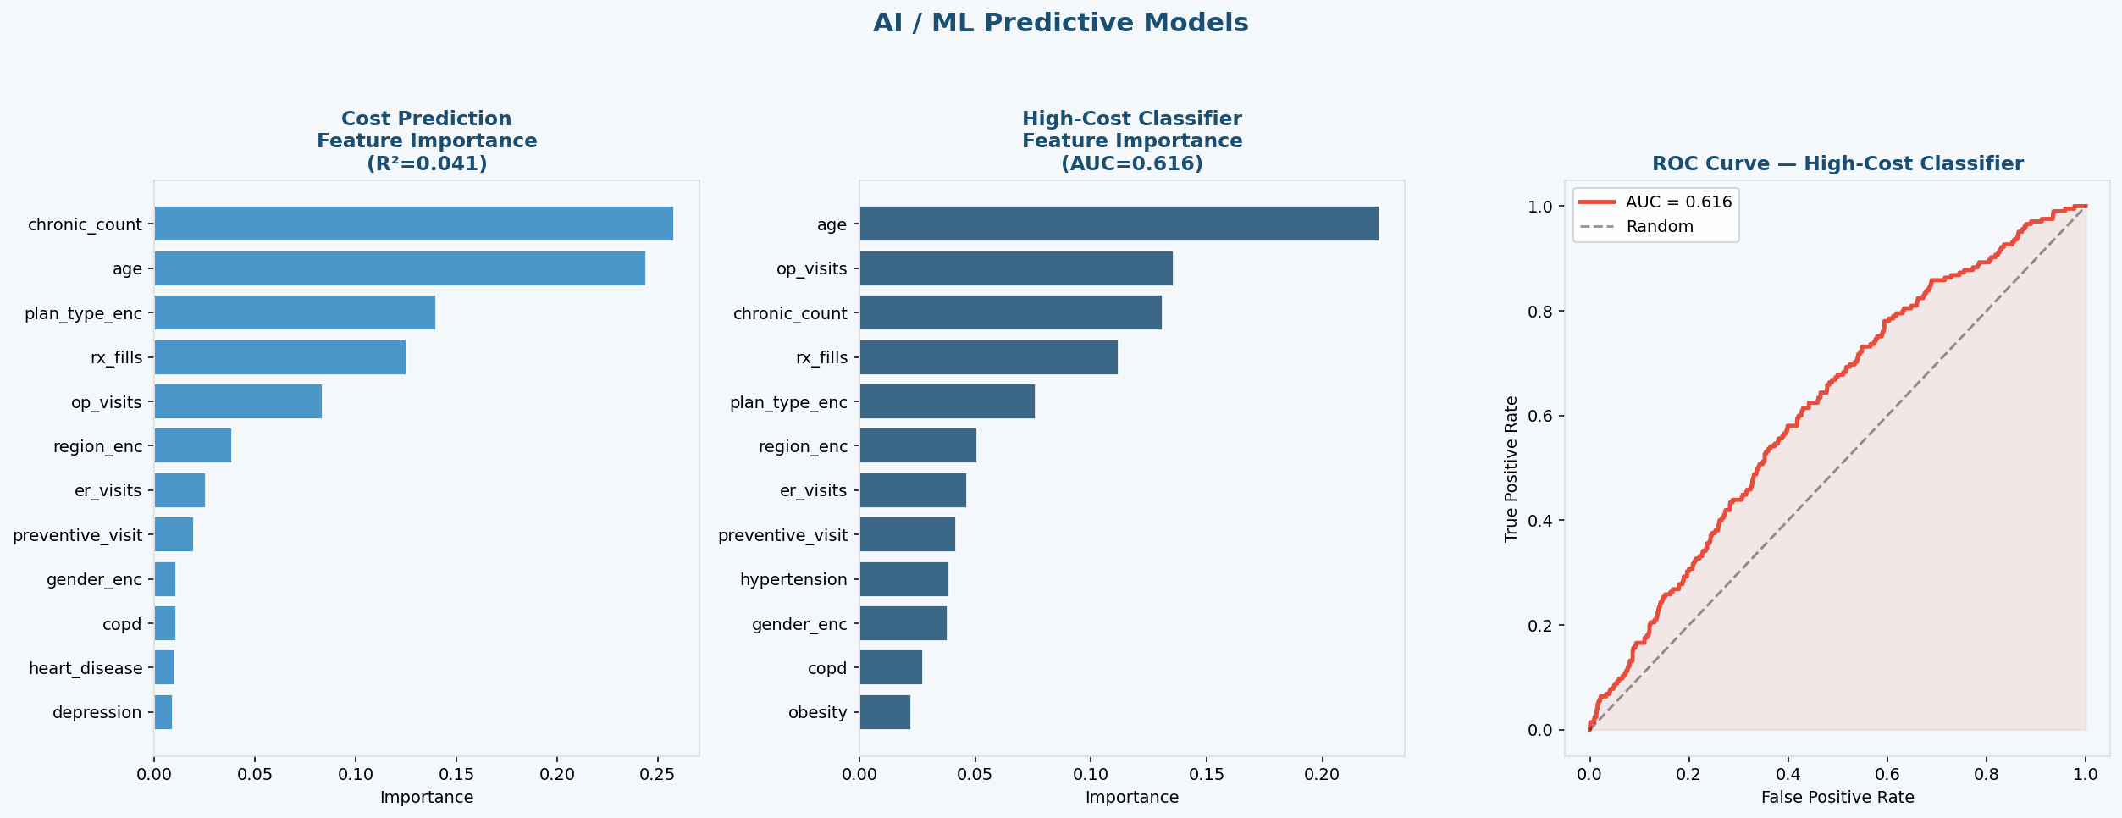
AI & PREDICTIVE MODELING
Cost Prediction (GBM): MAE: $5,501 | R²: 0.041
High-Cost Classifier: AUC-ROC: 0.616
Top Features: Chronic count, ER visits, Rx fills

Slide 8
RECOMMENDATIONS
Risk Stratification
Close Quality Gaps
Deploy ML classifier to identify top 10-15% high-cost members for proactive care management enrollment.
A1c & mammography below HEDIS targets. Automated outreach and provider incentives can close gaps in 1-2 years.
Chronic Disease Mgmt
Transition-of-Care
Structured programs for diabetes, HTN, COPD. 3+ condition members drive 3x avg cost.
Post-discharge follow-up within 7 days for high-risk members reduces readmissions by 15-25%.
Reduce Avoidable ER
Data Infrastructure
ER at 193/1,000 is above benchmark. Telehealth and nurse triage can reduce by 15-25%.
Integrate clinical + SDOH data to improve model AUC from 0.62 toward 0.80+.

Slide 9
CONCLUSION
AI-Driven Analytics
Transforms Healthcare
Cost concentration and chronic burden are the primary drivers of healthcare spend
Quality gaps in diabetic monitoring and screening present clear intervention targets
ML models achieve meaningful risk discrimination for care management prioritization
Integrated analytics can unlock $3-5M+ in avoided annual expenditure
Simulated Healthcare Claims Analytics | 2025 | Ritvik Raj Padige

