Slide 1
Predictive Analytics and Explainable AI for Hospital Readmission Risk
Midterm Project Review
CS 719 — Data Science Project | Winter 2026
Raj Panchal (200490453)
March 3, 2026
Instructor: Howard J. Hamilton
University of Regina | Department of Computer Science
1/16

Slide 2
Goal & Motivation
Predict whether a diabetic patient will be readmitted within 30 days and explain which clinical factors drive the prediction — enabling hospitals to intervene early.
$26 B+
11.4 %
Preventable
Annual cost of unplanned readmissions in the U.S.
Patients in our dataset readmitted within 30 days
Early risk identification triggers interventions
CS 719 | Raj Panchal | Midterm Review
2/16

Slide 3
Method — 6-Step Pipeline
1
Data Cleaning
2
Feature Engineering
3
Train 3 Models
4
Compare & Select Best
5
Explain (PFI + PDP)
6
Interactive Dashboard
• Cleaned 101,766 records from 130 US hospitals
• Trained Logistic Regression, Random Forest, and XGBoost
• XGBoost selected as best model (ROC-AUC = 0.671)
• Explainability via Permutation Feature Importance & Partial Dependence
CS 719 | Raj Panchal | Midterm Review
3/16

Slide 4
Project Schedule
Week
Dates
Task
Status
Week 1
Jan 27 - Feb 2
Dataset exploration & literature review
✓ Done
Week 2
Feb 3 - Feb 9
Data cleaning, missing values, encoding
✓ Done
Week 3
Feb 10 - Feb 16
Feature engineering & binary target
✓ Done
Week 4
Feb 17 - Feb 23
Model training: LR, RF, XGBoost
✓ Done
Week 5
Feb 24 - Mar 2
Evaluation, model selection, midterm prep
✓ Done
Mar 3
MILESTONE: Mid-Term Review (TODAY)
★
Week 6-7
Mar 4 - Mar 17
Hyperparameter tuning & explainability
Upcoming
Week 8
Mar 18 - Mar 24
Visualization of predictions & results
Upcoming
Wk 9-10
Mar 25 - Apr 7
Draft report: all sections
Upcoming
Wk 11-12
Apr 8 - Apr 23
Review, proofreading & submission
Upcoming
Apr 24
MILESTONE: Final Report Due
4/16
CS 719 | Raj Panchal | Midterm Review
★

Slide 5
Achievement 1 — Data Preparation
• Cleaned 101,766 records from 130 US hospitals
• Dropped 4 high-null + 2 zero-variance columns
• Removed 2,426 expired/hospice rows
• Engineered 4 new features: total_visits, num_med_changed, num_med_active, age_numeric
• Binary target: readmitted <30 days = 1 (11.4%), else = 0 (88.6%)
BEFORE
AFTER
101,766 rows × 50 columns
99,340 rows × 23 columns
CS 719 | Raj Panchal | Midterm Review
5/16

Slide 6
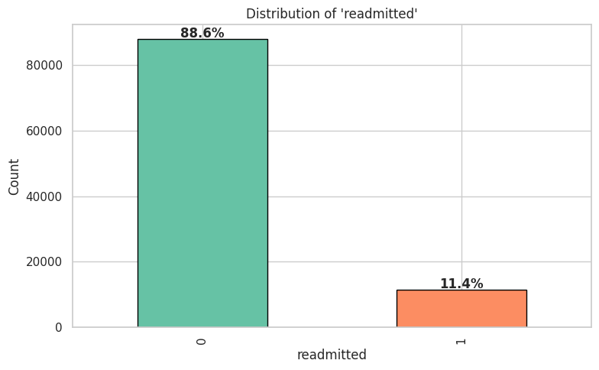
Target Variable Distribution
Key Takeaway
88.6%
Not readmitted
11.4%
Readmitted within 30 days
Severe class imbalance!
CS 719 | Raj Panchal | Midterm Review
6/16

Slide 7
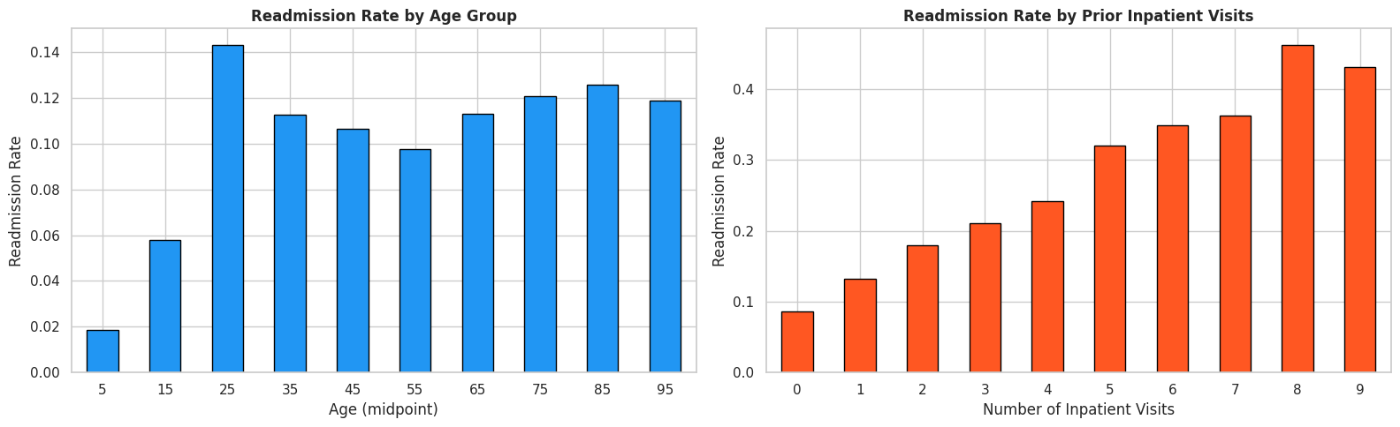
Key Discovery — Readmission by Prior Visits
Key Finding
Prior inpatient visits = strongest predictor
0 visits
9% readmission
4 visits
25% readmission
8 visits
47% readmission
CS 719 | Raj Panchal | Midterm Review
7/16

Slide 8
Achievement 2 — Model Training & Selection
Logistic Regression
Random Forest
XGBoost
Linear Baseline
Ensemble (Bagging)
Ensemble (Boosting)
Accuracy: 64.0% ROC-AUC: 0.642 Recall: 55%
Accuracy: 88.0% ROC-AUC: 0.653 Recall: 6%
Accuracy: 88.6% ROC-AUC: 0.671 Recall: 2%
⭐ XGBoost Selected — Best ROC-AUC
CS 719 | Raj Panchal | Midterm Review
8/16

Slide 9
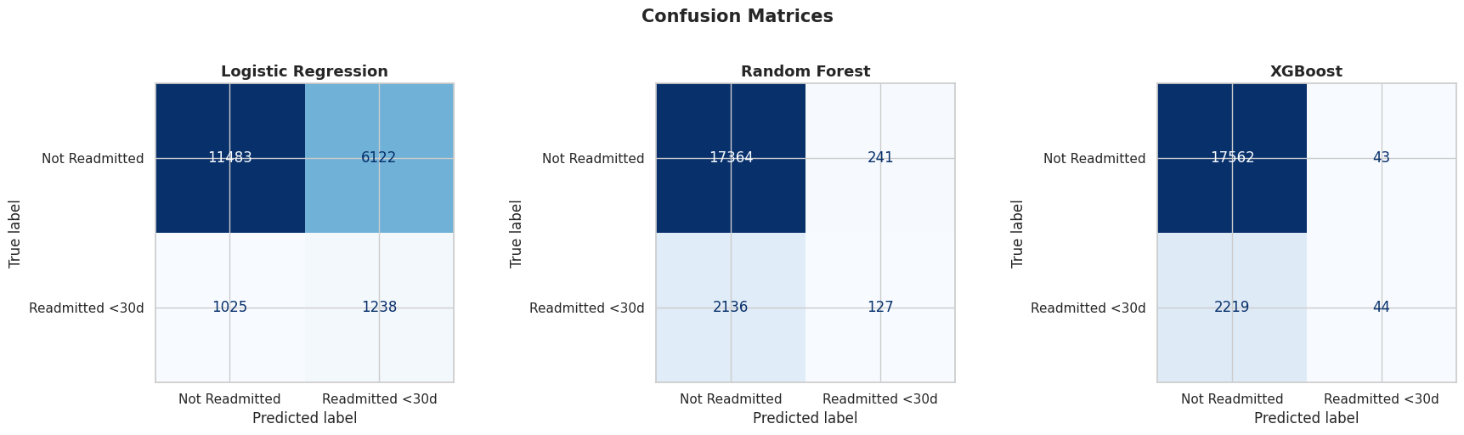
Model Evaluation — Confusion Matrices
CS 719 | Raj Panchal | Midterm Review
9/16

Slide 10
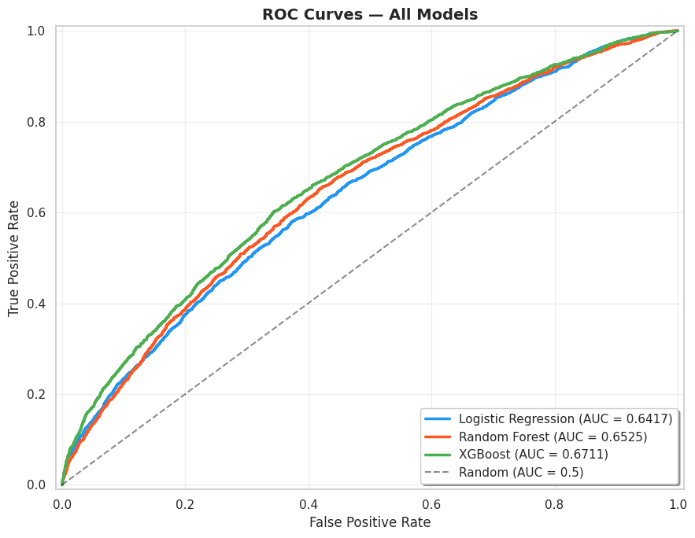
Model Evaluation — ROC Curves
ROC-AUC Scores
XGBoost
0.671
Random Forest
0.653
Logistic Reg.
0.642
All above 0.5 random baseline
CS 719 | Raj Panchal | Midterm Review
10/16

Slide 11
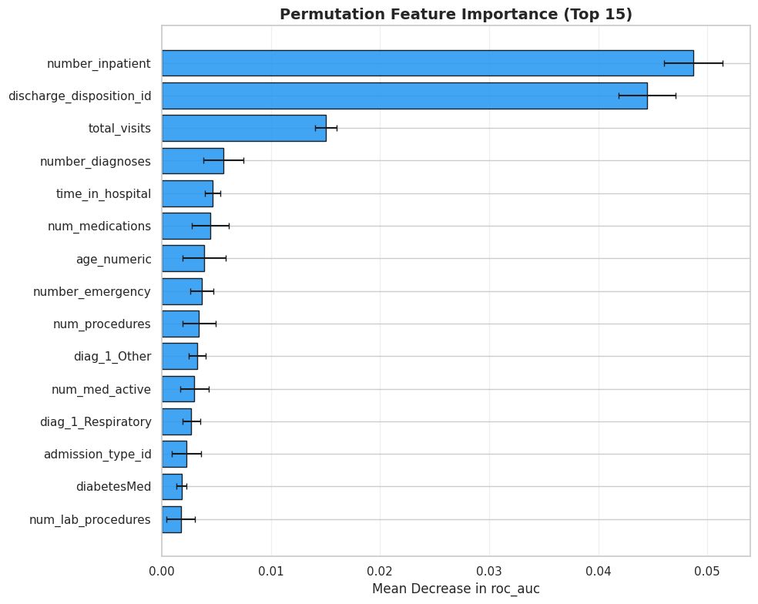
Achievement 3 — Permutation Feature Importance
Top Features
#1
number_inpatient
(prior hospital visits)
#2
discharge_ disposition_id
(where patient sent)
#3
number_diagnoses
CS 719 | Raj Panchal | Midterm Review
11/16

Slide 12
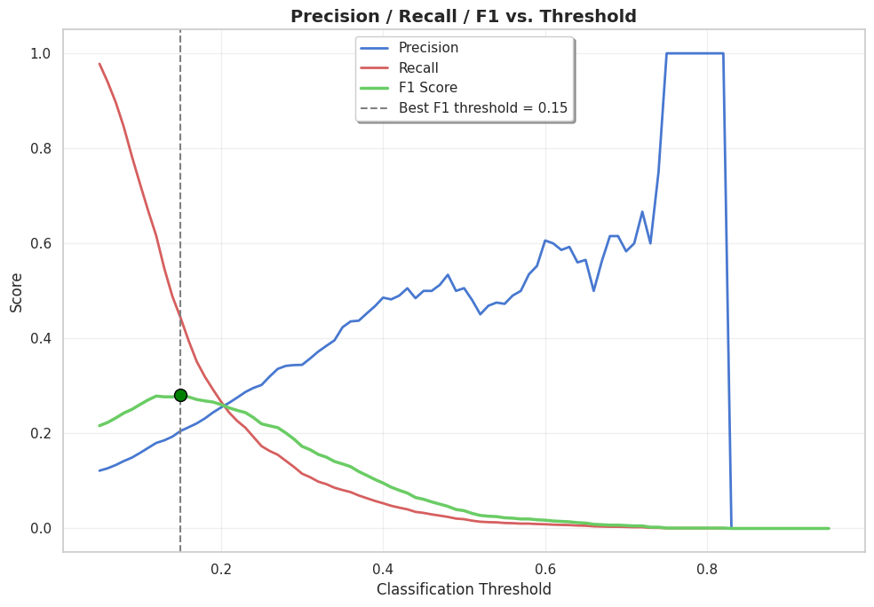
Threshold Optimization
BEFORE (t = 0.50)
Recall: 2%
Only 44 of 2,263 readmissions caught
AFTER (t = 0.15)
Recall: 44%
1,004 of 2,263 readmissions caught
22× improvement!
CS 719 | Raj Panchal | Midterm Review
12/16

Slide 13
Biggest Problem & Solutions
THE PROBLEM
Severe class imbalance (88.6% vs 11.4%) — XGBoost at default threshold achieves 88.6% accuracy but catches only 2% of actual readmissions.
SOLUTION 1: SMOTE
SOLUTION 2: Threshold Tuning
• Oversample minority class on training data only
• Balanced: 70,421 per class
• Test set untouched (no leakage)
• Default 0.50 too conservative
• Optimal threshold: 0.15
• Recall: 2% → 44% (catches 22× more)
CS 719 | Raj Panchal | Midterm Review
13/16

Slide 14
Revised Schedule & Progress
On schedule. No revisions needed. All Week 1-5 milestones completed on time.
COMPLETED (Weeks 1-5)
✓ Dataset exploration & literature review
✓ Data cleaning, missing values, encoding
✓ Feature engineering & binary target
✓ Model training: LR, RF, XGBoost
✓ Evaluation, selection & midterm prep
UPCOMING (Weeks 6-12)
○ Hyperparameter tuning & explainability
○ Visualization & Streamlit dashboard
○ Final report (all sections)
PROGRESS
42%
5 of 12 weeks
Risk: LOW
No blockers
CS 719 | Raj Panchal | Midterm Review
14/16

Slide 15
Why This Project Should Continue
❶
Strong Foundation Built
❷
Clear Path to Completion
Complete pipeline from 101,766 raw records to trained, evaluated XGBoost model.
Remaining work well-defined: tuning, explainability, dashboard, report.
❸
Real-World Clinical Impact
❹
On Schedule, No Blockers
Readmissions cost $26B+. Explainable predictions enable targeted interventions.
All 5 weeks done on time. Class imbalance solved. On track for April 24 deadline.
CS 719 | Raj Panchal | Midterm Review
15/16

Slide 16
Thank You
Predictive Analytics and Explainable AI for Hospital Readmission Risk
Midterm Project Review | CS 719
Raj Panchal (200490453) | March 3, 2026
Instructor: Howard J. Hamilton | University of Regina
Questions?
16/16

