Slide 1
MIDTERM PROJECT REVIEW
Hospital Readmission Prediction for Diabetic Patients
Diabetes 130-US Hospitals | Explainable Machine Learning
Raj Panchal
CS 719 | March 3, 2026
CS 719 | Midterm Project Review | Raj Panchal
1 / 11

Slide 2
Goal, Motivation & Method
GOAL
Build a machine learning system that predicts whether a diabetic patient will be readmitted to the hospital within 30 days of discharge, and explain which clinical factors drive the prediction — enabling hospitals to intervene early and reduce costly readmissions.
WHY IT MATTERS
$26B+
11.4%
Preventable
Annual cost of unplanned hospital readmissions in the U.S.
Diabetic patients in our dataset readmitted within 30 days
Early risk identification can trigger targeted interventions
METHOD
1
Data Cleaning
2
Feature Engineering
3
Train 3 Models
4
Compare & Select Best
5
Explain (PFI + PDP)
6
Interactive Dashboard
CS 719 | Midterm Project Review | Raj Panchal
2 / 11

Slide 3
Pictorial Overview — Project Design
Raw Dataset
Data Cleaning
Feature Engineering
Exploratory Data Analysis
101,766 records 50 features 130 US hospitals
Drop high-null cols Remove expired rows 99,340 × 42
4 new features Binary target 99,340 × 23
Distributions Correlations Statistical tests
Preprocessing
Model Training
Evaluation & Selection
STATUS
One-Hot Encode 80/20 split SMOTE + Scale
Logistic Regression Random Forest XGBoost
ROC-AUC, F1, CV Confusion matrices Best: XGBoost
Rows 1 & 2: DONE
Data pipeline fully complete. Models trained & evaluated.
Row 3: UPCOMING
Explainability
Dashboard
Final Report
Explainability, dashboard & final report in Weeks 6–12.
PFI + PDP on best model
Streamlit app what-if analysis
Complete write-up
CS 719 | Midterm Project Review | Raj Panchal
3 / 11

Slide 4
Original Project Schedule
Week
Dates
Task
Status
Week 1
Jan 27 – Feb 2
Dataset exploration & literature review
✓ Done
Week 2
Feb 3 – Feb 9
Data cleaning, missing values, encoding
✓ Done
Week 3
Feb 10 – Feb 16
Feature engineering & binary target
✓ Done
Week 4
Feb 17 – Feb 23
Model training: LR, RF, XGBoost
✓ Done
Week 5
Feb 24 – Mar 2
Evaluation, model selection, midterm prep
✓ Done
Mar 3, 2026
MILESTONE: Mid-Term Project Review (TODAY)
★
Week 6
Mar 4 – Mar 10
Hyperparameter tuning & cross-validation
Upcoming
Week 7
Mar 11 – Mar 17
Explainability: PFI & PDP on final model
Upcoming
Week 8
Mar 18 – Mar 24
Visualization of predictions & results
Upcoming
Week 9
Mar 25 – Mar 31
Draft report: Intro, Background, Approach, Results
Upcoming
Week 10
Apr 1 – Apr 7
Write Discussion, Conclusion; add figures & tables
Upcoming
Week 11-12
Apr 8 – Apr 23
Review, proofreading & final formatting
Upcoming
Apr 24, 2026
MILESTONE: Final Project Report Due
★
CS 719 | Midterm Project Review | Raj Panchal
4 / 11

Slide 5
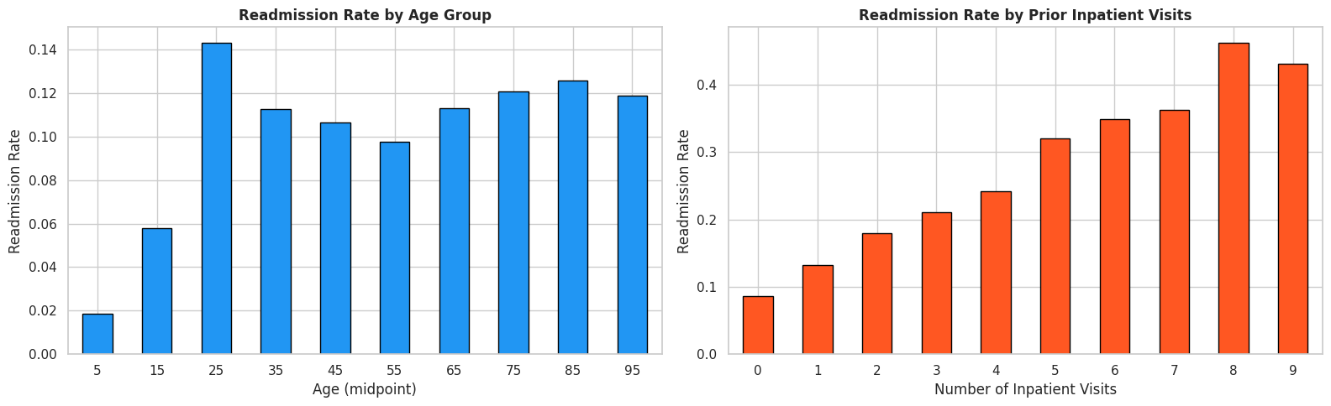
Achievement 1 — Data Preparation & Exploratory Analysis
What Was Done
• Cleaned 101,766 records: dropped 4 high-null columns, 2 zero-variance
columns, and 2,426 expired/hospice rows → 99,340 × 42
• Engineered 4 new features: total_visits, num_med_changed,
num_med_active, age_numeric — capturing hospital utilization patterns
• Converted target to binary: <30 days = 1 (11.4%), else = 0 (88.6%)
21 redundant medication columns summarized and dropped → 99,340 × 23
• Statistical tests: Shapiro-Wilk (non-normal), Chi-squared (diagnosis
matters, gender does not), Pearson/Spearman correlations
KEY DISCOVERY FROM EDA
Prior inpatient visits is the strongest
predictor of 30-day readmission
• 0 prior visits → 9% readmission rate
• 4 prior visits → 25% readmission rate
• 8 prior visits → 47% readmission rate
Near-linear monotonic increase — clinically actionable
Other important EDA findings:
• Diagnosis category significantly predicts readmission (p ≈ 0.00)
• Gender does NOT predict readmission (p = 0.43)
• All numeric features are non-normal → justifies tree-based models
• Weak feature-target correlations → inherently difficult problem
• Elderly population (55-85) dominates; most stays 1-6 days
CS 719 | Midterm Project Review | Raj Panchal
5 / 11

Slide 6
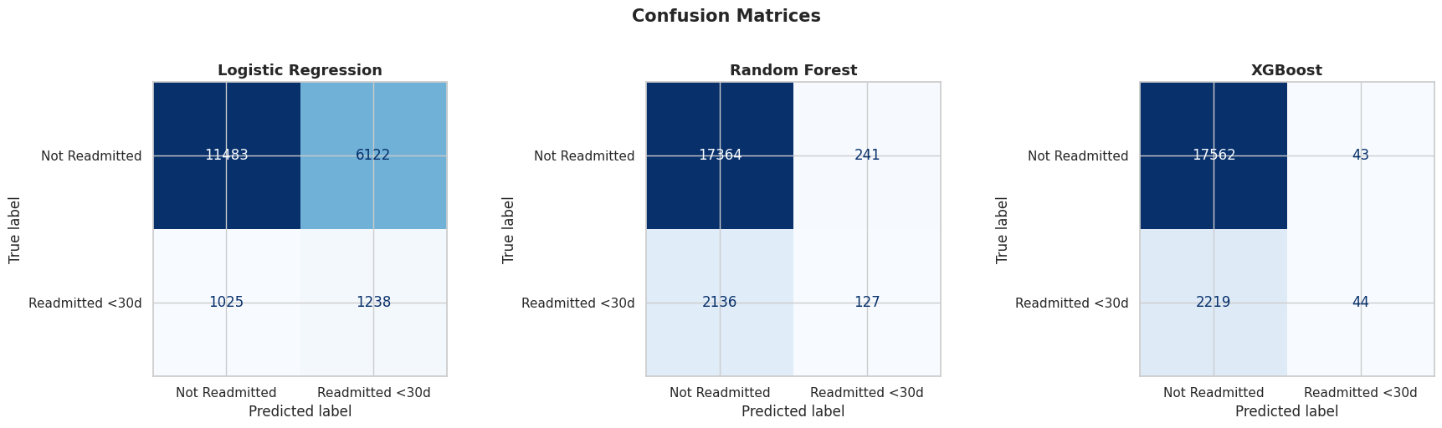
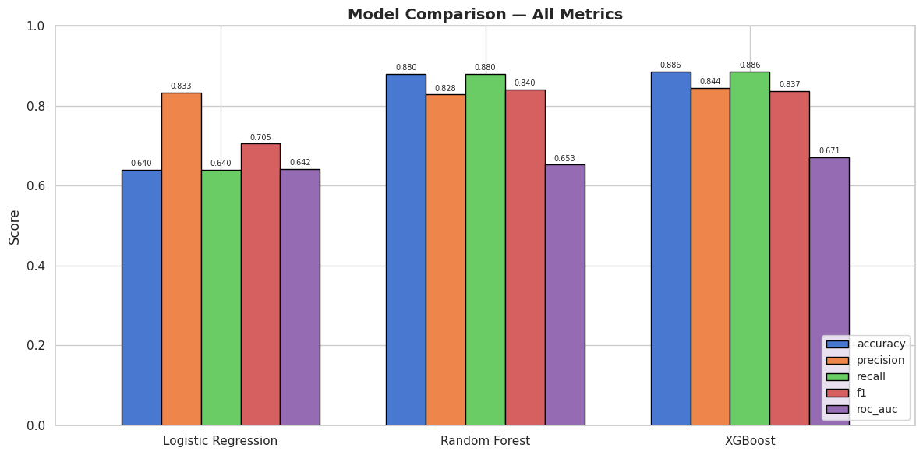
Achievement 2 — Model Training, Evaluation & Selection
⭐ SELECTED — Best ROC-AUC
Logistic Regression
Random Forest
XGBoost
Linear Baseline
Ensemble (Bagging)
Ensemble (Boosting)
max_iter=1000 solver=lbfgs
Acc: 64.0% ROC-AUC: 0.642 Recall: 55%
200 trees max_depth=15
Acc: 88.0% ROC-AUC: 0.653 Recall: 6%
200 estimators max_depth=6, lr=0.1
Acc: 88.6% ROC-AUC: 0.671 Recall: 2%
Selection Rationale: XGBoost has the highest Test ROC-AUC (0.671), highest Average Precision (0.228), and best cross-validation stability (σ = 0.0015). All three models were validated using 5-fold stratified CV on SMOTE-balanced training data.
CS 719 | Midterm Project Review | Raj Panchal
6 / 11

Slide 7
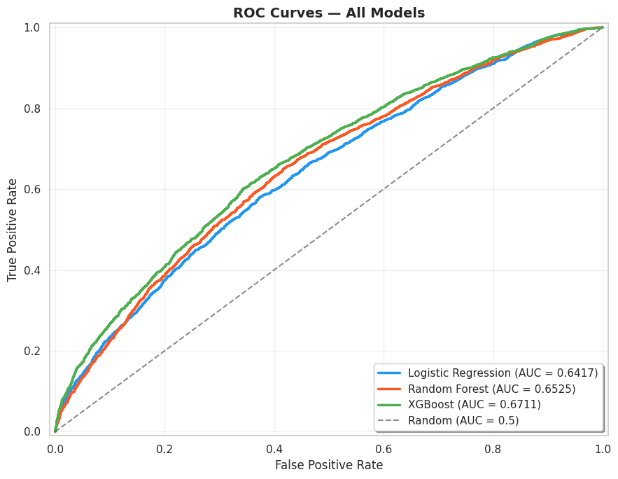
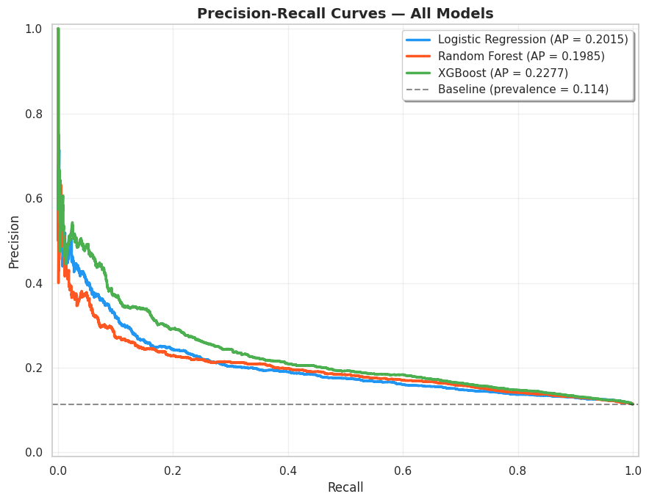
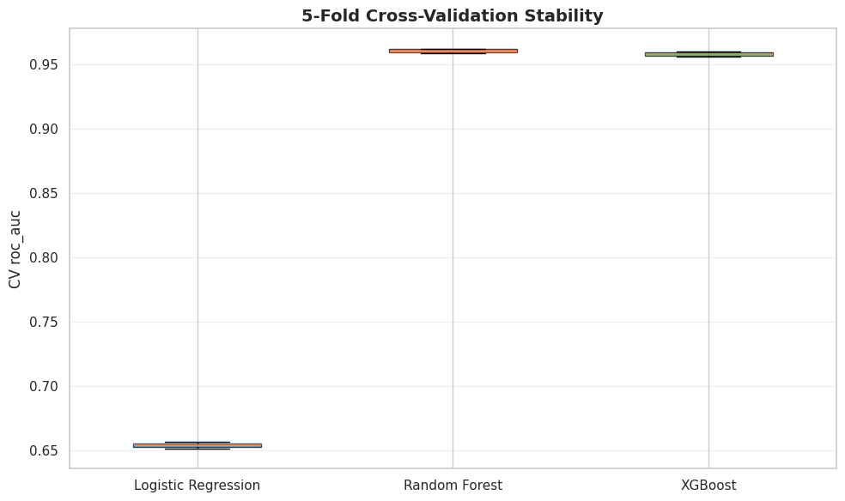
Achievement 3 — Deeper Insights from Evaluation
ROC Curves
Precision-Recall Curves
Cross-Validation Stability
XGBoost: 0.671
RF: 0.653 | LR: 0.642
All models above random
baseline (0.5). XGBoost
consistently leads.
XGBoost AP: 0.228
LR: 0.202 | RF: 0.199
All above baseline prevalence
(0.114). Steep drop-off confirms
this is a hard task.
RF: 0.960 | XGB: 0.958
LR: 0.654
RF and XGBoost both highly
stable (σ = 0.0015). Tree-based
models vastly outperform LR.
CS 719 | Midterm Project Review | Raj Panchal
7 / 11

Slide 8
Biggest Problem Encountered & How I Am Dealing With It
THE PROBLEM
Severe class imbalance (88.6% negative vs 11.4% positive) causes high-accuracy models that are clinically useless. At the default threshold of 0.50, XGBoost achieves 88.6% accuracy — but catches only 2% of actual readmissions (44 out of 2,263). A naive model that predicts 'not readmitted' for everyone gets the same accuracy. High accuracy is misleading.
SOLUTION 1: SMOTE (Synthetic Minority Oversampling)
SOLUTION 2: Classification Threshold Tuning
• Applied SMOTE on training data only (no data leakage)
• Balanced classes: 70,421 per class (from 9,051 vs 70,421)
• Test set remains untouched — evaluation is on real data
Result: Models learn meaningful patterns from both classes
instead of defaulting to the majority class.
• Default threshold 0.50 is far too conservative
• Swept thresholds from 0.05 to 0.95
• Optimal threshold: 0.15 (maximizes F1 score)
Result: Recall jumps from 2% to 44%
(catches 22× more readmissions at cost of some false alarms)
BEFORE (threshold = 0.50)
AFTER (threshold = 0.15)
Accuracy: 88.6% | Recall: 2% | True positives: 44 / 2,263
Accuracy: 74.0% | Recall: 44% | True positives: 1,004 / 2,263
CS 719 | Midterm Project Review | Raj Panchal
8 / 11

Slide 9
Revised Schedule
The project is on schedule. No revisions needed. All Week 1–5 milestones completed on time.
COMPLETED (Weeks 1–5)
PROGRESS OVERVIEW
✓
Week 1
Dataset exploration & literature review
42%
✓
Week 2
Data cleaning, missing values, encoding
✓
Week 3
Feature engineering & binary target
5 of 12 weeks complete
✓
Week 4
Model training: LR, RF, XGBoost
✓
Week 5
Evaluation, selection & midterm prep
★ Mid-Term Project Review — March 3, 2026 (TODAY)
What Remains:
• Hyperparameter tuning of XGBoost
• Full PFI + PDP explainability analysis
• Streamlit interactive dashboard
• Prediction visualization & tables
• Complete final report (all sections)
Risk assessment: LOW
No blockers. Clear path forward.
UPCOMING (Weeks 6–12)
○
Week 6
Hyperparameter tuning & cross-validation
○
Week 7
Explainability: PFI & PDP on XGBoost
○
Week 8
Visualization of predictions & results
○
Wk 9–10
Draft & write final report sections
○
Wk 11–12
Review, proofreading & submission
CS 719 | Midterm Project Review | Raj Panchal
9 / 11

Slide 10
Why This Project Should Continue
❶
Strong Foundation Built
❷
Clear Path to Completion
The entire data pipeline is complete — from raw data (101,766 records) through cleaning, feature engineering, EDA, statistical validation, and preprocessing. Three models have been trained, evaluated with multiple metrics, and the best model (XGBoost, ROC-AUC = 0.671) has been selected. This represents a solid, reproducible foundation.
The remaining work is well-defined: hyperparameter tuning (Week 6), explainability analysis with PFI and PDP (Week 7), visualization (Week 8), and report writing (Weeks 9–12). The Streamlit dashboard framework is already built — it just needs the tuned model artifacts. No unknowns remain.
❸
Real-World Clinical Impact
❹
On Schedule, No Blockers
Hospital readmissions cost $26B+ annually. This project delivers an explainable prediction tool — not just a black-box model. Clinicians will understand why a patient is flagged as high-risk (e.g., prior inpatient visits, discharge destination), enabling informed, targeted interventions.
All 5 weeks of the original schedule completed on time. The biggest technical challenge (class imbalance) has been identified and addressed with SMOTE + threshold optimization. There are no outstanding risks or dependencies. The project is fully on track for the April 24 deadline.
CS 719 | Midterm Project Review | Raj Panchal
10 / 11

Slide 11
Thank You
Hospital Readmission Prediction for Diabetic Patients
Raj Panchal | CS 719 | March 3, 2026
Questions?
CS 719 | Midterm Project Review | Raj Panchal
11 / 11

